Slide 1
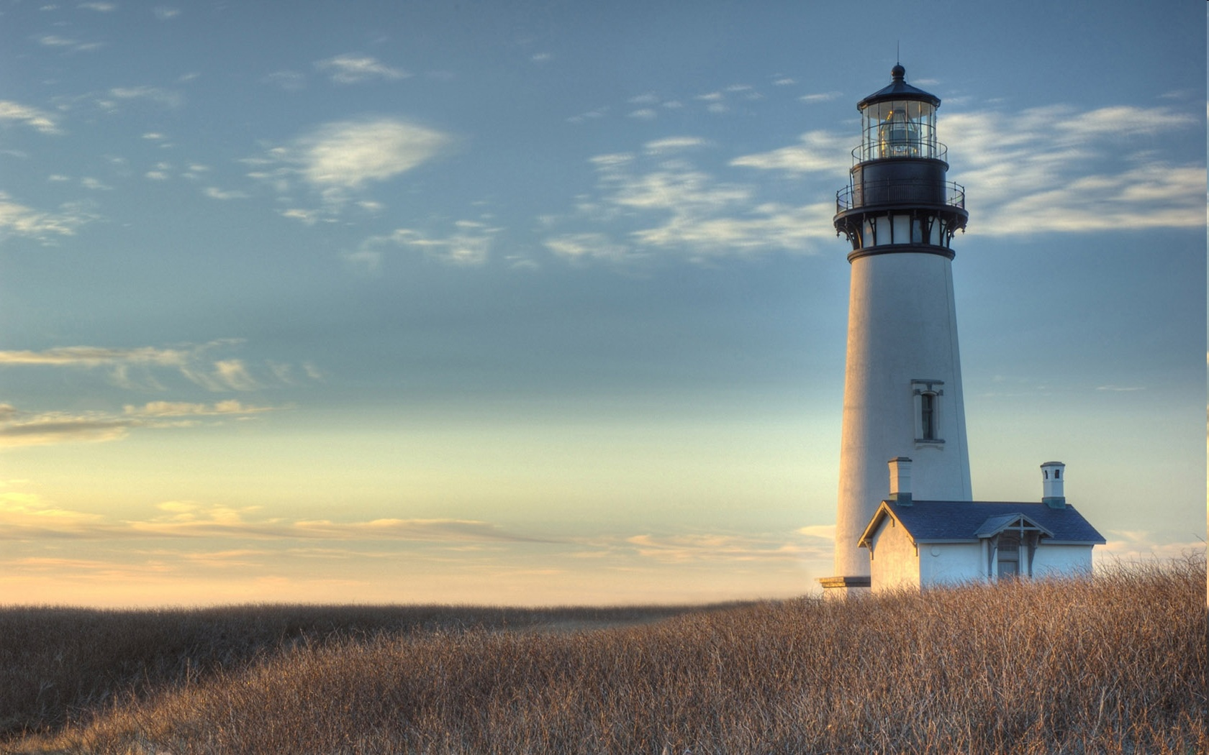
Chestnut Street
Baptist Church
Thank you for joining us!
Notes:
1

Slide 2

Tuesday 6:30 p.m.
Life Group at the Harmsen’s

Slide 3
Wednesday 6:30 p.m.
Ignition (Youth, Grades 6-12)
Prayer Group
Cornerstone Kids Club
(Grades 1-5)

Slide 4
Thursday 6:00 p.m.
Crosswalk for CWU and Young Adults

Slide 5
Friday 4:30 p.m.
LIFE Group (Briarwood)

Slide 6

Giving Options
(Thank you for supporting this ministry!)
Mail: 609 N. Chestnut St. Ellensburg, 98926
Online: Giving link at www.csbcfamily.com
In Person: Offering Box in lobby

Slide 7

CALLED BUSINESS MEETING Tonight
The Pastoral Transition Team has called a business meeting at 6 p.m. tonight. They will present the candidate they have chosen, Jeremy Johnson. Members, please be there to cast your vote. We will meet in the Worship Center.

Slide 8

Church workday This Saturday
November 14
Join us on this Saturday when we gather with the Building and Grounds crew to finish a few things around the church building. We will begin at 9 a.m. and should be finished by 1 p.m. If you have gardening gloves and rakes, please bring them. See you there!

Slide 9
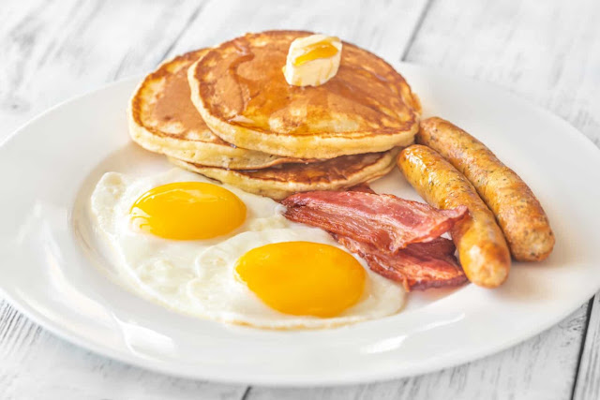
Men’s Breakfast
Men, come for our monthly breakfast in the Fellowship Hall at 8:00 a.m. this Saturday. You will be conveniently on hand for the workday at 9:00 a.m.!
Join us for fellowship and good food!

Slide 10

Celebrate Veteran’s
Day
The office will be closed for Veteran’s Day, November 11. All evening programs will resume next week on November 18. We invite you to enjoy the Veteran’s Day Parade beginning at 11 a.m. Thank you all who served!
Ignition will meet at a special time, 2 p.m. this week.

