Slide 1
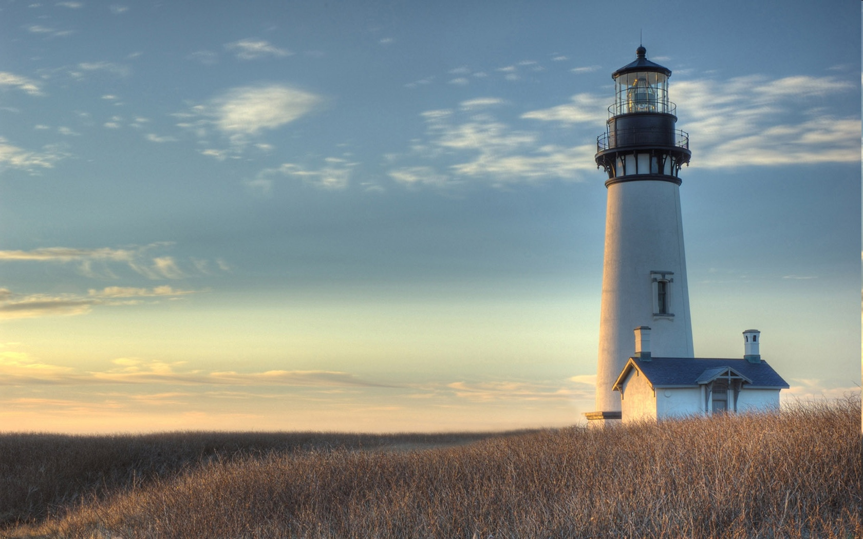
Chestnut Street
Baptist Church
Welcome!
Lead Pastor Frank R. Johnson
Associate Pastor Jeremy Johnson
Notes:
1

Slide 2

Tuesday 6:30 p.m.
Life Group at the Harmsen’s

Slide 3
Wednesday 6:30 p.m.
Ignition (Youth Group), Prayer Group

Slide 4
Thursday 6:00 p.m.
Summer Sizzle (Young Adults) begins June 25

Slide 5
Friday 4:30 p.m.
LIFE Group (Briarwood)

Slide 6

Giving Options
(Thank you for supporting this ministry!)
Mail: 609 N. Chestnut St. Ellensburg, 98926
Online: Giving link at www.csbcfamily.com
In Person: Offering Box in lobby

Slide 7

www.fidelitymonth.com

Slide 8

Sign up for lawn mowing!
Please help us this summer by signing up to mow the lawn. Mow on Thurs.-Sat. of the week for which you sign up (after 5:30 p.m. on weekdays).
Building and Grounds Team will have the mower ready. Check with the office or a team member to get the combination to the lock on the shed.

Slide 9

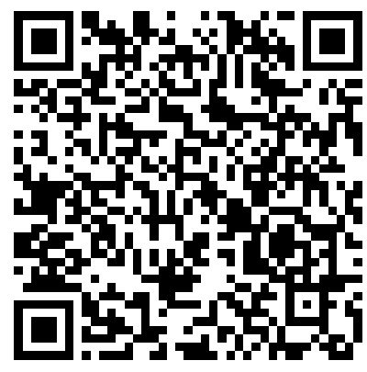
bible Readers Club Today
Join us in the Fellowship hall at 6 p.m. for the monthly discussion of our June readings. If you would like to take part, please scan the qr code to join the July reading plan and we’ll see you tonight!

Slide 10

Mission Dignity serves retirement-aged ministers, workers and widows as they face advancing age, illness, infirmity, death of a spouse, and even national disasters. Through it all, we provide constant care, prayer and financial need directly at the point of need. Please give today. Designate under “Mission Dignity” to support retired ministers in their need. Thank you!

Slide 11
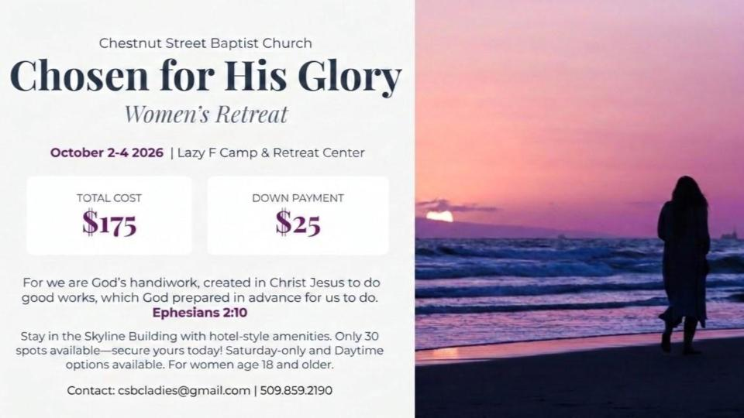

Slide 12


