Slide 1
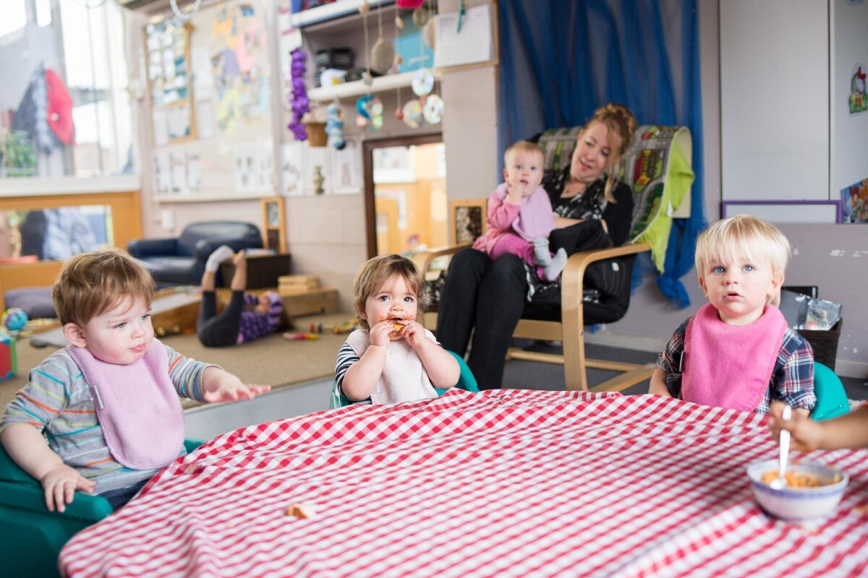
Volunteers needed for the Nursery
Come supervise our Nursery during the Church hour. Help the children be introduced to Jesus! If it’s something you’ve been thinking about, please contact Risa Wood, our Childcare Coordinator.
This Photo by Unknown Author is licensed under CC BY-NC-ND

Slide 2

4o DAYS FOR LIFE PRAYER VIGIL
Pray to end abortion. Sign up for the Vigil, September 24-November 22 at 40DaysforLife.com/en/ellensburg.

Slide 3

Business Meeting October 19
Please join us for our business meeting at 6p.m. at the Church building. Please plan to attend

Slide 4

Choir Rehearsals October 19
If you love to sing, join the Choir, meeting every Sunday at 4:30 p.m. The Choir Concert will be December 14. No experience needed, just a willingness to sing to the Lord!

Slide 5
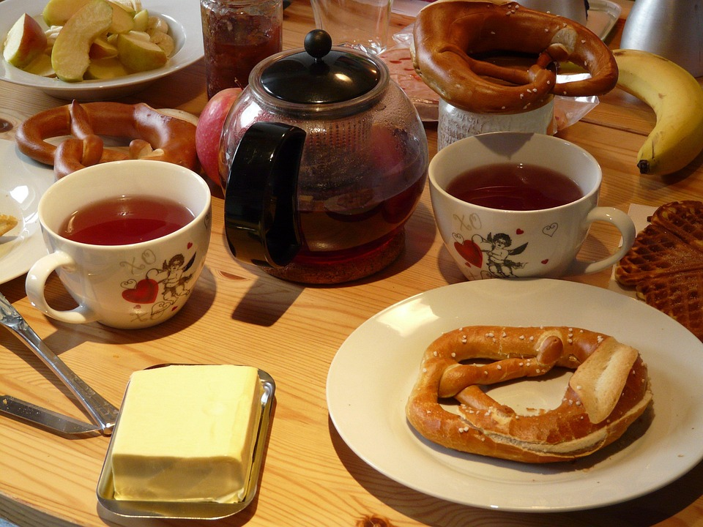
Women’s Fellowship Breakfast
Join the Women’s Ministry as they have a potluck breakfast on Saturday October 18 at 9a.m. in the Fellowship Hall. Bring a breakfast item to share. We will discuss Scripture and our time at the retreat.

Slide 6

October is Pastor Appreciation Month

