Slide 1

4o DAYS FOR LIFE PRAYER VIGIL
Pray to end abortion. Sign up for the Vigil, September 24-November 22 at 40DaysforLife.com/en/ellensburg.

Slide 2
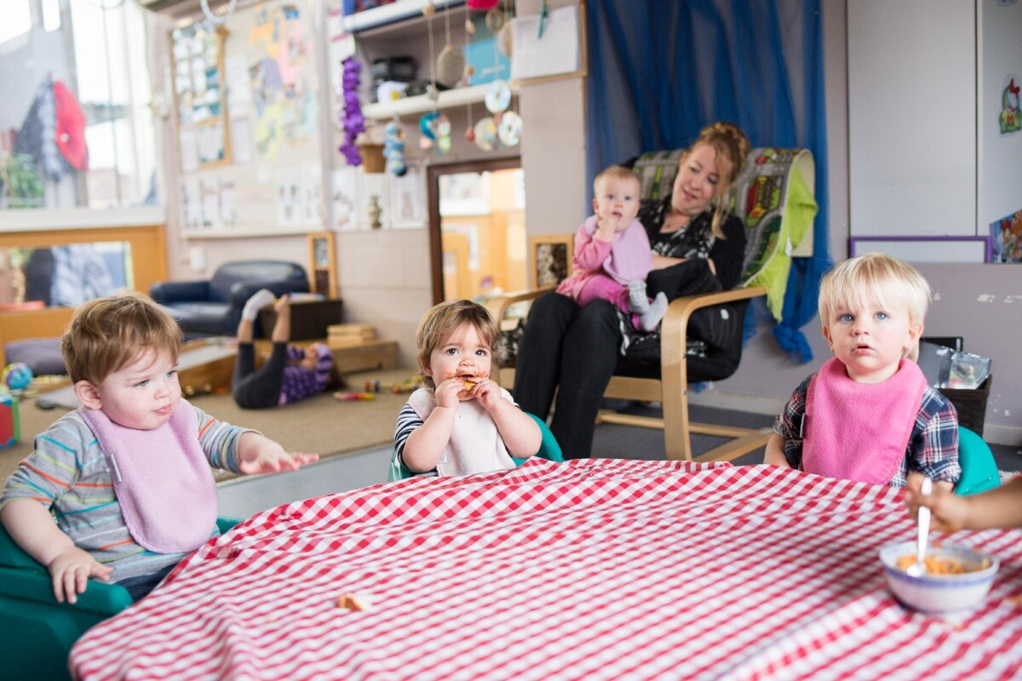
Volunteers needed for the Nursery
Come supervise our Nursery during the Church hour. Help the children be introduced to Jesus! If it’s something you’ve been thinking about, please contact Risa Wood, our Childcare Coordinator.
This Photo by Unknown Author is licensed under CC BY-NC-ND

Slide 3

Business Meeting October 19
Please join us for our business meeting at 6p.m. at the Church building. Please plan to attend

Slide 4

October is Pastor Appreciation Month

Slide 5
Women’s Retreat Finale’
Pray that those who went to the Retreat come back refreshed and filled with the Holy Spirit. Thank you, Husbands, for watching the children. Good on you!

Slide 6

Choir Rehearsals October 19
If you love to sing, join the Choir, meeting every Sunday at 4:30 p.m. The Choir Concert will be December 14. No experience needed, just a willingness to sing to the Lord!

Slide 7
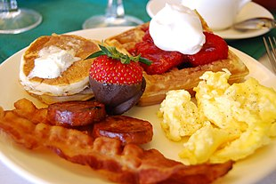
Men’s Breakfast October 11
Join the men for a full breakfast on Saturday October 11 at 8a.m. in the Fellowship Hall.

Slide 8
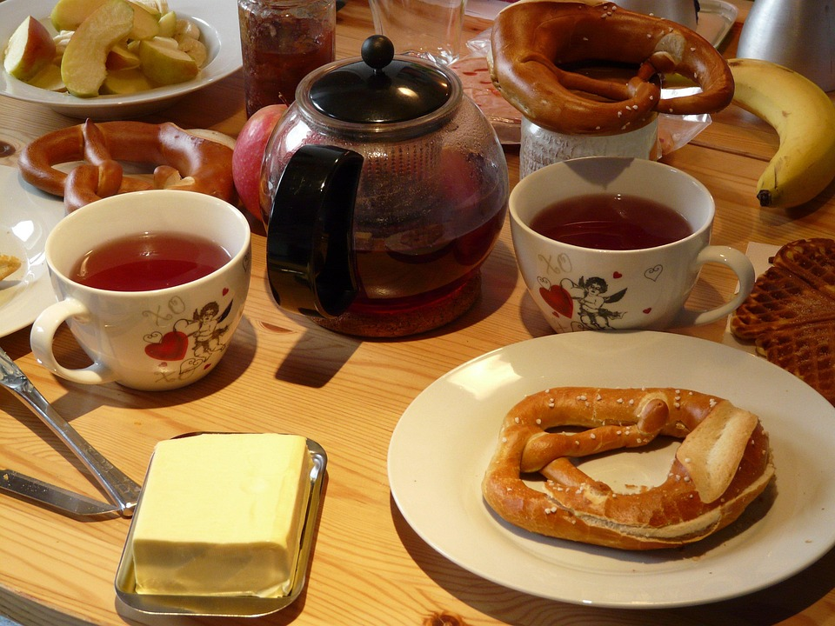
Women’s Fellowship Breakfast
Join the Women’s Ministry as they have a potluck breakfast on Saturday October 18 at 9a.m. in the Fellowship Hall. Bring a breakfast item to share.

