Slide 1
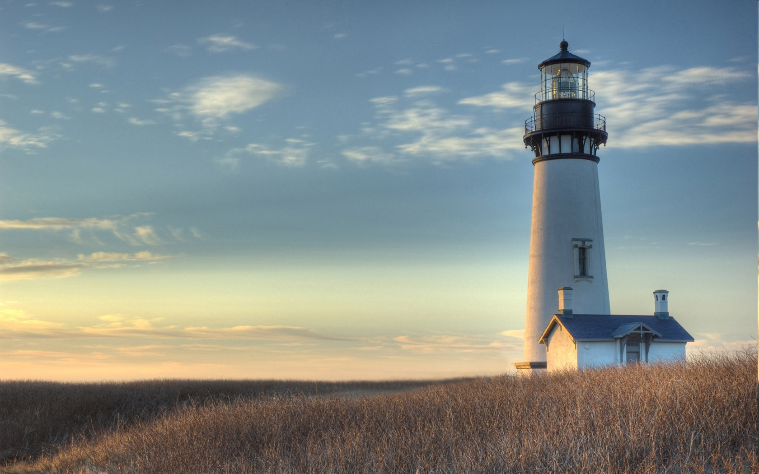
Chestnut Street Baptist Church
Welcome
Pastor Frank R. Johnson Associate Pastor Jeremy Johnson
Notes:
1

Slide 2

Tuesday 6:30 p.m.
Life Group at the Harmsen’s

Slide 3
Wednesday 6:30 p.m.
Prayer Group
Cornerstone Kids Club (Grades 1-5)
Ignition (Youth Group, Grades 6-12)

Slide 4
Thursday at 6 p.m.
Cross Walk (Collegiate/Young Adults)

Slide 5
Friday 4:30 p.m.
LIFE Group (Briarwood)

Slide 6
Keep on Praying!
If you would like to receive PrayerNet Today emails, send us a request at prayer@csbcfamily.com.
Stay connected: www.csbcfamily.com
Find us on Facebook

Slide 7
Giving Options
(Thank you for supporting this ministry!)
Mail: 609 N. Chestnut St. Ellensburg, 98926
Online: Giving link at www.csbcfamily.com
In Person: Offering Box in lobby

Slide 8

Budget Requests
Ministry Team Leaders, please have all written budget request in the office today.
This Photo by Unknown Author is licensed under CC BY-SA

Slide 9
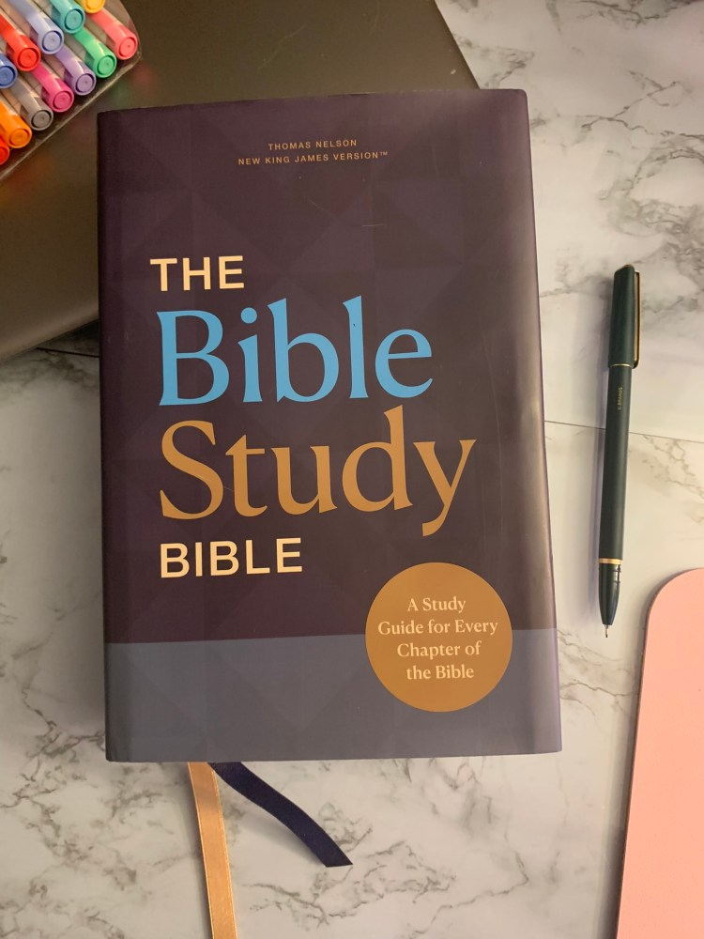
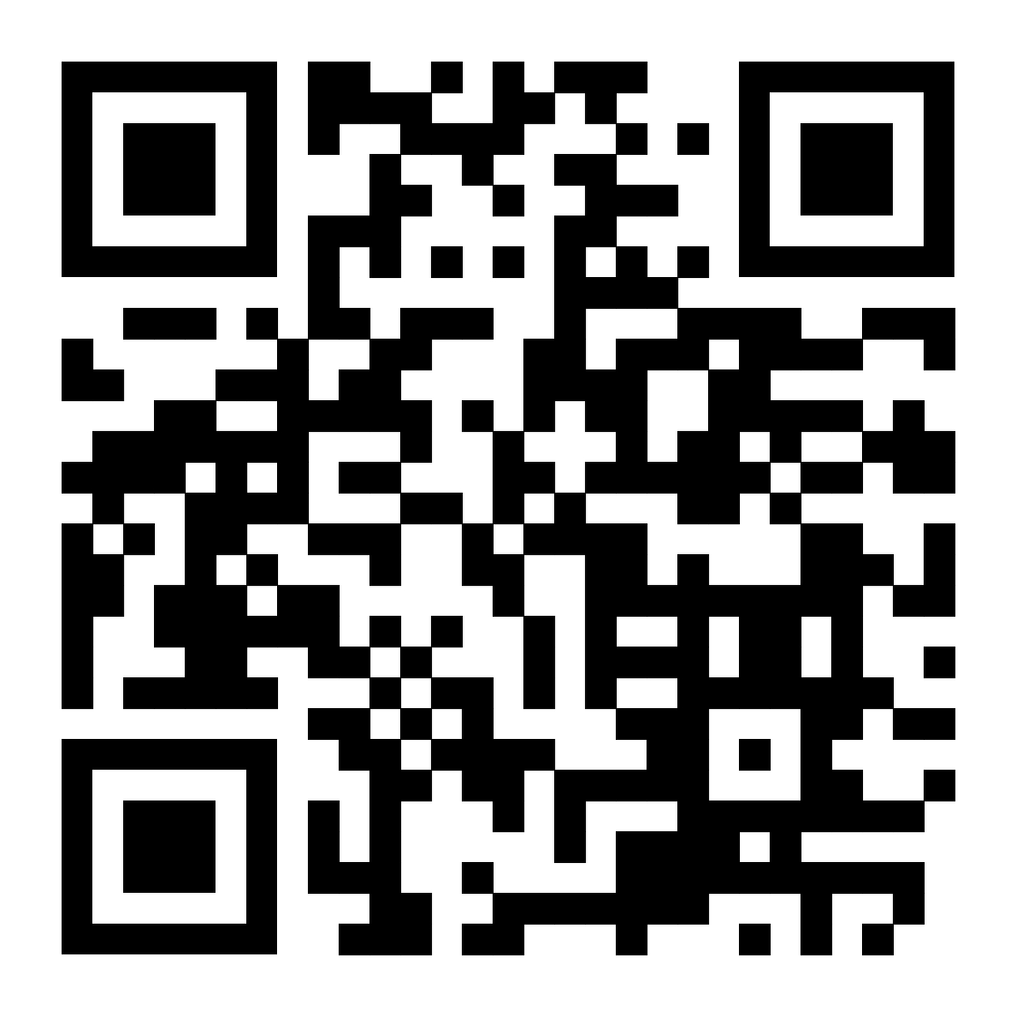
Bible READERS WORKSHOP flyers on table in foyer
Dr Mark Bradley and his son, Jordan will have two sessions, How We Got the Bible and How to Read and Understand the Gospels on November 21, 6:30 to 9 p.m. This will continue on Saturday November 22, from 9 a.m.-12:00 p.m. Register today!
This Photo by Unknown Author is licened under CC BY-NC-ND

Slide 10
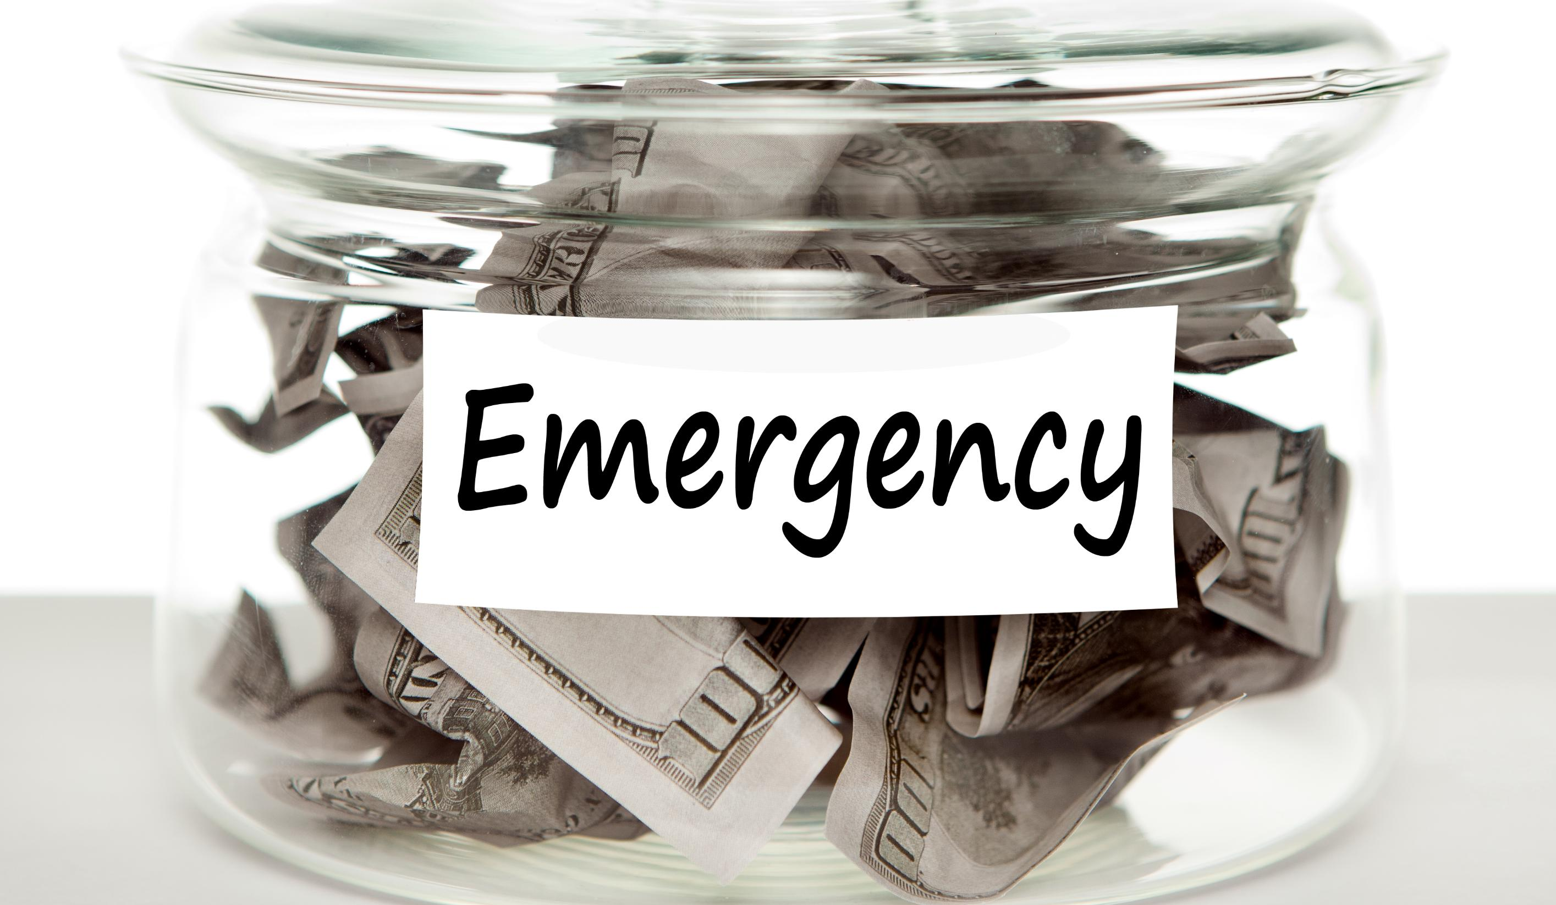
Emergency Medical fund
Help with expenses for our Youth Director, Aren Blackwood. His medical expenses will be high, so if you could help, it will be much appreciated. Make sure to designate to “Youth Director Medical Emergency.”

Slide 11

Women’s Potluck Breakfast
Join the women for a potluck breakfast on November 15 at 9 a.m.
We meet in the Fellowship Hall. Bring a breakfast item to share. See you then!

Slide 12

Youth Sunday Service
We are excited the Youth will be conducting the service next Sunday November 16. Encourage them when you see them!

