Slide 1
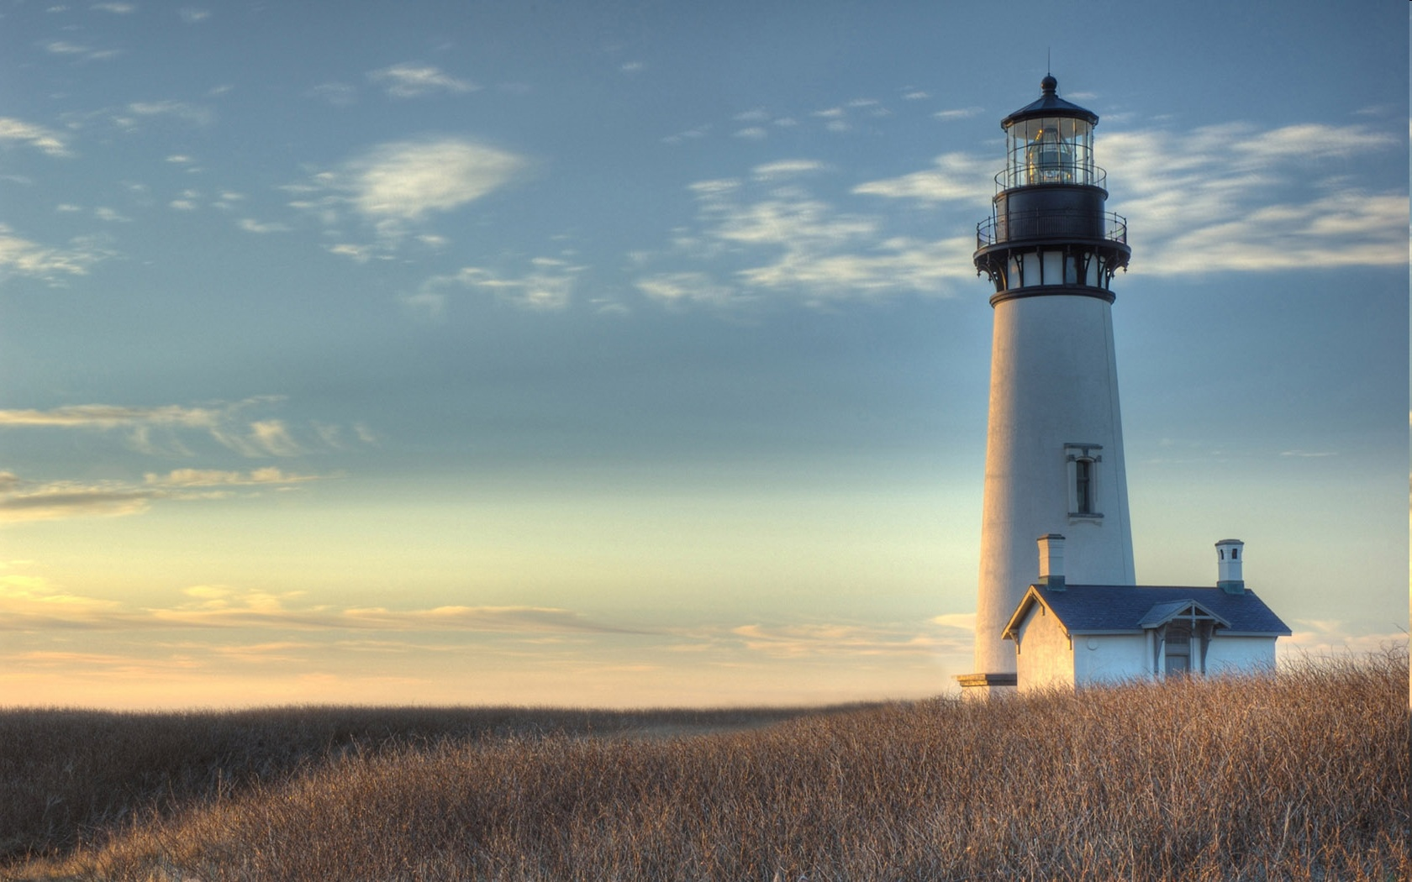
Chestnut Street
Baptist Church
Thank you for joining us!
Notes:
1

Slide 2

Tuesday 6:30 p.m.
Life Group at the Harmsen’s

Slide 3
Wednesday 6:30 p.m.
Ignition (Youth, Grades 6-12)
Prayer Group
Cornerstone Kids Club
(Grades 1-5)

Slide 4
Thursday 6:00 p.m.
Cross Walk for CWU and Young Adults

Slide 5
Friday 4:30 p.m.
LIFE Group (Briarwood)

Slide 6

Giving Options
(Thank you for supporting this ministry!)
Mail: 609 N. Chestnut St. Ellensburg, 98926
Online: Giving link at www.csbcfamily.com
In Person: Offering Box in lobby

Slide 7

New Office Hours!
Our Office Hours have changed. Note the new schedule below:
Tuesday and Wednesday
9 a.m. – 12:00
12:30 p.m. – 2:30 p.m.
Thursday
12:00 – 2:00 p.m.
Stop in and say hi!

Slide 8

Redeem Trick or Treating
Expect trick or treaters? Use these stickers to remind them the Lord is indeed Good. Just paste on your candy.
Pick up some on the table in the foyer!

Slide 9
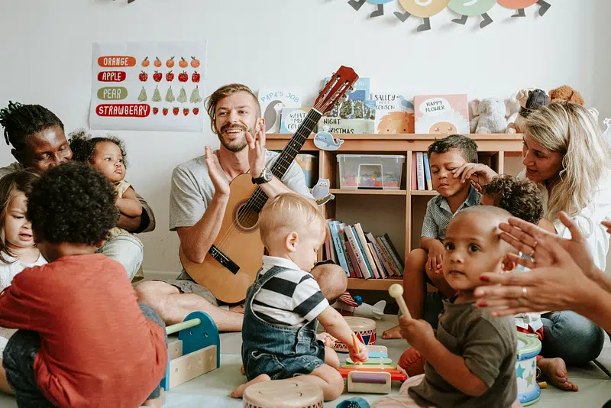
Nursery Volunteers needed
We would love to have you volunteer for Nursery Duty!
You will not be alone. Usually, two people will be with you. If you’d like to join us, please speak with Risa Wood or contact the Office at 509-925-2424. Guitar playing isn’t needed!

Slide 10

CALLED BUSINESS MEETING NOVEMBER 8
The Pastoral Transition Team has called a business meeting to present the candidate they have chosen. Members, please be there to vote your choice.

