Slide 1
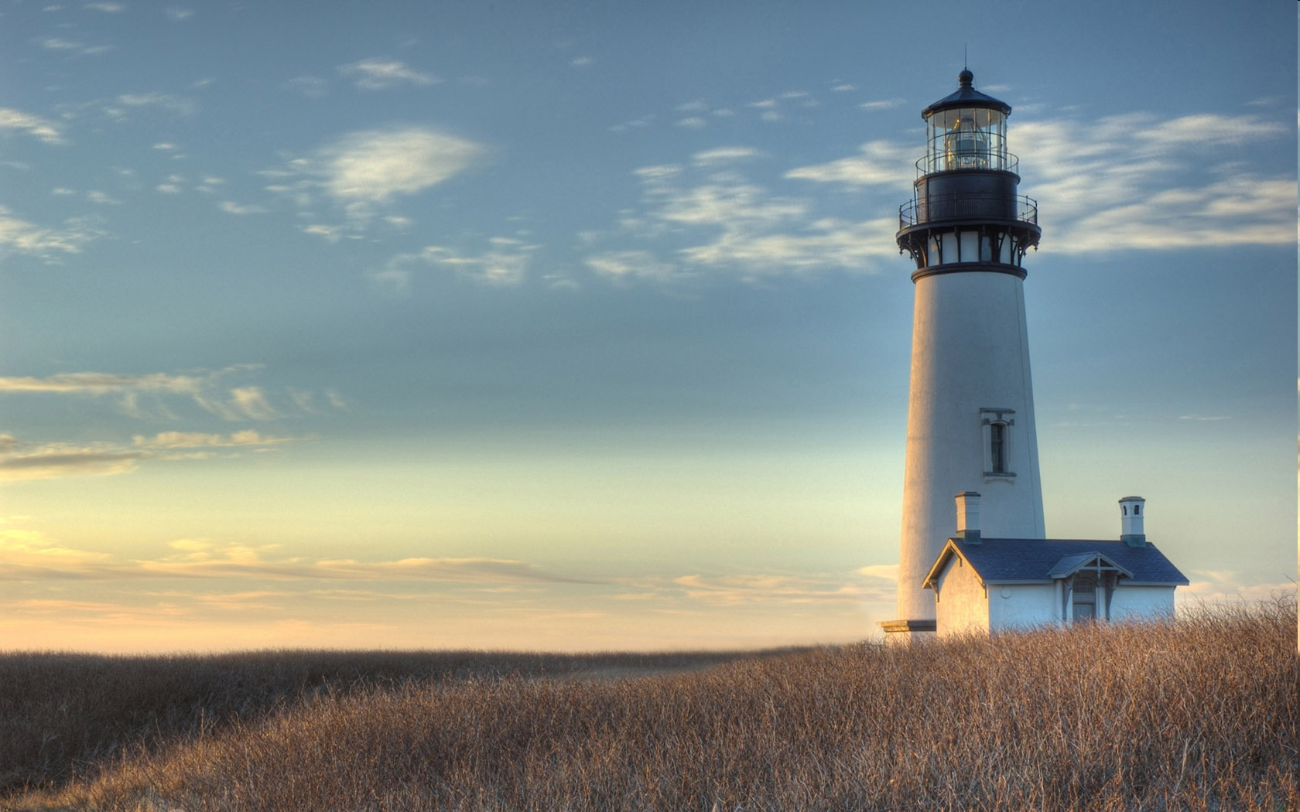
Chestnut Street Baptist Church
Welcome
Pastor Frank R. Johnson Associate Pastor Jeremy Johnson
Notes:
1

Slide 2

Tuesday 6:30 p.m.
Life Group at the Harmsen’s

Slide 3
Wednesday 6:30 p.m.
Prayer Group
Ignition (Grades 6-12)
Cornerstone Kids Club (Grades 1-5)

Slide 4
Thursday 6:00 p.m.
Crosswalk (Young Adults)

Slide 5
Friday 4:30 p.m.
LIFE Group (Briarwood)

Slide 6
Giving Options
(Thank you for supporting this ministry!)
Mail: 609 N. Chestnut St. Ellensburg, 98926
Online: Giving link at www.csbcfamily.com
In Person: Offering Box in lobby

Slide 7

Lottie Moon Christmas Offering until Today
Together We Can Do More We will continue this special offering through Today.
To give, designate to “Missions” on the envelope or select the giving link online.

Slide 8


Women’s Potluck Breakfast Saturday Jan 17th at 9:00a.m.
Bring an item to share!
9:00 a.m., Saturday January 17.
Please come and join us!

Slide 9

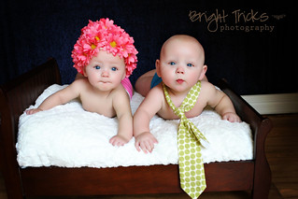
Sanctity of Human Life Sunday January 25, 2026
Stand for life and protect the most vulnerable among us – we can pray and we can give and we can serve.
This Photo by CC BY-ND

Slide 10




Bible Readers’ Luncheon
Saturday January 24, at noon, Pastor Frank and Jeannie are hosting a luncheon for those who have read through the Bible in 2025. Please let Jeannie know you did so that you can attend.
This Photo by Unknown Author is licensed under CC BY-SA

Slide 11
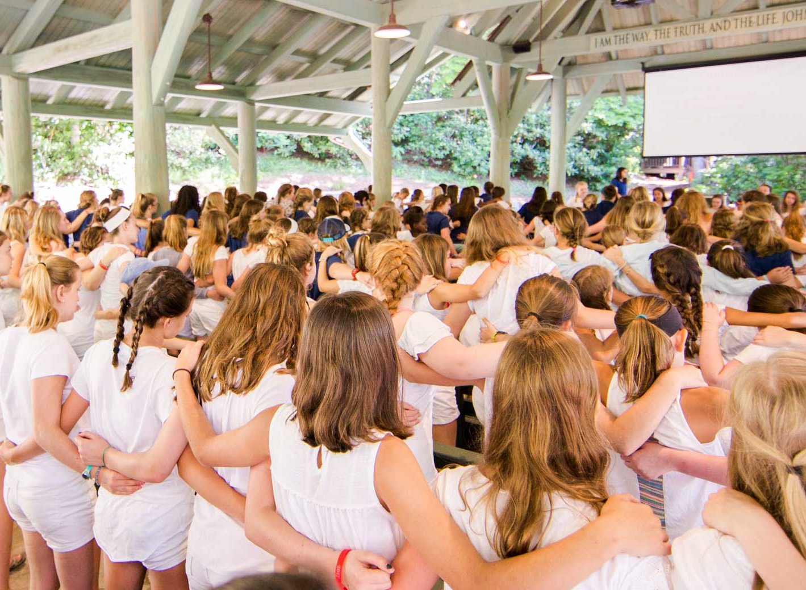
Centrifuge Camp Deadline
Youth, get your pre-registration and deposit in today to Aren. Centrifuge is awesome!

