Slide 1

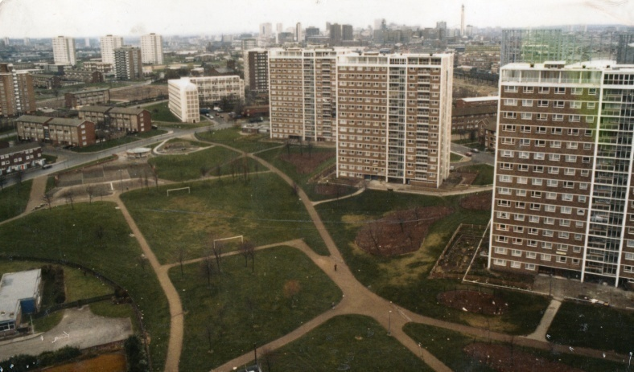
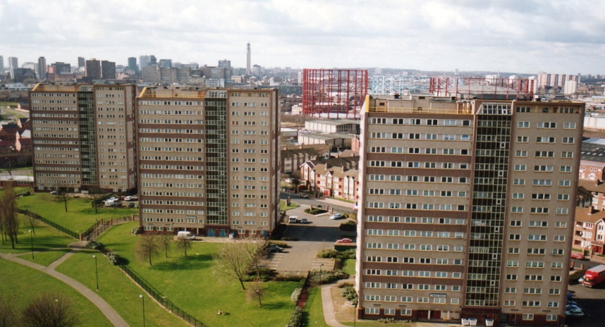
Bloomsbury Old and New

Slide 2
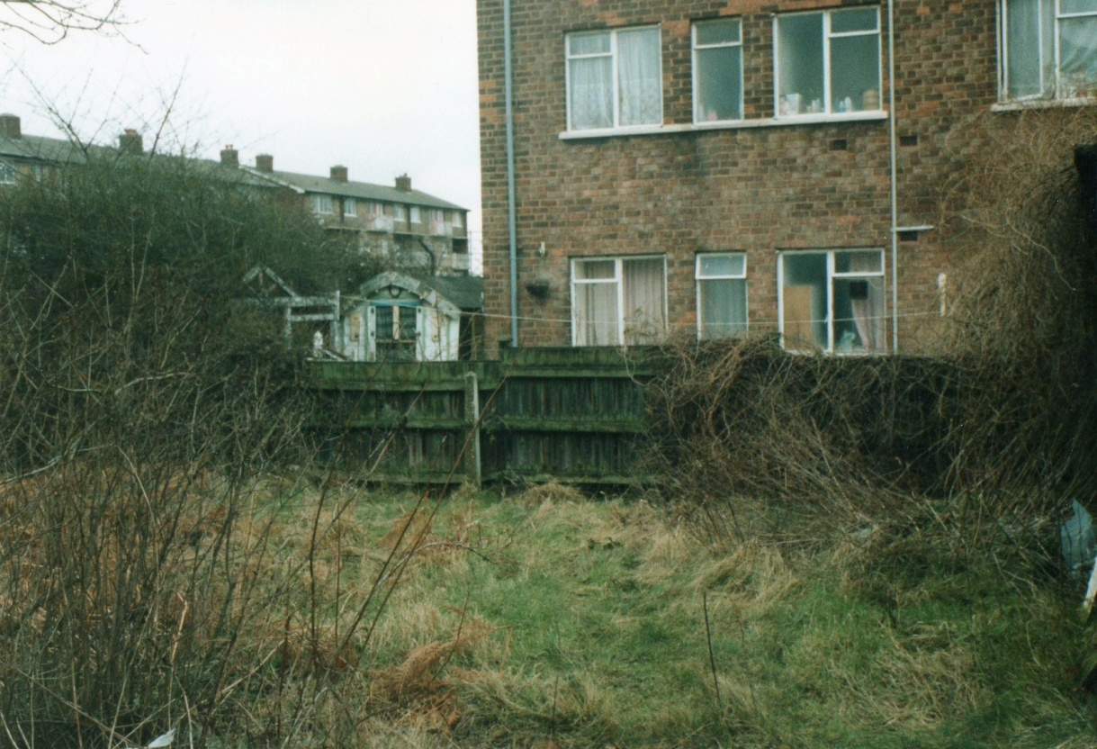
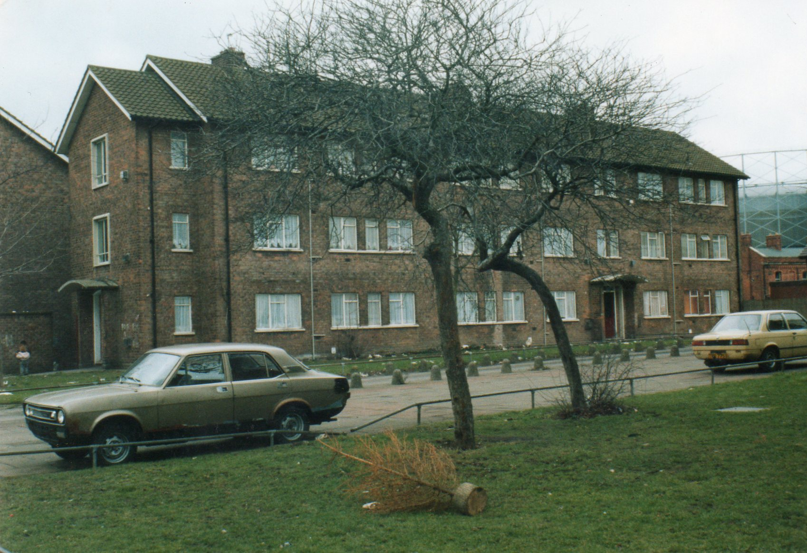
Rear of Cromwell Street gardens before government Estate Action funding work started in the early 1990’s.
In between the blocks on Cromwell Street showing the lack of car parking facilities

Slide 3
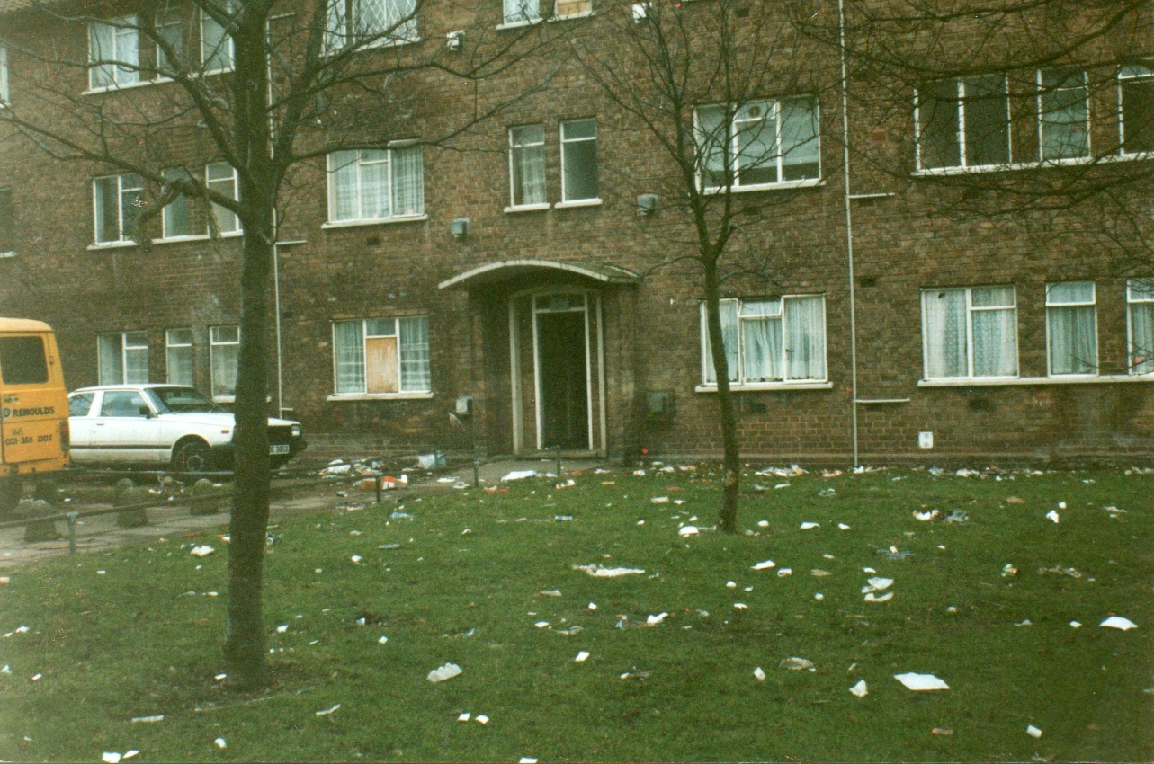
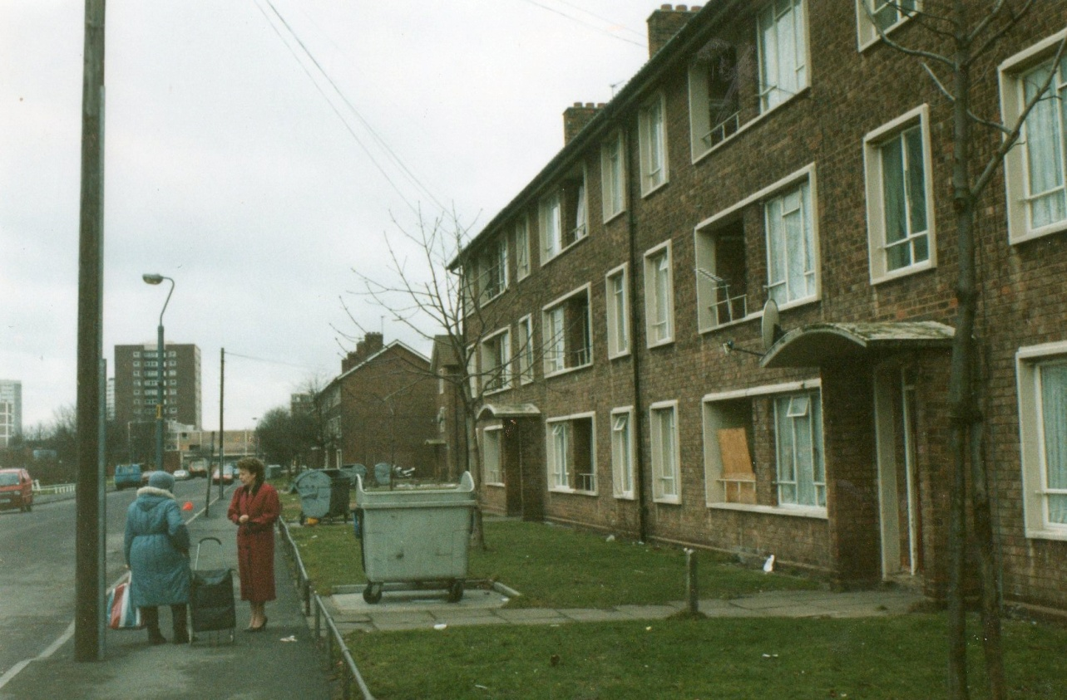
Cromwell Street properties – again highlighting the lack of car parking and an excess of litter.
The front of Cromwell Street before Estate Action works. Note no fencing and metal framed single-glazed windows

Slide 4
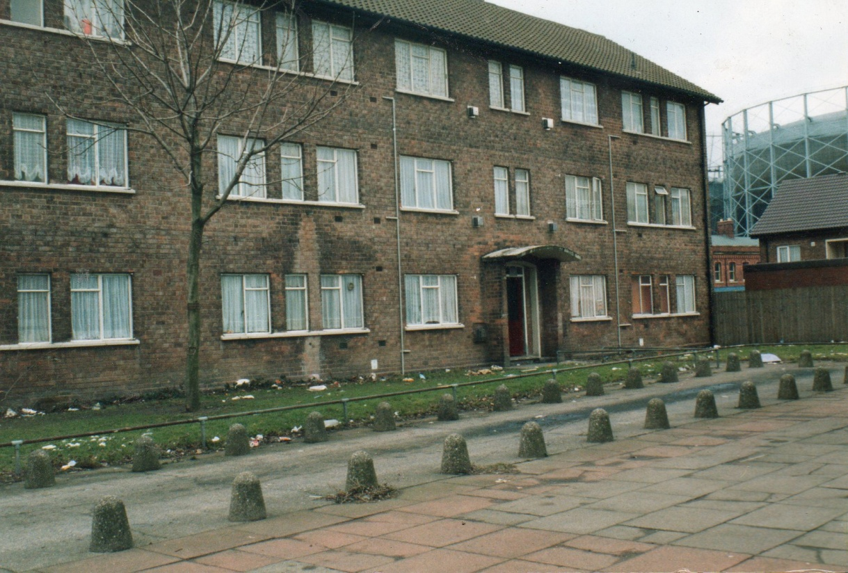
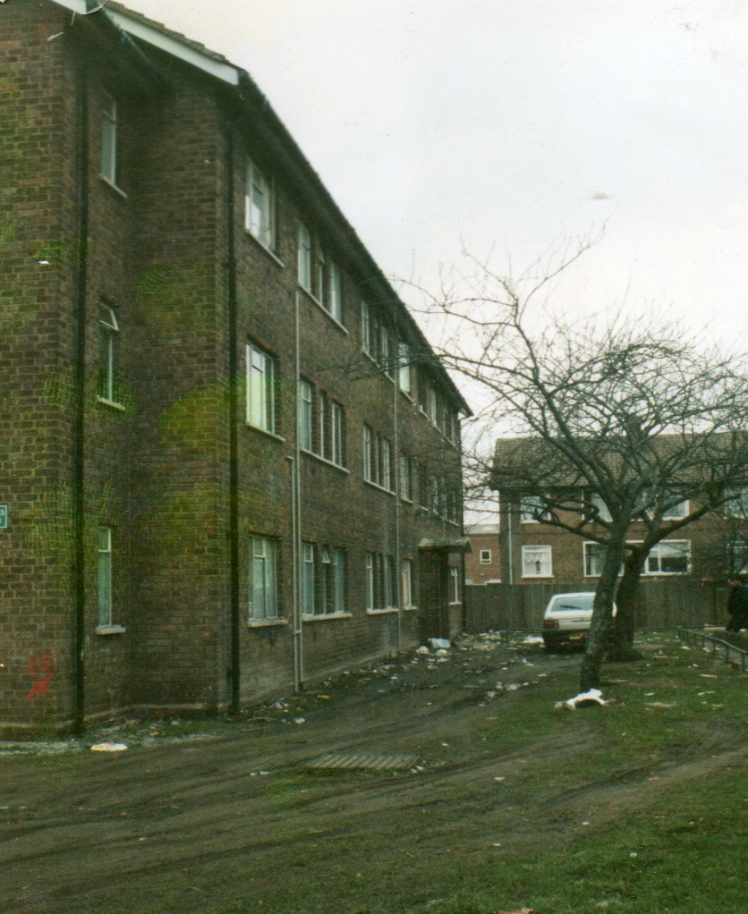
Frontages of Cromwell Street.
Cromwell Street showing where cars drove over grassed areas and lack of car parking facilities.

Slide 5
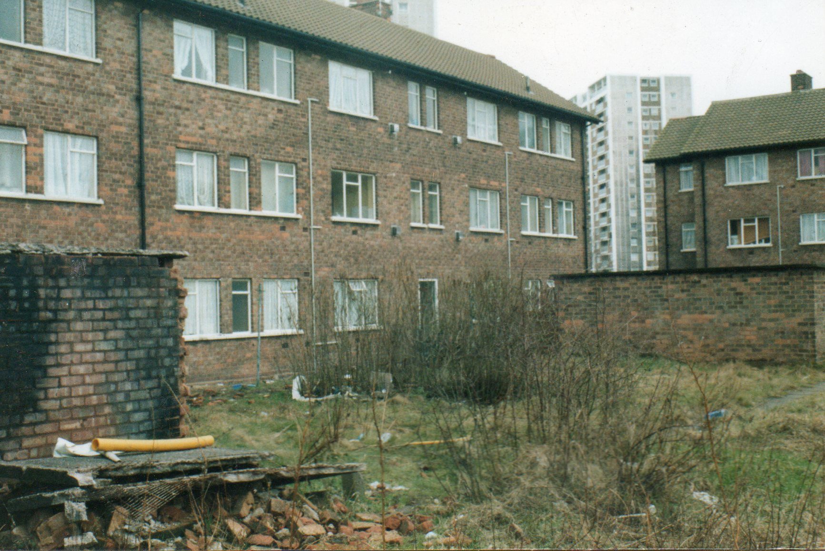
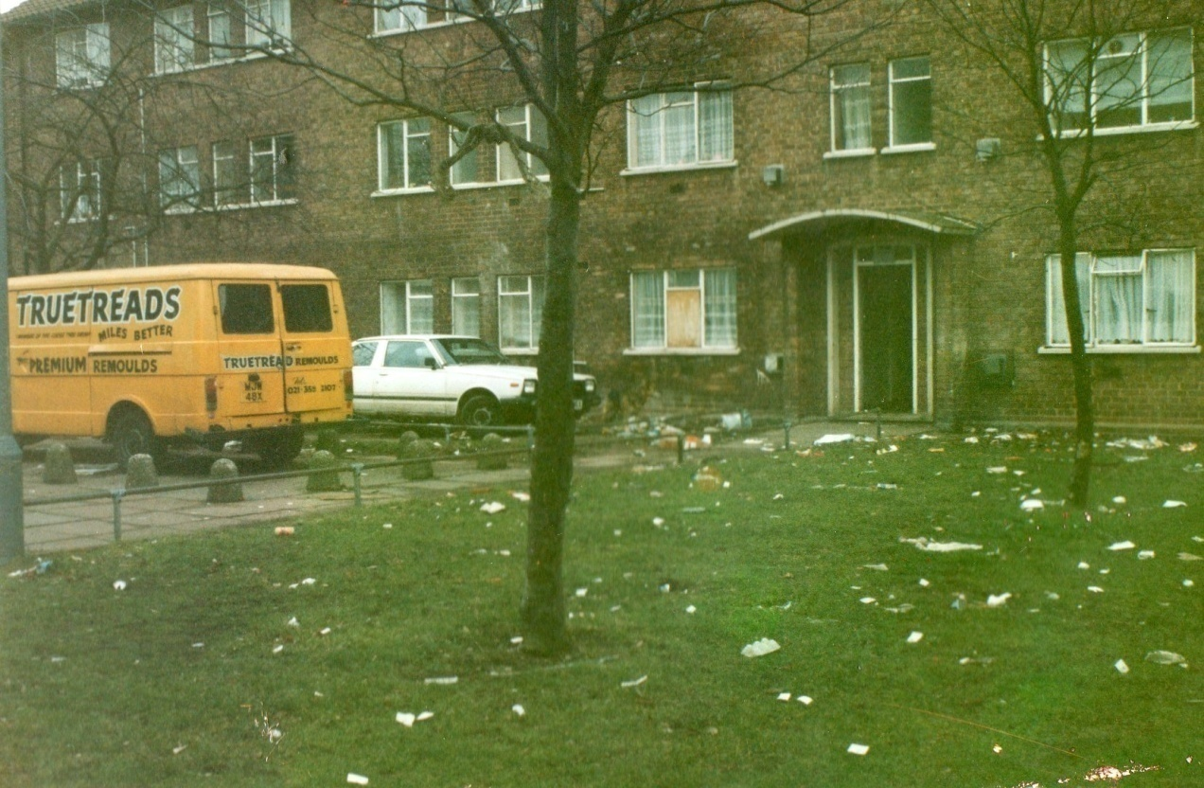
Rear of Cromwell Street properties. The area was overgrown. Originally each flat had its own garden area but this was not taken up and the grounds ran into disrepair.
Further pictures of lack of car parking facilities.

Slide 6
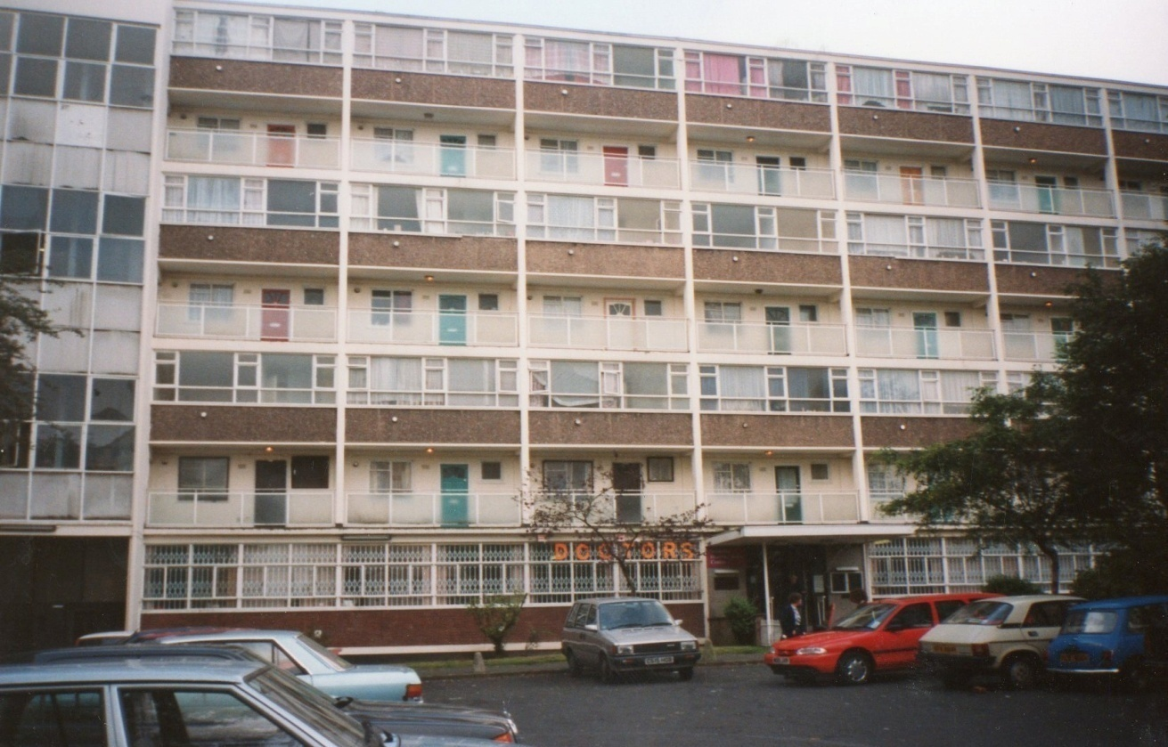
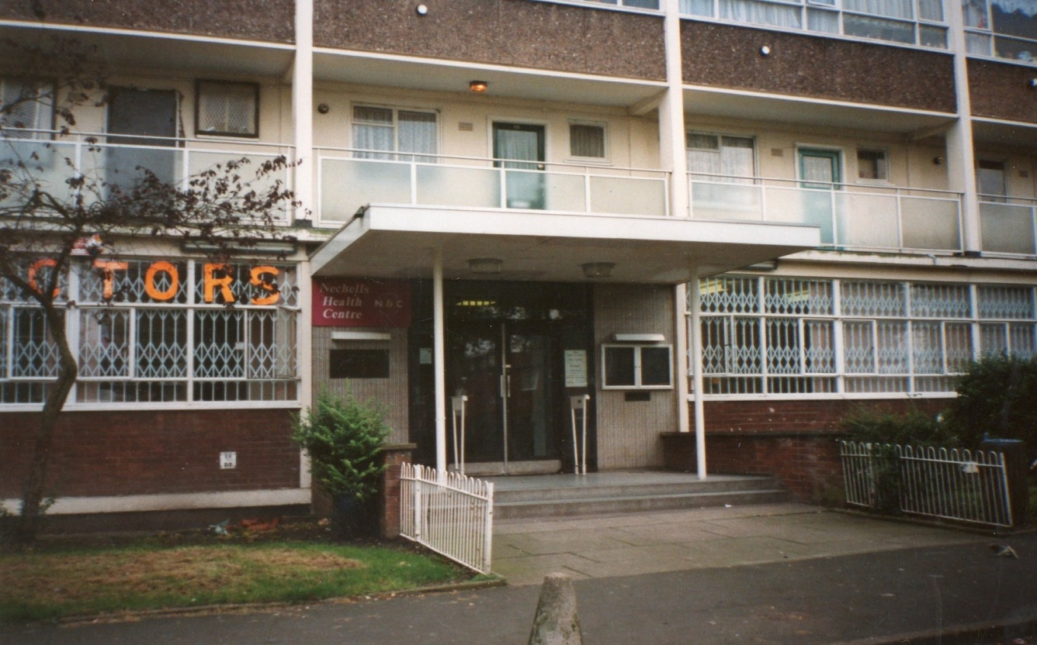
Greenbank House – this was the site of the old doctors surgery on Bloomsbury.
This site has now been demolished and was on the site between Bodmin Grove and Quba (old United Reformed Church)

Slide 7
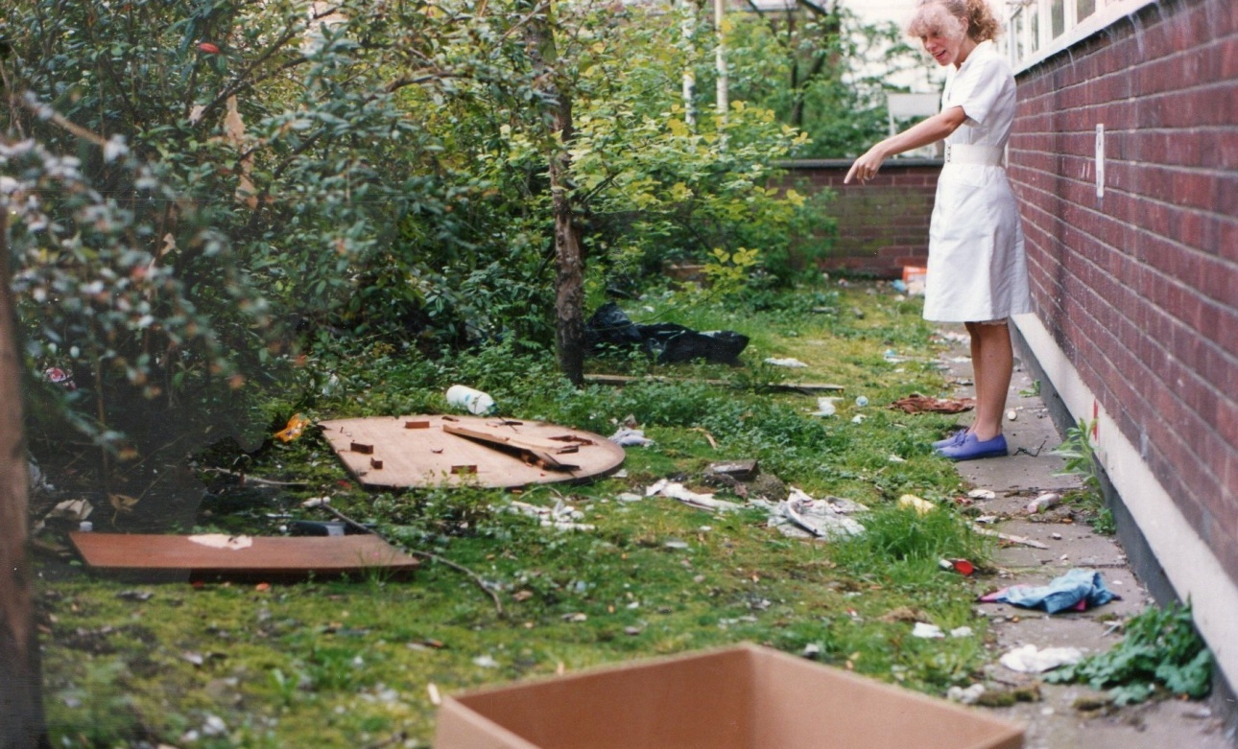
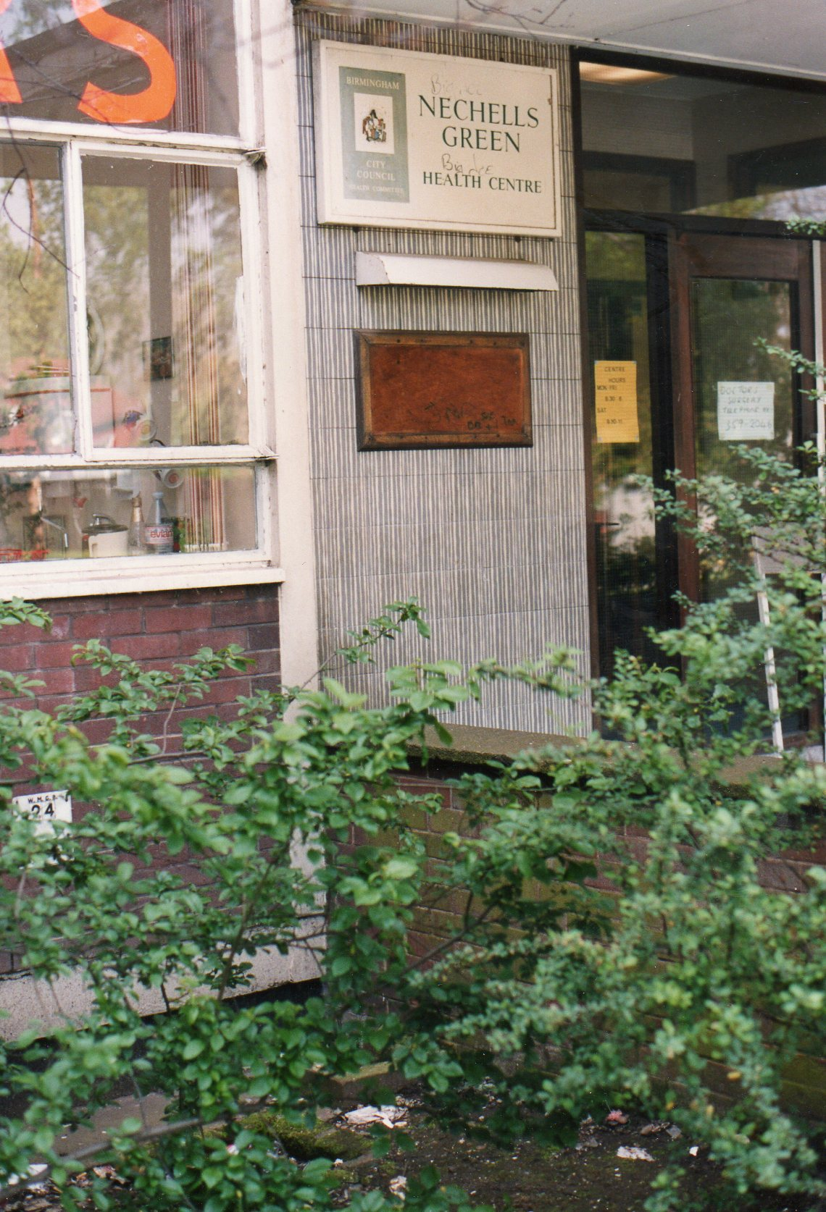
At the rear of the old doctors surgery at Greenbank House.

Slide 8
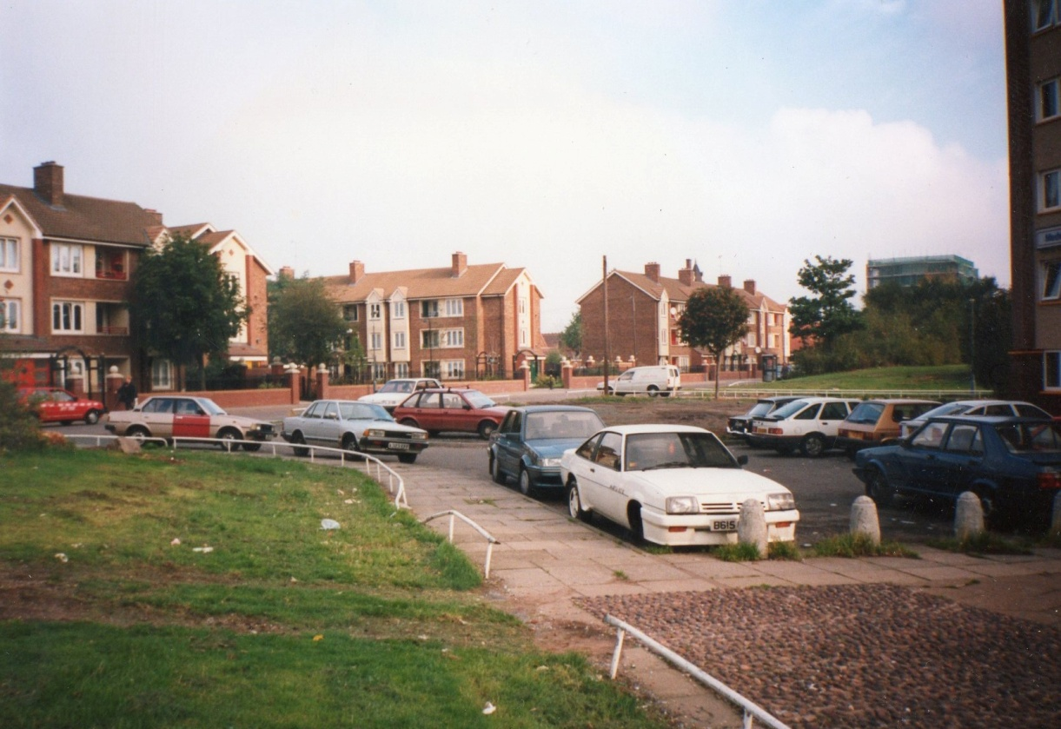
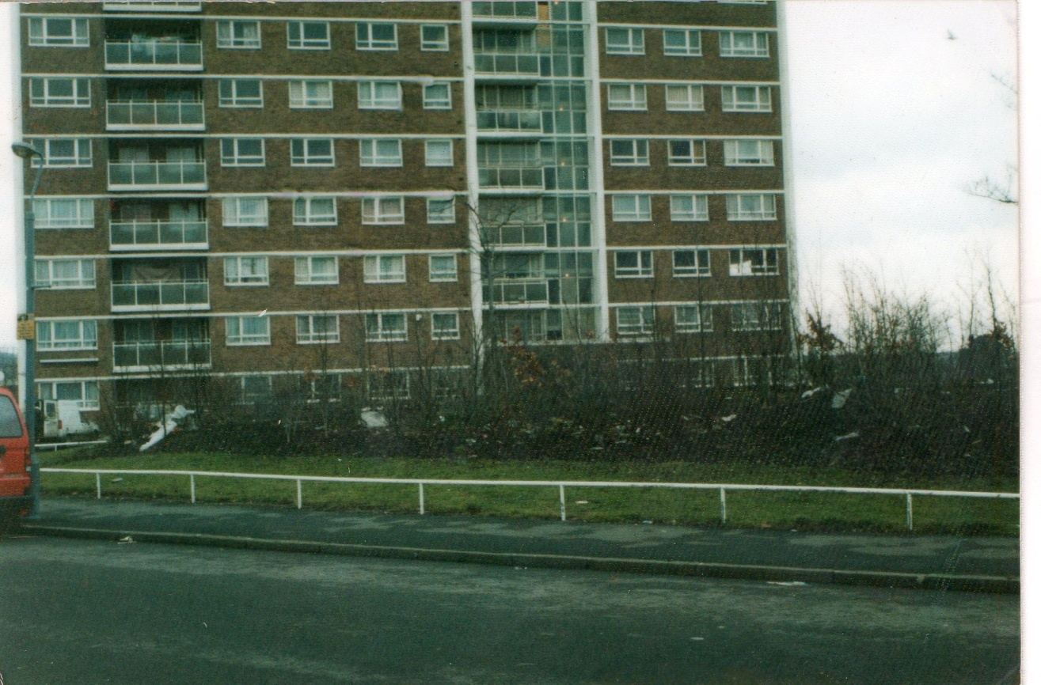
Medway Tower – this shows how small the car parking are was in front of Medway Tower prior to improvements in the early 1990’s.
Frontage of Severn Tower – showing the open balconies. Burglars used to climb onto the white concrete support beam by the stairwells and break into the middle flats.

Slide 9
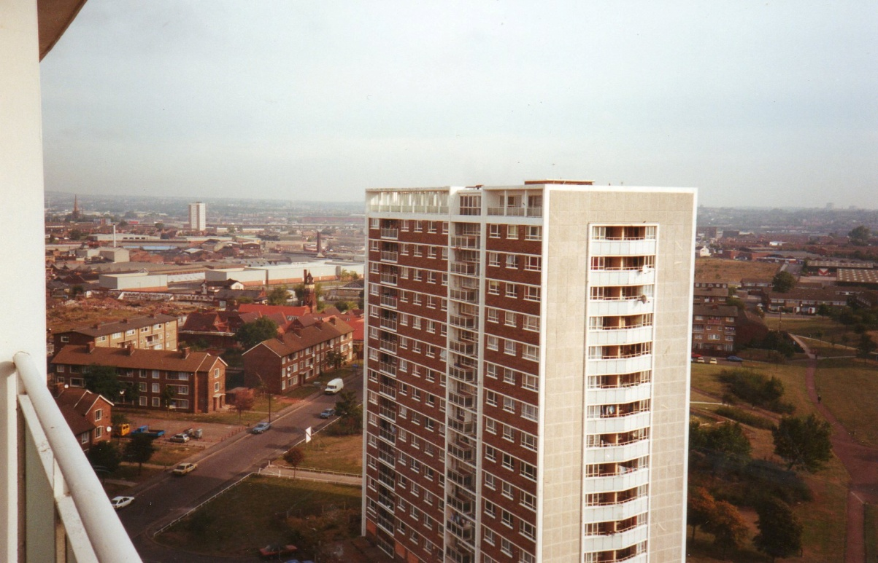
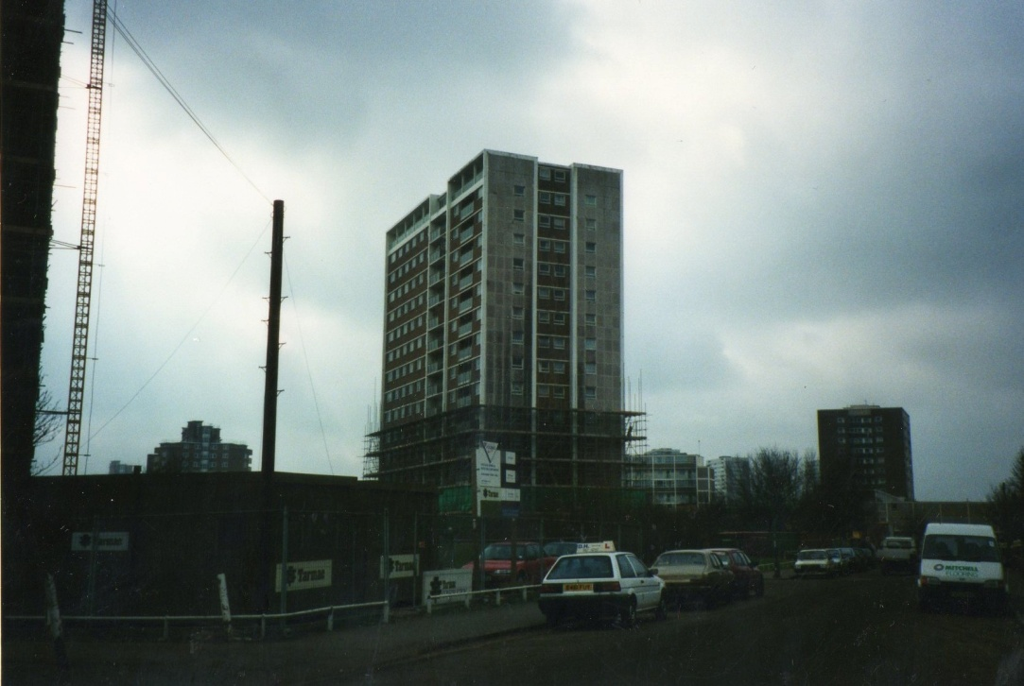
Medway Tower – again note the open balconies on the gable end of the properties.
Work starting on Thames Tower back in the 1990’s

Slide 10
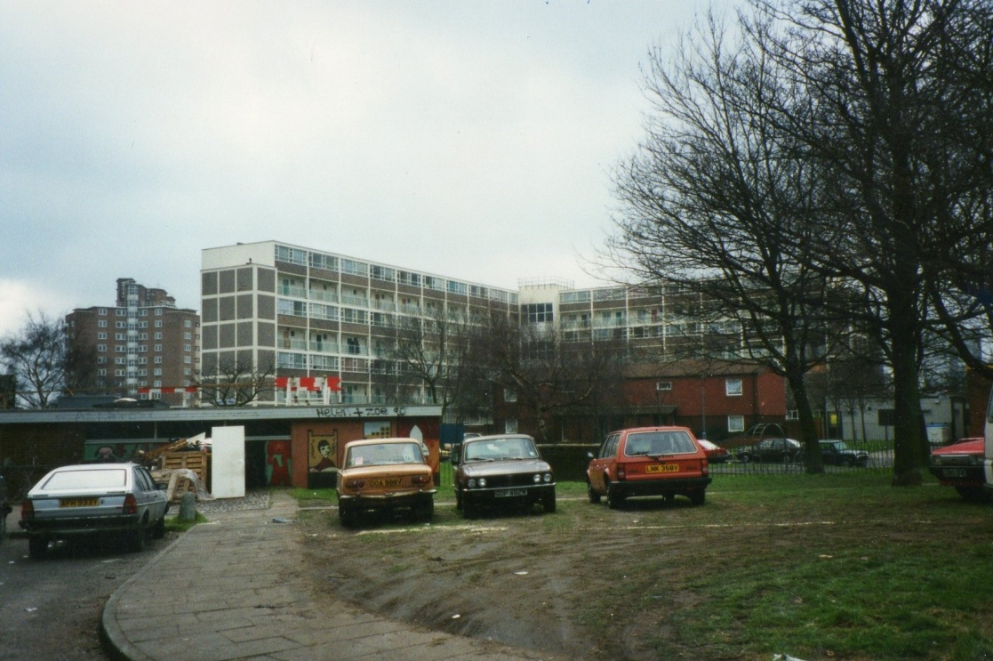
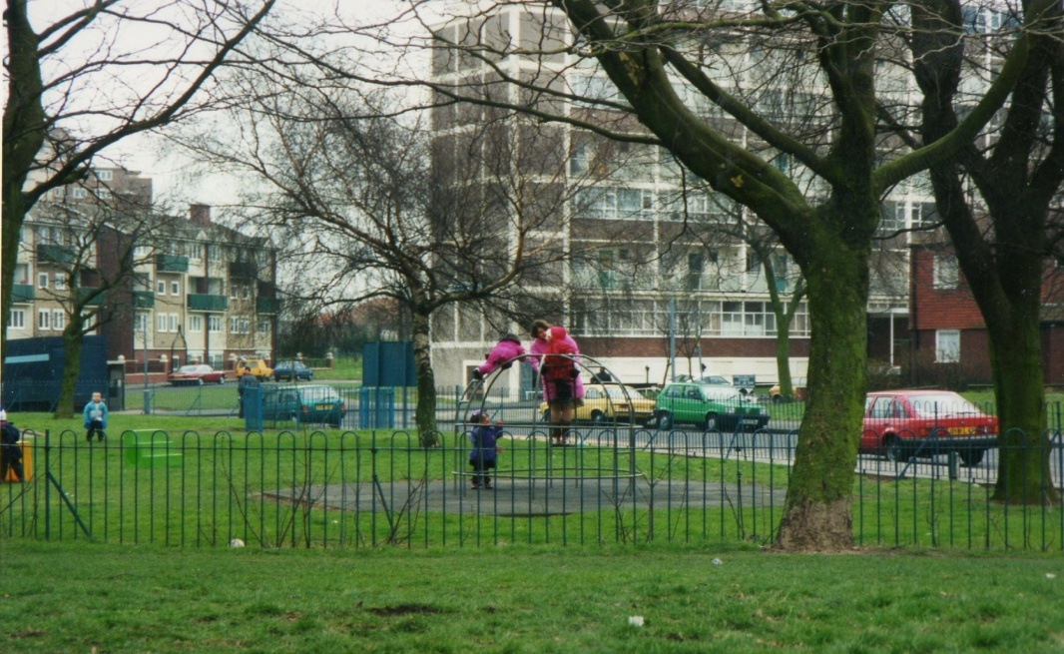
Car parking outside Thames Tower in the 1990’s.
Play area outside Thames Tower Nursery – (now the PoD.

Slide 11
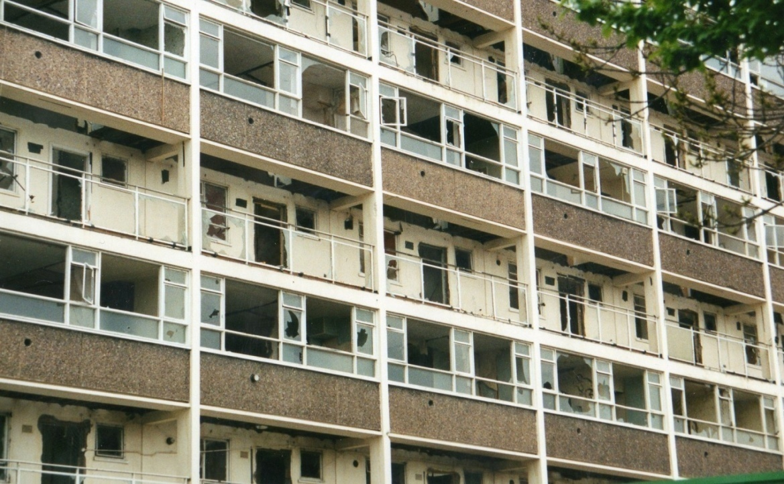
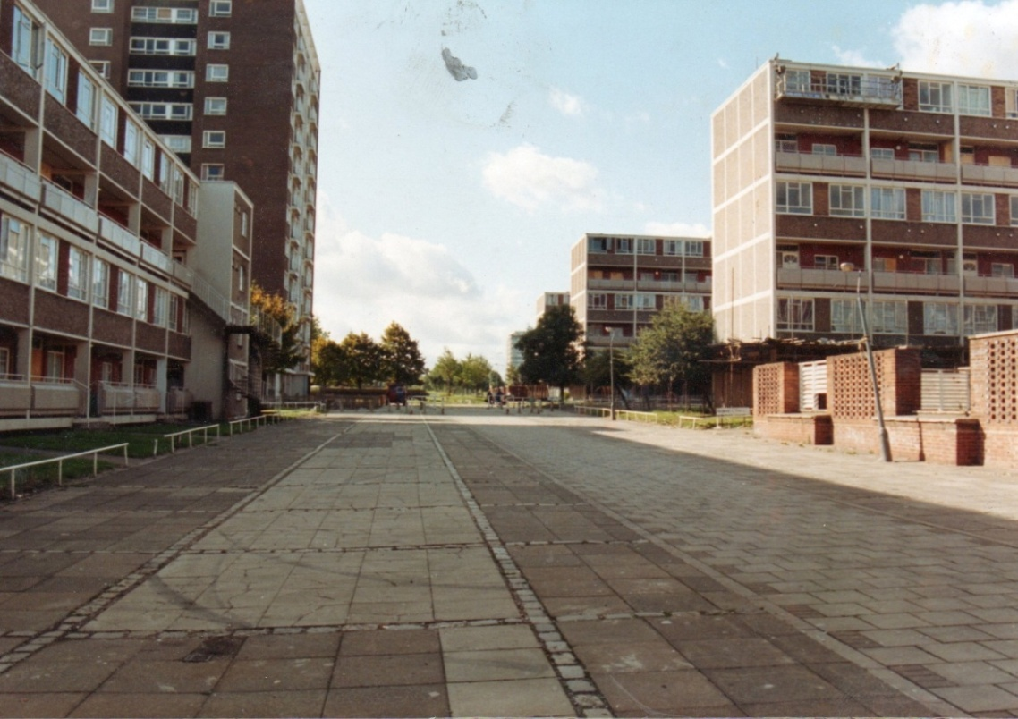
Greenbank House – prior to demolition.
Site of Bradburn Way – this was demolished and made way for the houses on the new Bradburn Way and Verbena Gardens.

Slide 12
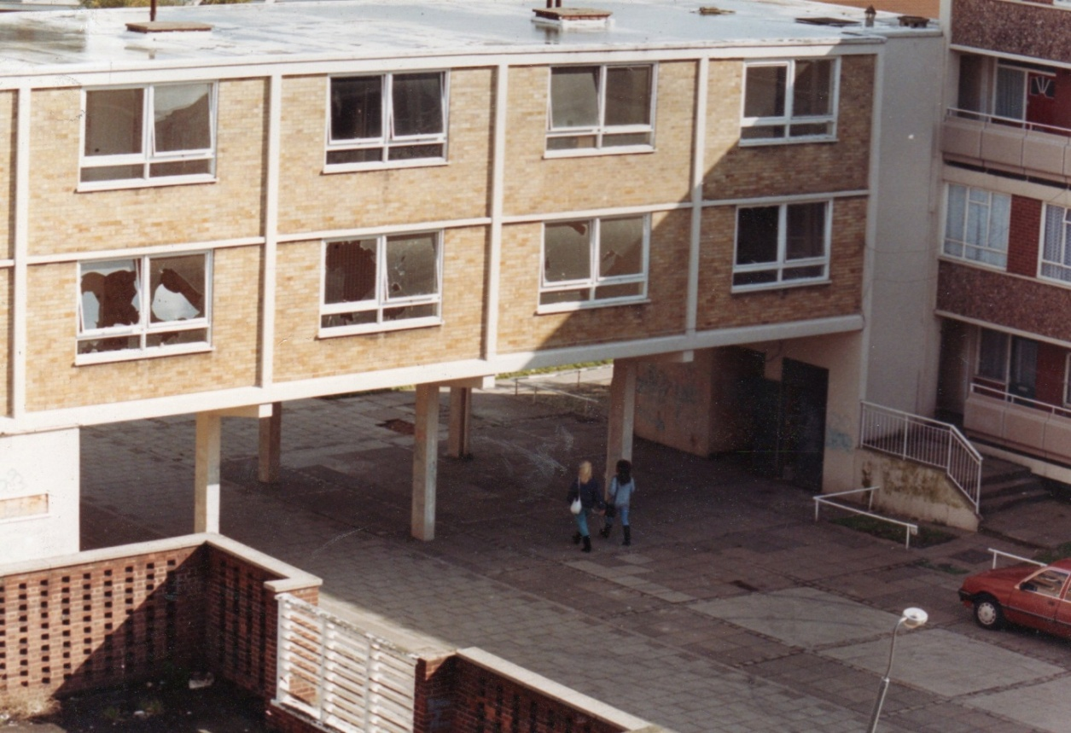
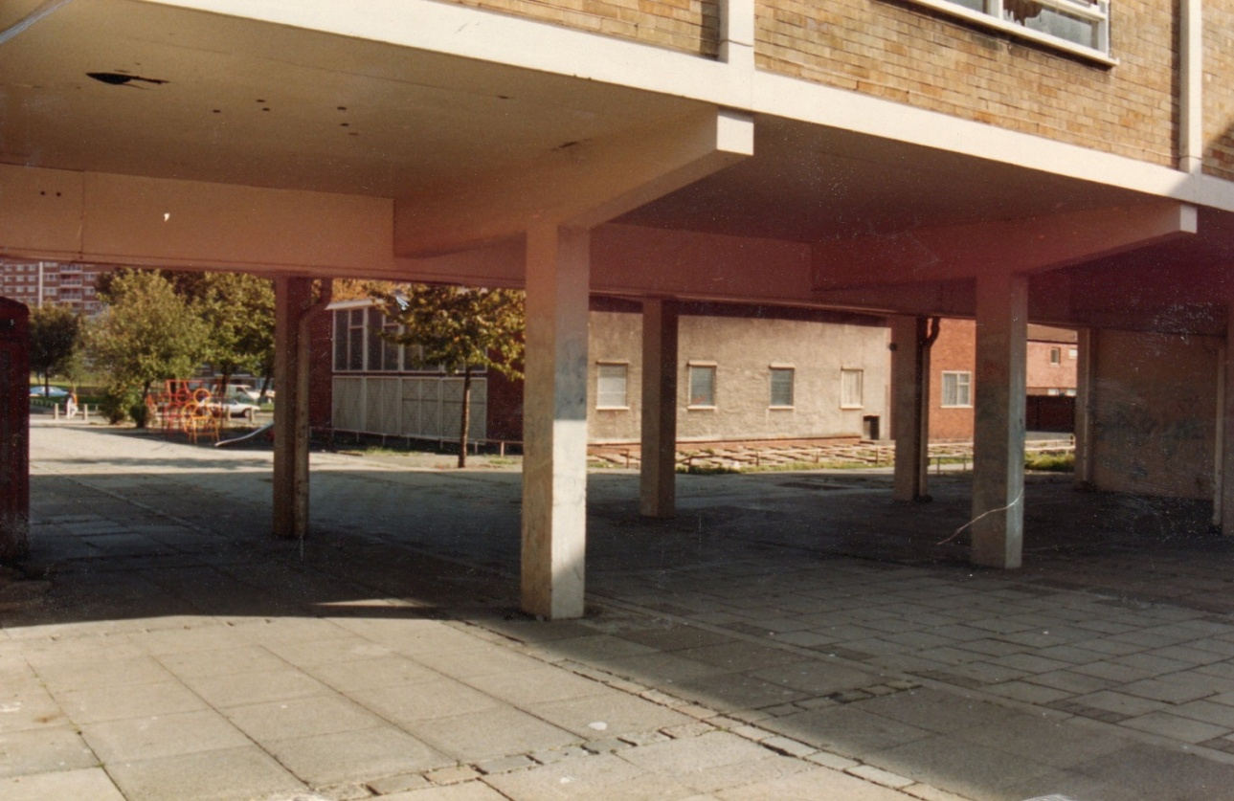
More properties on Bradburn Way prior to demolition. The flats above the walkway were once lived in.
Another closer view of the above.

Slide 13
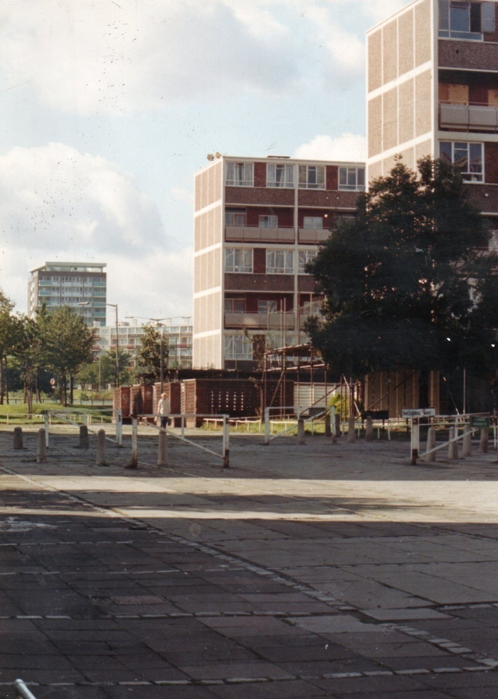
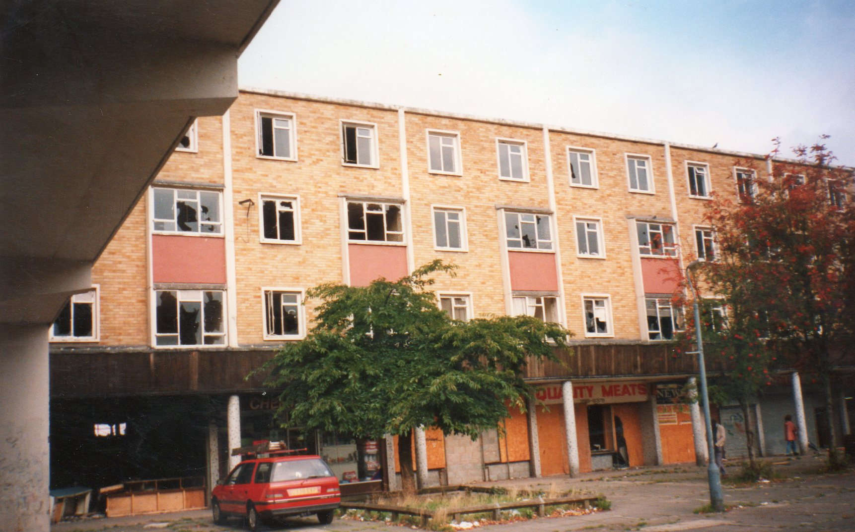
Another view of the old Bradburn Way.
Below were the old shops on Bradburn Way with maisonettes above.

Slide 14
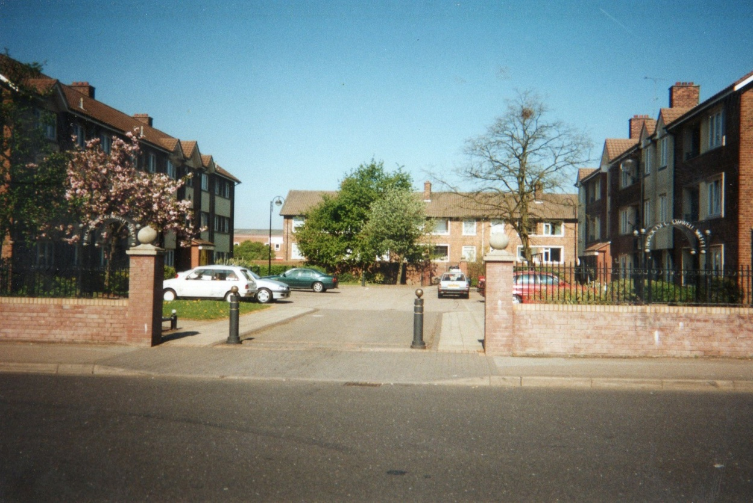
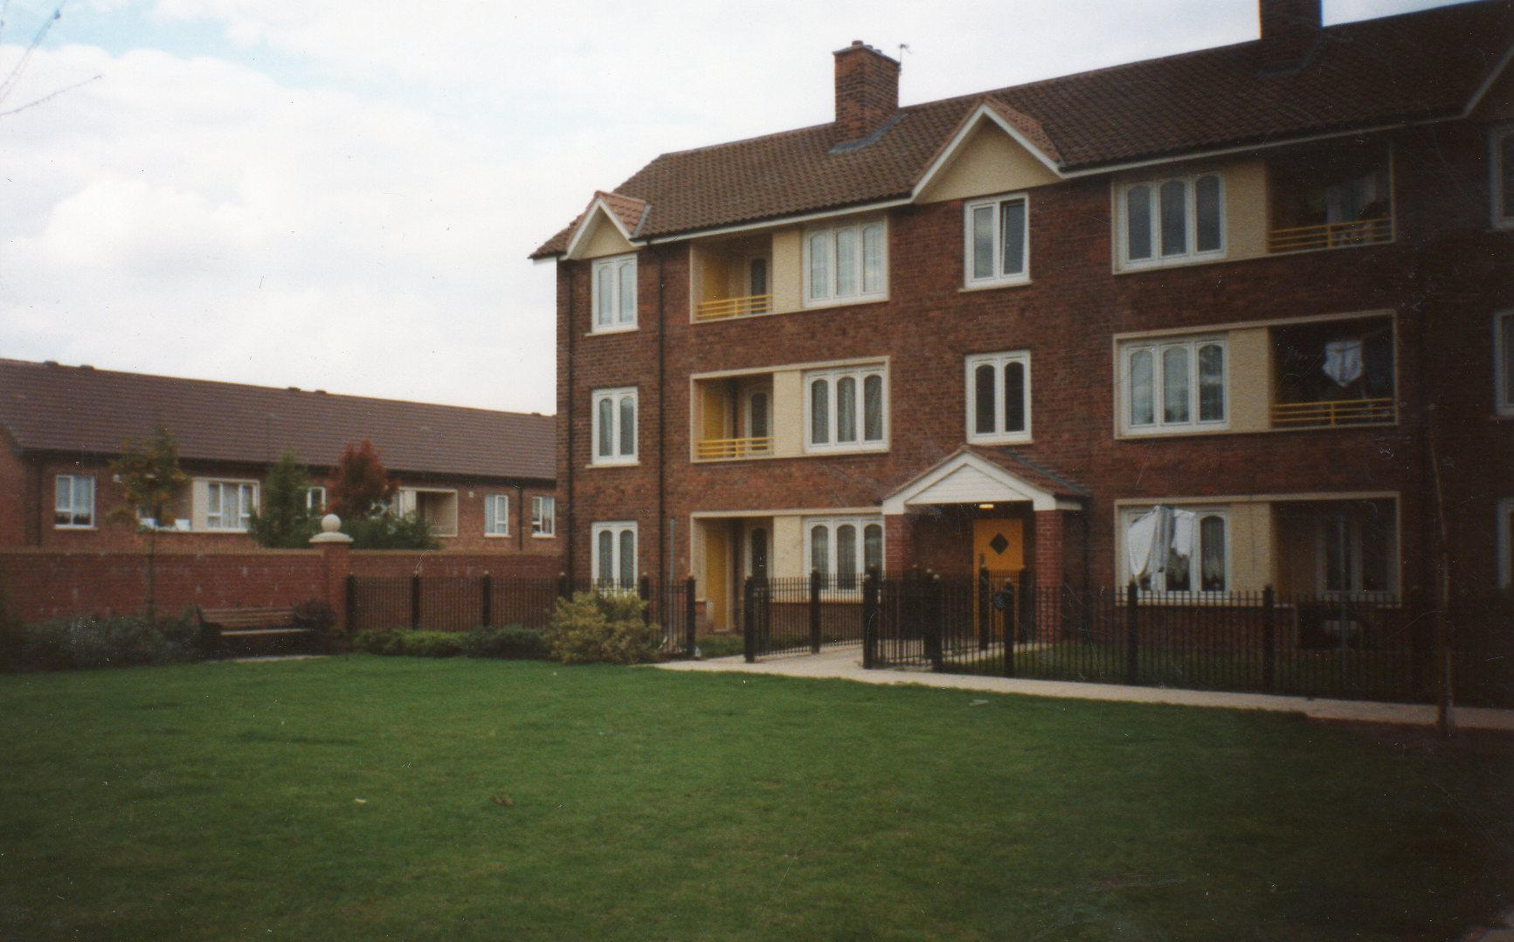
Improved car parking on Cromwell Street.
Fenced off lower gardens and communal grassed area at rear of Cromwell Street properties.

Slide 15
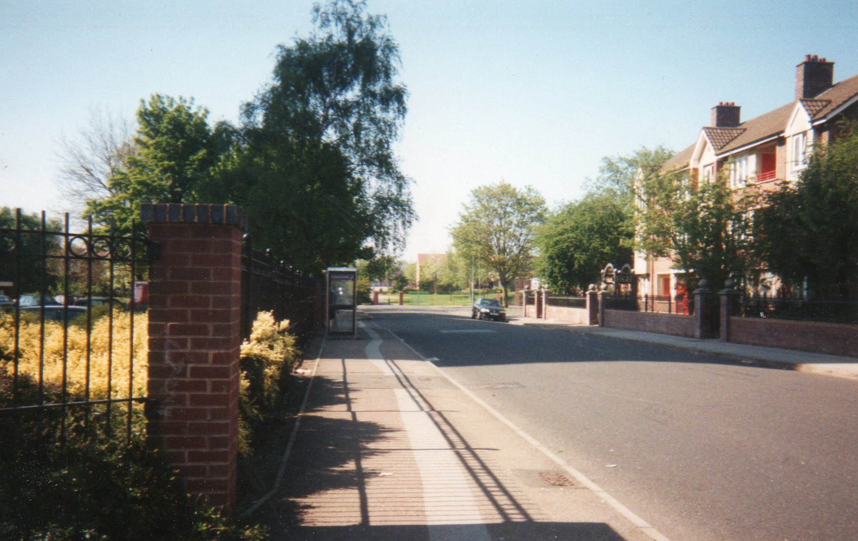
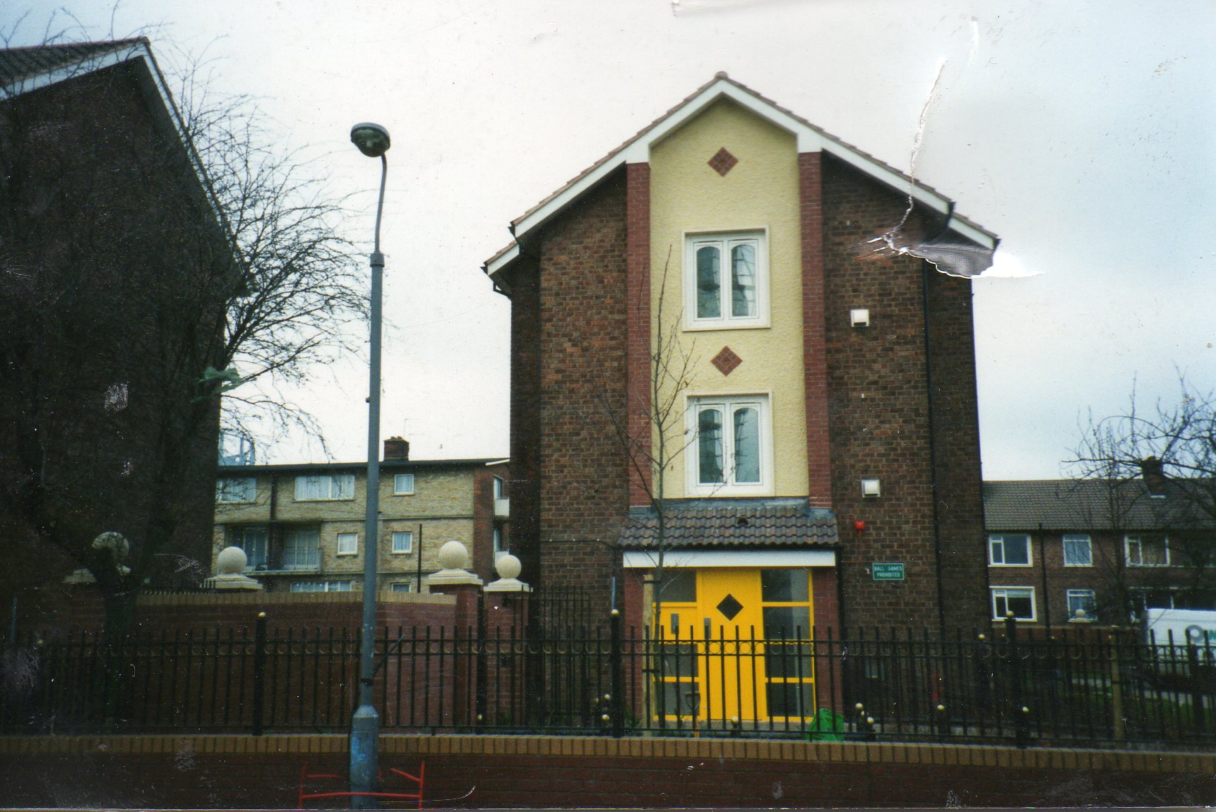
“Secure by Design” walled frontages on Cromwell Street.
Improved entrance to 133 Cromwell Street. Note double glazed windows and secure door-entry system.

Slide 16
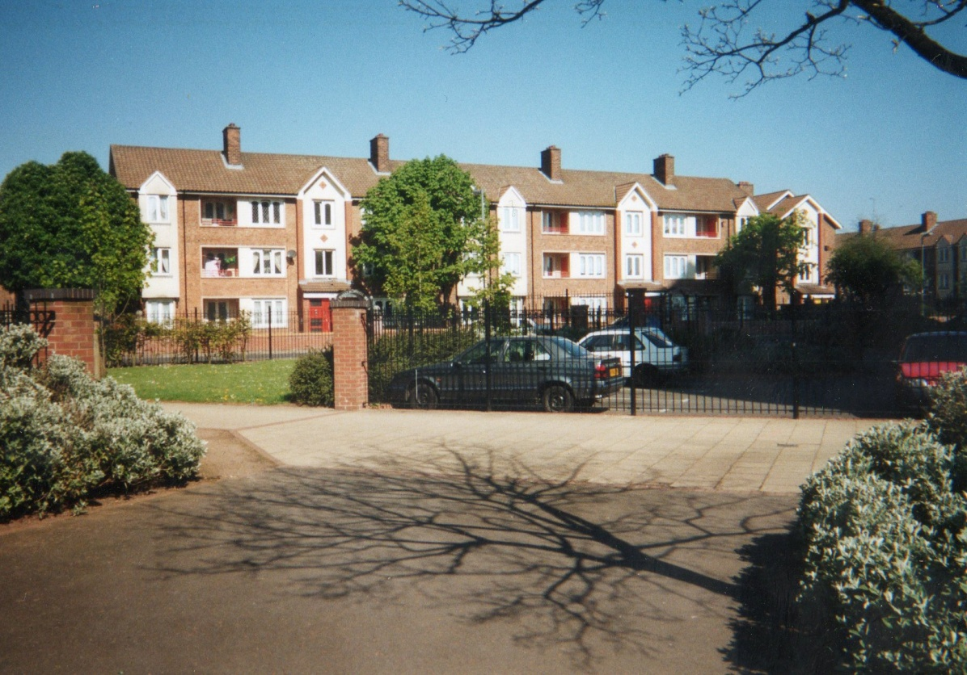
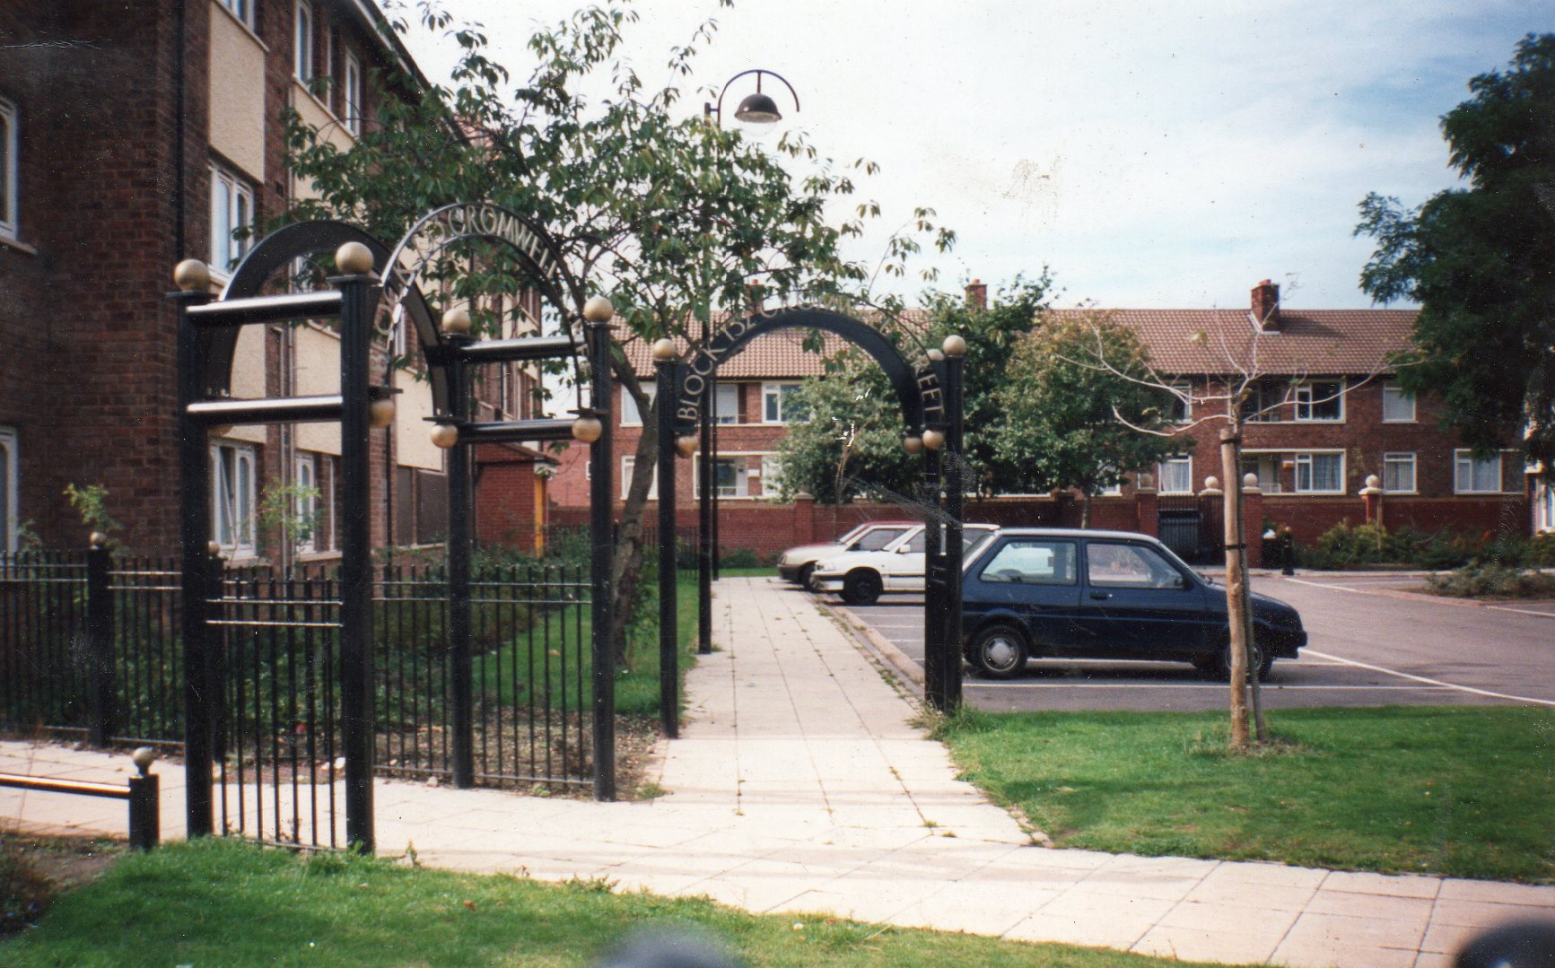
New frontage to Medway Tower after improvement works in the 1990’s.
New frontage and improved car parking outside of properties on Cromwell Street.

Slide 17
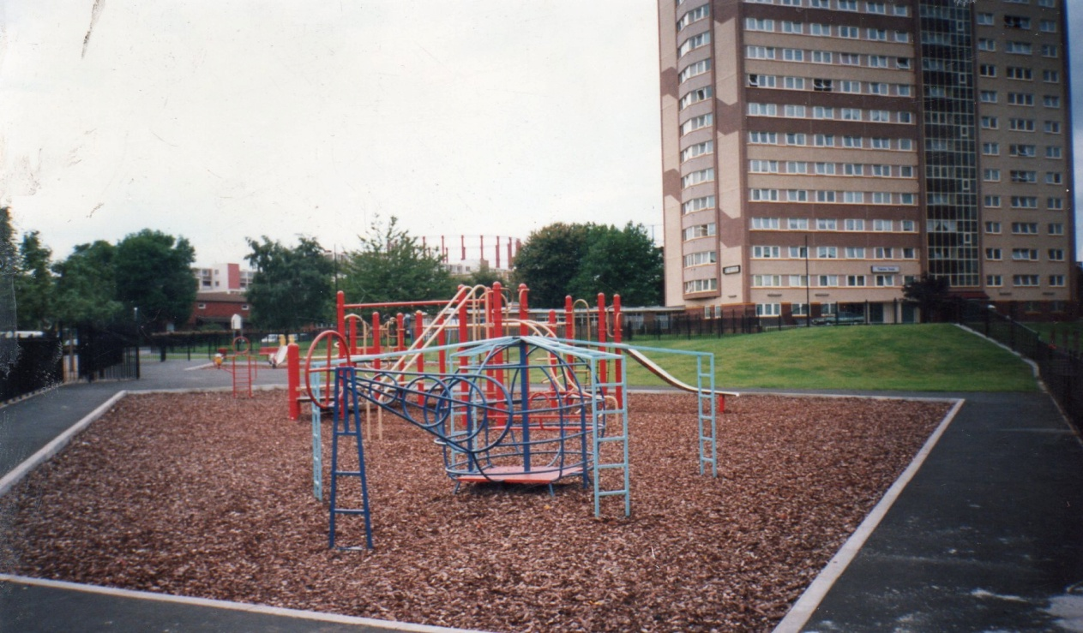
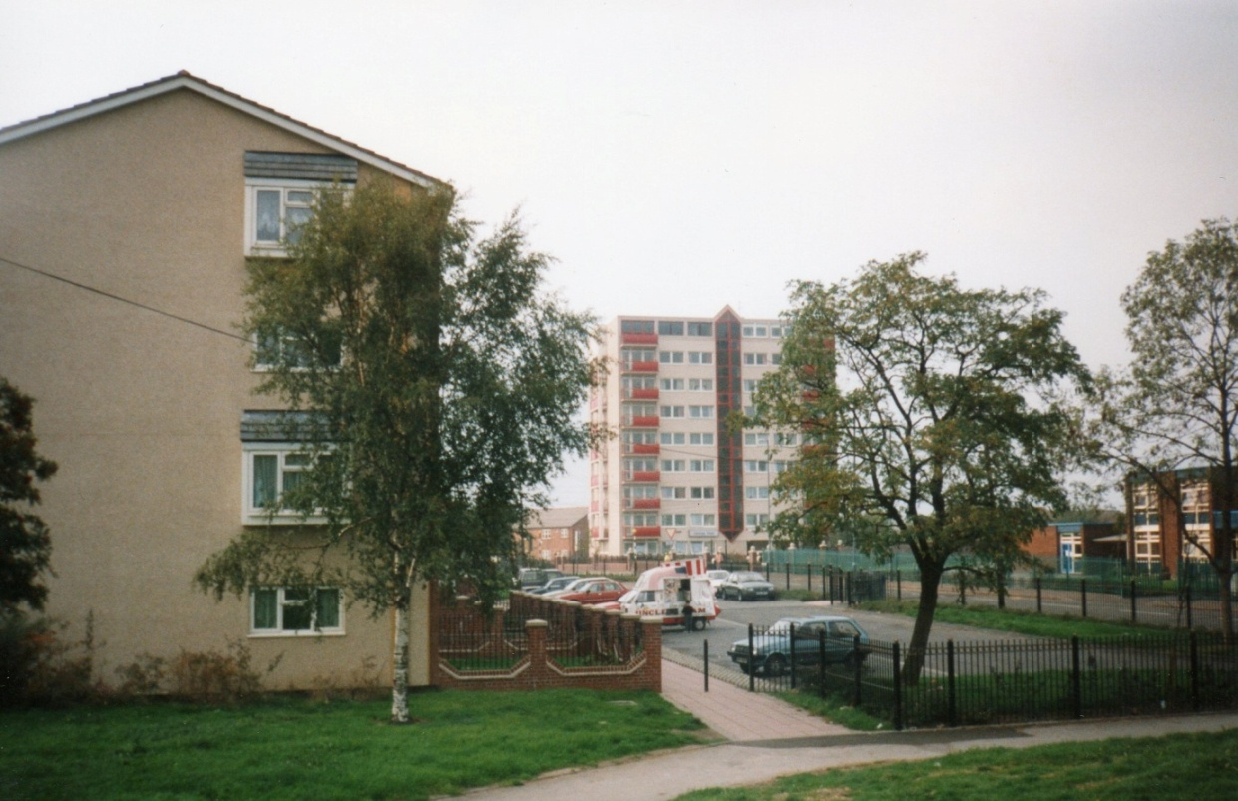
Improved children’s play area in Bloomsbury Park. The EMB, local schools and Birmingham City Council were involved in planning and designing the area.
Improvements on Rocky Lane showing defined garden areas and improved parking.
In the rear note the improvements to Camrose Tower. The improvements were requested by the EMB when an underspend in the budget for the improvements in 1990’s was identified.

Slide 18
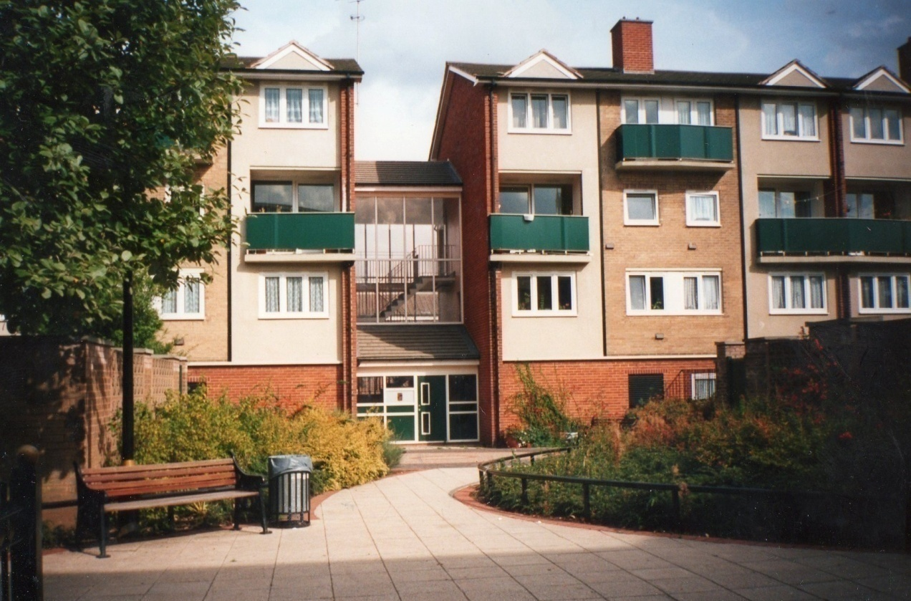
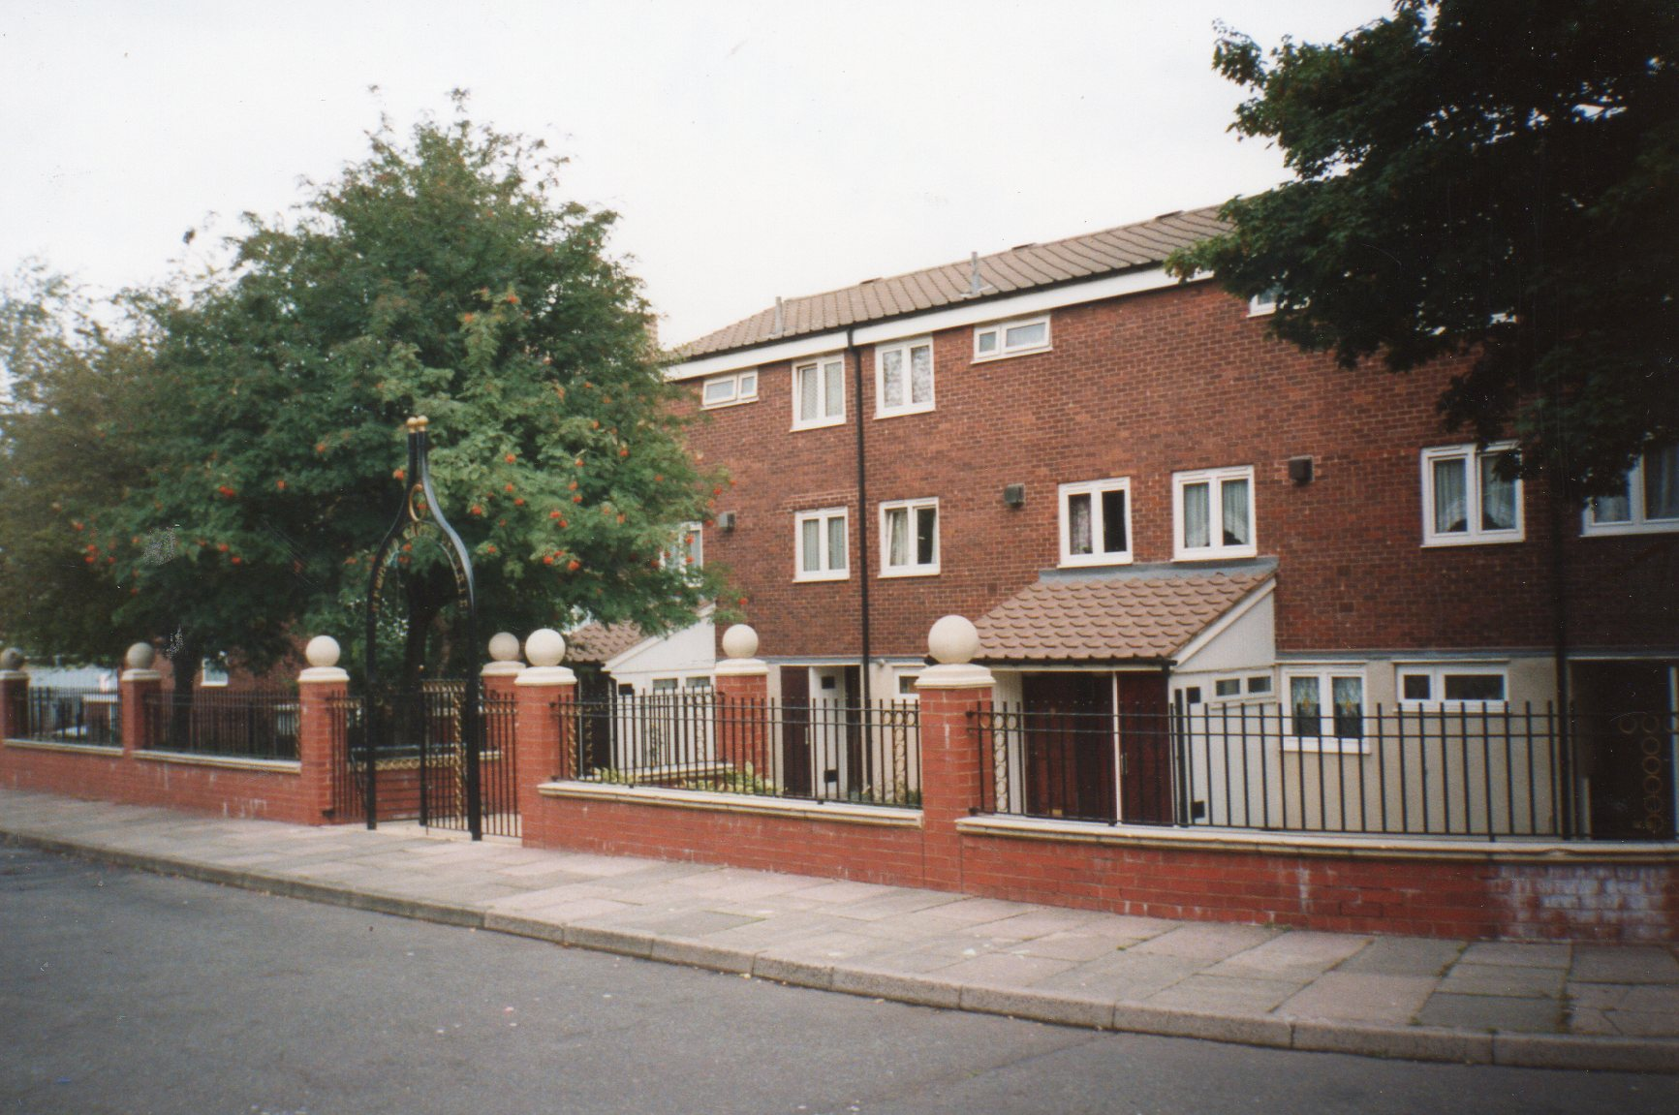
Improvements the garden and washing areas in between Newbold Croft and Bodmin Grove.
Improvements to the frontages of Newbold Croft completed in the mid-1990’s.

Slide 19
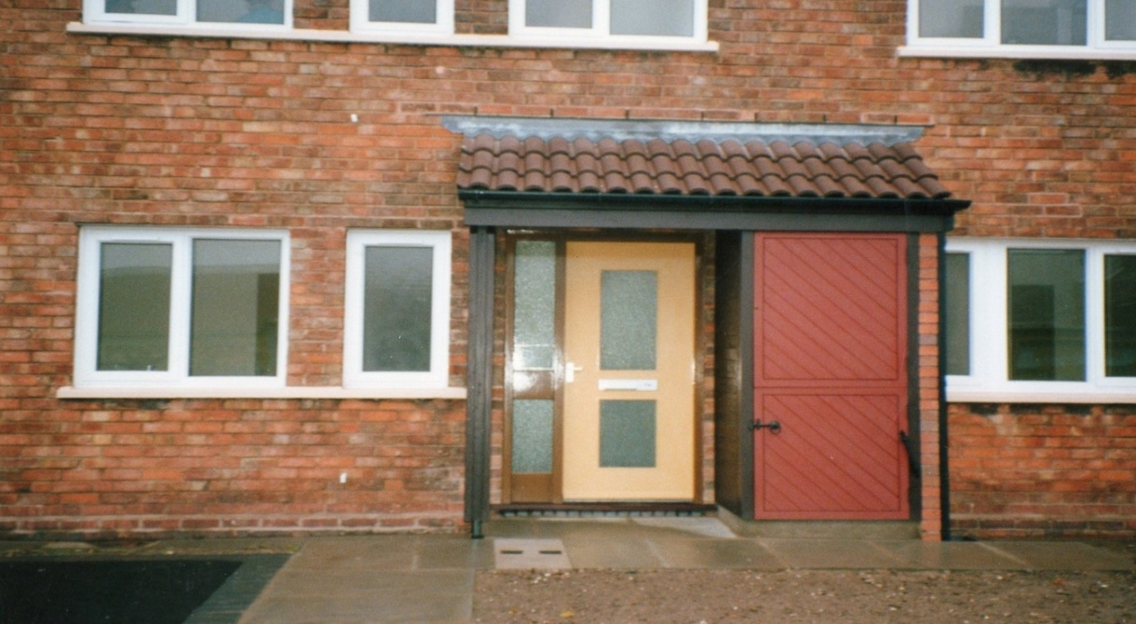
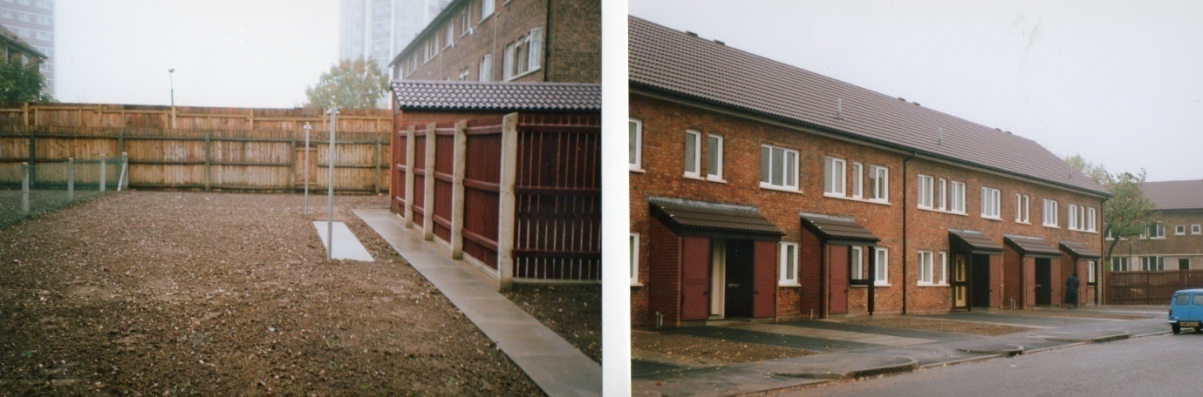
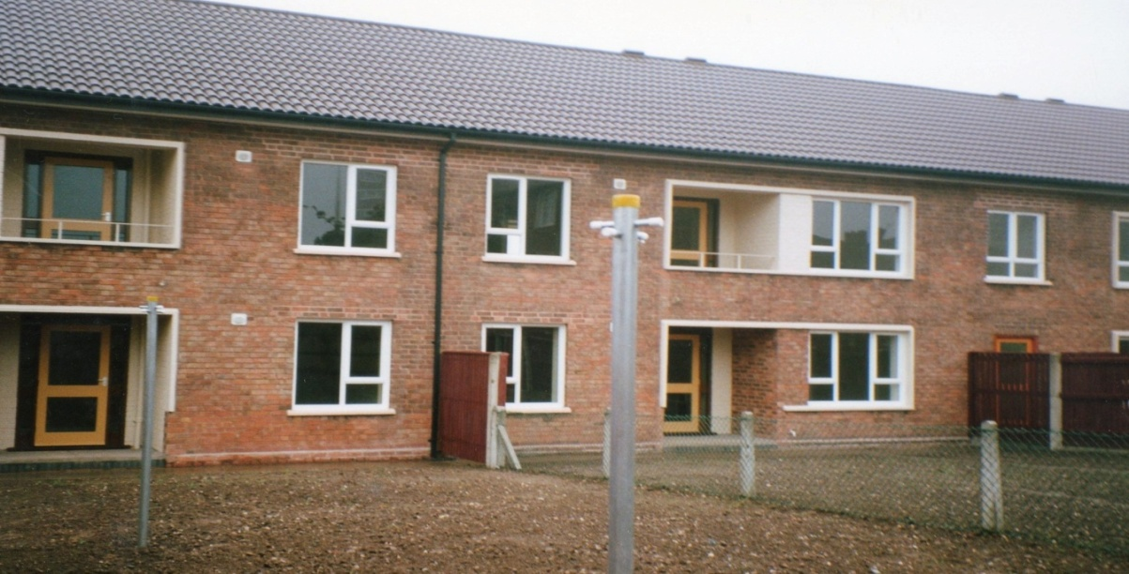
Rupert Street – improvements to the entrances and windows. New kitchens were also installed within the funding from government.
Improvements to the rear of properties in Rupert Street.

Slide 20
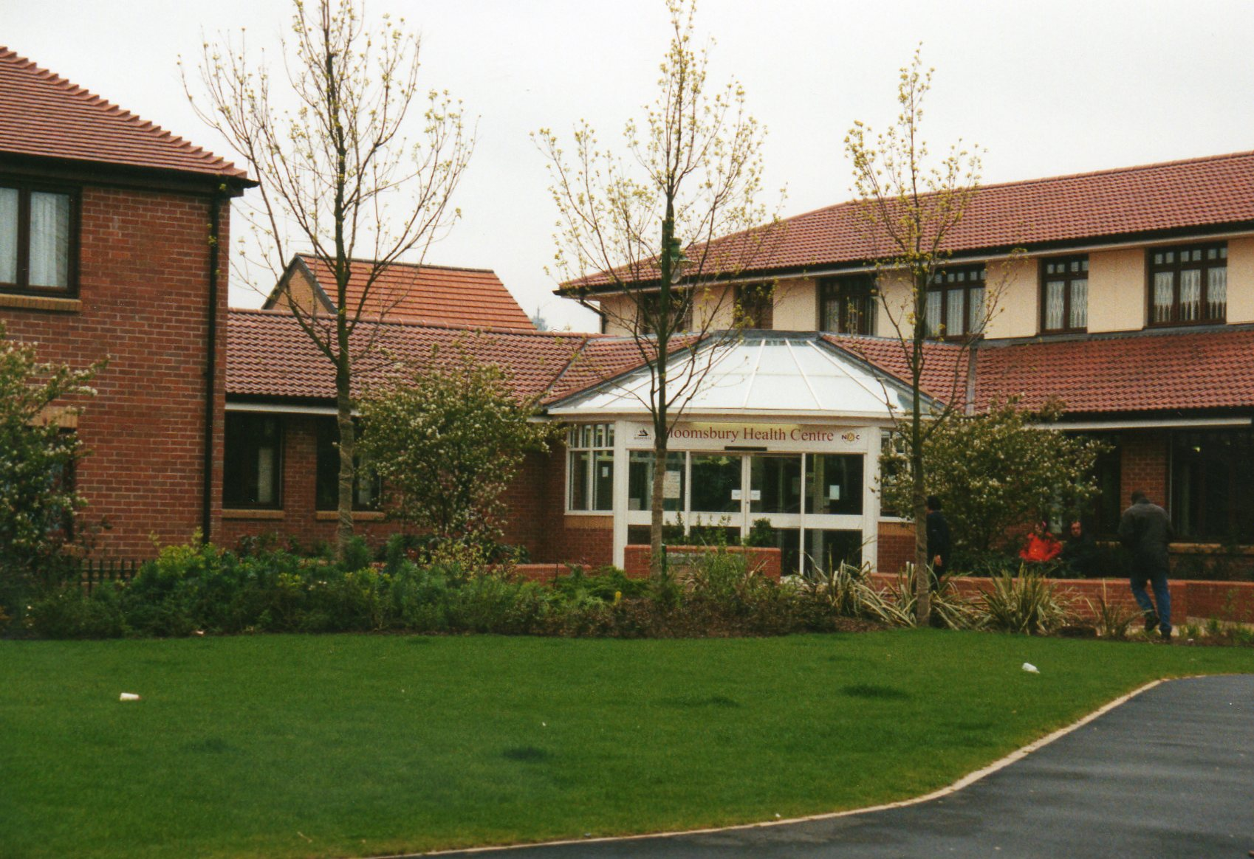
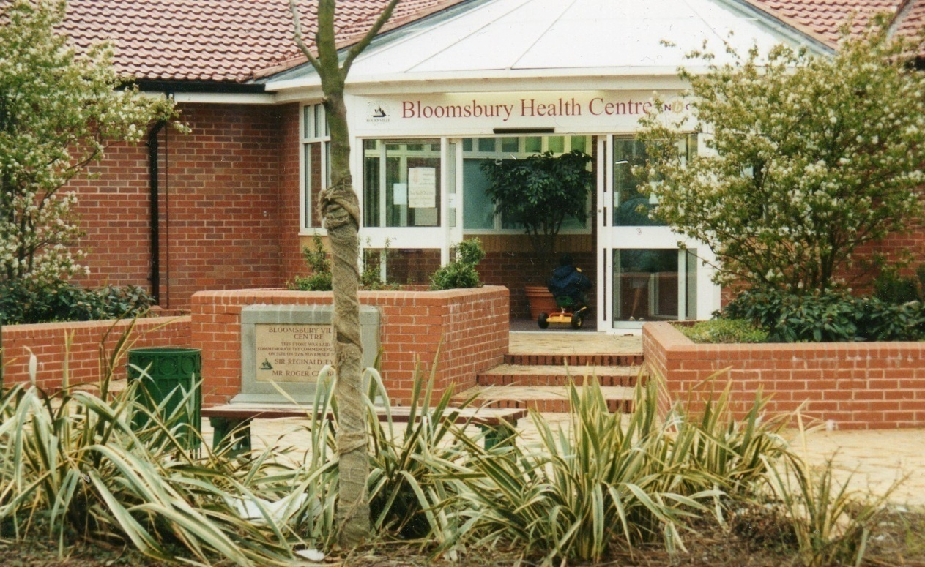
The “new” Health Centre on Bloomsbury which was built by Bournville Village Trust.
They also built the shops near the Health Centre with financial contributions from Heartlands Development Corporation

