Slide 1
Presentation to FCDA Topic: HOW TO PROMOTE TAX CREDIT DEVELOPMENTS IN YOUR AREA
SEPTEMBER 29, 2021

Slide 2
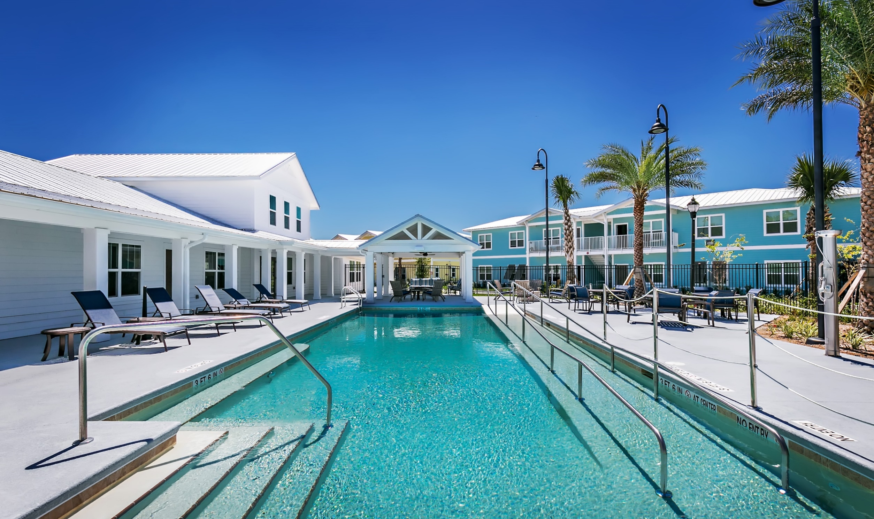
Outline
About Blue Sky
Tax Credit Housing
Case Study
On Safari
Policy Recommendations

Slide 3
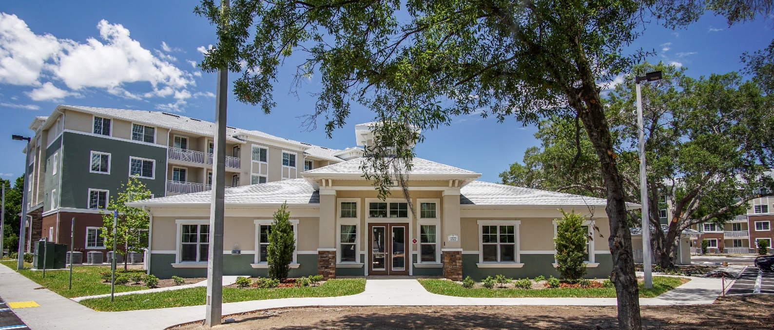
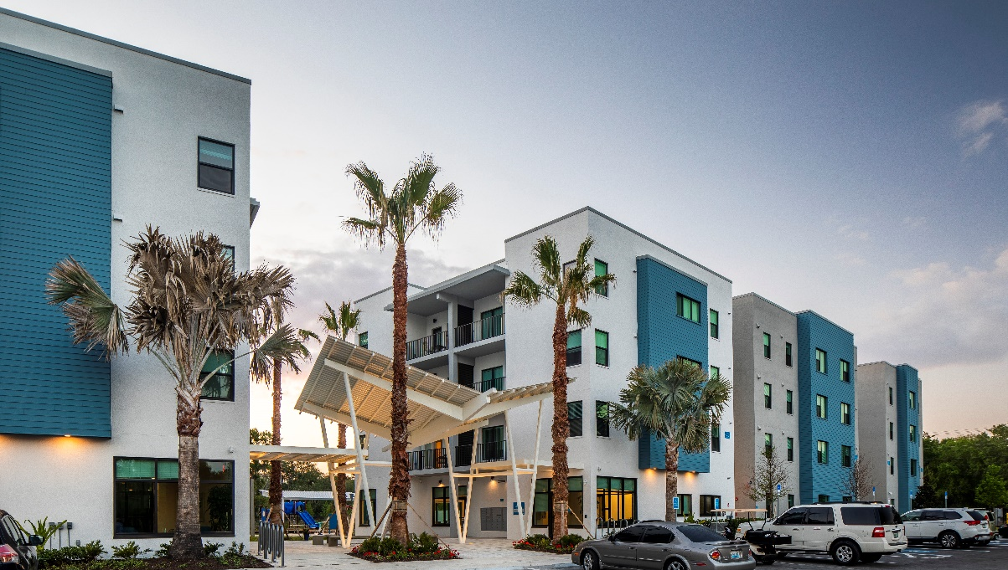
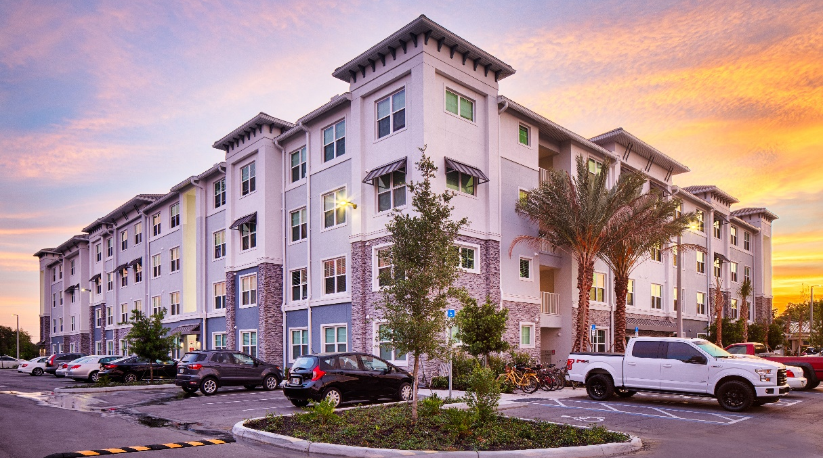
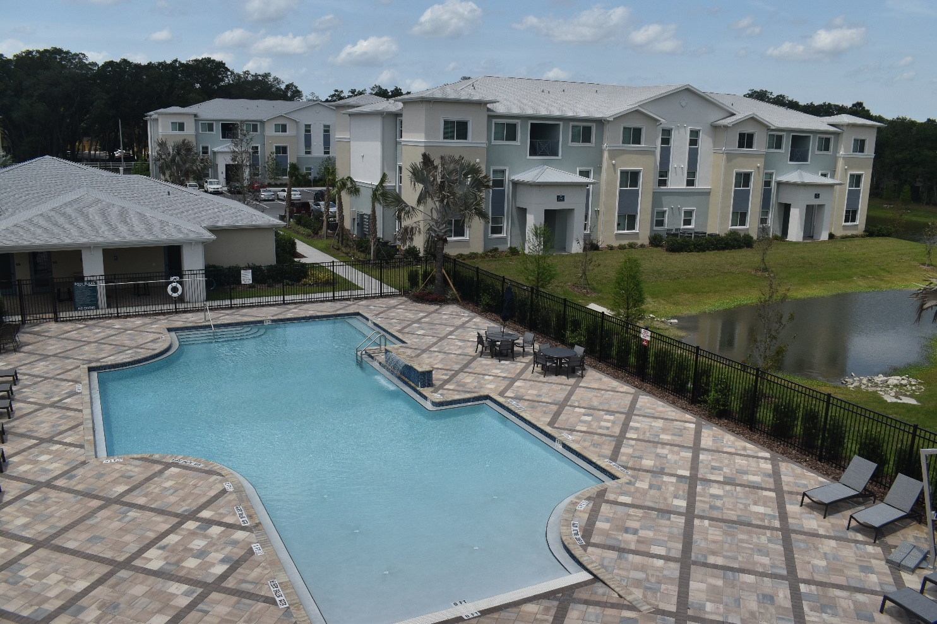
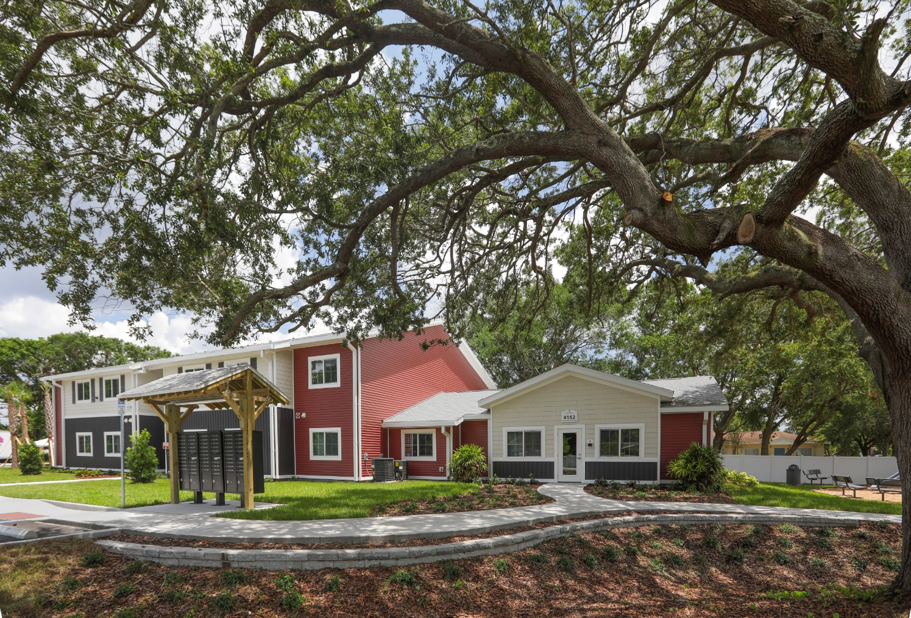
Questions? – please post in q&a box as we go

Slide 4
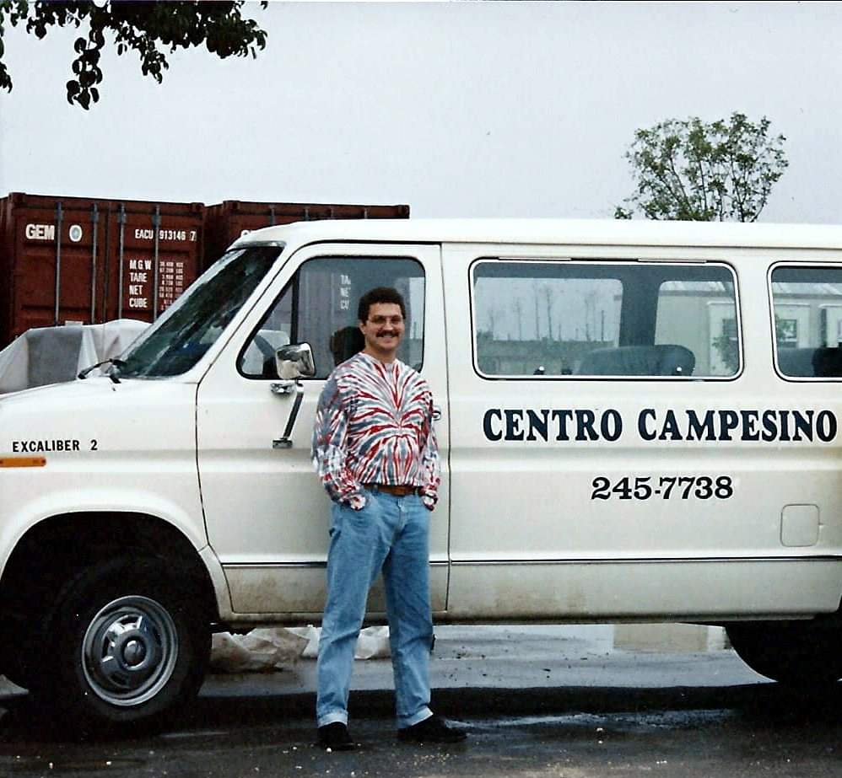
About Blue Sky and Shawn Wilson
Founded in 2012
Number 30 on the AHF Top 50 in the USA List
29 total Developments
Staff of 18
Shawn
Started in 1992
4 years with Non-Profits
16 years at other Tax Credit Developers
City of Tampa AHAC
CAHP Chair
Fall 1992, Andrew recovery supplies in trailers in background

Slide 5
Tax credit housing
US Treasury program, but interlaced with HUD, State Gov (FHFC), and Local Gov. (HFA)
Two kinds, 4% and 9%
With 9%, provides more than 75% of Total Development Costs (average say $20 million)
With 4%, provides less than 40% of Total Development Costs – but still better than nothin!
Filling the gap
How much?
When? Before winning at FHFC, or after?

Slide 6
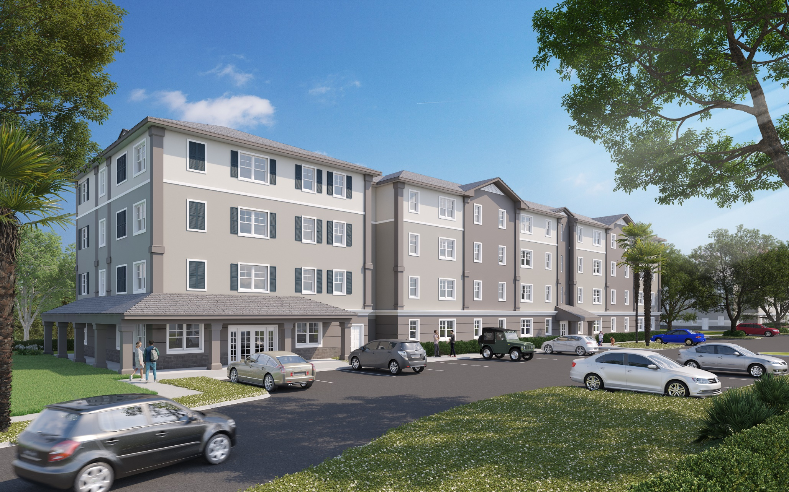
Financing for Fairlawn Village (per Final CUR approved by FHFC Board, April 2020)
Sources:
1st Mortgage – FHFC Tax Exempt Bonds/Chase Bank: $4,300,000
2nd Mortgage – FHFC SAIL: $6,250,000
3rd Mortgage – FHFC ELI: $600,000
4th Mortgage – FHFC NHTF: $1,308,000
5th Mortgage – City of Orlando HOME: $2,000,000
Tax Credits – Raymond James: $8,257,752
Deferred Developer Fee – Blue Sky: $761,130
Total Sources: $23,476,882 (/116 units = $202,386/unit)
Uses:
Land acquisition: $1,500,000
Hard Costs:$15,354,568
Soft Costs: $1,828,843
Financing costs: $1,177,449
Developer Fee: $3,304,954
Fairlawn Village Rendering
116 Units in Orlando
Anticipated Completion March 2022

Slide 7
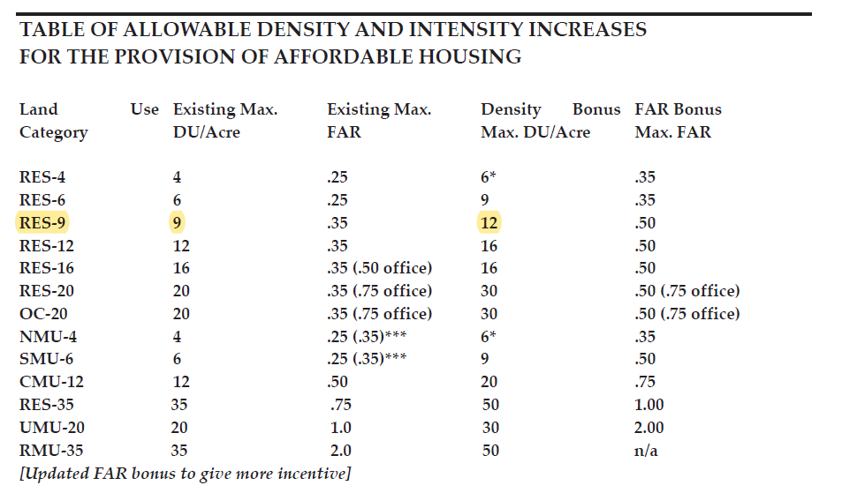
Case study density bonus
23 acres in Unincorporated Hillsborough County
Prior Approvals for 190 units
Phase 1
144 units
Key early County funding commitment
9% Housing Credits
Only 46 units left for Phase 2
Hillsborough County Density Bonus Program
Implemented through the “Major Mod” process
Increased Phase 2 from 46 to 112 units
Non Profit Joint Venture
Homeless families
9% and SAIL

Slide 8
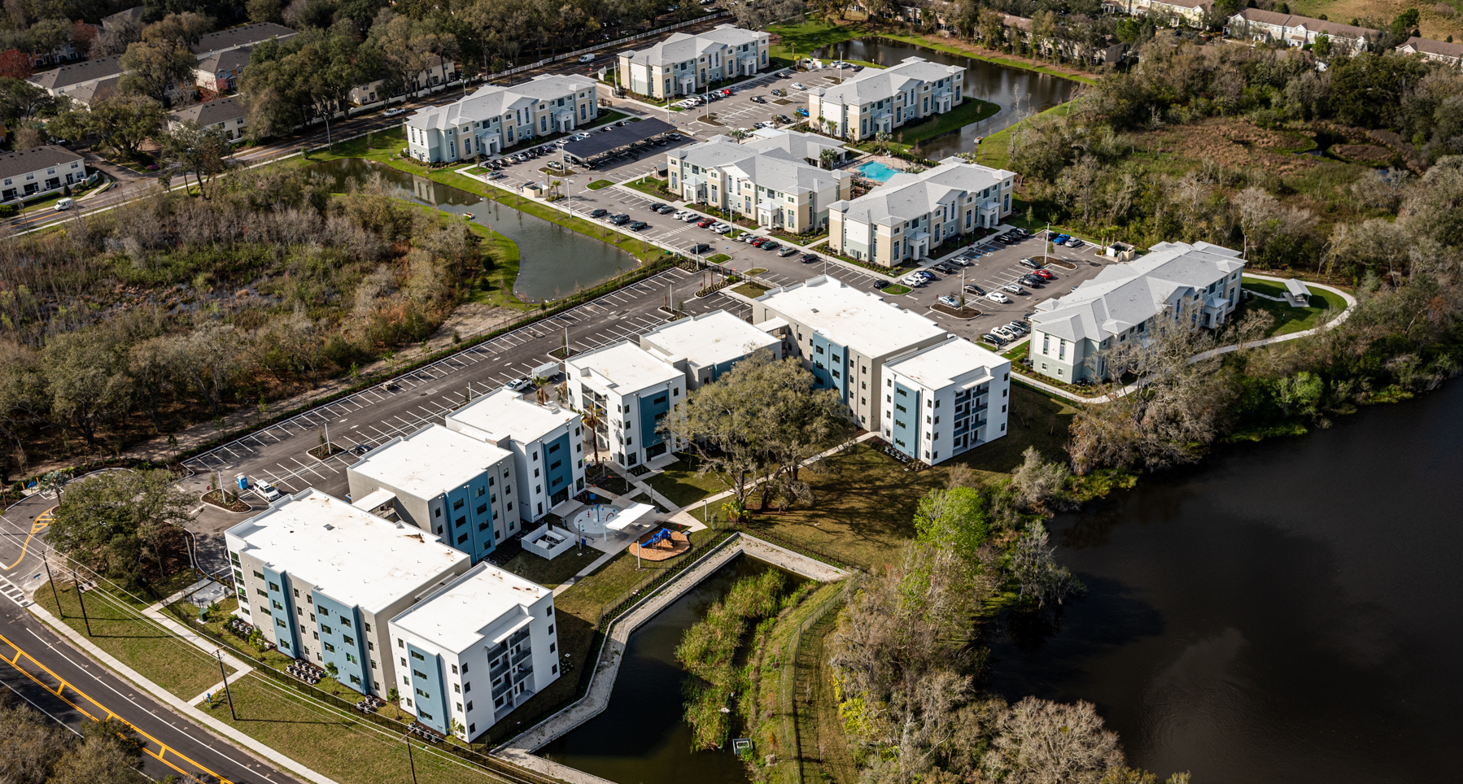
Case study page 2
Phase I
Preserve at Sabal Park
Phase II
SabalPlace

Slide 9
Let’s go on a safari!
A savannah in East Africa
Developers are the adults in the herds -say Giraffe or Gazelle.
New developments are the babies and young.
Cities and Counties are the Watering Holes.
A Watering Hole that is reliably full and has easy access will have happy/healthy adults in the Herd who will make happy/healthy offspring.
A watering hole that dries up sometimes and is hard to get to will have a hard time supporting a healthy batch of young Giraffe or Zebras.

Slide 10
Policy recommendations
1. Create a 3-year plan for Tax Credit RFP’s.
Allows Developers to carefully plan in advance
Better sites
More “ready”
Political momentum
2. Create a pot of funding to do one 4% deal without FHFC funds
Probably will be a smaller deal
Harder to do deal
Has to be something that the City really wants, to justify all that funding.
3. ARP Funds (County will receive over $107 Million Coronavirus State and Local Fiscal Recovery Funds)
Yes can be used for Affordable Housing Development.
Per 5/17/21 Interim Final Rule “Eligible services include: Affordable housing development to increase supply of affordable and high quality living units”

