Slide 1

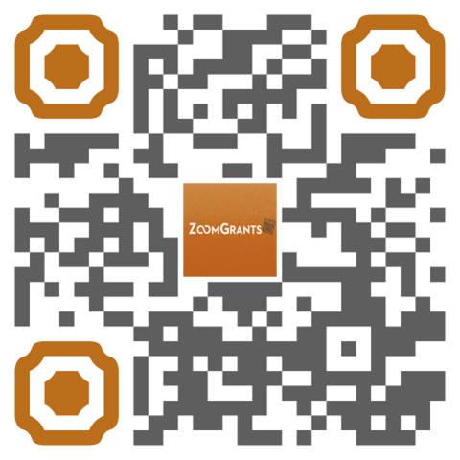
GRANT MANAGEMENT SOFTWARE
Receive applications and manage funding allocations in ZoomGrants
www.zoomgrants.com Request a demo - Email sales@zoomgrants.com or scan the QR code

Slide 2
WHO WE ARE
Since 2002, ZoomGrants’ software solution has helped organizations get away from paper-based grant management processes
ZoomGrants tracks the full grant management cycle for multiple grant programs and funding sources – from accepting online applications to reviewing, awarding and managing the project/program to close-out
Fully configurable platform that is internet-based, with no hardware to purchase, install or download
www.zoomgrants.com Request a demo - Email sales@zoomgrants.com or scan the QR code

Slide 3
WHAT WE DO
No per-user license fees – ZoomGrants is a subscription, and pricing is based on the number of RFPs/Programs needed
Customizable Applications
Simplified Review Process
Post-Decision Subrecipient Management & Administrative Tools
Responsive Technical Support included – No limit
www.zoomgrants.com Request a demo - Email sales@zoomgrants.com or scan the QR code

Slide 4
PROGRAM TYPES
HUD: CDBG, HOME, HOME-ARP, HOPWA, ESG, Continuum of Care
Housing Trust Fund, SHIP
State Grants,
City/County General Fund Grants
Small Business Assistance
CRA/Economic Development
Facade Improvement
Microenterprise/ Workforce Investment
Homeowner down payment and housing rehabilitation
Digital Equity/Broadband
Infrastructure Grants
Transit Grants
Planning Grants
Surveys
www.zoomgrants.com Request a demo - Email sales@zoomgrants.com or scan the QR code

Slide 5
…OTHER ZOOMGRANTS PROGRAM TYPES
Foundation, Arts & Cultural Grants
Health, Education and Research Grants
Victim Services, Justice and Safety Grants
Cultural & Heritage, Conservation Grants
Tourism/Marketing Grants
Call for Speaker
Scholarships/Employee Giving Campaigns
www.zoomgrants.com Request a demo - Email sales@zoomgrants.com or scan the QR code

Slide 6
FEATURE HIGHLIGHTS
All Inclusive (no extra fees)
Auto-Save/Auto-check for Completion
Training & Technical Support
Customizable Dashboards and Content
Optional Features: Turn on/off features you want to use within each individual program
www.zoomgrants.com Request a demo - Email sales@zoomgrants.com or scan the QR code

Slide 7
NO PER-USER LICENSE FEES
No Maximum Number Administrative Users
No Maximum Number Reviewer/Committee Users
All-Inclusive Technical Support
All-Inclusive Virtual/Remote Training
Transparent Pricing: www.zoomgrants.com/pricing
www.zoomgrants.com Request a demo - Email sales@zoomgrants.com or scan the QR code

Slide 8
AUTO-SAVE AND AUTO-CHECK: NO LOSING IT
Users don’t need to click a ‘save’ button - ZoomGrants has an auto-save feature!
Auto-check for completion to make sure all questions are answered, including budget and tables, and all required documents are uploaded with the application.
www.zoomgrants.com Request a demo - Email sales@zoomgrants.com or scan the QR code

Slide 9
EASY PROGRAM SETUP
Intuitive User Interface
DIY: Administrator control design and content
Copy an Existing Best Practice Template to edit
Assisted by Knowledgeable ZoomGrants staff
www.zoomgrants.com Request a demo - Email sales@zoomgrants.com or scan the QR code

Slide 10
TRAINING & TECHNICAL SUPPORT
Customer support for ALL users is included!
Not just buying software – Knowledgeable staff with best practice template programs available for CDBG, HOME, SHIP, and other programs
ZoomGrants University - Online knowledgebase with ‘Colleges’ for Administrators, Reviewers, Applicants & Collaborators
ALL setup and training can be done remotely, and can be setup by the admin, or with assistance from ZoomGrants
www.zoomgrants.com Request a demo - Email sales@zoomgrants.com or scan the QR code

Slide 11
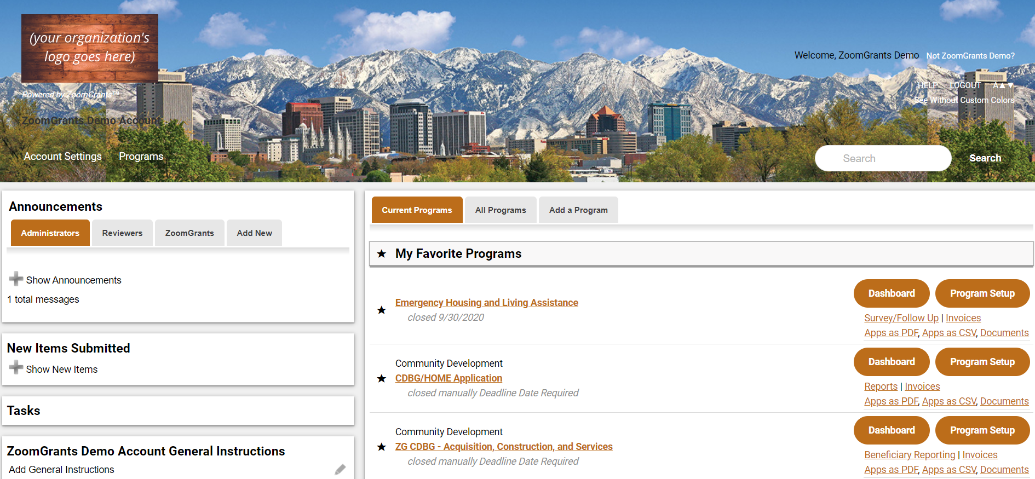
PROGRAM LIST DASHBOARD
www.zoomgrants.com Request a demo - Email sales@zoomgrants.com or scan the QR code
Notes:
Access all your programs from an one dashboard

Slide 12
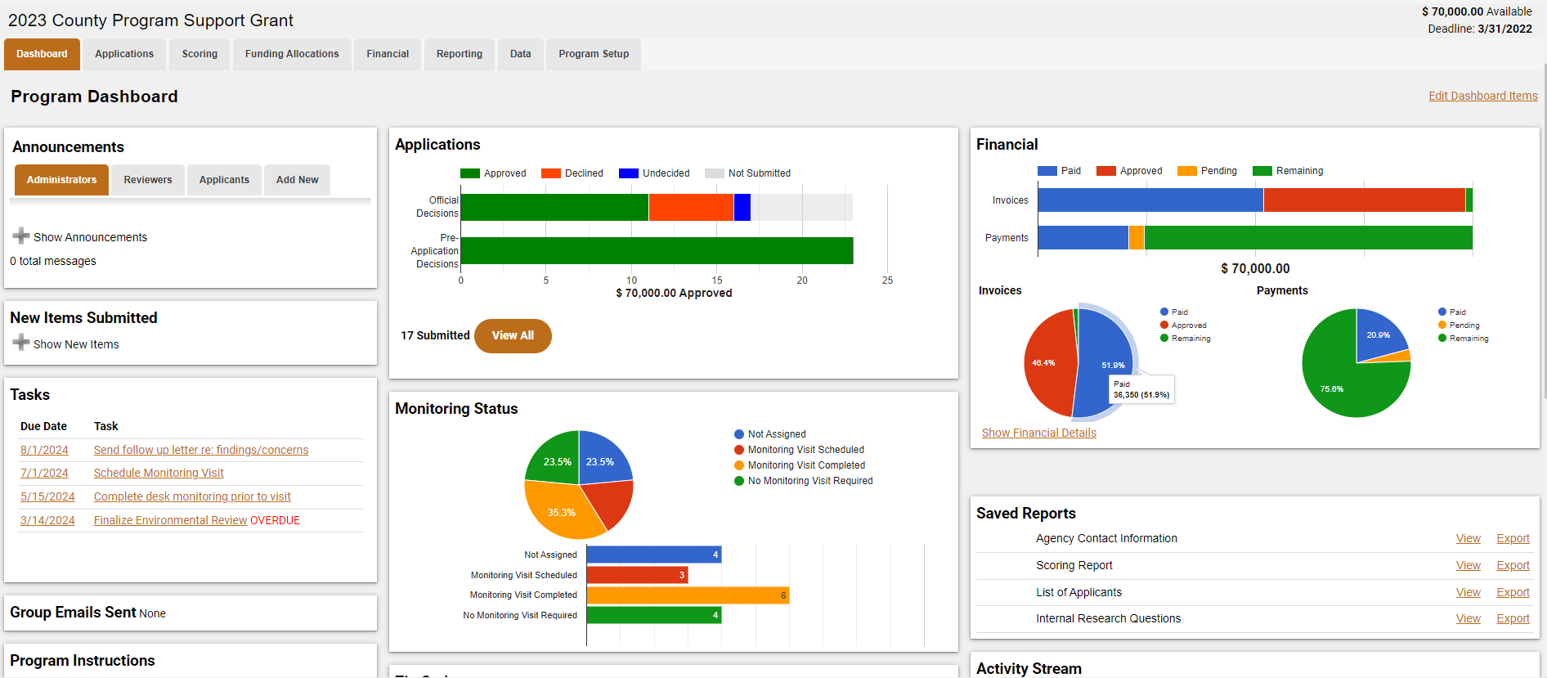
PROGRAM SPECIFIC WORKFLOW DASHBOARD
www.zoomgrants.com Request a demo - Email sales@zoomgrants.com or scan the QR code
Notes:
Review the health of your program from the Program Specific Workflow Dashboard. Each Administrative User can Customize the Dashboard to their unique needs.

Slide 13
CUSTOMIZE CONTENT & QUESTION TYPE
Customize Instructions, Questions, and Document Requests
Optional Modules for the Application process (Pre-app, Budget, Tables, etc.)
Extra/Follow-up Questions
Post-award Reports and Financial Tracking/Invoices
Multiple Question/Answer Types - Short Answer, Multiple Choice, Checkbox, Table, and Paragraph
www.zoomgrants.com Request a demo - Email sales@zoomgrants.com or scan the QR code
Notes:
Each program is unique. Turn on/off the settings for each program that are relevant to your program.

Slide 14
FULL LIFE-CYCLE MANAGEMENT
Application: including optional Pre-Application/Eligibility Screening
Review/Scoring/Ranking: Custom Scoring questions & methodology
Official Decision: Contract & Award/Fund Source Tracking
Post-Decision: Contracting, Progress Reporting, Financial Management
Data Analysis: Export Standard & Custom Reports at an application, program and account level
www.zoomgrants.com Request a demo - Email sales@zoomgrants.com or scan the QR code

Slide 15
POST-DECISION ADMINISTRATIVE TOOLS
10 Customizable Checklists/Task Lists – track due dates, who assigned to, notes
Internal Research aka Custom Data Fields
Custom Status - Categorize/Group Applications
PDF Generator - use merge fields to build forms for each applicant
Bulk/List Update - update data and check work across multiple applications
Messaging w/Mail Merge – Customize Templates and save for future use
Upload Administrative Documents - can be viewable to applicant, or not
www.zoomgrants.com Request a demo - Email sales@zoomgrants.com or scan the QR code

Slide 16
RECORD KEEPING & AUDIT TRACKING
Overall activity stream for the whole program. Add administrative notes for future reference.
Activity Log on every application
Audit log for super-fine scrutiny (Program & Application)
Announcements to different user groups
PDF/Email/Print Applications
Backup/Export your data any time (Report Templates)
Bulk Export Documents Program-Wide
www.zoomgrants.com Request a demo - Email sales@zoomgrants.com or scan the QR code

Slide 17
100% MADE IN THE USA
ZoomGrants is 100% designed, built, and supported in the United States.
We don’t outsource our code, and all data is stored in the U.S.
www.zoomgrants.com Request a demo - Email sales@zoomgrants.com or scan the QR code

Slide 18
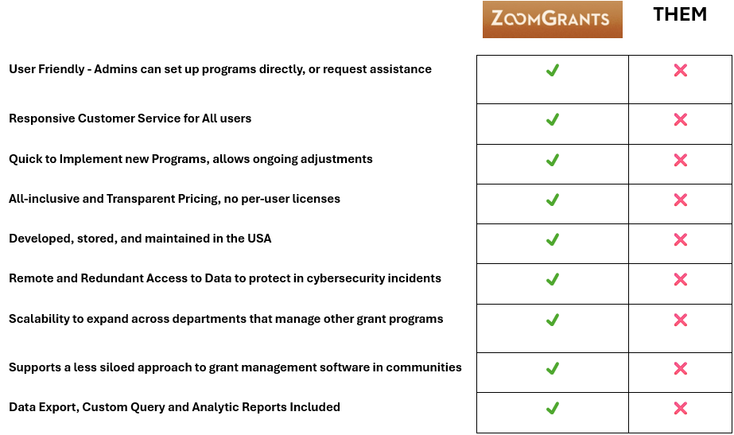
“WHAT MAKES ZOOMGRANTS DIFFERENT?”
www.zoomgrants.com Request a demo - Email sales@zoomgrants.com or scan the QR code

Slide 19


User Friendly
Admins can set up and make edits to their own Programs directly, or request assistance from our knowledgeable staff.
“WHAT MAKES ZOOMGRANTS DIFFERENT?”
OTHERS
www.zoomgrants.com Request a demo - Email sales@zoomgrants.com or scan the QR code

Slide 20
Responsive Customer Service for ALL users
“WHAT MAKES ZOOMGRANTS DIFFERENT?”
OTHERS
www.zoomgrants.com Request a demo - Email sales@zoomgrants.com or scan the QR code

Slide 21
Quick to Implement new programs, allows ongoing adjustments
“WHAT MAKES ZOOMGRANTS DIFFERENT?”
OTHERS
www.zoomgrants.com Request a demo - Email sales@zoomgrants.com or scan the QR code

Slide 22
All-inclusive and Transparent Pricing – no per user licenses
“WHAT MAKES ZOOMGRANTS DIFFERENT?”
OTHERS
www.zoomgrants.com Request a demo - Email sales@zoomgrants.com or scan the QR code

Slide 23
Developed, stored and maintained in the USA
“WHAT MAKES ZOOMGRANTS DIFFERENT?”
OTHERS
www.zoomgrants.com Request a demo - Email sales@zoomgrants.com or scan the QR code

Slide 24
Remote and Redundant Access to Data to protect in cybersecurity incidents
“WHAT MAKES ZOOMGRANTS DIFFERENT?”
OTHERS
www.zoomgrants.com Request a demo - Email sales@zoomgrants.com or scan the QR code

Slide 25
Scalability to expand use across departments that manage other grant programs
“WHAT MAKES ZOOMGRANTS DIFFERENT?”
OTHERS
www.zoomgrants.com Request a demo - Email sales@zoomgrants.com or scan the QR code

Slide 26
Supports a less siloed approach to grant management software in communities
“WHAT MAKES ZOOMGRANTS DIFFERENT?”
OTHERS
www.zoomgrants.com Request a demo - Email sales@zoomgrants.com or scan the QR code

Slide 27
Data Exports, Custom Query and Analytic Reports INCLUDED
“WHAT MAKES ZOOMGRANTS DIFFERENT?”
OTHERS
www.zoomgrants.com Request a demo - Email sales@zoomgrants.com or scan the QR code

Slide 28
QUESTIONS?
Visit the ZoomGrants website for more info:
https://www.zoomgrants.com/
To request a demo, standard proposal with pricing, or help answer questions you may have, please reach out to Sales@ZoomGrants.com or call (866) 323-5404 ext. 1.
www.zoomgrants.com Request a demo - Email sales@zoomgrants.com or scan the QR code

Slide 29

IS PROUD TO SPONSOR THE
2025 FCDA Training Conference
Welcome to Kissimmee, FL!
www.zoomgrants.com Request a demo - Email sales@zoomgrants.com or scan the QR code

