Slide 1
Florida Community Development Association
Inclusive Transformative Development
In the Urban Core
April 22, 2025
INSPIRE! Passion and Innovation leading to bold initiatives and groundbreaking housing strategies
LEROY MOORE, Senior Vice-President/COO
Notes:
Line spacing + Page numbers

Slide 2
Partnering with a Housing Authority
●Opportunities for Developers
● Opportunities for Collaborating
● Opportunities for Partnering

Slide 3
Background…
• Mission
Cultivating affordable housing while empowering people and transforming communities.
• Overview
The Tampa Housing Authority (THA) is one of the largest and most innovative housing authorities in the nation. Over 14,000 units of housing/subsidy in the Tampa/Hillsborough market, 43,000+ units of PBRA management throughout State of Florida and USVI, Staff of 240, and an annual entity-wide budget of $820 Million.

Slide 4
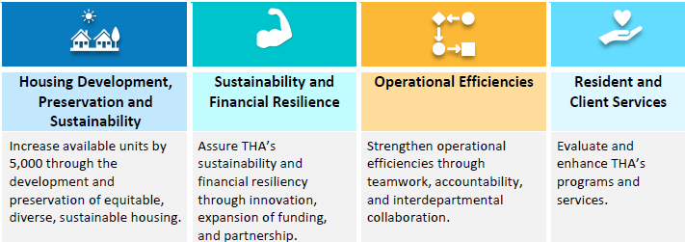
2025-2030 Strategic Plan…

Slide 5
2025-2030 Strategic Plan…
Create 3,700 new units through development.
Acquire 500 units.
Rehab 400 units.
Implement the Legacy Homeownership Program.
Implement the redevelopment of Robles Park Village.
Expand the HCV Program by 400 vouchers.

Slide 6
Why Partner with a PHA?
• Access to funding and incentives
Major HUD grants
Ability to project base operating assistance
Some ability to close funding gaps
• Opportunities for public-private partnerships
• Opportunities for Inter-Local Agreements
• Contribute to affordable and mixed-income housing solutions in otherwise market rate deals

Slide 7
Development Opportunities
• Affordable housing development
• Mixed-income housing
• Mixed-use projects
• Redevelopment and revitalization projects
• Senior and workforce housing initiatives
• Deployment of Tiny homes or Micro Units
• Affordable homeownership (single family or multifamily)
• Adaptive re-use projects
• More…

Slide 8
Examples…
● Central Park Village/ENCORE Tampa
● North Boulevard Homes/West River
● Robles Park Village Redevelopment
● Casa Bel Mar (value-add partnership)
● Zion Village (faith-based partnership)

Slide 9
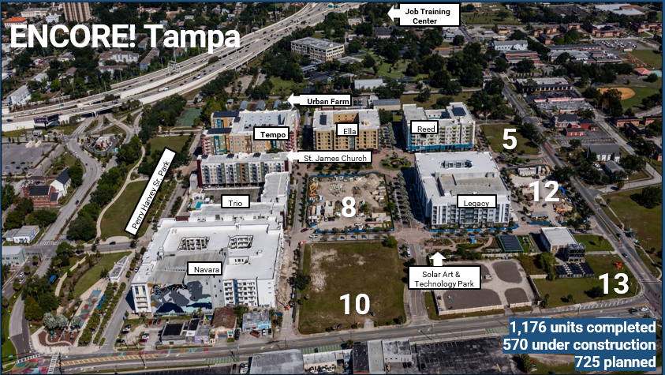

Slide 10
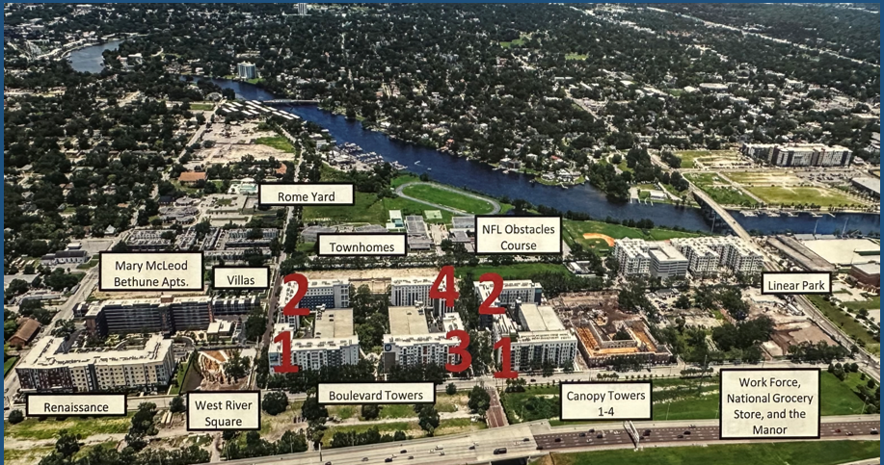
West River Tampa

Slide 11
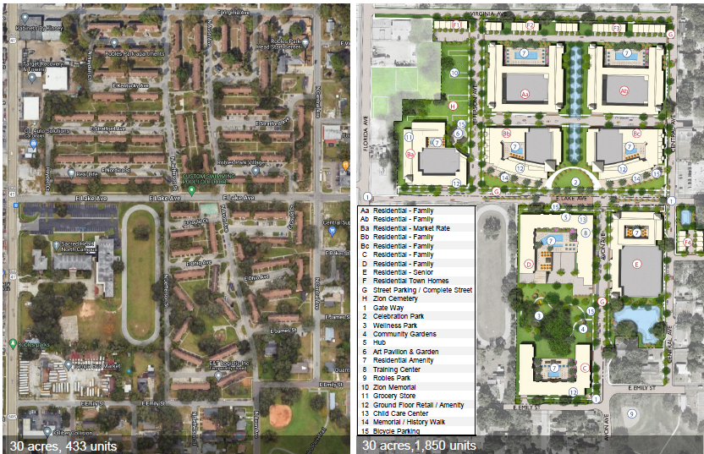
New Robles Park

Slide 12
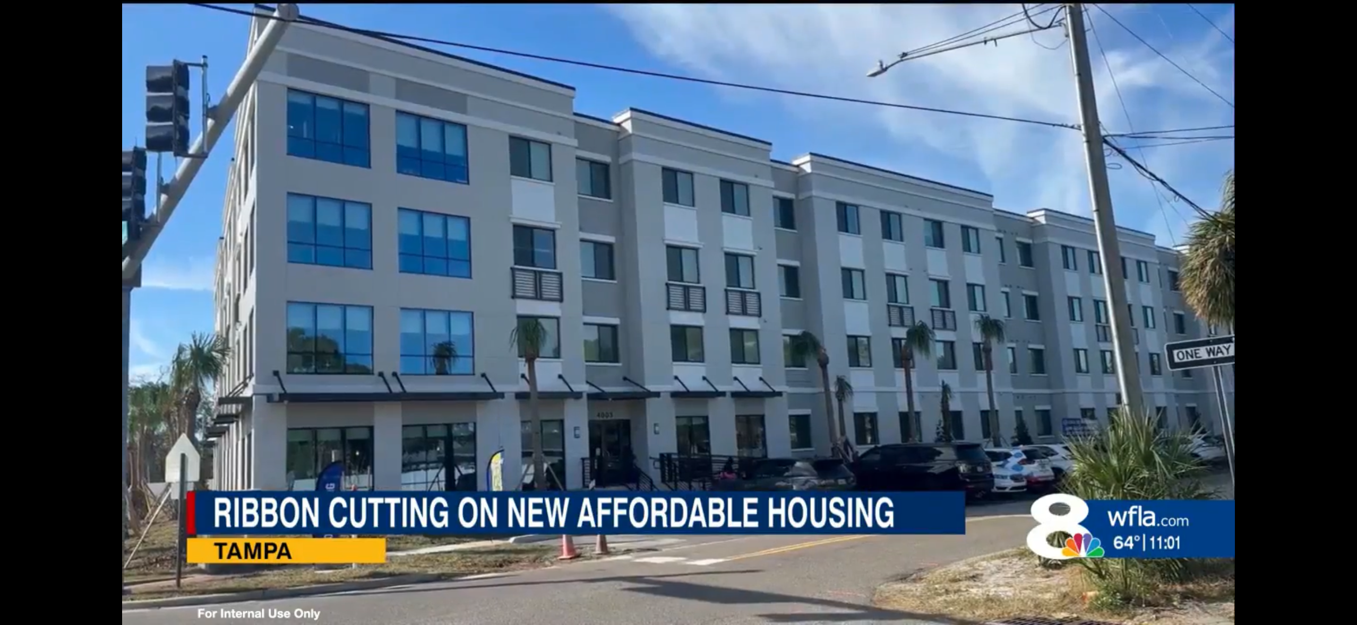
Casa Belmar

