Slide 1
Live Local Act: A Year In
FCDA Conference Presentation| May 1, 2024

Slide 2
About the Florida Housing Coalition
Statewide nonprofit organization providing training and technical assistance to local governments and nonprofits on all things affordable housing
Our work covers:
Compliance with local, state, and federal affordable housing programs
Affordable housing program design
Capacity building for nonprofit housing providers
Land use planning for affordable housing
Research & data gathering
We can provide free training and technical assistance to you under the Catalyst Program.

Slide 3
What the Live Local Act (LLA) covered, what’s left for local housing policy
LLA Coverage
No/Partial LLA Coverage
State funding – up to $811 million
Property tax exemptions for affordable housing (mandated and optional)
Sales tax relief for building materials for certain AH projects
Land use mandate for 40% affordable projects in commercial, industrial, mixed-use areas
Affordable housing inventory requirement
State housing strategy update
Other technical assistance
Zoning reform in residential districts
By-right housing allowances for missing middle, multifamily, mixed-use housing
Incentive zoning (density bonuses, lot design relief, etc.)
Local funds for AH
Local decisions on state, federal housing funds
Permitting reform
Clear directives on identifying, using public land for AH
Existing housing stock preservation
Fee waivers
Infrastructure investments in housing
Strategic partnerships
Community land trusts
Role of CRAs, HFAs, similar entities
Support for people experiencing homelessness
Tenant rights’ work
Employer assisted housing
& more!

Slide 4
Funding in the Live Local Act (2023)
Funding
Program | Live Local Act
State Housing Initiatives Partnership (SHIP) | $252M
State Apartment Incentive Loan (SAIL) | $109M for traditional SAIL $150M for “Innovative Multifamily Development”*
Hometown Heroes | $100M (from General Revenue) gone as of 8/23/23 Additional $36M allocated by FHFC
Inflation Response | $100M - gone
Live Local Tax Donation | Up to $100M – nearly all credits reserved
Total funding | $811M
*Note: $150 million is pledged for each year for 10 years through the Live Local Act.

Slide 5
2024 Florida legislative budget for housing
Funding
Program | Funding
State Housing Initiatives Partnership (SHIP) | $174,000,000
State Apartment Incentive Loan (SAIL) | $84,000,000 for traditional SAIL $150,000,000 for “Innovative Multifamily Development”
Hometown Hero Housing Program | $100,000,000
Live Local Tax Donation | $100,000,000
Homeless Programs (including Challenge Grants) | $42,433,851
My Safe Florida Home Program | $200,000,000 for traditional MSFH program $30,000,000 for condominium pilot program
Homelessness Member Projects | $15,580,750
Other Affordable Housing Member Projects | $39,852,356
Total funding | At least $935,866,957

Slide 6
FHFC RFAs issued to date: LLA “Innovative Multifamily Development”
Funding
RFA 2023-213 SAIL Funding for Live Local Mixed-Income, Mixed-Use, and Urban Infill Developments
Awards announced Feb 2, 2024
RFA 2024-216 SAIL Funding for Construction of Large-Scale Developments of Significant Regional Impact
Due date TBD
RFA 2024-215 SAIL Funding for Developments Near Military Installations
Due date TBD
RFA 2024-206 HOME and Live Local SAIL Financing to be used for Rental Developments in Certain Hurricane Idalia Impacted Counties
Awards announced Mar 7, 2024
RFA 2024-214 SAIL Funding for Live Local Redevelopment
Due date July 16, 2024

Slide 7
Local option affordable housing property tax exemption
Tax Exemptions
Grants local governments the option to enact an ordinance providing property tax exemptions to certain affordable housing developments
Eligible developments: 50 or more units with at least 20% of units set aside as affordable to households at or below 60% AMI
Local government renews every 3 years
Jacksonville and St Petersburg adopted

Slide 8
Property tax exemption: nonprofit land with 99-year ground lease for affordable housing
Tax Exemptions
Provides a property tax exemption on the value of land owned by a nonprofit and leased for a period of 99 years to predominately provide affordable housing
Housing must serve households at or below 120% AMI

Slide 9
Multifamily Middle Market (“Missing Middle”) property tax exemption
Tax Exemptions
Provides a property tax exemption to developments that have more than 70 affordable units to households at or below 120% AMI
Affordability threshold options:
Units affordable to households 80-120% AMI = 75% property tax exemption
Units for <80% AMI = 100% property tax exemption
Two-step application process:
1) Florida Housing Finance Corporation
2) County Property Appraiser

Slide 10
NEW! MMM property tax exemption opt-out for eligible taxing authorities
Tax Exemptions
Adopted in House Bill 7073 (2024)
Allows taxing authorities to “opt-out” of the 80-120% AMI “missing middle” property tax exemption if:
The taxing authority is located in a county where the number of affordable/available units for 0-120% AMI is greater than the number of renter households at that income level as determined by the Shimberg Center for Housing Studies Annual Report
The governing body of the taxing authority votes by a 2/3 majority to “opt-out”
Jurisdiction must renew “opt-out” each year
Property owners getting exemption initially can continue applying for and receiving it

Slide 11
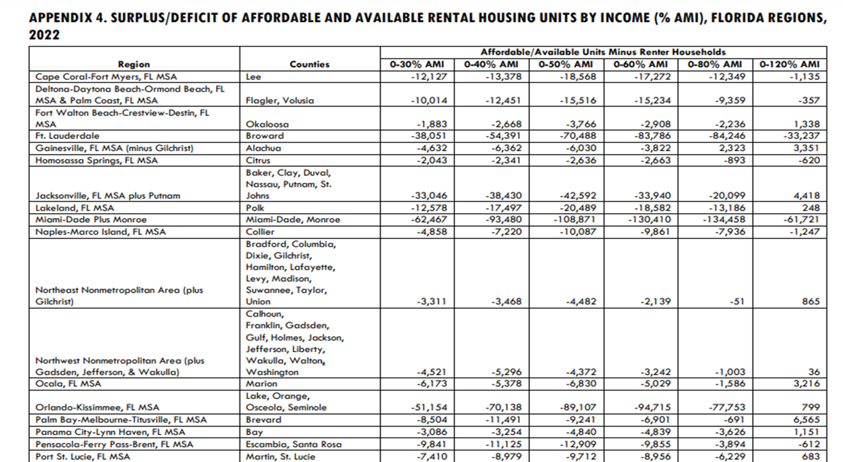
HB 7073 – “opt-out” for the 80-120% AMI “Missing Middle” exemption
Tax Exemptions
Must have surplus to opt out

Slide 12
Live Local Act land use mandate – s. 125.01055(7)/166.04151(7), F.S. + SB 328 (2024) amdts.
Land Use
Mandate introduces use, density, height, floor area ratio, administrative approval, and parking standards for affordable housing development if a proposed project is:
Multifamily or mixed-use residential in any area zoned for commercial, industrial, or mixed use;
At least 40% of units are rental units affordable for households up to 120% AMI for at least 30 years; and
If mixed-use, at least 65% is residential
Local government cannot require a development authorized under this preemption to obtain a zoning/land use change, special exception, conditional use approval, variance, or comp plan amendment for use, density, height, floor area ratio, or parking (under certain limited circumstances).

Slide 13
Live Local Act land use mandate w/ amendments– entitlement summary
Land Use
Use | Multifamily or mixed-use with multifamily allowance in commercial, industrial, or mixed-use zones without zoning or land use change
Density | Highest density allowed on any land in City or County where residential development is allowed
Height | Highest currently allowed height for a commercial or residential development within 1 mile of the proposed development or 3 stories, whichever is higher Exception – if proposal is on two or more sides adjacent to SF zoned property within SF home development w/ at least 25 contiguous SF homes, local gov’t. may limit height to the highest of the following: 150% of tallest building adjacent to development Highest currently allowed height for the property based on LDRs 3 stories

Slide 14
Live Local Act land use mandate w/ amendments– entitlement summary cont’d.
Land Use
Floor Area Ratio | 150% of the highest currently allowed floor area ratio in the jurisdiction where development is allowed under the jurisdiction’s LDRs
Parking | Reduction of at least 20% if proposal is 1) within ½ mile of a “major transportation hub”; and 2) has available parking within 600 feet Elimination of parking requirements if proposal within an area recognized by the jurisdiction as a transit-oriented development or area
Admin. Approval | Proposal must be administratively approved if proposal satisfies the LDRs and is otherwise consistent with the comp plan excepting density, floor area ratio, height, and use.

Slide 15
Live Local Act land use mandate w/ amendments- other notable provisions
Land Use
All other state and local laws still apply to LLA preemption projects.
Proposals within a transit-oriented development or area must be mixed-use residential.
Consider the 20% rule in subsection (7)(f).
Additional exceptions for:
Areas in close proximity to an airport any in “airport-impacted areas”
Administrative approval standards in areas in close proximity to a military installation
Recreational and commercial working waterfront
Maintain administrative approval procedures on City/County website

Slide 16
Live Local is heating up!
Land Use
Examples of AH developments in the administrative approval process as more developers use this LLA tool:
Providence Place, Melbourne: approved by City last Fall, the planned complex will construct 120 units on 3 acres of city-owned industrial land.
The Sandbar, Walton County: approved by the County, the Sandbar is a large mixed-use development that will feature 330 multifamily workforce units, 15,000 sq. ft. of commercial retail, a 3,700 sq. ft. financial institution, a hotel, amenities, and new infrastructure.
Clara Wynwood, Miami: planned 154-unit residence tower located in Miami's Wynwood neighborhood to include 40% workforce units.

Slide 17
Live Local is heating up!
Land Use
Examples of AH developments in the administrative approval process as more developers use this LLA tool:
Green Tower, Orlando: 32-story, mixed-use apartment tower to provide 140 units at or below 120% AMI. It will also include a small grocery store, restaurant, and coffee shop.
Casa di Francisco, Hillsborough County: a 140-unit development for seniors planned to open in early 2025, held a groundbreaking ceremony in December at 4450 Mango Rd. in Seffner, adjacent to St. Francis of Assisi Catholic Church. Developed by Blue Sky Communities.
Miami-Dade County: Miami-based developer approved for mixed-use project containing 948 workforce apartments and 7,500 square feet of retail space near the Palmetto Metrorail Station.

Slide 18
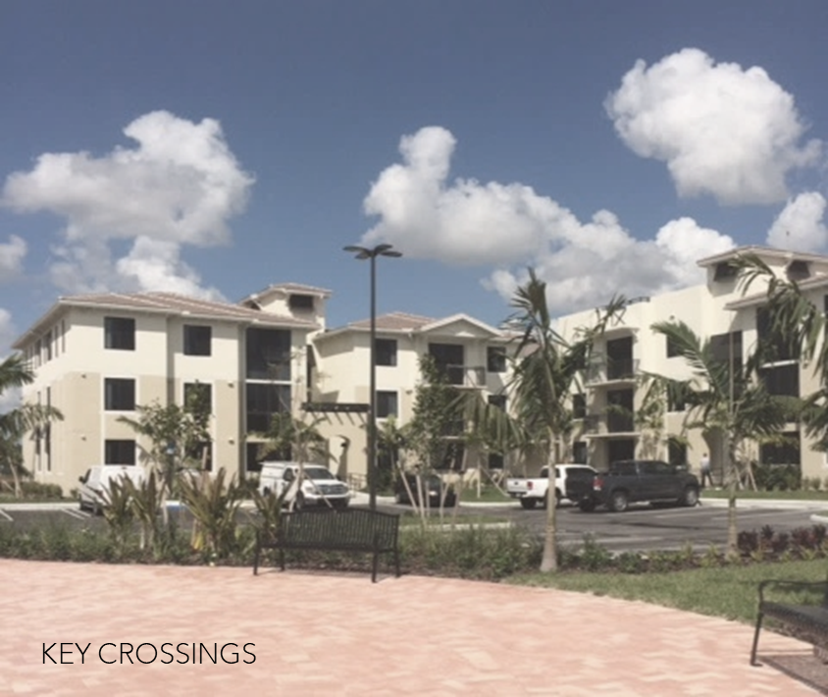
Best Practices for implementing the mandate
Land Use
Mapping exercises
Proactive ordinance/ policy implementation
Guided growth
Monitoring/enforcement approach
Tracking usage

Slide 19
Jurisdictions with local policies/ordinances for LLA land use mandate
Land Use
St. Johns County
Ocoee
Orange County
Minneola
Titusville
Tampa
Hillsborough County
St. Cloud
Largo
St. Petersburg
Boca Raton
Sarasota
Coconut Creek
Weston

Slide 20
Considerations for proactive local policies
Land Use
A local policy or ordinance that clearly defines local interpretation of the land use mandate could contain:
Clear statement of eligible zoning districts
Clear statement of maximum density and height allowances
Certification process to identify eligible proposals (pre-application review, etc.)
Clear statement of which multifamily regulations apply to receive administrative approval
Compliance monitoring requirements

Slide 21
Example: Titusville
Land Use
Ordinance
General LLA state law compliance terms
Definitions of mixed-use, industrial, commercial zones
Identified zones to calculate 20% rule (subsection f)
General process referencing required agreements
General reporting terms for developer
Permitted uses for mixed-use development
Applicable multi-family regulations for administrative approval
Buffer, setback, airport overlay, open space, noise standard, phasing restriction, unit of title requirements
Resolution
Checklist of major required compliance terms, agreements, other documents
Establishment of administrative review, monitoring fees

Slide 22
Example: St. Petersburg
Land Use
Establishes Neighborhood Suburban Multi-family as the standard for Industrial zoning districts
Clearly defines the administrative process for preemption projects (based on their existing process for using s. 166.04151(6))
Sets out the application materials required
Clearly states a max density of 82 units/acre

Slide 23
Example: Orange County
Land Use
References multi-family regulations to use for administrative approval
Clearly states which zoning districts are eligible

Slide 24
Example: Boca Raton
Land Use
Specifies eligible zoning districts
Actively states that the 20% rule applies and only mixed-use projects are allowable in commercial and industrial districts
Fleshes out required non-residential component: minimum of 5,000 square feet, or 10% of overall square footage, to be non-residential and on the ground floor
Defines applicable setback standards, buffering, landscaping, minimum square footage of residential units, parking open space requirements, and more

Slide 25
Pre-Development Agreement Example: Titusville
Land Use
Pre-Development Agreement (Site Plan Application)
General Live Local Act compliance terms defined by state law
Federal, state, local code requirements, generally
Monitoring standards, generally
General reference to environmental review and testing required by law
Agreement to eventual LURA

Slide 26
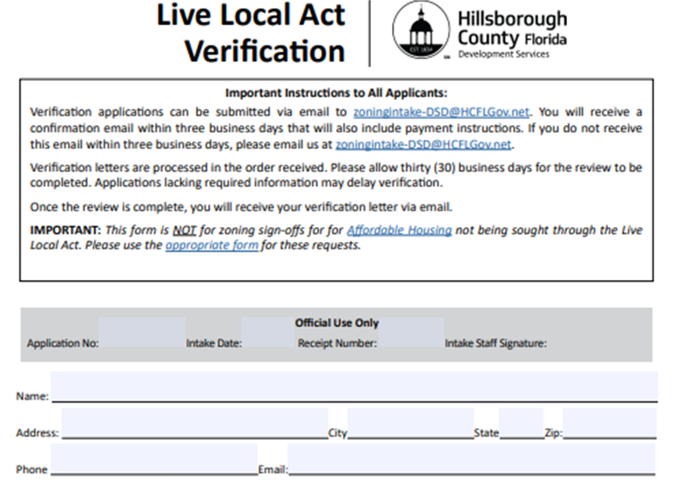
LLA Verification Example: Hillsborough County
Land Use

Slide 27
Guiding growth in light of the LLA mandate
Land Use
Local governments still have levers to “guide growth” despite this mandate
Allow more multifamily development in residential areas
Allow more areas where multi-family, commercial, and/or light industrial can be mixed
Layer incentives in targeted areas to guide growth (impact fee waivers, density bonuses, etc.
Use ss. 125.01055(6)/166.04151(6) land use tool for affordable housing

Slide 28
Local governments “compete” with LLA mandate: City of Sarasota downtown density bonus example
Land Use
Provides 4x density in four targeted downtown districts for developments that set aside as affordable at least 15% of units exceeding the base density
Affordability: 60-120% AMI
At least 1/3 of attainable units must serve households 80% or below AMI
No more than 1/3 must serve 100-120% AMI
Ownership and rental housing

Slide 29
HB 1339 (2020) + Live Local Act (2023) w/ SB 328 (2024)
Land Use
Commercial, industrial, mixed-use zone
MF housing; 40%-100% affordable if total of 40% of units are rental housing
MF or SF housing; 10-39.9% affordable + rental or ownership + any project not covered by sub. (7)
Live Local Act land use mandate – 125.01055(7)/166.04151(7)
“HB 1339” discretionary approval – 125.01055(6)/166.04151(6)

Slide 30
Boca Raton “HB 1339” tool example
Land Use
Ord. 5684 (2024) implements 166.04151(6) and includes
Affordability requirements, consistent with subsection 6
Eligible zoning districts
Max. density and intensity, including density bonus for inclusion of additional units at 80-140% AMI
Land use mix and applicable land development regulations
Number of units allowed across developments using the tool
Application and review process, enforcement mechanism

Slide 31
Compliance monitoring long-term affordability
Land Use
The Act is silent on how local governments should monitor long-term affordability – local governments have broad discretion.
Compliance monitoring plan could include:
Developer responsibility to income certify tenants with City/County as oversight authority
Partnerships with third party monitoring organization
Random spot checks of tenant income and rents
1- or 3-year audits
Stern penalties for noncompliance

Slide 32
Local Enforcement/ Monitoring Example: Titusville
Land Use
Land Use Restriction Agreement
Live Local Act compliance terms with specified number of units
More detailed compliance, monitoring, and enforcement/remedy terms
Covenants running with the land and sale/transfer terms
Affordable Rental Housing Agreement – most detailed information on:
Income verification and affordability calculations, including utility allowance
Project monitoring documentation
Forms of noncompliance and remedies
Forms for: tenant application, release of tenant information, income verification, income re-certification

Slide 33
Project tracking example: Forward Pinellas
Land Use
New dashboard to track projects using preemptions in HB 1339 (2020), SB 962 (2022), and the Live Local Act (2023)
Local governments submit monthly data to countywide transportation and land use agency, Forward Pinellas, on projects submitted for review
Local governments submit a data form with specific information for each project; this information populates the dashboard

Slide 34
Dashboard Link: https://pinellas-egis.maps.arcgis.com/apps/dashboards/a66289aa8aab49dda315092593dba60e

Slide 35
Publicly owned land inventory requirements
Land
F.S. 125.379/166.0451 –
Requires every county and city to identify publicly owned lands that are “appropriate for use as affordable housing” to be placed on an affordable housing inventory list.
The Live Local Act amends these statutes to:
Newly apply to all dependent special districts, including CRAs
Require local government by October 1, 2023, to post their affordable housing inventory list online
Encourage local governments to adopt best practices including:
Establishing eligibility criteria for the receipt or purchase of surplus land by developers;
Making the process for requesting surplus land publicly available; and
Ensuring long-term affordability through ground leases by retaining the right of first refusal to purchase property

Slide 36
Additional webinar resources
Overview of the Live Local Act
Recording: https://vimeo.com/825231697?share=copy
PowerPoint: https://flhousing.org/wp-content/uploads/2023/05/Overview-of-the-Live-Local-Act-5.9.pdf
Dissecting the Land Use Tools and Property Tax exemptions in the Live Local Act
Recording: https://vimeo.com/837681484
PowerPoint: https://flhousing.org/wp-content/uploads/2023/07/LLA-Land-Use-and-Property-Tax-Incentives.-6.15.23.pdf
Land Use Tool for Affordable Housing in Commercial, Industrial, and Mixed-Use Districts – a Live Local Act Webinar
Recording: https://vimeo.com/883265655
PowerPoint: https://flhousing.org/wp-content/uploads/2023/11/Land-Use-Tool-for-Affordable-Housing-110623.pdf
Surplus Land and Permanent Affordability:
Recording: https://vimeo.com/873761639
PowerPoint: https://flhousing.org/wp-content/uploads/2023/10/Surplus-Land-and-Permanent-Affordability-10.11.23.pdf
Expedited Permitting and Innovative Housing Solutions Promoted in the Live Local Act
Recording: https://vimeo.com/878777909
PowerPoint: https://flhousing.org/wp-content/uploads/2023/10/LLA-Innovative-Housing-Solutions-Webinar.-10.26.23.pdf

Slide 37
Contact for Technical Assistance Opportunities
Ali Ankudowich, Technical Advisor
Ankudowich@flhousing.org

