Slide 1
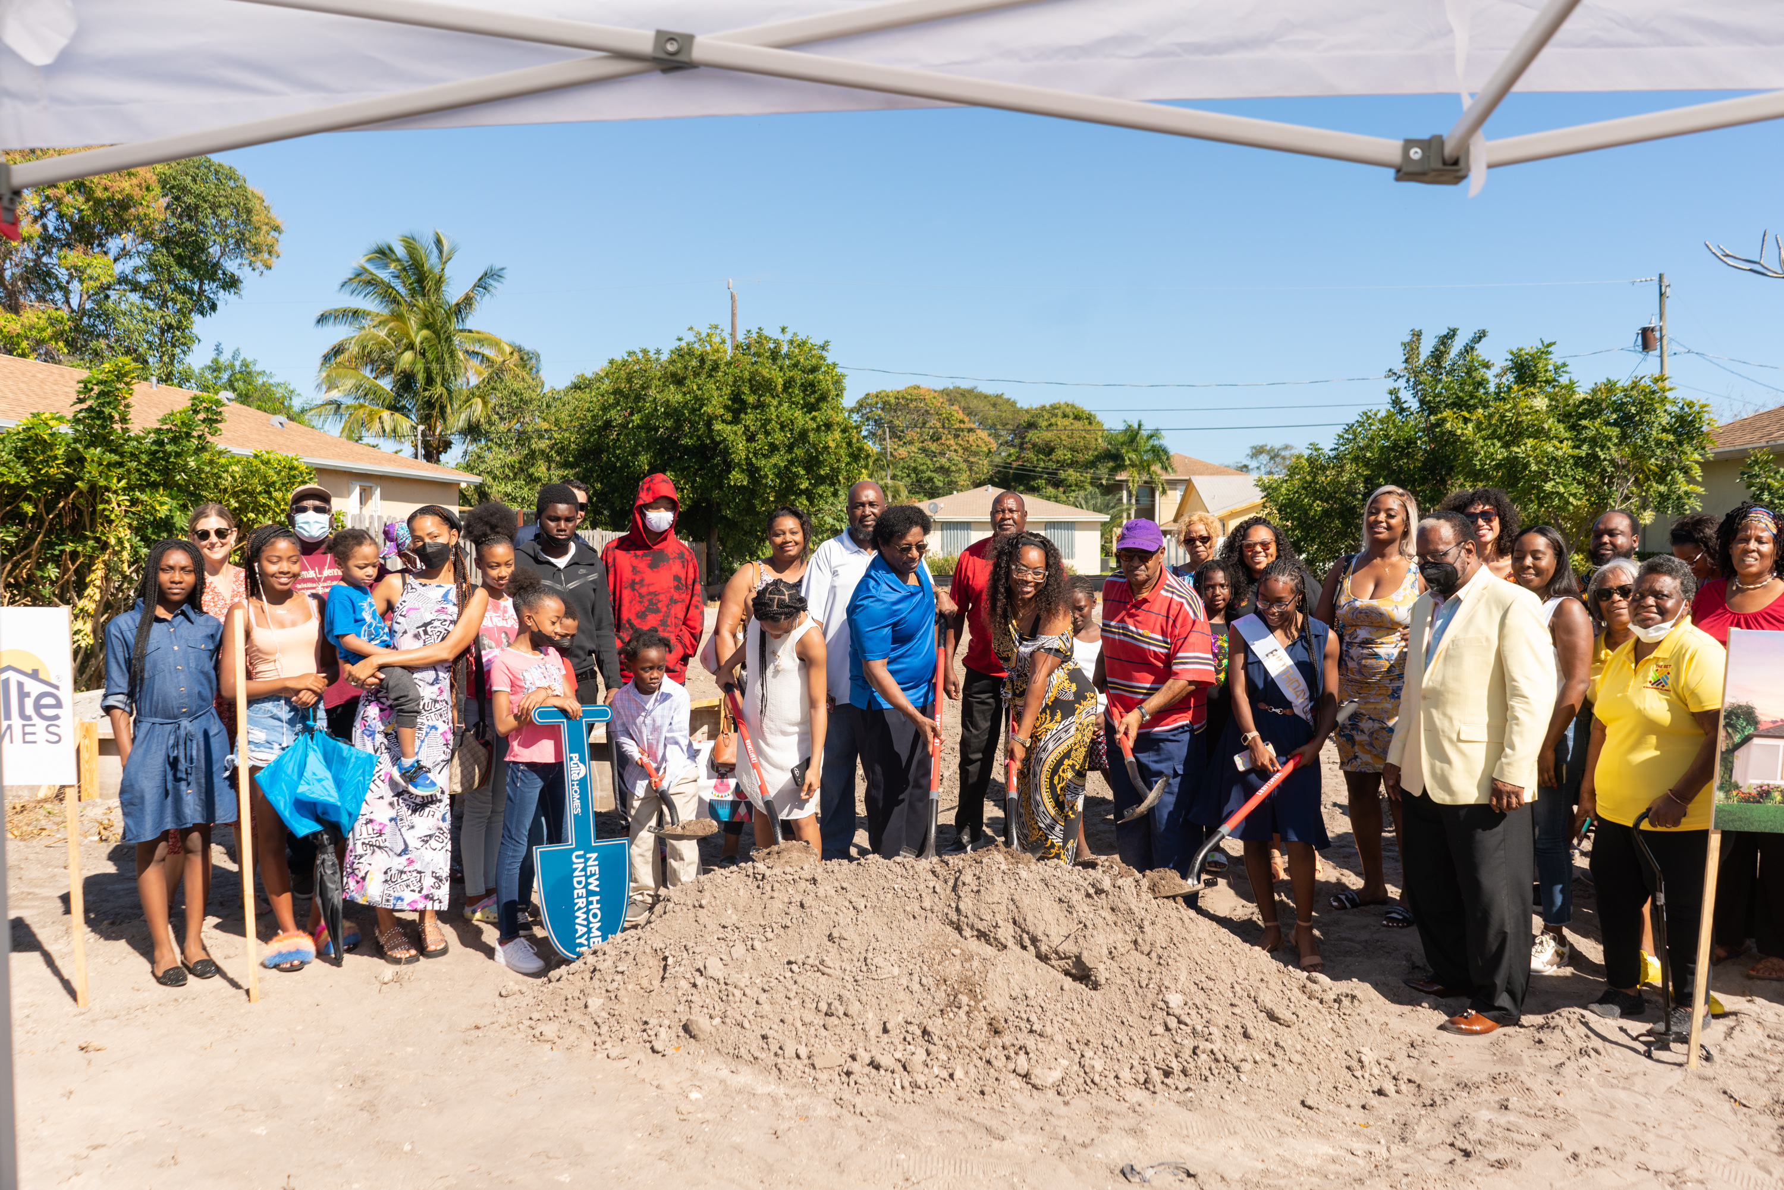
DELRAY BEACH CDC: WE ARE HOME

Slide 2
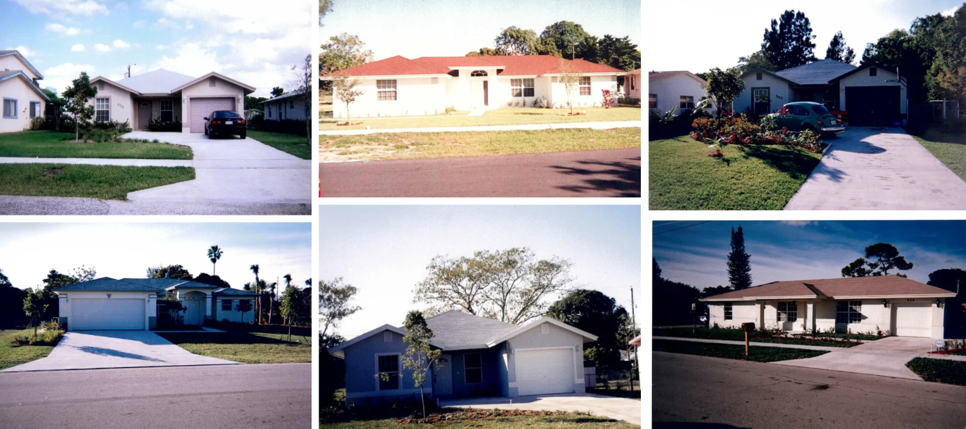
DELRAY BEACH CDC – OUR HISTORY
Chartered in 1992 focusing on repair & restore and new construction
Secured several discounted land deals through partnerships with the City of Delray Beach and CRA
Assembled the community together for social and community events
Built over 300+ homes
/ units
Examples of our past
affordable housing
projects in The Set
Notes:
Catch program

Slide 3
WE ARE HOME PHASE 1 KEY PARTNERS
Mix of nonprofits, foundations, neighborhood groups, banks, builders, and government working together to a common goal

Slide 4
WE ARE HOME – Project Description
Legacy housing preservation initiative to celebrate and preserve community heritage
Protecting and promoting homeownership and wealth-building with residents of The Set, a historically relevant community of color in the heart of Delray Beach
Builds attainable homes on the private properties of legacy families

Slide 5
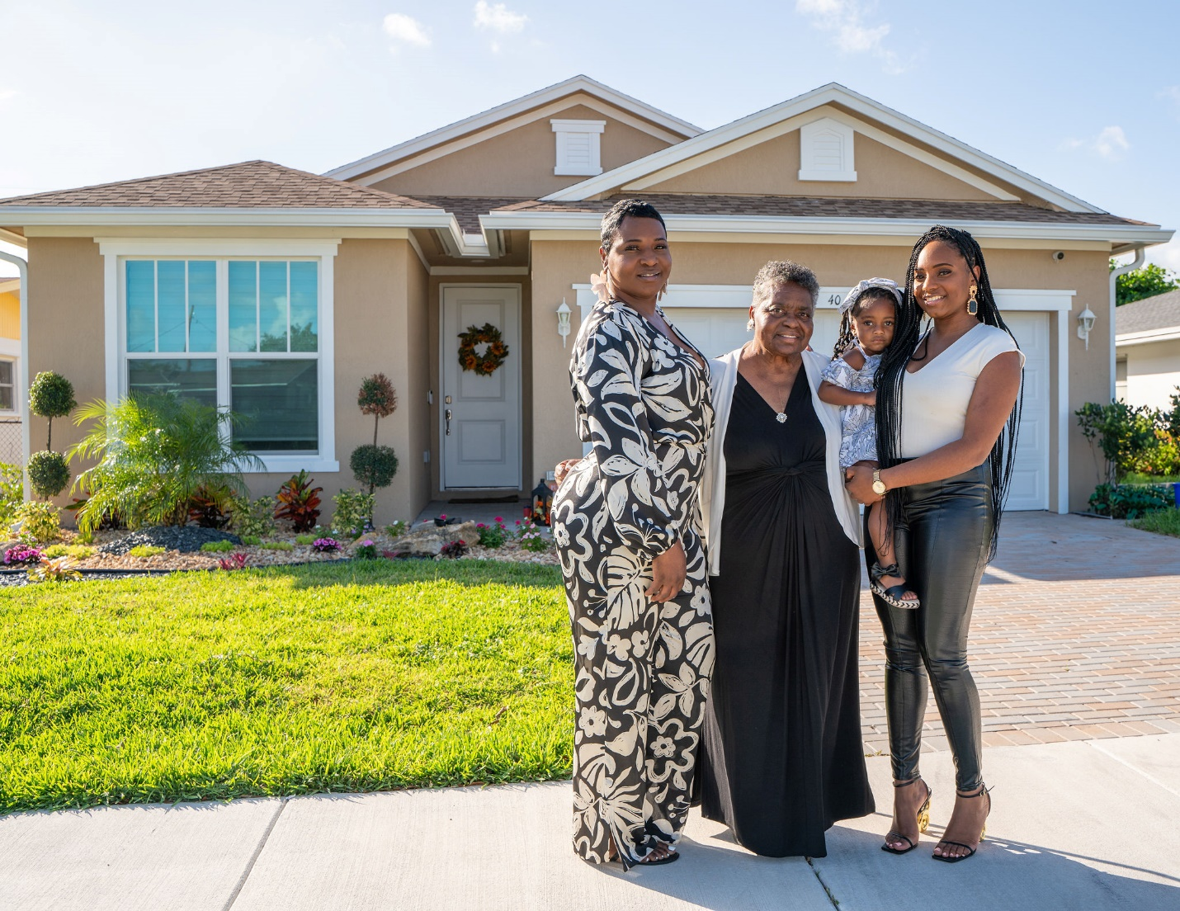
WE ARE HOME – The Families
House 1 Family
“This is a dream come true for home ownership, preventing gentrification, building community wealth, and focusing on the importance of keeping this land and this new home in our family from generation to generation.”

Slide 6
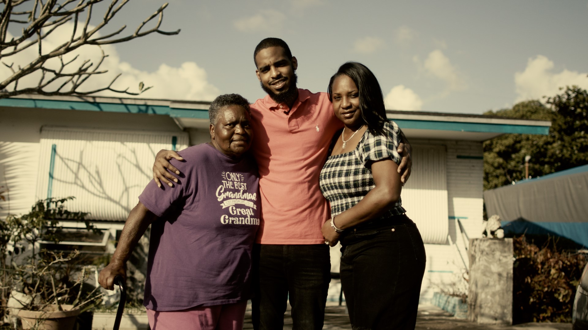
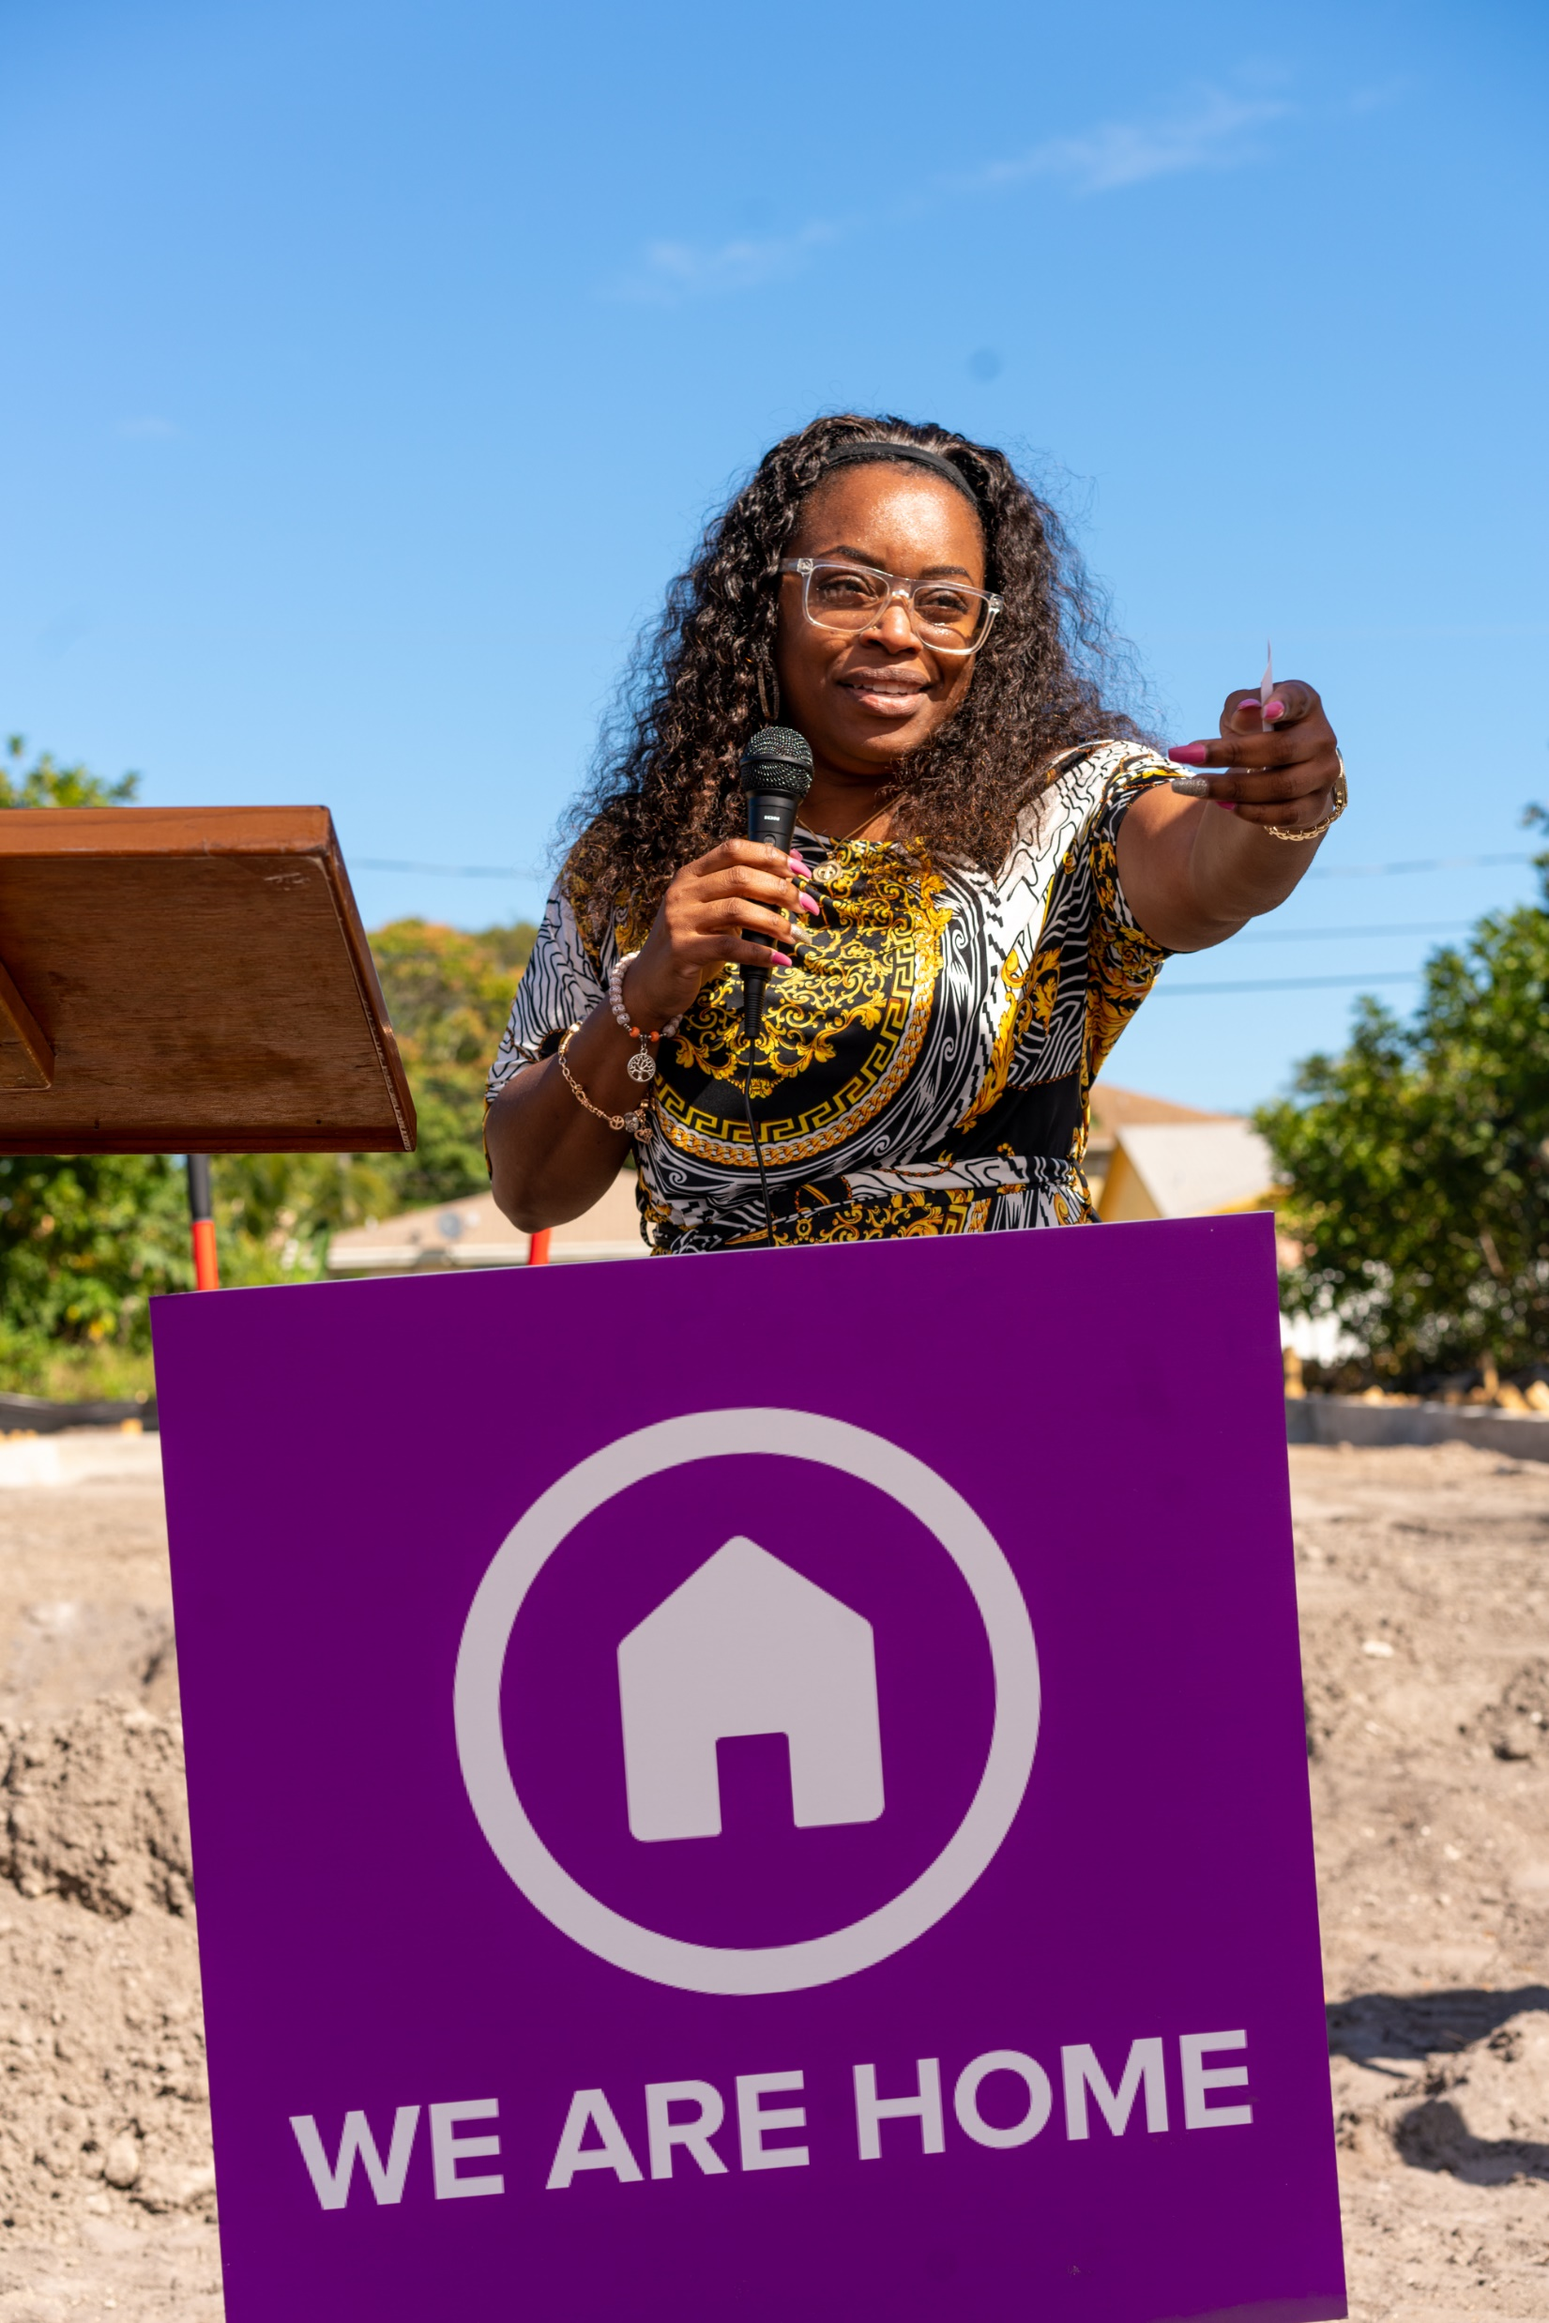

Slide 7
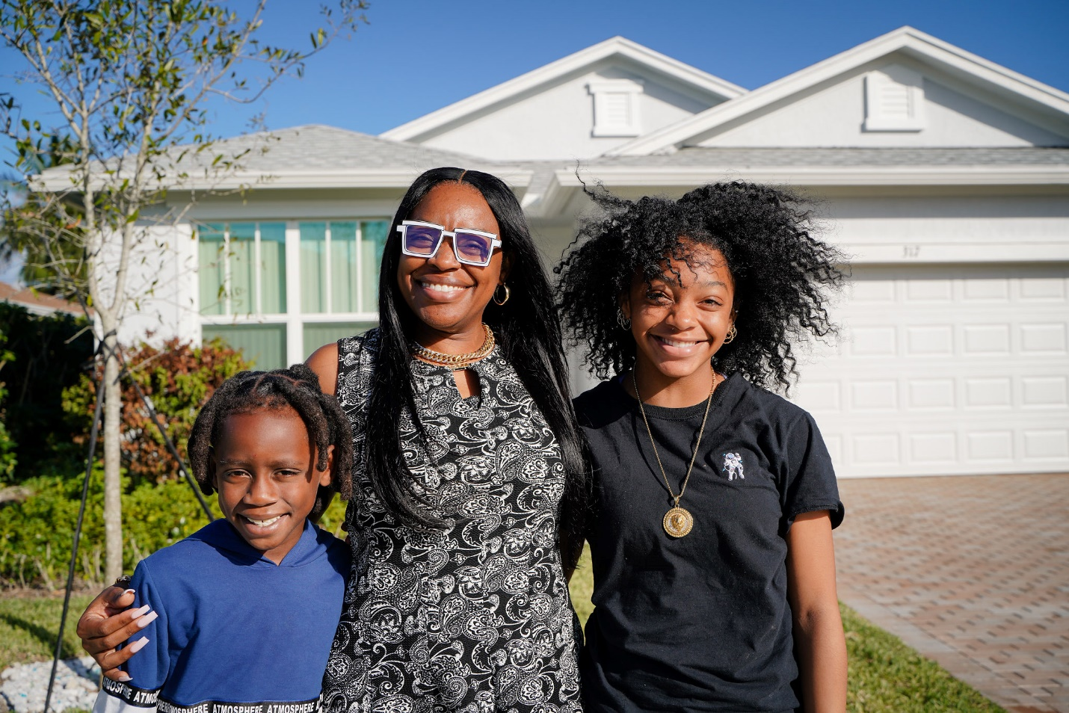
WE ARE HOME – The Families
House 2 Family
“Being able to get an affordable home, now I have the opportunity to create generational wealth for my children. I am grateful for this opportunity.”

Slide 8
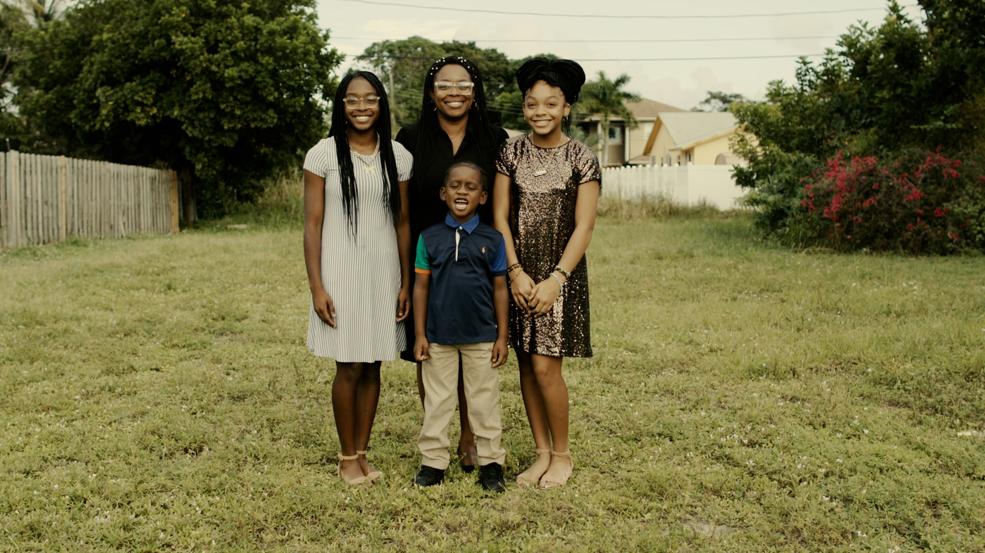

Slide 9
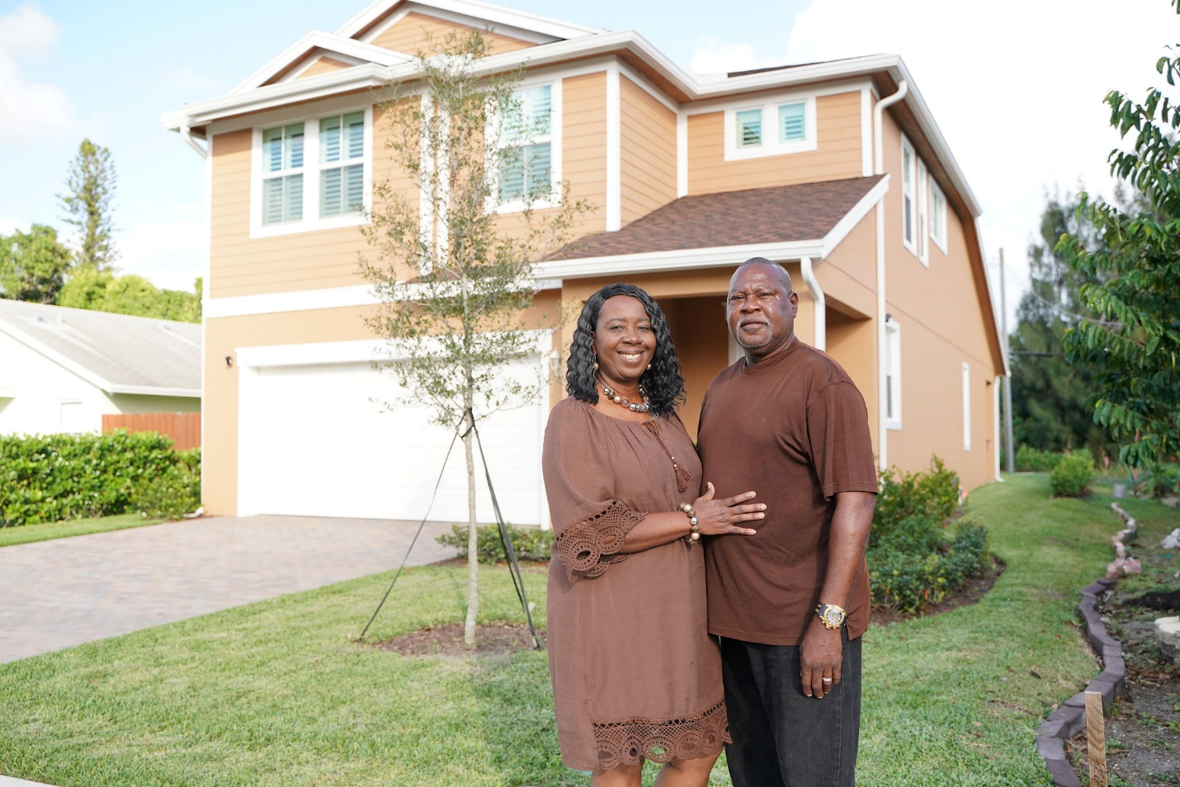
WE ARE HOME – The Families
House 3 Family
“Thanks so much for the wonderful opportunity to have a beautiful new home that is truly affordable and allows our family to live in Delray Beach.”

Slide 10
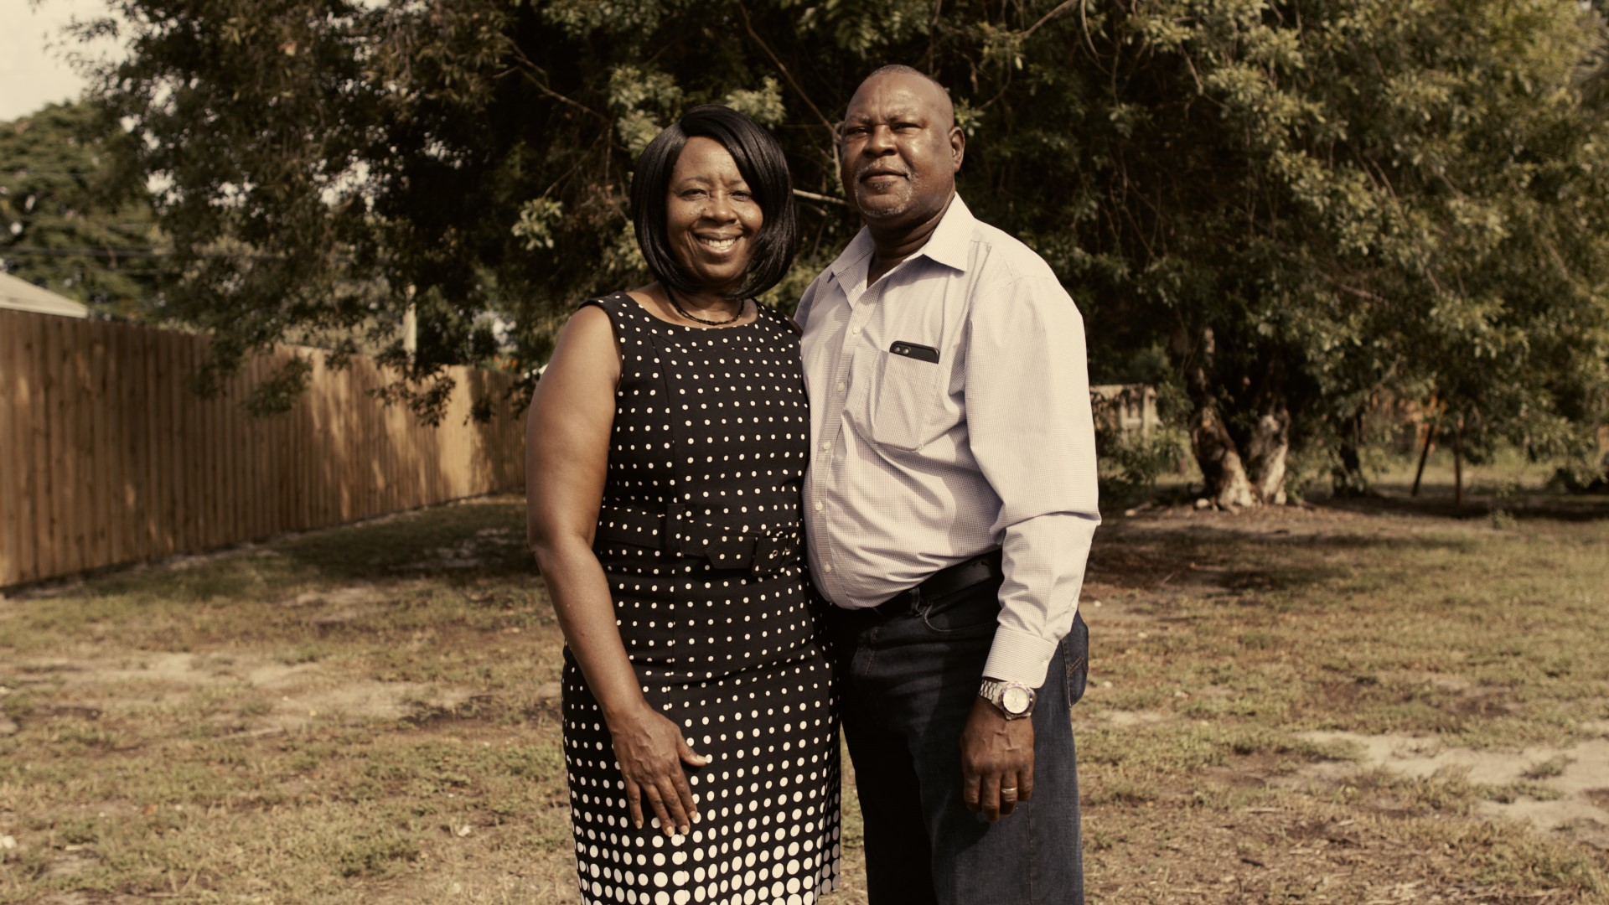

Slide 11
WE ARE HOME - Future Phases
Start new homes from ‘We Are Home’ Waiting List
Fundraise for construction subsidies to cover difference from the construction costs and the sales prices set by PBC Workforce Housing Prices
Continue forming relationships with builders interested in this project
Expand beyond Delray Beach
Work with other CDCs and other nonprofits in other areas in Palm Beach County
If interested in helping or signing up for future phases, contact: The Delray Beach CDC at ali@delraycdc.org

