Slide 1
Addressing Homelessness with Available Funding Resources
Amanda Rosado she/her/hers
Chief Strategy Officer
Florida Housing Coalition
September 30, 2021

Slide 2
State of Homelessness in Florida
 | 2017 | 2018 | 2019 | 2020 | 2021
Total | 32,190 | 31,030 | 28,328 | 27,487 | 21,218
Families | 2,831 | 2,346 | 2,171 | 2,294 | 1,687
Chronic | 5,120 | 5,230 | 5,727 | 5,182 | 2,778
Veterans | 2,789 | 2,515 | 2,472 | 2,436 | 2,153
*Important to note:
PIT Count was different this year – less outreach
Homeless schoolchildren numbers from 19-20 report 79,949 students (a decrease)
Providers reported increase in calls for assistance over the past year

Slide 3
Federal Funding Landscape
Federal Funding
Emergency Solutions Grant 2020 $25,774,171
Emergency Solutions Grant -CV $188,842,885
State ESG is awarded to Continuums of Care
Continuum of Care Program $98,991,639

Slide 4
Federal and State Sources Chart
Challenge | ESG | TANF | Staffing | ESG-CV | HUD CoC | Total (State & Federal)
$3,181,500.00 | $5,337,544.00 | $820,257.50 | $2,892,856.95 | $83,212,659.90 | $98,991,639.00 | $194,436,457.35
*See handout

Slide 5
What they Can Pay For
Homeless Management Information System (HMIS)
Rapid Rehousing (Short-term rental assistance)
Permanent Supportive Housing (Long-term rental and support services)
Street Outreach
Emergency Shelter
Supportive Services
Homelessness Prevention

Slide 6
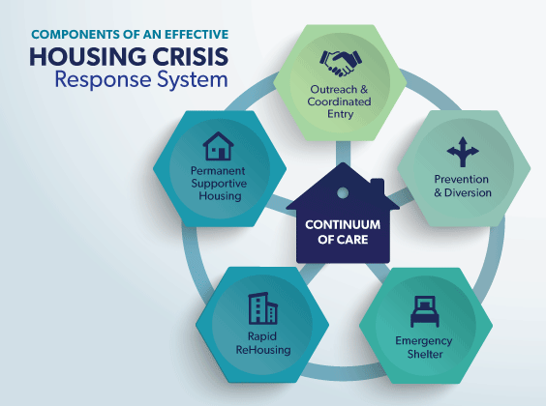

Slide 7
Maximizing Federal Resources
Emergency Solutions Grant – CV
HOME American Rescue Plan (ARP)
Emergency Housing Vouchers (EHVs)
Community Development Block Grant – CV
Coronavirus State and Local Recovery Fiscal Funds
Emergency Rental Assistance Program

Slide 8
Don’t Forget About SHIP!
SHIP Rent Subsidies strategy can serve homeless and special needs under 50% AMI with rental assistance
Great local source, especially in rural areas and smaller cities
Incorporate into your LHAP
Partner with your Continuum of Care

Slide 9
Strategic Questions
What’s missing from our system (remember the graphic)?
What’s there but could benefit from robust funding?
How can we build it?
How can we subsidize it?
How can we make it long term?
How can we make it equitable?
How can we provide support services?

Slide 10
Rapid Re-Housing
100 x 100 Campaigns
Local Government Funds
ESG-CV (HUD & DCF)
Continuum of Care
HOME TBRA
Special Initiatives
Landlord Incentives
Furniture and Household Items
Welcome Home Kits
Notes:
100 x 100
First started 12/1/2020
Second start 5/1/2021
100 days, evaluate what worked and what didn’t for 30-45 days, adjust, then restart.

Slide 11
Pro Tips
Prioritize RFPs based on the needs of the community – not necessarily every eligible activity available
Partner with your Continuum of Care
Use the flexibilities available (e.g., landlord incentives)
Bring those most impacted to the table when decisions are being made

Slide 12
Much Broader Overview of CARES and ARP Acts Resources
National Alliance to End Homelessness
https://endhomelessness.org/wp-content/uploads/2021/08/CARES-ARPA-Funding-programs_August-2021.pdf

Slide 13
rosado@flhousing.org

