Slide 1

Tampa Hillsborough homeless initiative
Antoinette Hayes-Triplett, Chief Executive Officer
Thursday, September 30, 2021

Slide 2
Today’s Discussion
About Tampa Hillsborough Homeless Initiative (THHI)
2020 Homeless Point-In-Time Count
Myths About Homelessness
Solution To Homelessness
Addressing The Housing G.A.P.
What Is Low Income?
Poverty Simulation
560 In 560 Strategic Plan On Homelessness

Slide 3
About Tampa Hillsborough Homeless Initiative
Tampa Hillsborough Homeless Initiative (THHI) is designated by federal, state and local governments to serve as the lead entity and grant administrator of the Tampa/ Hillsborough County Continuum of Care (CoC). The CoC is a strategic planning body on the issue of homelessness that consist of homeless service providers, government officials, advocates, business and community leaders, and people who are homeless. This collaboration engages and mobilizes systems of care on a local, regional and national level to develop prevention and intervention services for people who are homeless or at risk of becoming homeless.
Develop, coordinate, and monitor new and existing housing and service programs
Administer federal, state, and local funds to social service agencies
Lead and coordinate the Continuum of Care (CoC)
Ensure that funds are utilized based on community needs
Coordinate the annual homeless count in Hillsborough County

Slide 4
2020 Point-in-Time Count Results
In February 2020, an annual Point-in-Time (PIT) count was conducted to count the people experiencing homelessness in Tampa/Hillsborough County. The PIT count is a requirement of the Department of Housing and Urban Development that helps us learn more about homelessness so that our community can strategically address the issue. The results of the count: 1,452 people were homeless of those 612 did not have shelter.
2020 Results Compared to 2019 Results:
12% decrease in overall homelessness
9% decrease in unsheltered homelessness
Progress since 2014:
25% decrease in overall homelessness
44% decrease in unsheltered homelessness
35% decrease in chronic homelessness
32% decrease in Veteran homelessness
24% decrease in family homelessness
66% decrease in unaccompanied youth homelessness

Slide 5
Approximately 1.5 million people live in Hillsborough County; 1,452 people experienced homelessness during the 2020 PIT County of those 612 did not have shelter.
Less than .1% of the total population of Hillsborough Couth is experiencing homelessness on any given night. The other 99.9% can work together to make homeless rare, brief and non-recurring in our community.

Slide 6
MYTH: People are homeless by choice.
Fact: No one starts life with a goal of becoming homeless. Yes, poor choices can contribute to homelessness. But outside circumstances strongly influence those choices. People are homeless for a wide variety of reasons, a good number of which are at least partly and often largely beyond a person’s control. Homelessness occurs when people or households are unable to acquire and/or maintain housing. Two major factors that account for homelessness are the lack of jobs that pay a living wage and the lack of affordable housing. Additionally, people lose jobs and then housing. Women run away to the street to escape domestic violence. Many people have experienced significant trauma and simply cannot cope with life. Others struggle with mental illness, depression or post-traumatic stress.

Slide 7
MYTH: People come to Tampa-Hillsborough County to become homeless because of our good weather.
​
Fact: The 76% of people experiencing homelessness report that they lived in Hillsborough County for at least a year PRIOR to the first time they became homeless (based on the 2017 Tampa-Hillsborough County CoC Homeless Count Survey responses). This is not a new trend either, as in all homeless counts conducted in Hillsborough County since 2007, at least 70% of people experiencing homelessness reported having either already resided in Hillsborough County or Florida for at least a year prior to becoming homeless.

Slide 8
Fact: While many homeless people do report having a substance abuse issue, most report that the addiction occurred AFTER they became homeless and was not the cause of their homelessness. Often times, people experiencing homelessness turn to alcohol or drugs as a way to dull the realities that come with living on the street. While it depends on the person, many people find that once they are off the street they no longer find that they need or desire to continue with their addiction.
MYTH: Most people experiencing homelessness are addicted to drugs or alcohol.

Slide 9
What is the solution to ending homelessness?

Slide 10
HOUSING!

Slide 11
Addressing The Housing g.a.p.: Gentrification, Affordable Housing & Preservation
Gentrification: Gentrification is the process whereby the character of a poor urban area is changed by wealthier people moving in, improving housing, and attracting new businesses, typically displacing current inhabitants in the process.
Affordable Housing: Affordable housing is housing that is appropriate for the needs of a range of very low to moderate income households and priced so that these households are also able to meet other basic living costs such as food, clothing, transport, medical care and education.
Preservation of Housing: Preservation refers to retaining existing affordable housing, whether subsidized or market-rate, and protecting its affordability for current and future tenants. Affordable housing preservation is essential to meeting a community's affordable rental housing needs.

Slide 12
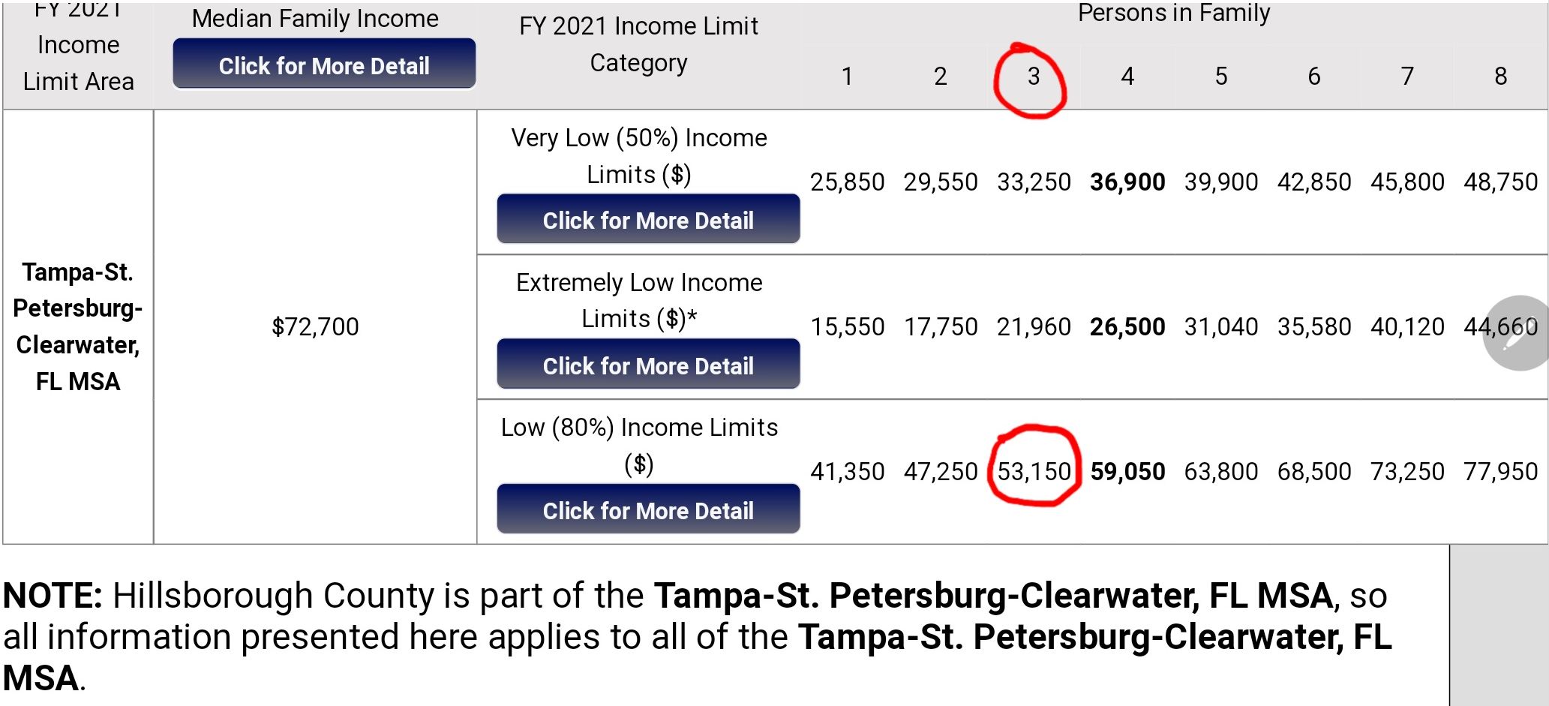
What is Low-Income??

Slide 13
Poverty Simulation
How much is minimum wage?
What is the average rent for a one-bedroom apartment?
Let’s consider other expenses:
  Utilities
  Transportation (Car payment, Insurance, Gas)
  Groceries
  Personal Care Items

Slide 14
Poverty Simulation
How much is minimum wage? $10/hour
  $10/hr X 40/week X 4 weeks = $1600/month income before taxes
What is the average rent for a one-bedroom apartment? $1,647
Let’s consider other expenses:
  Utilities? $150
  Transportation (Car payment, Insurance, Gas)? $200
  Groceries? $180
  Personal Care Items $75
  No internet, cable, clothes, cell phones, restaurants, entertainment, education, medical expenses

Slide 15
560 In 560 Strategic Plan On Homelessness
With seed money from the Board of County Commissioners (Lead by Commissioner Overman and former Commissioner Murman…
560 In 560: The Tampa/Hillsborough County Continuum of Care’s plan to address unsheltered homelessness and some of the top causes of homelessness by providing housing opportunities to 560 people in 560 days, beginning June 2019 through December 2020.
1. Hillsborough County Expungement Clinics: Clinics that offer county residents who have been charged with a crime the opportunity to have one criminal record sealed or expunged, provided that the charge didn’t result in a criminal conviction (complying with Florida law). The expungement of a charge improves residents’ opportunities for housing, employment and education.
2. Second Chance/Re-Entry Job Fairs: An opportunity for residents of Hillsborough County with a criminal record to re-enter the job force. It will remove barriers for employment and housing by assisting ex-offenders who are ready to return to the job market make connections with potential employers and improve their interview skills.
3. Hot Spot Mobile Outreach (HSMO): Addresses the issue of unsheltered homelessness within several “hotspots” that are experiencing high rates of homelessness throughout Hillsborough County. HSMO will be housing-centered. Mobile command centers will be established and remain at the hot spot locations for up to 30 days.

Slide 16
560 In 560 Strategic Plan On Homelessness
4. Rapid Exit from Shelters: THHI’s effort, over the last three years, has been to increase the number of Rapid Re-housing Program vouchers in our community by partnering with bridge-housing/emergency shelter providers. The rapid rehousing vouchers allow the providers to develop housing plans upon shelter entry and work to rapidly house individuals and families as soon as possible.
5. Speed Leasing: A formalized matchmaking process which provides financial incentives to landlords who rent to residents that are experiencing housing barriers.
6. Operation: REVEILLE: A housing-first initiative aimed at rapidly re-housing Veterans experiencing homelessness and developing a system of care to ensure that a Veteran never sleeps on the streets again.
7. Housing is Healthcare: An effort to streamline the treatment process for participants and to increase the number of housing vouchers in our community.

Slide 17
560 In 560 Strategic Plan On Homelessness
8. C.A.S.H. Program: The Community-wide Affordable Supportive Housing (C.A.S.H.) Program is a method of increasing access to housing for people emerging from homelessness and are unlikely to obtain housing without assistance. The C.A.S.H. Program has four components: Developer Incentive, Risk Mitigation, Set Aside Units, and Rental Gap Incentive.
9. Shared Housing: A solution to providing immediate housing for single adults experiencing homelessness. Shared Housing will make housing affordable, keep those relationships intact and promote long term housing stability for those that may currently live together in shelters, encampments and parks throughout Hillsborough County.
10. The B.E.A.C.H. House: The Beginning of the End to Abolish Chronic Homelessness (B.E.A.C.H.) House is an initiative aimed at addressing chronic homelessness in Tampa/Hillsborough County. The B.E.A.C.H. House would provide a friendly and safe living environment for chronically homeless individuals who are the most visible and the most vulnerable in our community and who would never be able to maintain their own living space due to physical or mental disability.

Slide 18
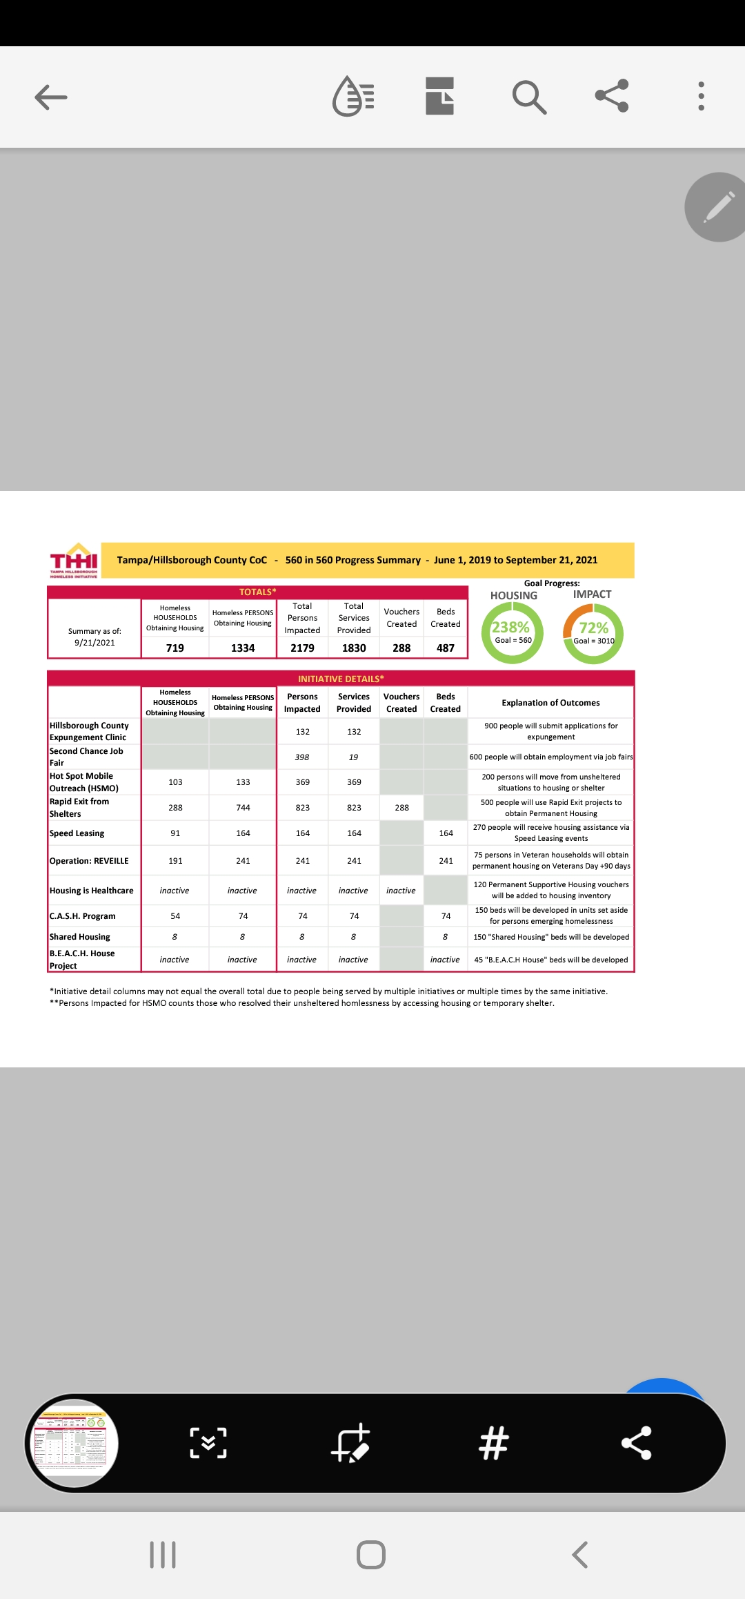

Slide 19
Thank you!
Visit us at: THHI.Org

