Slide 1
“Brownfields to Healthfields Transformations as an Equitable Development and Environmental Justice Catalyst”
Miles G. Ballogg
Senior Principal Brownfields Practice Leader – Cardno, Inc.
For: FCDA 45th Annual Training Meeting/ Conference - Best Practices: Brownfields Resources, Environmental Review Reports, Due Diligence And Environmental Justice
September 29, 2021

Slide 2
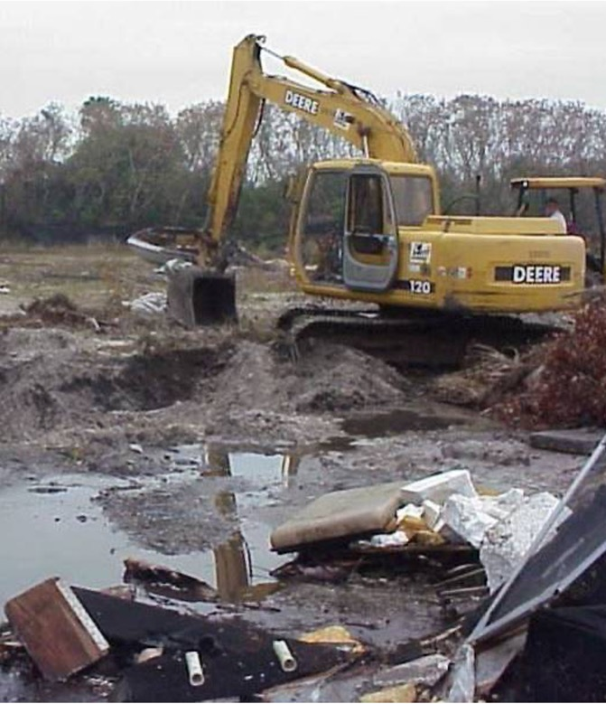
Agenda
Remove the Junkyard from the Backyard
What is a Brownfield/Heathfield Project
Environmental Justice and Equitable Development Concerns and Issues
Brownfields and Environmental Justice Grants and Resources
Successful Brownfields/Healthfields Projects

Slide 3
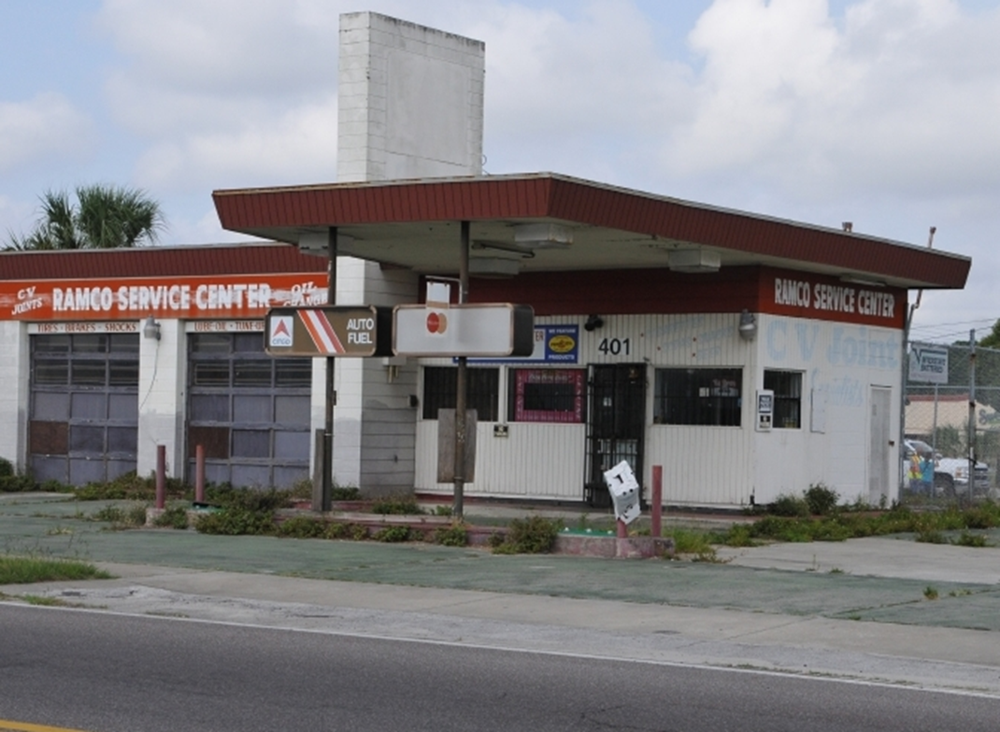
What is a Brownfield?
EPA – A brownfield site is defined as real property, the expansion, redevelopment, or reuse of which may be complicated by the presence or potential presence of hazardous substances, pollutants, contaminants, controlled substances, petroleum or petroleum products, or is mine-scarred land.
Communities Perspective – Redevelopment that can result in removing Environmental Contamination and provide end uses that the Community needs from a Health, Economic and Community Development Perspective. Projects that make a visible difference !
  Projects that lead to wholistic improvements to the natural and built environments and can begin to reverse years and years of environmental injustice and resulting health disparities .
Cardno – Pursuing redevelopment opportunities that result in viable and visible economic and community development, residential and open-space/green-space, affordable and workforce housing , mixed-use projects and other community driven projects that provide direct community benefit through redevelopment .

Slide 4

Types of EPA Brownfields Funding
EPA Grant | Amount and Application
Community-wide assessment grant | $500 k – assessing properties, conducting redevelopment planning, and engaging in community outreach activities.
Cleanup grant | $650k – funding for cleanup activities / multiple sites
Coalition assessment grant | $1 M – funding to three or more entities to conduct assessment grant activities within their defined area (Cant be lead by a Non- Profit)
Multi-purpose grant | Up to $800k – provide funding to conduct a range of eligible activities (planning/assessment/remediation) at one or more brownfield sites
Revolving loan fund | Up to $1 million – enable recipients to make subgrants and low interest loans for cleanup activities
Job Training | $200k – funding for the recruitment, training, and placement of local residents in environmental technician occupations.

Slide 5
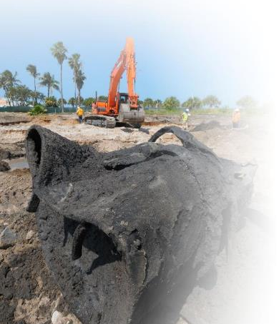
Assessment, Cleanup, and Redevelopment Process Pulling it all together – Environmental Due Diligence/Remediation

Slide 6

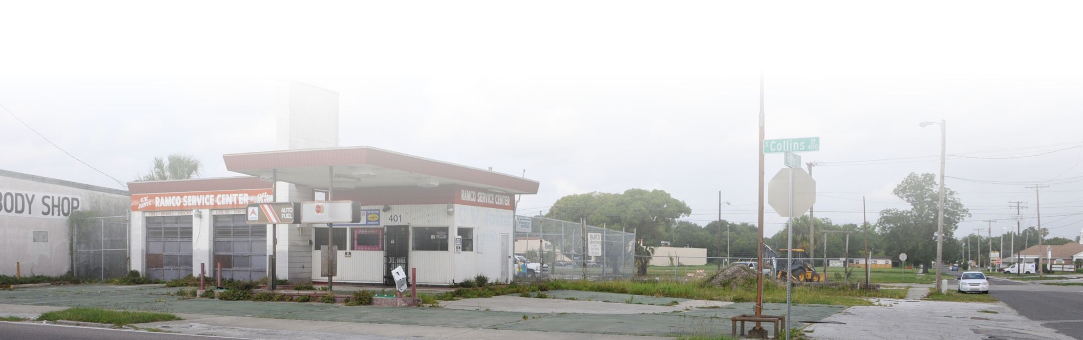
What are Healthfields ?
“Brownfields to Healthfields B2H” - refers to the transformation of Brownfields sites into viable projects that improve access to health and healthcare of the community through brownfields redevelopment, principals, tools, and resources.
Healthfields Redevelopment has the potential to improve local access to care and reduce health disparities through redevelopment.
Healthfields is the broader strategy of improving access to health and healthcare through brownfields redevelopment

Slide 7
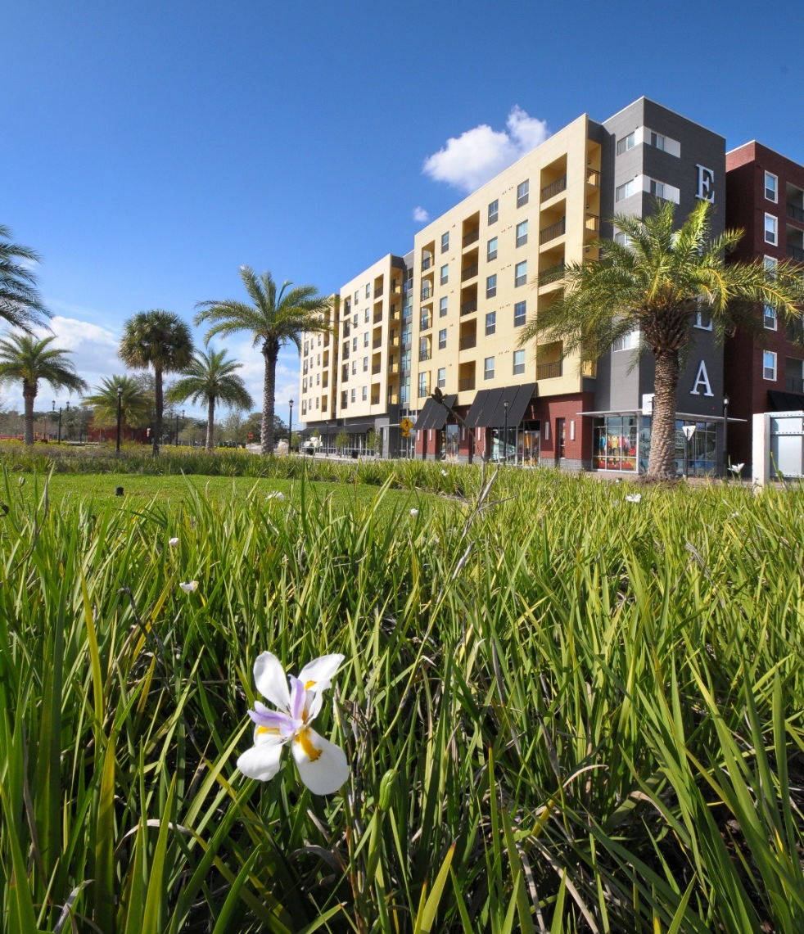
Brownfields Transformations - Bringing Value Back to Communities
Local Governments
Economic development job creation
  Equitable Development Projects that lead to improvements in Environmental Justice Conditions
Removing environmental stigmas to promote redevelopment
Conversion of sites to revenue-generating assets
to stimulate the local economy
Returning abandoned and underutilized
properties to the tax rolls
Community Members
Risk management and or communication for actual or perceived contamination
Healthfields Redevelopment
  Healthy Attainable Housing, Health Care, Open Space, Fresh Food
“From Blight to Right”

Slide 8
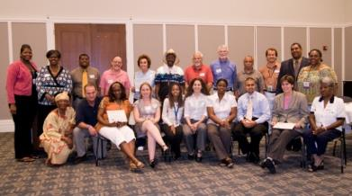
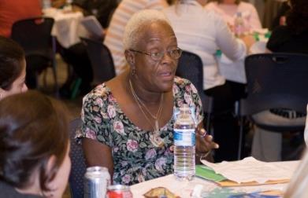
Successful Brownfields/Healthfields Projects Address
Environmental Justice Concerns
Environmental Justice
  Environmental Justice is the fair treatment and meaningful involvement of all people regardless of race, color, culture, national origin, income, and educational levels with respect to the development, implementation, and enforcement of protective environmental laws, regulations, and policies....
    Disproportionate Negative Environmental Impacts
    Disproportionate Health Disparities
    End Uses not found in more affluent Communities
  Brownfields and Healthfields Redevelopment are tools to reverse negative environmental impacts and provide positive steps to provide access to Health and Health Care and to remove Contamination in Environmentally Overburdened communities….
  Removes contamination and provide health-related end uses to improve access and reduce health disparities.
  Brownfields/Environmental Justice/Healthfields Grants, Incentives and Strategies are a powerful Equitable development tool.

Slide 9
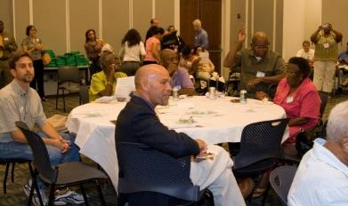
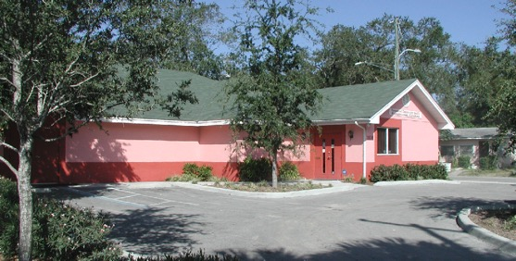
Equitable Development Concerns
Equitable Development Concerns
  Equitable development is an approach for meeting the needs of underserved communities through policies and programs that reduce disparities while fostering places that are healthy and vibrant. It is increasingly considered an effective placed-based action for creating strong and livable communities.
  ‘Gentrification commonly refers to 'the process of neighborhood change that occurs as places of lower real estate value are transformed into places of higher real estate value.’
  What does Equitable development look like –
    Projects that are “Beyond Buy-In” and are Community Lead or Driven
    Project extends to beyond the usual players
    Project Provides direct and peripheral benefits to the community
    Projects that are community driven and do not lead to displacement .
    Projects that lead to wholistic improvements to the natural and built environments and can begin to reverse years and years of environmental injustice and resulting health disparities .
    Community Benefit Agreement
    “If you are not at the table you are on the menu ”

Slide 10
Types of EPA Environmental Justice Funding
EPA Grant/Federal Programs | Amount and Application
Environmental Justice Collaborative Problem-Solving (EJCPS) Cooperative Agreement Program | $200k – Funds will be awarded to local community-based organizations, US territories, tribes, and tribal organizations seeking to address environmental and public health concerns in local underserved communities through collaboration with other stakeholders.
State Environmental Justice Cooperative Agreement Program | $200k – funding to eligible entities to work collaboratively with underserved communities to understand, promote and integrate approaches to provide meaningful and measurable improvements to public health and/or the environment in under served communities.
Environmental Justice Small Grants Program | $75K – Program supports and empowers communities working on solutions to local environmental and public health issues. The program is designed to help communities understand and address exposure to multiple environmental harms and risks.
Justice 40 | 40% of Federal Investments - A whole-of-government effort to ensure that Federal agencies work with states and local communities to make good on President Biden's promise to deliver at least 40% of Federal Investments in climate and clean energy to disadvantaged communities.

Slide 11
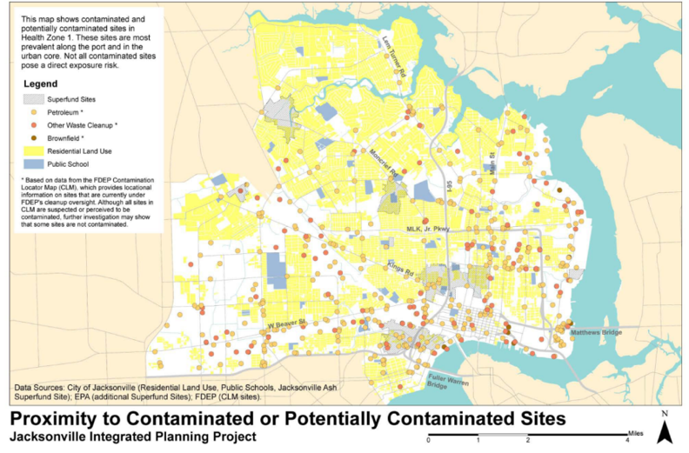
Why Healthfields?
Address Health Disparities and Provide Acess to Health & Healthcare in Underserved Communities
Health Zone 1, City of Jacksonville
Many Brownfields Communities Suffer Disproportionate Numbers of Health Disparities
Health Zone 1 has the highest rates of:
  Infant mortality
  Heart disease mortality
  Asthma-related emergency room visits
  Uncontrolled diabetes emergency room visits
  Need for fresh food and health care is paramount
  COVID 19 highlights the need to address health disparities
Gulf County Florida – North Port St. Joe
  Major Health Disparities throughout the County
** Information provided by SKEO Solutions

Slide 12

Why Healthfields Redevelopment ?
Disparities in Access are Common, Especially Among African Americans, Hispanics, and Low-Income Communities
Many Brownfields Communities
Suffer Disproportionate Numbers of
Health Disparities
High number of food deserts in
brownfields communities
Many environmentally overburdened communities of color
Lack of basic services – healthcare, dental, pharmacy, grocery
Provides an opportunity to quantify and remove contamination and replace with end uses that can reduce health disparities
Economic opportunities resulting from health-related redevelopment
“Your Zip Code Shouldn’t predict how long you live but it does.”
Improving Access to Health and Healthcare can assist in Addressing/Reducing Health Disparities
Notes:
11

Slide 13
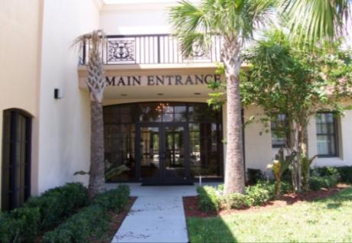
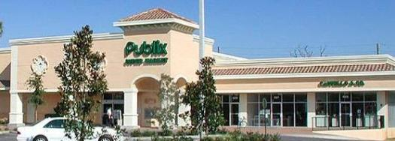

Healthfields Redevelopment Opportunities / Benefits
Healthy Housing
Healthcare
  Community-based health clinics
  Federally qualified health centers
  Hospitals
  Vision care
  Dental care
  Urgent care
  Health-related industry
Open-space / green-space
Access to healthy food choices to address
  Food desert issues
  Grocery
  Community gardens (on safe sites / safe practices)
  Farmers markets
  Healthy food choices
Health In the Built Environment

Slide 14

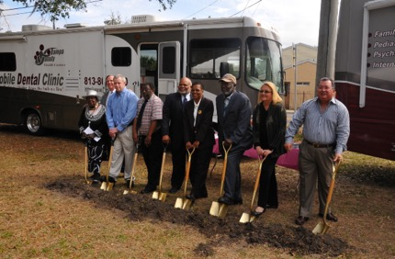
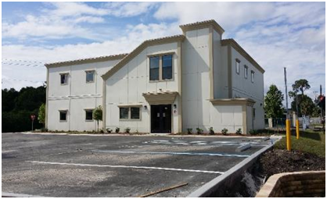
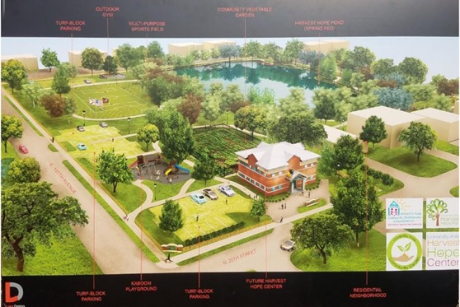
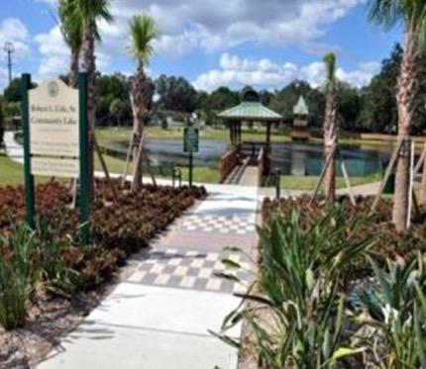
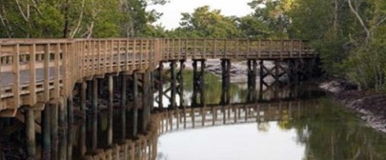
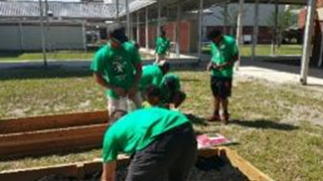
Florida Healthfields Success Stories

Slide 15
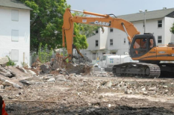
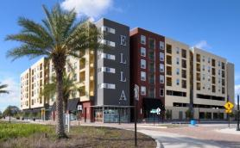
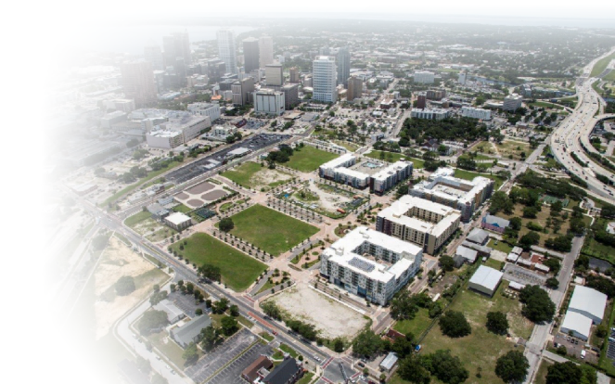
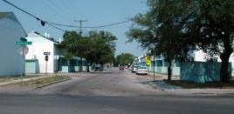
Encore Redevelopment -Tampa, FL
Healthy Housing and Major Economic Driver – Public Housing Brownfields Transformation
Challenges
  BOA & Tampa Housing Authority partnership
  on former “Central Park Village Housing Project”
  Asbestos abatement required
  Obsolete / sub-standard housing
Tools
  FDEP Brownfields designation
  Brownfields Building Materials Tax Refund
  VCTC Program eligible
  EPA $400,000 Multi-Purpose Site Specific Brownfields Grant
  ($28M NSP Grant), state (OTTED, LIHTC, etc.) & local grant funding
Results
  28 acre mixed-Use, TOD development in downtown Tampa
  1,200 multi-family residential units (700 affordable)
  60K SF of neighborhood commercial
  50K SF of office, 30K SF grocery, 200 hotel units
  Public gathering space, middle school
  Historic church revitalized as an African-American museum

Slide 16
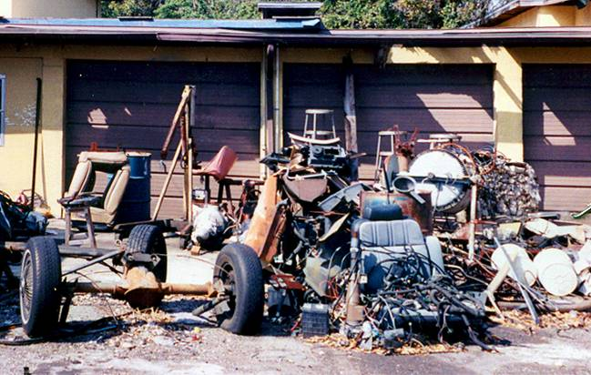
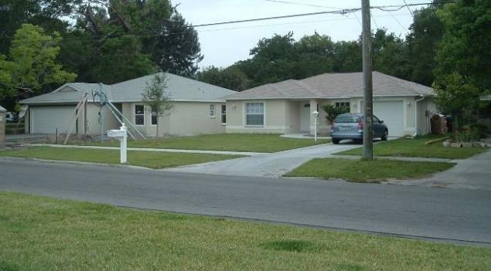
Pennsylvania Ave /Single Family Holmes - Clearwater, FL
Community Driven / Healthy Housing-Brownfields Transformation
Brownfields challenges
  Mini junkyard in residential neighborhood
  Inappropriate land use – junkyard in residential community
  Environmental injustice – junkyard next to infill housing
  Hazardous waste / petroleum / waste oil / arsenic in soil
Tools
  Clearwater Neighborhood Housing Services
  CDBG – demo / city liens
  State brownfields designation
  FDEP targeted site assessment
  Clearwater Neighborhood Housing Services – Deeded property after clean up
Brownfields transformation
  2 quality, affordable single-family units
  Install environmental justice
  Restore fabric of the neighborhood
    Consistent with other infill housing
Bunting Property – Mini Junkyard Next to Infill Housing
CNHS Housing – Clearwater, Florida

Slide 17
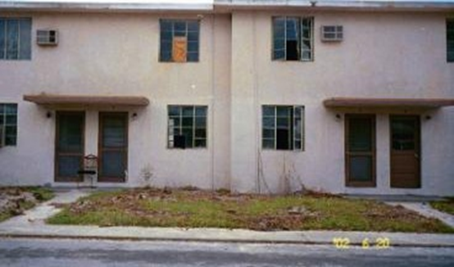
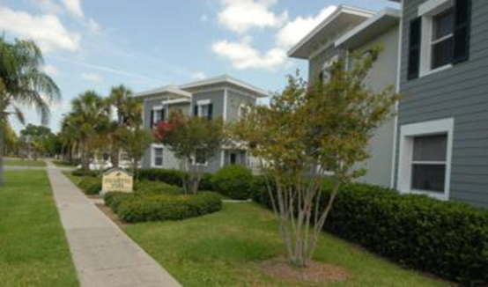
Greenwood to Palmetto Park Apartments - Clearwater, FL
Healthy Housing Project – Community Driven / Housing-Brownfields Transformation
Brownfields challenges
  Unhealthy Housing - Asbestos Lead Based Paint and IAQ Issues
  Slum Lord – Absentee Ownership
  High Crime – Hundreds of Police Responses
  Environmental injustice – Lead High Hazard Area, Transformer Stations, Multiple Bulk Fuel Facilities, Solid Waste Facilities, Incinerator, Junk Yards
  Economic Hardship – Rental of AC Units…
Tools
  Brownfields Assessment Grant – Asbestos and Lead Based Surveys
  Redevelopment Partnership - City of Clearwater Community Development, Bank of America CDC, Clearwater Neighborhood Housing Services
  $14.3 million public/private partnership.
  Local Partner Clearwater Neighborhood Housing Services trusted by the Community
Brownfields transformation
  192 Affordable Redeveloped Rental Units
  Removal of Asbestos and Lead Based Paint
  Beginning of North Greenwood Renaissance
  Reduction in Crime
Greenwood Apartments – Asbestos / Lead Based Paint and IAQ Issues
Palmetto Park / Greenwood Apartments
Clearwater, Florida

Slide 18

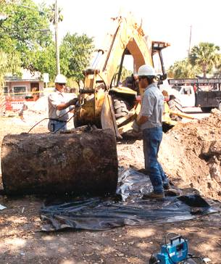
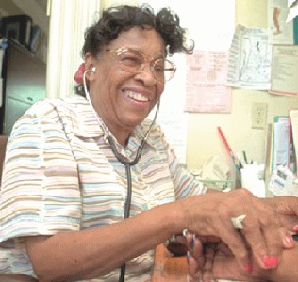
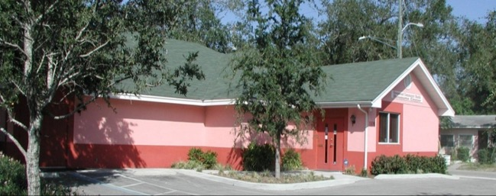
Willa Carson Health Resource Center - Clearwater, FL
Petroleum Brownfields Transformation to Public Health Success – Free Clinic (2001)
Challenges
  Lack of Trusted Healthcare
  Abandoned Gas Station Site in Heart of the Community
  Underground Storage Tanks
  Hydraulic Lifts
  Contaminated Soil
  Crime Hot Spot
  Contiguous Finding
Tools
  Ms. Willa Carson's Vision – North Greenwood Community
  Community / City and Legislative Partnership
  Florida Legislature Appropriations for Clean Up and Construction
  Tobacco Settlement Funds for Operation
  CDBG Funds for Acquisition
Results
  Community-based Free Clinic
  Walkable Health Care
Ms. Willa Carson the Pioneer of the Healthfields Movement
Willa Carson Health Resource Center – Clearwater, Florida
Community Partners
Willa Carson Health Resource Center
City of Clearwater Housing and Economic Development
Ms.
Notes:
17

Slide 19

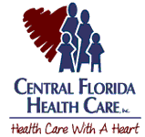
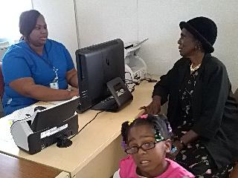
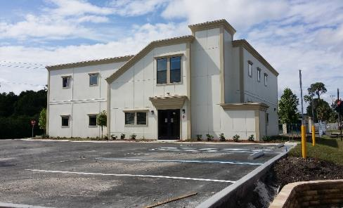
Central Florida Healthcare - Mulberry, FL
Brownfields to Public Health Success (2015)
Challenges
  Medically underserved community in Polk County, Florida to healthcare on brownfields sites
  Numerous abandoned petroleum sites and mined lands within the city
  Funding for assessment remediation and redevelopment
  Nearest hospitals or clinics 9.8 miles and 12.01 miles
Tools
  USDA community visioning
  CFRPC – Brownfields Assessment Grant
  Donation of city land
  HHS - HRSA Planning Grant
  EPA – Brownfields Assessment Grant – outreach, reuse
  planning, & Phase I & II ESA
  HHS – HRSA School-Based Grant
  HHS – HRSA New Access Point Results
Results
  Community-based healthcare in
  rural underserved community
Health Center Grand Opening 4/8/2015
Community Partners
Ann Claussen – Central Florida Health Care
Jennifer Codo-Salisbury – Central Florida Regional Planning Council
Rick Johnson – City of Mulberry

Slide 20

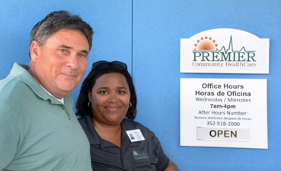
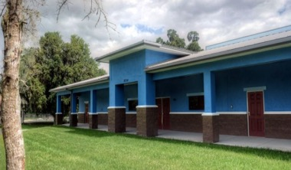
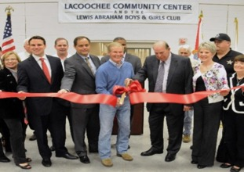
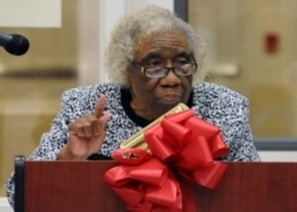
Lacoochee Community Center/Health Care Center - Pasco County, FL
Brownfields to Public Health Success (2015)
Challenges
  No access to healthcare
  Former borrow pit / sinkhole geology
  Former dump area
  Metals and petroleum contamination
  Environmental justice – highest concentration of Hispanic and African-American population
Tools
  Community partnership
  Withlacoochee Regional Electric Cooperative
  Nearly $2M in state appropriations and private funding
  Pasco County Brownfields Assessment Grant
    Phase I & II ESAs, geotechnical reports
  HRSA change in scope
  Health Impact Assessment – demonstrating need
Results
  12,800 sq. ft. building
  Premier Healthcare FQHC
  Nutrition and job training programs
  Gymnasium
  Boys & Girls Club
  Officer-friendly program in the center / violence prevention
  Public Housing Authority involvement
Community Partners
Melanie Kendrick – Pasco County
Cheryl A. Pollock – Premier Community HealthCare Group, Inc.
Sandra Whitehead – NACCHO
Health Center Grand Opening 3/25/2015

Slide 21
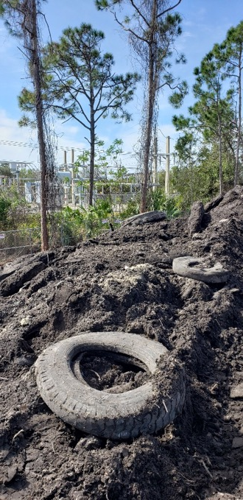


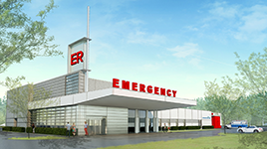
Advent Health 24 Hour Emergency Room - Port Orange, FL
Brownfields to Public Health Success (2020)
Challenges
  Large quantities of solid waste
  Large volume of impacted soils PAHs
  (Polyneculear Aromatic Hydrocarbons), arsenic
  Ability to make impacted site feasible for redevelopment
Tools
  Brownfields Site Rehabilitation Agreement
    Site Rehabilitation Tax Credit
    Solid Waste Tax Credit
    Health Care VCTC
    Liability Protections
    Brownfields Job Bonus Refund
    $17M Capital Investment – Advent Health
Proposed project
  18,400-square foot, 24-bed hospital-based
  emergency department
  40 full-time employees – New physicians and staff
  Trimly in light of COVID Situation

Slide 22
Successful Healthfields Projects Access to Fresh Food

Slide 23

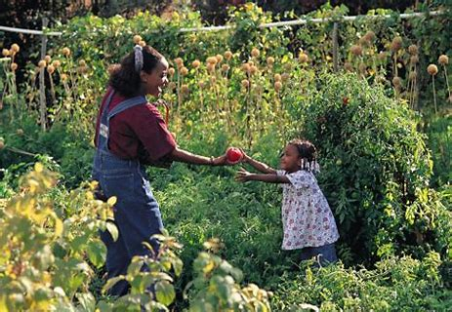
Why Healthfields?
Provide Fresh Foods to Combat Health Disparities
Low-income neighborhoods frequently lack full-service grocery stores and farmers’ markets where residents can buy a variety of fruits, vegetables, whole grains, and low-fat dairy products
Obesity is a risk factor for a variety of chronic conditions, including diabetes, hypertension, high cholesterol, stroke, heart disease, certain cancers, and arthritis.
....the more impoverished a neighborhood, the fewer the number of independent or chain supermarkets and the less access to fresh fruits, vegetables, low-fat milk, high-fiber foods, and other healthy meal and snack options.
“Many Brownfields Communities are low income and minority communities with lack of access to fresh food and healthcare and have properties that can be used to improve access to fresh foods .”

Slide 24
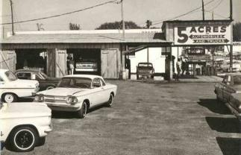
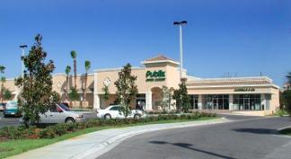
Harbor Oaks Shopping Center - Clearwater, FL
Healthfields Transformation – Improved Access to Fresh Food
Challenges
  Former Automobile Dealership for 45 Years
  Blighted Buildings
  Market Uncertainty – Third Time is the Charm
  Underground Storage Tanks
  17 Hydraulic Lifts
  Environmental Stigma
  Need for a Community Grocery Store
Tools
  State Brownfields Appropriation
  State Brownfields Loan Guarantee
  Developer Investment
Results
  44,287 sq. ft. Shopping Center
  125 New Jobs
  Catalyst for Infill Redevelopment
  $12,000,000 Capital Investment
  Catalytic Town Home and Commercial Developments
Community Partners
South Clearwater Citizens for Progressive Action
Diane Hufford – City of Clearwater
Jim White – White Development Company

Slide 25

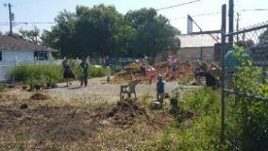

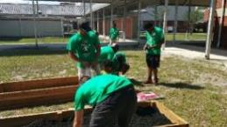
Northeast Florida Health Care – Health Zone 1, Jacksonville, FL
School-Based Community Gardens
Challenges
  Disproportionately high incidences of health issues
  Numerous Brownfield sites adjacent to residential areas including a Superfund site
  Lack of fresh food
  Healthcare access impacted by transportation / location of health care facilities
  Large, urban area – limited resources & support
Tools
  Designation as EPA EJ Showcase Community – increases visibility – focuses resources
  Grants, Public – private partnerships
  ATSDR $150,000 community health projects related to contamination at brownfield / land reuse sites
Results
  Potential fresh foods in desert area school-based gardens at
  7 schools
  Increased access to affordable healthcare through St. Vincent’s mobile health outreach
  Decrease in health disparities – increase in wellness
  Community market
Community Partners
St. Vincent's Mobile Health Outreach Ministry
Tina Anderson – East Side Environmental Council
Wynetta Wright / Ken Pinnix – East Side Environmental Council
Teena Anderson – School Farms & Urban Ag Initiative
Grazyna Pawlowicz – Duval County Health Department

Slide 26

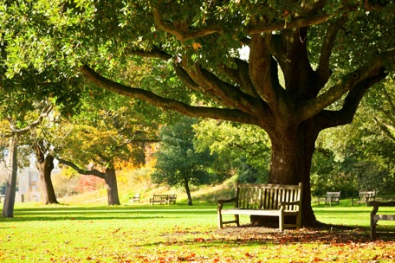
Open Space, Green Space, Recreation & Multipurpose Projects
Pasco County, FL
Brownfields Redevelopment Services

Slide 27
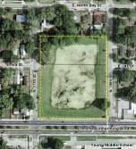
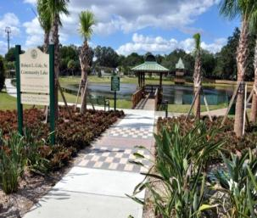
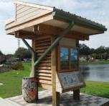
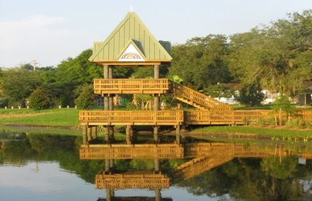
Robert L. Cole Community Lake & Park
Brownfields to Open Space Green Space (2009)
Challenges
  Former landfill site
  Need for community open / green-space
Tools
  Community support
    Project named after community legend, Robert L. Cole
  $1.1 tax increment funding
  (East Tampa Community Redevelopment Agency)
  Designs provided by University of South Florida
  School of Architecture
Results
  Multi-use community park / lake
  Opportunity for open / green space in underserved community
  Recreational opportunities
    Boardwalk, walking trail, exercise stations
  Observation tower, pier
  University of South Florida and local elementary schools partner on water quality research project
  Public art/culture – historic African-American quotes engraved in walking trail
Open Space / Green Space Address Health Issues through Opportunities for Physical Activity

Slide 28
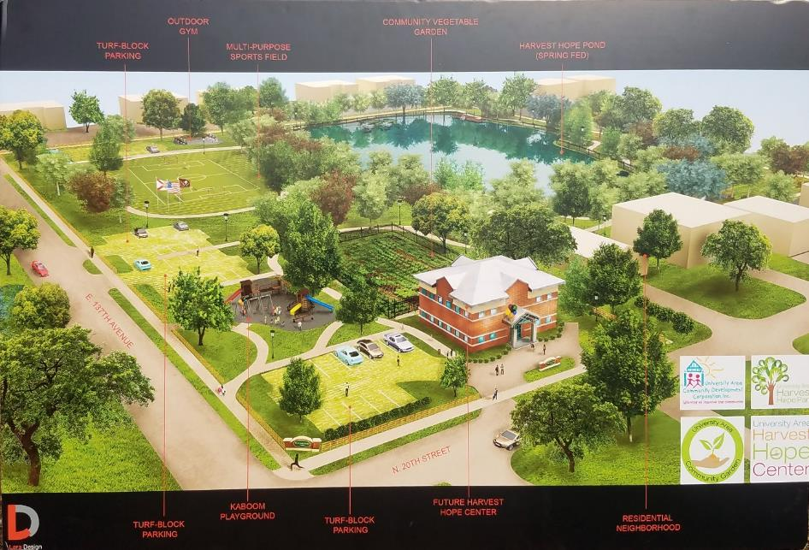

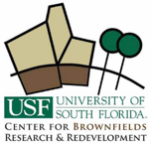

University Area CDC Harvest Hope Park - Hillsborough County, FL
Holistic Catalyst Project to Improve Community Health and Environment (2020)
Challenges
  Underserved community
  Obsolete unhealthy housing stock
  Multiple brownfields sites
  Lack of access to fresh food
  Lack of economic opportunities
  Need for recreational opportunities
Tools
  $300,000 EPA Community Wide Assessment Grant
  $200,000 EPA Brownfields Planning Grant
  UACDC – Amazing work >>>>>>>
  Strong community partnerships
Results
  Community garden and fresh food kitchen
  Proposed – healthy and attainable housing
  Increased access to health care =
  increased access to economic activities
  attainable and 125 new jobs
  Catalyst for infill redevelopment
Key Partners
University of South Florida
Florida Brownfields Association
University Area Community Development Corporation
Mort Elementary School
Environmental Protection Commission of Hillsborough County
Florida Department of Health-Hillsborough County
Hillsborough County Economic Development
Hillsborough County City-County Planning Commission
Vistra
BGW Associates

Slide 29






Northwest Fire Station #51- Clearwater, FL
Brownfields Transformation (Junkyard to Public Safety - Fire Station) – 2004
Former Junkyard
Contaminated Site
Demolition & Remediation
Redevelopment
A Healthfields Project that Save Lives !

Slide 30

Conclusion
Healthfields redevelopment projects can result in potential opportunities to improve health and healthcare, install environmental justice and health equity, and promote economic development in underserved communities.
“Healthfields – Reducing Health Disparities through Redevelopment”

Slide 31

How Can Cardno Help ?
Environmental Services
  Brownfields Redevelopment Consulting
  Environmental Assessment & Remediation
  Grant Writing & Incentives Management
  Ecological Restoration
  Risk-based Closure Strategies
  Industrial Hygiene & Building Sciences
  Lead, Asbestos, Mold Assessments
  & Abatement
  Site-specific Ecological Risk Assessment
  & Incident Response
  Environmental Regulatory Support,
  Permitting & Compliance
  UST Management, Removal & Remediation
  Emergency Response, Spill Prevention
Engineering Services
  Roadway/Bridge Design
  Traffic & Safety
  Planning & Landscape
  Architecture
  Right of Way
  Asset Management
  Construction Management
  Geological Logging Systems
  Site Development
  Water Resource Engineering
  Wastewater/Water Infrastructure

Slide 32
Contact:
Miles Ballogg
Senior Principal
Brownfields & Economic Development Practice Leader
Cardno
727.423.1587
miles.ballogg@cardno.com

