Slide 1
Conversations with your Finance and Administrative teams to help meet CDBG, HOME, and SHIP expenditure deadlines
Presenter: Brenda L. Brackins
Hillsborough County Board of County Commissioners
Affordable Housing Services Director
48th Annual Florida Community Development Association (FCDA) Conference
May 1, 2024
Notes:
Good morning. For weeks now, I’d been looking forward to coming to Jensen Beach, enjoying the conference, networking, and relaxing. As I was about to pack my car yesterday to head this way, I received a call from Cheryl Howell and Felicia Crosby-Rucker at 6:57 a.m. They told me that a presenter was not going to be able to make it and wanted to know if I would present. I just knew that it was an early morning prank. Well, guess what … it wasn’t! My name is Brenda L. Brackins, and I’m the Affordable Housing Director for Hillsborough County. Prior to forcing the right side of my brain to work so hard, I was responsible for the finances and managed the grants. Today is my 32nd year Anniversary being in County Government … and yes, I started when I was 5. They didn’t have child labor laws back then. Of those 32 years, 23 of them have been in Budget, Finance, and Grant Management.
Thank you for joining us today to talk about what you can do to ensure that we are meeting deadlines and requirements.
I’d like to do a quick survey to see who our audience is today.
Please raise your hand if:
You are new to the field, less than one (1) year?
1-5 years?
5-10 years?
More than 10 years?
Raise your hand if you primarily work in:
Finances and/or Grant Management?
Planning?
Contacts?
Procurement?
Compliance?
Legal?
Thank you for participating

Slide 2
Keys to Managing Grants
Planning
Tracking Systems
Effective Communication – Everyone must understand their role and the importance of effective communication
Having staff member(s) dedicated to Finance essential
Finance must talk to managers
Team members must keep their managers informed on the status of projects
Managers must communicate with the partners
Information must be provided to supporting departments such and Budget, Legal, and Procurement
Notes:
When managing these grants, planning and keeping a good tracking system will help you to remain on track. But the main thing that we MUST have is communication. Effective communication is key and very crucial in every relationship that you have, especially your working relationships.
Therefore, it’s imperative that Finance talk to managers;
Team members keep their managers informed;
Managers communicate with the partners;
Managers provide information to supporting departments, such as Budget, Legal and Procurement.
It’s also very important that managers, team members, and partners understand their role and the part that they play in keeping the projects moving. Periodic meetings on the status of projects are also helpful in spending the funds in a timely manner.

Slide 3
Tracking Systems
Implement a system to track your grants and projects
Utilize the tools that have been provided to you (don’t reinvent the wheel)
HUD’s Information Disbursement & Information System (IDIS) Reports examples:
List of Activities (PR 02)
Timeliness Report (PR 56)
SHIP Tracking Sheets
Go to Florida Housing Finance Corporation's website
Log in and go to “Annual Reports” tab
The TRAKSHIP Form is on the “References” tab
Notes:
For you to share with managers and team members a plan of action or a road map to follow, you must plan and have a system to track your spending, or lack of spending. You have to utilize the tools and reports that are provided to you, but you also must find ways to enhance those tools to make it work for you and your organization. We have different models, different software, and we just do things differently.
There are a lot of shared reports in IDIS that you can you use to help you and your entire team stay on target. And I don’t know what staff would do without the older version of SHIP Tracking Sheets. I strongly encourage you to use them along with the SHIP AR Data Upload Excel workbook that is used to upload your data.
Always use the most up-to-date spreadsheet, and they can be found on Florida Housing Finance Corporation’s website. When you log in, go to the “Annual Reporting” tab; then click on “Reference” and you will find the SHIP AR Data Upload Excel workbook.
My first introduction to SHIP was being handed a huge file of reports printed on greenbar and a lot of receipts. Many employees were laid off because they had “run out of SHIP Admin money”. The agency that I worked for at the time did not use SHIP Tracking Sheets. Instead, strategies were split between managers and they were responsible for spending the funds, but no one kept track of the program income.
Who remembers what happened in 2006-2007? Yeap, the housing bubble, where housing prices peaked. So, you had a lot of clients that had received assistance that sold or refinanced their homes. We had millions of dollars of unaccounted for Program Income that had not been reported to the state, but 5% of that income could have saved a lot of jobs. Staff was spending the allocation, but the Program Income was being sent directly to the Finance and deposited, and no one was tracking it.
I was new to SHIP and the tracking sheets, and I got to know them very intimately. Not only did I start using the SHIP Tracking Sheets, but I enhanced them so that we stayed in compliance.

Slide 4
Timeliness (HUD)
Compliance with the regulatory requirement to spend program funds in a timely manner
HUD calculates the ratio of unexpended funds to the annual grant award 60 days prior to the end of the program year
Program Income plus Funds in CDBG line of credit divided by
Amount of the Annual Grant Award = Ratio of unexpended funds
Ratio < 1.5 = TIMELY
Ratio > 1.5 = UNTIIMELY
Notes:
Let’s look at your federal grants and how you can take the information from the reports in IDIS to help you meet compliance requirements.
Are we all familiar with “timeliness”? For those that are new and may not know what timeliness means and how important it is to your organization, it is the compliance with the regulatory requirement to spend program funds in a timely manner. HUD calculates ratio of unexpended funds to the annual grant award 60 days prior to the end of the program year.
Basically, it’s a formula, where you have Program Income + Funds in CDBG line of credit; divided by the amount of the annual grant award. When I say CDBG line of credit, I’m talking about unspent funds from prior years and any funds that are not spent for the current grant year
If the ratio is less than or equal to 1.5 times the grant amount, then the grantee has met the timeliness requirement.
If the ratio is more than 1.5, the grantee is considered untimely.

Slide 5
CDBG Timeliness Report (PR 56)
Notes:
Often grantees don’t factor in Program Income and will be misled into thinking that they are going to be timely. HUD makes it easy for you. As long as your draws are up to date and you have entered your program income accurately, you can run a PR 56 to determine timeliness. Look under the adjusted column to get your Draw ratio to determine timeliness. In order for your calculations to be accurate, you must enter your Program Income, because you don’t want to be misled into believing that you’re going to meet timeliness.
Many grantees will have issues with meeting timeliness because they are not monitoring the projects that have not been funded, but at the same time, you don’t want to take all of your projects from your Action Plan and fund them in IDIS prematurely.
You want to make sure that your Environmentals are completed, that you have a contract in place, etc., but you also want to keep in mind that when you fund a project in IDIS, the clock starts ticking. If those projects don’t have activity for a certain period of time, you will get notifications, where you have to report on the status of the project.
Hopefully, you have always been timely. For those that have not, you may be familiar with the steps that are taken to help you get back on track. HUD will send Finding of Non Compliance letters, you have to submit Workout Plans, and HUD will eventually reduce your funding.

Slide 6
Summary of Plan Years Spreadsheet
Balances to List of Activities Report (PR 02)
Summary of activity status , activity drawdown information, and balances
Allows grantee to determine the progress of an activity, monitor the amount of funds that are funded and drawn for an activity
Ensure that activities are being completed in a timely manner
Does not include projects that have not been funded
Do not fund ineligible projects (Ex: Environmental Review Record not complete)
Keep in mind that time starts for activity once funded in IDIS
Notes:
You can use the PR 02 (List of Activities Report) to create a working document that summarizes the plan years. The PR 02 will show you the amount that has been funded in IDIS, the amount drawn, and the balance that has not been drawn on the project. The PR 02 will not show any projects that have not been funded in IDIS.
A summary such as this will allow grantees to determine the progress of an activity, monitor the amount of funds that are funded and drawn for an activity, and help you ensure that projects are being completed in a timely manner.

Slide 7
Summary of Plan Years
Including Program Income
Notes:
This is an example of what I meant by taking a tool that has been provided and enhancing it. If you incorporate your entitlements, you can use this spreadsheet to keep track of the balance of projects and know how much you have unfunded. I like this format because it allows me to see when the same activity is funded annually or if projects are funded in phases. Basically, it gives you a snapshot of the projects that are in IDIS
(Elaborate on Spreadsheet)
You will need to update this spreadsheet every time that you draw down funds.

Slide 8
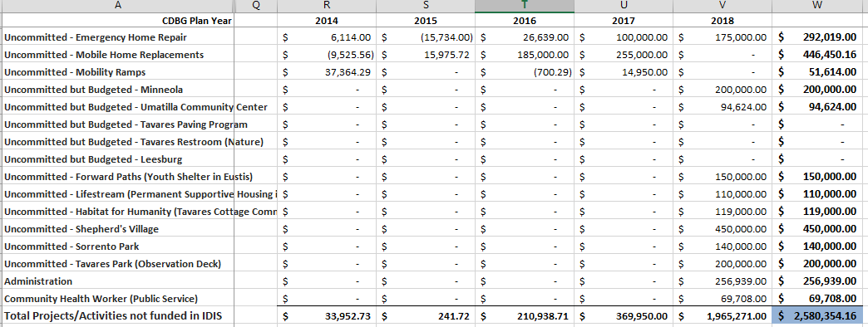
Summary of Plan Years
Amount Available to Commit
Notes:
From there you take the amount that is available to commit, which ties back to the PR 01 in IDIS and you make a list of projects that are you in your Action Plan or a planned amendment and track how you plan to spend those funds

Slide 9
SHIP Encumbrance and Expenditure deadlines
SHIP PROGRAM YEAR | ENCUMBRANCE DEADLINE | EXPENDITURE DEADLINE
21/22 Funds | Encumbered by 06/30/23 | Expended by 06/30/24
22/23 Funds | Encumbered by 06/30/24 | Expended by 06/30/25
23/24 Funds | Encumbered by 06/30/25 | Expended by 06/30/26
24/25 Funds | Encumbered by 06/30/26 | Expended by 06/30/27
Notes:
Although the state does not have a formula for timeliness for SHIP, you do have encumbrance and expenditure deadlines that you must meet in order to stay in compliance.

Slide 10
Tracking of SHIP Program funds
Understand your Statutory set asides
Execute a contract with a partner(s) that can meet your 20% Special Needs set aside
Set a cap on the amount that can be spent on rental activities
Update SHIP Tracking sheets on a regular basis
Reconcile SHIP Tracking sheet to cash in the fund
Utilize the SHIP Tracking sheets that have been provided by the state
Notes:
There are some things that you can do to help you meet these deadlines and complete your SHIP Tracking Sheets:
Understand your statutory set asides
Special Needs – 20%
Construction – 75%
Home ownership – 65%
Very Low Income – 30% [up to 50% of the Area Median Income (AMI)]
Low Income – 30% [up to 80% of the Area Median Income (AMI)]
Remaining funds may be reserved for households 121-140% percent of Area Median Income (AMI)
Maximum of 10% on Allocation on Administrative Expenses (5% on Program Income)
Execute a contract with a partner that can meet your Special Needs set aside (20% of Allocation and Program Income)
Special Needs Special Needs Definition “Person with special needs” means: • an adult person requiring independent living services in order to maintain housing or develop independent living skills and who has a disabling condition; • a young adult formerly in foster care who is eligible for services
If you provide direct services, make sure that you have enough Special Needs clients on your waiting list in the event that you need to pull some of them off the list.
Set a cap on the amount that can be spent on rental activities. Since your Homeownership set aside is 65%; and you can use up to 10% on Admin, then you know that you can’t spend more than 25% on rental activities. One of the challenges that you can run into with SHIP is that developers will request a large amount, and that’s good when they are providing multi-family units, but you can’t go over your 25%

Slide 11
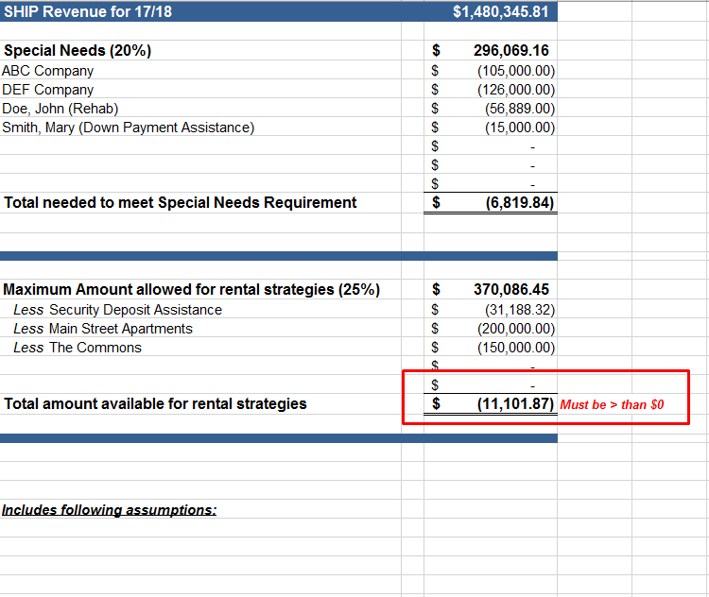
Special Needs and Rental Strategy
Tab added to SHIP Tracking Sheets and linked to Summary Tab
Notes:
Here is an example of a sheet that I keep in my SHIP Tracking Sheets that I use to help me with my set asides. (Elaborate on spreadsheet)
There is a section on compliance at the bottom of Summary tab, but most of those calculations are for expended funds, which does not really help you when you are in the planning stage and trying to project out how you will spend the funds.

Slide 12
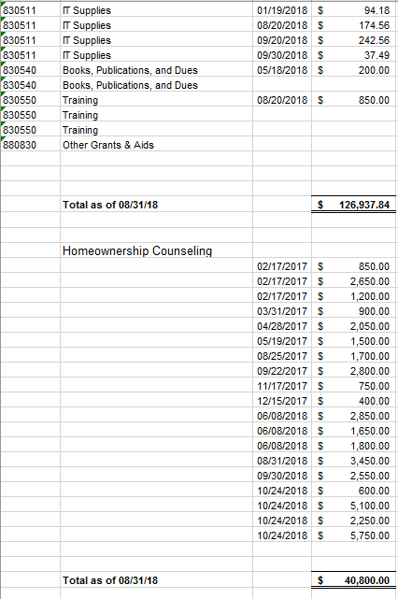
Administrative Expenses
Tab added to SHIP Tracking Sheets and linked to Summary Tab
Notes:
This is a tab that I added to track Admin Expenses and Homeownership Counseling (in the years that you receive it)
There is a link from this sheet to the Summary tab so that I can always see the amount allowed, less what expended to get the amount the balance of Admin funds.

Slide 13
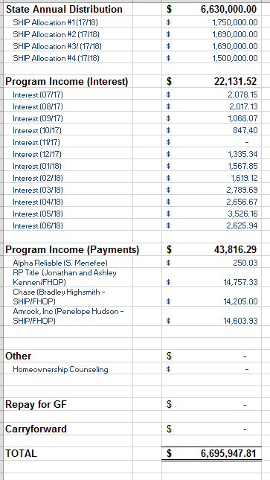
Revenues
Tab added to SHIP Tracking Sheets and linked to Summary Tab
Notes:
I use this sheet to track Revenues (the disbursements, Interest, and payments). Again, there is a link from this sheet to the Summary tab on the SHIP Tracking sheets so that I’m not hard keying numbers in, and I always have backup as to where the numbers are coming from.

Slide 14
SHIP AR Data Upload Excel workbook
Notes:
If you have every completed an Annual Report back when you had to enter the data, you know how time consuming it is to enter the client’s data and demographics. Florida Housing has a spreadsheet that you can import directly into the reporting tool.
It was a game changer when it came to saving time entering the data, but it does not keep all the pertinent information that is in the SHIP Tracking sheets. Since you will need the additional information, it’s best to keep both spreadsheets.
I require staff to use the SHIP Tracking Sheets as “working documents” until it’s time to start preparing the Annual Report since there are times that you may need to move files from one year to another. Once you have a final SHIP Tracking Sheet, then you can copy the information into the SHIP AR Data Upload spreadsheet.

Slide 15
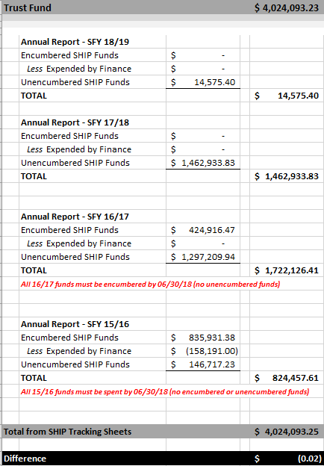
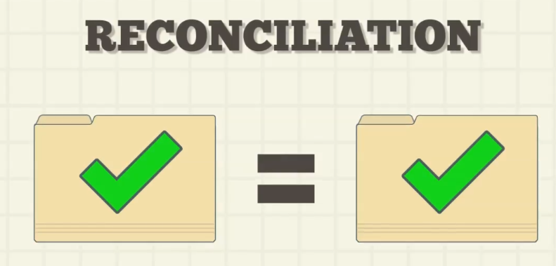
Reconciliation of SHIP Funds
Should be done monthly (after month closes)
Should balance to SHIP Tracking Sheets
Notes:
You should reconcile your SHIP Tracking sheets on a regular basis (at least monthly) so that you can monitor income levels to ensure that you will meet those set asides Since you typically have 3 years of SHIP funds open at one time. SHIP expenses are not reimbursed, but disbursed on a schedule, it’s always good to reconcile SHIP Tracking Sheets to the amount of cash that you have in your funds. This will ensure that you are accurately accounting for your program income Many times payments will be posted to your GL that you are not aware of (when payments are sent directly to your comptroller or finance department, etc.) and you want to keep track of these funds
(Elaborate on spreadsheet)
I receive this from person that provided Technical Assistance and Auditors love it. It shows how to account for all of your SHIP dollars, especially if you have all of your SHIP dollars in one fund.
Provide it to managers as a planning tool.

Slide 16
Begins with Planning
Award Projects that will happen on time
Solicit and select projects, where there is a “need” and that are ready to proceed
Review the partner’s track records and how they have been performed in the past
Begin award process between funds are awarded so that projects are ready once the funds are received
Divide large projects in phases instead of setting money aside and tying up funds that may run into issues or be delayed
Anticipate Program Income and include it in the planning (Program Income must be spent before grant funds)
If your organization allows, have a list of activities that are easy to implement in case projects fall behind, are delayed, or unexpected program income are received
Notes:
Those are some tips to help you with the tracking, here are some things that can be beneficial to everyone
Plan wisely
Begins with planning
Award projects that will happen on time.
Solicit and select projects that have need and are ready to proceed. This can be addressed in your RFP
Review partner’s track records and how they have performed in the past
Begin award process before funds are awarded so that projects are ready once the funds are received
Divide large projects in phases instead of setting money aside and tying the funds up in the event of delay
Anticipate program income receipts and include in activity planning (PI must be spent before grant funds)
Have a list of activities that are easy to implement in case projects fall behind, are delayed, or unexpected program income are received (Example: Emergency Home Repair)

Slide 17
Set clear expectations for performance
Meet with partners regularly
Have process in place so that contracts can be executed quickly and efficiently
Layout expectations for reporting and accountability in your contracts
Describe actions if partners fail to achieve performance goals
Explain how past performance will have impacts on future funding decisions
Provide sample RFPs, contracts, administrative plans, and sample file documentation
Share tips and best practices to help partners administer their activities efficiently
Pay attention to new partners and those that have had problems implementing their activities in the past
Make sure that your elected officials and senior management understand the consequences of not being in compliance
Notes:
Set clear expectations for performance
Meet with partners regularly to get status and explain the importance of timely performance and how their spending contributes to overall performance
Set up administrative systems so that once you make awards, contracts can be executed quickly and efficiently.
Layout expectations for reporting and accountability in your contacts.
Ensure that contracts details, performance timelines, interim milestones, and the number of expected beneficiaries or other measures of impacts are included in your contracts
Be sure to describe the actions that you may take if the partner does not achieve performance goals. May include:
Providing technical assistance on grant administration and project management
Possible reductions in current funding if it can’t be expended
Explain that past performance will have impacts on future funding decisions.
Provide sample RFPs, contracts, administrative plans, and sample file documentation.
Share tips and best practices to help partners administer their activities efficiently.
Pay special attention to new partners and those that have had problems implementing their activities in the past.
Make sure that your elected officials, leaders, and upper management understand the consequences of not being in compliance.

Slide 18
Monitor project implementation and spending
Have systems in place to track spending and performance
Run IDIS reports, such as PR 02 and PR 56
Track Program Income and Enter in IDIS
Report spending issues at staff meetings
Develop expenditure schedules and review them with the partners; follow-up
Require that partners submit invoices in a timely manner
Identify partners that may be at risk of low performance (Provide technical assistance as soon as possible)
Notes:
Monitor project implementation and spending
Once contracts are awarded, have systems in place to track spending and performance.
Run IDIS reports, such as PR56, which shows timeliness
Must track and enter Program Income in IDIS
Report on spending issues at staff meetings
Develop expenditure schedules and review them with partners and follow up.
Require that partners submit invoices in a timely manner
Identify partners that may be at risk of low performance and keep your eye on their progress (Provide technical assistance as soon as possible)
In my experience, I have learned to reach and ask for help when it’s needed. You can contact other agencies. I’ve even gone to shadow other that are successful in meeting their deadlines. I may not have implemented what they did, but I got a lot good ideas and tips. As always, if you need help, contact your local field office.
Again, thank you for joining us today and I hope that something was said, or a tip was given that you can take back to your agency to help you with your process.

Slide 20
Brenda L. Brackins, Director Hillsborough County Board of County Commissioners Affordable Housing Services
Office: 813.274.6732
Cell: 813.538.3000
Email: brackinsb@hcfl.gov
Notes:
Here is my contact information. Please don’t hesitate to contact me if you would think of something later or would like to discuss anything that I’ve shared.

