Slide 1
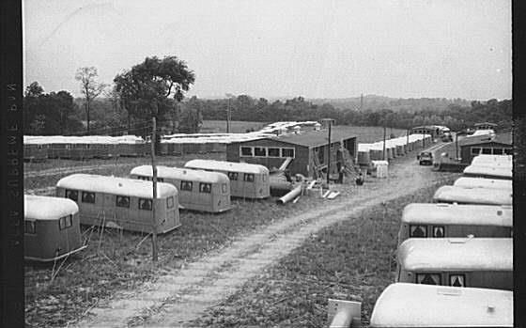
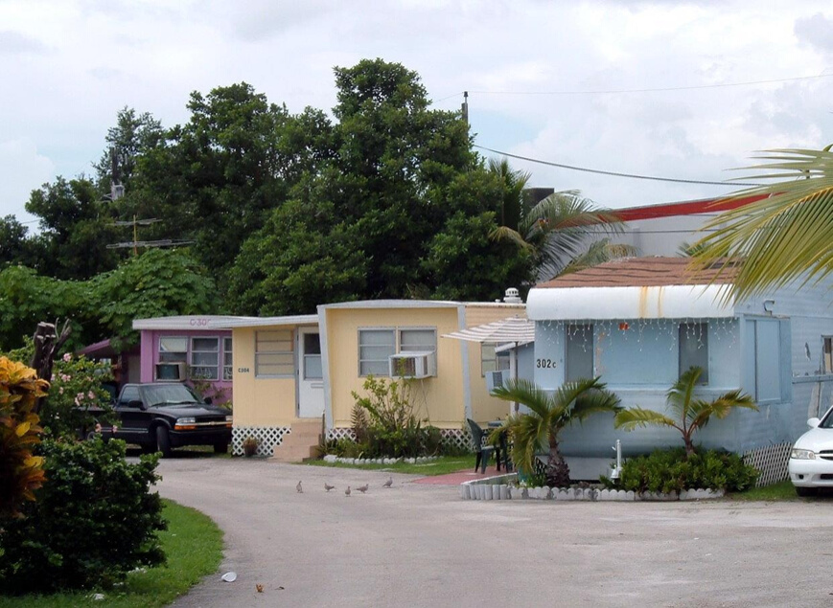
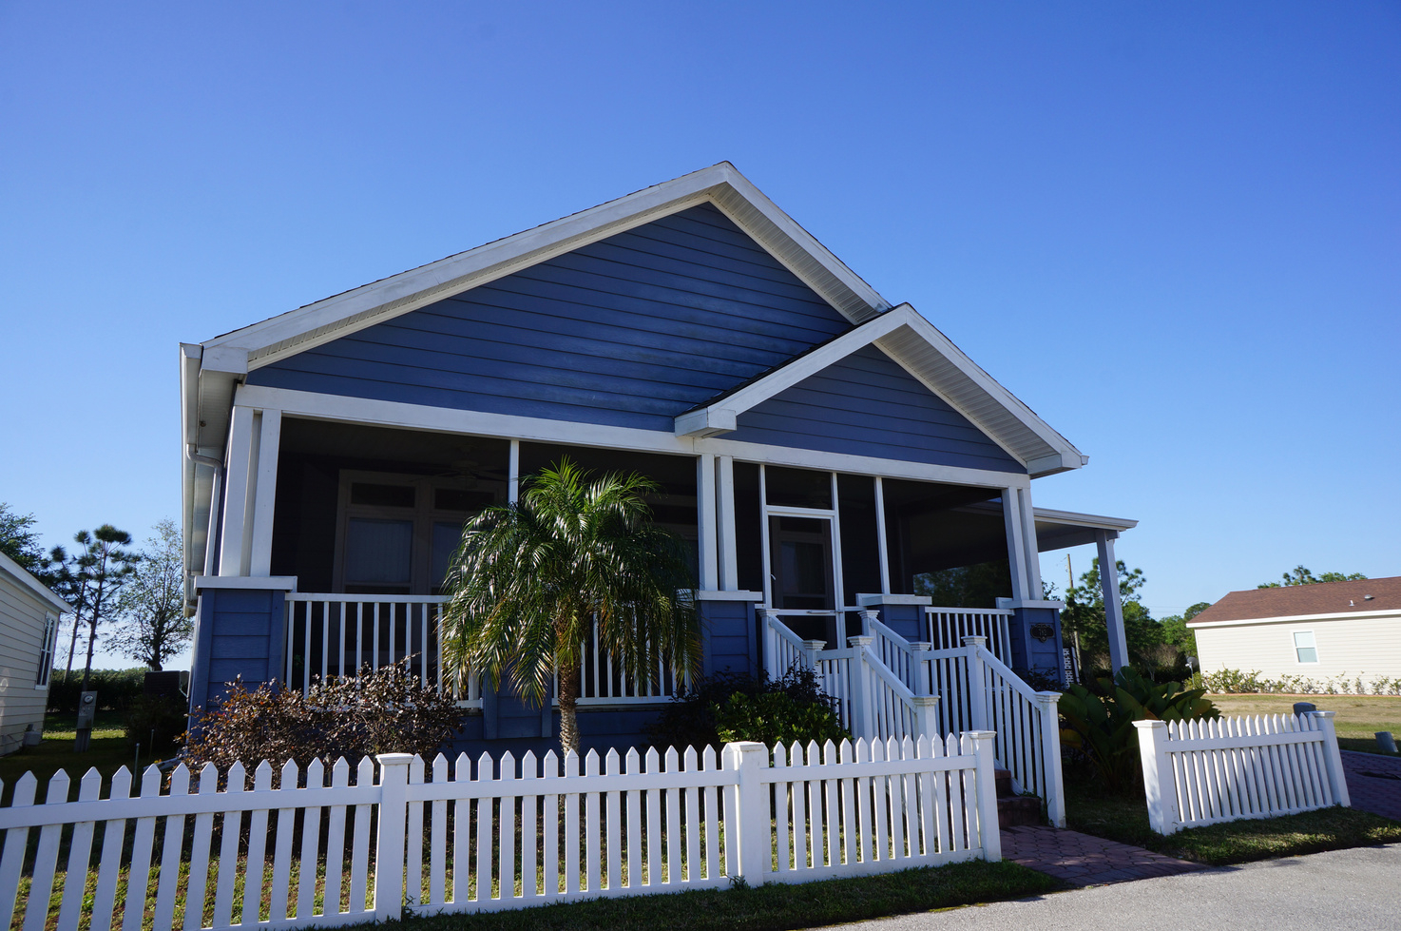
Florida Community Development Association Annual Conference
September 20, 2023
Evolution of Factory-Built Housing

Slide 2
1970 Dodge Dart Swinger

Slide 3
2020 Acura MDX

Slide 4
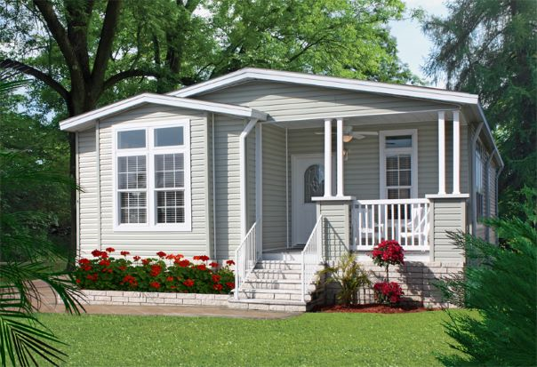
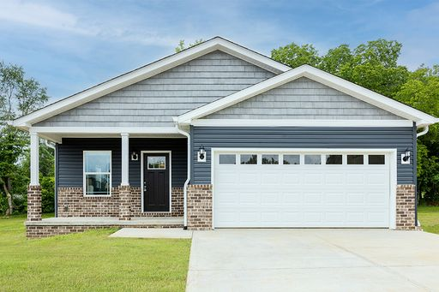
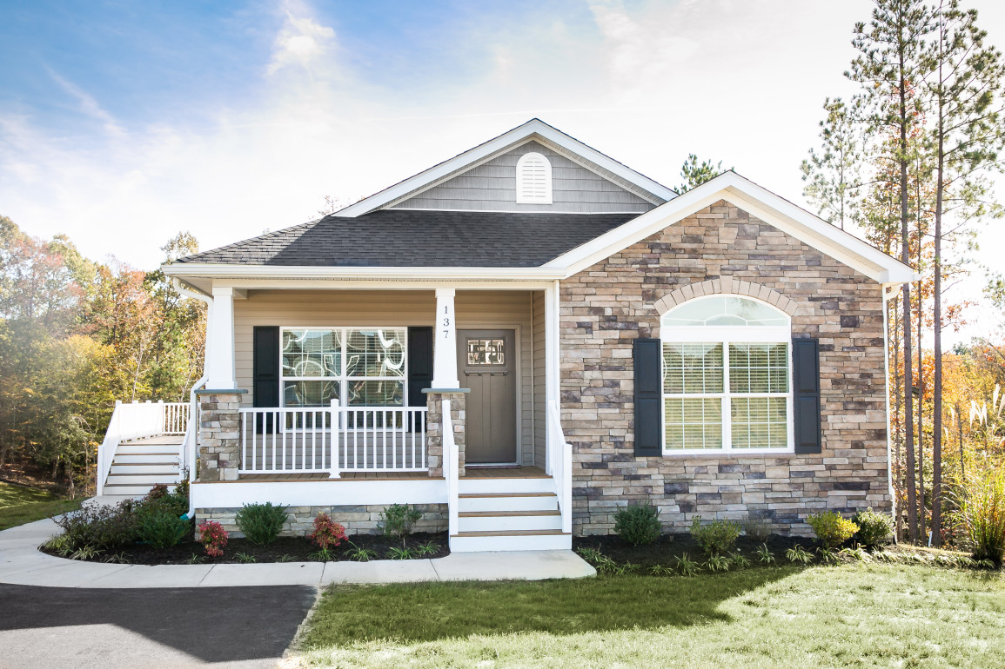
Manufactured Home: Built in compliance with the Federal Manufactured Home Construction and Safety Standards (Title 24, CFR, Part 3280 and 3282). HUD has delegated responsibility for the administration and enforcement of the federal program to the State of Florida. FLHSMV is the industry’s regulator and oversees home construction, sales, installation and repair and remodeling of mobile and manufactured homes under Chapter 320.8232 and 320.8245, F.S.
CrossMod® Home: Contains many features of a high-end manufactured home or a custom site-built home, but is built to the federal manufactured home code. CrossMod® homes meeting the requirements of the Fannie Mae MH Advantage® and the Freddie Mac CHOICEHome® programs are eligible for 30-year conventional mortgage financing.
Modular Home (Manufactured Building): Built to the Florida Building Code (Chapter 553.35-42, F.S.) and regulated by the Florida Building Commission at the Department of Business and Professional Regulation (DBPR).

Slide 5
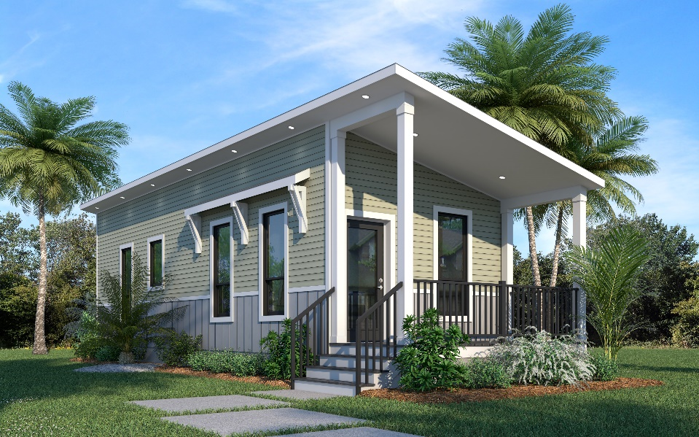
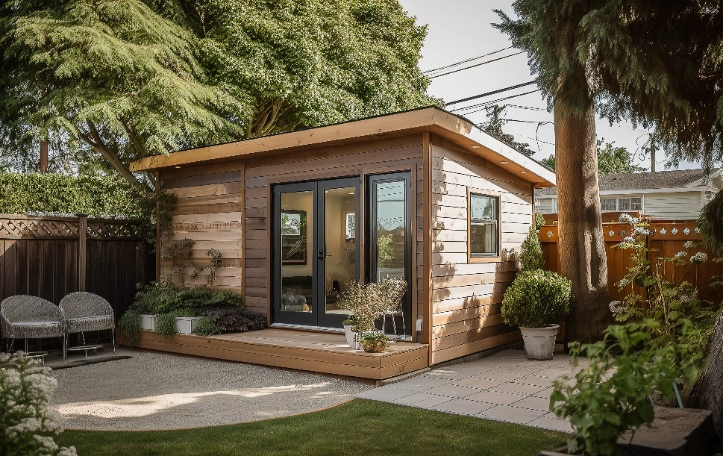
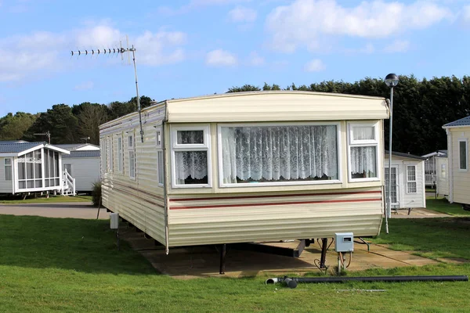
Accessory Dwelling Unit (ADU): An ancillary or secondary living unit that has a separate kitchen, bathroom, and sleeping area within the same structure, or the same lot, as the primary dwelling unit. An ADU is intended for year-round living and should be built to the federal HUD Manufactured Home Construction and Safety Standards or a recognized state or local building code, such as the Florida Building Code.
Tiny Home: A dwelling that is 400 square feet or less in floor area excluding lofts. A Tiny Home on a foundation is a dwelling unit and must comply with the requirements of Florida Building Code (Appendix Q). A Moveable Tiny Home (MTH) is designed and intended for seasonal or temporary living and is a recreational vehicle. An MTH is not a dwelling unit. A Tiny Home can be an ADU if built to a recognized building code.
Mobile Home: A predecessor of today’s manufactured home. Oficially, the name changed following the implementation of the HUD code requirements in 1976. Many people still use the term even though the mobile home of yesteryear bears little resemblance to the manufactured home of today.

Slide 6
Questions?
CONTACT: Jim Ayotte, CAE
CEO, FMHA
JAYOTTE@FMHA.ORG
MyFloridaManufacturedHome.com
850-907-9111

