Slide 1
Introduction to IDIS
CDBG & HOME
Presented by Erich Chatham, Civitas LLC

Slide 2
Agenda
Introduction to IDIS Modules
Setting up CDBG Activities
Adding CDBG Accomplishments
Setting up HOME Activities
Adding HOME Accomplishments
Funding Module
Reports Module
Questions

Slide 3
Introduction to IDIS Modules
Basic Components of IDIS are:
Grants, Subfunds, and Subgrants
Consolidated Plan/Annual Action Plan
Projects
Activity Setup
Activity Funding
Receipts
Drawdowns
Accomplishment Reporting
Reports
Security and Data Access
CDBG, HOME, ESG, HOPWA, and the Recovery Act programs all use the same screens to add a new activity, access an existing activity for update, copy an activity, and reopen a completed or canceled activity.

Slide 4
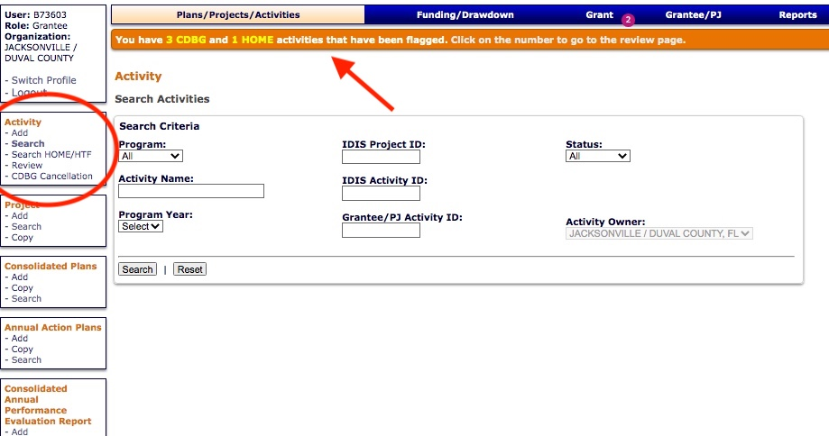
Setting up CDBG Activities

Slide 5
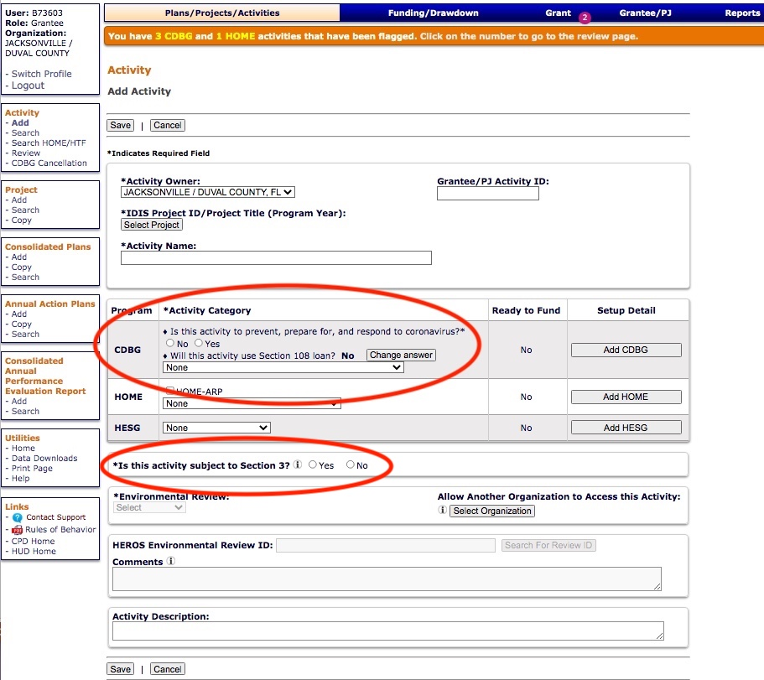
Setting up CDBG Activities
Add Activity:
Determine:
CDBG Matrix Code and
Section 3 requirement
Environmental Review

Slide 6
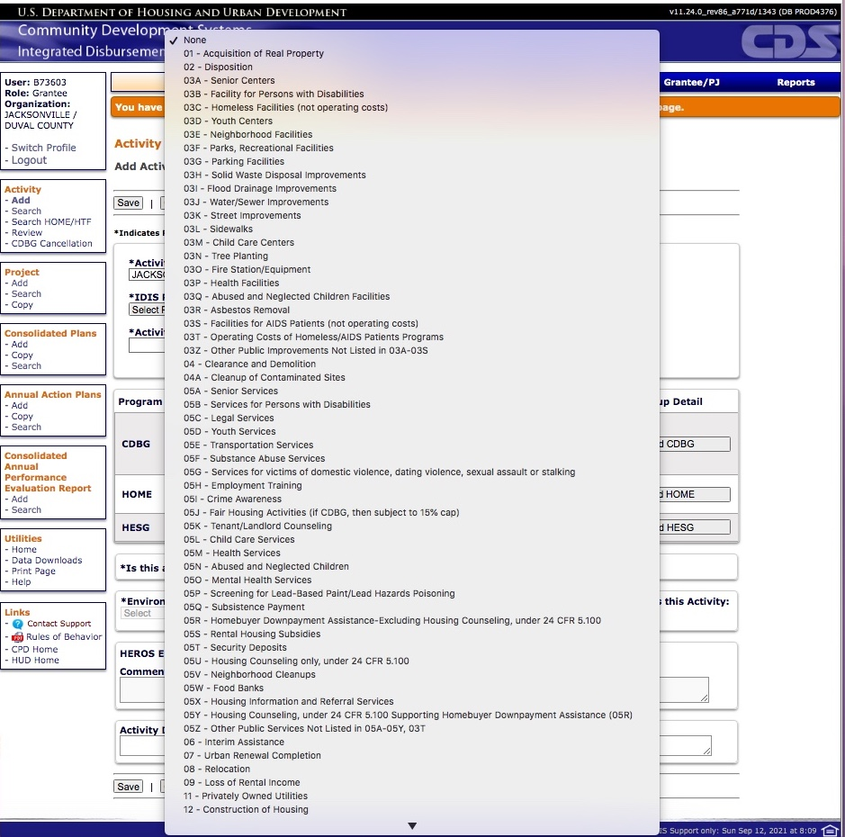
Setting up CDBG Activities
Edit Activity Screen:
Select CDBG Matrix Code by Activity Type

Slide 7
Setting up CDBG Activities
EXAMPLE: CDBG Matrix Codes
03K Street Improvements
03L Sidewalks
03M Child Care Centers
03N Tree Planting
03O Fire Stations/Equipment
03P Health Facilities
05A Senior Services
05B Services for Persons with Disabilities
05C Legal Services
05D Youth Services
05E Transportation Services
14A Rehabilitation; Single-Unit Residential
14B Rehabilitation: Multi-Unit Residential
03A Senior Center
03B Facilities for Persons with Disabilities
03C Homeless Facilities (not operating costs)
03D Youth Centers
03E Neighborhood Facilities
03F Parks, Recreational Facilities
03G Parking Facilities
03H Solid Waste Disposal Improvements
03I Flood Drainage Improvements
03J Water/Sewer Improvements

Slide 8
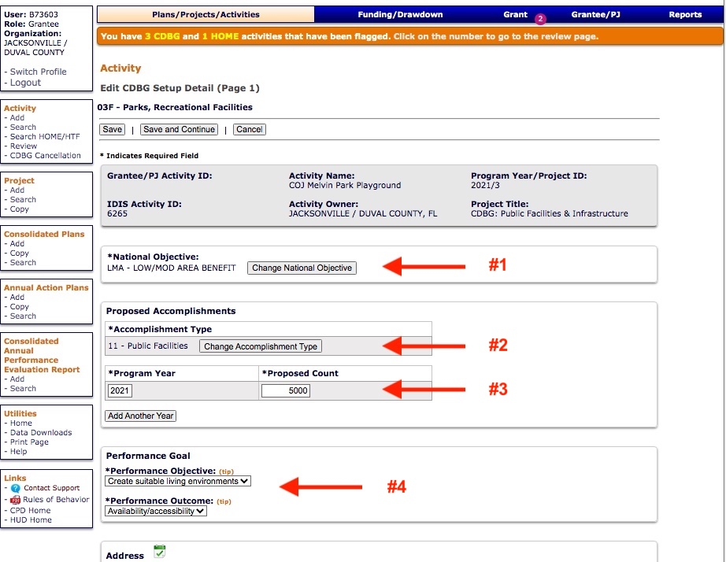
Setting up CDBG Activities
Edit CDBG Setup Detail –
Page (1/4)
1. National Objectives
2. Accomplishment Type
3. Program Year/Proposed Count
4. Performance Objective/Outcome

Slide 9
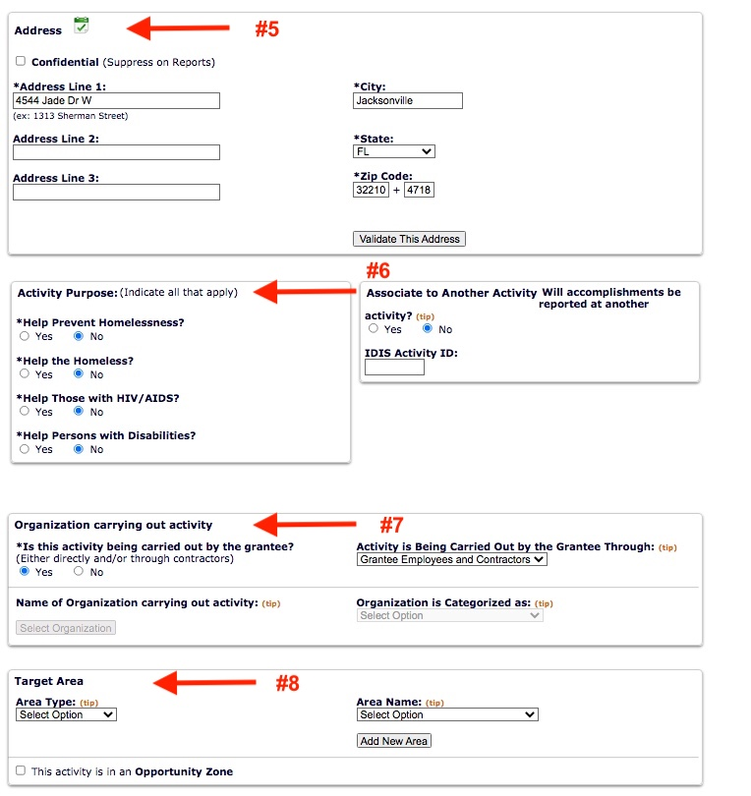
Setting up CDBG Activities
Edit CDBG Setup Detail –
Page (1/4 continued)
5. Address
6. Activity Purpose
7. Organization Carrying Out
8. Target Area
(Save and Continue)

Slide 10
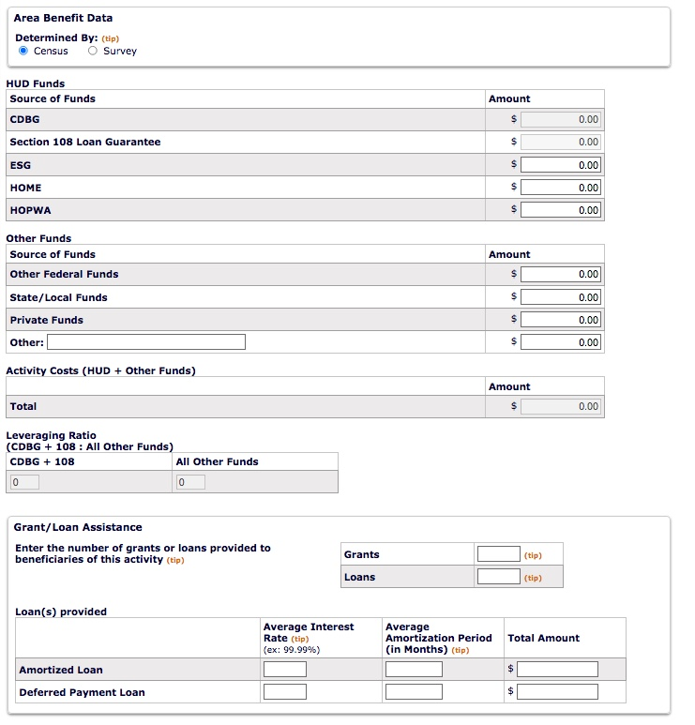
Setting up CDBG Activities
Edit CDBG Setup Detail –
Page (2/4)
HUD Funds
Other:
Leverage Ratio
Grant/Loan Assistance
(Save and Continue)

Slide 11
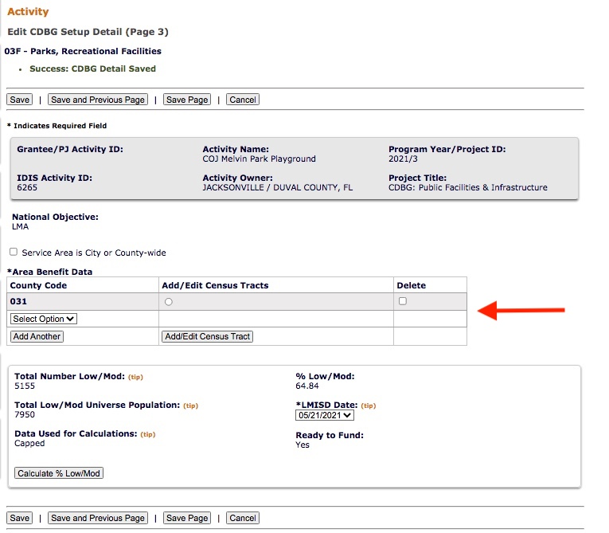
Setting up CDBG Activities
Edit CDBG Setup Detail – Page (3/4)
For Public Facilities/ Infrastructure activities:
Area Benefit Data

Slide 12
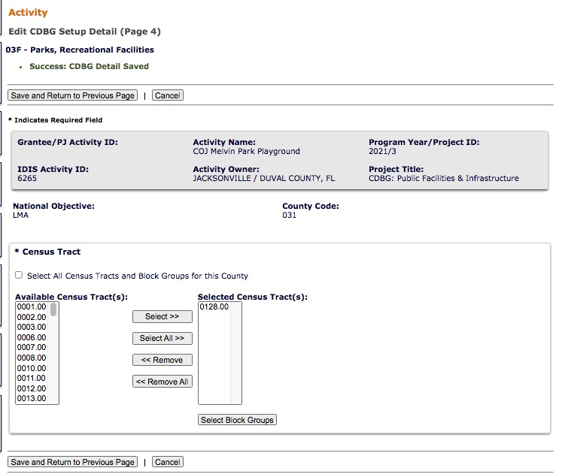
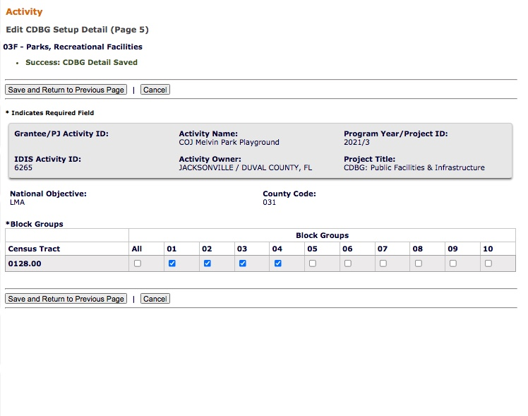
Setting up CDBG Activities
Setup Detail – Page (4/4 continued)
Setup Page 4
Setup Page 5

Slide 13
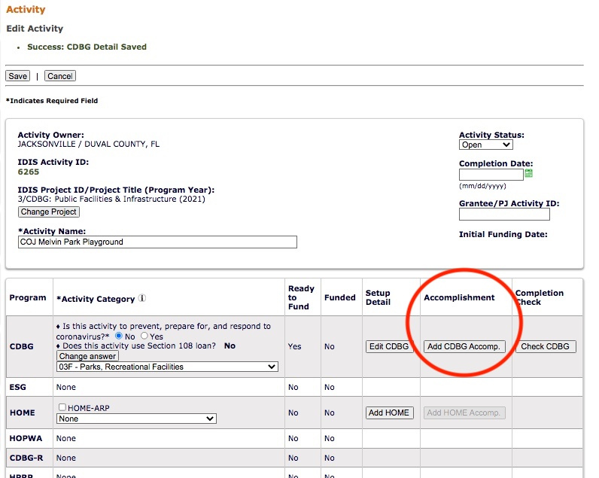
Adding CDBG Accomplishments
Add CDBG Accomplishment Detail

Slide 14
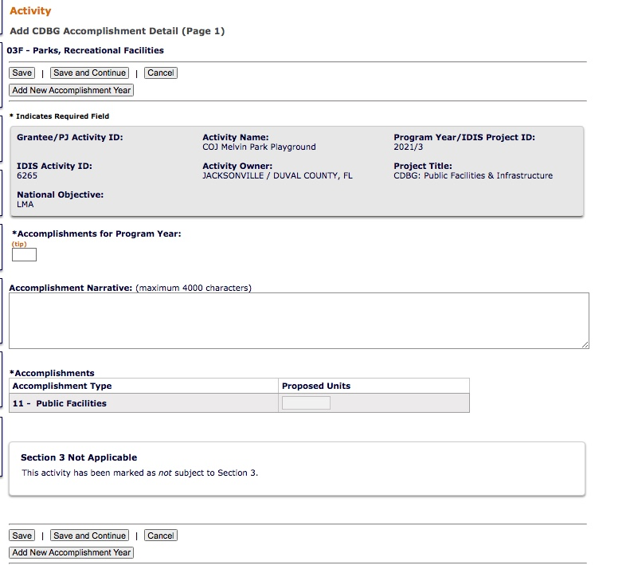
Adding CDBG Accomplishments (Area)
Add CDBG Accomplishment Detail
Page (1/2)

Slide 15
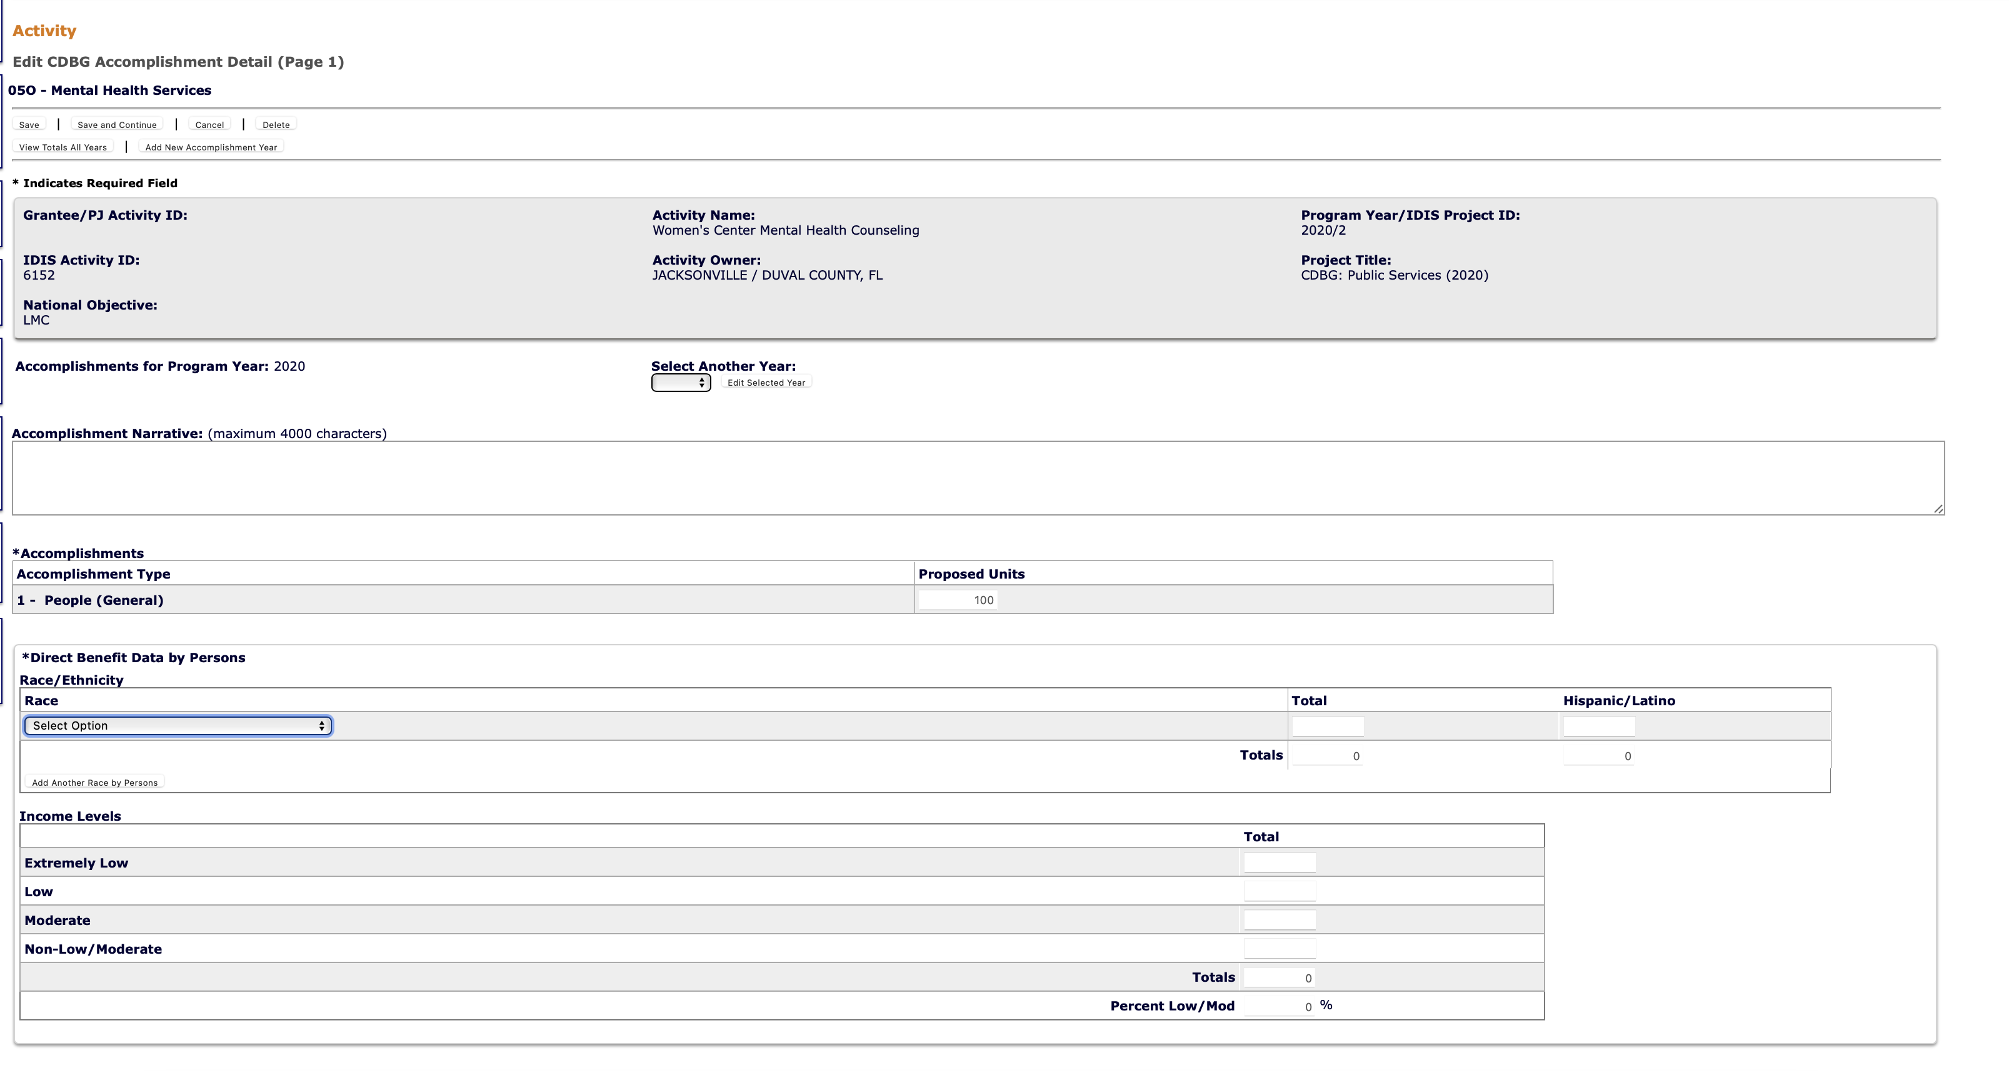
Adding CDBG Accomplishments (Direct)
Add CDBG Accomplishment Detail
Page (1/2)

Slide 16
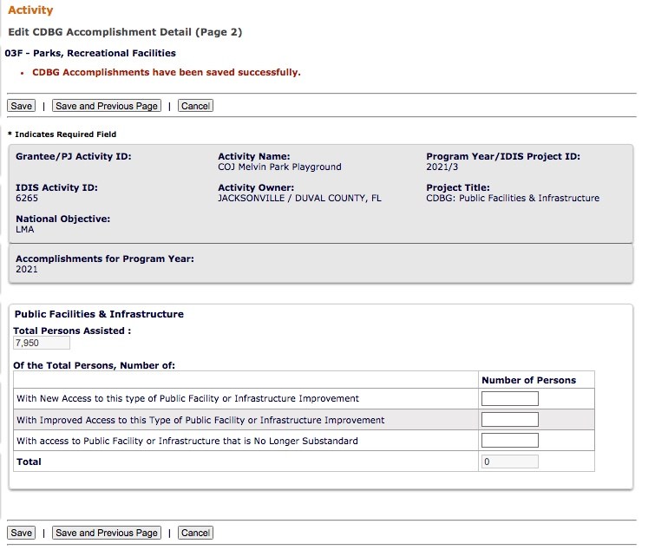
Adding CDBG Accomplishments
Add CDBG Accomplishment Detail
Page (2/2)

Slide 17
Setting up CDBG Activities
Each CDBG Activity is associated with a CDBG Matrix Code and National Objective Code.
Link to CDBG Matrix Code definitions:
https://www.hudexchange.info/resource/2545/matrix-code-definitions/
Link to National Objective Codes:
https://www.hudexchange.info/resource/2555/national-objective-code-descriptions/
Link to allowable combinations of CDBG Matrix Codes and National Objective Codes:
https://www.hudexchange.info/resource/2546/matrix-code-national-objective-table/

Slide 18
Setting up HOME Activities

Slide 19
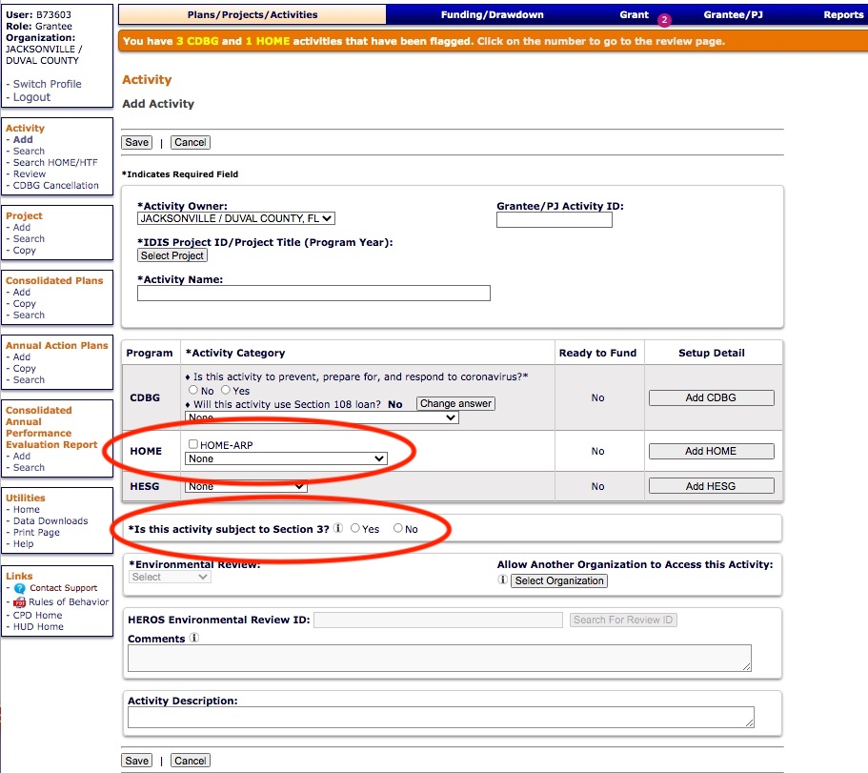
Setting up HOME Activities
Add Activity:
Determine:
HOME Activity Type
Section 3 requirement
Environmental Review

Slide 20
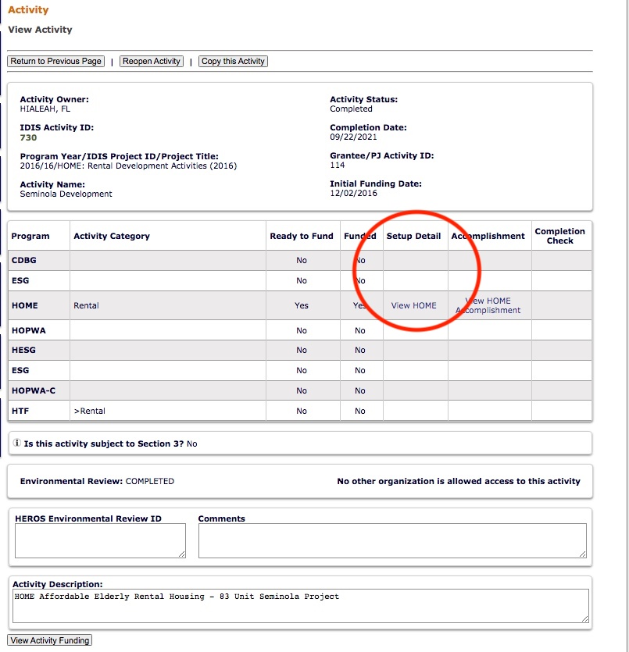
Setting up HOME Activities
Edit HOME Setup Detail:
Page (1/3)
Select Setup

Slide 21
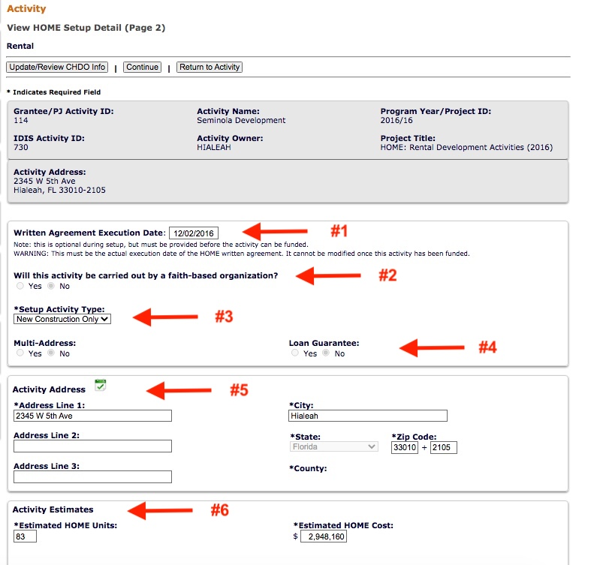
Setting up HOME Activities
Edit HOME Setup Detail:
Page (2/3)
(1) Written Agreement Execution
(2) Faith-based?
(3) Setup Activity Type
(4) Multi-Address/Loan Guarantee
(5) Activity Address
(6) Activity Estimates

Slide 22
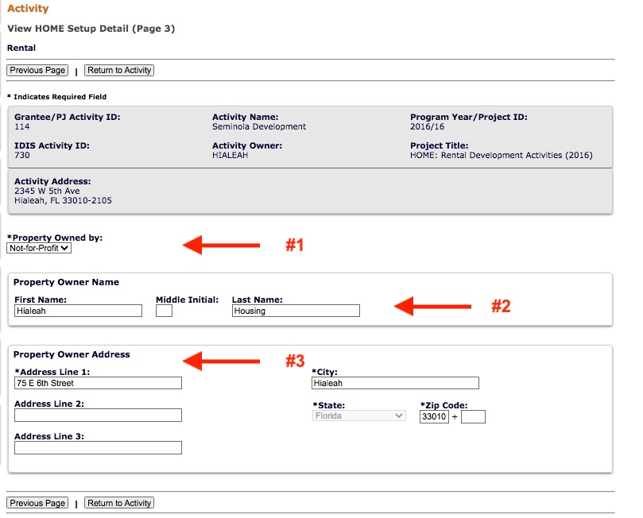
Setting up HOME Activities
Edit HOME Setup Detail:
Page (3/3)
(1) Property Owned By
(2) Property Owner Name
(3) Property Owner Address

Slide 23
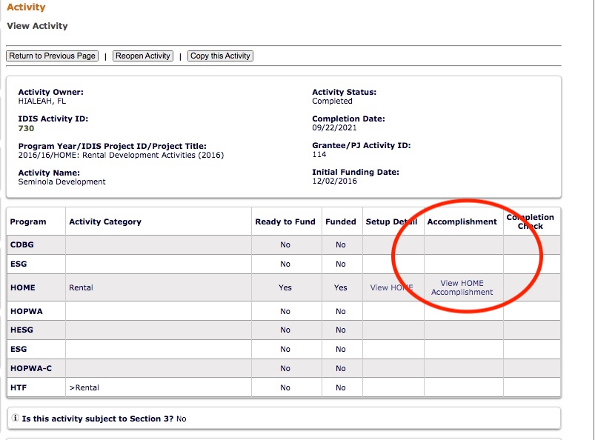
Adding HOME Accomplishments
Edit HOME Accomplishments:
Page (1/3)
Select Accomplishments

Slide 24
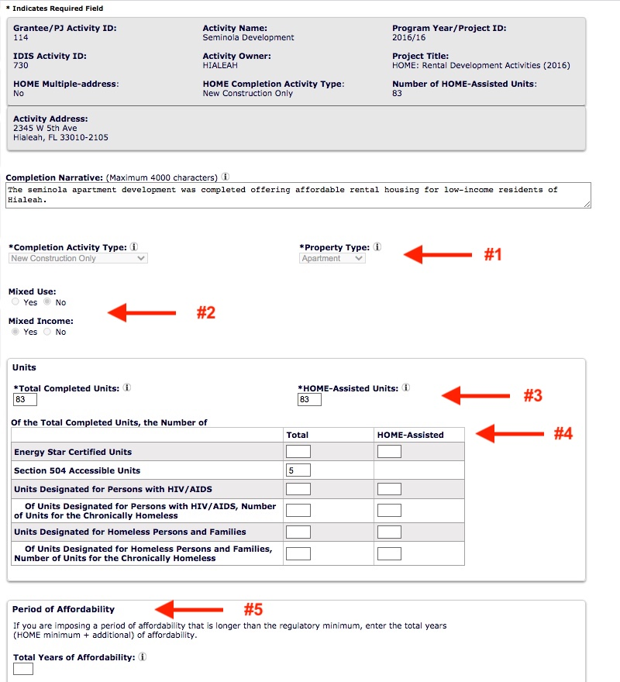
Adding HOME Accomplishments
Edit HOME Accomplishments:
Page (2/3)
Completion Activity Type / Property Type
Mixed Use / Income
Units: Total / HOME Assisted
Units: Type Completed
Period of Affordability

Slide 25
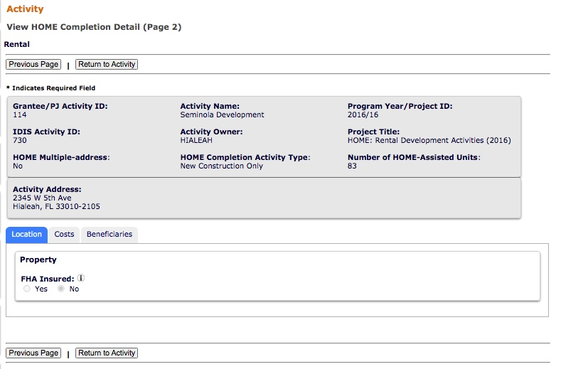
Adding HOME Accomplishments
Edit HOME Accomplishments:
Page (3/3)
Location Tab

Slide 26
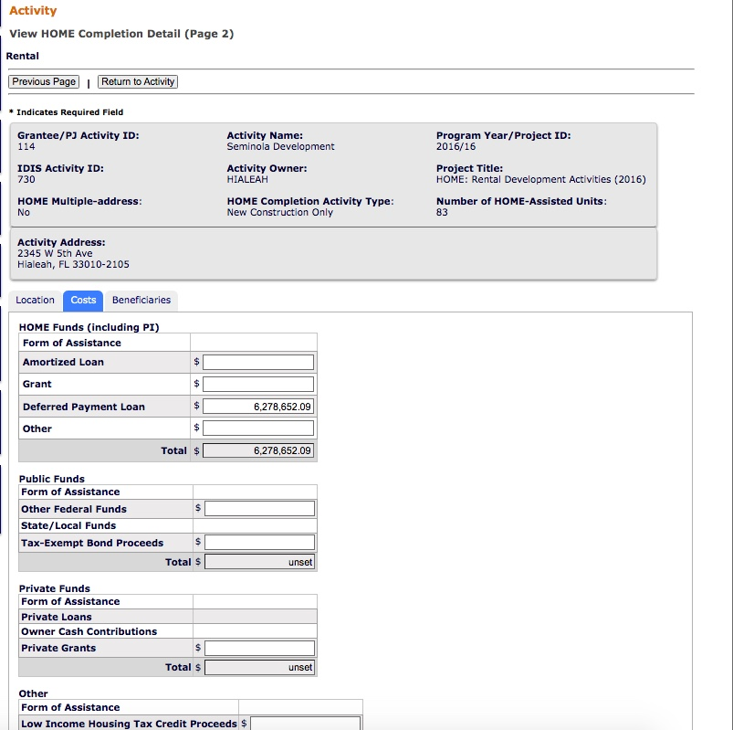
Adding HOME Accomplishments
Edit HOME Accomplishments:
Page (3/3)
Costs Tab

Slide 27
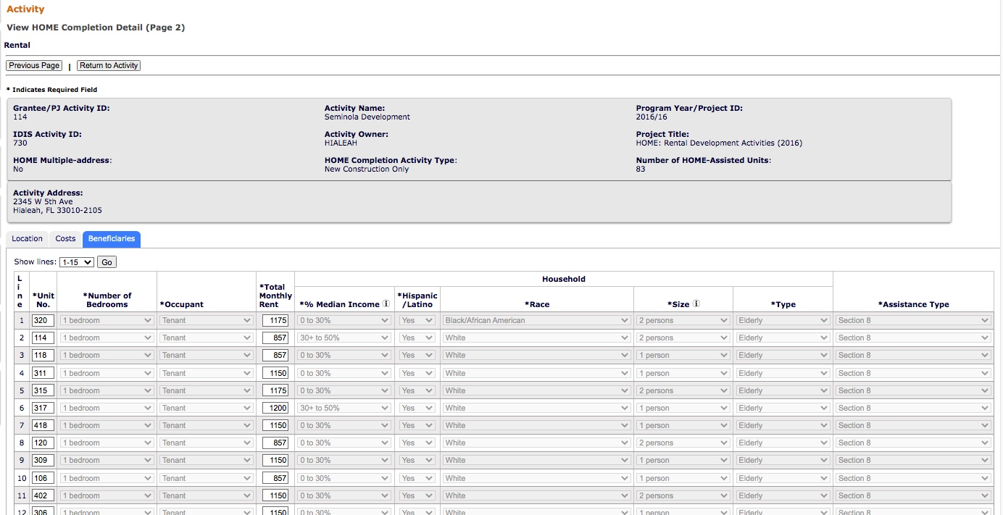
Adding HOME Accomplishments
Edit HOME Accomplishments:
Page (3/3)
Beneficiaries
Tab

Slide 28
Funding Module
Add/Edit Funding

Slide 29
Funding Module
Add/Edit Funding

Slide 30
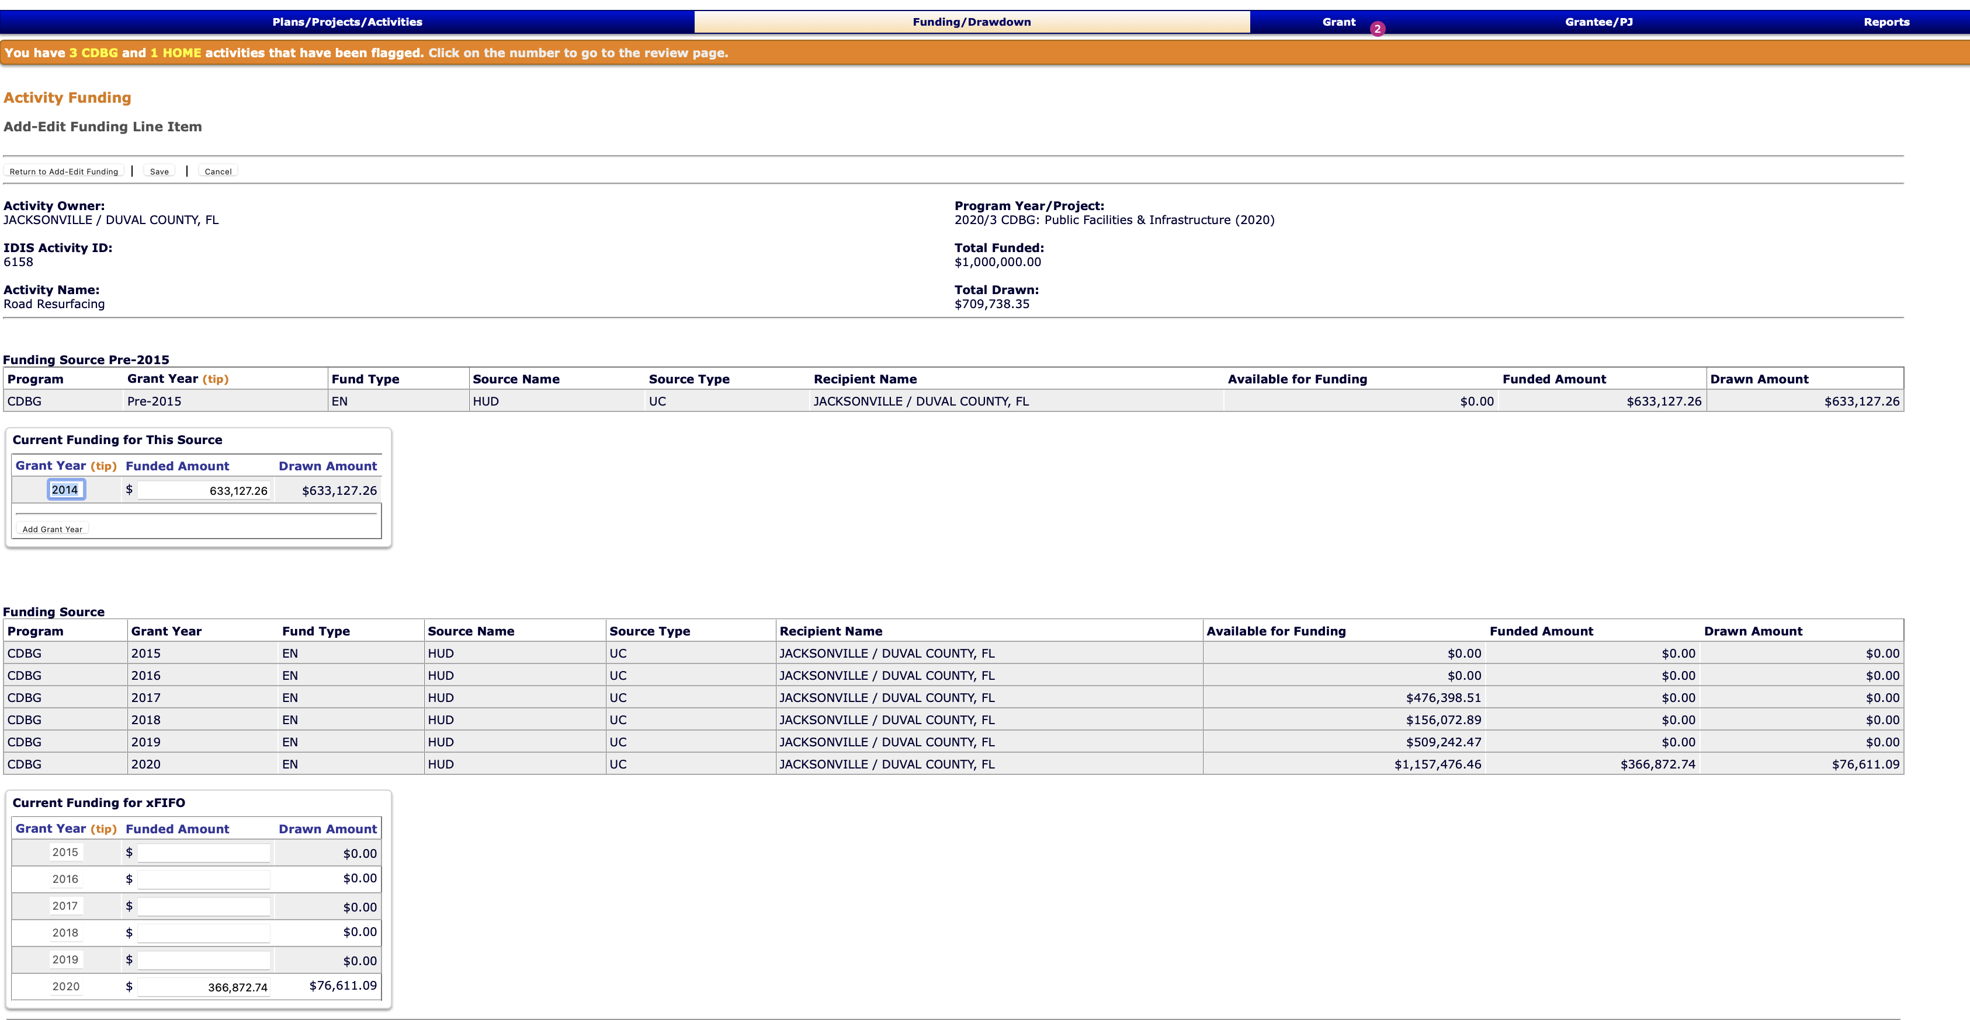
Funding Module
Add/Edit Funding

Slide 31
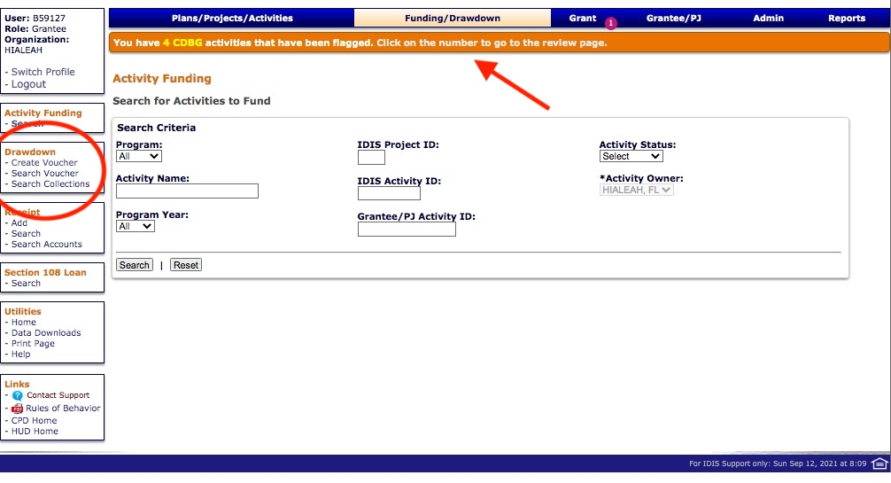
Funding Module
Vouchers can be created under the “Drawdown” menu item in the “Funding/Drawdown Module”

Slide 32
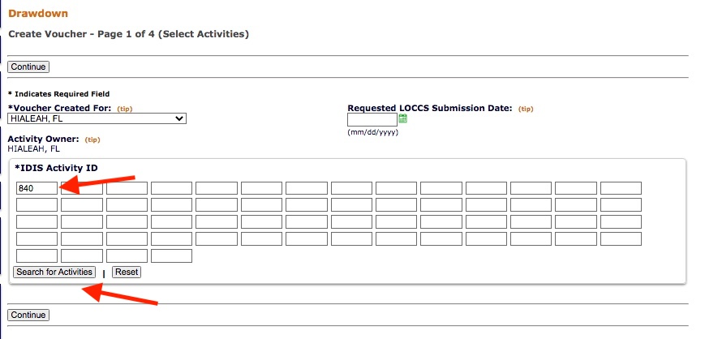
Funding Module
Creating a Voucher
Page (1/4)
Enter and Search for Activities

Slide 33
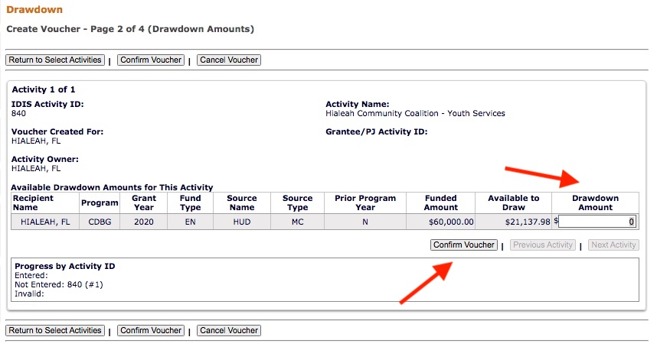
Funding Module
Creating a Voucher
Page (2/4)
Enter Drawdown Amount and Confirm Voucher

Slide 34
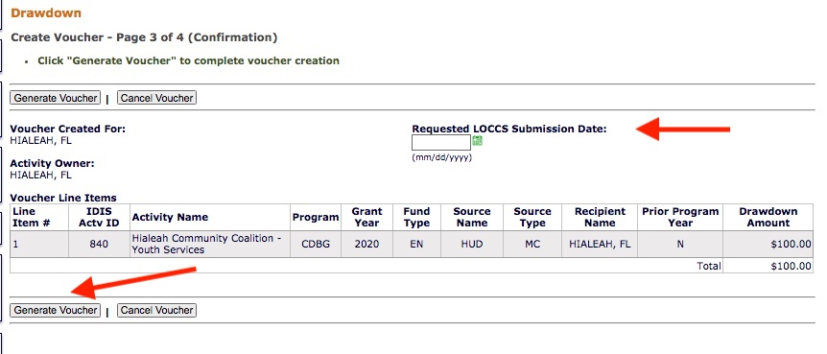
Funding Module
Creating a Voucher
Page (3/4)
Request LOCCS
Submission Date
and Generate
Voucher
Note: A second reviewer will approve the voucher

Slide 35
Reports Module
IDIS offers numerous reports to grantees, including program year, activity and financials reports in the Reports Module (MicroStrategy).
MicroStrategy reports (PR reports) are used to inform the annual CAPER report and the performance review of programs.
For the CAPER the following are a list of important PR reports for CDBG & HOME:
CDBG
PR02 – List of Activities
PR03 – CDBG Activity Summary
PR07 – Expenditures (use to calculate expenditures for program year)
PR23 – Summary of Accomplishments
PR26 – CDBG Financial Summary – Required as an upload with the CAPER submission

Slide 36
Reports Module
HOME
PR02 – List of Activities
PR05 – Drawdown Report (use to calculate expenditures for program year)
PR07 – Expenditures (use to calculate expenditures for program year)
PR09 – HOME Program Income
PR20 – HOME Production report
PR23 – Summary of Accomplishments
PR33 – HOME Match Liability
PR22 – Status of HOME Activities

Slide 37
Additional Resources
IDIS Resources for the CDBG Program
https://www.hudexchange.info/programs/idis/guides/cdbg/
IDIS Resources for the HOME Program
https://www.hudexchange.info/resource/2465/home-idis-training-manual-for-pjs/

Slide 38
Erich Chatham
(843) 573-7825
erich.chatham@civitassc.com
www.civitassc.com

