Slide 1
Hot Topics in IDIS:
Understanding Recent Updates
Presented by Erich Chatham, Civitas LLC

Slide 2
Agenda
Preparing the Quarterly Cash on Hand Report
CDBG-CV Activities & Accomplishments
Annual PR-26 & CDBG-CV PR-26
HOME Commitments
Section 3 Requirements
HOME-ARP
Reports Module
Questions

Slide 3
Preparing the Quarterly Cash on Hand Report
Entitlement Communities are required to
Complete the Cash on Hand (COH) Quarterly Report and
Submit it to grantee’s HUD local field office through IDIS
Federal fiscal year quarter reporting periods (to be used for all quarterly reports):
Reporting Period (Quarters) | Due Date of Report
Q1: 10/1 – 12/31 | 1/30
Q2: 1/1 – 3/31 | 4/30
Q3: 4/1 – 6/30 | 7/30
Q4: 7/1 – 9/30 | 10/30

Slide 4
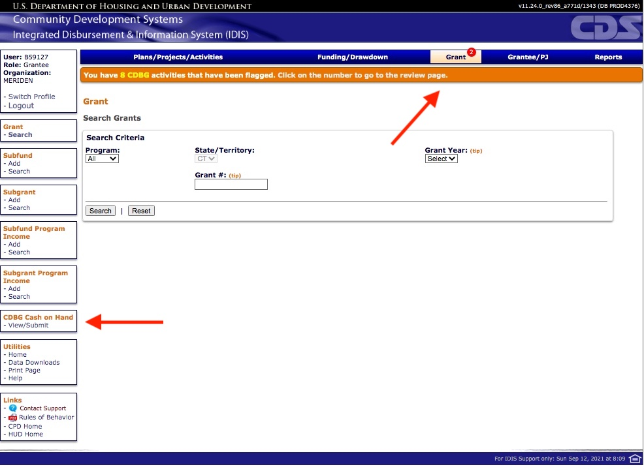
Preparing the Quarterly Cash on Hand Report
Accessing the COH View/Edit Screen
COH reports access:
Under the “Grant” module
CDBG Cash on Hand “View/Submit” link

Slide 5
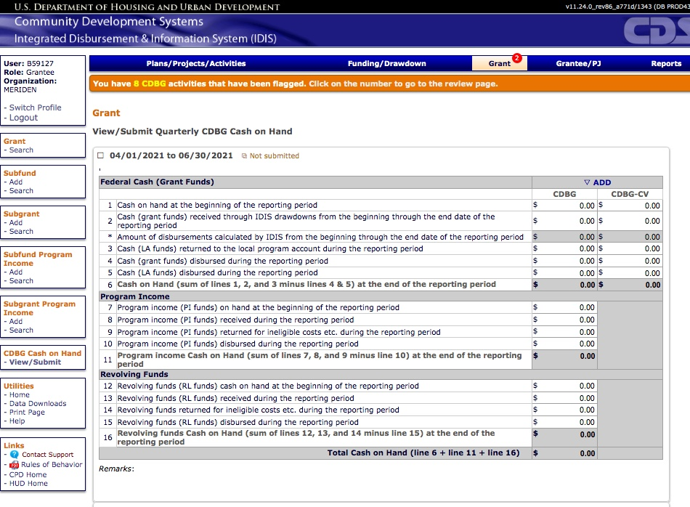
Preparing the Quarterly Cash on Hand Report
Entering the COH Report in IDIS
Three parts:
Federal Cash (Grant Funds): EN CDBG, EN CDBG-CV & LA
Program Income
Revolving Funds
Detailed instruction: https://www.hudexchange.info/resource/5947/instructions-for-idis-cash-on-hand-quarterly-report/

Slide 6
Preparing the Quarterly Cash on Hand Report
Helpful PR Reports for the Quarterly COH Report
PR07 - Drawdown Report by Voucher Number - Vouchers Submitted to Line of Credit Control System (LOCCS)
This report is run for EN funds (CDBG & CDBG-CV)
PR09 - Receipt Fund Type Detail Report
This report is run for LA, PI & RL funds, entering the start and end dates of the quarter that is being reported on.

Slide 7
CDBG-CV Activities & Accomplishments
CDBG-CV Activities
Similar to regular CDBG activities but must “tie back” to activities that prevent, prepare for, and respond to COVID-19.
Entered into IDIS like regular CDBG activities; however,
CDBG-CV activities must be set up separately from other activities, even if they have the same matrix code and are carried out by the same entity.
CDBG-CV Public Services: The CARES Act lifted the 15% cap on the amount of grant funds that can be used for public services activities.
Required to track and report on program income received and complete all other required financial and programmatic reporting in IDIS.
CDBG-CV Toolkit: https://www.hudexchange.info/programs/cdbg-cv/cdbg-cv-toolkit/documentation/idis-and-reporting/

Slide 8
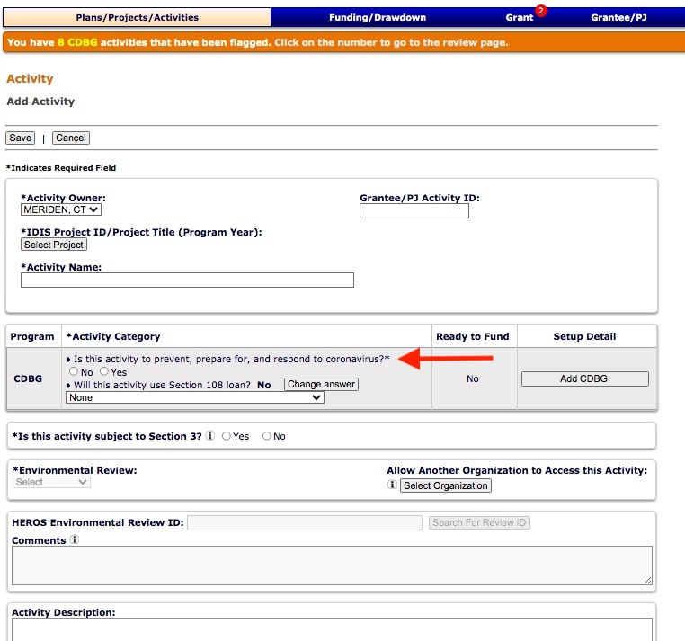
CDBG-CV Activities & Accomplishments
Must Select:
Is this activity to prevent, prepare for, and respond to coronavirus?

Slide 9
Annual PR-26 & CDBG-CV PR-26
Submitted annually to HUD by CDBG entitlement communities at the time of a CAPER submission.
The PR26 is used to determine if:
an entitlement grantee has remained in compliance with the primary objective of the Housing and Community Development Act of 1974 (HCDA) which is to ensure that CDBG funds are primarily used for the benefit of LMI persons.
the entitlement grantee has remained in compliance with the limitations placed on planning and administrative costs and public service costs.

Slide 10
Annual PR-26 & CDBG-CV PR-26
Annual PR-26
(Select in Red)
PR26 - CDBG Financial Summary Report
This report is the original PR26 CDBG report.
Documents a grantee’s (1) compliance with the LMI benefit requirement, (2) the amount obligated and expended for public services, and (3) the amount obligated for planning and administration for the selected PY.
PR26 - Activity Summary by Selected Grant
Documents the grantee’s compliance with the amount of CDBG funds expended for planning and administration.
This is a new requirement under §570.200(g)(1) as a result of grant-based accounting currently being implemented.

Slide 11
Annual PR-26 & CDBG-CV PR-26
Annual PR-26
Important PR Reports for Reviewing the CDBG-CV PR26
PR03 – CDBG Activity Summary Report
Displays program and financial information on projects and activities that have been funded with CDBG dollars.
PR07 – Drawdown Report by Voucher Number
Displays all drawdown vouchers by date, and provides details by voucher including the activity IDs, status, amount drawn, the voucher creation date, and the date the voucher was (or will be) sent to LOCCS.
PR09 – Program Income Detail Report by Program Year and Program
Provides a list of all receipts for program income (PI), revolving loan funds (RL), Section 108 program income (SI), and funds returned to the local program account (LA).
This report is most useful when run using the default parameters of day 1 of the grantee’s program year through to the current day.
PR26 – CDBG Financial Summary Report (Prior Year)
The prior year PR26 report is needed to review and reconcile the current year PR26 Report.

Slide 12
Annual PR-26 & CDBG-CV PR-26
CDBG-CV PR-26
(Select in green)
Important PR Reports for reviewing the CDBG-CV PR26
PR05 – Drawdown Report by Project and Activity
Displays voucher line items by project and activity.
Produces totals by activity, project, and program year. There is a prompt to select CARES Act Grants Only.
PR07 – Drawdown Report by Voucher Number
Displays all drawdown vouchers by date.
Details by voucher include the activity IDs, status, amount drawn, creation date, and the date (or will be) sent to LOCCS. There is a prompt to select CARES Act Grants Only.
PR26 – CDBG Activity Summary Report by Selected Grant
Groups activities by grant year and activity type.
Can be generated for a single origin grant year or multiple origin grant years.
Can be used to determine if no more than 20% of CDBG-CV grant has been expended for planning and program administrative costs.

Slide 13
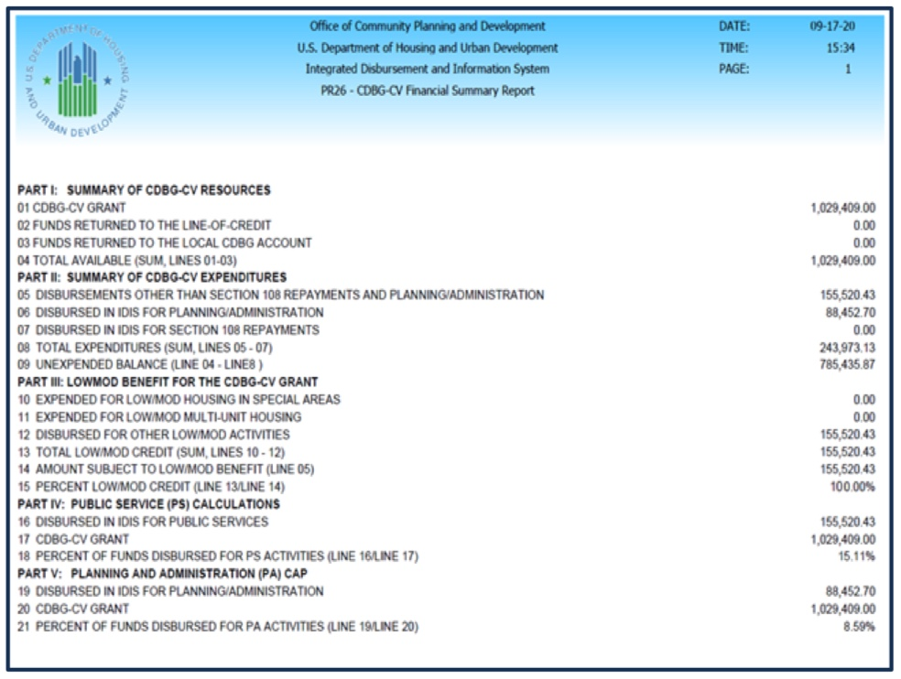
Annual PR-26 & CDBG-CV PR-26
CDBG-CV PR-26
Designed explicitly to report on the status of CDBG-CV funds allocated through the CARES Act.

Slide 14
Annual PR-26 & CDBG-CV PR-26
For information on how to prepare the Annual PR-26:
https://www.hudexchange.info/resource/2652/updated-instructions-completing-cdbg-financial-summary-report-pr26/
For information on how to prepare the CDBG-CV PR-26:
https://www.hudexchange.info/resource/6286/pr-26-cdbg-cv-financial-summary-report-instructions/

Slide 15
HOME Commitments
Suspension of the HOME Commitment and CHDO Reservation Deadline
The Consolidated Appropriations Act of 2019 includes a provision suspending the 24-month commitment requirement for:
Community Housing Development Organization (CHDO) set-aside funds, as well as
Continuing the suspension of the 24-month commitment requirement for regular HOME Investment Partnerships Program (HOME) funds.
Both deadline requirements are suspended through December 31, 2021.

Slide 16
HOME Commitments
Background Information
HOME Commitment Requirement
Section 218(g), NAHA: PJs must commit HOME allocation within 24 months of last day of month in which HUD obligated the grant
• HUD implemented commitment requirement using “cumulative method
Total commitments from ALL grants must be Equal to or greater than Total amount required to be committed through grant year being examined
CHDO Reservation Requirement
Section 231, NAHA – PJs must reserve 15% of allocation to CHDOs within 24 months
• HUD implemented as a “cumulative average”
HUD measures whether PJ reserved an average of at least 15% of HOME funds to CHDOs from all HOME allocations

Slide 17
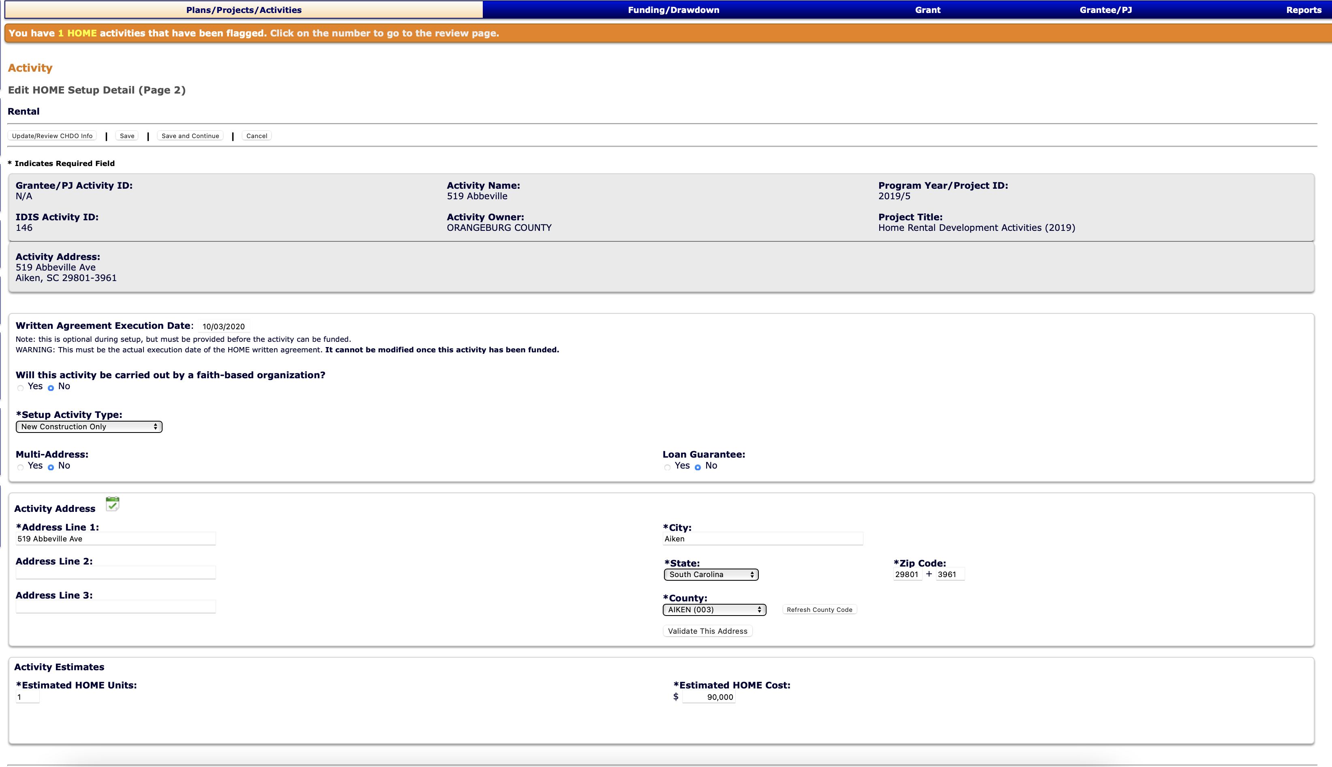
HOME Commitments/Written Agreements

Slide 18
Section 3 Requirements
Grantees now required to report Section 3 data in IDIS
Section 3 reporting data fields are available on the IDIS activity setup and accomplishment screens
Grantees must enter Section 3 applicability and data before they can mark a CDBG, Section 108 or CDBG-CV rehabilitation or construction activity complete in IDIS
The data reported at the activity level in IDIS will be populated into the CAPER and a Section 3 MicroStrategy report
When grantees submit their CAPER, they will fulfill the requirement for annual reporting.

Slide 19
Section 3 Requirements - Benchmarks
Section 3 regulations at 24 CFR 75.25 provide a list of qualitative efforts that demonstrate what HUD considers to be efforts to comply with the Section 3 benchmarks.
If a grantee did not meet benchmarks for a Section 3-triggered activity, IDIS will display a checklist of the qualitative efforts on the activity accomplishment screen.
Section 3 Grantees and/or its recipients must also maintain records in their project files to document the efforts reported in IDIS.
IDIS has an empty text box next to “Other” to give grantees the option of entering a description about efforts taken that are not included in the list of qualitative efforts provided.
Section 3 Overview: https://www.hudexchange.info/programs/section-3/

Slide 20
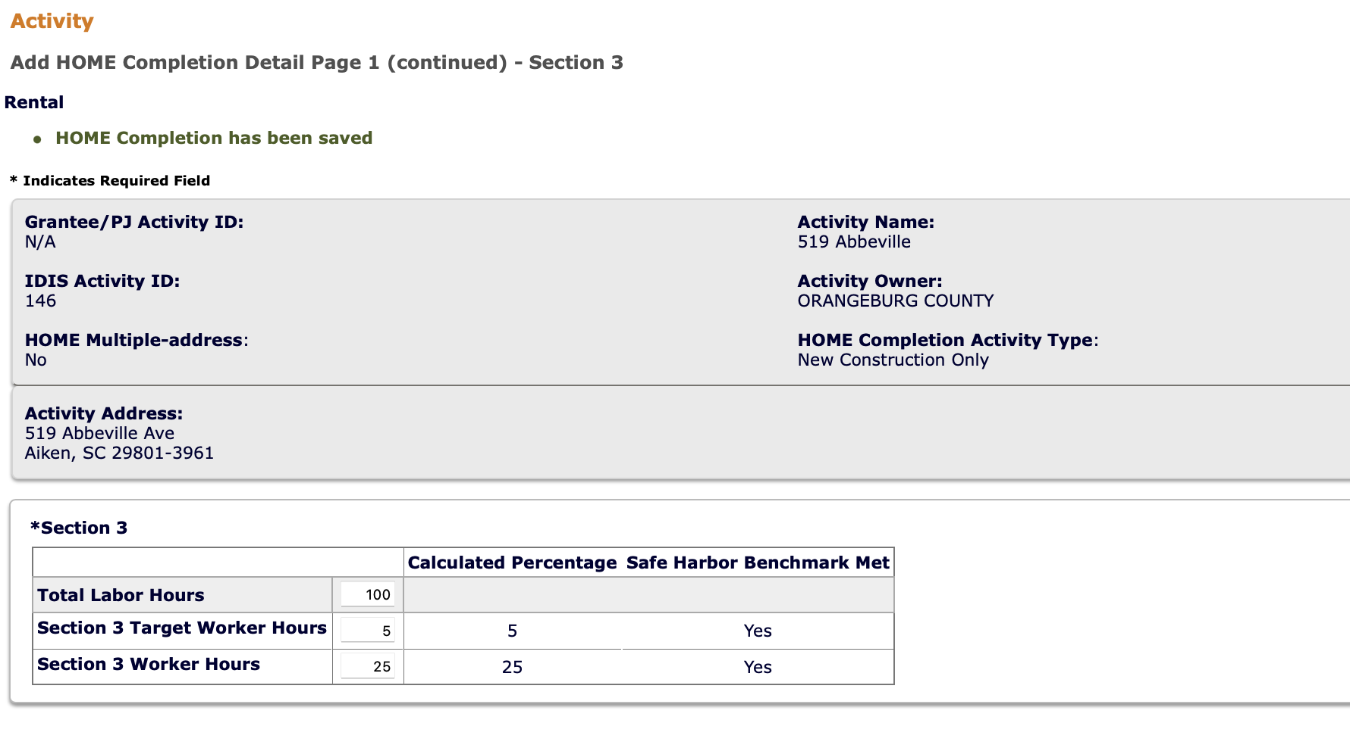
Section 3 Requirements – Benchmarks (yes)
Section 3 Overview: https://www.hudexchange.info/programs/section-3/

Slide 21
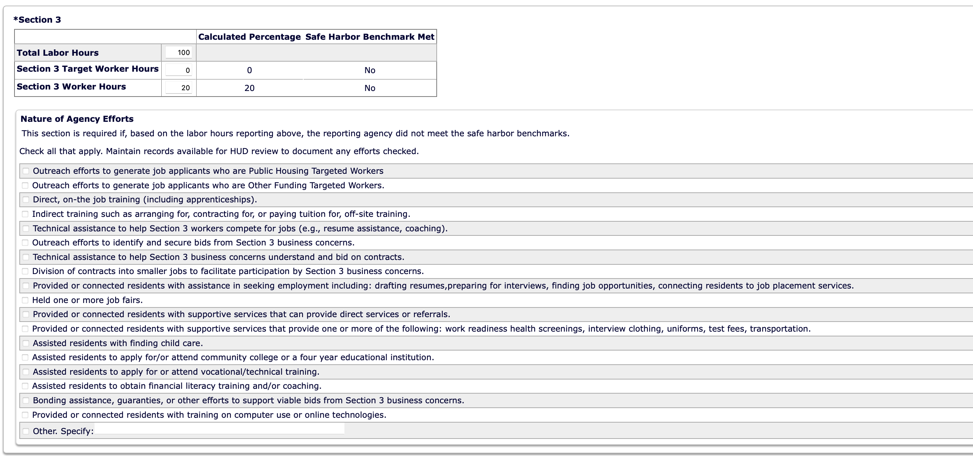
Section 3 Requirements – Benchmarks (no)
Section 3 Overview: https://www.hudexchange.info/programs/section-3/

Slide 22
HOME-American Rescue Plan (ARP)
ARP provides funds for homelessness and supportive services assistance
Funds must be used to primarily benefit the qualifying populations through the four eligible activities:
Tenant-Base Rental Assistance (TBRA),
Development and support of affordable housing,
Provision of supportive services; and
Acquisition and development of non-congregate shelter (NCS) units.
PJ staff with HOME IDIS privileges will have identical IDIS privileges for HOME-ARP.
The PJ will use IDIS to
Set up HOME-ARP eligible activities;
Fund the activities with HOME-ARP funds pursuant to a commitment of funds,
Drawdown the funds for eligible costs, and
Report HOME-ARP accomplishments.

Slide 23
HOME-ARP
When a HOME-ARP grant is entered into IDIS, the PJ’s access to the funds will be limited to 5% of the total grant amount for a portion of the administrative and planning set-aside.
The remaining grant amount, including the remaining 10% administrative and planning set-aside funds, will not be available to commit or drawdown until HUD reviews and accepts the PJ’s HOME-ARP Allocation Plan.
A PJ may use the administrative and planning funds for eligible costs (outlined in Section VI.A of the Notice) by funding an AD/CO/CB activity in IDIS and drawing down the funds for eligible administrative and planning costs.
The PJ may not commit funds to HOME-ARP projects until it has submitted its HOME-ARP Allocation Plan and HUD has reviewed and accepted the Plan.

Slide 24
Reports Module
The Reports Module (or “MicroStrategy”) is a vital tool available to grantees to analyze and/or troubleshoot data already entered into IDIS.
Grantees are highly encouraged to utilize MicroStrategy (PR) reports to review a series of data elements including financial information, accomplishment information, and user account information.
PR reports are used to inform the annual CAPER report, quarterly COH reports and the performance review of programs.

Slide 25
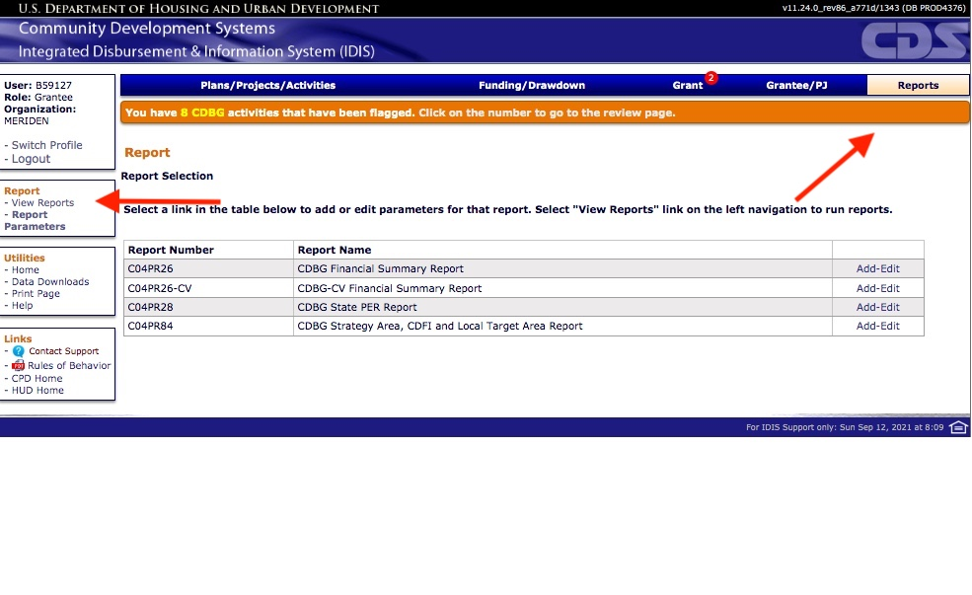
Reports Module
Accessed through
The “Reports” link in the left-hand menu
Under the ”Reports” module.

Slide 26
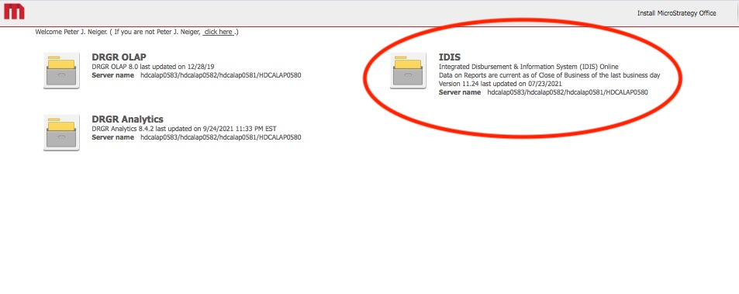
Reports Module
Select red option for PR reports.

Slide 27
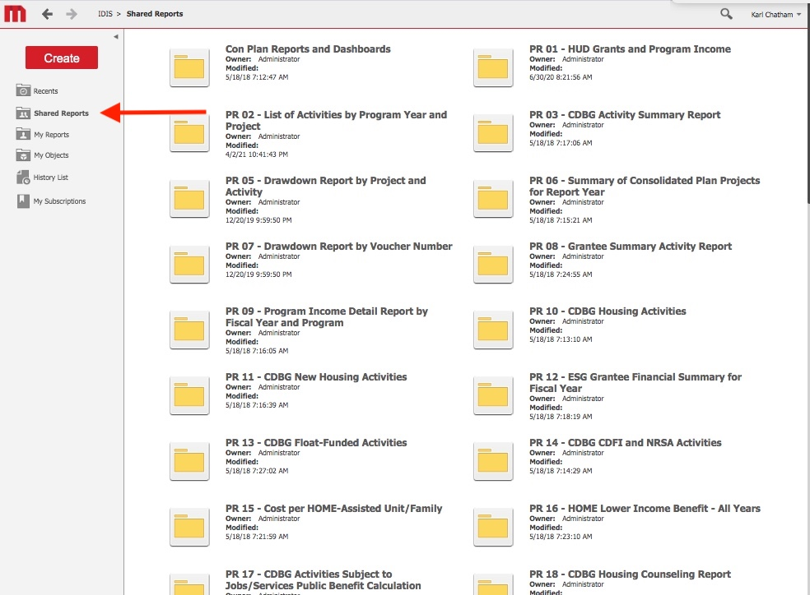
Reports Module
Select “Shared Reports” for access to list of PR reports.
PR reports may be generated in Excel or PDFs

Slide 28
Reports Module
Important PR Reports for the CAPER Submission
CDBG
PR02 – List of Activities
PR03 – CDBG Activity Summary
PR07 – Expenditures (use to calculate expenditures for program year)
PR23 – Summary of Accomplishments
PR26 – CDBG Financial Summary – Required as an upload with the CAPER submission
ESG (Note: ESG accomplishments are reported from the ESG Sage Report)
PR02 – List of Activities
PR07 – Expenditures (use to calculate expenditures for program year)
PR91 – ESG Financial Summary

Slide 29
Reports Module
Important PR Reports for the CAPER Submission
HOME
PR02 – List of Activities
PR05 – Drawdown Report (use to calculate expenditures for program year)
PR07 – Expenditures (use to calculate expenditures for program year)
PR09 – HOME Program Income
PR20 – HOME Production report
PR23 – Summary of Accomplishments
PR33 – HOME Match Liability
PR22 – Status of HOME Activities
HOPWA (Note: HOPWA accomplishments are reported from the HOPWA CAPER Report)
PR-07 – for expenditures for program year.

Slide 30
Reports Module
Important PR Reports for the Quarterly Cash on Hand report.
CDBG
PR05 – Drawdown Report (use to calculate expenditures for quarter)
PR07 – Expenditures (use to calculate expenditures for quarter)
PR09 – LA / PI / RL funds (use to calculate expenditures for quarter)

Slide 31
Additional Resources
For more information on all HUD grants:
https://www.hudexchange.info
CDBG-CV program:
https://www.hudexchange.info/programs/cdbg-cv/
HUD Section 3 Notice: CPD-21-09:
https://www.hud.gov/sites/dfiles/OCHCO/documents/2021-09cpdn.pdf
HUD HOME-ARP CPD-21-10
https://www.hud.gov/sites/dfiles/OCHCO/documents/2021-10cpdn.pdf

Slide 32
Erich Chatham
(843) 573-7825
erich.chatham@civitassc.com
www.civitassc.com

