Slide 1
Hotel Conversions:
Converting the Ambassador Hotel into the Palm Gardens Orlando Apartments
February 23, 2023
Presenter: Jessica Frye, AICP
Housing Initiative Manager

Slide 2
Presentation Outline
History of the Ambassador Hotel
Project Programming and Goals
Funding and Incentives
Lessons Learned
Notes:
Funding will be from 10/1/2023 through 9/30/2024

Slide 3
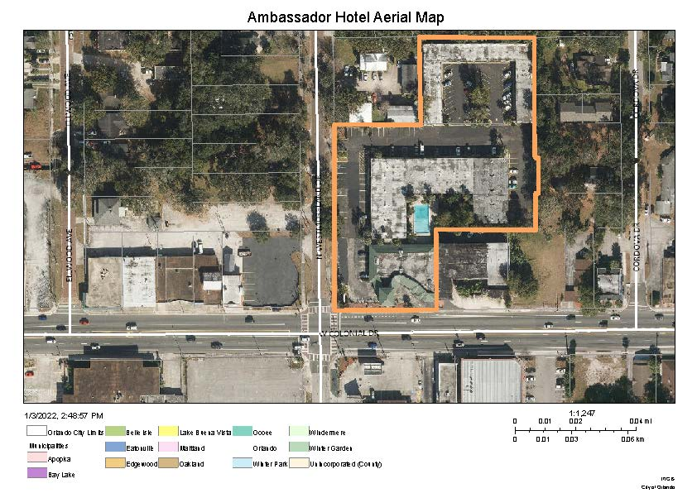
History of the Ambassador Hotel
Ambassador Hotel Location:
Notes:
Funding will be from 10/1/2023 through 9/30/2024 The word “Entitlement” is used to designate the City of Orlando as a jurisdiction in need of funding annual, therefore we do not apply to HUD for funding. As long as we are in compliance, which we are, we anticipate receiving funds.

Slide 4
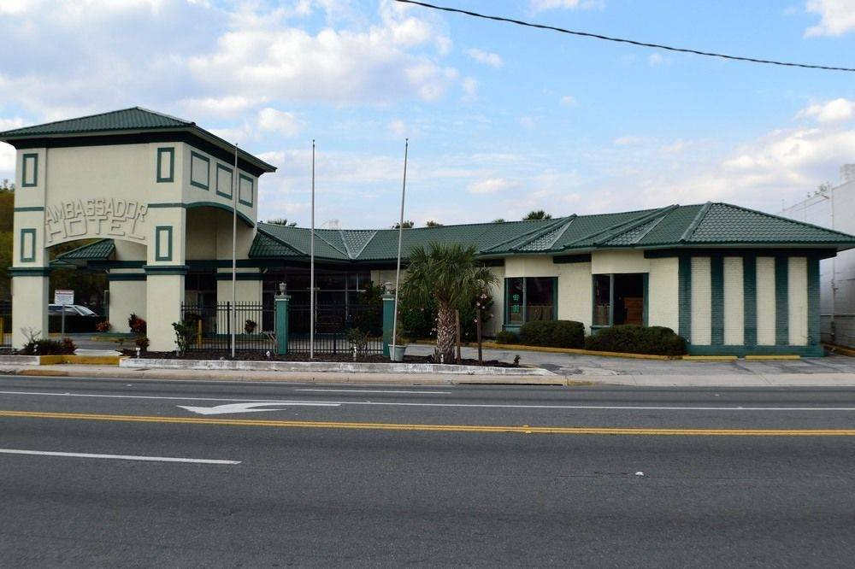
History of the Ambassador Hotel
Ambassador Hotel:
Built in 1958 and 1960
History of negligence and blight
At time of sale only a portion of the rooms were operational due to poor and unhealthy conditions
Significant issues of crime on and around the property
Predatory to those who were experiencing homelessness
If you don’t believe me, check TripAdvisor…

Slide 5
History of the Ambassador Hotel
What Happened . . . ?
The hotel went on the market
Key location for the City
Cost approximately $6 million
Intensive rehabilitation around $6 million
One Stop Housing acquired the property
Development and housing provider that converts hotels and charges about $750 per month (all-inclusive)
Had property nearby annexing into the City
No prior experience with income qualification/rent restriction, but they owned and operated their properties and were willing to learn

Slide 6
Project Programming and Goals
The City started conversations with the One Stop Team
Goals for the City:
Inclusion of permanent supportive units at extremely low-income levels
Mixed-income development
Fully converted rooms
Not just a hotplate and minifridge
Intensive rehabilitation/hazard abatement
Catalyst for change in the community
SAFETY!!!

Slide 7
Project Programming and Goals
The City started conversations with the One Stop Team
Goals for One Stop Housing:
Funding assistance for the conversion
Development incentives
Fee waivers/discounts
Expedited permitting
Stable, long-term viable community to add to existing portfolio

Slide 8
Project Programming and Goals
Programming for the Project:
Total of 150 units
Affordability Period set for 30 years
15 units dedicated for Permanent Supportive Housing
119 @ 60% AMI
15 units @ 80% AMI
1 On-Site manager suite

Slide 9
Funding and Development Incentives
Financing the Project:
The One Stop team bought the property
City provided $4,159,300 in Accelerate Orlando Funding
General City funds made available through the State and Local Fiscal Recovery Funds
Certified Affordable Housing projects receive incentives:
School Impact Fee Waivers estimated at $1,005,899
Transportation Impact Fee Discounts and Credits
Exemption of Park Impact Fees

Slide 10
Funding and Development Incentives
Financing the Project:

Slide 11
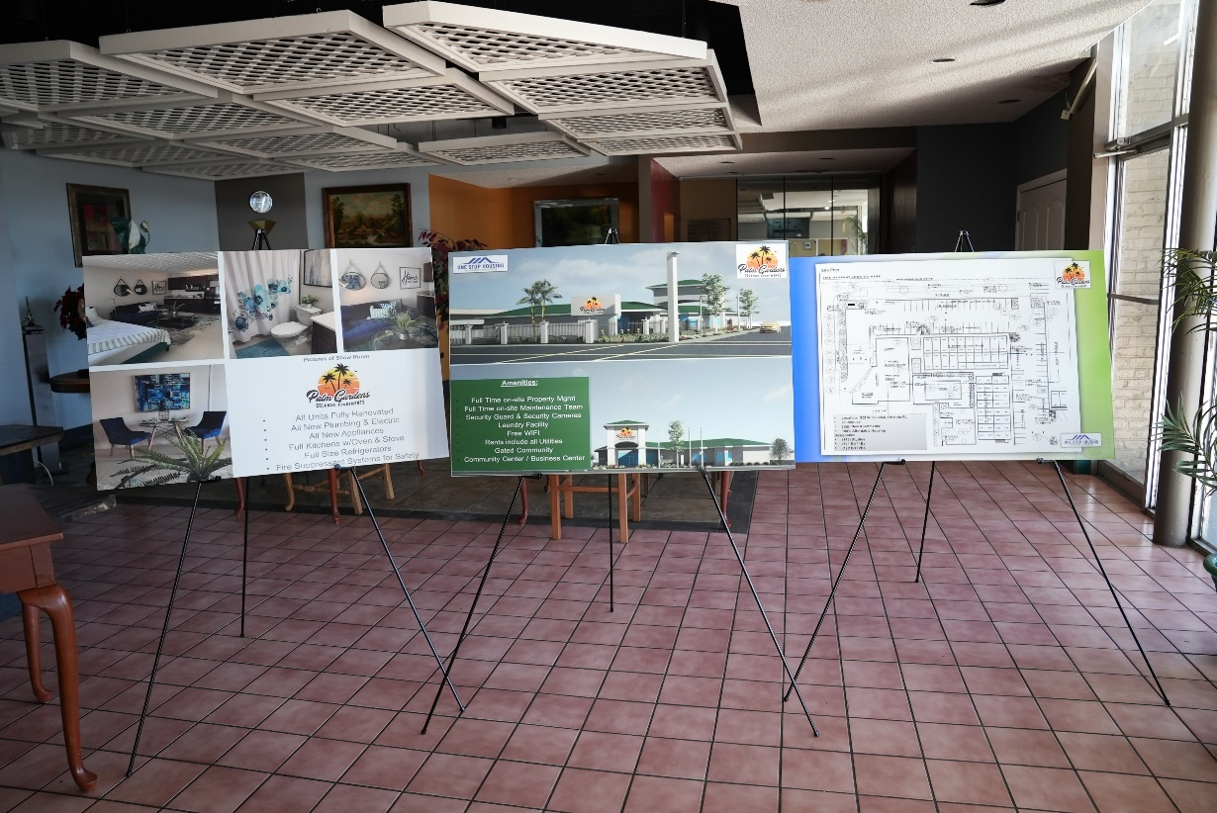
Funding and Development Incentives
Land Development Approvals:
Requires Rezoning and Future Land Use change
Went with a Planned Development
Required multiple community meetings
The City looked into State Statute 165.04151 (County 125.01055) to expedite the process (did not go that route)

Slide 12
Lessons Learned
Lessons Learned:
Technical training regarding rent/income restrictions
Technical training on compliance and monitoring
Reconciling with risk and construction
Example: Doing lump sum draws at certain percentages or more regularly invoicing
Seek additional funding sources to support project

Slide 13
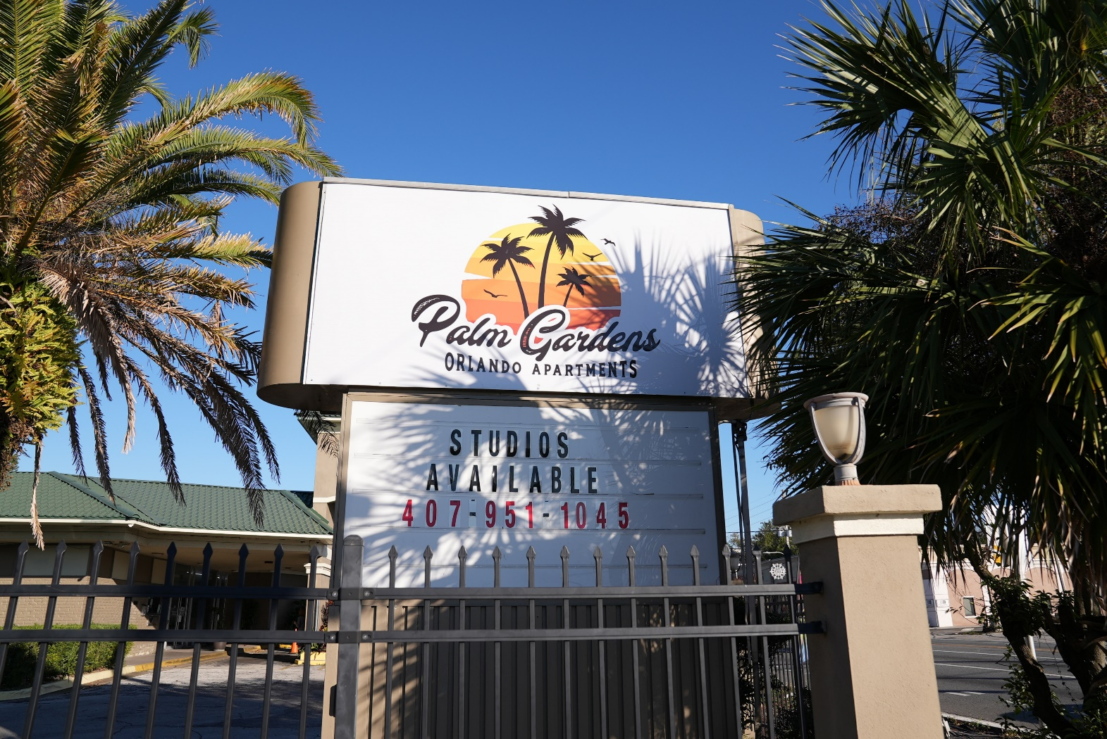
Questions?
Email: Jessica.Frye@orlando.gov
Phone Number: 407.246.3413
mynews13.com/fl/orlando/news/2022/07/19/hotel-becomes-affordable-housing

