Slide 2
Marion County Hospital District
Leased public hospital
Operate like a foundation
Invest $10M to $17M Annually
Focus Areas
Mental Health & Substance Abuse
Dental
Diabetes
Obesity
Tobacco
Match Funding

Slide 3
Modalities
Chronic Disease Prevention Projects
Capacity-Building Capital Projects
Grants & Partnerships

Slide 4
Dental

Slide 5
FreeDOM Mobile Clinics
Projects
Langley Dental Bus
Safety Net Investments – Access to Primary Care, Dental & Behavioral Health
CF Dental Hygiene School
FQHC LIP Funding

Slide 8
Diabetes/Obesity &
Healthier Lifestyles

Slide 9
Fitness & Nutrition in Schools
Active Marion Project
Projects
Community Home Project
Mary Sue Rich Community Center

Slide 10
Experiential Health Education with STEAM
Crop-producing greenhouses at high schools Hydroponic greenhouses at middle/high schools FANS at all elementary, middle, high schools FANS Clubs - health awareness/taste tests/events
Health Educator – Vaping/Smoking/Drug Dangers

Slide 12
Increased Physical Activity & Health Education
Workplace Wellness at 40 Employers
School, Employer, Elected Official Step Challenges Quarterly Fitness Challenges
AMP Mobile App – Tracks Competitions & Progress Diabetes Education & Pre/Post

Slide 13
A collaboration of community partners with the goal of reducing obesity, chronic diseases and poverty by providing nutrition education, healthy food and life-enhancement services to underserved communities.
Healthy Food Options, Access to Healthcare
Home Safety, Maintenance, Cleaning & Food Handling Educational Advancement & Career Opportunities Medical, Dental, Mental Health & SUD Services
Credit Repair, Finance Education & Home Ownership

Slide 14
AMP - Fitness Programming & Activities FANS – Nutrition Education
Mobile Dental Clinic Diabetes Testing & Education

Slide 15
Match Funding and Low Income Pool Funds

Slide 16
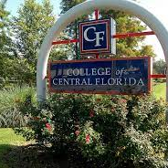
Dental Hygiene Program
Health Sciences
Nursing School

Slide 17
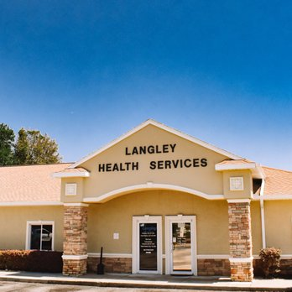
Safety Net Primary Care through LIP funds

Slide 18
Behavioral Health &
Substance Use

Slide 19
Beacon Point
Amnesty
Match $ for Behavioral Health
First Responder Program
Peer Support Services
Detox and Crisis Beds
Projects
Safety Net – Uninsured Behavioral Health & Substance Use Disorder Investments

Slide 20
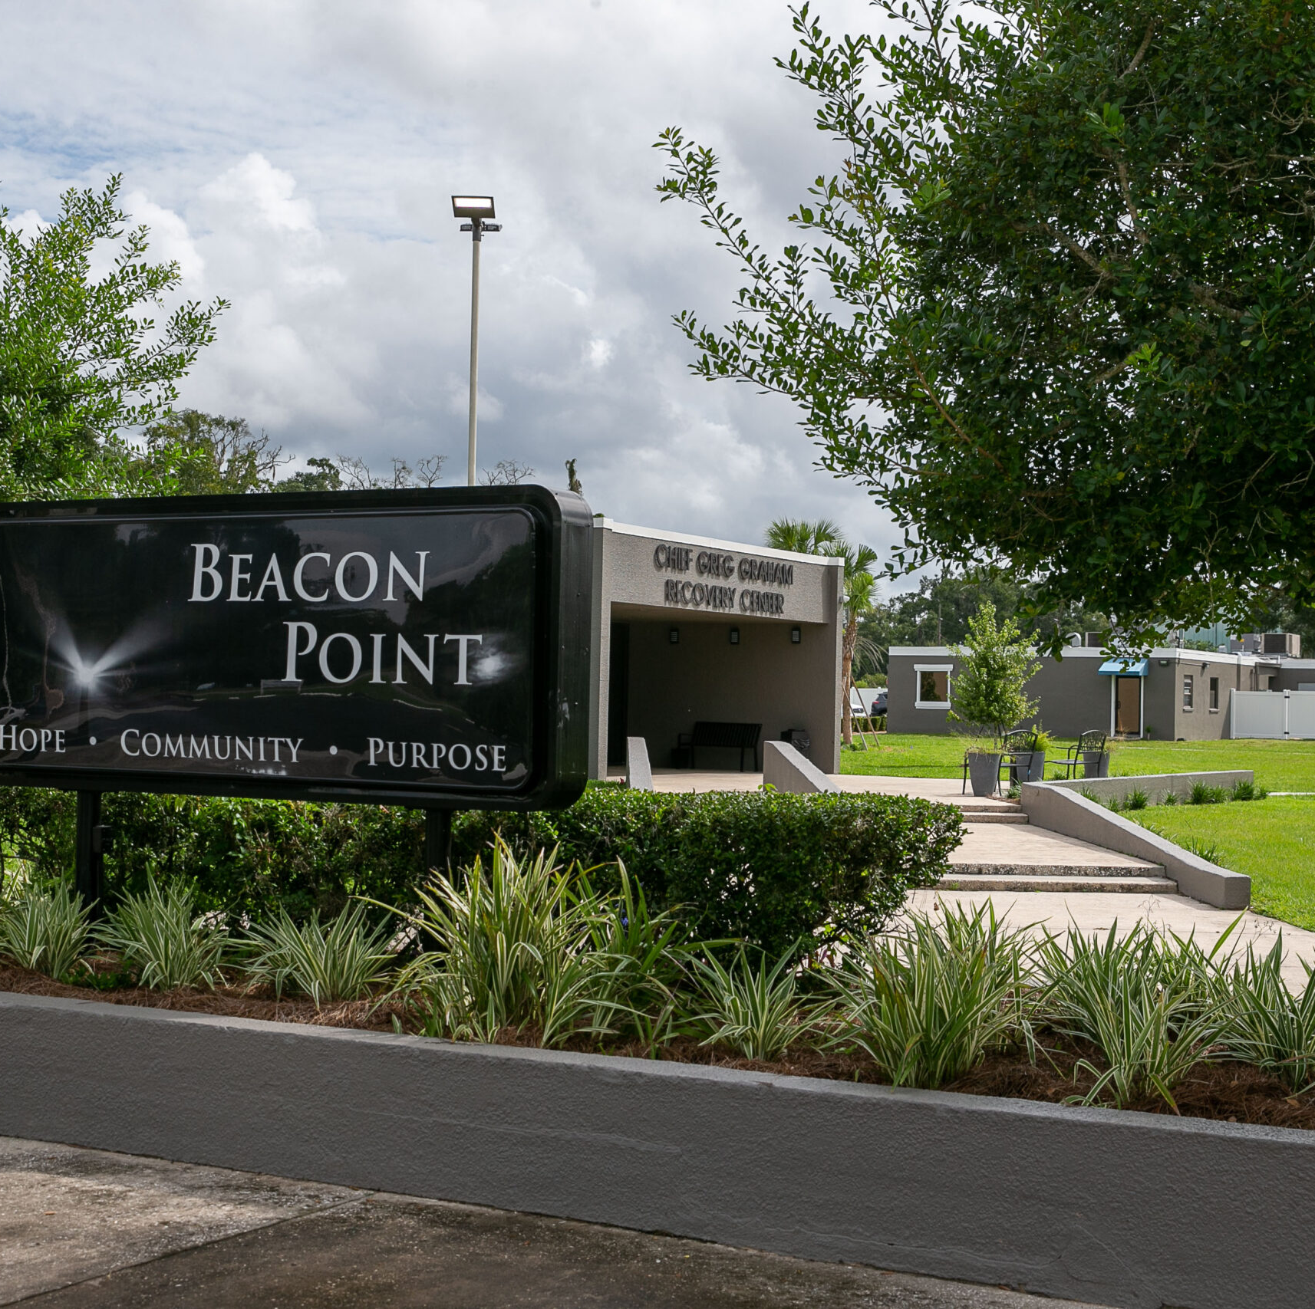
Beacon Point connects individuals who need assistance with substance use recovery and behavioral health with those who can help. Without the assistance of CDBG funds, this project would not be possible.

Slide 21
SMA Healthcare
LifeStream
Heart of Florida
Langley
Well Florida
CASA of Marion
Beacon Point Service Providers

Slide 22
Beacon Point Services
Detox
Residential
Peer Specialist
Access Services
Medication Assisted Treatment
Outpatient Counseling
Behavioral Medication Management
Primary Care
Domestic Violence Outreach
Substance Exposed Newborn

Slide 23
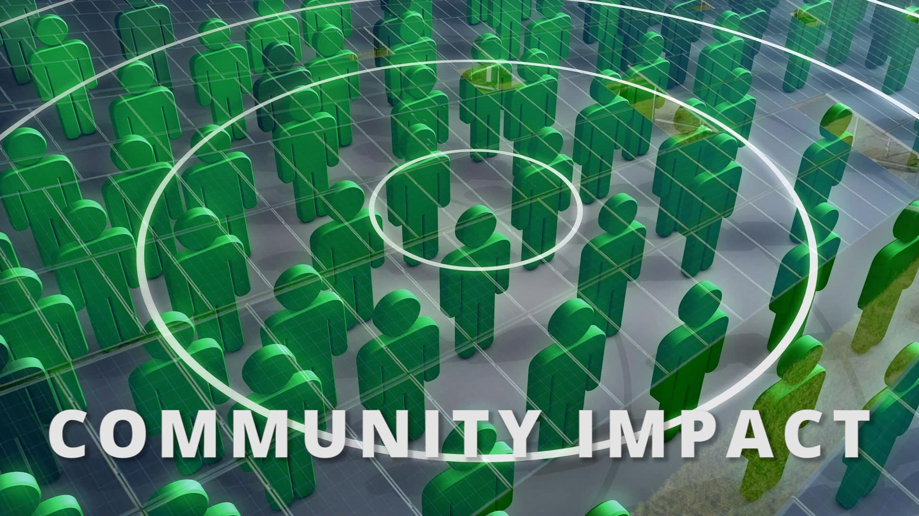

Slide 26
38%
of Marion County
Population*
Has been impacted in some way by MCHD Projects
*Based on current data reported by Marion County (marionfl.org) the current population of Marion County is 396,000
396,000
38%
Population of Marion County
IMPACT
149,856 residents

