Slide 1
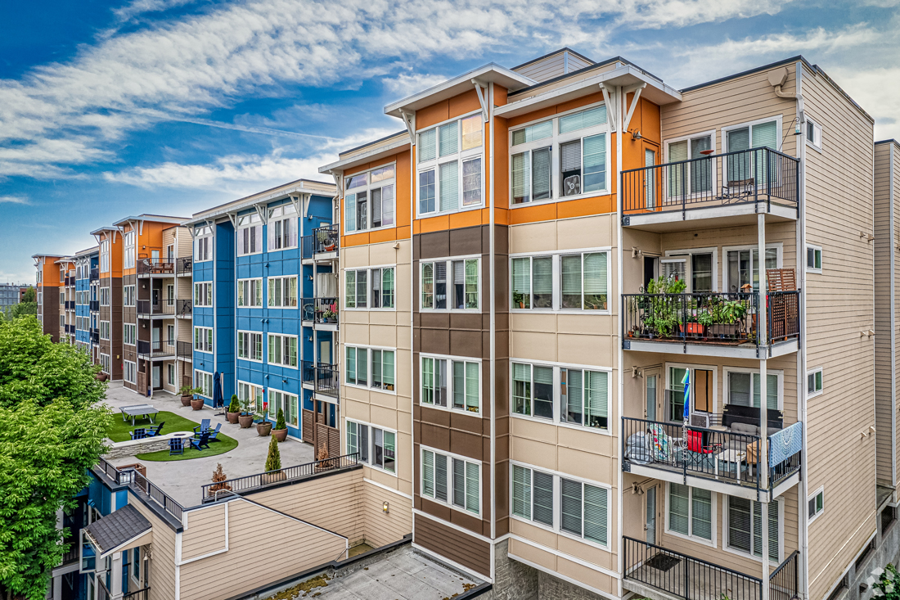

Slide 2
About us
Our cloud-based software is revolutionizing Housing, Economic, Community Development, Disaster Recovery-MIT, and Housing Choice Voucher program administration.
Serving 375+ clients (‘Neighbors’), we deliver efficiency, compliance, and data-driven insights that maximize community impact.
Our platform automates and simplifies the enrollment, administration, and reporting of 20+ Treasury & HUD programs.

Slide 3
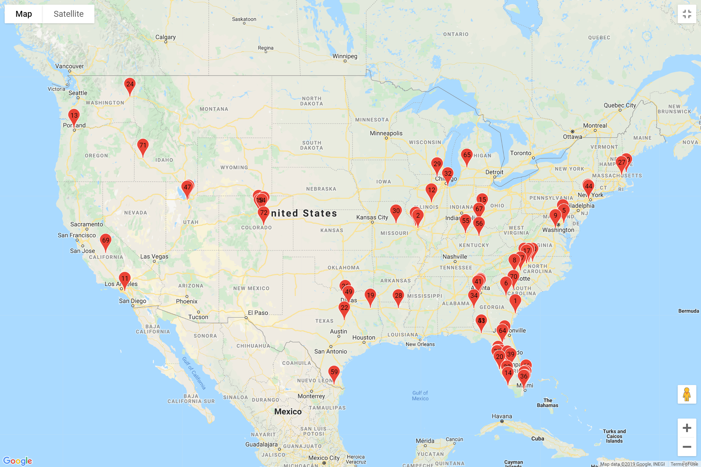
The Neighborhood : January 2020

Slide 4
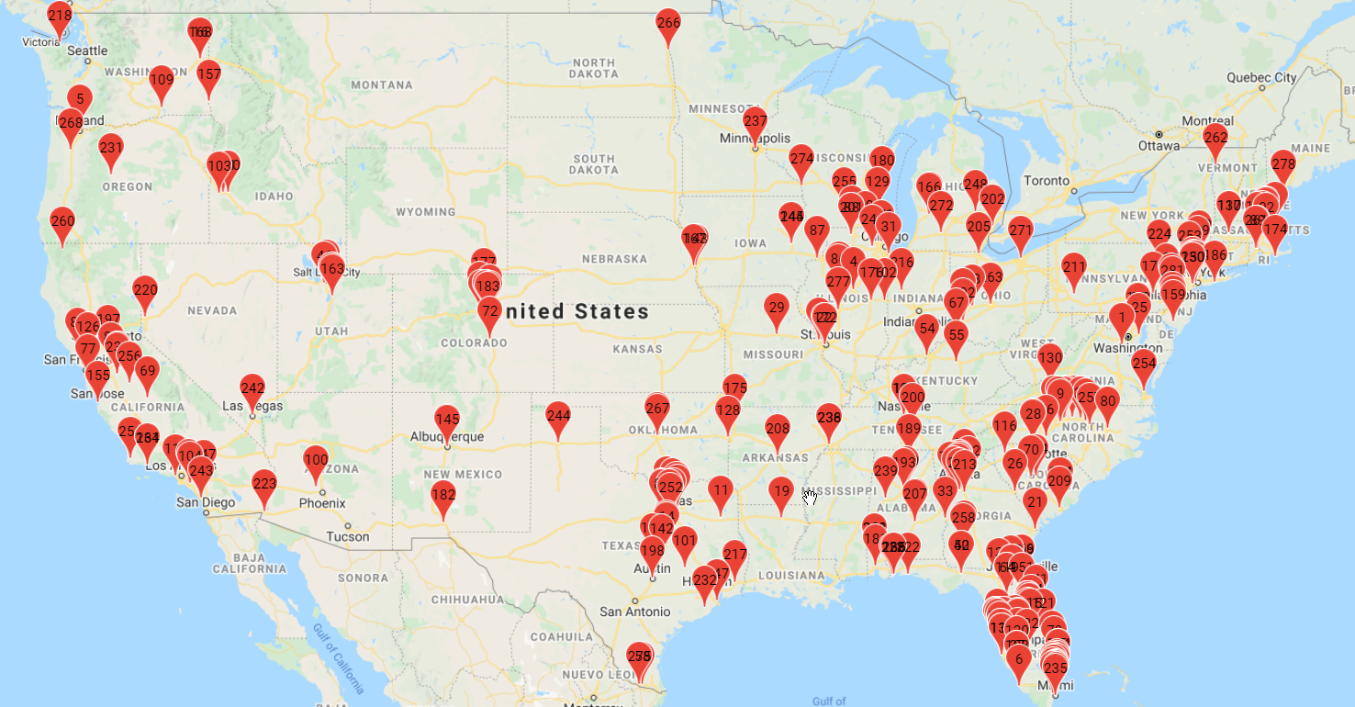
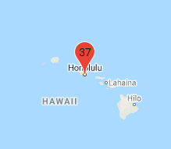
The Neighborhood : January 2023

Slide 5
Crazy 30+ months for HCD organizations
KEY CHALLENGES FACED
Historic Funding Allocations
Need to distribute huge sums of money in a short period of time
COVID-19
Ability to work from home
Great Resignation
Loss of knowledge capital
Affordable Housing
Homelessness crisis

Slide 6
OUR SOLUTIONS
Market-Leading Treasury & HUD Program Management
Helping Communities Help People
Housing, Economic &
Community Development Programs
Administer 20+ HECD activities with an end-to-end application designed specifically for the public sector.
Disaster Recovery – MIT Programs
Help your community recover from natural disasters by administering CDBG-DR and CDBG-MIT activities on an integrated, comprehensive platform.
Housing Choice Voucher Program
Simplify with a single, connected solution supporting every PHA function. Gain agency-wide oversight and streamline management of PHA’s, Housing Choice Vouchers, finance, and compliance.

Slide 7
Six Modules, One Comprehensive Solution
Grant Management
Case Management
Loan Processing
Construction
Asset Monitoring
Reporting
Accept, review and score grant applications
Process subrecipient draw requests
Submit accomplishment reports
Track funding & program income
Manage beneficiary information
Track household demographics
Upload & store case documents
Conduct audit reviews
Originate & track deferred, forgivable, and amortized loans
Complete underwriting
Generate loan documents
Produce Payoff Statements & 1098’s
Complete property inspections
Generate work write-ups
Accept online contractor bids
Process contractor draw requests
Evaluate housing unit affordability
Re-certify tenants
Complete property inspections
Manage cure notices
Complete monitoring
Produce standard HUD CAPERs reports
Create ad-hoc reports based on unique inquires
Export data to excel or third-party data mart
Display activities on a map

Slide 8
Software Designed to
Help Communities
Recover From Disasters
Enroll, administer & report for typical CDBG
Disaster Recovery – MIT programs, including:
Homeowner
Buyout
Economic
Revitalization
Public
Infrastructure
Housing Rehab/
Reconstruction
Disaster Mitigation/
Preparedness
Emergency
Repairs

Slide 9
Out-of-the-Box CDBG
Disaster Recovery- MIT
Program Management
CONFIGURE AND LAUNCH RECOVERY PORTAL IN AS LITTLE AS 48 HOURS
ACCELERATED
DISBURSEMENT OF FUNDS
ACCESS & COLLABORATION
FOR ALL STAKEHOLDERS
CREATE CATEGORIES OF TIE BACK & UPLOAD DIRECTLY TO SYSTEM
BEST PRACTICE
APPLICATIONS & CHECKLIST

Slide 10
HCV Software with a Fresh Approach
Get the right fit for your your HCV activities and
say goodbye to force-fitting into large, costly and complicated systems you don’t need
Comprehensive online access,
from waitlist to voucher close-out
Intuitive design organized around all your HCV workflows
Standard HUD & ad-hoc reports
available in one click

Slide 11
Connect & Empower Your Staff, Landlords & Tenants
APPLICANTS
TENANTS
-Apply for housing
-View waitlist status
-Upload & sign documents
-Complete household income
recertification
-Submit family self-sufficiency data
COMPLIANCE
OWNERS/
LANDLORDS
-Monitor timeliness of
re-examination
-Monitor SEMAP
indicators
-Conduct audit reviews
-Track key dates/
processing times
-Respond to cure notices
-Manage units
-Digitally sign RFTA
ADMINISTRATOR
INSPECTOR
-Enroll & qualify applicants
-Generate standard reports (RFTA, HAP, 50058, VMS)
-Manage & track HAP payments
-Process port-ins & port-outs
-Align & schedule inspections
-Complete property inspections
-Generate failed report

Slide 12
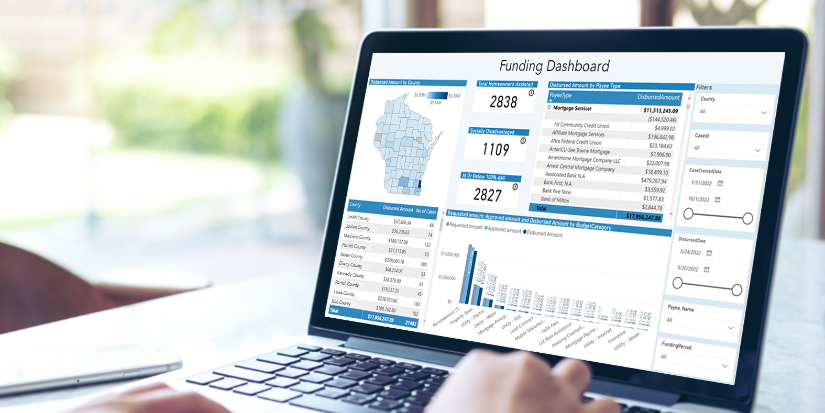
Neighborlytics Daas
Data as a Service
Sharper Insights.
More Informed Decision-Making.
Connect directly to your Snowflake Data Warehouse & eliminate APIs/ third-party data file sharing
Access your data through tables for Cases, Submissions, Audit Logs, Draws, Funding, Income Sources, Transactions
Stream analytics in near real-time (15-minute intervals)
Connect Snowflake with various reporting software
Create your own unique data pulls
Generate custom, embedded, and public visualization reports

Slide 13
Sales Territory Map
WA
ME
MT
ND
OR
MN
VT
NH
ID
SD
WI
MA
WY
MI
CT
IA
NJ
NV
NE
OH
DC
GU
UT
IL
IN
DE
CA
CO
VA
KS
MO
KY
TN
NC
AZ
OK
SC
VI
NM
AR
MS
AL
GA
PR
TX
LA
HI
Leah Larson
FL
Martin Greenlee
Leah Larson
Gloria O’Neal
Graham Levitas
360.964.0694
martin.greenlee@neighborlysoftware.com
Schedule a Meeting
208.598.6966
leah.larson@neighborlysoftware.com
Schedule a Meeting
404.449.5748
gloria.oneal@neighborlysoftware.com
Schedule a Meeting
404.229.9212
graham.levitas@neighborlysoftware.com
Schedule a Meeting

