Slide 2
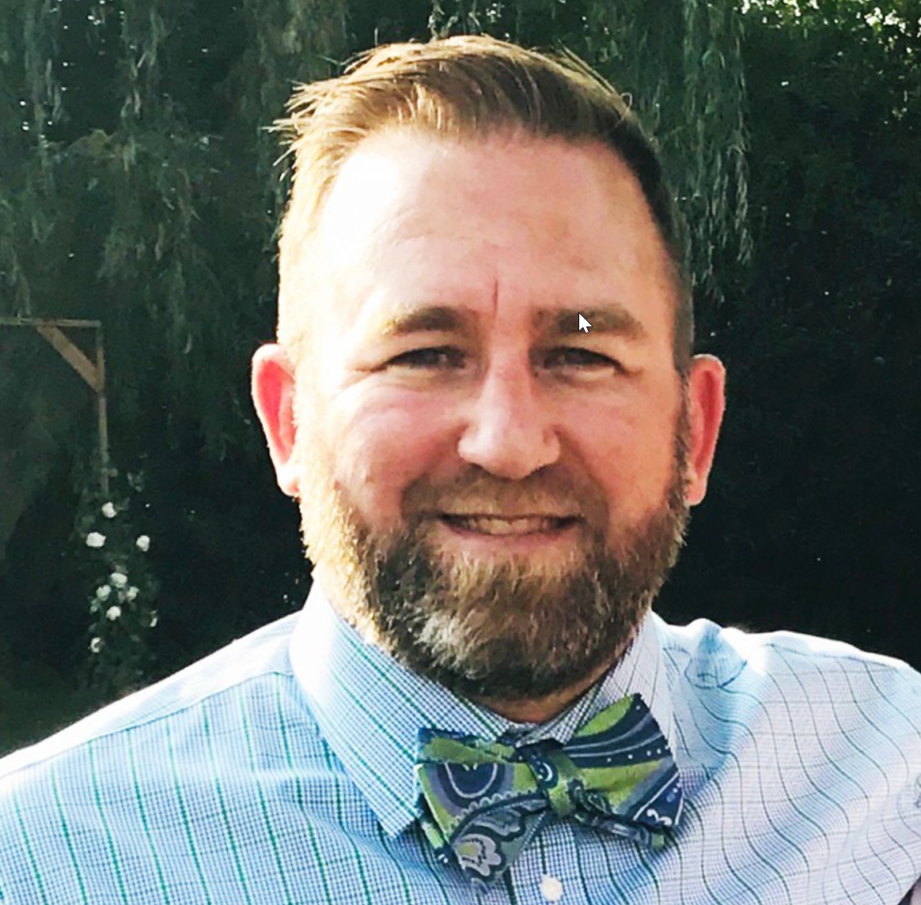
Introduction to Neighborly Software
Martin Greenlee
Senior Vice President, Sales
Martin.Greenlee@neighborlysoftware.com
Housing
Rehabilitation

Slide 3
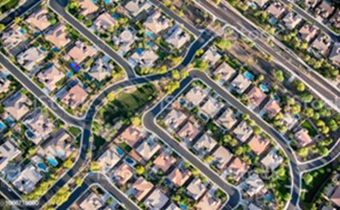
We Are Purpose-Driven & Mission-Ready
Our Mission
Our Solution
Our Team
We pride ourselves on our core values of Community, Innovation, Teamwork, Integrity, Enthusiasm & Service (CITIES). Our passion is Helping Communities
Help People.
An innovative software that has reinvented the way Housing, Economic & Community Development programs are administered.
With 275 public sector clients using our software and a team with over 150 years of experience implementing and/or administering govt. programs, we have a proven track record.

Slide 4
Partnerships + Community Development = the Neighborly Way
A Few of Our Public Sector Clients

Slide 5
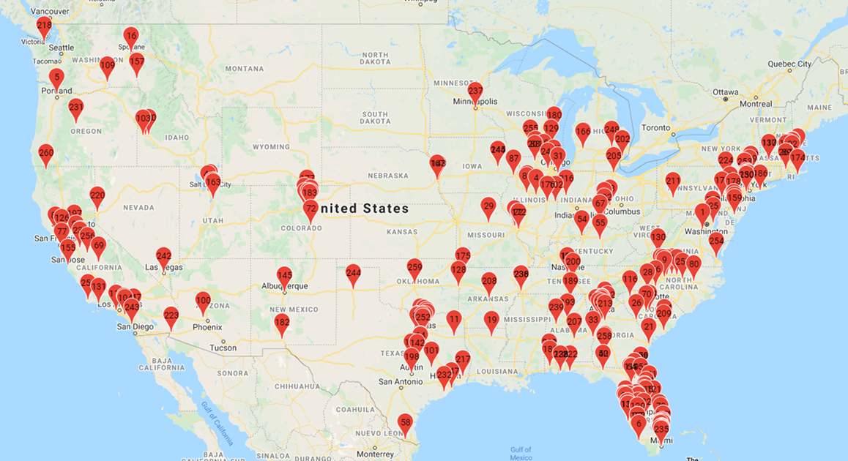
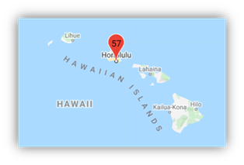
Our “Neighborhood” is 275+ Strong

Slide 6
Our Florida Neighbors
By County, City, and Organization (53 Neighbors)
Alachua County
Bradford County
Brevard County
Broward County
Charlotte County
Collier County
Columbia County
DeSoto County
Escambia County
Hardee County
Highlands County
Hillsborough County
Lee County
Leon County
Manatee County
Martin County
Orange County
Pasco County
City of Miami Beach
City of North Miami
City of North Miami Beach
City of Oakland Park
City of Orlando
City of Pompano Beach
City of Sarasota
City of St. Cloud
City of St. Petersburg
City of Tallahassee
City of Tamarac
City of Tampa
City of West Palm Beach
Jacksonville Bar Association
Opening Doors NW FL
Orlando Economic Partnership
Turning Points Manatee
Pinellas County
Polk County
Putnam County
Sarasota County
St. Lucie County
City of Clearwater
City of Daytona Beach
City of Deerfield Beach
City of Fort Myers
City of Fort Walton Beach
City of Gainesville
City of Hialeah
City of Jacksonville
City of Kissimmee
City of Lakeland
City of Largo
City of Lauderhill
City of Miami

Slide 7
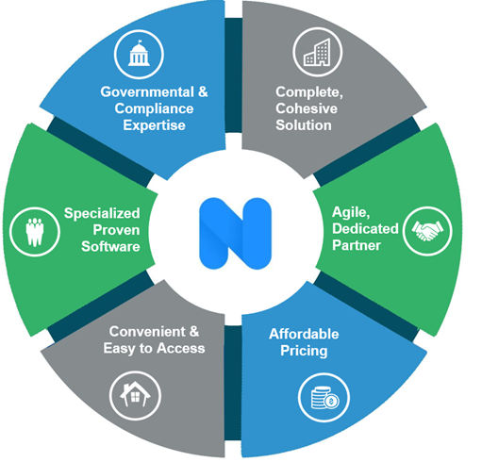
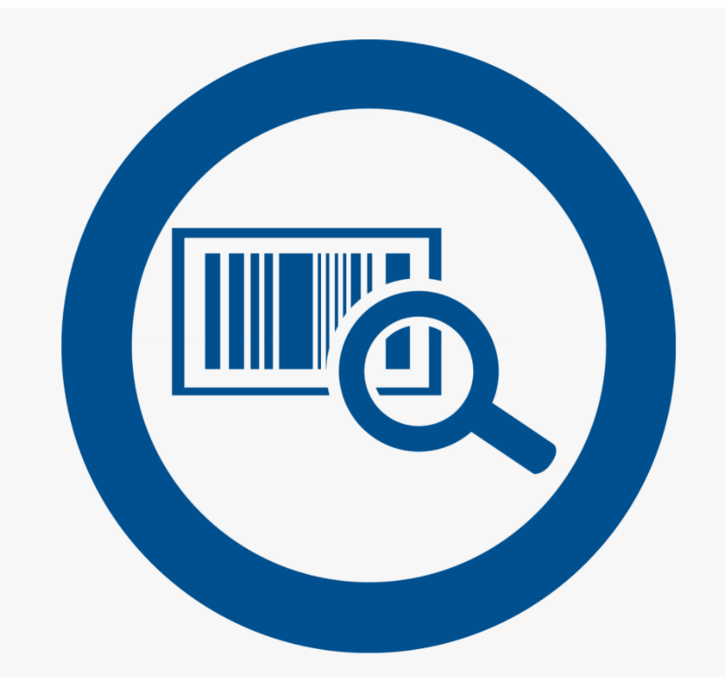
A Powerful, Adaptive Platform That Meets Your Unique Needs
Grant Management
Construction
Accept, review and score grant applications
Process subrecipient draw requests
Submit accomplishment reports
Track funding & program income
Complete property inspections
Generate work write-ups
Accept online contractor bids
Process contractor draw requests
Case Management
Asset Monitoring
Manage beneficiary information
Track household demographics
Upload & store case documents
Conduct audit reviews
Evaluate housing unit affordability
Re-certify tenants
Complete property inspections
Manage cure notices
Loan Processing
Originate & track loans
Complete underwriting
Generate loan documents

Slide 8
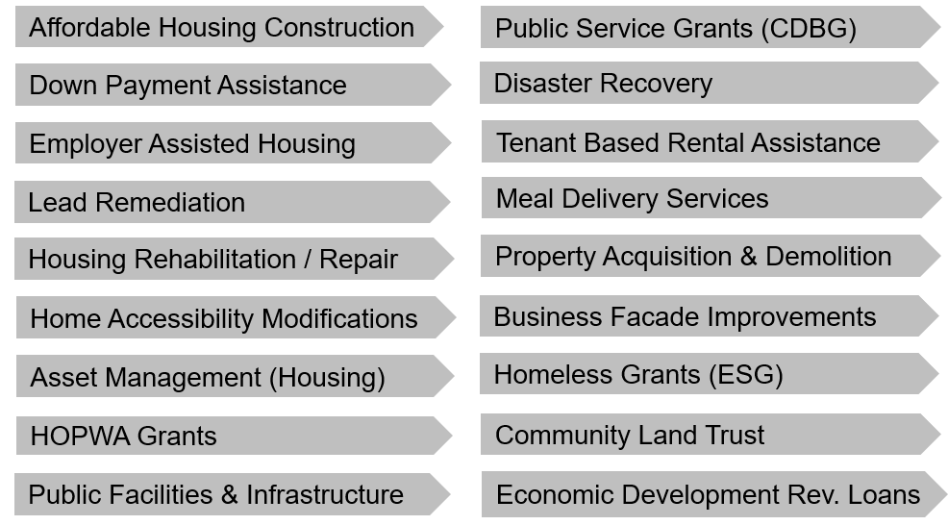
All Programs – Administered in an All-In-One Solution!
We Serve 20+ Different Housing, Economic
& Community Development Programs
CARES Act
Programs
Eviction Diversion / Foreclosure Prevention
Non-Profit/Food Pantry Assistance
Rent, Mortgage &Utility Assistance Programs
Small Business/Micro-Enterprise Assistance

Slide 9
Flexible Features – Designed to Work For You
Our Software is Extremely Scalable
& Designed to Streamline Workflows
Administrators
Property Managers
Enroll & qualify applicants
Manage projects and funding
Track and manage loans
Upload rent rolls
Respond to cure notices
Request rent increases
Subrecipients
Inspectors
Apply for grant/loan programs
Submit accomplishment reports
Make draw requests
Complete inspections (mobile)
Estimate project costs
Generate work write-ups
Reviewers
Contractors
Score applications
Make funding recommendations
& comments
Assign and invite other reviewers
Register & Update business info
Submit construction bids
Make draw requests
Beneficiaries
Apply for programs
Attest to annual program compliance
Check loan balances

Slide 10
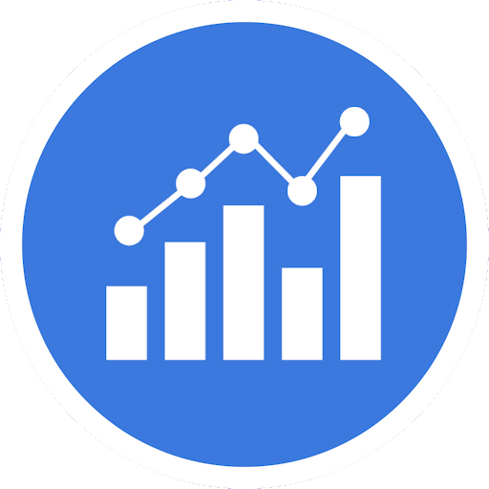
An Agile Partner, Dedicated to Improve Impact
We know the Challenges of Managing Federal/State funded Grant Programs
Inefficient Use of Resources
Long
Cycle
Times
Require Volumes of Paper
Manual Processes
Program Oversight & Compliance Challenges
Time-Consuming Reporting
Poor Beneficiary/
Sub Recipient
Experience
Untimely Distribution of Funds

Slide 11
A Single, Integrated Solution That Drives Efficiency
Online
Validation
Workflow
Eliminate rekeying data and filing paper copies with online application and document storage.
Reduce incomplete applications with software guided application and validation process.
Improve cycle time with automated workflow and approval routing.
Document Generation
Reporting
Self Service
Generate promissory notes, deeds and other program documents with the click of a mouse.
Understand program results with real time dashboards and
pre-configured reports.
Reduce inquiries by enabling self service access to account information 24/7.

Slide 12
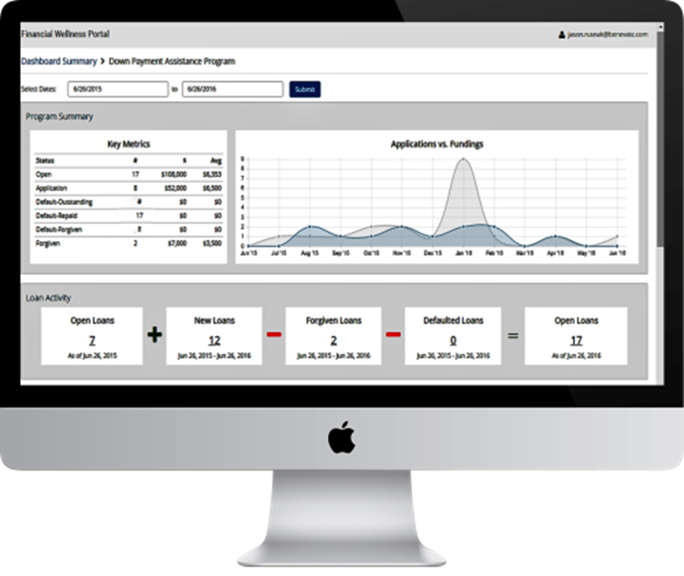
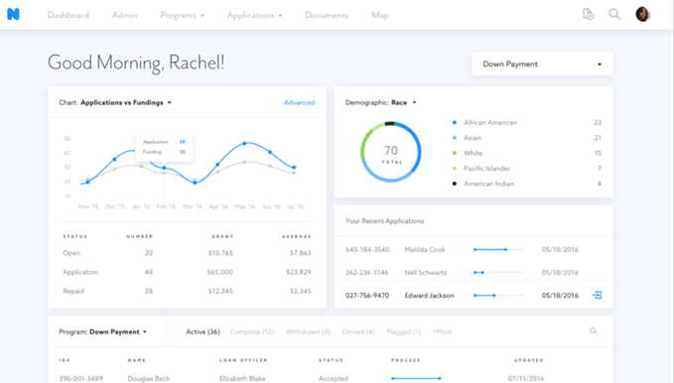
We Ensure Compliance & Minimize Fraud
“Oh good, the auditors are coming” – said nobody
Audit log that includes a time stamp of all transactions/ approvals completed
Ensure collection & storage of all beneficiary supporting documentation
Enforce principal residency requirements during the period of affordability
Reconcile & report on program income
Evaluate real-time, sub-recipient activities & results
Produce accurate & auditable CAPERs data

Slide 13
Security & Support You Can Count On
Hosted in the cloud by Microsoft Azure
All data stored in US FedRAMP certified Tier IV Microsoft datacenters
Geo-replication across multiple data centers for business continuity
Encryption of all data “at rest” and “in transit”
(no IT infrastructure required)
System accessed via web browser
Supported on all modern web browsers (i.e. Chrome, Firefox, Edge, Safari, IE v11+)
60+ languages available
Meets Tier 2 AA accessibility requirements
(no IT support required)
Automated data backups
Weekly data backups performed automatically and stored for 12 months
Point In Time Restore to any point within the last 35 days
Advanced security features
Tenant-specific audit log tracks all software activity with User Id and IP address logging
Session timeout warnings and auto-logout after 30 minutes of inactivity
Separate tenant database architecture logically isolates client data
*IT Hosting/Security FAQ available with additional information

Slide 14
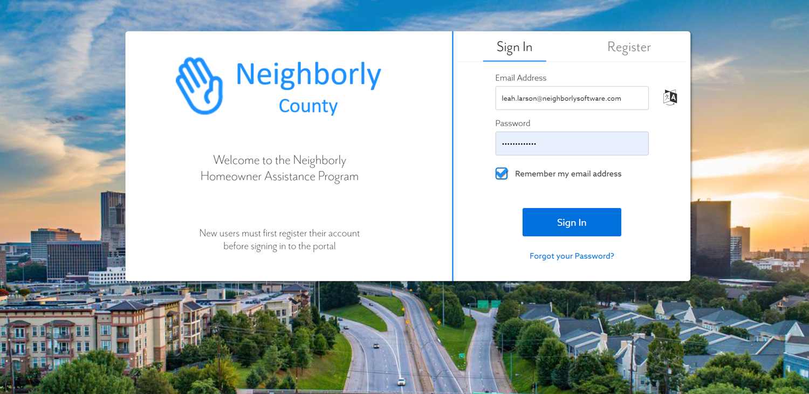
Custom branded portal, 60+ languages, and accessible

Slide 15
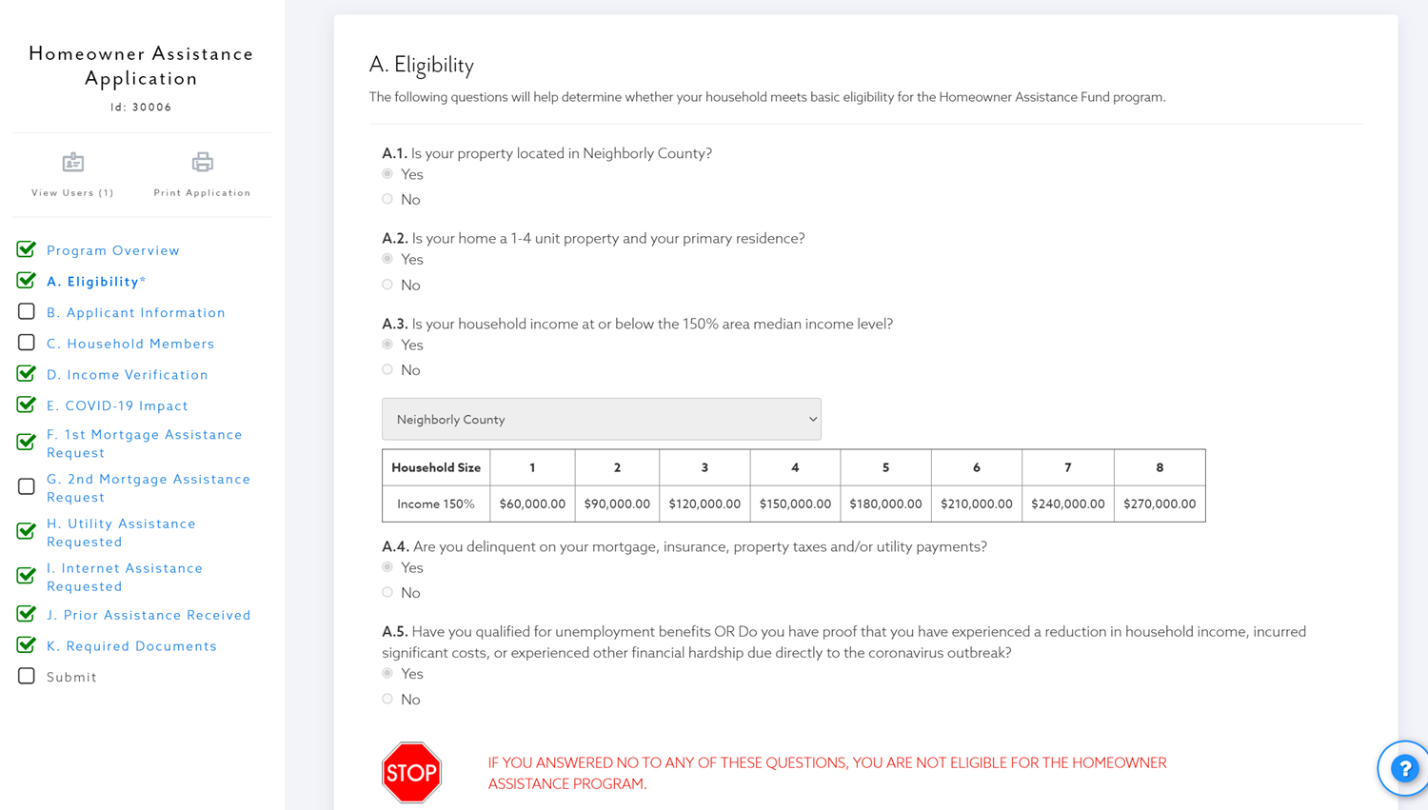
Intuitive Application for all applicant/participant types

Slide 16
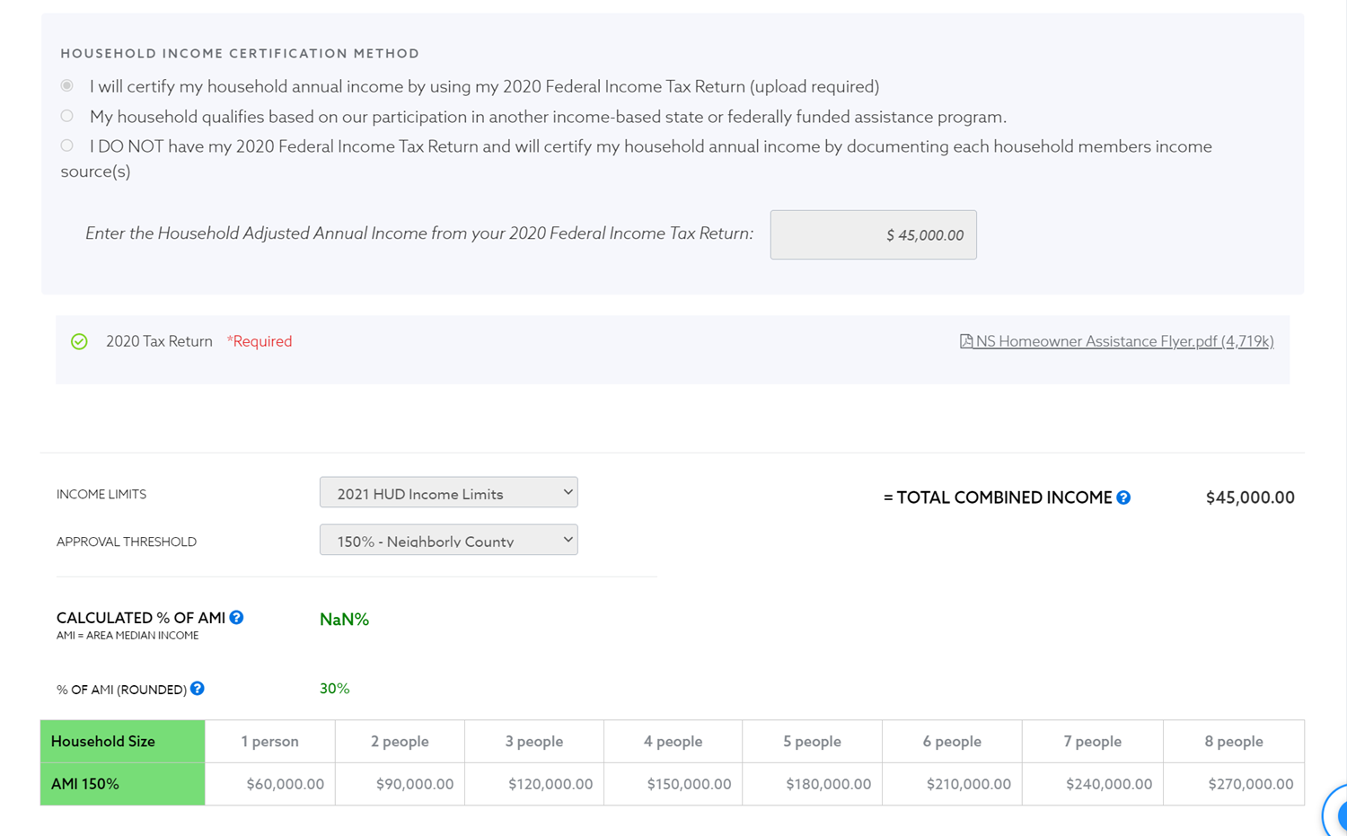
Supports multiple household income certification methods

Slide 17
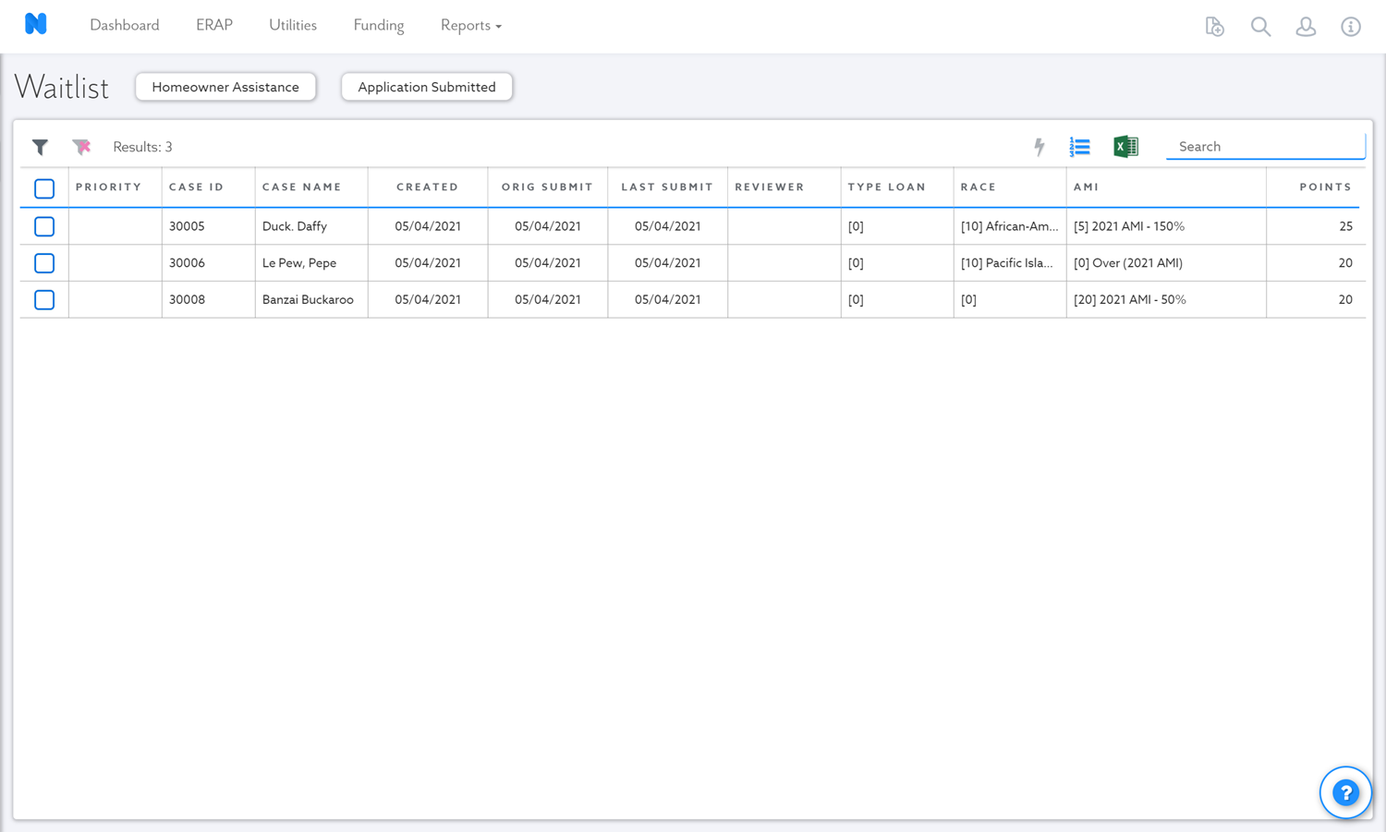
Prioritize review based on legislation/local-preference

Slide 18
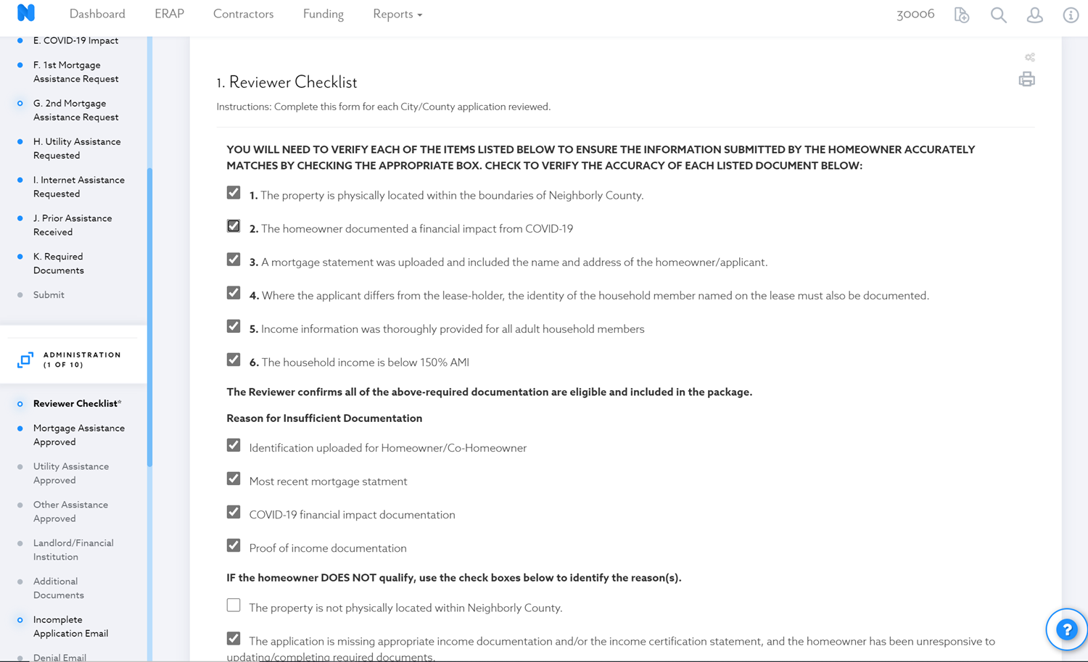
Ensure application review process is consistent and streamlined

Slide 19
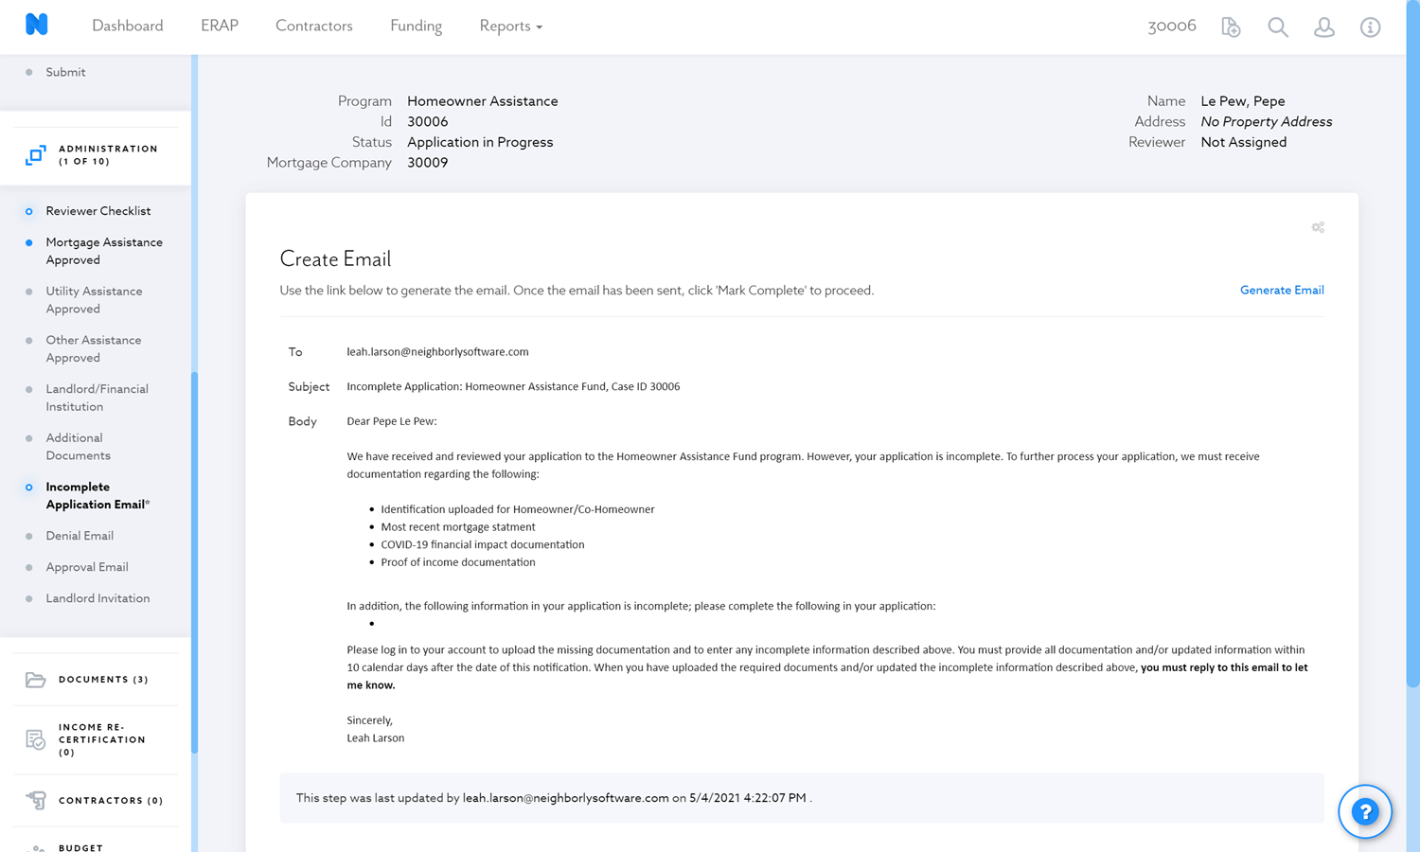
Generate approval, denial, and incomplete application emails via standard templates

Slide 20
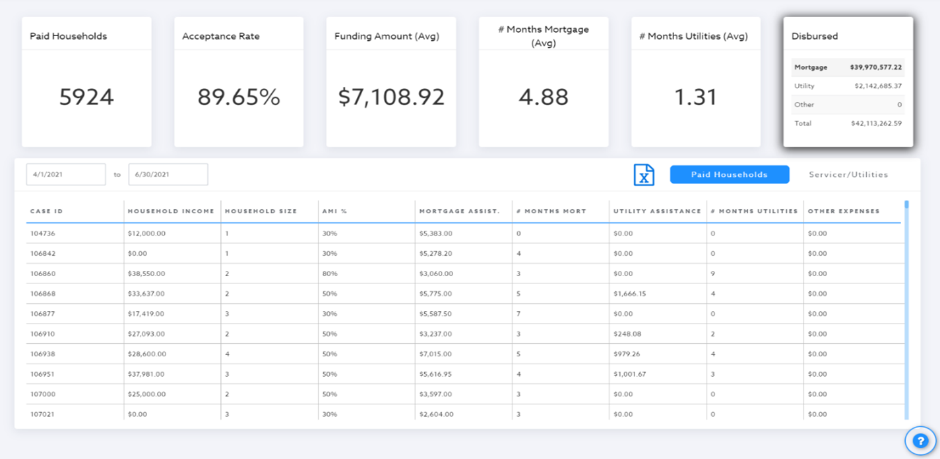
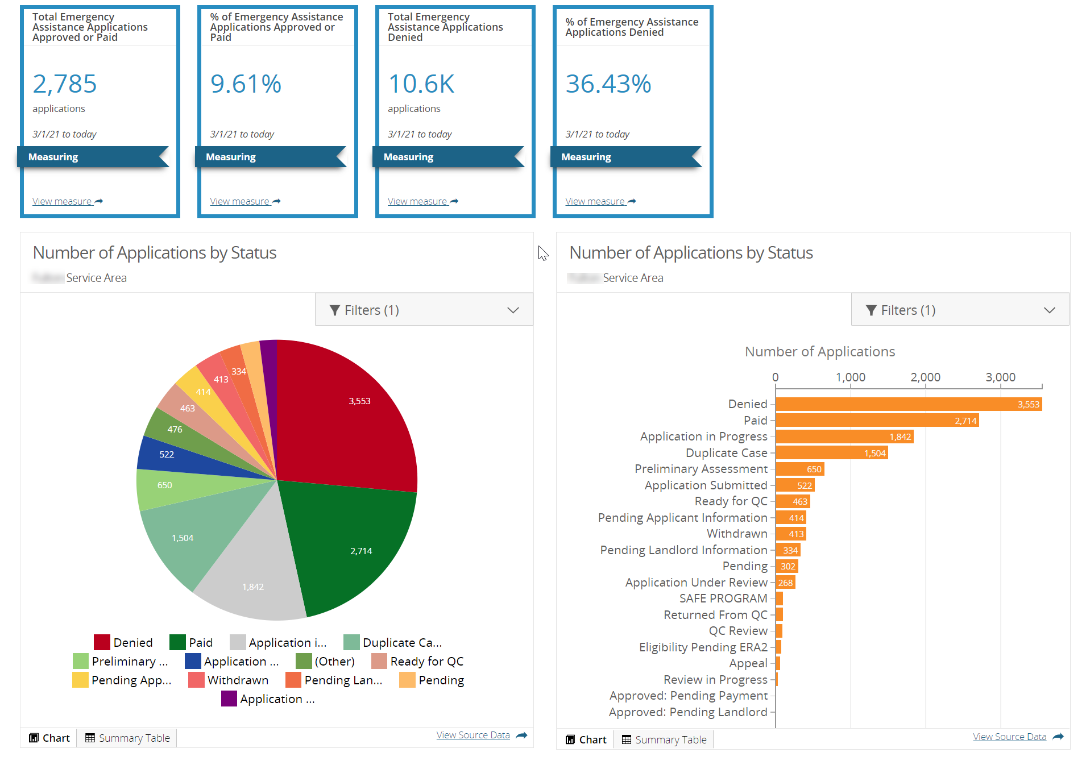
Custom Reporting and Reporting API

Slide 21
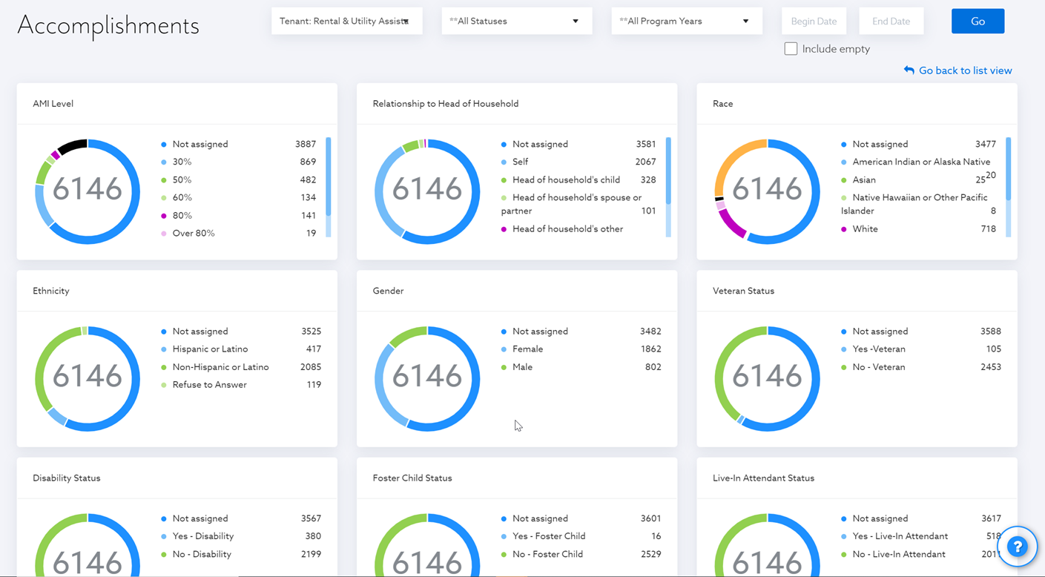
Accomplishment reporting unique to specific demographics

Slide 22
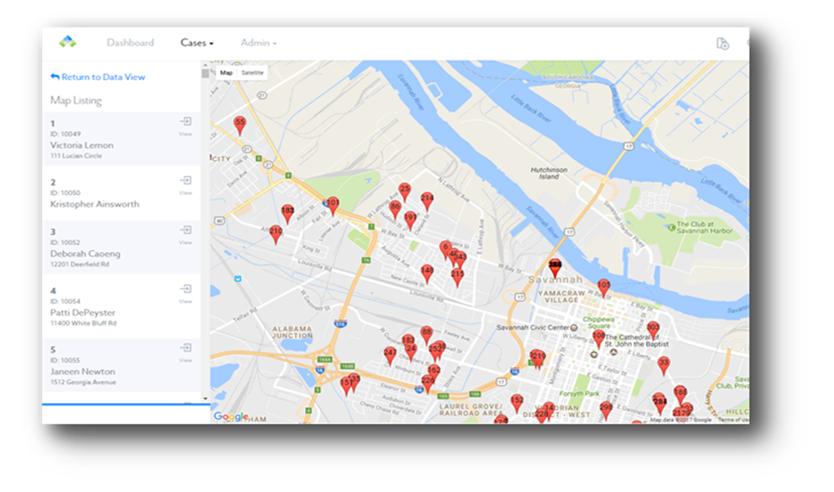
Plot all applicants/projects on a city/county/state-wide map

Slide 23
IMPLEMENTATION PROCESS

Slide 24
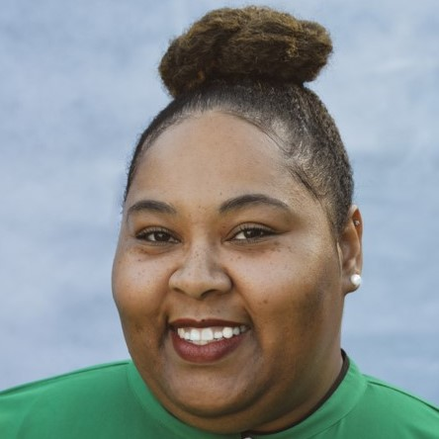
Implementation Process
Qiana Daughtry
Director, Implementation
Qiana.Daughtry@neighborlysoftware.com
Housing
Rehabilitation

Slide 25
Implementations
What we will cover:
Overview of the implementation process
Phases
How many programs do we implement at time?
Homework assignments
Meetings (5-6)
Transition to Client Success Team
Questions – feel free to interrupt me! ☺

Slide 26
Date | Event | Location | Key Activities
9/30 2PM | Kickoff Meeting (1 Hours) | Virtual | Demonstration of the software to all key stakeholders. Project objectives and software requirements are reviewed Implementation timeline is reviewed and required roles are identified. Implementation Guide is reviewed. Homework due date Wednesday, October 6th at 12pm
10/7 10AM EST | Workshop (2 Hours) | Virtual | Review completed Implementation Guide Review all historical data sources Review and recommend client best practices to incorporate Project requirements are finalized Historical data template is provided for data capture by client
10/21 9AM EST | Configuration Review Meeting #1 (3 Hours) | Virtual | First pass configuration is demonstrated to all key stakeholders. User credentials are given to administrators for testing – recommended that at least two existing cases are entered into the system for each program Detailed feedback is captured and incorporated into next review.
10/28 9AM EST | Configuration Review Meeting #2 (3 Hours) | Virtual | Second pass configuration is demonstrated to all key stakeholders, including draw approval workflow by program and Additional cases are entered in the system Historical data is uploaded into the system; client review and final acceptance testing begins Detailed feedback is captured and incorporated into next review.
11/4 1PM EST | Go-Live Administrator Training (4 Hours) | Virtual | Initial configuration is complete. Virtual training is conducted for all administrators
1-1.5 months post Go-Live | Neighbor System Admin. Training (4 Hours) | Virtual | Neighbor System Administrator(s) training is conducted for configuration tools

Slide 27
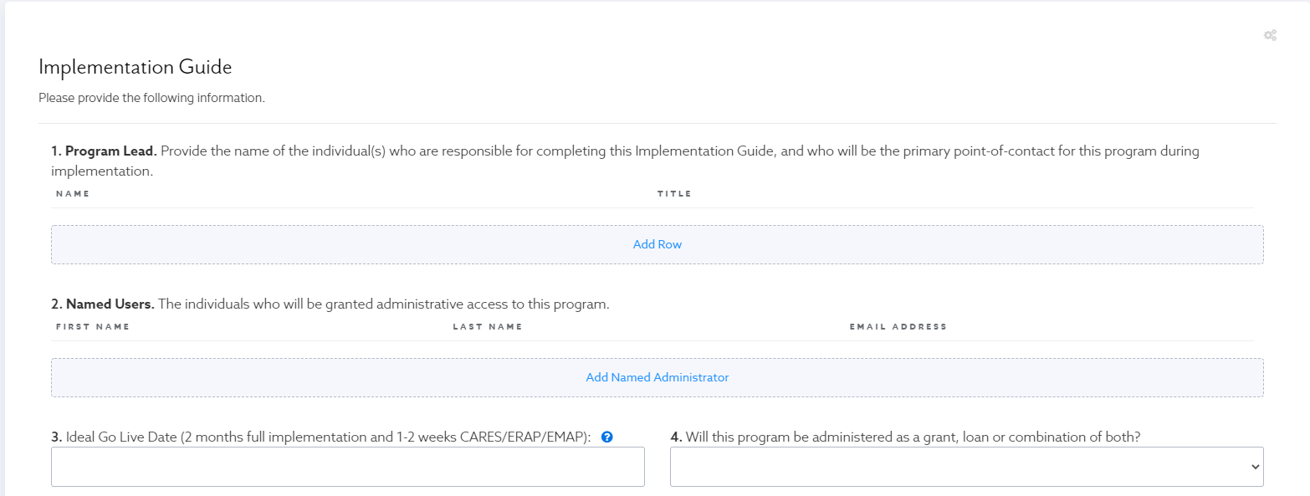
Implementation Guide

Slide 28
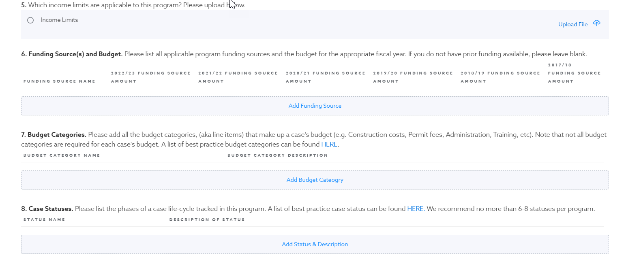
Implementation Guide

Slide 29
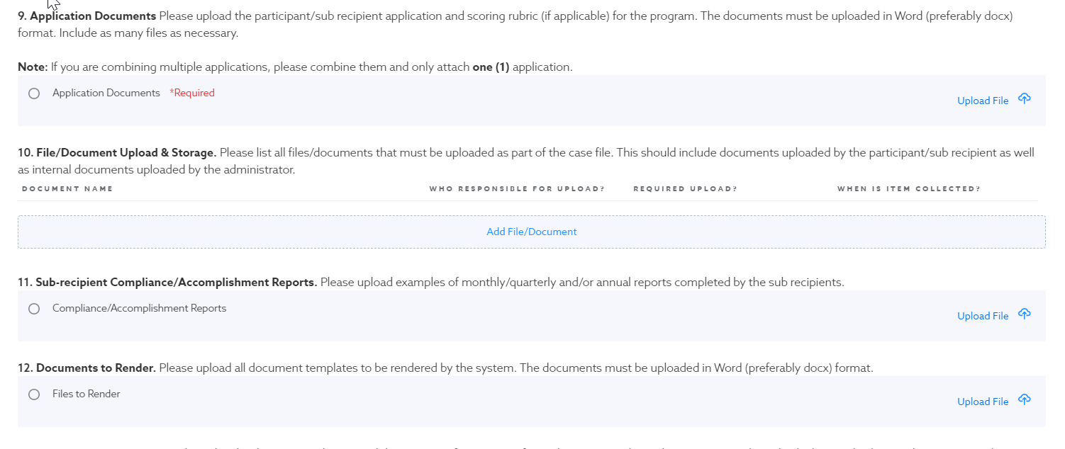
Implementation Guide

Slide 30
Implementation Guide

Slide 31
CLIENT SUCCESS

Slide 32
Neighbor (client) Success
Tanya Rustin
Director, Client Success
Tanya.Rustin@neighborlysoftware.com
Housing
Rehabilitation

Slide 33
Client Success
What we will cover:
Transition from the Implementation Team
What we do
Technical Assistance/Support and Self Training Resources
Optimization Process
Questions – feel free to interrupt me! ☺

Slide 34
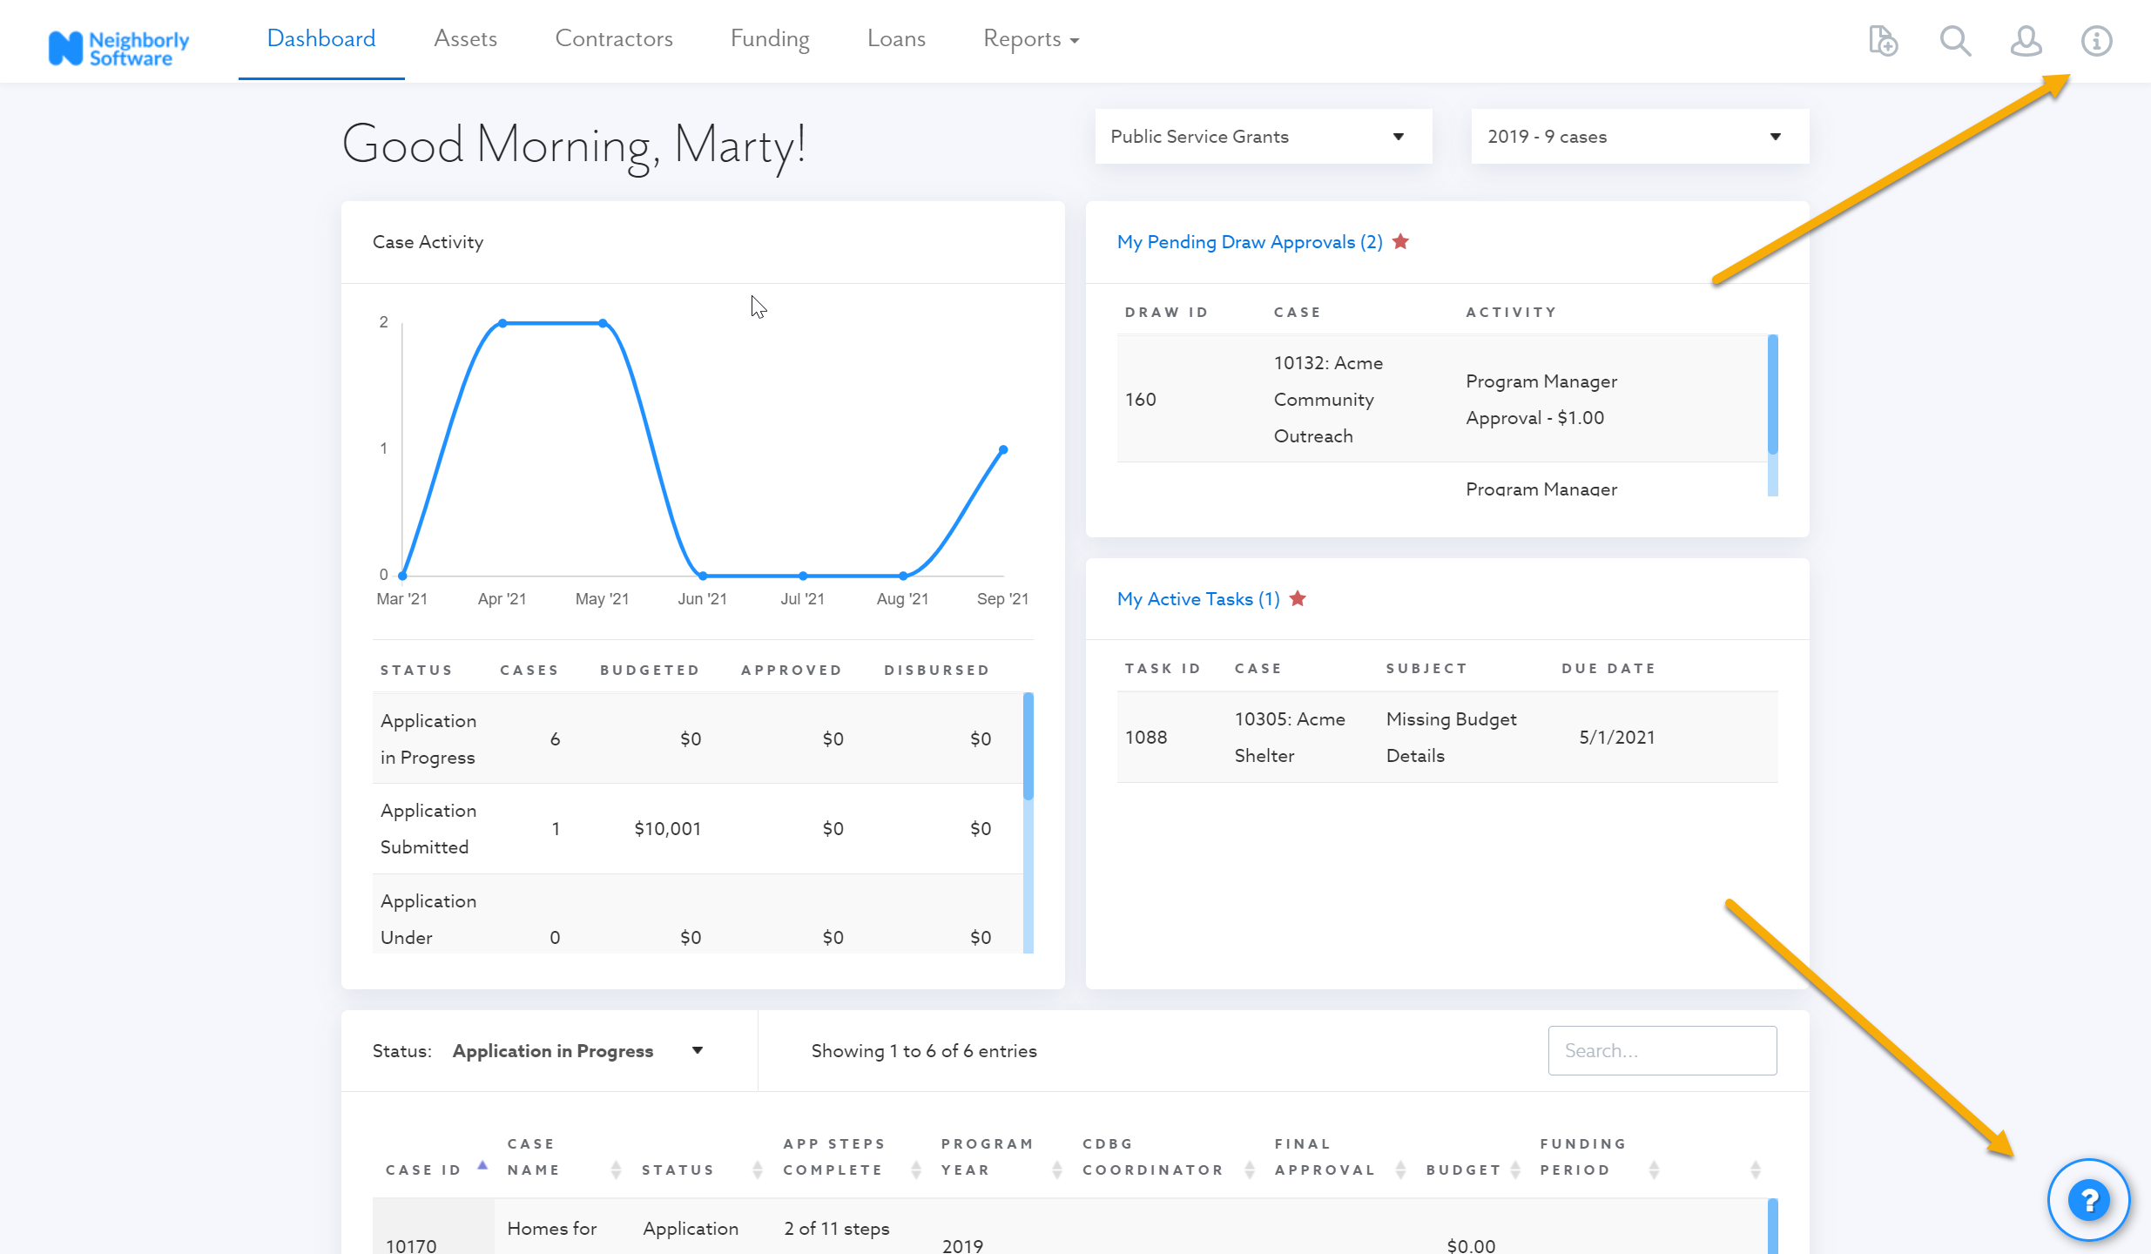
Easy to access technical assistance options

Slide 35
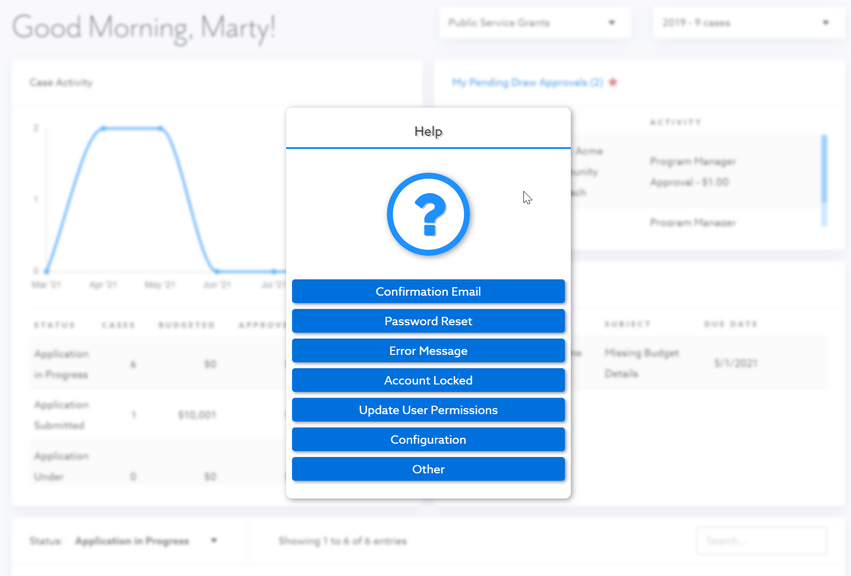
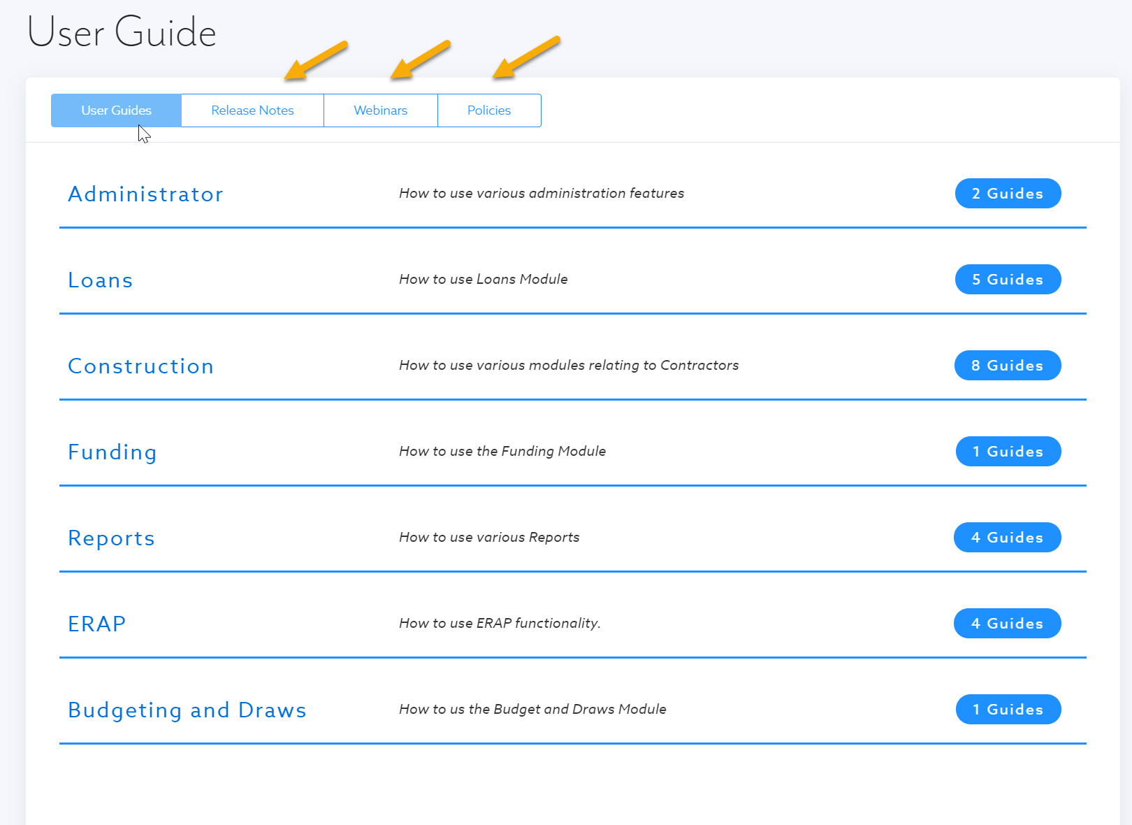
Easy to access technical assistance options

Slide 36
Optimization Review

Slide 37
Optimization Review

Slide 38
Optimization Review

Slide 39
Q & A
Thank you and a special thanks to our many Neighbors!
Request a Demo by going to
www.NeighborlySoftware.com
Thank you!

