Slide 1
Washington DC Update
Florida Community Development Association

Slide 2
American Rescue Plan Act
Status Update
HUD has played a central role in delivering relief to address COVID-19 related housing needs through the Biden administration’s $1.9 trillion American Rescue Plan.
In April, HUD announced an addition $3 million in available ARP funding to fight housing discrimination related to COVID-19.
Emergency Rental Assistance
The Treasury Department projects that $25 to $30 billion of combined ERA funds were spent or obligated by the end of 2021.
Treasury has also begun the process of reallocating underutilized funds from certain grantees to others who have already obligated or spent their funds.

Slide 3
Trending Housing Policies
Equity Action Plan
In April, HUD released its first ever Equity Action Plan in coordination with the Biden administration’s whole-of-government equity agenda.
HUD’s plan includes actions to reduce the racial homeownership gap and center equity in the delivery of services to people experiencing homelessness.
President Biden’s Fiscal Year 2023 Budget
President Biden’s FY 2023 budget requests $71.9 billion for HUD, about $11.6 billion more than the FY 2022 total.

Slide 4
Current Department of Housing and Urban Development (HUD) Initiatives
Homelessness
HUD launched House America, a national partnership with administration officials, states, and local governments to use ARP resources to rehouse at least 100,000 people experiencing homelessness and create 20,000 new affordable and permanent supportive housing units.
In March, HUD announced $2.6 billion in Continuum of Care awards to help individuals experiencing homelessness.

Slide 5
Rent Control and Expanding the Housing Credit
President Biden’s FY 2023 Budget Request
The budget request provides $8.8 billion for the Public Housing Fund, which provides grants to Public Housing Authorities to operate, maintain, and make capital improvements to the approximately 1.7 million residents of public housing.

Slide 6
Expanding the New Markets Tax Credit (NMTC)
The NMTC expires on December 31, 2025. The New Markets Tax Credit Extension Act (H.R. 1321), introduced by Reps. Terri Sewell (D-AL), and Tom Reed (R-NY) in 2021, would permanently extend the NMTC. The extension was included as part of the House-passed Build Back Better Act (H.R. 5376), which has stalled in the Senate.
The president’s FY 2023 budget includes provisions to make the NMTC permanent at $5 billion in annual credit authority.

Slide 7
Maximizing Resources for Affordable Housing and Community Development
Community Development Block Grants
President Biden’s FY 2023 Budget Request
The president’s request provides $3.8 billion for the Community Development Block Grant (CDBG) Program, including $195 million in targeted resources to remove barriers and revitalize 100 of the most historically underserved neighborhoods in the United States, and $86 million for fair housing programs for targeted and coordinated enforcement, education, and outreach.
CDBG received $3.3 billion in the final FY 2022 budget.

Slide 8
Maximizing Resources for Affordable Housing and Community Development
President’s FY 2023 Budget
President Biden’s budget requests $35 billion for the Housing Supply Fund, a new mandatory program providing grants to State and local housing finance agencies and their partners to invest in strategies to increase the supply of affordable housing.
The Budget also proposes $15 billion to fully fund renewals and amendments in the Project-Based Rental Assistance (PBRA), Housing for Persons with Disabilities, and Housing for the Elderly Programs, along with $180 million for new development in Section 202 Housing for the Elderly and Section 811 Housing for People with Disabilities.
In the final FY 2022 budget, PBRA received $13.9 billion.

Slide 9
HOME Investment Partnerships Program, Section 4 Capacity Program, and PHA programs
HOME Investment Partnership
Through ARP funding, HUD made $5 billion available to state and local governments to reduce homelessness and increase housing stability.
Provided financing for rental housing development, acquisition, and development of non-congregate shelter, tenant-based rental assistance, and supportive services.
Public Housing Authorities (PHAs)
HUD awarded 70,000 Emergency Housing Vouchers to PHAs through funding made available by ARP.
FY 2023 Budget
The president’s FY 2023 budget requests $1.95 billion for the HOME Investment Program.
In the final FY 2022 budget, the Home Investment Program received $1.5 billion.

Slide 10
Advancing Fair Housing and Racial Equity through Housing and Community Development
Advancing Equity in Appraisals
HUD released its action plan for the Interagency Task Force on Property Appraisal and Valuation Equity (PAVE) aimed at eliminating racial bias in the home lending and appraisal process.
Fair Housing Initiatives Program (FHIP)
HUD has awarded more than $16 million in ARP funding to assist 62 FHIP agencies in combating housing discrimination relating to COVID-19.
The funds focus directly on the unequal impact COVID-19 has had on communities of color, low-income communities, and other vulnerable populations.

Slide 11
Strengthening Accountability and Transparency and Promoting Equitable Investments through Opportunity Zones
The bipartisan Opportunity Zones Transparency, Extension, and Improvement Act (S. 4065), introduced by Sen. Cory Booker (D-NJ) in April would extend the incentive through the end of 2028, decertify zones that are not impoverished, and provide grants to enable states to drive capital to underserved businesses and communities.

Slide 12
Ensuring Housing Finance Reform and CRA Modernization Strengthen and Expand Affordable Housing Investments
Martin Gruenberg, Acting Chair of the Federal Deposit Insurance Corporation (FDIC), released a statement stating that strengthening the CRA is one of five areas of emphasis for FDIC in 2022.
The president’s FY 2023 budget includes provisions to allow selective basis boosts for bond-financed affordable housing properties, which pair with 4 percent low-income housing tax credits (LIHTCs).

Slide 13
Supporting Investments in Housing as Part of Our Nation’s Infrastructure
Reconciliation Outlook
Despite not being included in the IIJA, housing programs were funded through the Build Back Better Act.
This proposal included $170 billion to build and support affordable housing.
The president’s reconciliation package is currently stalled in the Senate following Sen. Joe Manchin’s (D-WV) rejection of the existing proposal.
Sen. Manchin’s primary concerns was related to inflation, which has not subsided since December. As a result, passage of the Build Back Better Act has only become more tenuous.
President Biden’s FY 2023 Budget
The request provides $32.1 billion for the Housing Choice Voucher Program, which accommodates 200,000 new vouchers - the largest one-year increase in vouchers since the program was authorized in 1974.

Slide 14
Providing More Resources and Better Guidance to Communities for Improved Environmental and Disaster Recovery and Resilience
President Biden’s FY 2023 Budget
The proposal provides $1.1 billion in targeted climate resilience and energy efficiency improvements in public housing, Tribal housing, multifamily-assisted housing, and other assisted housing.
The budget request also provides $400 million to remove dangerous health hazards from homes, including mitigating threats from fire, lead, carbon monoxide, and radon.

Slide 15
Infrastructure Investment and Jobs Act
Implementation
On November 15, 2021, President Joe Biden signed into law the Infrastructure Investment and Jobs Act (“IIJA”), a five-year, $1 trillion comprehensive infrastructure package that includes funding for transportation – roads, bridges, ports, airports, rail, and transit – as well as water infrastructure, broadband, power infrastructure, and climate resiliency.
Following bipartisan negotiations in the Senate, housing provisions were ultimately not included in the IIJA.
The bill contains $550 billion in new spending over baseline numbers and over $100 billion in competitive grant funding.
Additional program funding for the IIJA was made available in March following the passage of the Fiscal Year 2022 Appropriations legislation.

Slide 16
How the Funding Flows
Two Primary Funding Methods
Discretionary Grants: Discretionary, or competitive grant programs, are run by the operating administrations who solicit applications and select projects based on program eligibility, evaluation criteria, and departmental or program priorities. Examples include the RAISE or INFRA grant programs.
Formula Grants: Formula grant programs allocate funding to recipients based on formulas set by Congress. The Urbanized Area Formula Grants is an example of one such program.

Slide 17
Highways
Federal Highway Administration (FHWA) competitive grants for nationally significant bridges and other bridges ($12.5B, new): This new competitive grant program will assist state, local, federal, and tribal entities in rehabilitating or replacing bridges, including culverts. Large projects and bundling of smaller bridge projects will be eligible for funding.
Reconnecting Communities Pilot Program ($1B, new): This new competitive program will provide dedicated funding to state, local, MPO, and tribal governments for planning, design, demolition, and reconstruction of street grids, parks, or other infrastructure.
FHWA Nationally Significant Federal Lands and Tribal Projects ($1.5B, expanded): This discretionary program provides funding for the construction, reconstruction, and rehabilitation of nationally significant projects within, adjacent to, or accessing federal and tribal lands. The bill amends this program to allow smaller projects to qualify for funding and allows 100% federal share for tribal projects.

Slide 18
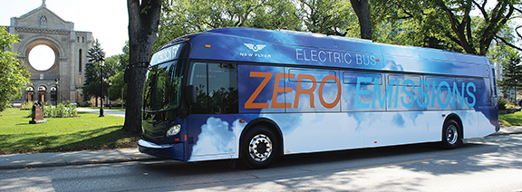
Transit
FTA Low and No Emission Bus Programs ($5.6B, expanded): The IIJA expands this competitive program which provides funding to state and local governmental authorities for the purchase or lease of zero-emission and low-emission transit buses as well as acquisition, construction, and leasing of required supporting facilities. This application is currently open.
FTA Buses and Bus Facilities Competitive Program ($2B, expanded): This program provides competitive funding to states and direct recipients to replace, rehabilitate, and purchase buses and related equipment and to construct bus-related facilities including technological changes or innovations to modify low- or no-emission vehicles or facilities. This application is currently open.

Slide 19
Transit
Capital Investment Grants (CIG) Program ($23B, expanded): The bill guarantees $8 billion, and authorizes $15 billion more in future appropriations, to invest in new high-capacity transit projects communities choose to build. The bill provides funds that may support the 25 projects included in the FTA’s Annual Report on Funding Recommendations for FY22, as well as additional projects across the country seeking CIG funding over the next five years. Projects must meet CIG program requirements to receive funding.
FTA All Station Accessibility Program ($1.75B, new): This competitive grant program will provide funding to legacy transit and commuter rail authorities to upgrade existing stations to meet or exceed accessibility standards under the Americans with Disabilities Act.

Slide 20
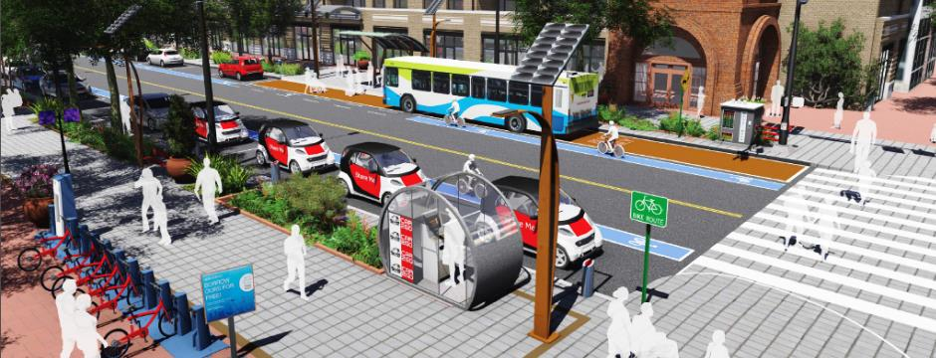
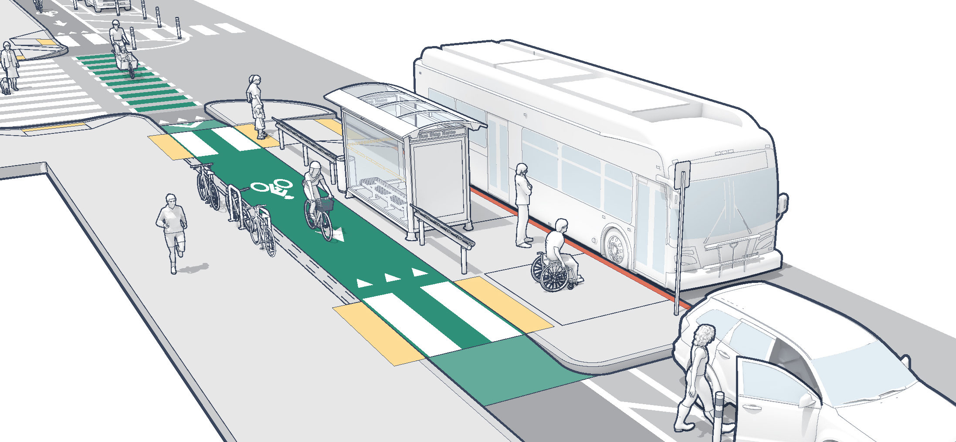
Multimodal Projects
Rebuilding American Infrastructure with Sustainability and Equity (RAISE) Grants ($15B, expanded): Will support surface transportation projects of local and/or regional significance. Adds tourism to the grant criteria.
Infrastructure for Rebuilding America (INFRA) Grants ($14B, expanded): Will offer needed aid to freight infrastructure by providing funding to state and local government for projects of regional or national significance. The bill also raises the cap on multimodal projects to 30% of program funds. This grant opportunity is currently open.
MEGA Projects ($15B, new): This new National Infrastructure Project Assistance grant program will support multi-modal, multi-jurisdictional projects of national or regional significance. This grant opportunity is currently open.

Slide 21
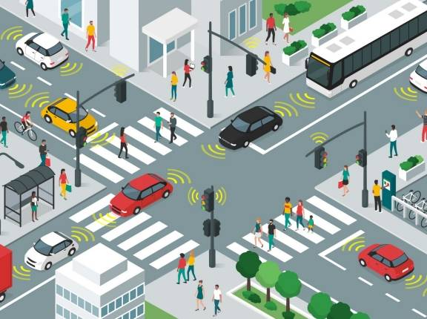
Safety
Safe Streets for All ($6B, new): This program will provide funding directly to local and tribal governments to support their efforts to advance “vision zero” plans and other improvements to reduce crashes and fatalities, especially for cyclists and pedestrians.
Strengthening Mobility and Revolutionizing Transportation (SMART) Grant Program ($1B, new): This program will be a programmed competition that will deliver competitive grants to states, local governments, and tribes for projects that improve transportation safety and efficiency.

Slide 22
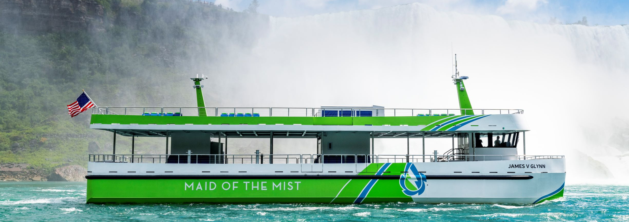
Port/Ferry
Port Infrastructure Development Program ($2.25B, expanded): The IIJA will double the level of investment in port infrastructure and waterways, helping strengthen our supply chain and reduce pollution.
5307 Ferry Program ($150M, existing): The bill retains the $30 million per year passenger ferry program for ferries that serve urbanized areas.
Electric or Low Emitting Ferry Program ($500M, new): This competitive grant program will support the transition of passenger ferries to low- or zero-emission technologies.
Rural Ferry Program ($2B, new): This competitive grant program will ensure that basic essential ferry service continues to be provided to rural areas by providing funds to states to support this service.

Slide 23
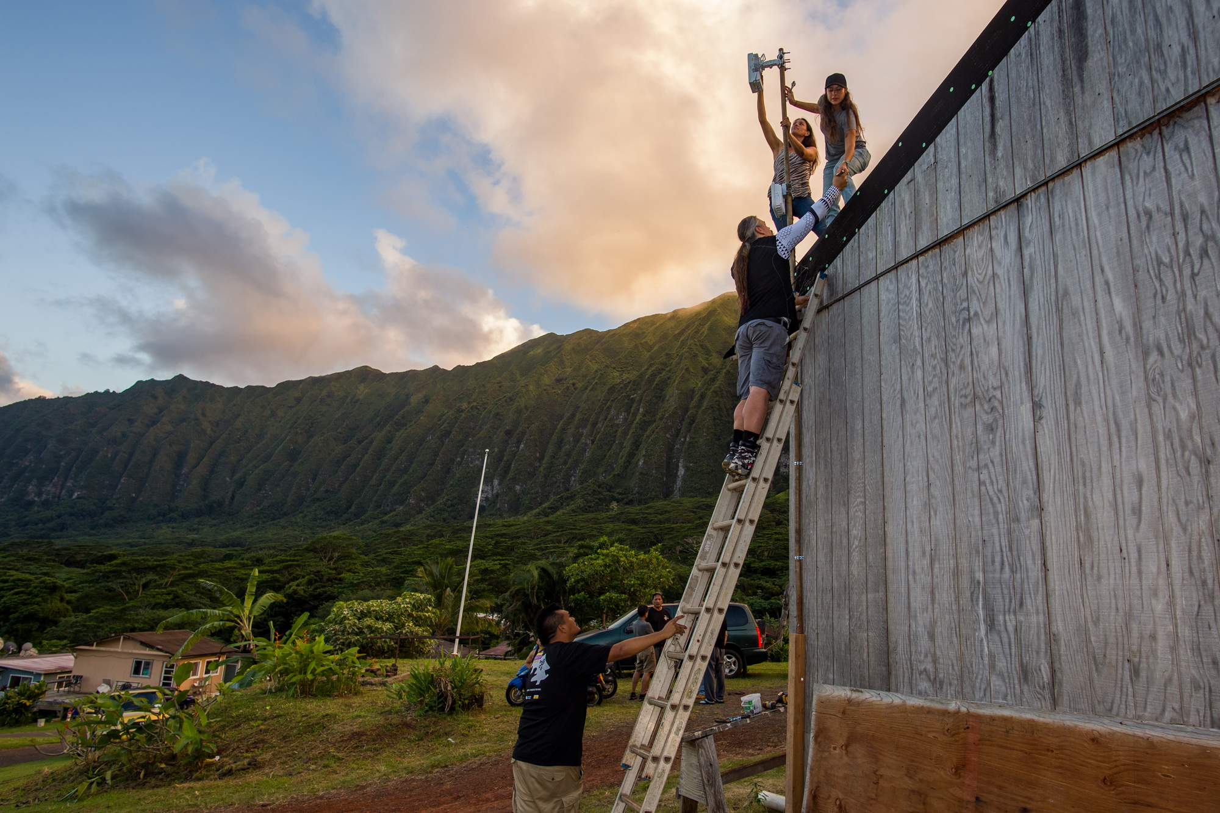
Broadband
Broadband Equity, Access, and Deployment (BEAD) Program ($42.5B, new): Each state will receive a minimum of $100 million and each territory a minimum of $20 million for broadband expansion and/or affordability. The remaining funding will be distributed based on a formula that considers the number of unserved and high-cost locations in the state, based on maps to be published by the FCC in 2022.
Tribal Broadband Connectivity Grant Program ($2B, existing): The IIJA provides $2 billion in additional funding to this competitive grant program that directs funds to tribal governments to be used for broadband deployment on tribal lands, as well as for telehealth, distance learning, broadband affordability, and digital inclusion.

Slide 24
Broadband
Digital Equity Act Programs ($2.75B, new):
State Digital Equity Planning Grant Program ($60M, new): This new formula grant program for states and territories will fund the development of digital equity plans.
State Digital Equity Capacity Grant Program ($1.44B, new): This new formula grant program for states and territories will distribute funds to implement digital equity projects and support the implementation of digital equity plans.
Digital Equity Competitive Grant Program ($1.25B, new): This new competitive grant program will fund the implementation of digital equity projects, such as those that accelerate the adoption of broadband through digital literacy training, workforce development, devices access programs, and other digital inclusion measures.
Enabling Middle Mile Broadband Infrastructure Program ($1B, new): This new competitive program will fund the construction, improvement or acquisition of middle mile infrastructure that reduces the cost of connecting unserved and underserved areas to the internet backbone.

Slide 25
Energy
Grants for Electric Vehicle Charging and Fueling Infrastructure ($7.5B, new): This funding will be divided between a competitive grant program ($2.5B) and a formula funding program ($5B) to support states and localities in deploying EV charging stations and ensuring equitable access for rural areas.
Electric Grid Reliability and Resilience Funding ($11B, new): A portion of the funding ($5B) will be distributed to states and electric grid operators via a formula based on population and probability of natural disasters to support grid resilience against natural disasters. The rest of the funding ($6B) will go to creating a competitive grant program for states, localities, and public utilities for projects related to electricity transmission and resilience.
Clean Energy Demonstration Program on Mine Land ($500M, new): This funding will be used to support five clean energy demonstrations on current and former mine land. At least two of the projects must be focused on solar energy, but the other projects can involve direct air capture, energy storage, and advanced nuclear technologies.

Slide 26
Energy
Advanced Nuclear Reactor Demonstration Program ($3.2B, new): This funding establishes a new competitive grant program to support demonstration projects that advance the research and development of affordable nuclear energy technology.
Carbon Capture Demonstration and Pilots ($2.9B, new): This funding will create a competitive grant program for carbon capture pilot projects, with a portion of the funding ($2B) going to support the construction of five carbon capture demonstration programs.

Slide 27
Drinking and Wastewater
Drinking Water State Revolving Fund (DWSRF) and the Clean Water State Revolving Fund (CWSRF) ($23.4B, existing): These programs are partnerships that provide communities low-cost financing for a wide range of water quality infrastructure projects.
Lead Service Line Replacement ($15B, new): The funding for lead service line replacement would allow up to 49 percent to be distributed as loans that can be forgiven and the remaining 51 percent awarded as low-interest loans that would have to be repaid.
Addressing PFAS ($10B, new): The funding will address per- and polyfluoroalkyl substances (PFAS) in water sources. Of the $10B, $1B is directed to address emerging contaminants in wastewater through the CWSRF, $4B is directed to address PFAS in drinking water through the DWSRF, and $5B is allocated for small and disadvantaged communities to address emerging contaminants. Participants in the programs would be eligible for loan forgiveness.
Sewer and Stormwater Grants ($1.4B, existing): The funding would be used for sewer overflow and stormwater reuse municipal grants.

Slide 28
Other Programs
Electric or Low-Emitting Ferry Pilot Program ($250 million, new): This new competitive grant program will provide DOT with funding for five years for the purchase of low or no-emitting ferries. Funds can also be used for electrification and reduction of emissions from existing ferries.
Clean School Bus Program ($5 billion, new): This new competitive grant program provides $1 billion per year for five years to replace school buses, with a priority on rural and low-income communities. Fifty percent of funds are for zero-emission buses, and 50 percent are for low-emission buses.
FEMA Building Resilient Infrastructure and Communities (BRIC) Competitive Grant Program ($1 billion, existing): IIJA provides $200 million per year in competitive funds to support pre-disaster mitigation activities. Examples of BRIC projects include those “that demonstrate innovative approaches to partnerships, such as shared funding mechanisms, and/or project design.”
FEMA Flood Mitigation Assistance (FMA) Competitive Grant Program ($3.5 billion, existing): IIJA provides $700 million per year to provide assistance to communities seeking to mitigate flood risks to buildings insured by the National Flood Insurance Program.

Slide 29
Other Programs
Brownfields Program ($1.5B, existing): The EPA Brownfields program helps communities, states, and tribes to assess, safely clean up, and sustainably reuse contaminated properties.
Superfund Program ($3.5B, existing): The Hazardous Substance Superfund program allows EPA to invest in cleanups and continue moving forward on remedial actions for Superfund sites.
U.S. Army Corps of Engineers (USACE) Projects ($17B, existing): The funding would be directed to investigations, construction, and maintenance/operations for already authorized projects, including flood mitigation and waterway management. The USACE has some discretion under the legislation as to how it will use the funding and it will likely be guided by its annual work plans.

