Slide 1
ZoomGrants
Top Ten Reasons to Choose ZoomGrants
Quotes from actual grant administrators who receive applications and manage funding allocations in ZoomGrants

Slide 2
Discussion Topics
ZoomGrants - Who we are, what we do, clients we currently serve.
Different types of grant programs administered in ZoomGrants.
Grant Relief Programs of Yesterday and Going Forward under the American Rescue Plan.
Top Ten Reasons to Choose ZoomGrants– Specific reasons provided from top administrators across the country to consider when choosing technology to develop and manage grant programs.

Slide 3
ZoomGrants – Who we are
ZoomGrants has been assisting cities, counties, state agencies, foundations, and other organizations across the country since 2002 with accepting online grant and scholarship applications.
Tracks the full application and grant management cycle for multiple grant programs and funding sources - ideal for the management of pass-through funding which must comply with 2 CFR 200.
ZoomGrants is a subscription-based, pre-built internet-based platform with no hardware to purchase, install or download.

Slide 4
ZoomGrants – Who uses us
Cities
Counties
State Agencies
Foundations / Non-Profit Organizations
Consultants (such as Indelible Solutions)

Slide 5
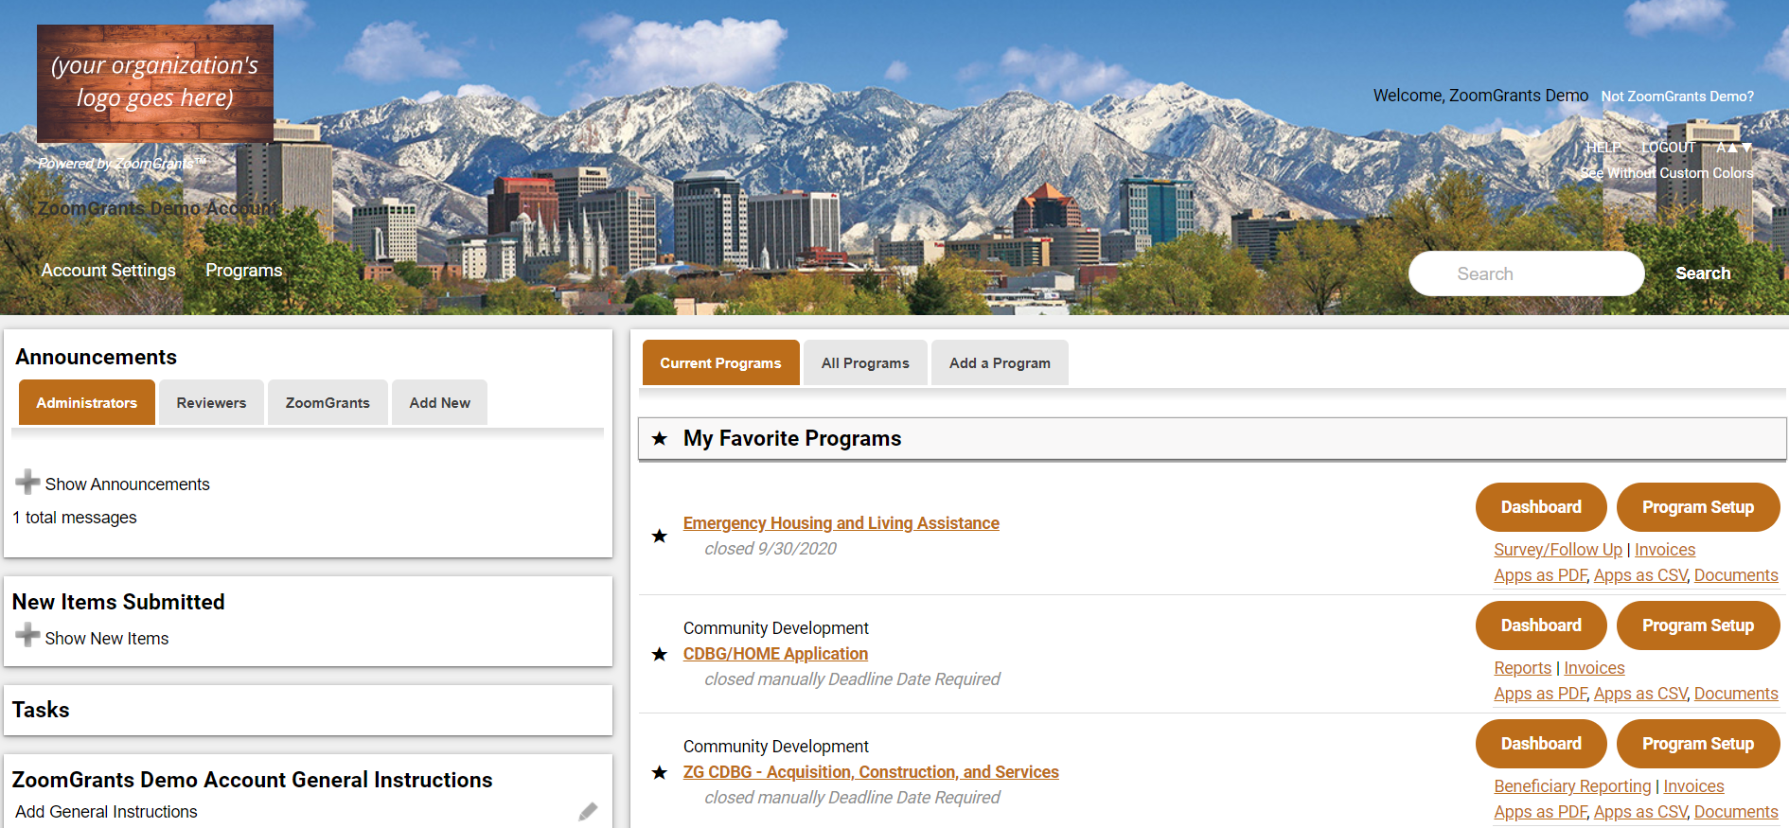
ZoomGrants – What It Can Do

Slide 6
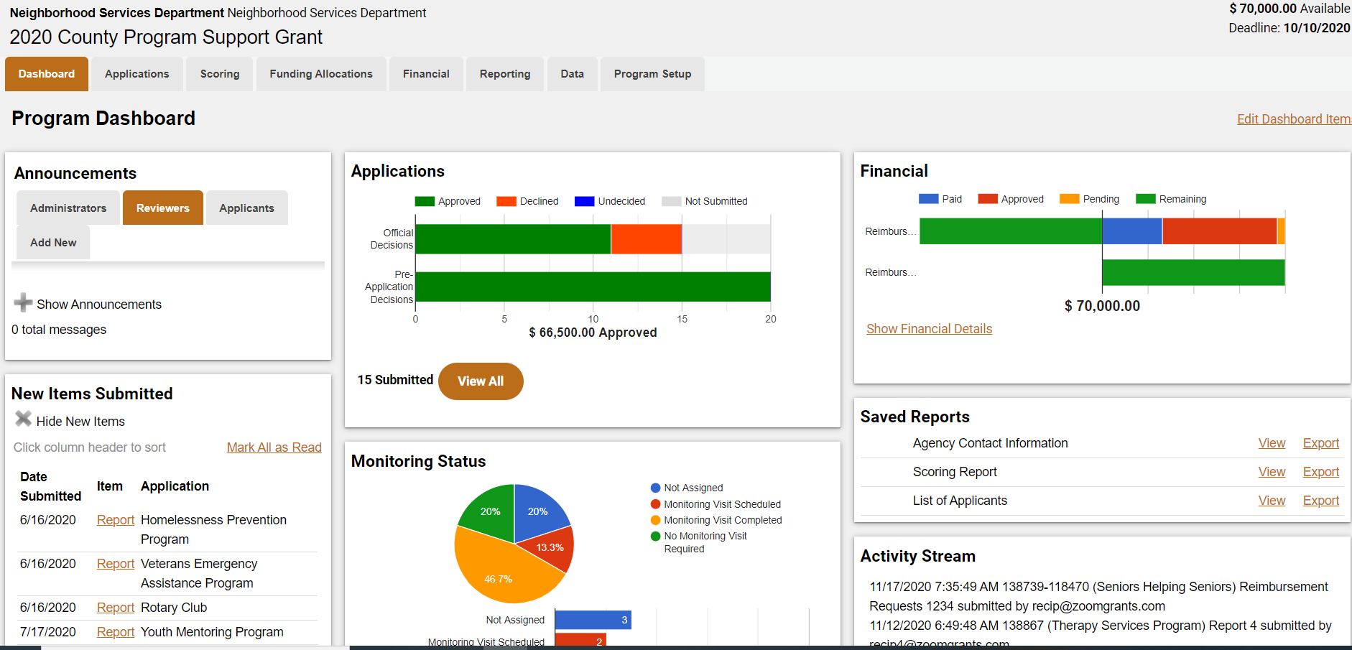
ZoomGrants – What It Can Do

Slide 7
ZoomGrants Grant Program Types
CDBG/CDBG-CV
HOME/HOME-ARP
ESG/ESG-CV
HOPWA
Continuum of Care
SHIP
State General Fund Grants
City/County General Fund Grants
American Rescue Plan (ARP)
Digital Equity/Broadband Infrastructure
Small Business Assistance
CRA/Economic Development
Microenterprise/ Workforce Investment
Homeowner down payment and housing rehabilitation
Foundation, Arts & Cultural Grants
Transit Grants
Health Education and Research grants & scholarships
Victim Services, Justice and Safety Grants
Cultural & Heritage, Conservation Grants
Tourism and Marketing Grants

Slide 8
ZoomGrants – Grant Relief Programs of Yesterday and Going Forward under ARP
Small Business Grant Programs – Grants to mitigate financial hardship.
Nonprofit Support Programs – Grants to mitigate operation financial hardship.
Community Aid Programs – Grants to nonprofits for housing and community development activities primarily serving low-income individuals and families.
Rent/Mortgage/Utility Assistance, Eviction and Foreclosure prevention, legal assistance grants – Grant programs to prevent evictions and foreclosure proceedings and provide services to individuals and families who are at-risk or experiencing homelessness.
Property Tax Relief – Homeowners who are struggling to pay mortgage and property taxes, as well as fixed-income seniors who own their home outright.

Slide 9
ZoomGrants – Grant Relief Programs of Yesterday and Going Forward (cont.)
Market Rebuilding/Storefront Facade/Retrofit Grants - Businesses needing to make adjustments to their operations
Provide PPE supplies and protective barriers
Reconfigure interior spaces to be able to physically accommodate social distancing while still being able to support sales volume for their business
Housing and Community Development Retrofit Grants –
Build digital equity/broadband infrastructure
Improve Infrastructure
Improve open spaces and parks

Slide 10
ZoomGrants
Top Ten Reasons to Choose ZoomGrants Quotes from actual grant administrators who receive applications and manage funding allocations in ZoomGrants

Slide 11
Top 10 Reasons to Choose ZoomGrants
#10
10. Consistency
“Almost all grant programs at [redacted] use this system.... Nationally, this is used by lots of governments to disperse money to state and local governments, especially during COVID. A new online system would create confusion and require program staff to learn multiple systems.”
Helpful to applicants because ZoomGrants creates consistencies in the application, monitoring/oversight and data collection processes across agencies or within a jurisdiction, region, or state.

Slide 12
Top 10 Reasons to Choose ZoomGrants
#9
9. Simple
“Information is written or copy/pasted in text boxes and uploaded to the system.”
“On our website we simply include the ‘apply now’ button supplied by ZoomGrants that automatically brings jurisdiction staff to the submission packet on ZoomGrants. Simple and effective.”
ALL setup and training can be done remotely with assistance from ZoomGrants onboarding and support staff- Accounts have been created and applications launched within the same day.

Slide 13
Top 10 Reasons to Choose ZoomGrants
#8
8. Time-Saving
“ZoomGrants saves the program management information and allows for easy submission of packet. Jurisdictions would not need to worry about design or formatting of the information submitted since it’s a simple text format.”
This also helps streamline the application review and monitoring efforts.
Pre-Application Feature allows you to pre-screen applicants and allows only those who meet your requirements to submit a full application.

Slide 14
Top 10 Reasons to Choose ZoomGrants
#7
7. Comparison
“The format allows for programs to be easily compared for similar information and data.”
Applicant questions and internal data questions/checklists are customizable to your specific needs.
Data is easily exported to a variety of reports and formats for comparison and analysis.

Slide 15
Top 10 Reasons to Choose ZoomGrants
#6
6. “No Losing It”
“In 2014 (prior to ZoomGrants) a non-profit submitted their application packet (via email and misspelled the email address). They did not follow up until three months later – too late to include their application in the review.”
You don’t need to click a ‘save’ button. Zoomgrants has an auto-save feature.

Slide 16
Top 10 Reasons to Choose ZoomGrants
#5
5. Access
“It is easy to set up access to staff (or a review committee) to see the information submitted and rate its completeness or fit for the program. No printing, no saving, no creating pdfs. Just a link to the information on ZoomGrants.”
“ZoomGrants offers any program staff to be able to quickly and easily see program information, reports and invoices.”
Multiple staff/community partners can be logged into the system at one time. Work doesn’t stop because of vacations, turnover, lost emails, firewalls, pandemic, earthquakes, riots, etc.

Slide 17
Top 10 Reasons to Choose ZoomGrants
#4
4. Automatic Scoring and Ranking
“ZoomGrants compiles scores for fit of program and calculates rank.”
“ZoomGrants allows for easy compilation of notes or feedback by staff to be shared with the jurisdictions.”
“Privacy: If any materials are not to be shared with the reviewing staff, just click on a box to make it internal. (For example, demographic data).”

Slide 18
Top 10 Reasons to Choose ZoomGrants
#3
3. Tracking
“Efficient, simple and incredible time-saving tracking features allow program staff to track programs with minimal time. Without these features, program staff must manually enter information into an excel spreadsheet or Word, which is time-consuming and prone to human error.”
“Any good management system allows for double-checking that the work is complete. The program manager can quickly and easily see whether an invoice has been processed by the contracts coordinator. The CIP manager can easily and quickly see missing reports and view messages sent by the program manager or contracts coordinator.”

Slide 19
Top 10 Reasons to Choose ZoomGrants
#2
2. Messaging & Record-Keeping
“Gentle reminders and requests are the key to any good management system. This allows for automation of that work by messages with built-in mail merge features (like name, organization, name of project, funding allocated).”
“ZoomGrants keeps records of the messages sent, reports, invoices, and more! Any program staff can access this information and it is easy to download for public records retention.”
*ZoomGrants is 100% designed, built and supported in the United States.*

Slide 20
Top 10 Reasons to Choose ZoomGrants
#1
1. Customer Service
“Thanks so much for your excellent and always prompt customer service. You are a great asset to your company and we at [redacted] appreciate all you do for us.”
"Again, I cannot express to you enough my appreciation of you and the ZoomGrants team for the incredible customer collaborative services provided, not to mention this incredible platform that continues to grow and improve."
All customer support for all users is included!
Not just buying software – Best practice template programs for CDBG, HOME and other grant programs with pre-built compliance monitoring content.
ZoomGrants University – online knowledgebase with ‘Colleges’ within for Administrators, Reviewers, Applicants & Collaborators.

Slide 21
ZoomGrants Questions?
Email me: jennifer.yost@zoomgrants.com
Visit the ZoomGrants website for more info:
https://www.zoomgrants.com/
To request a demo, standard proposal with pricing, or help answer questions you may have, please reach out to Sales@ZoomGrants.com or call (866) 323-5404 ext. 1.

