Slide 1
Hotel Conversions
Non-Congregate Shelters and Permanent Supportive Housing

Slide 2
Why is this becoming a thing?
Increase in homelessness throughout the country
Influx of new funding
CDBG-CV
Cares Act
American Rescue Plan
HOME-ARP
Supply/Change in Market
The stock already exists
Motels are becoming less profitable
Speed
COVID

Slide 3
Financing
CDBG-CV
American Rescue Plan
HOME
HOME-ARP
SHIP

Slide 4
Cash Flow
Cash Flow is typically tight
Support Services
Funded from Cash flow
Funded through third party contracts
Covering Operating Deficits
Fundraising
Operating deficit reserves
Both

Slide 5
Land Use
Zoning
Can trigger change of use requirements
Proposed use may not be permitted in current zoning district
Codes
Change of use can trigger compliance with all codes
Parking
Minimum unit size
Kitchens
Individual meters

Slide 6
Housing First
Evidence-based
Client-centered
Recognizes housing as a necessary tool to make other voluntary life changes, such as
Seeking treatment
Seeking medical care
Increasing income
In contrast with the traditional model of rewarding “housing readiness.”
The goal of Housing First is to provide housing to individuals and families quickly with as few obstacles as possible, along with voluntary support services according to their needs

Slide 7
Housing First
“Screen in” vulnerable populations by—
Accepting referrals from coordinated entry systems or other entities serving people experiencing homelessness, and
Eliminating policies excluding applicants based on poor credit history or evictions, criminal justice involvement, use of drugs or alcohol, or completion or participation in treatment.
Emphasize tenant-driven services plans to provide flexible, voluntary services, and abolish policies that condition tenancy on program compliance or failure to participate in services.
Provide tenants with leases and rights and responsibilities of tenancy under law in non-time limited housing (except in some housing for homeless youth).
Allow tenants to use alcohol or drugs in their own apartments, without evicting based on use, so long as the tenant does not violate lease terms

Slide 8
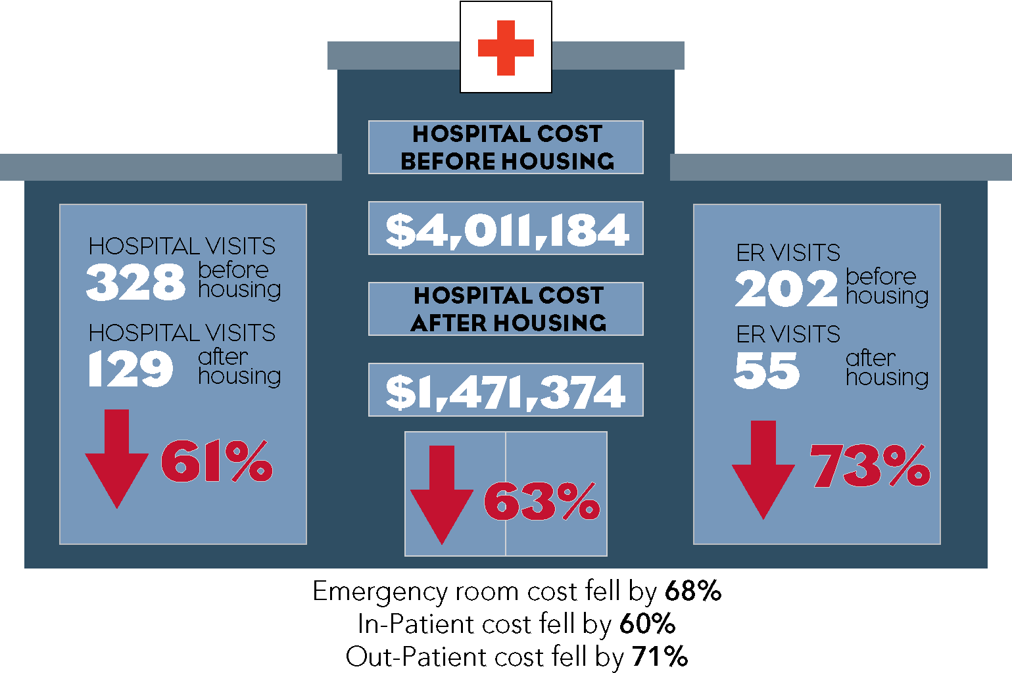
Evidence Based
The Solution That Saves is part of a statewide pilot to provide Florida-specific data concerning the effectiveness of providing permanent supportive housing for high utilizers of crisis services.

Slide 9
California’s Project Homekey

Slide 10
For Further Info
Stan Fitterman, President
SFF Consulting Group
stan@sffcg.com
(813) 240-5435

