Slide 1
--------------------------------------------
USDA, Rural Development
Single Family Housing Program
Presented by: Amber E. Steed, Loan Specialist
Champions Gate Area Office

Slide 2
Agenda
Who
What
When
Where
Why

Slide 3
Who: Rural Development, Single Family Housing
Background
The purpose of the direct single family housing program is to provide low- and very low- income people the opportunity to own adequate, modest, decent, safe, and sanitary homes in rural areas.
Eligible areas are defined as rural areas with populations of 20,000 or fewer. In some circumstances, the population limit increases to 35,000 or fewer. Please visit the USDA Income and Property Eligibility website for complete details. (CENSUS)
Government lender with several partnerships that include Florida Home Partnership, and other leveraged partners of applicant(s) choice etc. Rural Development must be in first lien position.
502 Direct Program usually lowest interest rate! Currently 4.125%

Slide 4
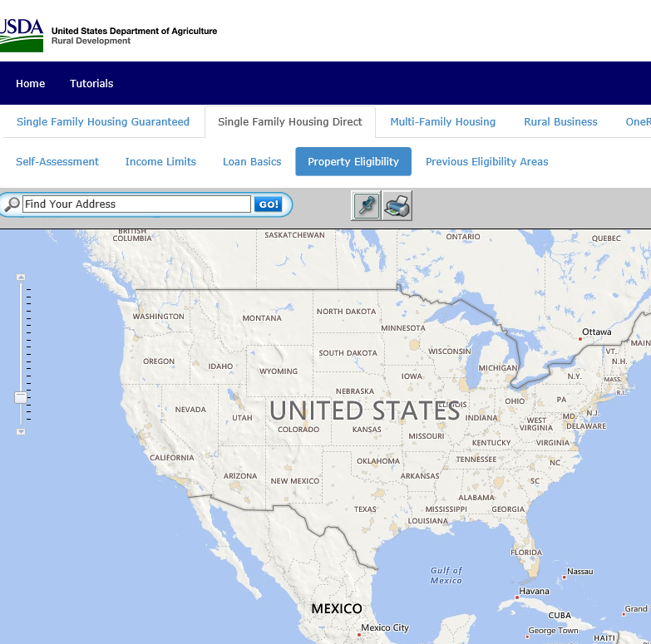
Rural Development Eligibility Maps
https://eligibility.sc.
egov.usda.gov/eligibility/welcomeAction.do

Slide 5
What: Programs within…USDA, Rural Development, Single Family Housing
502 Direct Loan Program – Champions Gate Area Office, income restricted
502 Direct Self-Help Program Champions Gate Area Office, income restricted
502 Guaranteed Loan Program Southeast Region, Moderate income restricted
504 Repair Loan Program - Champions Gate Area Office, income restricted
504 Repair Grant Program Champions Gate Area Office, income restricted
504 Rural Disaster Home Repair Grant - Champions Gate Area Office, income restricted

Slide 6
Section 502 Single Family Housing Program
Helps low-income families and individuals buy or build safe, affordable housing in rural areas.
Overview
No down payment, 100% financing
Payment assistance available based on income
New construction / purchase existing homes
Closing cost and repairs may be included
Support for very-low-income and low-income families/individuals

Slide 7
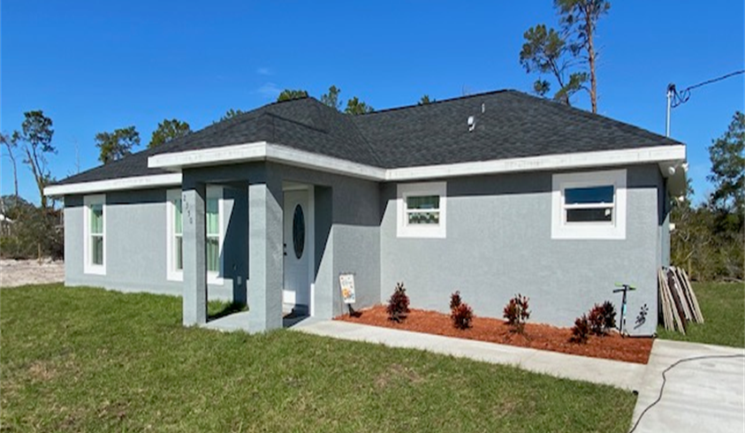
New Construction
3 Bedrooms/2 Bath 1,564 SQ. FT.
Notes:
Purchase New or Existing Home for Primary Residence
Closing Expense Included w/loan
Low & Very-Low Income Borrowers
Mortgages are fixed rate for 30-38 years
Interest Rates (as low as 1%)
100% financing available.
Partial “Recapture” of interest subsidy
Credit history must be established
FY 23 Funding~$1.3 Billion

Slide 8
502-Single Family Housing Guaranteed Loans
Purchase New or Existing Home for
Primary Residence
Closing Expense Included w/loan
Applications made with approved lenders
Mortgages are 30 years fixed rate
100% Financing Available
Interest rates are negotiated with the lender
There is no maximum loan amount
In some cases, closing costs and repairs can be financed with the home purchase
FY 23: Upfront Fees:
Purchase & Refinance: 1.00%
1 to 4 Person Household: $110,650
5 to 8 Person Household: $146,050
Typical Lenders are:
1. Metroplex Mortgage Services
2. Movement Mortgage
3. Ameris Bank
4. Amerifirst Financial Corporation
5. Fairway Independent Mortgage

Slide 9
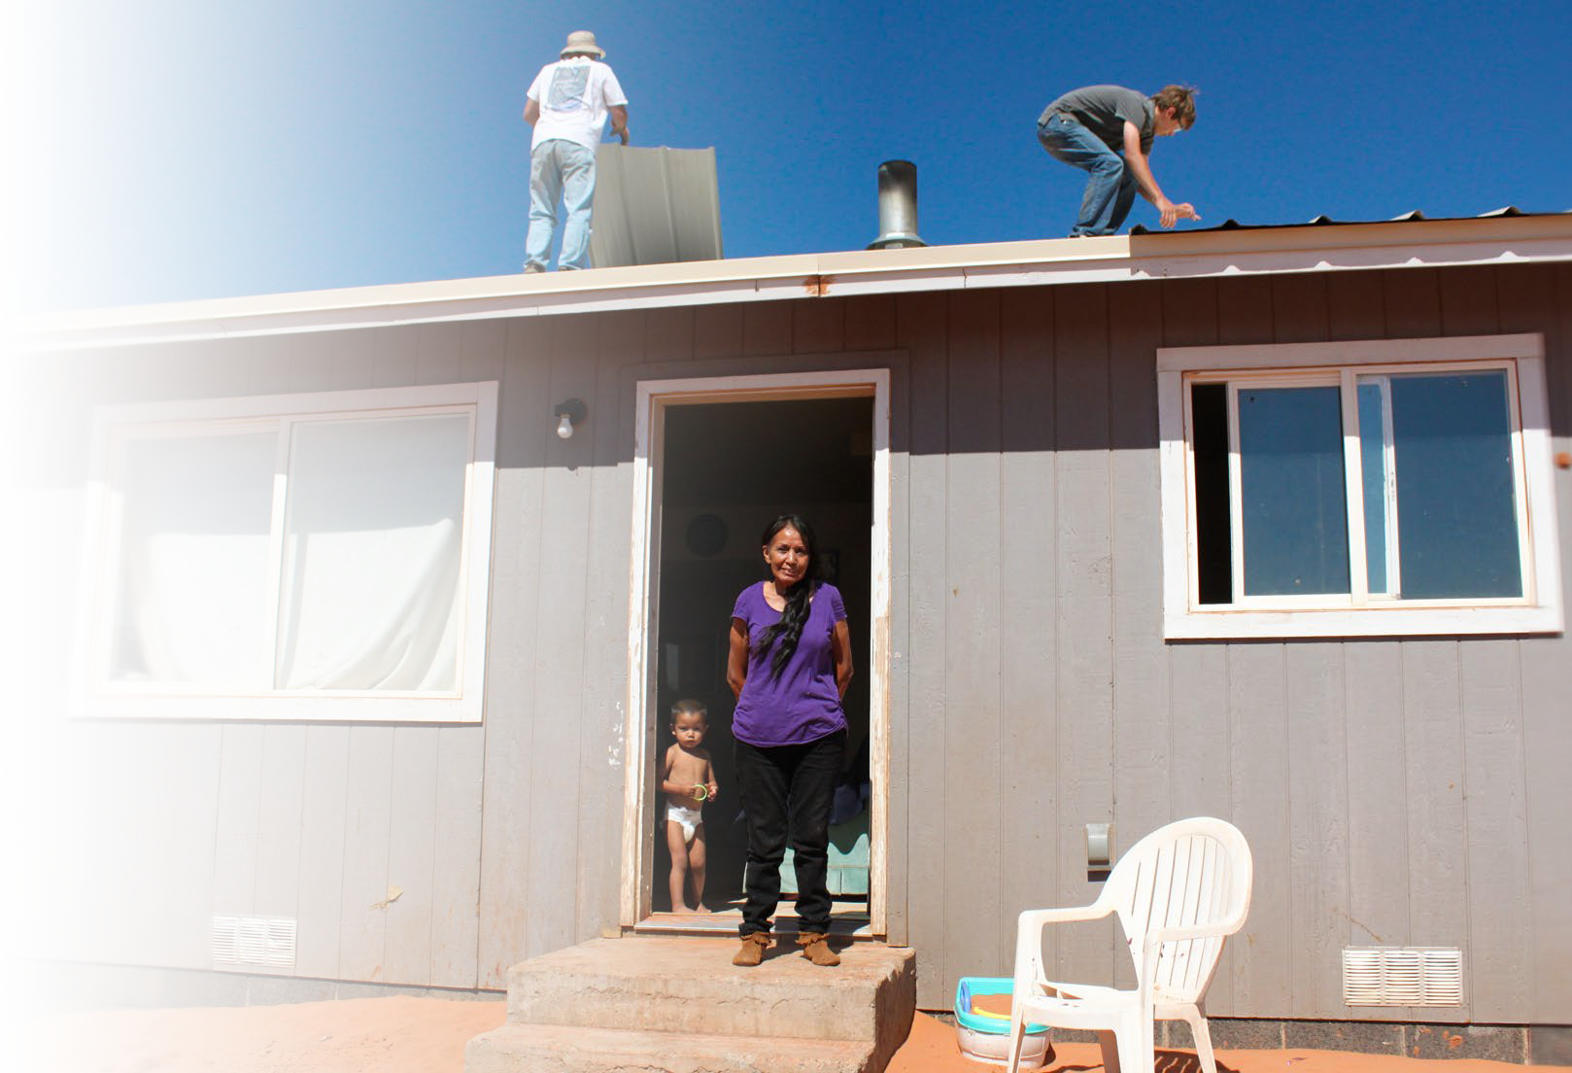
504 Home Repair Loan and Grant (non-disaster)
.
Very-low-income homeowners in eligible rural areas can make necessary repairs to homes.
If eligible, can receive these funds in addition to those from the Disaster Repair Grant.
Grants
Must be age 62+
Maximum of $10,000
Loans
Maximum of $40,000
20 years – 1%
Notes:
Loans and grants to help rural residents repair, improve, or modernize their homes.
Loans of up to $40,000 available for any eligible homeowner, no age restrictions.
Loans and grants may be combined. Health & safety examples:
Accessibility for persons with disabilities Roofs, flooring, wiring, windows Hazardous trees/brush removal
Wells and septic tanks – often not covered by insurance Energy-saving upgrades, and more.
Loans and grants may be combined. Health & safety examples:
Accessibility for persons with disabilities Roofs, flooring, wiring, windows Hazardous trees/brush removal
Wells and septic tanks – often not covered by insurance Energy-saving upgrades, and more.
Presenter Notes

Slide 10
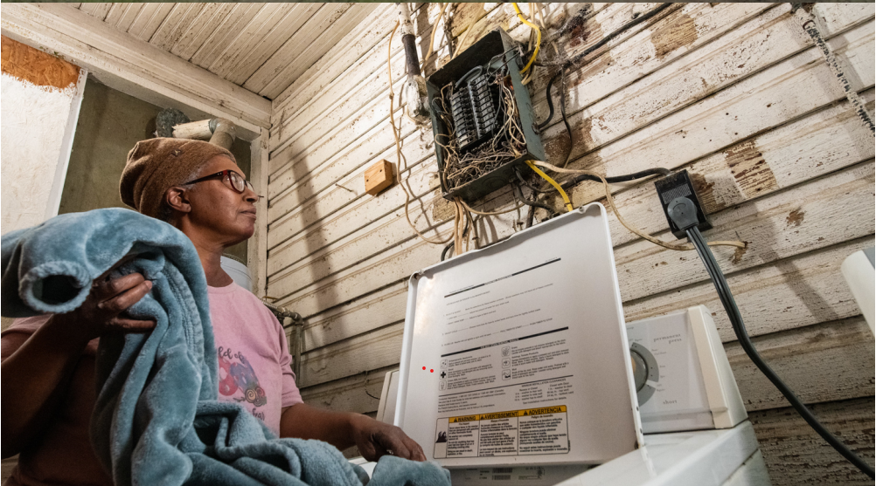
Photos of Before and or After Repairs

Slide 11
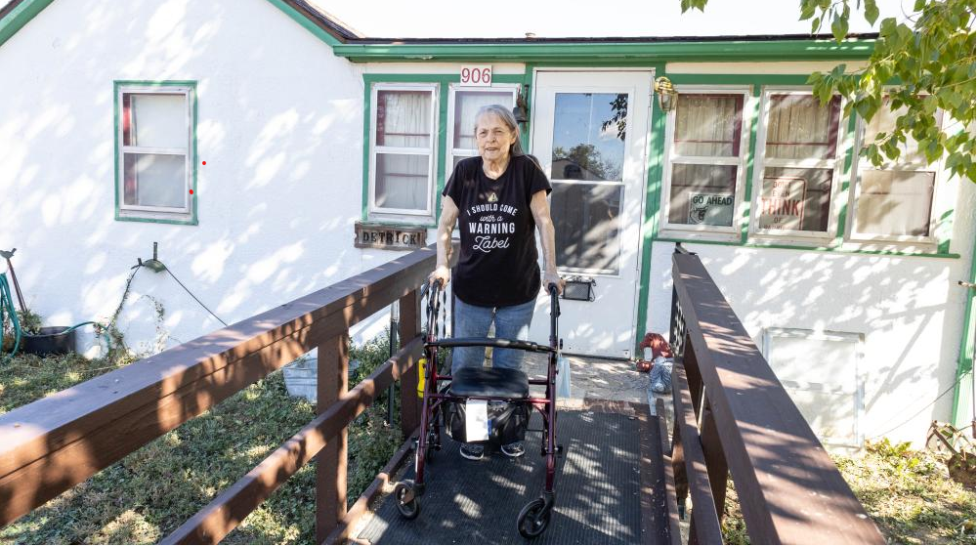
Repair Photos

Slide 12
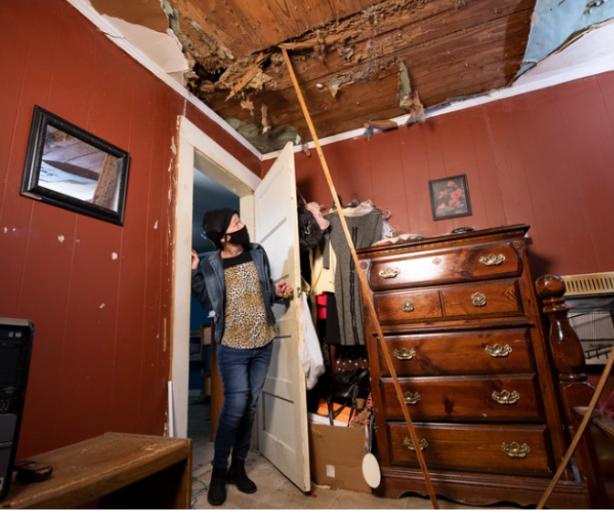
Photos of Before and or After Repairs

Slide 13
What: Rural Disaster Home Repair Grants
Background
Authorized by the 2023 Consolidated Appropriations Act.
To make essential repairs and improvements to rural homes located in
Presidentially declared disaster areas that occurred in calendar year 2022 and 2023.
Includes “Major Disaster Declaration” and “Fire Management Declaration”
Eligible disasters are based on incident date, not declaration date.
$55.7 million available nationwide until expended.
New program - does not impact eligibility for other home repair programs.

Slide 14
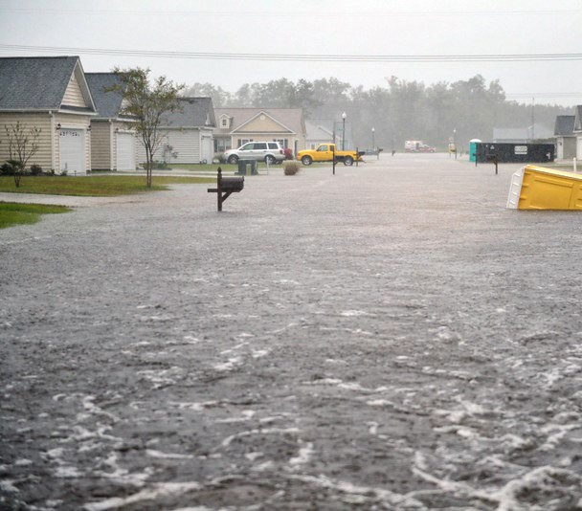
Overview, Rural Disaster Home Repair Grants
Helps low-income rural homeowners impacted by disasters make important repairs to their homes.
Maximum grant of $40,675.
Remove health or safety issues.
Cover disaster-related repair expenses incurred prior to applying.
Site preparation and costs to move a manufactured home.
Notes:
Section 504 grant funds may be used only for repairs and improvements that will remove
health and safety hazards, or to repair or remodel dwellings to make them accessible and useable for a
household member with a disability. A hazard is a property condition that jeopardizes the health or
safety of the occupants or members of the community, but that does not make it unfit for habitation.
A major hazard is a condition so severe that it makes the property unfit for habitation.

Slide 15
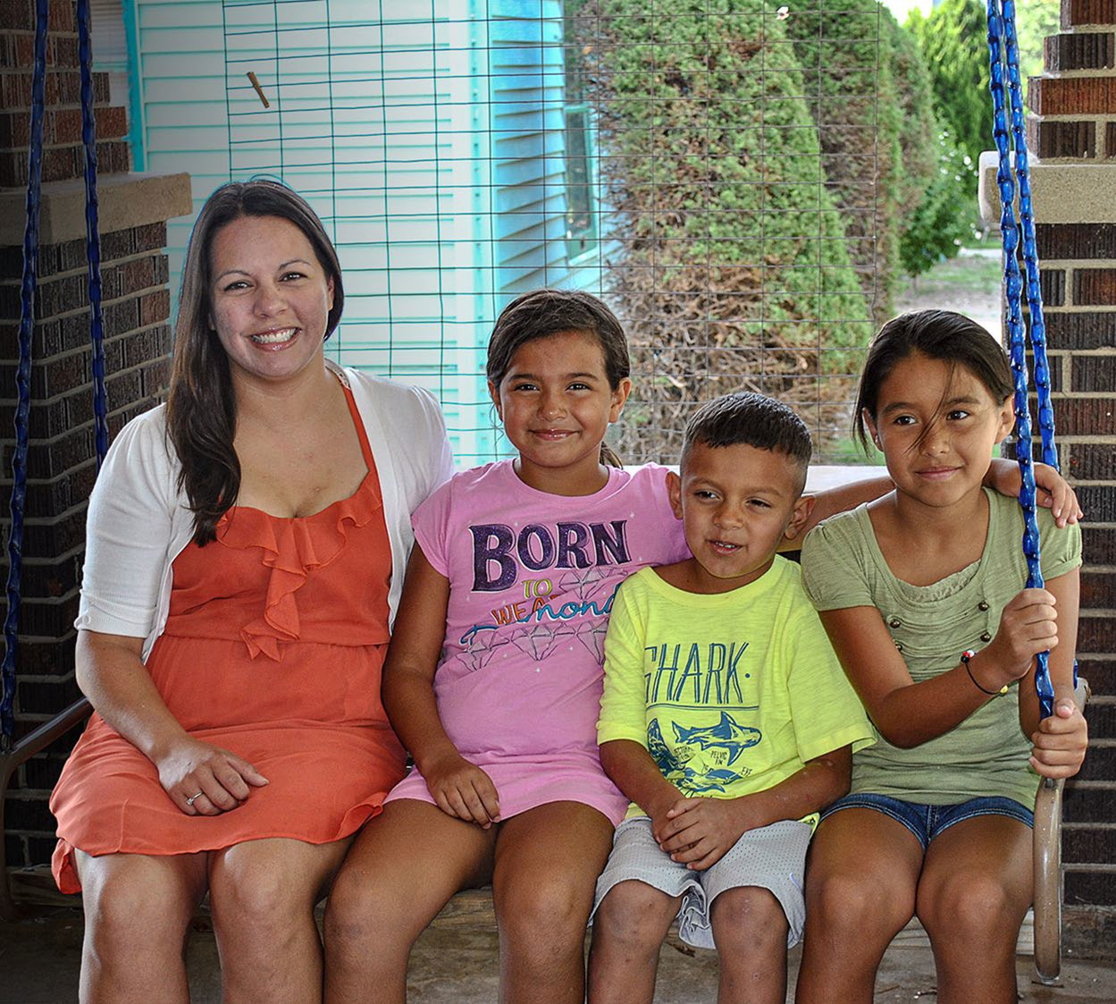
Applicant Eligibility, Rural Disaster Home Repair Grants
Income must not exceed applicable low- income limits. Varies by county and family size.
Home must be located in an eligible rural area.
Must be the homeowner and occupy the home (occupancy after can be authorized).
Property must have sustained damage as a result of an eligible disaster.
Legal status required for applicants

Slide 16
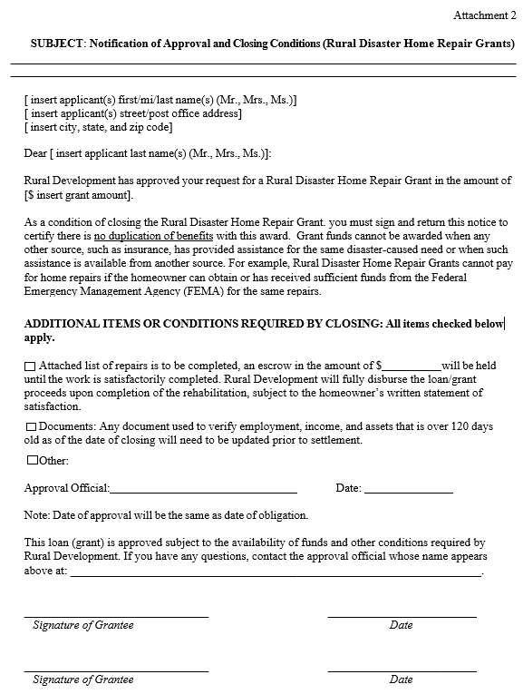
Approvals and Closing Conditions
Attachment 2, ‘Notification of Approval (Rural Disaster Home Repair Grants)
Form RD 3550-24, ‘Grant Agreement’ not needed
Lifetime grant assistance
Notes:
Application requirements for the Rural Disaster Home Repair Grant Program will mirror guidance in 7 CFR 3550, Subpart C and Handbook-1-3550, Chapter 12 for Section 504 Grants except for the following temporary exceptions:
1. The maximum grant assistance will be equal to ten percent of the national area loan limit which is $40,675 as of March 1, 2023.
2. Applicant may receive the maximum Disaster Grant without considering their eligibility for a Section 504 Loan. As stated previously, applicant can apply for both the Section 504 Home Repair Loan and Grant program, and the Rural Disaster Home Repair Grant Program.
3. The UL contains Attachment 2, ‘Notification of Approval (Rural Disaster Home Repair Grants)’ which will be used to advise applicant of grant approval instead of Handbook-1-3550, Handbook Letter 12. Applicants must sign and return the Attachment as certification that there is no duplication of benefits with this award.
4. Disaster Grant recipients will not be required to sign Form RD 3550-24, ‘Grant Agreement’.
5. Disaster Grants do not reduce or impact the applicant’s Section 504 lifetime grant assistance.

Slide 17
Rural Development Eligibility Maps
https://eligibility.sc.
egov.usda.gov/eligibility/welcomeAction.do

Slide 18
Low Income Limits – Declared Counties in 2023
County | 1-4 persons | 5-8 persons
Alachua | $65,500 | $86,450
Baker | $64,490 | $85,750
Bay | $61,100 | $79,350
Bradford Brevard | $48,550 $64,950 | $64,100 $85,750
Calhoun | $49,500 | $65,350
Charolotte | $58,000 | $76,550
Citrus | $49,500 | $65,350
Clay | $66,900 | $88,300
Collier | $75,450 | $99,600
Columbia | $52,400 | $69,150
DeSoto | $48,550 | $64,100
Dixie | $48,550 | $64,100
Duval | $66,900 | $88,300
County | 1-4 persons | 5-8 persons
Escambia | $61,850 | $81,650
Flager | $59,700 | $78,800
Franklin | $49,450 | $65,250
Gadsden | $64,950 | $85,750
Gilchrist | $65,500 | $86,450
Glades | $48,550 | $64,100
Gulf | $49,300 | $65,100
Hamilton | $48,550 | $64,100
Hardee | $48,550 | $64,100
Hendry | $48,550 | $64,100
Hernando | $65,700 | $86,700
Highlands | $49,500 | $65,350
Hillsborough | $65,700 | $86,700
Holmes | $48,550 | $64,100

Slide 19
Low Income Limits – Declared Counties in 2023
County | 1-4 persons | 5-8 persons
Indian River | $63,900 | $84,350
Jackson | $48,550 | $65,100
Jefferson | $64,950 | $85,750
Lafayette Lake Lee | $51,050 $66,300 $64,300 | $67,400 $87,500 $84,900
Leon | $64,950 | $85,750
Levy | $48,550 | $64,100
Liberty | $48,550 | $64,100
Madison | $48,550 | $64,100
Manatee | $ 69,050 | $91,150
Marion | $49,750 | $65,500
Martin | $ 64,000 | $ 84,500
Nassau | $66,900 | $88,300
Okaloosa | $70,300 | $92,800
County | 1-4 persons | 5-8 persons
Okeechobee | $ 48,550 | $64,100
Orange | $66,300 | $87,500
Osceola | $66,300 | $87,500
Palm Beach | $73,600 | $97,150
Pasco | $65,700 | $86,700
Pinellas | $0 | $0
Polk | $54,000 | $71,300
Putnam | $48,550 | $64,100
Santa Rosa | $61,850 | $81,650
Sarasota | $69,050 | $91,150
Seminole | $66,300 | $87,500
St. Johns | $66,900 | $88,300
St. Lucie | $64,000 | $84,500
Sumter | $60,250 | $79,550

Slide 20
Low Income Limits, Deductions and In-eligible Counties
County | 1-4 persons | 5-8 persons
Suwannee | $48,550 | $64,100
Taylor | $48,550 | $64,100
Union | $48,550 | $64,100
Volusia | $58,500 | $77,200
Wakulla | $63,050 | $83,250
Walton | $62,250 | $82,150
Washington | $48,550 | $64,100
Remember Deductions:
Children up to 17 years old- & full-time college students | $480 | Per Child
Elderly (Age 62 or Older) / Disability | $400 | Household
Child Care Expense (ages 12 and under)
In-eligible Counties
Broward
Miami/Dade
Monroe
Pinellas

Slide 21
When: Submission Process?
24/7/365 = Applications are accepted throughout the year.
Online
Mail
In-Person

Slide 22
Where: What counties do you cover?
USDA, Rural Development is nationwide, however the State of Florida and US Virgin Islands is serviced by seven Area Offices. The Champions Gate office services the counties below:
Brevard
Indian River
Hernando
Hillsborough
Pasco
Polk
Orange
Osceola

Slide 23
Why: Why USDA????
We have affordable housing!
Our loan terms is a benefit to many applicants
Again, we usually have the lowest interest rate. Currently, 4.125%
Once a borrower the servicing options is second to none.

Slide 24
Applications & Resources
Please note that you may see reference to “loans” in some of the income limit material. This disaster program is utilizing the same income limits as the Direct Home Loan program.
Applications
Applications accepted now.
Contact USDA Rural Development Loan Specialist, Amber E. Steed
Amber.Steed@usda.gov
863-420-4833
Funding is available until funds are exhausted.
Resources
Visit the Rural Disaster Home Repair Grant website.
USDA Property Eligibility website.
USDA Low Income Limits website.

Slide 25
Applications & Resources
Presenter Notes
Florida and US Virgin Islands Field Office Contacts
Area Director | Address | Phone number | Email Address | Counties Served
CRESTVIEW AREA OFFICE Jeffrey Archer | 3070 Adora Teal Way, Suite C, Crestview, FL 32539 | Work phone: 850-682-2416 Business cell: 850-333-2031 | jeffrey.archer@usda.gov | Escambia, Holmes, Okaloosa, Santa Rosa and Walton.
MARIANNA AREA OFFICE Loria Phillips | 2741 Pennsylvania Avenue, Suite 5, Marianna, FL 32448 | Work phone: 850-526-2610 Business cell: 850-317-6572 | loria.phillips@usda.gov | Bay, Calhoun, Franklin, Gadsden, Gulf, Jackson, Jefferson, Leon, Liberty, Wakulla and Washington
LAKE CITY AREA OFFICE Bruni Robles | 971 W Duval St, Suite 190, Lake City, FL 32055 | Work phone: 386-719-5590 Business cell: 386-365-9576 | brunilda.robles@usda.gov | Baker, Bradford, Clay, Columbia, Duval, Hamilton, Lafayette, Madison, Nassau, Suwannee, St. Johns, Taylor and Union
OCALA AREA OFFICE Stephanie Hodges | 2441 NE 3rd Street, Suite 204-1, Ocala, FL 34470 | Work phone: 352-732-7534 Business cell: 352-843-0042 | stephanie.hodges@usda.gov | Alachua, Citrus, Dixie, Flagler, Gilchrist, Lake, Levy, Marion, Putnam, Seminole, Sumter and Volusia.
CHAMPIONS GATE AREA OFFICE Angela Smith | 8390 Champions Gate Blvd, Suite 210, Champions Gate, FL 33896 | Work phone: 863-420-4833 | Angela.Smith2@usda.gov | Brevard, Hernando, Hillsborough, Indian River, Orange, Osceola, Pasco, Pinellas and Polk.
**N. Ft. Myers (Sub Office of Royal Palm Beach) Ada Rivera | 3434 Hancock Bridge Pkwy., Suite 209-A, N. Ft. Myers, FL 33903 | Work phone: 239-997-7331 | ada.rivera@usda.gov | Broward, Dade, Glades, Hendry, Highlands, Martin, Monroe, Okeechobee, Palm Beach, St. Lucie, Charlotte, Collier, DeSoto, Hardee, Lee, Manatee and Sarasota.
ST. CROIX U.S. VIRGIN ISLANDS AREA OFFICE Kimme Bryce | 4401 Sion Farm, Ste. #2, Christiansted, St. Croix, VI 00820 | Work phone: 340-773-9146 Business cell: 340-201-4211 | kimme.bryce@usda.gov | St. Croix, St. John and St. Thomas

Slide 26
Thank You

Slide 27
Amber E. Steed
amber.steed@usda.gov|
863-420-4833
USDA is an equal opportunity provider, employer, and lender.

