Slide 1
Increasing Housing Access with a Racial Equity Lens
Machelle Maner - Community Relations Officer
Connie Wright - Housing Affordability Philanthropy
Rulon Washington - Mortgage Outreach
© 2021 Wells Fargo Bank, N.A. All rights reserved. For public use.

Slide 2
Housing Affordability Philanthropy
The Wells Fargo Foundation has made a $1 billion philanthropic commitment to address housing affordability solutions. By combining its business expertise and financial capital, the Wells Fargo Foundation is focused on creating pathways to affordable, safe and quality homes with a focus four key strategies:
Driving Transformation and Innovation on the Ground in Local Communities
Housing Stability
Increasing Supply of Affordable Homes
Expanding Homeownership Opportunities including among people of color to narrow the homeownership gap

Slide 3
Driving transformation and Innovation in Local Communities
Transforming on-the-ground municipal and nonprofit capacity and approaches to improve housing affordability; Foster innovation in production, development and systems change. Examples include:
Housing Affordability Breakthrough Challenge: Wells Fargo and nonprofit Enterprise Community Partners launched a $20 million housing affordability challenge to uncover new, more rapid ways to increase the availability and sustainability of scalable housing affordability solutions. In 2020, the challenge awarded six winners with grants of $2 million each to turn concepts into real housing affordability solutions.

Slide 4
Housing Stability (Covid Update)
In the wake of the COVID-19 pandemic, Wells Fargo provided more than $160 million in philanthropic grant funding to address community needs related to housing. Initiatives currently include:
Keeping more than 200,000 people housed: helped renters and homeowners stay in their homes through more than $26 million in grants to nonprofits that offer eviction and foreclosure prevention assistance, rental assistance and financial counseling.
Legal assistance for renters to mitigate eviction: Wells Fargo Foundation expanded COVID relief by donating more than $8 million to 26 organizations that provide free or low-cost legal assistance and representation for renters, particularly vulnerable people disproportionately impacted by the COVID-19 in low-income communities.
Rural initiative in collaboration with Community Development Financial Institutions (CDFIs): funded grants for CDFIs serving rural, persistently poor communities to support capacity building; advancing policy; and providing access to capital for Black Americans, farm workers and Hispanics in areas of persistent poverty, including Appalachia, the Deep South, Native American lands, the U.S./Mexico border, and the south/central U.S.

Slide 5
Increasing Supply of Affordable Homes
Increasing supply and preservation of quality affordable homes for renters and homeowners.
Wells Fargo Builds: Wells Fargo committed $9 million in 2021 to nonprofits Habitat for Humanity International and Rebuilding Together to help build, renovate, paint, or repair homes for low-to-moderate income families through this program.
Impact: In 2020, Wells Fargo supported building, repairs and improvements for 484 homes across the U.S. through Wells Fargo Builds, an employee driven volunteer initiative.

Slide 6
Expanding Homeownership Opportunities
Expanding access to homeownership opportunities with a focus on reducing the racial equity gap.
NeighborhoodLIFT: A collaboration with NeighborWorks® America and its network members, provide down payment assistance and offer HUD-approved homebuyer education for low- and moderate-income families.
Impact: Since 2012, Wells Fargo has invested $521 million in NeighborhoodLIFT and other LIFT programs to help 24,979 Americans become homeowners through the purchase of more than $4.86 billion in real estate on an aggregate basis. While LIFT programs is focused on serving low- and moderate-income families regardless of race or ethnicity, the majority of LIFT homeowners represent people of color with 25% of all LIFT down payment assistance recipients identifying as Black homeowners and 29% representing Hispanic households.
Aligned with the Office of Comptroller of Currency’s Project REACh, NeighborhoodLIFT recently expanded to Minneapolis and St. Paul and in six Bay Area counties. The down payment assistance in particular can have a big impact on helping families achieve homeownership, since lack of funds for a down payment or closing costs is one of the most significant barriers to homeownership.

Slide 7
Expanding Homeownership Opportunities
Veteran Housing: Since 2015, the Wells Fargo Foundation has provided more than $36 million in grants to support sustainable housing and homeownership for veterans.
To date, over $7 million in grant assistance has resulted in more than 525 veterans having purchased a home through NeighborhoodLIFT.
In collaboration with the Military Warriors Support Foundation, Wells Fargo donates homes and vehicles to wounded veterans, who also receive financial mentoring. Since 2012, Wells Fargo has donated more than 400 homes valued at over $60 million to support veterans and their families in all 50 states.

Slide 9
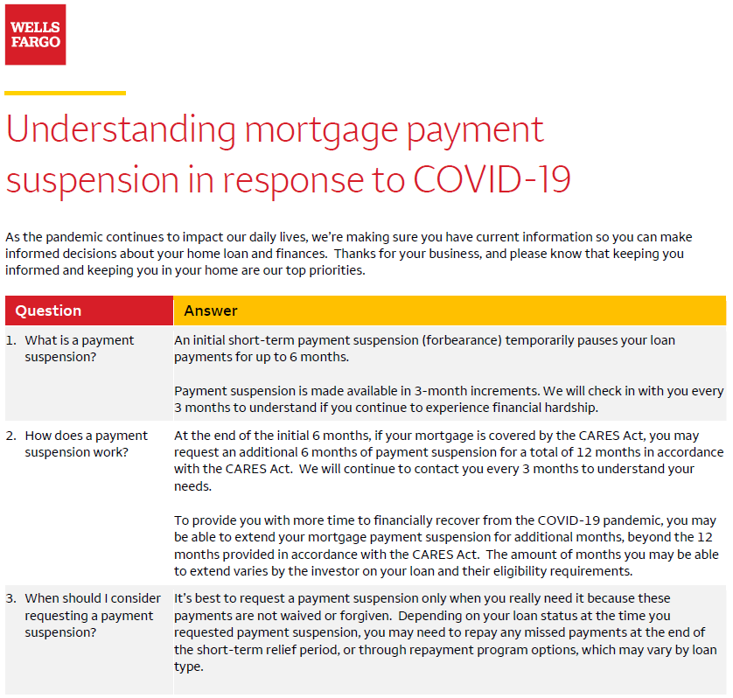

Slide 11
Questions?

