Slide 1
ZoomGrants
Grant Management Software: Feature Highlights
Receive applications and manage funding allocations in ZoomGrants

Slide 2
Discussion Topics
ZoomGrants - Who We Are, Who Uses Us & What We Do
Different types of grant programs administered in ZoomGrants
Feature Highlight

Slide 3
ZoomGrants – Who we are
ZoomGrants has been assisting cities, counties, state agencies, foundations, and other organizations across the country since 2002 with accepting online grant and scholarship applications
Tracks the full application and grant management cycle for multiple grant programs and funding sources - ideal for the management of pass-through funding which must comply with 2 CFR 200
ZoomGrants is a subscription-based, pre-built internet-based platform with no hardware to purchase, install or download

Slide 4
ZoomGrants – Who uses us
Cities
Counties
State Agencies
Foundations / Non-Profit Organizations
Consultants

Slide 5
What we do
Grant Management Software to help organizations streamline their application and funding allocation process.
Customizable Applications
Simplified Review Process
Post-Decision Management & Administrative Tools
Data Analysis

Slide 6
ZoomGrants Program Types
HUD: CDBG/CDBG-CV, HOME/HOME-ARP, ESG/ESG-CV, HOPWA, Continuum of Care
SHIP
State General Fund Grants
City/County General Fund Grants
American Rescue Plan
Transit Grants
Digital Equity/Broadband Infrastructure
Small Business Assistance
CRA/Economic Development
Facade Improvement
Microenterprise/ Workforce Investment
Homeowner down payment and housing rehabilitation
Foundation, Arts & Cultural Grants
Health, Education and Research Grants
Victim Services, Justice and Safety Grants
Cultural & Heritage, Conservation Grants
Tourism/Marketing Grants
Call for Speaker
Scholarships

Slide 7
Feature Highlights
All Inclusive (no extra fees)
Auto-Save
Training & Technical Support
Customizable Dashboards and Content
All Modules/Features Included: Turn on/off features you want to use within each individual program

Slide 8
No Per-User Licence Fees
No Maximum Number Administrative Users
No Maximum Number Reviewer/Committee Users
All-Inclusive Technical Support
All-Inclusive Virtual/Remote Training
Transparent Pricing: https://www.zoomgrants.com/pricing/

Slide 9
Auto-Save: No Losing It
Users don’t need to click a ‘save’ button - Zoomgrants has an auto-save feature!
Auto-check to make sure all questions are answered, and all required documents are uploaded with the application.

Slide 10
Training & Technical Support
All customer support for all users is included!
Not just buying software - Library of Templates
Best practice template programs for CDBG, HOME, SHIP and other programs with pre-built compliance monitoring content
ZoomGrants University
Online knowledgebase with ‘Colleges’ within for Administrators, Reviewers, Applicants & Collaborators
ALL setup and training can be done remotely with assistance from ZoomGrants onboarding and support staff

Slide 11
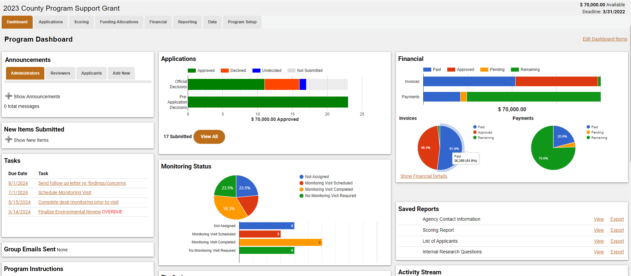
Program Workflow Dashboard

Slide 12
Customize Content & Question Type
Tailored Questions: Application, Report, Invoice and internal data questions/checklists are customizable to your specific needs
Branching Question/Conditional Logic
Multiple Answer Types
Organize Programs into Departments/Groups
Use Unique Name and Logos
Limit Admin/Reviewer User access

Slide 13
Application Period
Customize Application Guidelines/Instructions
Library of documents and links for Applicants
Announcement & Bulk/Mass Messaging (e.g. FAQ)
Pre-Application/Eligibility Screening/LOI
Applicant Budget
Document Request (Required vs. Optional)
Table-Style Data Collection (Spreadsheet-Lite)
Individualized Follow-up Question

Slide 14
Review Period
Unique Committees and Assignments
Hide Application Documents from Reviewers/Blind Review
Document Conflict of Interest
Voting and Recommended Award Amounts
Monitor Status of Completion of Reviews
Trial Decisions and Official Decision
Custom Scoring Questions and Methodology
Scoring Reports
Bulk Email Messaging

Slide 15
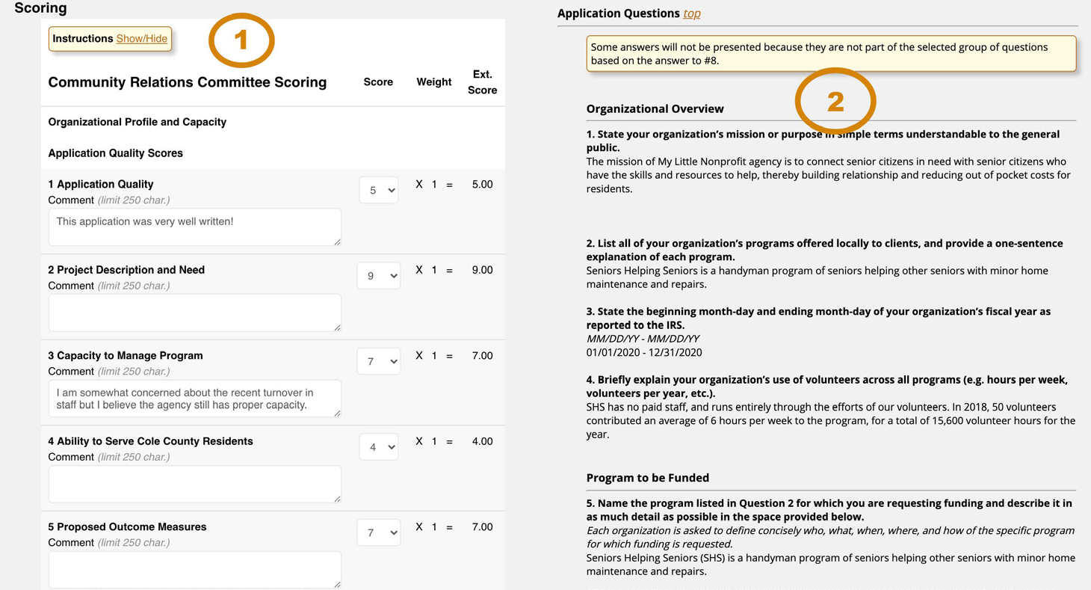
Side-by-Side Screen for Ease of Reviewing

Slide 16
Post-Decision Period
Contract Management
Progress Reporting
Multiple periods, unique deadlines, return to subrecipient, auto-reminder, overdue notifications
Track Performance Data against Goals
Financial Management
Invoice/Request for Reimbursement (Line-Item Budgeting)
Payment
Awarded Budget & Budget Adjustment Requests
Track Funding Allocations

Slide 17
Post-Decision Period (Administrative Tools)
Multiple Unique Checklist/Task
Customizable Internal Research Fields
Custom Status - Categorize/Group Applications
PDF Generator
Bulk/List Update of Data Across Multiple Applications
Messaging w/Mail Merge - Create Templates and Customize
Upload Administrative Documents

Slide 18
Data Analysis: Reporting & Exporting Data
Data is easily exported to a variety of reports and formats for comparison and analysis
Program Level
Account Level
Standard Reports
Customizable Reports - Export questions and data fields, including Internal Research & Custom Status in multiple formats (e.g. PDF, .CSV, Public-Facing link, etc.)
Save Dynamic Reports for Future Use

Slide 19
Data Analysis: Recording Keeping & Audit Tracking
Overall activity stream for the whole program
Activity Log for each application
Audit Log for full accountability and transparency
Announcements to different user groups
PDF/Email/Print Applications
Backup/Export your data any time

Slide 20
100% USA
*ZoomGrants is 100% designed, built, stored and supported in the United States.*

Slide 21
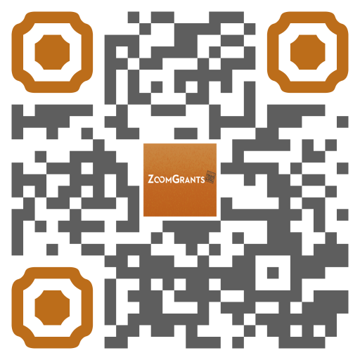
ZoomGrants Questions?
Email me: sales@zoomgrants.com
Visit the ZoomGrants website for more info:
https://www.zoomgrants.com/
To request a demo, standard proposal with pricing, or help answer questions you may have, please reach out to Sales@ZoomGrants.com or call (866) 323-5404 ext. 1.

