Slide 1

How to Get a Project Funded
Florida Community Development Association Conference
April 22, 2025

Slide 2
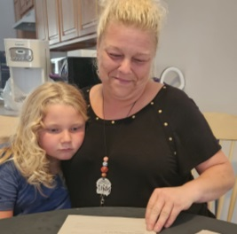

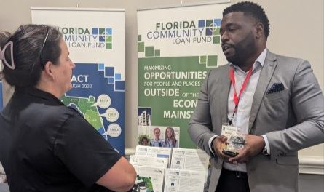

Who is Florida Community Loan Fund?
STATEWIDE CDFI
federally certified Community Development Financial Institution
CAPITAL AND EXPERTISE
SINCE 1994
founded by community leaders to provide flexible financing for development in Florida’s
low-income communities
TO HELP
BUILD STRONG COMMUNITIES
AFFORDABLE HOUSING
COMMUNITY FACILITIES
ECONOMIC DEVELOPMENT

Slide 3
Who is Florida Community Loan Fund?
 | FCLF exists to maximize opportunities for people and places outside the economic mainstream.
 | Opportunity and dignity exist for every person and community in Florida.
 | Our expertise and capital make projects successful and help organizations improve lives and communities.
CORE PURPOSE
OUR VISION
OUR MISSION

Slide 4
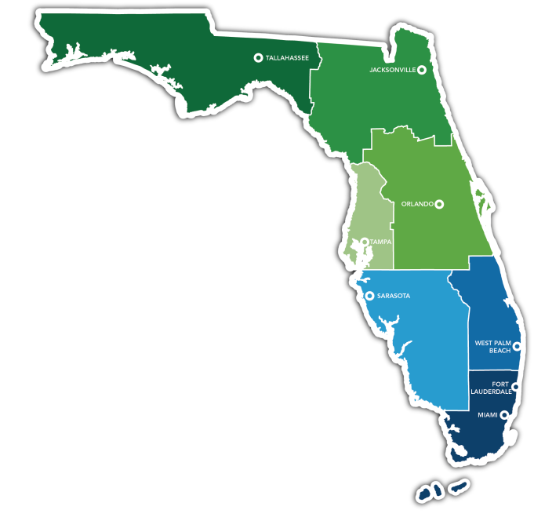

FCLF offers flexible financing to
help your project succeed.
COMMUNITY DEVELOPMENT FINANCING
commercial loans for projects in low-income areas or for low-income residents with a focus on high social impact
NEW MARKETS
TAX CREDIT (NMTC)
federal program sets the guidelines for these economic development projects

Slide 5
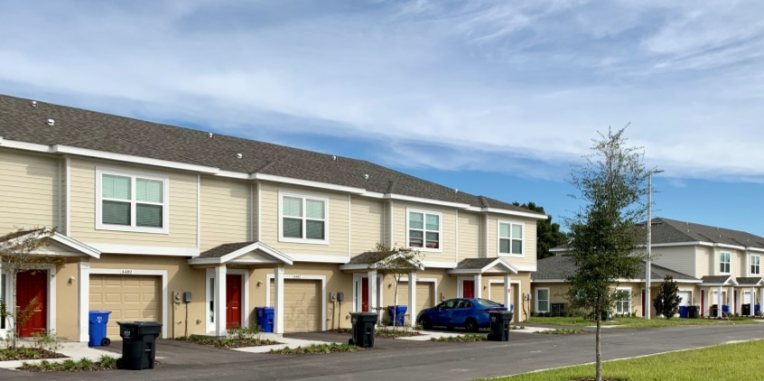
All FCLF Loans…
Must be in low-income communities or for low-income residents
Must have a community development or social services purpose
Must be to financially viable organizations and businesses
(no personal
loan products)

Slide 6
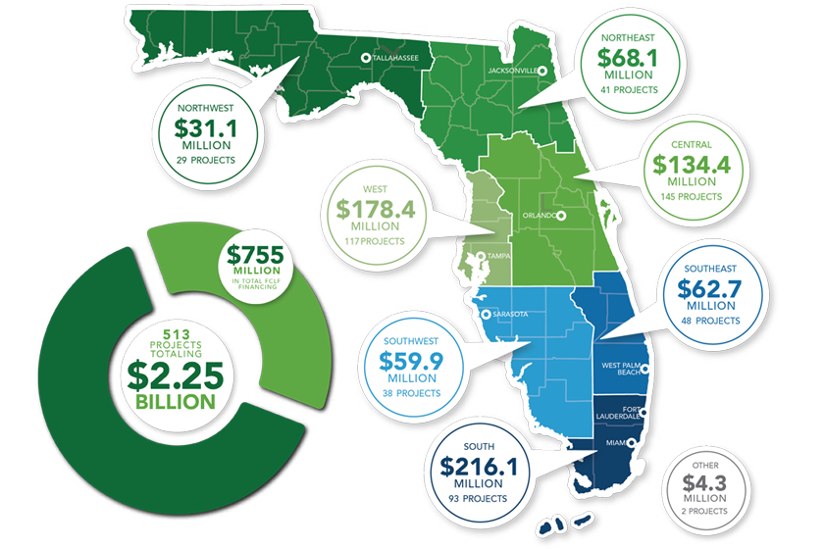
Our Impact
$755 million
financing + NMTC transactions
513 LOANS
$2.25 billion
total project costs
8,938 housing units
188 Facilities, 3.4 million sq ft
27,257 jobs created or retained
2.33 million+ FLORIDIANS receive social services every year
cumulative through 12/31/2024

Slide 7
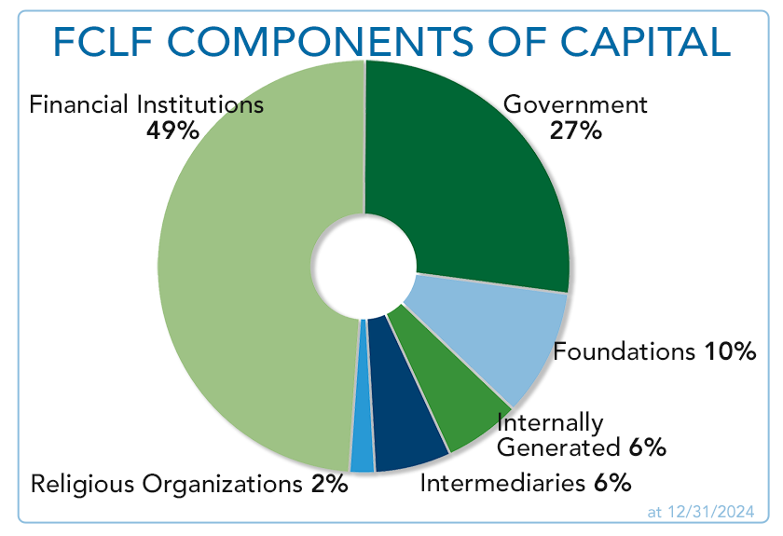

Components of Capital
Religious Organizations
Financial Institutions
Foundations
Nonprofits
Government
Individuals

Slide 8
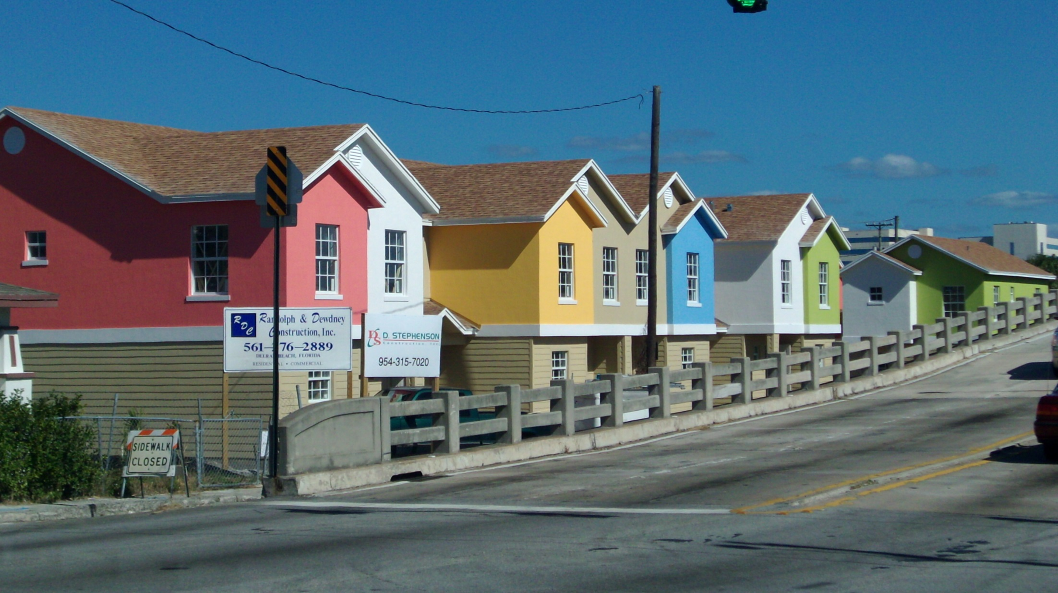

FCLF
SUCCESS
STORIES

Slide 9
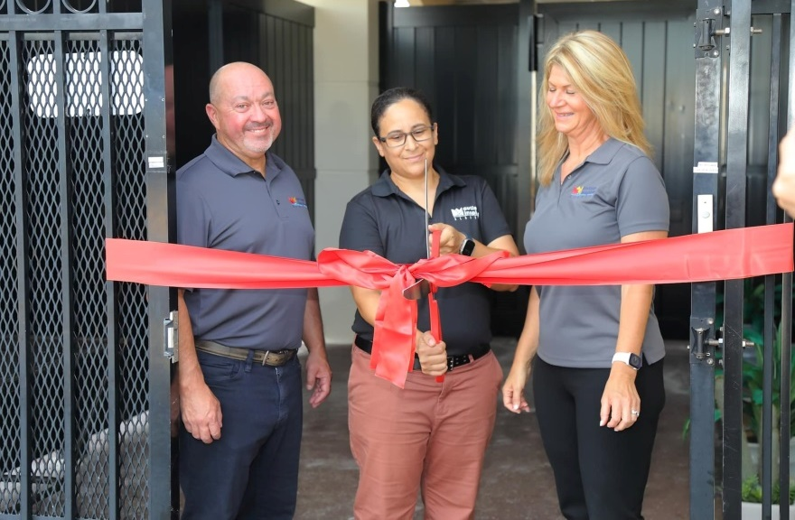
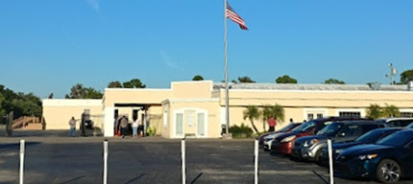
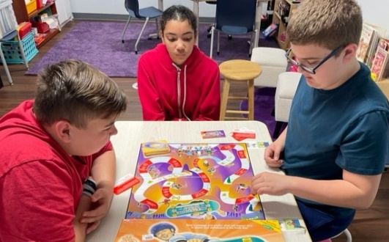
Autism Inspired Academy
  Private nonprofit school with 100% special needs populations
  Currently ~80 students with plans for expansion
  $3.65 million FCLF financing
  Acquired an existing building – which was formerly an FCLF borrower and a special needs school
  6+ acre campus
  with 5 buildings

Slide 10
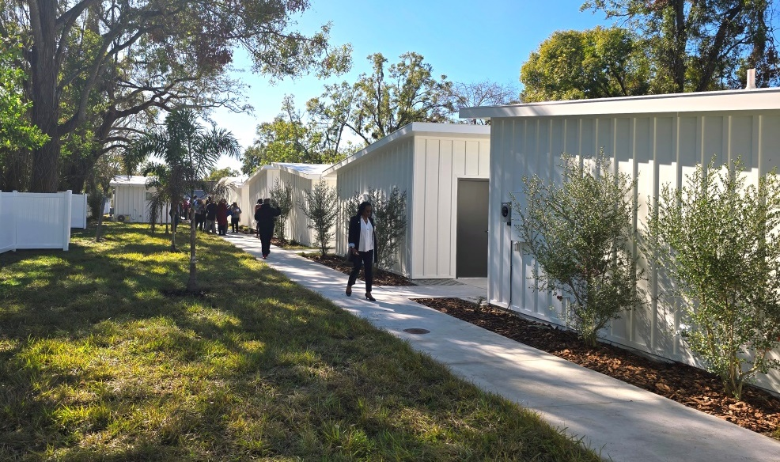
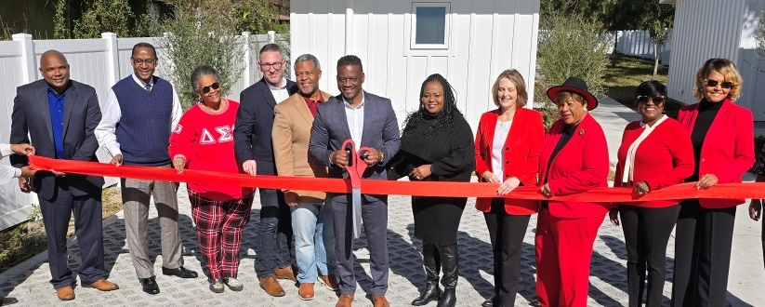
Manifestations Village, Tampa
  8 units of affordable housing for Veterans
  Services include mental health, financial literacy, homeownership training
  $931,000 FCLF financing
  Faith-based organization already providing services in East Tampa

Slide 11
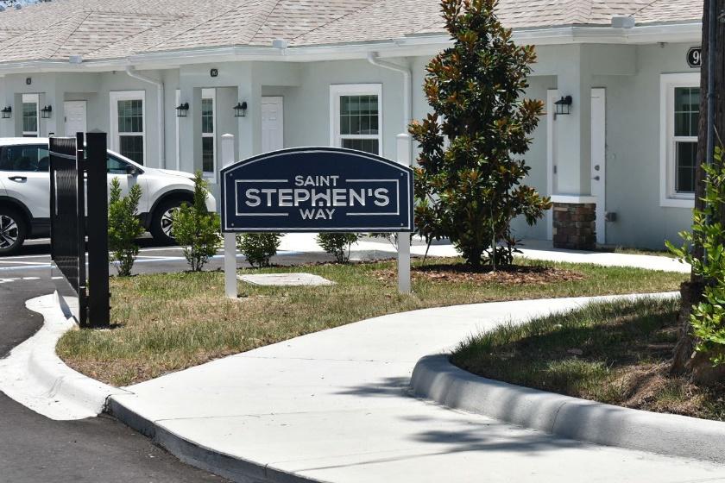
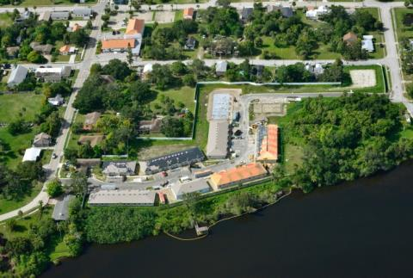
Saint Stephen’s Way, Melbourne
  40 units of supportive rental housing for families facing homelessness
  4000 sq. ft. community center
  $8.25 million FCLF financing, construction/term loan
  $10.49 million total project cost
  40 Project Based Housing Vouchers

Slide 12
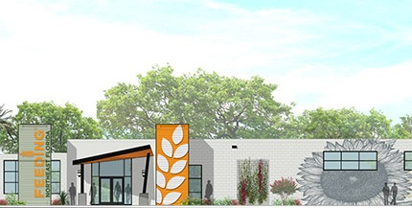
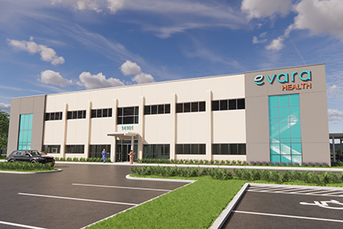
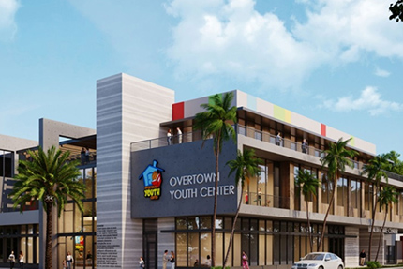
New Markets Tax Credit (NMTC)
Funding for community facilities, jobs-creating projects, economic development
Feeding Northeast Florida. Renovation of 120,000 sf facility to address food insecurity in 8-county region. $16 million project budget. $14 million FCLF NMTC. $7 million FCLF Community Development financing. Located in Jacksonville.
Evara Health, Clearwater Highpoint.
FQHC Construction of new 18,000 sf facility & 5,600 sf expansion of existing facility. $9 million project budget.
$9 million FCLF NMTC. $5.3 million FCLF Community Development financing.
Overtown Youth Center, Miami. Construction of 62,620 sf facility providing community youth and family services. $19.2 million project budget. $15 million FCLF NMTC allocation.

Slide 13
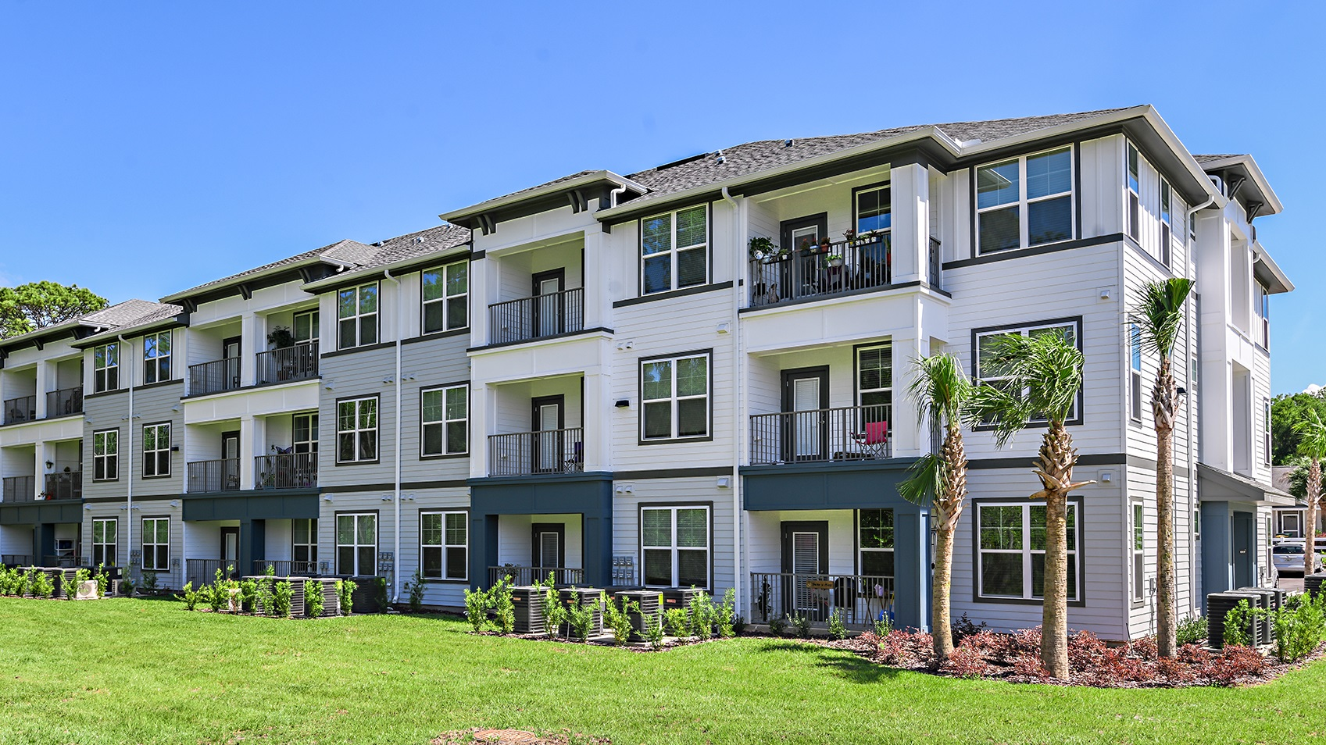
FCLF
FINANCING
FEATURES

Slide 14
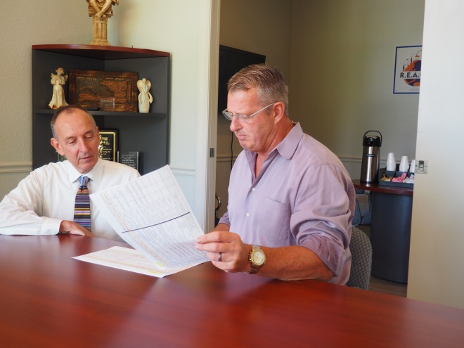
FCLF Reduces Gaps in Financing
Increased LTV
Lower minimum Debt Service
Coverage (DSC) requirement
Reduced interest rates
Address “intangible” gaps – such as
developer experience, financial strength
Direct forms of subsidy –
such as Capital Magnet Fund

Slide 15
Community Development Fund
Financing Features
Loan Size | $6.5 million maximum Larger may be available through partnerships
Loan Types | Acquisition & pre-development • Construction & rehabilitation Lines of credit • Term & permanent loans Refinancing in certain situations
Collateral | Loans must be secured Loan-to-value (LTV) will vary based on collateral type, typically 70% to 90%
Technical Assistance | Free technical assistance may be available in some cases; FCLF will cover the cost. Technical assistance may be delivered by FCLF staff, Florida Housing Coalition, or others.

Slide 16
Community Development Fund
Financing Features
Loan Terms | Fixed rates 7.00% to 8.25%, depending on term Application fee $300. Commitment fee varies depending on type of loan; typically 0.25% to 1% No prepayment penalties 1.12x minimum DSC based on stabilized NOI (1.20x for community facilities) No or minimal legal fees on typical transactions Terms up to 10 years with up to 35-year amortizations and no prepayment penalties

Slide 17
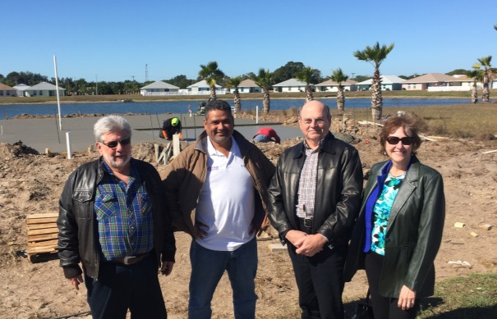
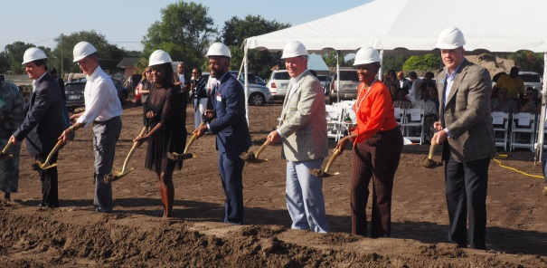
WHY FCLF?
We are willing to…
Commit early in a project
Structure loan rate and terms to meet the cash flow needs of our borrower
Access other conventional and nonprofit lenders
Assume a higher risk

Slide 18
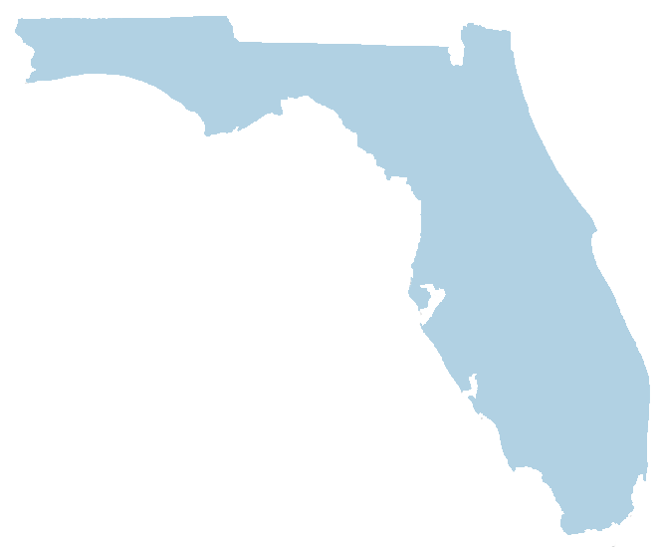
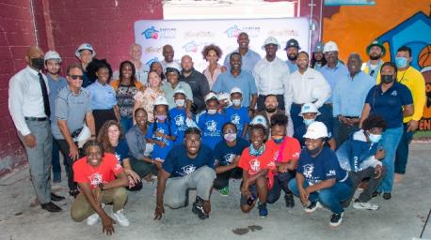
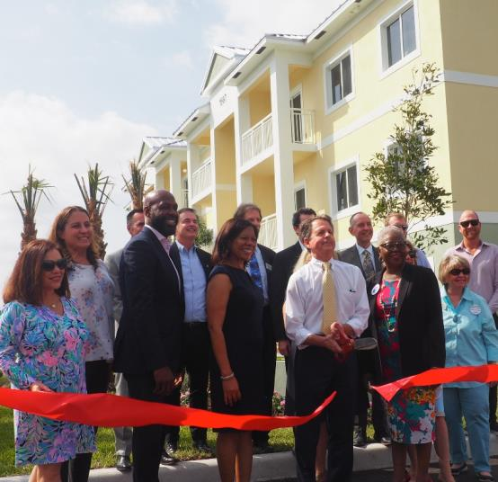

THE RESULT:
HIGH SOCIAL IMPACT
IN LOW-INCOME COMMUNITIES

Slide 19
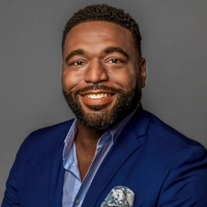

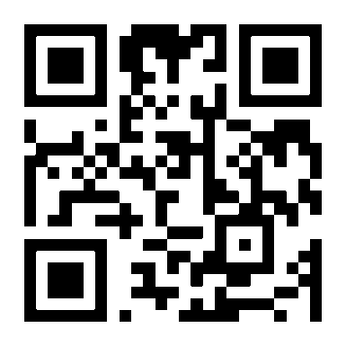

DWAYNE RANKIN
Community Development Loan Officer
DRankin@FCLF.org
Tampa
NELSON BLACK, CHIEF LENDING OFFICER
NBlack@FCLF.org
Tampa
OUR LENDING TEAM
Jim Walker, South & SE Florida
JWalker@FCLF.org
Dwayne Rankin, West & SW Florida
DRankin@FCLF.org
Anna Upchurch Pernell, Central & North Florida
APernell@FCLF.org
Michael Jones, Central & South Florida
Mjones@FCLF.org
800 N MAGNOLIA AVE • SUITE 106
ORLANDO FL 32803
407.246.0846
www.FCLF.org
SERVING FLORIDA FROM OFFICES IN ORLANDO • TAMPA • FORT LAUDERDALE
@FloridaCommunityLoanFund

Slide 20
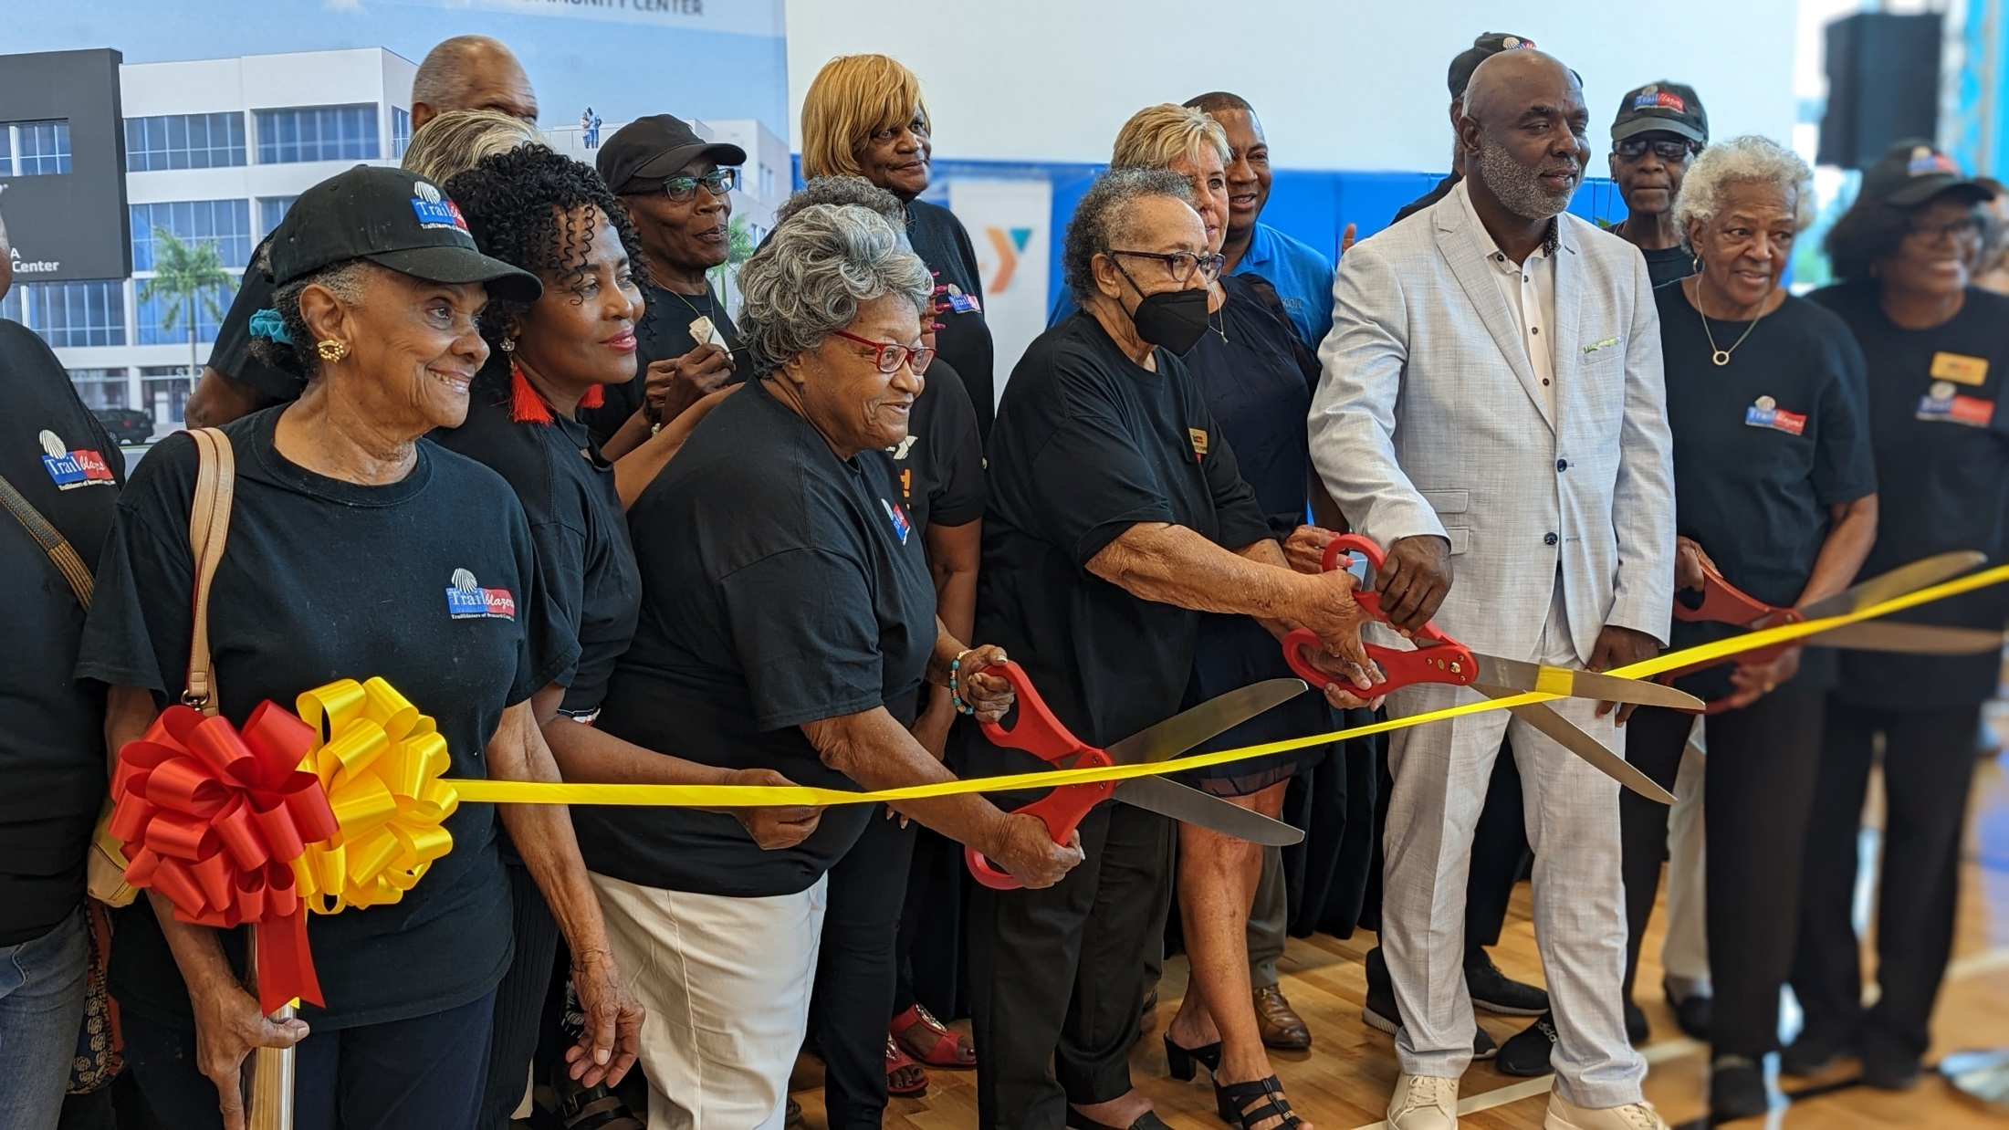
Thank You!
QUESTIONS?

