Slide 1
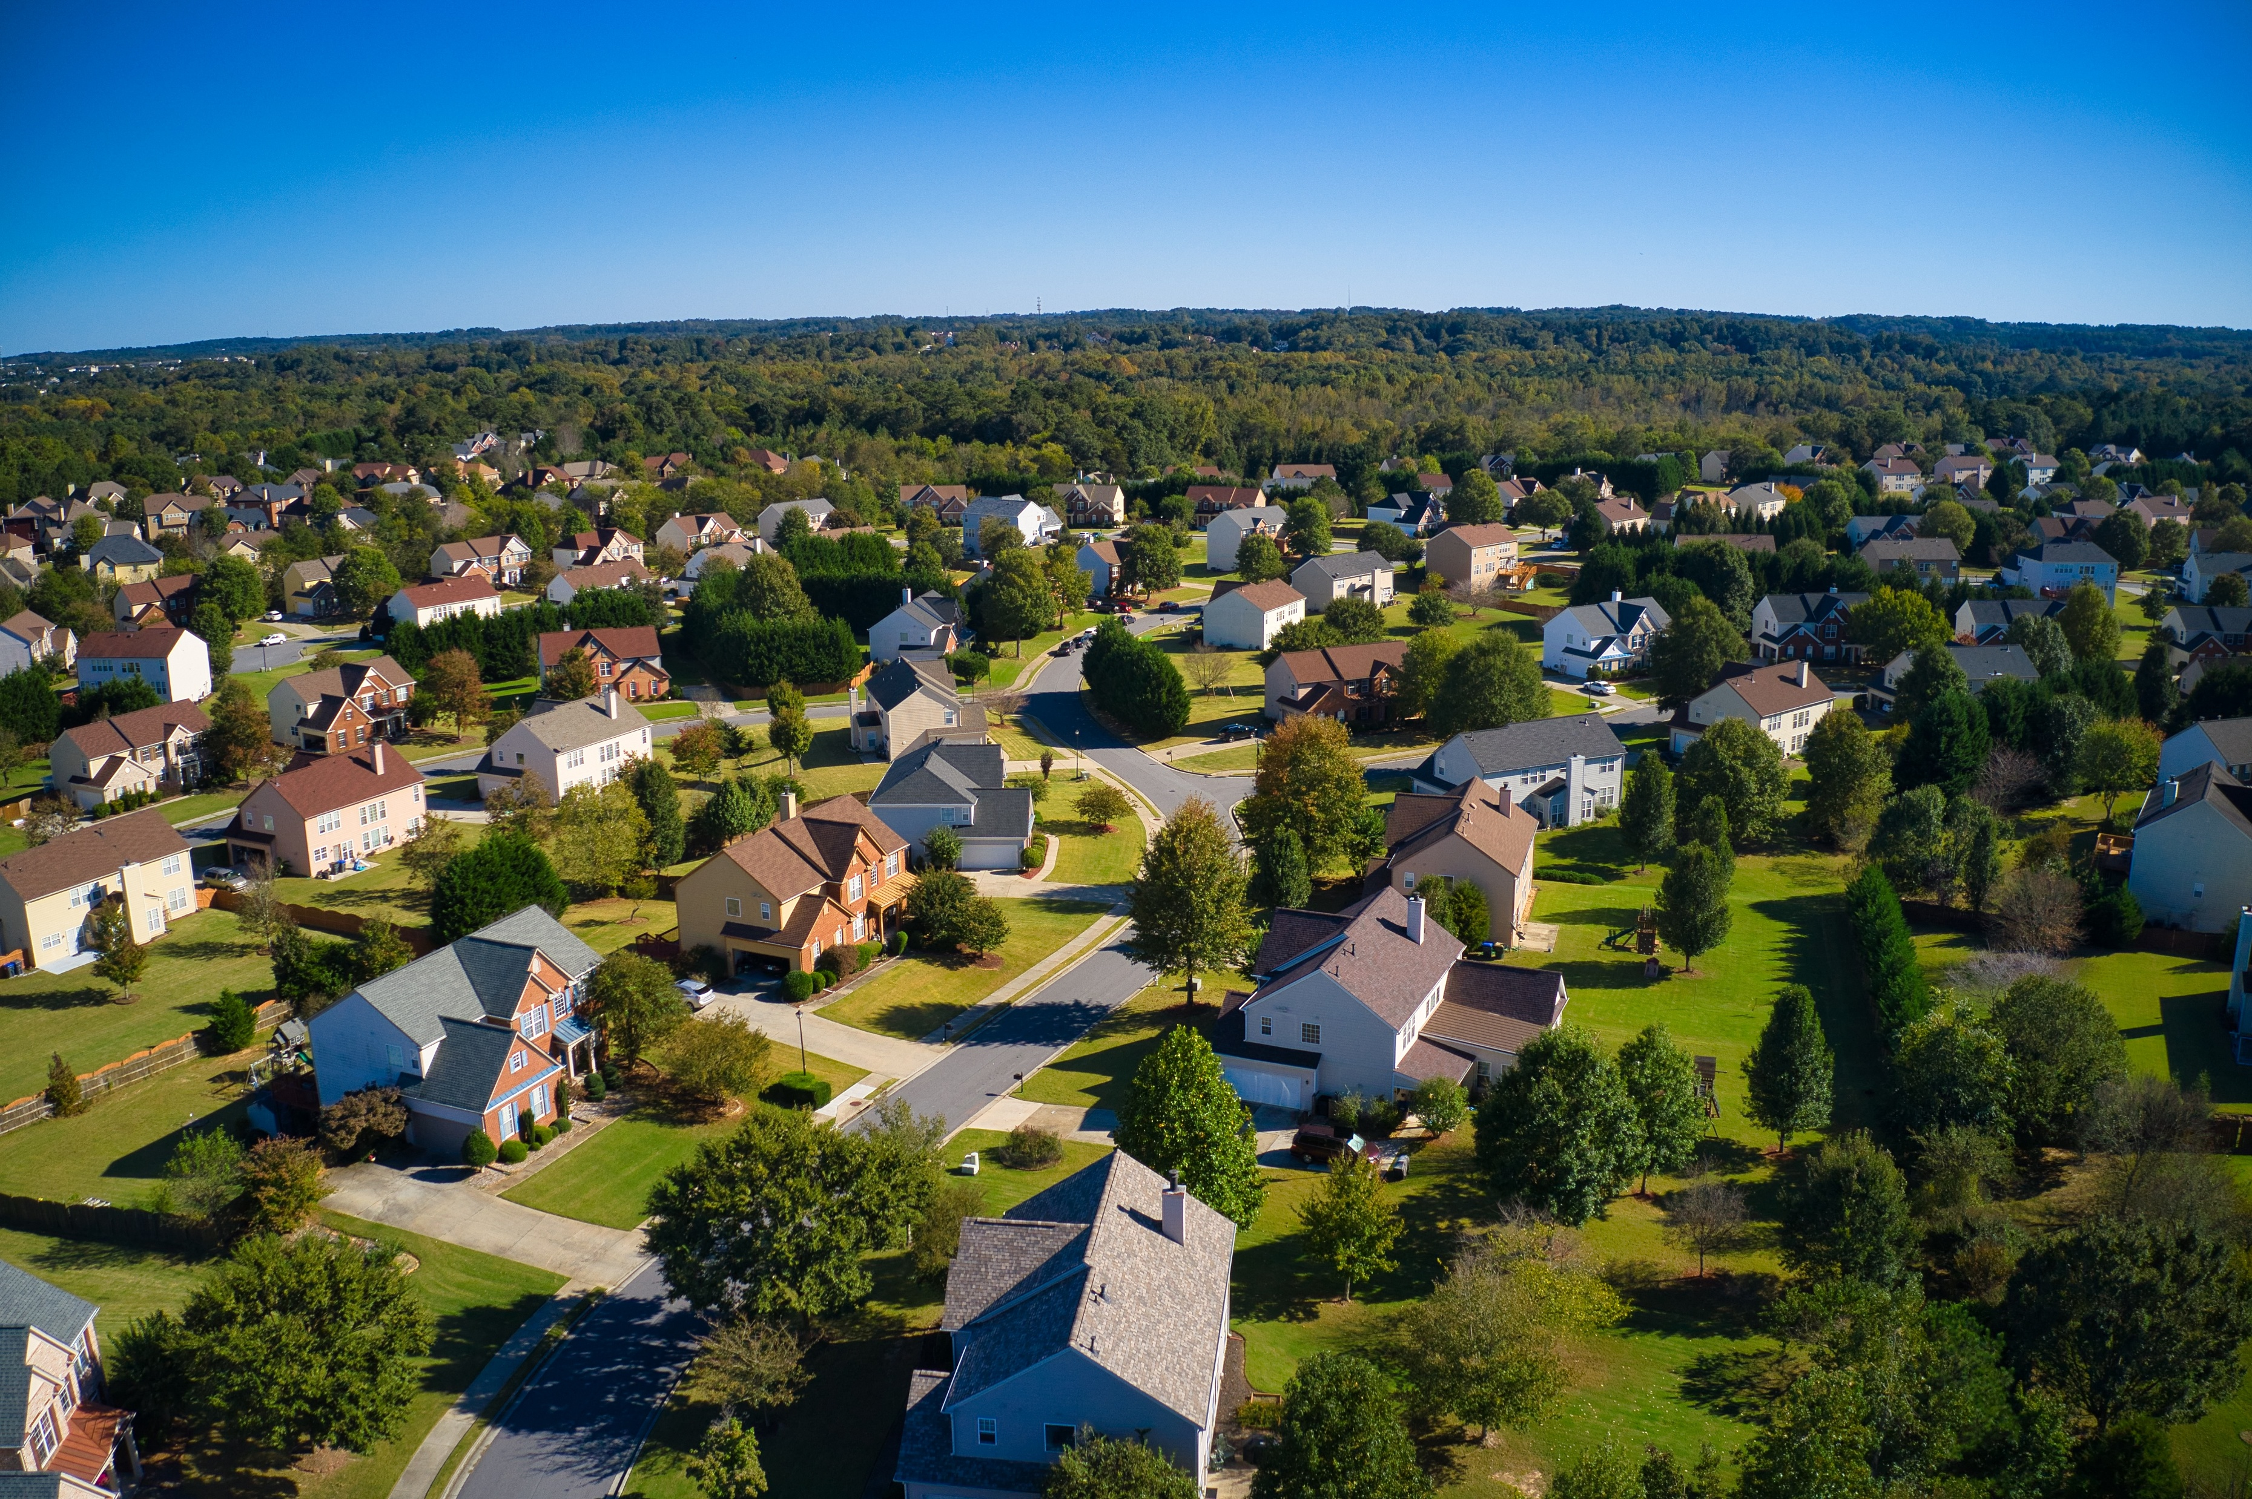


Mastering Digital Efficiency:
Leveraging Web-Based Tools in Community Development

Slide 2
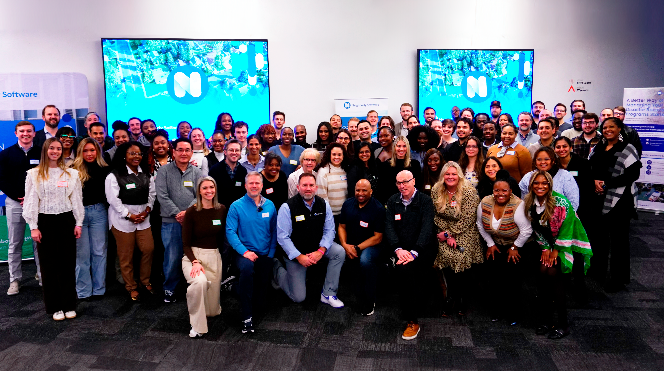
OUR
MISSION
We are purpose-driven people and dedicated to serving something bigger than ourselves.
Helping Communities Help People
is at the heart of all we do.
It's how we’ve designed our software,
and how we deliver unmatched experiences to our Neighbors. ​
Notes:
As we are about to embark on our 10th anniversary, we help over 650 Cities, Counties, States, and Non-profits to streamline the administration of housing and community development programs. We are the market leading, cloud based platform, securely stored with the highest level of security, that gives access to HCD staff, tenants, homeowners, subrecipients, and property managers - to manage HCD, DR, HCV, and DOE programs. But first and foremost, our mission is to help communities help people. We know there is a ton of uncertainty in the current climate at the federal level. This is why we are here to stand with you. We understand how stressful this is, we support you, and we're here to make you more efficient and compliant. We take a holistic approach to how we help you administer these programs. Because we recently received a large investment, we've been able to act on our Neighbors' request

Slide 3


Neighborly Software has received a growth investment from Falfurrias Growth Partners!
Notes:
Neighborly Software and Falfurias Growth Partners entered into a partnership last October. Because of this partnership, we have now been able to start building out many requests that folks in this room have asked about.

Slide 4
What is the single most frustrating component of the CDBG program at the federal level?

Slide 5

OUR COMMITMENT
TO INNOVATION
Proudly neighbor-centric in our innovation and 2025 Product Roadmap. We’re here to acknowledge your sacrifices, your struggles, your needs. And provide you with tools, community, resources, and best practices to make your work more impactful.
IDIS Integration– COMING SOON!
General Ledger Integration
Third-party Integrations & APIs
New Data Warehouse & Reporting
VPAT Conformance (508 ADA Accessibility)
Outbound Payments
Platform & Security Enhancements
Document Viewer and eSignatures
Offline Inspections
Notes:
The biggest topic I want to discuss today is Neighborly’s Road map. What if software could adapt to the unique rules and needs of each program? Lesa from THHI – what is one of the main reasons as a subrecipient you decided to purchase your own portal with Neighborly Software?

Slide 6
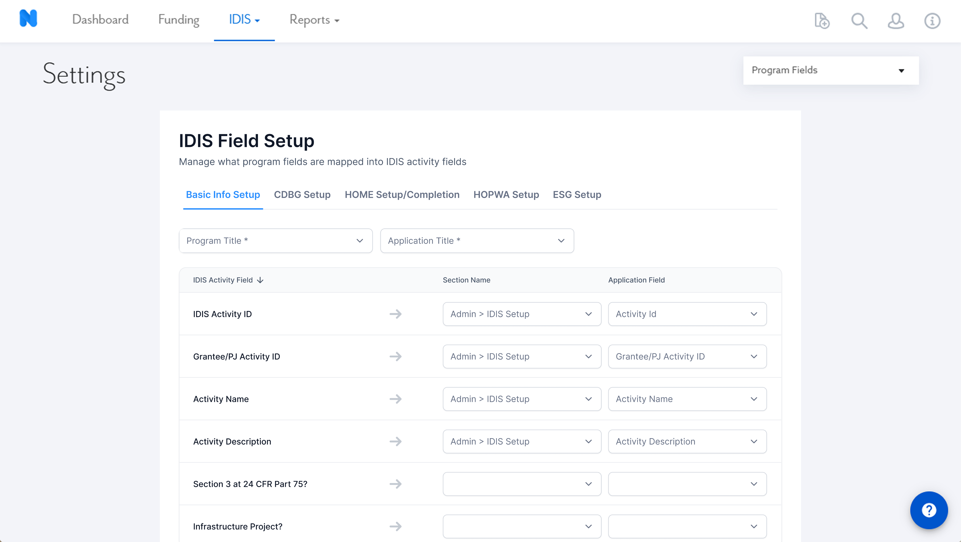
Notes:
· Direct bi-directional connection between Neighborly Software and HUD's IDIS
· Automated submission of both Activity Setup and Activity Accomplishments data
· Comprehensive field mapping for CDBG programs. We are starting with CDBG only, and will slowly begin to incorporate HOME, HOPWA, and ESG.
· Centralized data collection and reporting workflow

Slide 7
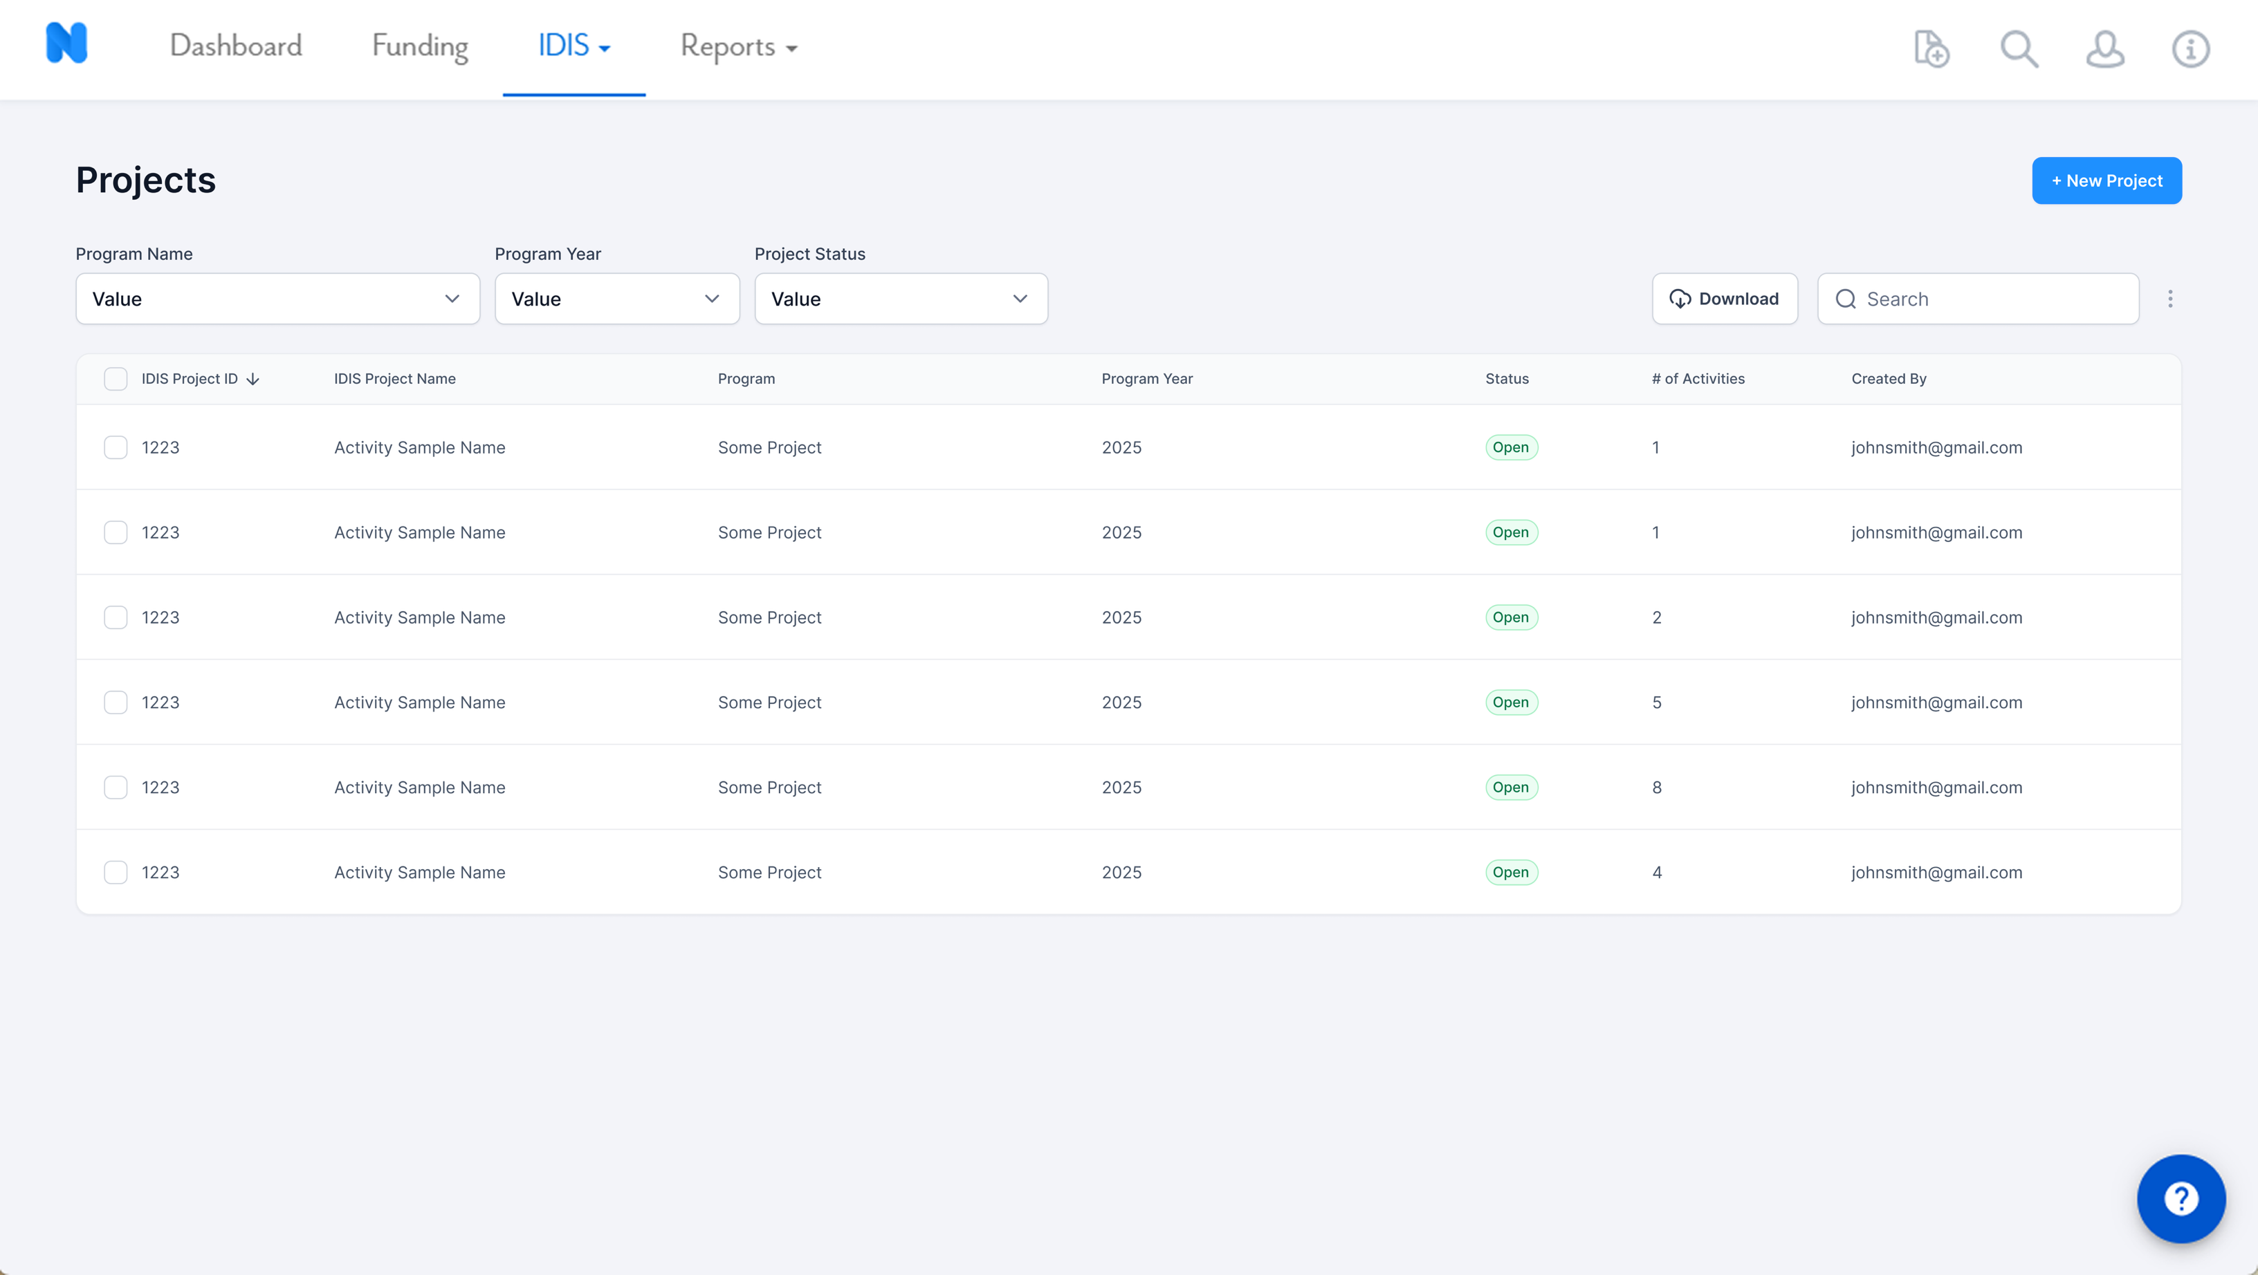

Slide 8
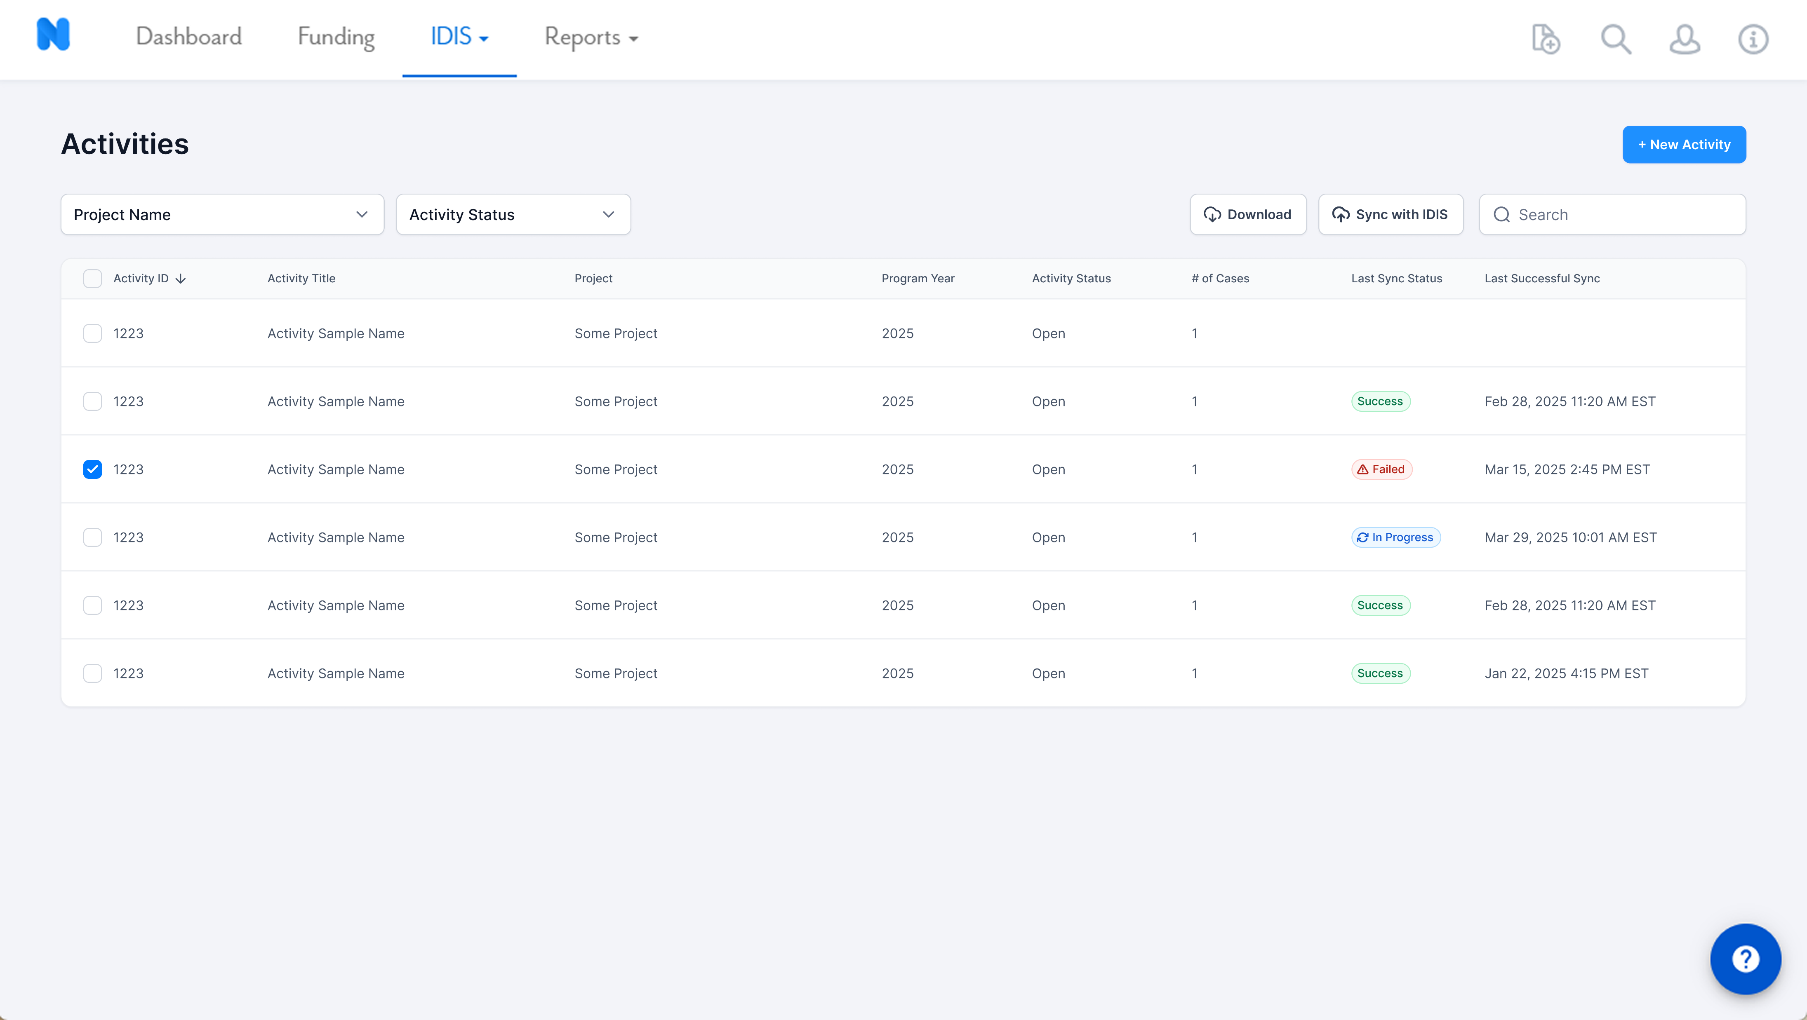

Slide 9
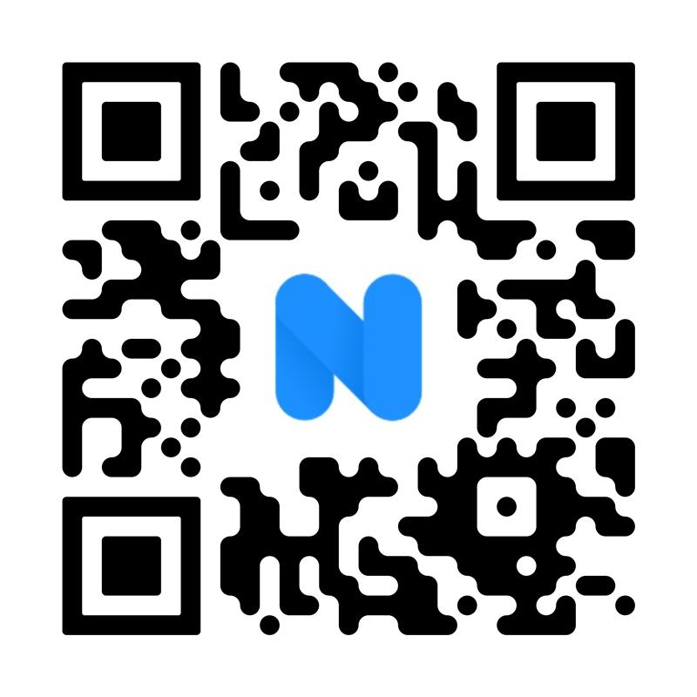
SCAN TO SIGN UP FOR IDIS NEWS

Slide 10
30+ PROGRAMS
HOUSING, ECONOMIC & COMMUNITY DEVELOPMENT
Public Services (CDBG)
Public Facilities and Improvements
Housing Rehabilitation (CDBG, HOME, SHIP)
Lead Based Paint & Healthy Homes
Tenant Based Rental Assistance (HOME)
Down Payment Assistance (CDBG, HOME, SHIP)
Affordable Housing Construction/Development
Asset Management (Housing)
State Housing Initiatives Partnership
Emergency Home Repair
Community Based Development Organization
Choice Neighborhoods
Small Landlord Revolving Loans
Micro-enterprise Grants/Loans
Weatherization
Community Land Trust and Land Banks
Economic Development
Property Acquisition and Demolition
Homeless Programs (ESG)
Continuum of Care (CoC)
HOPWA
Small Business Loans
Utility Assistance
Low Income Home Energy Assistance
Low Income Weatherization Assistance
Neighborhood Revitalization Strategy Area
Behavioral Health
Public Infrastructure

Slide 11
SOLUTION JOURNEY
REVIEW
SCORING
PRIORITIZE FUNDING
LINE-ITEM BUDGET TRACKING and DrAWDOWNS
3
CONTRACT AWARD
DOCUMENT RENDERING
8
ANALYTICS
DASHBOARDS
AFFORDABILITY COMPLIANCE
2
6
1
ONLINE APPLICATION
Annual NOFA acceptance
4
7
LOAN SERVICING, INSPECTIONS, WORK WRITE UPS, SEALED BIDDING
SUBRECIPIENT MONITORING, REPORTING
ACCOMPLISHMENTTRACKING
REPORTING
5

Slide 12
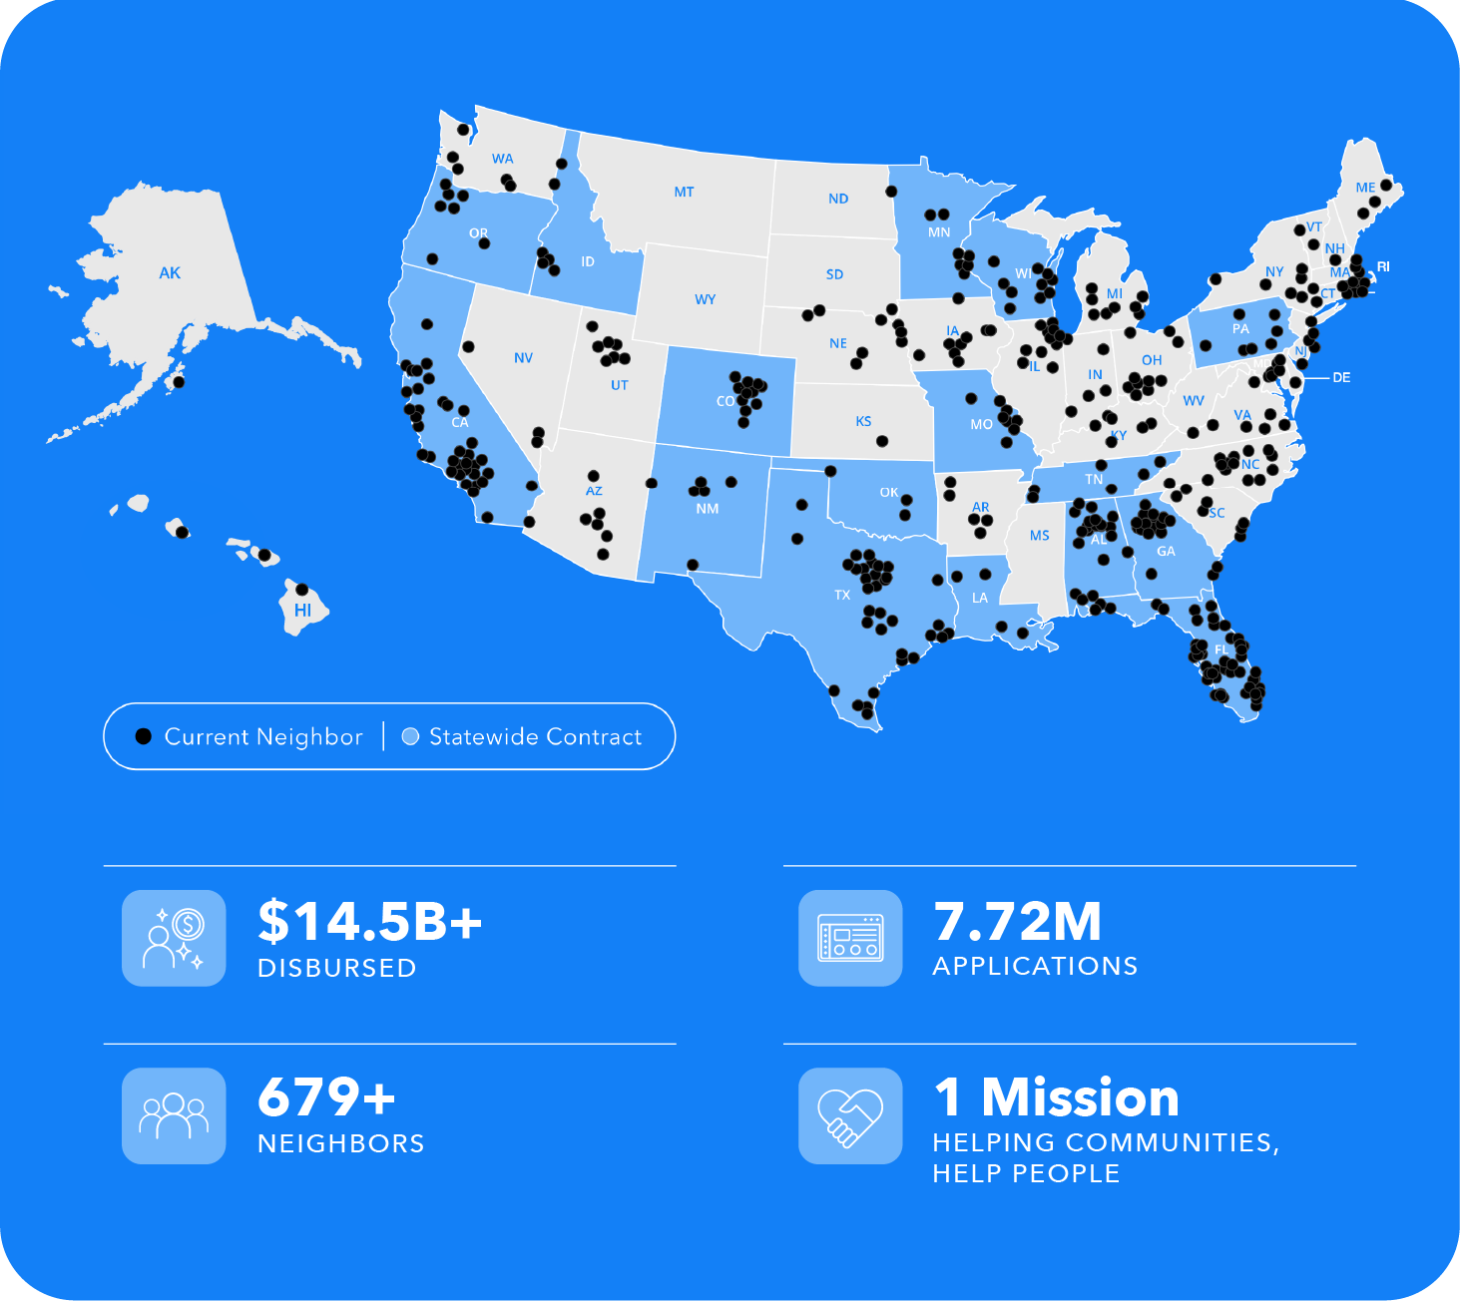
OUR NEIGHBORHOOD
Housing, Economic & Community Dev
HOUSING CHOICE VOUCHERS
DISASTER RECOVERY & MITIGATION
ENERGY REBATES & SOLAR FOR ALL

Slide 13

65 FLORIDA
NEIGHBORS
Alachua County
DeSoto County
Brevard County
Highlands County
Bradford County
Charlotte County
Orange County FL - Eviction Diversion
CRI CPA LLC (Columbia County, FL)
Cape Coral
Hardee County
Escambia County
Sarasota County
City of Miami Beach
City of Daytona Beach
Oakland Park
Orlando Economic Partnership
Putnam County
Jacksonville Bar Association
North Miami Beach
St. Lucie County
City of Jacksonville
City of St. Cloud
Pinellas County Human Services
Leon County
City of Fort Walton Beach
Collier County
Manatee County
City of Tampa
North Miami CRA
North Miami CPD
City of Pompano Beach
Bradford County
City of Hialeah
City of Largo
City of Fort Myer
Orange County
City of Lauderhill
City of Tallahassee
City of Kissimmee
City of West Palm Beach
Leon County
Pinellas County
Pasco County
Polk County
City of Clearwater
City of Gainesville
City of Deerfield Beach
City of Tamarac
Martin County
Hillsborough County
Pinellas County Economic Development
Polk County Board
Commissioners (Polk Prospers)
Lee County Government
City of Sarasota
West Palm Beach
Town of Wellington
The State of Florida
St. Johns County
Broward County
West Perrine CRA
Palmetto CRA
Riviera Beach CRA
Sarasota County – DR
Tampa Hillsborough Housing Initiative

