Slide 1



Leveraging HUD’s
PRO HOUSING GRANT for Sustainable
Growth
Wednesday, April 23, 2025
Presenters:
Annetta Jenkins, Director of Neighborhood Services, Riviera Beach CRA
Heather Pullen Glick, Grant Writer, Langton Consulting

Slide 2
HUD PRO Housing Program Overview
Two application cycles to date (FY 2023 and FY 2024)
FY 2023
$85 million awarded to
175 grant applications received
None awarded in Florida
FY 2024
$100 million awarded to
200+ grant applications received
1 awarded in Florida
18 successful applicants across 15 states
21 successful applicants across 19 states and the District of Columbia

Slide 3


HUD PRO Housing Program Purpose
Identify public and private barriers to affordable housing development in your community
Create projects that will address, reduce or eliminate identified barriers to affordable housing development in your community

Slide 4

HUD PRO Housing Program Goals and Objectives
Ensure access to and increase the production
of affordable housing
Support underserved communities
Promote homeownership
Advance sustainable communities

Slide 5

HUD PRO Housing Program Eligible Activities
Planning and Policy Activities Supporting Affordable Housing
Development
Activities
Infrastructure
Activities
Preservation
Activities

Slide 6
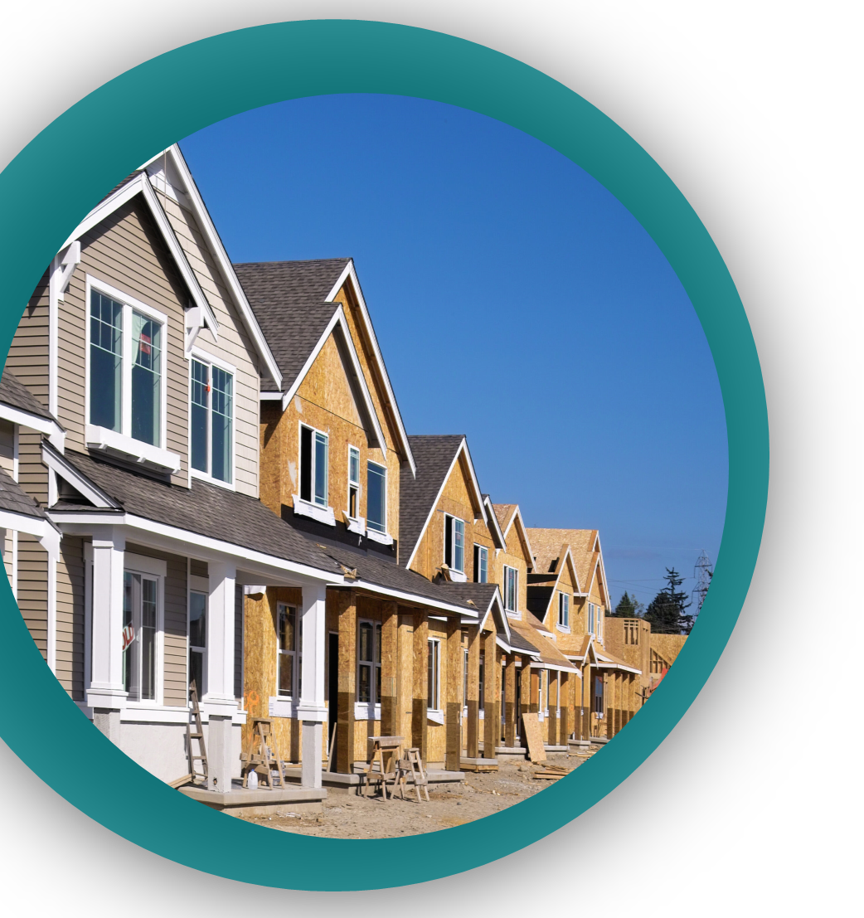
PATHWAYS HOME:
Neighborhood Housing Solutions for Palm Beach County
Applicant: Lake Worth Beach CRA
Subrecipient: Riviera Beach CRA
Project Collaborators:
  Community Partners of South Florida
  Community Land Trust for Palm Beach and the Treasure Coast
  Habitat for Humanity of Greater Palm Beach County
  City of Lake Worth Beach
  City of Riviera Beach
  Riviera Beach CDC

Slide 7

PATHWAYS HOME:
Neighborhood Housing Solutions for Palm Beach County
  Key Barriers:
  Permitting procedures and approval timing and predictability
  Zoning and land use controls
  Infrastructure constraints
  Availability of financing and subsidies for
  affordable housing
  Availability of education on the benefits of homeownership for minority populations
  Unfair credit requirements that prevent low- to moderate-income persons from securing home loans
  Aging housing stock

Slide 8


PATHWAYS HOME:
Neighborhood Housing Solutions for Palm Beach County
Federal
Funding
Awarded
$4.4 Million
Non-Federal
Leverage
$9.7 Million
Performance
Period:
2025-2030
(Five years)

Slide 9
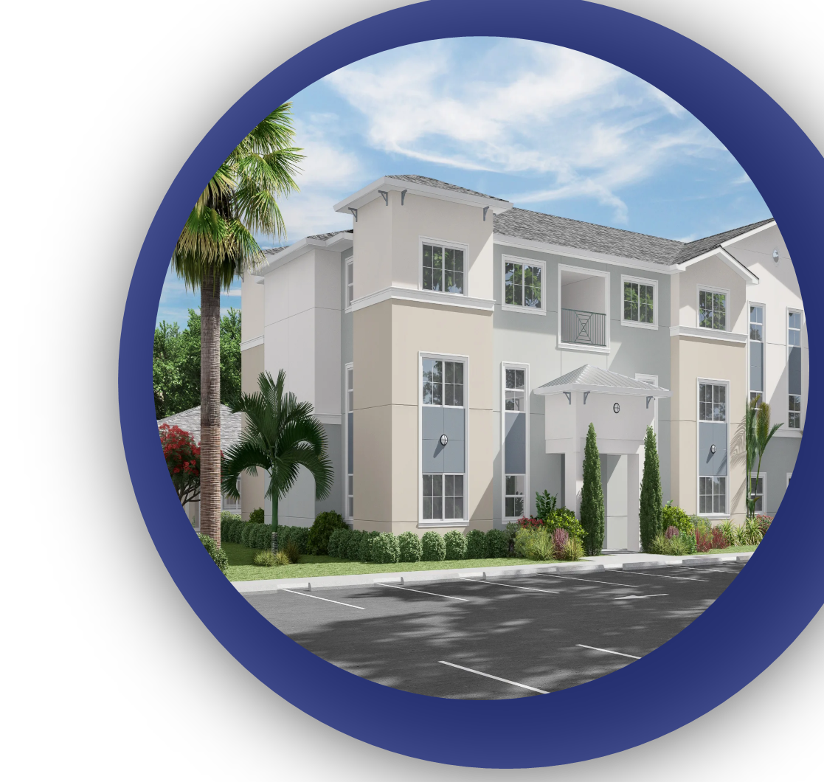
PATHWAYS HOME: Neighborhood Housing Solutions for Palm Beach County
Project #01: Policy Reform
Project #02: Infrastructure Improvements Fund
Project #03: Affordable Housing Development and Affordable Housing Preservation Seed Fund
Project #04: Expand Homebuyer Education Programs
Project #05: Program Administration

Slide 10
PATHWAYS HOME: Neighborhood Housing Solutions for Palm Beach County
Project Name | Performance Metrics | Project Budget | Performance Period
Policy Reform | Procure Consultant Review City Processes Develop Policies Enforce Policies | $875,000 | 2025-2028
Infrastructure Improvements Fund | Establish fund Identify projects E & D Construction | $3.1 million | 2025-2030
Affordable Housing Development and Preservation Seed Fund | Establish fund Develop incentive programs Incentive programs in effect Approve eligible homeowners for rehabilitation | $8.5 million | 2025-2030
Expand Homebuyer Education Programs | Contract with Project Collaborators Create plan to expand services Implement new services | $950,000 | 2025-2028
Program Administration | To Be Determined | $630,000 | 2025-2030
Notes:
All proposed Project activities will address the HUD National Objective of Benefitting Low- to Moderate-Income Persons

Slide 11
Thank You
Questions & Answers

