Slide 1


MARKET SHARE REPORT
BY DONNA HAYNES DWYER

Slide 2
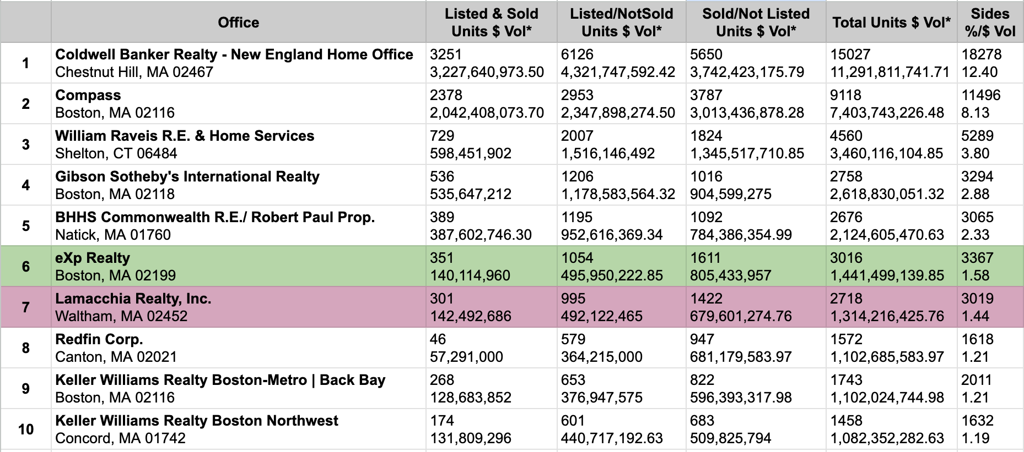
FULL MARKET SHARE REPORT
REPORT RUN DATE: 9/26/2023 1:31:03 PM
Property Type(s): SF,CC, LD, ME,RN,CI, BU,MH
Start Date: 9/26/2022
End Date: 9/26/2023
Town(s): any town

Slide 3
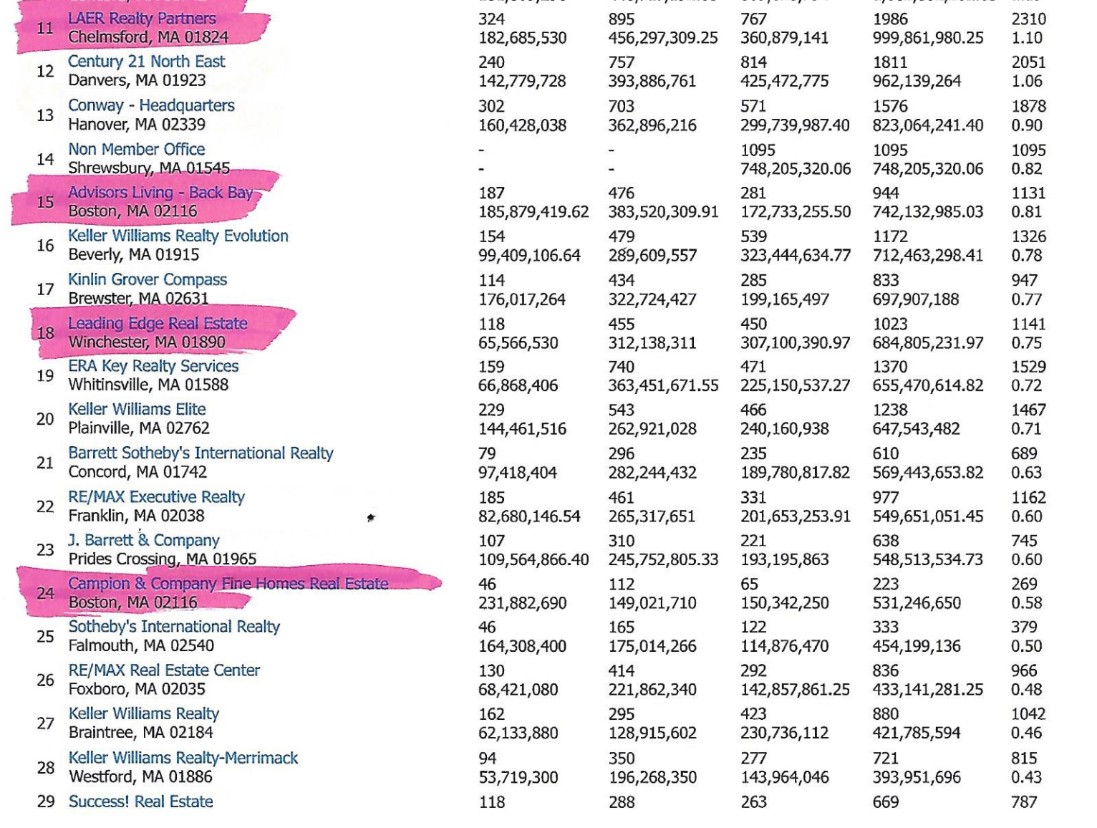
FULL MARKET SHARE REPORT
REPORT RUN DATE: 9/26/2023 1:31:03 PM
Property Type(s): SF,CC, LD, ME,RN,CI, BU,MH
Start Date: 9/26/2022
End Date: 9/26/2023
Town(s): any town

Slide 4

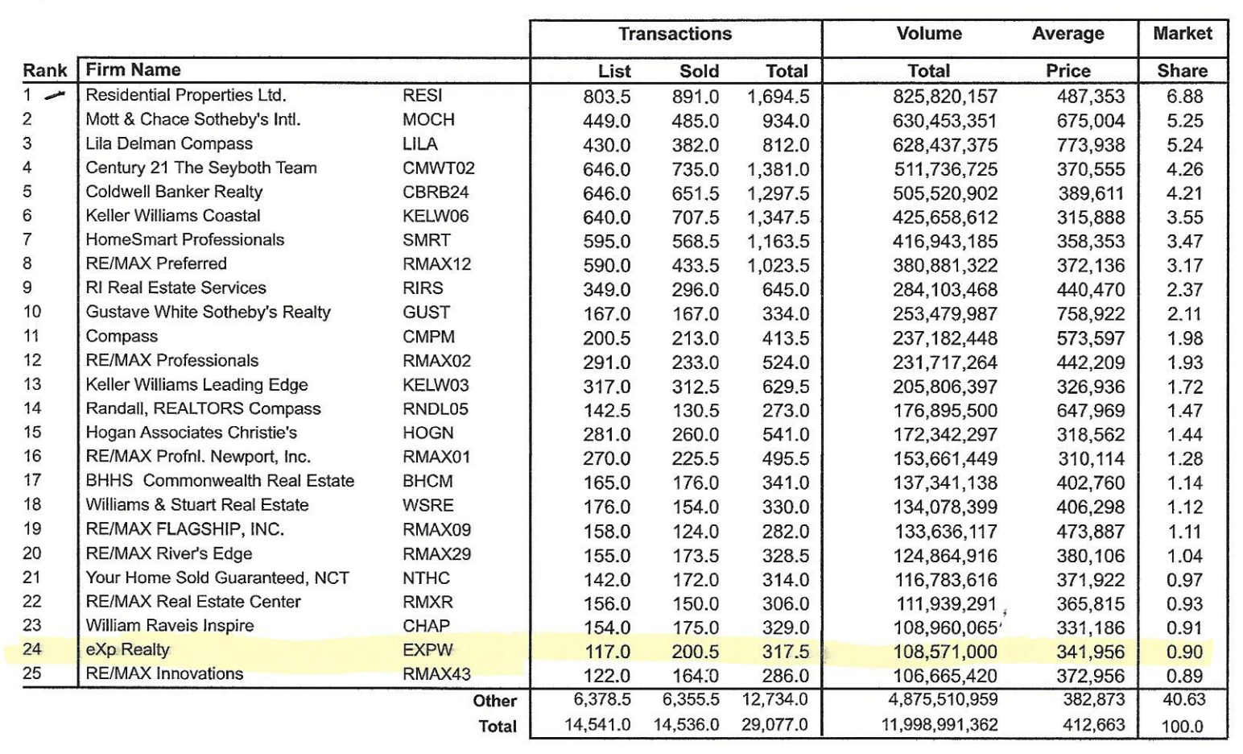
RANKING REPORT
RAN ON 9/26/2023 BY DONNA DWYER
Date Range: 9/26/2022 to 9/26/2023
Criteria:
State Or Province is 'Rhode Island'
Tran Type:
Sales
Grouping:
Firm
Sort Order:
Total Volume
Top:
25

Slide 5

THANK YOU

