Slide 1


Team Building
By Jack McPartlen

Slide 2
What We Will Cover
Team Building Topics
What is your Why?
Do you have a Vision Board?
Networking examples
Join the team that’s
breaking down boundaries
Notes:
Revamp ‘Who We Are’ and ‘Our Business Model’
Breaking Boundaries
The three C’s
https://docs.google.com/presentation/d/1Ep8aFWEVeIPT-K5KUKxSSAJ-SRLXCVKBp1jvpTx5K5o/edit#slide=id.ga445603bfe_0_7

Slide 3
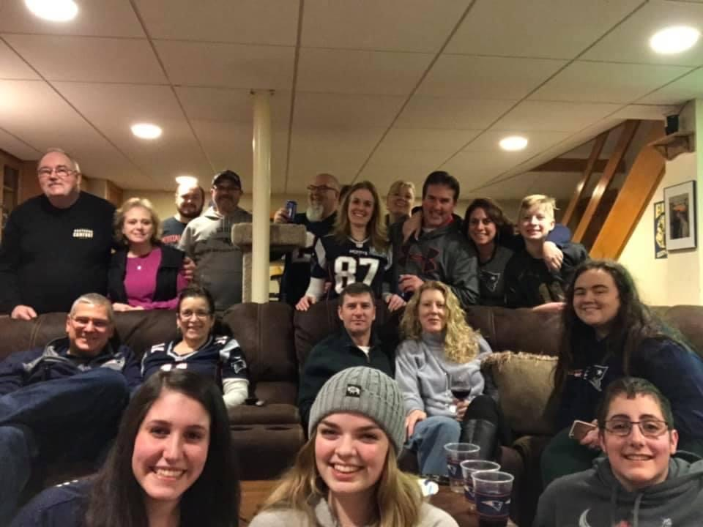
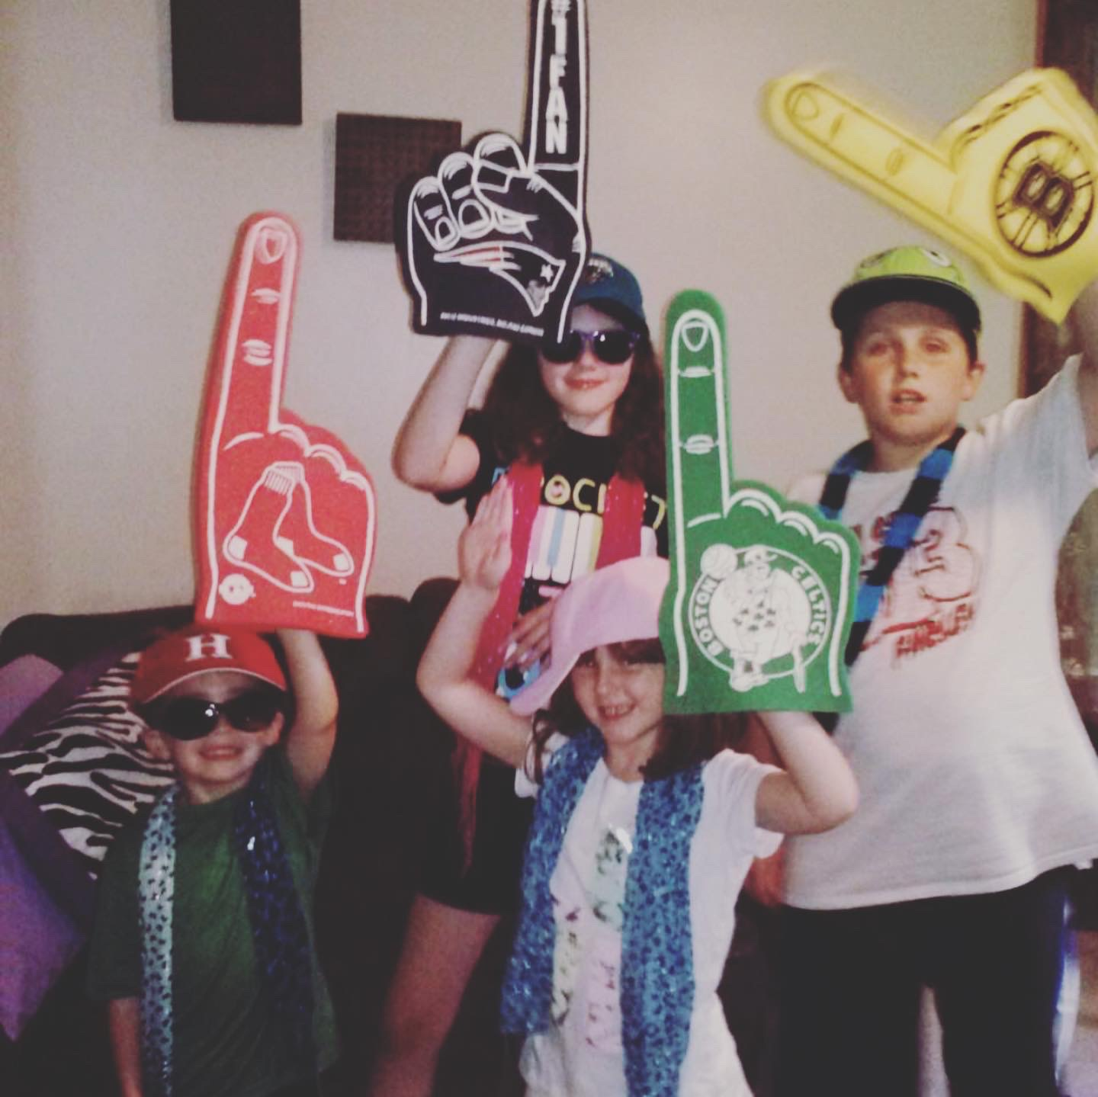
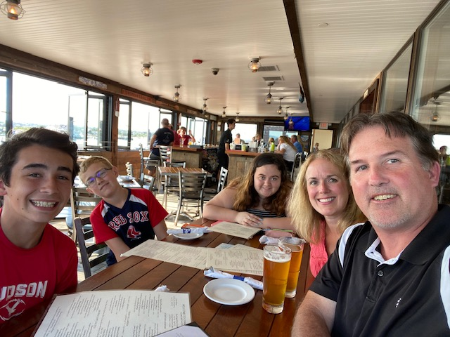
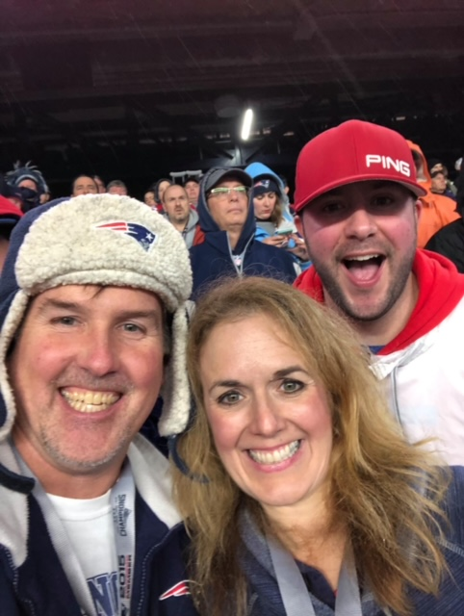
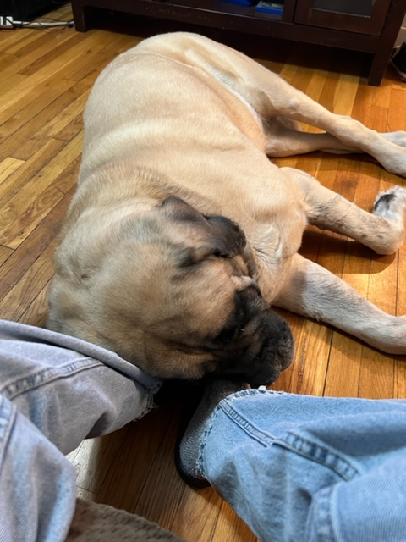
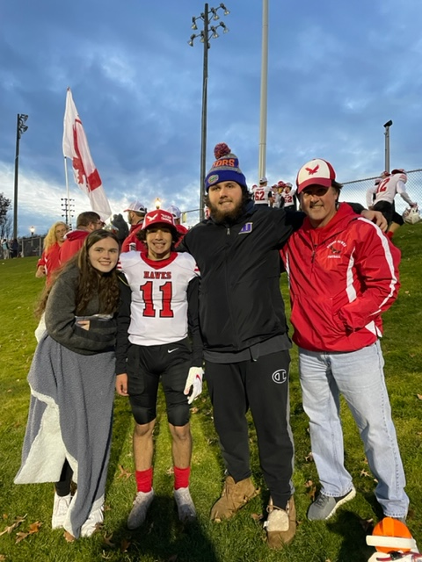
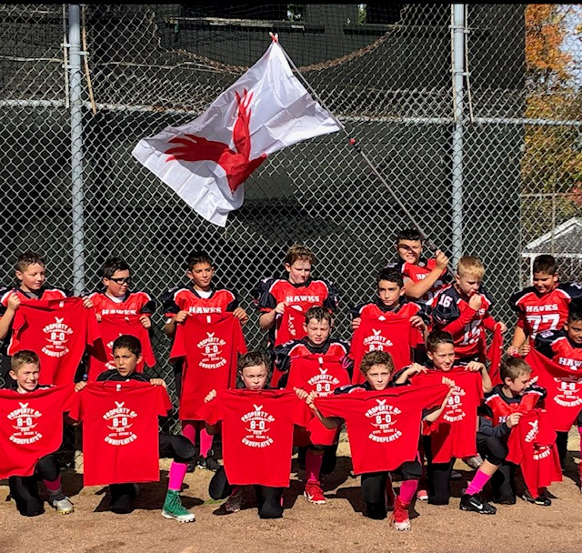
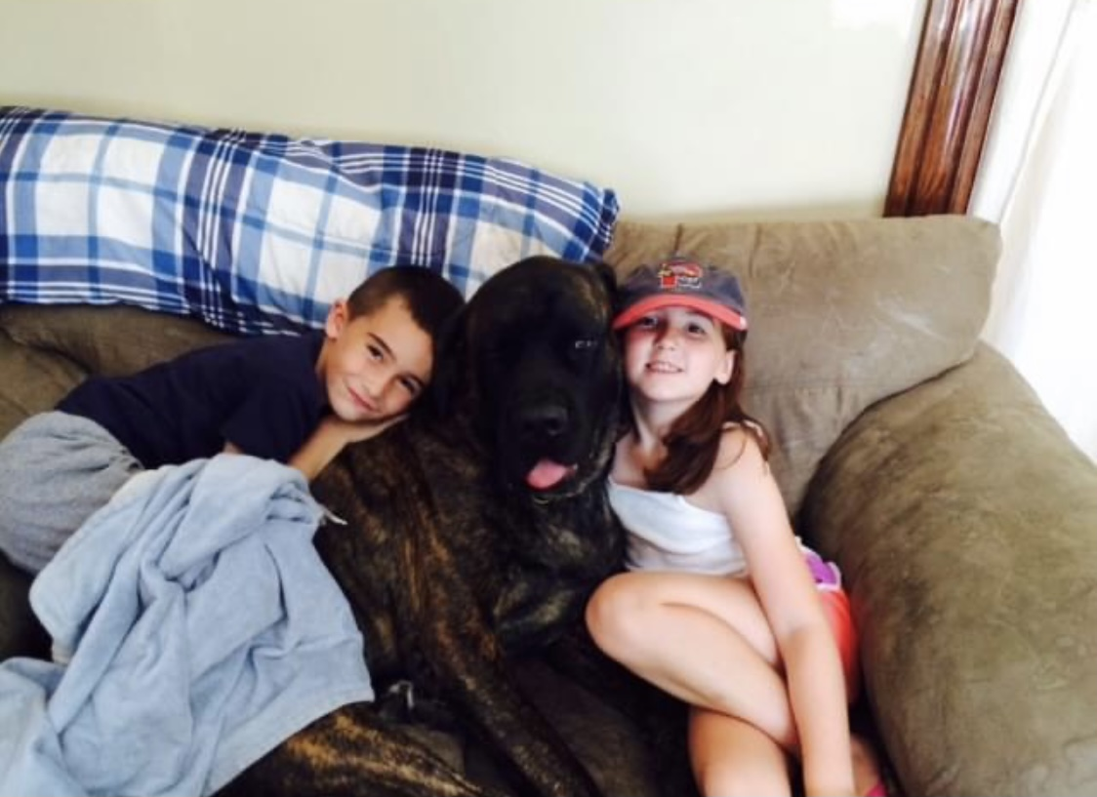
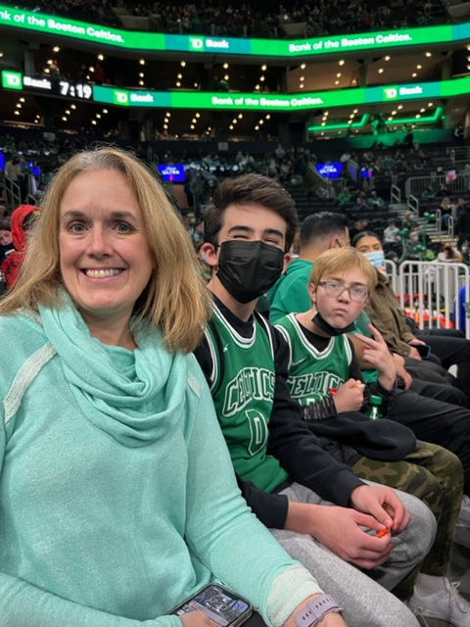
My Why

Slide 4


Slide 5
Team Building
Network, Network, Network
What I’ve learned and present as a team message, we can all be more successful as a unit vs. working independently
Even with message of sharing best practices
Initial conversation ex., I’m looking to connect with like minded team achievers. Are you open to learning and leveraging from best practices? This may lead into, What are your goals this year, How are you being supported now?
Even better if you have a like activity or common interest, for me it’s football and coaching

Slide 6
Team Building Cont.,
Build your network and do it each day
Use all the awesome eXp resources around us, including 3 way calls! It works!
Be sincere and get to know your new business partner
Message of I am here to help first, lead with giving first, and just like BNI theme, givers gain

Slide 7
Join The Team That’s Breaking Down Boundaries
What will your success story be?

