Slide 1

eXp VIP Onboarding Plus+
by Transition Partner Service
www.TeamDisrupterOnboardingPlus.com
Launching You to The eXp World!!

Slide 2

Day One Reality . . . .
Testimonials for Change
  AGENT: This is a disruption to my business while I wade through the onboarding process
  SPONSOR: As a sponsor, I want to help but even I am not sure what all the steps are
  SPONSOR: I have been in eXp for over two years and have yet to fully “onboarded”
  AGENT: This is the most painful experience I have been through and if I wasn’t resilient, understanding the ultimate benefit – I would not have joined. I will not attract another person into this until I understand it and this onboarding pain is solved.
  SPONSOR: The onboarding in Australia was so poor that an Australian team has made a decision to not Attract because of the critical nature of the dissatisfaction.
  AGENT: I get that it is in a check list. I really don’t like checklists, I want someone to do it for me or show me how.
  AGENT: The available, new eXp Concierge Connect is good but unless I follow the check list precisely there are gaps
  AGENT, 3 MONTHS: On Day 1, I received 12 emails from various eXp organizations, eXp affiliates, eXp non-affiliates, people claiming to be eXp - - - did I mention the texts . . .
  LEADERSHIP: The onboarding process was difficult . . . (Dave Conord, Co-President, eXp Realty, PV Mexico, Feb 2020)

Slide 3
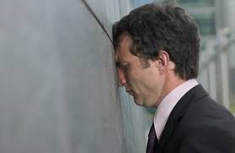

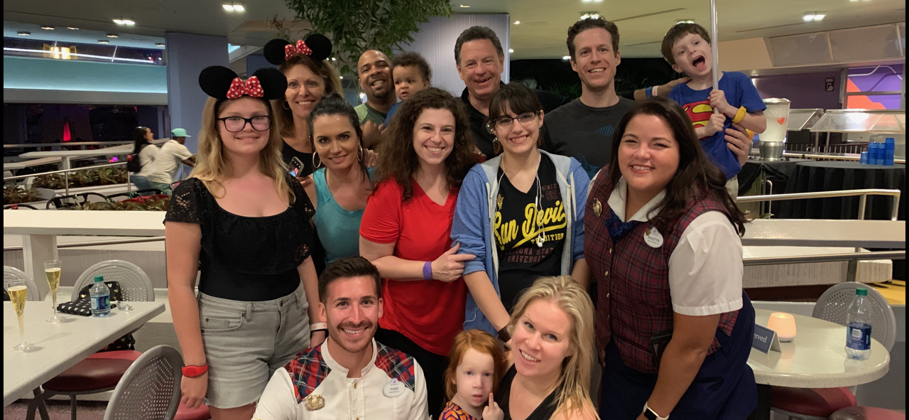



eXp VIP Onboarding Plus+
Transition Partner Service = YOU are the VIP!
BEFORE
eXp Sponsor & New eXp Agent
AFTER
What do you think Gene Frederick and his family’s NPS was after their VIP experience at Disney World?

Slide 4
eXp VIP Onboarding Plus+ with Transition Partner Service’s Support
What we offer
Dedicated eXpert Transition Partner Concierge for a VIP level eXperience for your new eXp Agent’s onboarding & orientation process
Personal introduction of your new Agents to critical eXp departments, platforms, tools, processes & programs
eXpert navigation through occasional digital ‘detours’ that might otherwise add significant time, stress and frustration for Sponsors and new Agents
What you receive
Sponsors
Easy, no frustration, more $ faster
Increase rev share:
  Accelerate new agent time to 1st transaction
  Accelerate new agent time to first attraction
  Increase in agent retention
Increased Sponsor Net Promoter Score (sNPS)
New Agents
- Dedicated eXpert Transition Partner Concierge for a VIP level eXperience during your eXp onboarding & orientation process
Easy, no frustration, more $ faster
  Accelerated transition allowing agents to get back to their business faster
  Accelerated confidence to begin attracting other agents immediately
Increased Agent Net Promoter Score (aNPS)
For only $395 per agent!
eXp Agents & Sponsors Serving eXp New Agents and their Sponsors!

Slide 5
eXp VIP Onboarding Plus+
General Flow of Concierge Led Zoom Sessions
Welcome, orientation and introduction
  Meet your VIP onboarding Concierge
  Orientation to the Service
  Schedule Zoom Meeting 1
Zoom Meeting 1: Onboarding
  Submit online application
  Review, Sign & Submit ICA
  Activate eXp World Pass
  Initiate license transfer to eXp Realty
  Schedule Zoom Meeting 2
Zoom Meeting 2: eXp World
  Download eXp World to desktop
  Create avatar and provide World tour
  Visit Education Center and review available training
  Answer any & all questions
  Schedule Zoom Meeting 3 (if “active”)
Zoom Meeting 3: eXp Platforms
  Confirm eXp Email Alias
  Activate eXp Passport
  eXp Enterprise set up
  eXp Tools & Systems Overview
  Tour Skyslope and Download Forms
  Register KvCore Account
  Tour of Marketing Center
  Setup, log into & tour Workplace
For Session 1 new agents should have the following available at the session:
  Real Estate License Number
  Credit Card – for application fees
  Bank Routing details for commissions
  EIN, if applicable
  Proof of cap, if requesting cap deferral

Slide 6
www.TeamDisrupterOnboardingPlus.com
Bobby Magee
786-897-4628

Slide 7
APPENDIX

Slide 8


Slide 9
Team Disrupter Onboarding Plus+ Development Team
John Rozak
Lisa Parenteau
Dorothy Manning
Kristina Foster
Lynn Steen
Bob McGlynn
Charles Honeycutt
Terry Tran
Julie Nelson
Christi Davidson-Magee
Bobby Magee

Slide 10
“What” and “Why” for launching Team Distrupter Onboarding Plus+
Transition Partner Service
What We Want for Team Disrupter
Make the process of onboarding and transition to eXp Realty to be an eXplosive positive differentiator.
Improve speed to first transaction and first attraction = increase rev share faster
Retention of our most valuable assets – our Agents = retain rev share
Increase Agent & Sponsor Net Promoter Score (a & sNPS) = focus on business, not process and frustration
Why is a positive+ Onboarding and Transition so important?
  First impressions set the tone and attitude immediately - - MAKE IT COUNT!!
    A warm and hearty WELCOME to eXp Realty & Team Disrupter
    Demystify the Cloud based brokerage and its tools
  The first 1 – 2 weeks will set the overall opinion and lasting commit to eXp & Team Disrupter - - MAKE IT COUNT!!
    Imprint is complete and the agent has decided if they will stay or go
  Sponsors need a focused, reliable and consistent process to secure & retain new Agent commitment for top focus & energy on Real Estate & Attraction. We cannot rely only on eXp Realty to fill the gap.
WELCOME, NEW HOME, TEAM (WE), KEEP WORKING, ACCELERATE ATTRACTION, GREAT EXPERIENCE, DO THIS FOR MY AGENTS
Intended response – How you want our agents to FEEL - - - - VIP!!
  Turn today’s “pain point” into tomorrow’s differentiating delighter!!

Slide 11
FIRST IMPRESSIONS COUNT! (50% + 50% = 100% ‘CLOSED and SOLD’)
TURN ‘ME’; INTO ‘WE’ (“I am Welcome, Comfortable and part of this TEAM, I have found a new HOME”)
Warm “Day 1” Welcome to Team Disrupter & eXp Realty: Immediate first Impression! (50% positive decision)
Insanely Simple Onboarding & Orientation (“Day 2 – n”): Demystify, Easy Button, Quick & Fun (50% positive decision)
OUTCOMES
  How we want the New Agent to feel
  It was a great experience
  I’ve found a new TEAM/HOME (high retention)
  I was able to get right to work (transactions and attraction)
  I will be a Sponsor and bring MY New Agents to eXp Realty through Transition Partner Service
  How we want the Sponsor to feel
  It was a great experience and GREAT VALUE
  I now have a great New Agent on MY Team (high retention)
  I was able to keep working without distraction (transactions and attraction)
  I want to always Sponsor and bring MY New Agents to eXp Realty through Transition Partner Service

