Slide 1
ITARs and FieldNotes
Dalhousie Family Medicine
Faculty Development April 3, 2018
Alethea Lacas, MD CCFP (COE)

Slide 2
Objectives
Understand what is the purpose of a Field Note and of an ITAR
01
Discuss common barriers and questions about FieldNotes and ITARs
02
Learn strategies to complete Field Notes more easily
03

Slide 3
What is a field note?
A brief document used in a clinical setting to provide and document specific behaviour-based feedback.
Intended to precipitate structured timely sharing of your experience with common reflection.
Provides documentation
  This encourages feedback on a wider spectrum of essential skills
  Improvement in assessing competence
Notes:
Field note definition:
A brief document on a prescription-sized note pad used in a clinical setting to provide and document specific behaviour-based feedback.
During daily clinical work, encourage the gathering and documentation of case-specific comments and feedback with reflection and coaching from preceptors to residents.
Improvement in assessing competence:
based on performance through a wide spectrum of skills
linked to the CFPC Evaluation Objectives
A guide to teachers and learners, and evidence that competence is developing by:
helping inform ITARs, periodic reports, performance reviews
acting as an aide-mémoire for periodic discussions on resident progress
https://medicine.dal.ca/content/dam/dalhousie/pdf/faculty/medicine/departments/department-sites/family/Education%20Documents/resident_resources/general/Field%20Notes%20-%20Use%20Easy%20to%20follow%20Instructions.pdf
3

Slide 4
Think of a field note as a way to document the feedback you are already giving verbally throughout the day.

Slide 5
Field Notes Inform ITARS

Slide 6
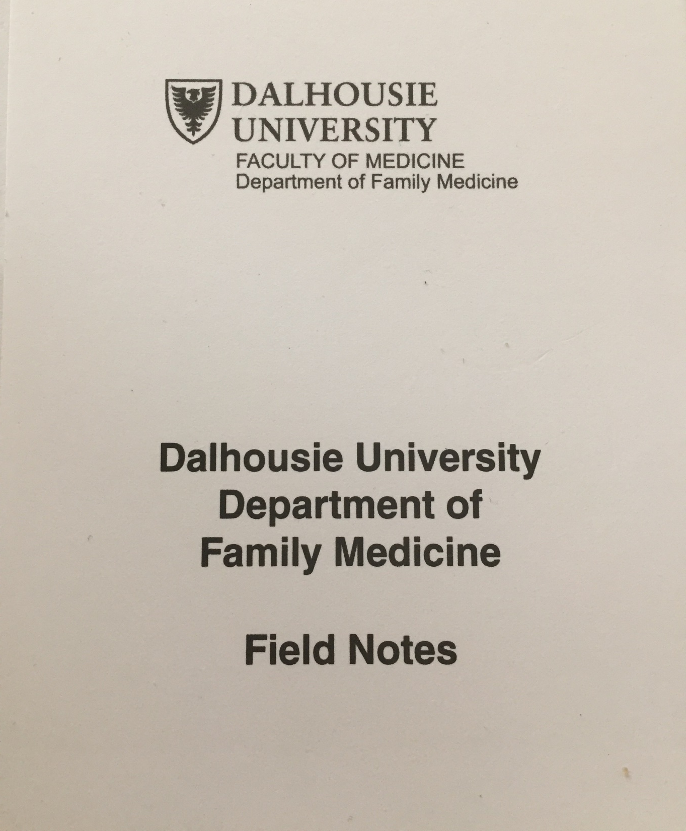
FIELD NOTES The How To

Slide 7
Common Questions
Whose responsibility is it to initiate completing the field note?
Who writes in the field note?
What are all the different fields and do I need to fill them in?
What do I choose as a topic to discuss?
Notes:
Observe an encounter, part of an encounter or simply discuss the case with the resident as close to the time of the encounter as possible
It is very important that both the preceptor and the resident are engaged in the discussion reflecting on the clinical situation. This requires face to face dialogue with input from both partners during completion.
Often it is helpful to have the resident do some or all of the writing, noting the demographic information, the problem/situation discussed, and the feedback given.
Indicate on the note if a direct observation has been involved.
Use the “Guide to the CFPC Evaluation Objectives” found on the duplicate field note pad to choose one phase of the encounter, one competency of one skill and appropriate domains of clinical care to be discussed. This encourages specific feedback to reinforce the take home message.
The responsibility to initiate the discussion should be shared between faculty and resident
https://medicine.dal.ca/content/dam/dalhousie/pdf/faculty/medicine/departments/department-sites/family/Education%20Documents/resident_resources/general/Field%20Notes%20-%20Use%20Easy%20to%20follow%20Instructions.pdf

Slide 8
Whose responsibility is it to initiate completing the field note?
It is a shared responsibility

Slide 9
It can be either.
Do what is most efficient for you.
Who writes in the field note?

Slide 10
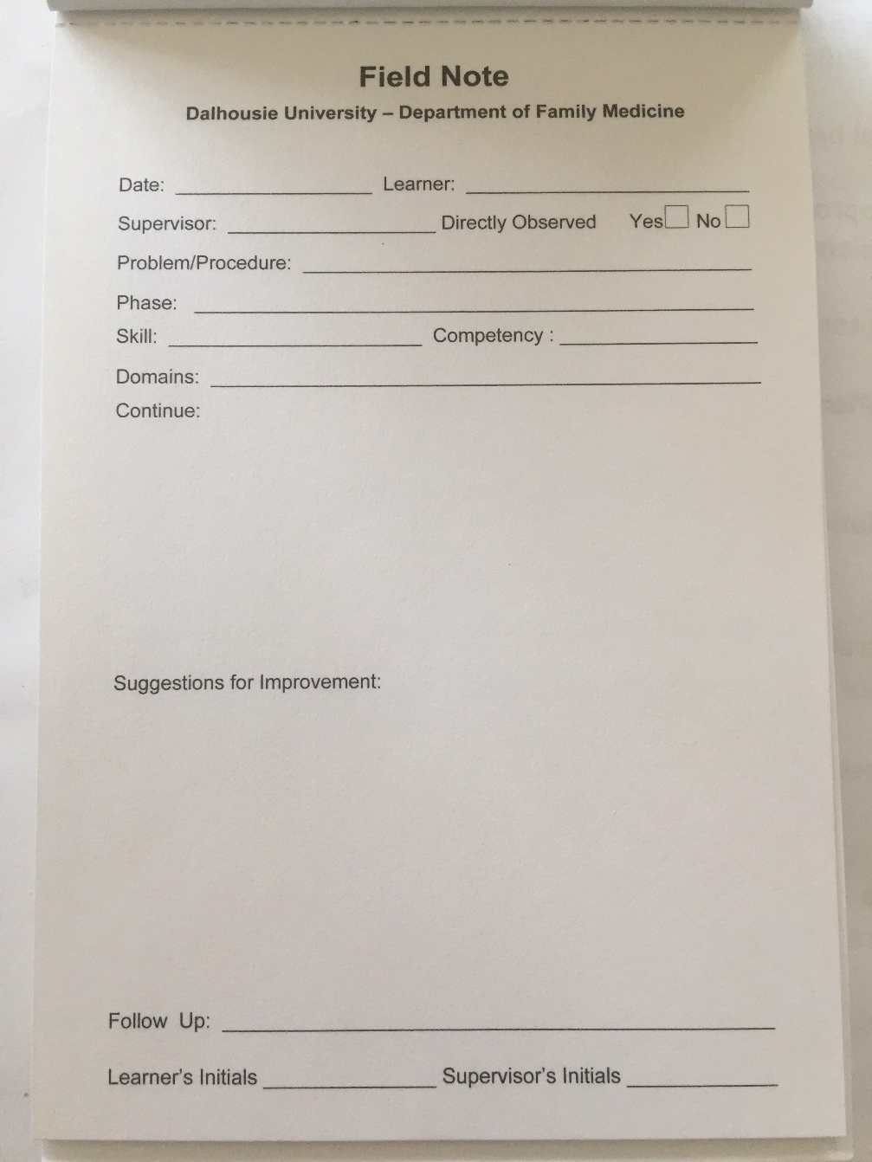
What are all the different fields and do I need to fill them in?
Notes:
Priority: Date, your initials?

Slide 11
A high quality Field Note
Is specific
Includes enough detail to provide context
Can use innovative sources

Slide 12
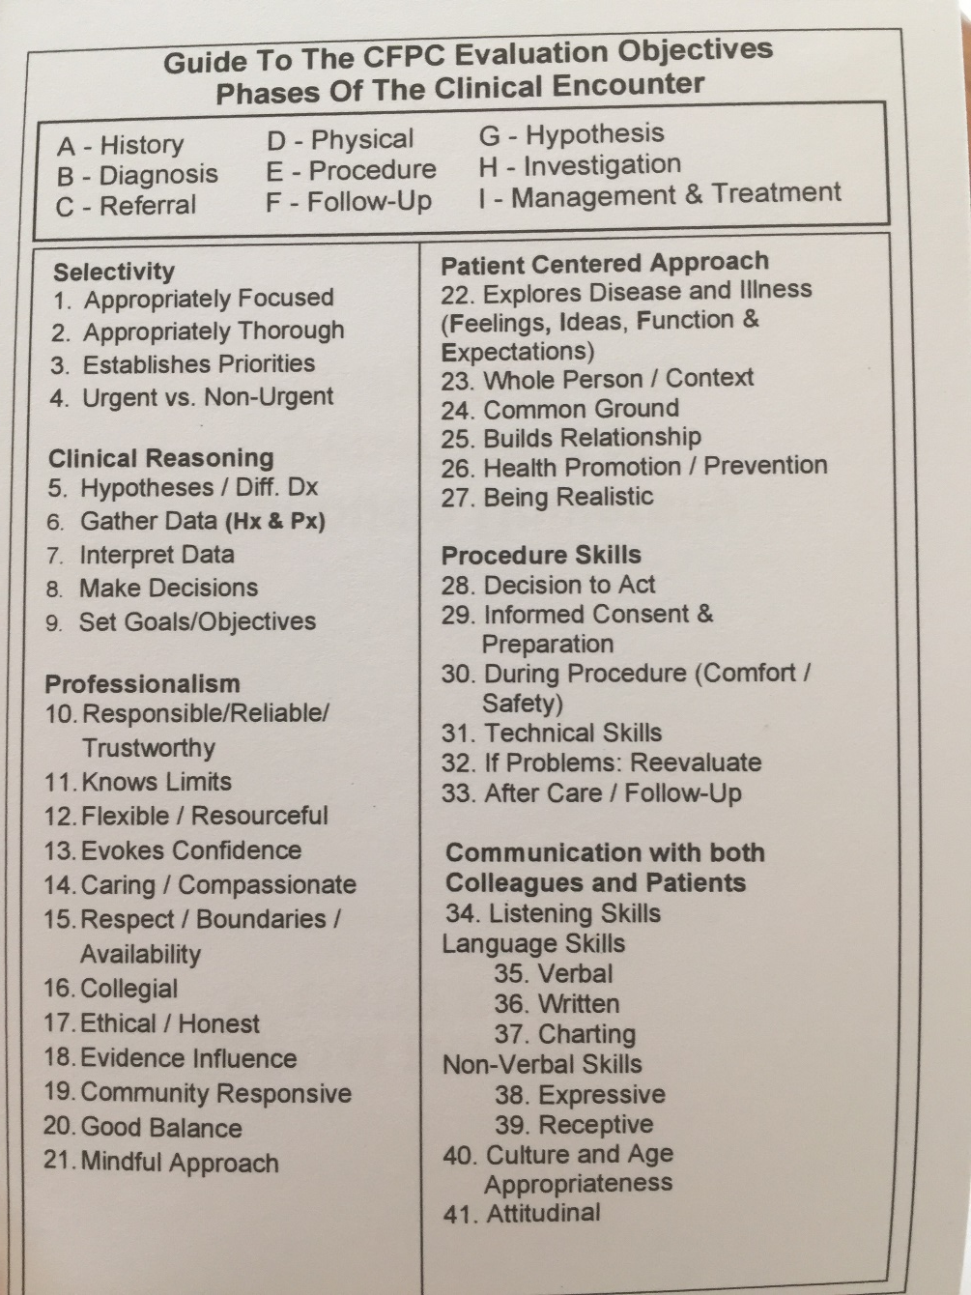
The idea is that by sampling across all phases, skills and domains you will have a better sense of competency.
Notes:
Priority: Date, your initials?

Slide 13
Do we have to talk about what is written down?
Ideally.
What is written is a documentation of verbal feedback.
The process of completing the Field Note is a reflective discussion.

Slide 14
ITAR
In Training Resident assessment

Slide 15
ITAR – what is the purpose?
Evaluation document
Did the resident meet the competencies for this rotation?
Narrative
Uses credible evidence (from field notes)

Slide 16
What goes in an ITAR?
Summative, overarching statement(s)
Use field notes as examples/evidence
Input from team
Patient feedback

Slide 17
Completing the ITAR
ITAR must be complete and submitted for the resident to graduate.
Make time before the end of the rotation.
Resident should organize their field notes and give to you.
It is okay to meet remotely to complete and submit to one45.
SUMBIT the completed ITAR

Slide 18

Questions?

