Slide 1
Faculty Development Workshop – August 20, 2015
Professionalism in the workplace

Slide 2
Agenda
Context - why we are here?
Small group discussions
Scenarios
Closing question

Slide 3
Please share
Imagine yourself at work on a really busy and stressful day.
How might someone on your team describe you?

Slide 4
Round 1
Why focus on professionalism?

Slide 5
Round 2
How could being more professional change the way we work in a team?

Slide 6
Round 3
What might you need to give up to be perceived as more professional?

Slide 7
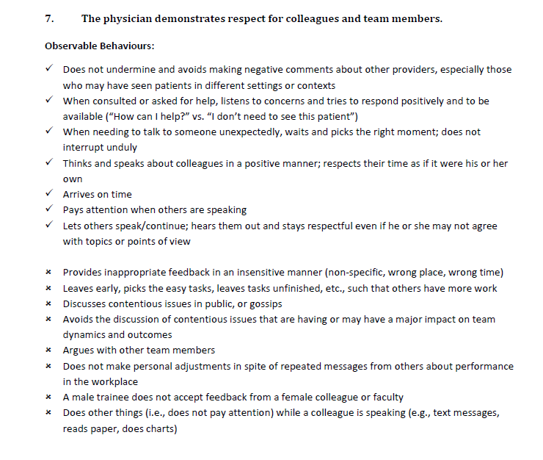

Slide 8
How are we as a team not meeting these core competencies?

Slide 9

Small Group Exercise
Scenarios

Slide 10
Closing Questions
What is one key takeaway from our time here together?
What might be commit to to better model professionalism for our learners?

