Slide 1
Teaching “On the Fly” and
Bedside Teaching
Alethea Lacas, MD CCFP (COE)
Dalhousie Family Medicine
November 27, 2017

Slide 2
‘Medicine is learned by the bedside and not in the classroom’
Sir William Osler

Slide 3

Objectives
To review an approach to teaching “on the fly”
To learn some methods for teaching “on the fly”
To gain an appreciation for the value of bedside teaching
To learn some strategies and skills for bedside teaching
³
Notes:
In other words, we need to find ways to obtain more documented observations of our residents performing the tasks identified as important by our specialty, in the real workplaces where family physicians practice.
³

Slide 4
What is Bedside Teaching?
Any situation where teaching occurs in the presence of a patient.
Bedside teaching is a vital component of medical education curriculum
Notes:
By bedside teaching we mean patient-based and patient-orientated teaching and learning; taking place in natural health related environments.

Slide 5
Teaching on the Fly
What does this mean to you?
Teaching in a clinical situation
Teaching inspired by patient encounters
Teaching without much time
“Informal” teaching

Slide 6
Key Message
PREPARE
Orientation Planning
Notes:
This really speaks to the importance of good orientation and preparation for learner.

Slide 7
Prepare
Know your learner
  Their level of training, past experience, goals for rotation, prior areas of difficulty
Know the curriculum
  What are the objectives for this rotation/shift?
  What are you going to teach?
Choose your patient(s)
Notes:
Videos/reading to update your skills
Faculty development
CAT course

Slide 8
Practice
Groups of 2-3
One person is learner
One person is staff
Practice asking questions that help with planning/orientation

Slide 9
Challenges in Bedside Teaching and Teaching “On the Fly”

Slide 10
Challenges
Productivity
Time
Preceptor Confidence
Don’t know what “material” you will have
Space
Patient present
Patients are “sicker”
Our Own Discomfort
Large group of learners
Notes:
Don’t know what “material” you will have
i.e. who/what are you going to see in clinic
Preceptor Confidence
Learner who challenges you
Our own discomfort:
Uncomfortable with our own skills
-worry that we will not know the answer/how to do something
Invasion of patient s’ privacy
Loss of control
Maintaining your own productivity if in an outpatient setting

Slide 11
One Minute preceptor and SNAPPS
Teaching On the Fly

Slide 12
One-Minute Preceptor
“5 Microskills”
Get a Commitment
Probe for Supporting Evidence
Teach General Rules
Reinforce what was done right
Correct Errors
One Minute Preceptor
Neher J et al. A five-step “microskills” model of clinical teaching. J of Am Board Fam Pract. 1992; 5(4): 419-424.
Notes:
1. Get a commitment
Examples:
What do you think is going on with this patient?
What investigations do you feel are indicated?
What do you think needs to be accomplished on this visit?
What do you want to do?
2. Probe for supporting evidence
Examples:
What are the major findings that lead to your conclusion?
What else did you consider?
What made you choose that particular treatment
3. Teach general rules
What is the "take home" message from this experience?
"In situations like this t is important to..."
"The key features of this illness are..."
Keep it brief and focused on identified issues
Avoid anecdotes and idiosyncratic preferences
4. Reinforce what was done right
Tell the learner what they did right
Be specific
"When you did this .... it worked well" or "patient responded..."
5. Correct errors
Consider appropriate time and place
Start with learner self-evaluation
Be specific
Consider language – “not best” rather than “bad”
"Next time this happens, try this..."

Slide 13
SNAPPS
Summarize
Narrow the differential
Analyze the differential
Probe SNAPPS explained
Plan management
Select case for self directed learning
Wolpaw T et al. SNAPPS: A learner-centered model for outpatient education. Academic Medicine. 2003; 78(9): 893-898.
Notes:
A model developed in medicine for busy outpatient settings where there is often little time to spend “teaching” between patient appointments.
Process takes 6-10 minutes
Is Learner centered model -

Slide 14
SNAPPS in ACTION
SNAPPS

Slide 15
Teaching at the Bedside

Slide 16
Types of learning opportunities
  Common
    History taking skills
    Physical exam skills and procedural skills
    Patient-learner interaction
    Case presentation
  Less Common
    Ability to explain findings or the plan to patient
    Managing family members’ questions
    Teaching more junior learners
  Model for the learner
    How to ask difficult questions
    Demonstrate how to say “I don’t know” or an apology

Slide 17
Benefits – For the Teacher
Direct observation of the clinical skills of the learner
Ability to observe how the learner interacts with patients
  Communication
  Professionalism
Learn from the learners
Opportunity to role model
Notes:
Impart the knowledge of clinical skills
Guide history taking skills
Observe performance
Role model
Hidden benefits:
You learn a lot from learners
You put your “stamp” on the students

Slide 18

Benefits – For the Learner
  Practice skills while being observed
  Meaningful Feedback
  Can observe the teacher(s)
  Teach the teachers
  Puts the learning in context
Notes:
Role model
Change of venue
Practicing skills while being observed
Feedback
Teaching the teacher
No medspeak = all on same level
Perhaps the most important reason is that it places all the learning in context. This will make the information easier to recall when a similar situation is encountered.

Slide 19
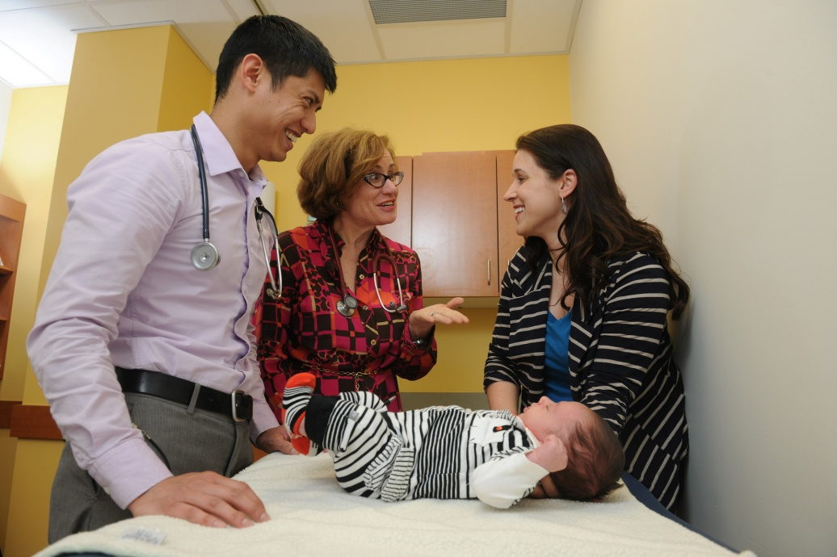
Benefits – For the Patient
Appreciate the extra time
Appreciate hearing more about their medical situation
Enjoy feeling like they
contribute to the training
Notes:
Well researched and well established.

Slide 20
When NOT to do bedside teaching
  Patient refuses or has high anxiety
  Patient psychotic/delusional
  Learner needs to practice skills in a more controlled setting
  Case presentation in front of patient may be upsetting
  Providing feedback to the learner
Notes:
Controlled setting – e.g. simulated patient, volunteer patient, role play

Slide 21
Teaching Tips
Bedside Teaching

Slide 22
Clinical Teaching Framework
Plan
Teach
Reflect
    PBSG-Ed “Time Efficient Teaching Strategies” Module, McMaster.
BEFORE
DURING
AFTER
Ongoing Needs Assessment
Notes:
From PBSG-Ed: “Planning is a key component of this framework.
Plan: Preparation, Orientain, Briefing
Teaching: Observe, use 5 Microskills or SNAPPS, Model
Reflect: Discussion, Thinking, Reading
Far from compromising spontaneity, planning provides structure and context for both teachers and students, as well as framework for reflection and evaluation.
While planning does require a small investment of time upfront, it can actually save considerable time in the long run.

Slide 23
Intent
Go to bedside with specific intent/plan
BUT
Remain flexible
Notes:
Road Map

Slide 24
Plan - Briefing
Review patient’s medical background
Give direction on what learner should focus on
Guidance on physical exam
Time limit for initial encounter
What you might NOT talk about
              PBSG-Ed Time Efficient Teaching Strategies
Notes:
May not discuss sensitive issues or ddx or preliminary results etc

Slide 25
Plan - Prepare the patient
  Introductions
  Establish permission
  Explain the purpose of the encounter
  Let the patient know that family may stay
  Explain what is being discussed
  Ask for patient’s input or questions

Slide 26
Teach - Observation
Remember to step back and observe
Try not to take over the encounter
Notes:
Take note of observable behaviors. Prepare to give specific examples in feedback (after)

Slide 27
Teach - Questioning
Ask appropriate questions
  Avoid the “guess what I am thinking”
  Target question to level of training
Discourage one-upmanship among learners
Gentle correction is okay, but avoid harsh feedback in front of patient and group of learners
Model that it is ok to not know an answer
SNAPPS + 5 Microskills

Slide 28
Debrief - Summarize
Summarize what has been taught/reviewed
  This is for both the patient and the learners

Slide 29
Debrief with Learners
What went well, what didn’t go well
What questions do they have
Discuss sensitive issues
Decompress if appropriate
Next steps for following up on questions/skills
Plan for next learning session

Slide 30
Summary

Slide 31
Summary
Bedside Teaching and Teaching on the Fly
Is important for learners and teachers
Is acceptable to patients and even enjoyed
Planning is key for successful teaching
Orient the learners and the patient to the plan
SNAPPS and One Minute Preceptor are two approaches
Summarize findings/what was taught
Debrief with learners
Learn from one session to plan the next

Slide 32
References and Resources
Baker RC, Klein M, Samaan Z, Brinkman W. Exam room presentations and teaching in outpatient pediatrics: effects on visit duration and parent, attending physician, and resident perceptions. Ambul Pediatr. 2007 Sep-Oct;7(5):354-9.
Cannon R and Newble D. A Handbook for Medical Teachers. 4th Edition. Accessed May 26, 2016 at: http://edc.medilam.ac.ir/Portals/10/A%20HANDBOOK%20OF%20MEDICAL%20TEACHERS.pdf
Clinician as Teacher “CAT” – Teaching at the Bedside Module by Dr. Chuck Maxner and Dr. Steve Miller. Dalhousie University.
PBSG-Ed “Time Efficient Teaching Strategies; Teaching on the Fly” fhs.mcmaster.ca/facdev/pbsg-ed.html. Accessed May 26, 2016.
Peters, M and ten Cate, O. Bedside teaching in medical education: a literature review. Perspect Med Educ (2014) 3:76–88.
    Snell L et al. Perceptions of bedside teaching: I - Faculty, resident & student perspectives. 2 - Patient perspective.
    Subha Ramani (2003) Twelve tips to improve bedside teaching, Medical Teacher, 25:2, 112-115, DOI: 10.1080/0142159031000092463
    http://www.umin.ac.jp/vod/files/Dr.Linda_Snell/Bedside_teaching_IRCME4.pdf Accessed May 26, 2016.
    http://www.faculty.londondeanery.ac.uk/e-learning/explore-further/teaching_and_learning_at_the_bedside.pdf Accessed May 26, 2016.

