Slide 1
Supervision in Virtual Care Setting
Teaching Module
Created by Alethea Lacas, MD CCFP (COE)
Director of Faculty Development, Dalhousie Family Medicine
July 2020

Slide 2
Special Thanks
This module was created with significant contributions and support from Dr Karen McNeil, Dr Lisa Searle, Ms Angela Hoggan, Ms Susan Love and Dr Lisa Bonang.
Thank you as well to all the family medicine teachers and faculty development leaders from across Canada who created and shared materials and tools that are used in this module. Learning to supervise in the virtual care setting has truly been a group effort.
Thank you!

Slide 3

Disclosure Slide
Nothing to Disclose
Notes:
Start with Introductions
-introduce myself including nothing to disclose
-ask attendees to share their name, where they practice, what they hope to get out of the workshop

Slide 4
Objectives
Participants will:
Identify how supervision both differs and is the same in a virtual care setting compared to traditional face to face settings
Develop an approach to supervising learners who are providing care in a virtual care environment
Develop an approach to providing feedback to learners in a virtual care environment
Identify best practices for providing virtual care that can be communicated with your learners

Slide 5
Case: Marcia R1, Providing Care in the Virtual Care Setting
Part 1
During the covid-19 pandemic you pivoted your family medicine clinic to exclusively virtual care during the height of public health restrictions.
Now you are offering a mixture of virtual care appointments to your patients as well as in- person appointments.
You have gained some comfort with virtual care and can appreciate the benefit for both you as a provider and for your patients.
Next week you will have a learner with you for the first time since offering virtual care appointments.
You have been thinking about how to set this up and are feeling quite anxious about making it work.

Slide 6
Question 1
How is virtual care both similar and different from traditional in-person care?

Slide 7
Question 1: How is virtual care both similar and different from traditional in-person care?
Info Point 1: Virtual Care encounters are still, at their core, similar to an in-person office encounter.
Info Point 2: Virtual Care encounters have some key differences.

Slide 8
Question 2
What are possible benefits of virtual care and virtual supervision?

Slide 9
Question 2: What are possible benefits of virtual care and virtual supervision?
Info Point 3: There are unintended benefits of virtual care and virtual supervision.

Slide 10
Question 3
What best practices for virtual care have you been following?

Slide 11
Question 3: What best practices for virtual care have you been following?
Info Point 4: You should become familiar with best practices for virtual care and ensure your learner is provided some teaching around this.
Info Point 5: Be aware of the any unique medico-legal risks associated with providing and supervising in the virtual care setting.

Slide 12
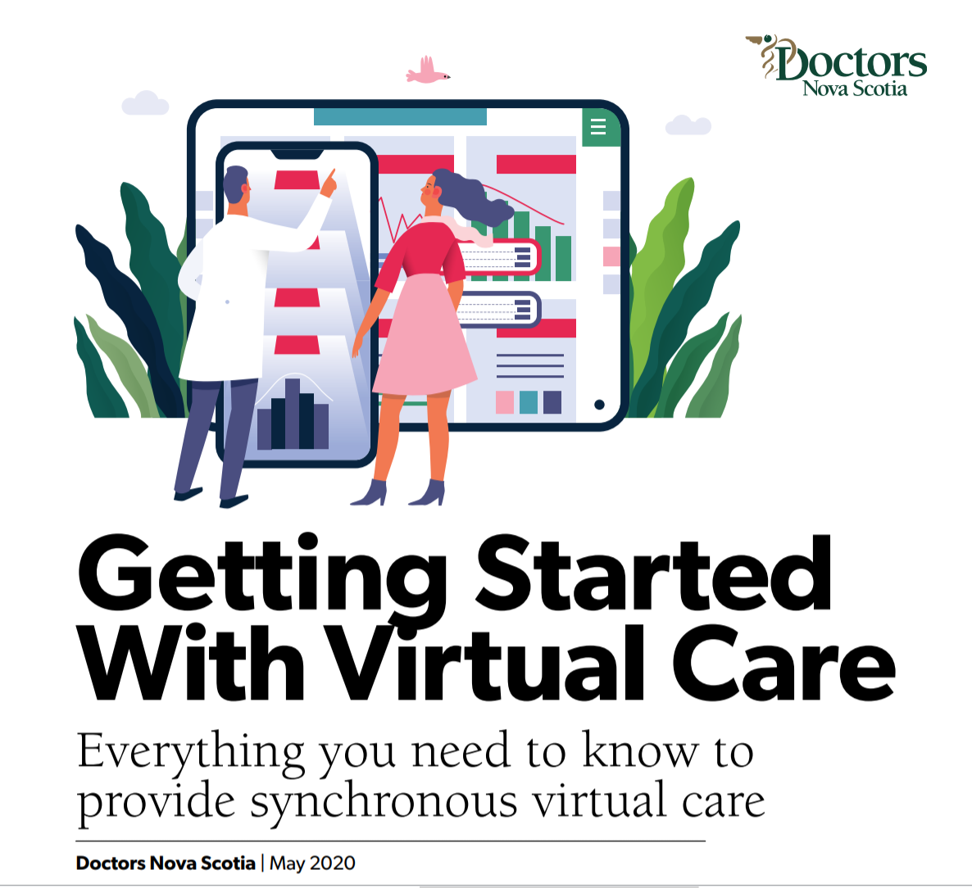
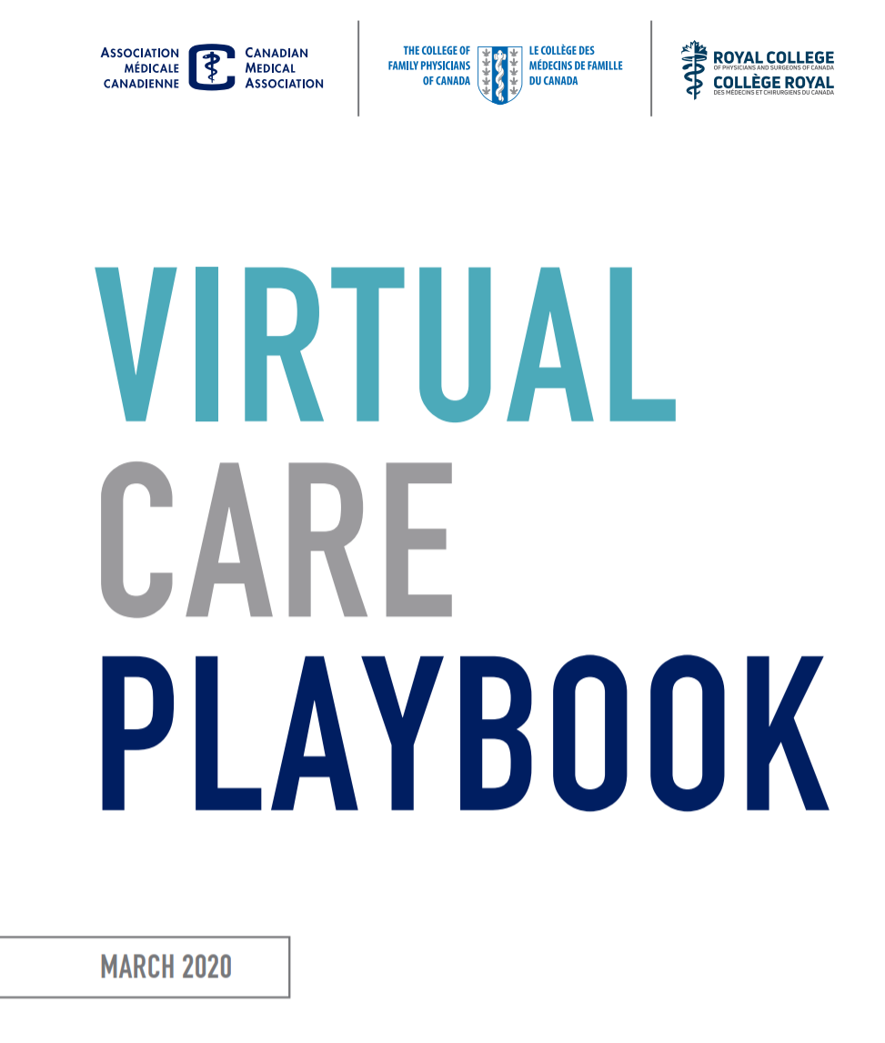
Appendix 1 + 2

Slide 13

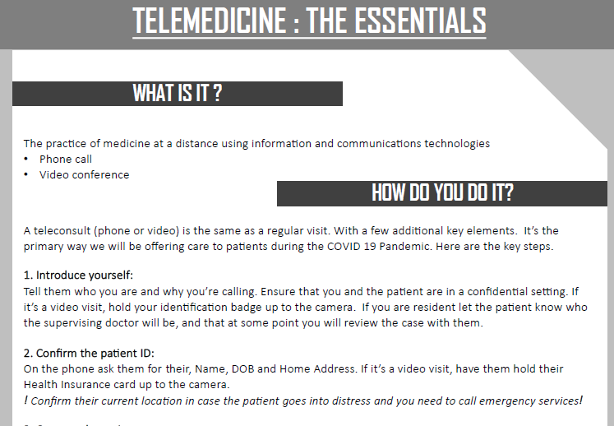
Appendix 4: Handouts for your learner
Virtual Visit Guidelines for Residents, Step-by-Step Guide & Telemedicine: The Essentials

Slide 14
Step by Step Visit Guide for Learners

Slide 15
Question 4
What technical considerations do you need to keep in mind to be successful integrating a learner into a virtual care environment?

Slide 16
Question 4: What technical considerations do you need to keep in mind to be successful integrating a learner into a virtual care environment?
Info Point 7: You will need to ensure that the learner has adequate access to and comfort with required technology.

Slide 17
Case: Part 2
In a blur the week passes and Sunday evening, when looking at your calendar you realize that your new learner starts the next morning.
Your learner is Marcia, a 1st year resident just starting her Foundation’s Month.
Her 4th year was cut short due to the pandemic and you suspect she has very little in the way of virtual care experience.
You want to make sure she will be prepared and safe while adjusting to virtual care.
You also realize your opportunities to observe her will be limited.

Slide 18
Question 5
How will you assess Marcia’s comfort with virtual care?

Slide 19
Question 5: How will you assess Marcia’s comfort with virtual care?
You can think of a virtual care visit as a procedure.
Use the same approach as you would use to assess a learner's comfort with a procedure prior to performing it.

Slide 20
Question 6
What are key parts of an orientation to virtual care that you should review with Marcia?

Slide 21
Question 6: What are key parts of an orientation to virtual care that you should review with Marcia?
Info Point 8: Orientation is paramount to working and supervising in a virtual care environment.

Slide 22
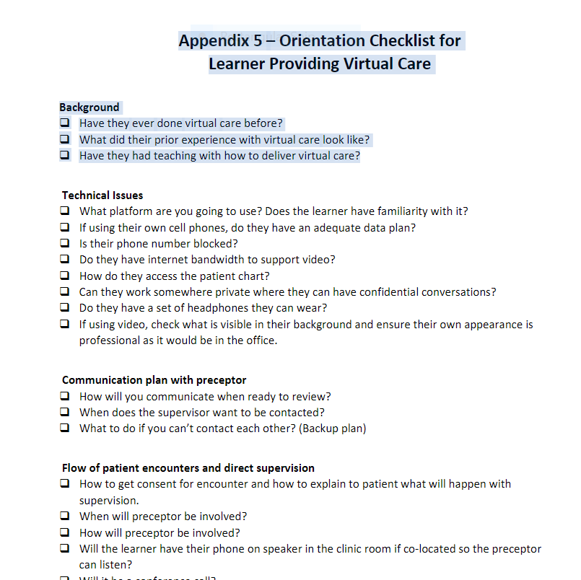
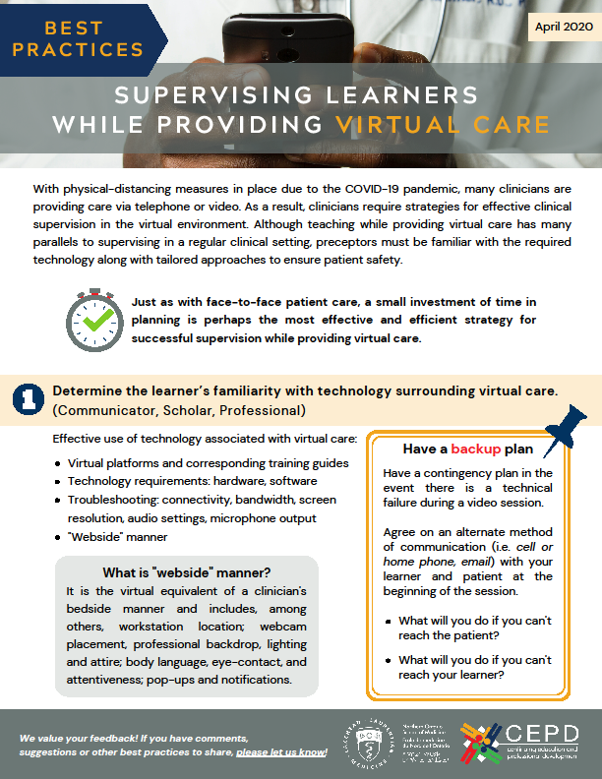
Orientation

Slide 23
Question 7
How might you set up your supervision and the flow of delivery of care with her?

Slide 24
Question 7: How might you set up your supervision and the flow of delivery of care with her?
Info Point 9: Consider adaptations to the schedule to allow for technical challenges and extra time to connect virtually with learner and patient.
Info Point 10: Ensure that you have a clear plan for communicating with the patient how the visit with a learner will be conducted.
Info Point 11: Develop a clear plan for how the learner and preceptor will communicate with each other and how to involve the preceptor in the patient encounter both for direct observation of the learner and patient care.

Slide 25
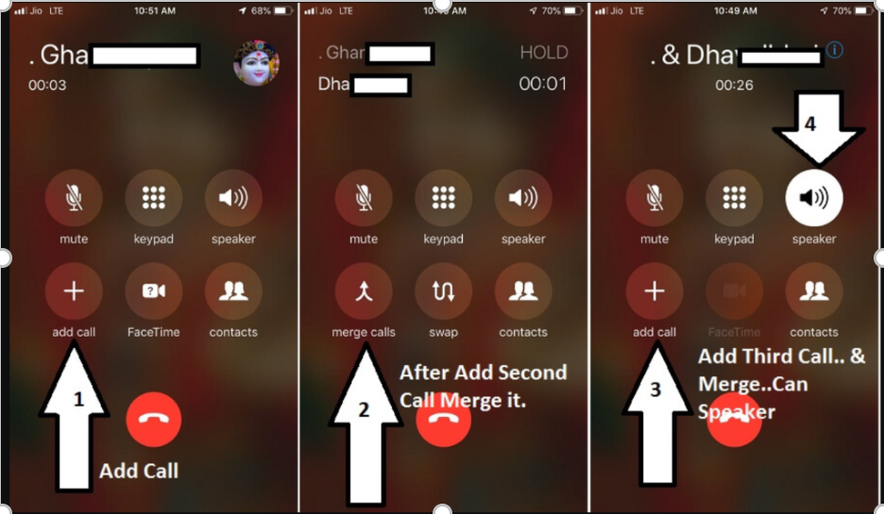
How to merge calls
Dial the first person and wait for the call to connect.
Tap add call .
Dial the second person, and wait for the call to connect.
Tap merge calls .
The two calls merge into a conference call.
To add additional people, repeat steps 2-4.

Slide 26
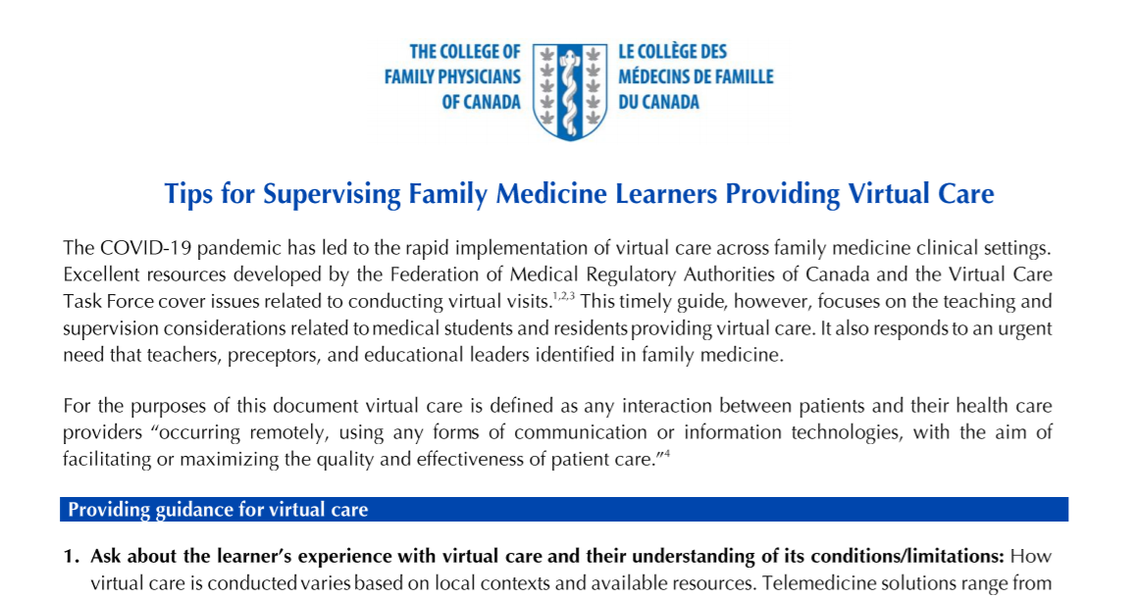
Tips for Supervising Family Medicine Learners Providing Virtual Care

Slide 27
Question 8
How will your discussion around feedback and supervision change because of the virtual care setting?

Slide 28
Question 8: How will your discussion around feedback and supervision change because of the virtual care setting?
Info Point 12: Feedback to learners is still a vital part of supervising learners, even while working in a virtual care environment

Slide 29

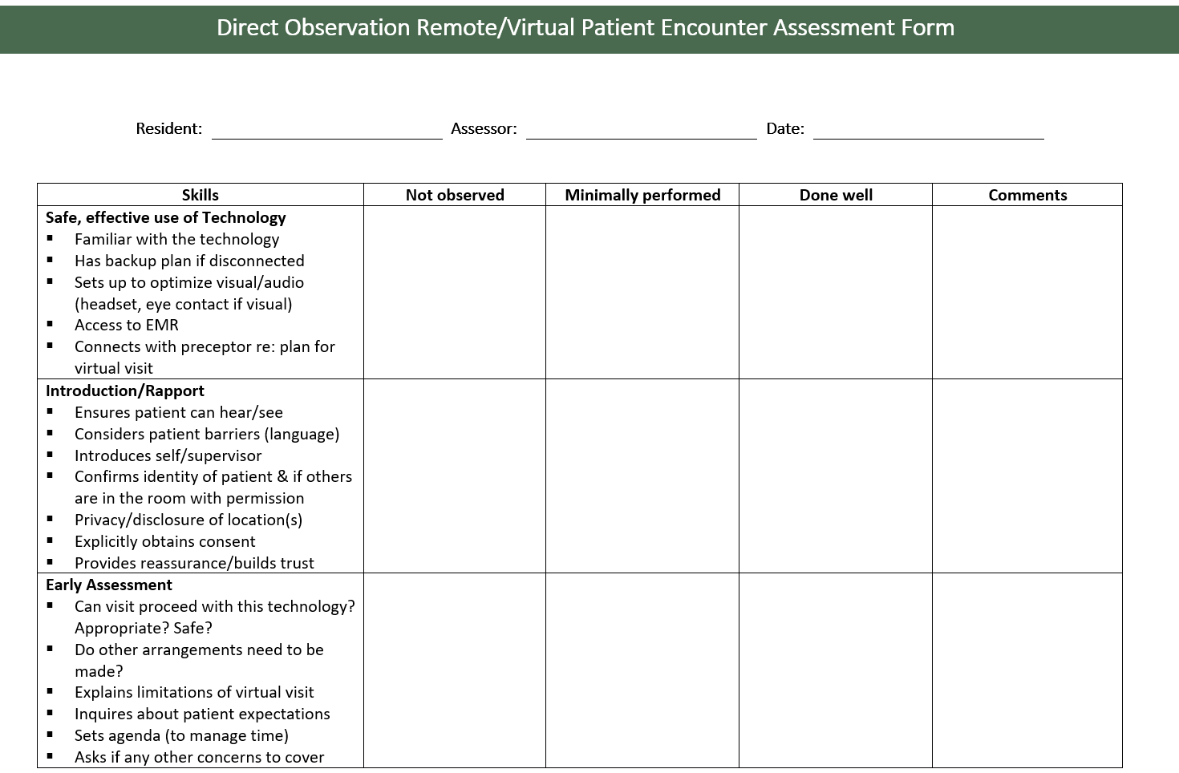

Slide 30
Question 9
What are some unique teachable moments in the virtual care setting?

Slide 31
Question 9: What are some unique teachable moments in the virtual care setting?
Info Point 13: Look for and act on unique teaching moments in the virtual care environment.

Slide 32
Optional UG Case for Further Discussion
Case 2 – Rick is a 3rd year medical student being placed with you for his 3-week family medicine rotation. You are providing a significant amount of patient care via virtual care platforms. The first three days of Rick’s rotation are all virtual patient encounters.
What will be different about setting up the patient encounter with an undergraduate learner?
Are there medico-legal requirements that are unique to supervising an undergraduate learner?
What will you include in your orientation with Rick today?

Slide 33
Resources and references are available at:
dfmfacdev.ca

