Slide 1
The Good, The Bad and the UGLY of Field Notes and ItARs; and how to give feedback
Faculty Development October 19, 2017
Alethea Lacas, MD CCFP (COE)
Notes:
INTRO:
Welcome. My name is ______. I am ______
We are going to start but I want to encourage you to continue to eat your meal, get up and get seconds. The evening should hopefully be interactive and relaxed so ask questions as we go.
We are going to discuss feedback, both the tools we use to structure and provide feedback (Field notes and ITARs) but also a bit about how we deliver feedback.
Next slide: Questions:
What are some of the reasons that you chose to come spend time learning about feedback? What is it about feedback that makes it one of the most requested faculty development topics and most commonly studied teaching tools in medical education?
Get comments from the group
Reiterate their reasons – it is hard to do well, it is something we do often, it is how we shape behaviours ….
It is also something that implicitly or explicitly we know is important. It has been well documented in studies that “Appropriate and consistent feedback can strengthen the preceptor/learner relationship and promote effective learning” (PBSG-Ed Feedback module) and from a 1985 study of family medicine residents “constructive feedback was rated second only to clinical competence as an important element of effective teaching.” (PBSG-Ed Feedback module)

Slide 2
Food for thought
What are some of the reasons that you chose to come spend time learning about feedback?
What is it about feedback that makes it one of the most requested faculty development topics and most commonly studied teaching tools in medical education?
Notes:
What are some of the reasons that you chose to come spend time learning about feedback? What is it about feedback that makes it one of the most requested faculty development topics and most commonly studied teaching tools in medical education?
Get comments from the group
Reiterate their reasons – it is hard to do well, it is something we do often, it is how we shape behaviours ….
It is also something that implicitly or explicitly we know is important. It has been well documented in studies that “Appropriate and consistent feedback can strengthen the preceptor/learner relationship and promote effective learning” (PBSG-Ed Feedback module) and from a 1985 study of family medicine residents “constructive feedback was rated second only to clinical competence as an important element of effective teaching.” (PBSG-Ed Feedback module)

Slide 3
Disclosure
I have nothing to disclose.

Slide 4
Credit where credit is due
Much of this workshop has been built on presentations developed by Dr Tom Laughlin and Dr Fiona Bergin, and content developed for Dalhousie’s “Clinician as Teacher” course, as well as content presented in the PBSG-Ed modules from University of McMaster.

Slide 5

Objectives
After the session the participants will be able to :
1. Better understand the purpose of field notes and ITARs
2. Complete a field note accurately and effectively.
3. Complete an ITAR, using field notes as a guide.
4. Identify the characteristics of effective feedback
5. Employ techniques for delivering meaningful feedback to learners

Slide 6
Field Notes
Notes:
Interaction with group. Get a show of hands:
Who finds field notes add a lot to the quality of their feedback?
Who enjoy completing field notes?
Who thinks that it is possible to improve ?
So many of us find field notes challenging and maybe annoying, and yet it is the tool that we are required to use. Hopefully this evening we will shed some light on how to make this tool less cumbersome and to help enhance the feedback process.
With that in mind, lets start with the basics “what is a field note” go to next slide

Slide 7
What is a field note?
A brief document used in a clinical setting to provide and document specific behaviour-based feedback
Notes:
Although the look and feel of a field note will differ from program to program or different sites, they all have the same ultimate purpose.
7

Slide 8
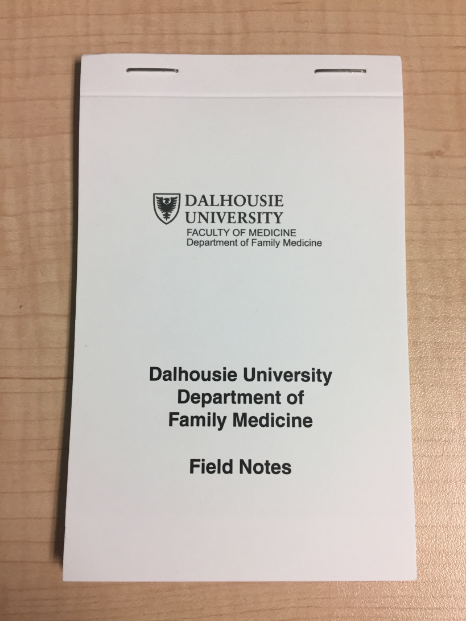
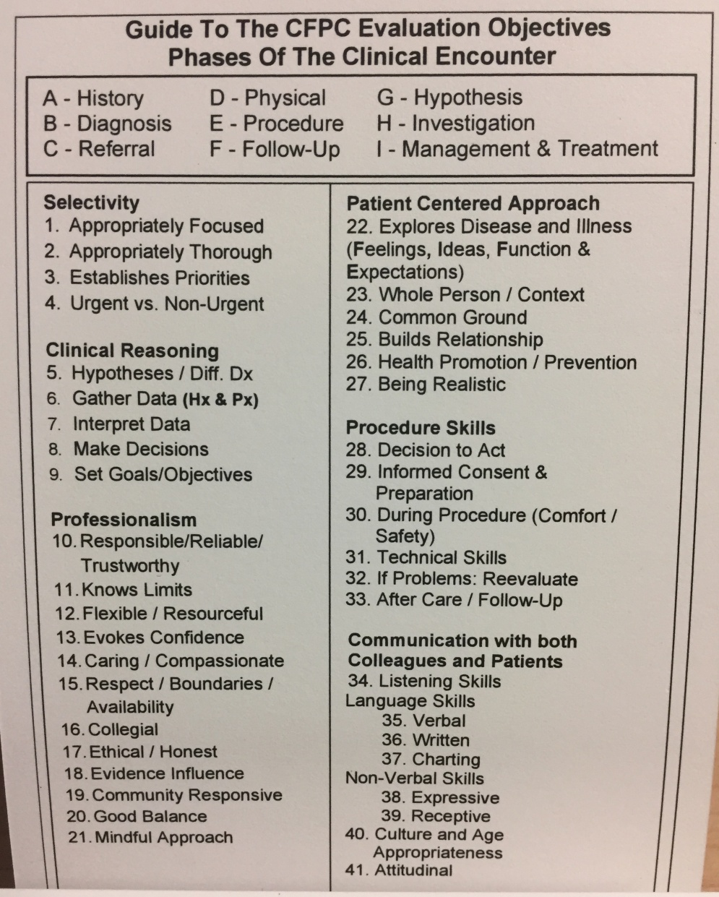

Dalhousie Family Medicine Field Note

Slide 9
What is purpose of Field Notes
Impetus for timely feedback
Structure for reflection
Documentation
Evidence if competencies not being met
Content for ITARs
Notes:
Ultimately a field note’s purpose is to spur on the giving of feedback and to document that we have given feedback.
We all likely spend a lot of time and energy giving feedback to our learners in the course of the clinical day or shift, and what I hope you will take away from this talk is that the field note is not meant to be additional feedback content, but rather a documentation of the feedback you are already giving.
Field notes also are incredibly important for documentation, especially for the program if there are areas of concern or poor performance. We know that many teachers shy away from giving or documenting that feedback was given about inadequate performance, but unless there is documentation of these concerns and an opportunity for the learner to adjust their performance, then the program is unable to take remediation action when needed. If there is a previously identified area needing improvement, follow up on this to ensure that improvement/growth has occurred.
Ultimately, the feedback documented in the field notes will support and inform what is said in the ITARs. (more to come on this)

Slide 10
“Both preceptors and trainees should start by getting into the habit of using some type of field note after most supervised clinical encounters to stimulate discussion, identify the critical steps in the resolution (or not) of the situation in question, reflect on the performance with respect to these, and document one or two points that seem to be most useful. Start to concentrate as much or more on the process (why and how) as on the results, paying particular attention to diagnostic reasoning and decision making. Many of these steps are already being done, but often without an awareness of the cognitive processes involved, and without always being able to articulate the judgments, reflection, and feedback that will be most useful in moving toward competence. Such a repetitive analytical approach will gradually become intuitive, for both trainees and preceptors.”
CFPC “Defining Competence for the Purposes of cerification by the College of Family Physicians of Canada; The evaluation objectives in Family Medicine; Report of the Working Group on Certification Process, October 2010
Notes:
This quote is from an older document from the CFPC, when the field note wave was just starting, but it captures nicely some of the important elements of using field notes. The quote says it more eloquently than I can say it, so I am going to let you read it to yourselves.
Participants read quote
Are there any comments or questions about that [the quote]?
Again, I hope you are seeing a common theme, which is that field notes are meant to document what you are already doing, which is giving feedback to the learner.

Slide 11
What can you base a field note on?
Observed clinical encounters
  Different domains of learning
Think broadly for sources of field notes
  Chart reviews
  Phone calls
  Professionalism
Use what you have already said during verbal feedback
Notes:
Get participants to brainstorm some ideas first

Slide 12
Characteristics of Good Field Notes
Has a date (for trajectory)
Identifies a topic and a competency
Is behaviourally specific and uses clear unambiguous language
Is detailed enough to paint a picture
Is focused on the individual
Is focused on a manageable amount of information
Is focused on higher order skills
Has a judgement about the performance
Identifies things to continue doing, things for further growth
Promotes reflection
Working Group on the Certification Process, College of Family Physicians of Canada August 2014
Notes:
This is another document from the CFPC. They have identified characteristics of a high quality field note. You may notice that many of the features of high quality field notes are similar to the features of effective feedback; and we will discuss that in the second half.
Are there any questions about that list?
For clarification if questions:
Higher Order Skills: Consider focusing on:
History vs Physical Exam
Diagnosis vs Treatment—(although higher order skills could go into treatment decisions if the focus is on patient centeredness and/or acuity rather than just knowledge)
Data interpretation vs Data gathering
Analytic Diagnosis vs Pattern Recognition
Differential Diagnosis (and why), vs Diagnosis
Undifferentiated Cases vs Clear Cut Cases

Slide 13
Sample Field Notes
Review examples of good quality and poor quality field notes.
Note how you could improve the quality of the field note.
Reflect on your own field notes.
Notes:
INTERACTIVE WORK
INSTRUCTIONS FOR PARTICIPANTS:
Work in groups of 2-3
Discuss the sample field notes
Take note of what is different about the high quality field notes and what you could do that you aren’t already doing
Don’t beat yourself up if you see yourself in the “poor” quality field notes. We all do some of these on some days, but see if you can take away a targeted change, e.g “I am going to try to be more specific with what the observable behaviour was and describe it”

Slide 14
Characteristics of Good Field Notes
Has a date (for trajectory)
Identifies a topic and a competency
Is behaviourally specific and uses clear unambiguous language
Is detailed enough to paint a picture
Is focused on the individual
Is focused on a manageable amount of information
Is focused on higher order skills
Has a judgement about the performance
Identifies things to continue doing, things for further growth
Promotes reflection
Working Group on the Certification Process, College of Family Physicians of Canada August 2014
Notes:
Leave this slide up while people are working in small groups so they can reference the characteristics.
Circulate around room to answer questions.
After 10-15 minutes bring group back together and solicit from the group what they noticed was different in the “good” field notes.
What is different from what they are doing.
Choose 1-2 “poor quality” field notes and brainstorm how to change so they would be more effective
e.g. on built rapport – what are the specific behaviours that allowed rapport to be built? (eye contact, eliciting parents’ concerns, empathising?)

Slide 15
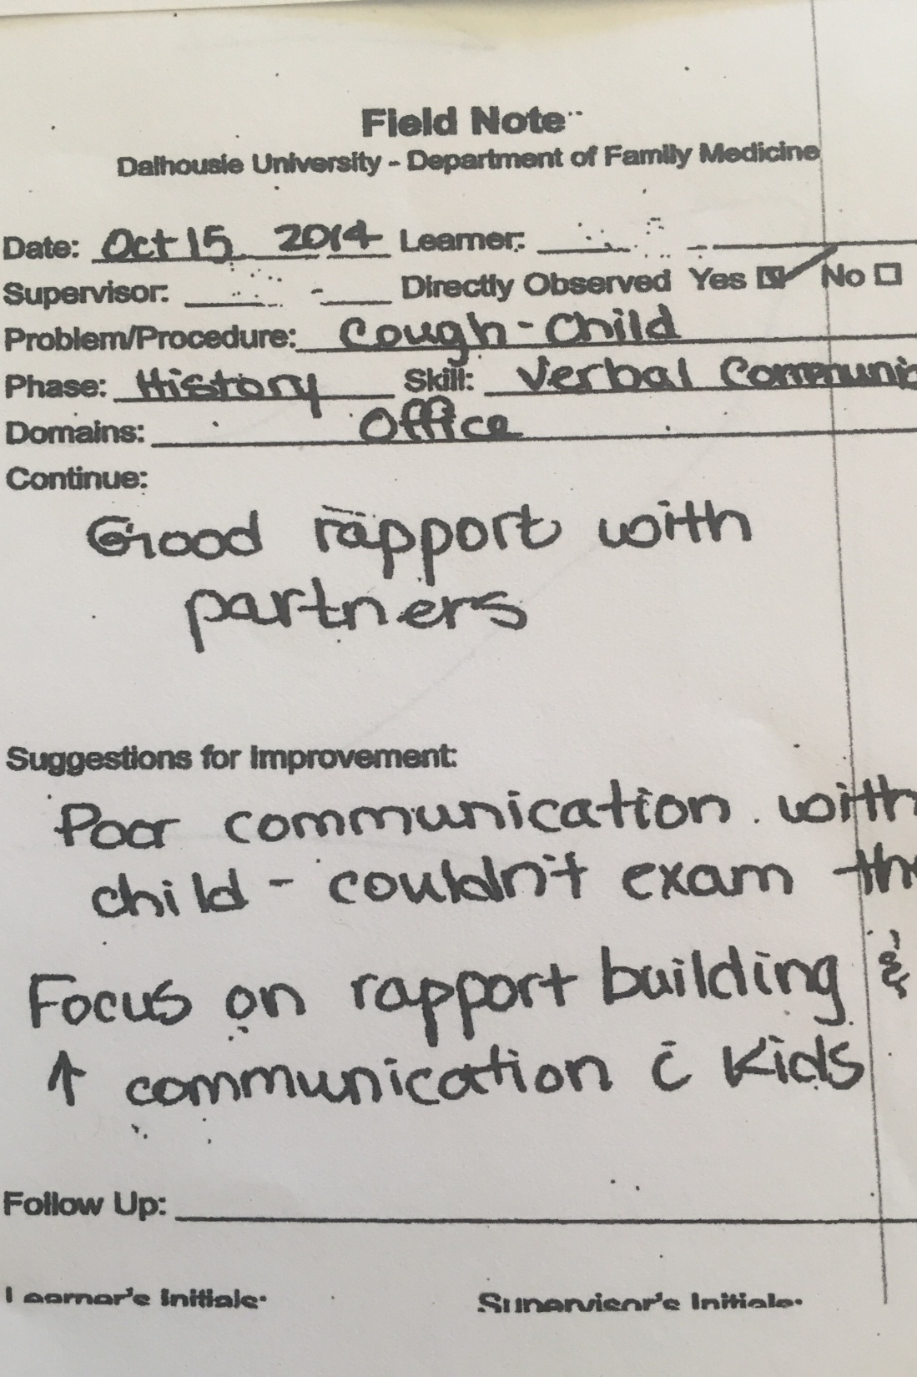
Notes:
Example of a Poor

Slide 16
ITARs
In Training Resident Assessment
Notes:
Questions for group:
Who has completed an ITAR?
Who has seen examples of completed ITARs?
Who has received feedback on their completed ITARs?
One of challenges of completing ITARs is we rarely see what our colleagues are doing. We work in silos and there isn’t the opportunity to listen or look in on this process. Today we are going to try to shine some light onto what are some “best practices” around completing ITARs.
The ITAR is designed to document competence and promote learning.
It is formatted using the CFPC Evaluation Objectives, as is our Field Note.
The intent is to populate the ITAR with cumulative credible information from field notes.
(from https://medicine.dal.ca/departments/department-sites/family/faculty-staff-resources/faculty-development/guide-to-teaching/FGTT_ITAR.html)

Slide 17

Best Practice ITARs
Summative, overarching statement(s)
Use field notes as examples/evidence
Input from team
Use patient feedback
Avoid listing
CCFP Evaluation Objectives
Notes:
Don’t be afraid to make a general summative statement about the competency domain. In fact, this is desirable. It gives a narrative tone to the ITAR and allow both the learner and other readers of the ITAR to have a general sense about performance.
You are not hamstrung to only use what is written down in field notes; so if you have a comment or a sense about a learner that is not documented in a field note, it is still ok, if not important to include, and the overarching statement is likely compiled not only from the field notes but also from your general gestalt, informal feedback given by other parts of the team, patients, etc.
The fields notes are evidence and back up your statements, and certainly if you are going to be marking any areas of concern there ideally are examples from field notes. If at the mid point of a short rotation or folks have no documented the negative feedback, but it is of concern, then docment in the ITAR, discuss with the resident/learner and emphasize that this is an area to seek out field notes to document improvement (or lack thereof) prior to the end of the rotation.
If you work in a team setting consider getting team input, similarly patient feedback can be useful, especially to corroborate behaviours in the domains of professionalism or communication.
You do not need to list all the field notes, nor is this desirable as it becomes less of a “useable” document. That said, any fieldnotes that document competency reached (especially procedures) should be listed.
Link to CCFP – professionalism observed behaviours
Does anyone already use these resources?
They can be really helpful, especially if you are finding it difficult to give tangible examples of what they should keep doing or what it is about their behaviour that is concerning.
From F.Bergin’s presentation:
“Don’t list every field note under each skill dimension.
May need to reference more field notes to provide sufficient examples of deficits to explain and justify when assessment is NOT “progress as expected”
Field notes should support your overall assessment but not dictate it. Remember they are formative not summative but can inform your summative assessment (ie ITAR). “

Slide 18
Characteristics of Good ITARs
Overarching statements
Note strengths and weaknesses, with examples
Examples are detailed
Lots of examples from field notes when noting an area of deficiency, or not meeting expectations
Provide suggestions for improvement
Clearly states when competencies met
Notes:
Another way to think about a high quality ITAR is, what are the characteristics of a good ITAR? And this is a another ay of describing.

Slide 19
Site Director’s Needs
Fill out ITAR completely and on time.
  Delays compromise ability to help learner.
Provide general statement regarding competency achieved in each skill dimension.
  Specific examples do not provide overall sense of competency.
Trajectory assessment (e.g progress as expected).
“From Field Notes to ITARs” presentation,
Dr. Fiona Bergin, October 2016.
Notes:
One of the main purposes of an ITAR is to allow our program director to see the trajectory of performance and improvement and to help guide a learning plan for our resident.
These are some of the important things to remember for our site directors.

Slide 20
Logistics of ITAR
Have resident organize their field notes
If you work with others get team input
Consider providing the resident with a copy of the ITAR to review prior to your meeting
Schedule the ITAR with adequate time to discuss and prior to end of rotation
Notes:
Questions for group:
What do you do to ensure ITAR gets completed?
How do you approach completing an ITAR?
Do you get your resident to organize their field notes? If so how? If not can discuss getting them to arrange in a binder with plastic sleeves for the different domains.
If you work in a team setting, consider circulating your completed ITAR for input to ensure team agrees/has any additional comments. This does require that you have it done ahead of time, but it has the added bonus of starting to create a culture where we break down the silos and see how your colleagues complete ITARs. The question of when it is ok to do this is a bit like the circle of care rule; if your colleagues are involved with the supervision and teaching of the learner then it is probably ok.

Slide 21
Critique ITARs
Does it have the characteristics of high quality ITAR?
Does it have enough information to inform if the learner is on the correct trajectory?
Does it provide the learner with enough information to formulate a learning plan?
Notes:
You have in front of you a made-up ITAR. Take a few minutes to look at the ITAR and then in groups of 2-3 discuss what you notice?
Do they have the characteristics of high quality ITARs?
Do they have enough information to inform if the learner is on the correct trajectory?
Do they provide the learner with enough information to formulate a learning plan?

Slide 22
Feedback
Notes:
Group activity:
Quietly, to yourself, remember an experience of receiving feedback as a learner. This about the situation, remember the setting. Recall what it was about, where you were, how you felt.
Now, if you thought about a negative experience I want you to dig a bit deeper and think of a positive experience, and vice versa.
To the group: How many of you remembered a negative experience first? What was it about that experience that stood out?
What about the positive experience? What did you remember? What made it a positive experience?
So these are some of the characteristics of constructive vs destructive feedback (go to next slide)

Slide 23
Characteristics of Feedback
Constructive
Destructive
Immediate
Specific
Changeable
Observed
Honest
Balanced
With a plan
Too late to make a change
Vague
Hearsay
Harsh, demeaning
No plan
Notes:
Immediate – even if you can’t document you can give verbal feedback in a timely way and then complete field note later.
Sometimes a super heated clinical encounter may require some cool down; but even then, consider flagging that you will debrief or don’t leave it too long before feedback occurs
Specific
Global statements make it hard for residents to know what you are talking about
Also it should be about their behaviour not their attributes e.g. at home if you say to partner “you are lazy” this will likely cause a fight, vs saying “when you leave your clothes on the floor…”
Changeable – this one is tricky – is it a personality trait/quirk that does not negatively impact patient care?
All feedback should give the opportunity for further learning
Feedback should be about actions or decisions, not about how you interpret the resident’s reasons behind those actions.
If you do give subjective feedback, be sure to indicate that you are doing so
Give example…
Balanced – doesn’t have to be the classic “feedback sandwhich” but don’t always only comment on the positive or the negative.
Frame feedback in a way that allows residents to self-evaluate first
*The characteristics of good feedback include: a) Ensuring the discussion is timely (at least the same day) b) Ensuring it is frequent (at least daily) c) Being specific and commenting on behaviours, not intentions or personal attributes d) Having reflective discussions that focus on challenging/discerning case characteristics e) Stimulating learning through making a judgement and documenting and discussing pertinent coaching points with each case f) Focusing on one take-home message each for the behaviours to continue and the behaviours to modify g) Making judgements based on standards, not comparators to others h) Using the CFPC Evaluation Objectives to help identify key messages

Slide 24
Delivery of Feedback
Timely and Frequent
Signal that feedback is occurring
Clear examples and language
If giving subjective feedback, indicate that you are
Only focus on one or two issues
If large issue, ensure a plan for follow up is developed
In private space or not?
Notes:
Consider establishing the time at beginning of shift
Fieldnotes become a natural signal
If you do give subjective feedback, be sure to indicate that you are doing so
Frame feedback in a way that allows residents to self-evaluate first

Slide 25
Barriers to feedback
Time
Defensiveness
Disinterest
Attitude
Uncertainty
Avoidance
Lack of preceptor confidence
Notes:
INDIVIDUALS WHO BELIEVE INTELLIGENCE TO BE A FIXED ENTITY ARE GENERALLY LESS RECEPTIVE TO FEEDBACK WHEN IT IS PROVIDED
Compare themselves to those less skilled
Intelligence – fixed vs fluid

Slide 26
Video – Constructive Feedback
Excerpted from Dalhousie’s Resident/Clinician as Teacher Course
*Used with permission

Slide 27
Ask Tell Ask
https://youtu.be/SYXgMobMU8U
Is learner-centered
Fosters students’ self-assessment skills
Increases students’ accountability for learning
Gives the preceptors insight into students’ perceptions of performance
Encourages preceptors to provide specific feedback
Can be used across a variety of settings
http://paeaonline.org/wp-content/uploads/2017/02/Ask-Tell-Ask-Feedback-Model.pdf

Slide 28

Video Vignette

Slide 29
Putting it All Together
Groups of 3-4
Role Play Giving Feedback
Fill out Field Note based on feedback

Slide 30
Objectives
After the session the participants will be able to :
1. Better understand the purpose of field notes and ITARs
2. Complete a field note accurately and effectively.
3. Complete an ITAR, using field notes as a guide.
4. Identify the characteristics of effective feedback
5. Employ techniques for delivering meaningful feedback to learners

