Slide 1


ACE Debate:
Christian Perspectives on AI and its Impact on the Economy
Thoughts inspired by ‘The Robot Will See You Now’ edited by John Wyatt and Stephen N.Williams, 2021, SPCK.
Michael G. Pollitt
Judge Business School
Cambridge
ACE UK Annual Conference
5 July 2024

Slide 2
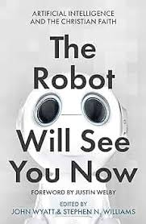
With thanks to John Wyatt and co-authors for the inspiration

Slide 3
What is AI?
Sensors
Processing of info
Robots
Singularity (Mathematician- John von Neumann) and Super-intelligence (Philosopher - Nick Bostrom)
Scientists tend to think inevitability about AI and not much we can do about it (e.g. Geoffrey Hinton from Google).
Somewhat self-fulfilling prophecies going on.

Slide 4
Lessons from history of technology
Industrial revolution: 1760-1820
Hours per worker have fallen from (2200 hours in 1950 to 1700 hours in 2013)
Intensity of work has possibly fallen for some
Expected number of years in retirement has risen
Jobs have migrated to other sectors
Value of unpaid work significant (averages 21 hours per adult per week in UK - ONS).
Humans prefer humans to machines in certain cases
Cost matters, some technological possibilities remain too expensive
Regulation matters and actively prevents autonomous ways of working

Slide 5
Economists et al. on this issue (see Cameron, 2021)
David Ricardo – 1817 – machines hurt certain labour
Maynard Keynes – 1930 – ‘technological unemployment’ possible
Larry Summers – 2013 – ‘not so completely certain now’
Richard and Daniel Susskind – 2015 - professions destroyed by AI
Andy Haldane – 2015 – labour’s share of GDP fell in Industrial Revolution
Some possible revisionism of past and doubt about future.

Slide 6
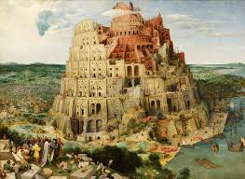
Theology of work
We were created to work in a Garden (Gen 2:15): work healthy and pleasurable.
At the Fall work became hard (Gen 3:19).
We then created things to make life easier and to be like God (Gen 11:1-9).
Work does not have to be paid or part of formal economy: e.g. looking after home or children.
Worship and work same word in Hebrew, so worship is work.
Good work can require rest: it did for God in creation (Gen 2:2).
However work can make us slaves and, in some sense, we already work for machines driven by clock, pace of machine we operate, technical possibility.
We already controlled by AI.

Slide 7
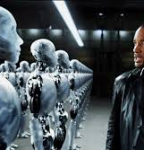
What is the economics of AI?
Supply and Demand: scientists always only think about supply of technology. Phones did not become smaller they became larger and we did not microchip ourselves for convenience. Human cloning was banned.
Demand for AI robots, outside of factory, not clear.
What would be resource cost of everyone having a robot?
Regulation will be affected by distributional consequences.
Privacy and rights of humans important.
Lots of imagined AI will compete with simpler solutions.
Disruption in middle class sectors such as law, accounting and healthcare could be large, but also arguably these are the sectors most able to adjust through repurposing and early retirement.
Source: I Robot

Slide 8
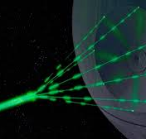
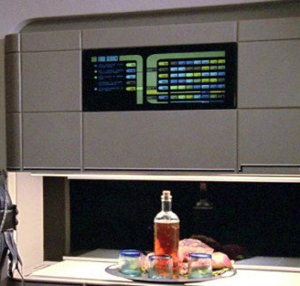
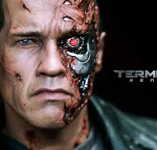

Could AI be used for evil?
Yes, of course. Already have international cyber-threats and malign country actors profiling their entire populations for threatening characteristics.
However, society a lot more stable than films portray. COVID-19 demonstrated that society did not breakdown under a sustained and apparently existential threat.
Star Wars vs Star Trek:
In Star Wars weapons can destroy whole planets and humanoid life forages on scrap heaps.
In Star Trek there is no scarcity (thanks to the Replicator) and no money.
Terminator vs Passengers:
In Terminator the AI takes over and attempts to destroy humanity with killer robots.
In Passengers the AI allows humans to colonise a new planet and travel safely in a spaceship for 120 years.

Slide 9
Conclusion
There is no such thing as a free market. Markets can and should be regulated.
Scientific discovery cannot be left to scientists (don’t put Nimrod in charge!).
It has so far been a wild west for technology companies with precious little regulation of their obviously harmful effects on society, with obvious parallels to tobacco, big pharma etc.
Lots of regulation required and can solve easy things first with AI (like better analysis of medical scans).
Need to be vigilant for signs of the times and to discern good and bad, and to focus on the good.
Legitimate concerns about technology provides church with opportunities for evangelism and for providing meaningful human contact and volunteering.

