Slide 1
A Christian Perspective on Economic Growth- “Moderately PRO” Dr Esmond Birnie, Senior Economist at Ulster University Business School Friday 7 July 2023

Slide 2
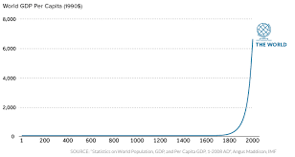
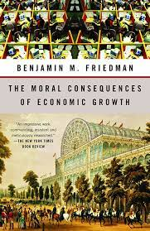
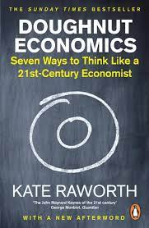
Introduction
Conclusion + broad approach
Growth not the highest good but does seem to have been part of God’s purposes and probably still is part of those purposes.
Base the latter on what the Bible (Creation, Fall, Redemption, Last Things) seems to imply about economic growth.
“…our beliefs about economic growth are almost religious…” (Raworth, 2022, Doughnut Economics, p. 243).

Slide 3
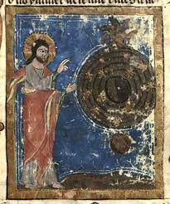
Biblical Creation & economic growth
Genesis 1:26, 28 “…fruitful..multiply…fill the earth…subdue…dominion…”
Clear endorsement/command for growth of human population. Population growth leads to growth of L (“N”) and hence growth of Q (“Y”) in the aggregate production function.
Less explicitly, still implied, a mandate for growth in Q/L as well.

Slide 4
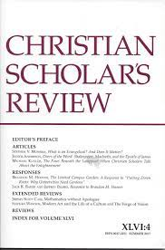
Also, can go from creation to growth
Via Imago Dei and hence creativity
“As long as successive generations steward resources creatively, invent new services that have value for others, or find new efficiencies in production that free resources for other good uses, there will be growth”.
Conclusion of E.S. Noell and S.L.S. Smith 2020, “Economics, Theology and the Case for Economic Growth”, Christian Scholars Review.

Slide 5
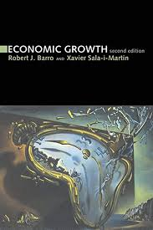
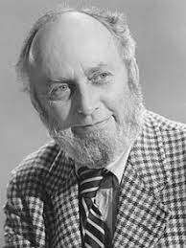
Biblical Fall & economic growth
Sin is now here and so…
God’s curse makes growth harder (Genesis 3:17-19) but not impossible.
The Genesis 1:26, 28 “cultural mandate” is still there and has been partly achieved (even if often by non-believers, see the music and metals in Genesis 4).
From Genesis 3:21 God has continued to show (material) kindness to the whole of humanity. There has been a “common grace”(Matt. 5:45 rain on all), part of that government/rule of law- a good thing (even if always flawed) in itself and also (North, Barro et al) a pre-condition for growth.

Slide 6
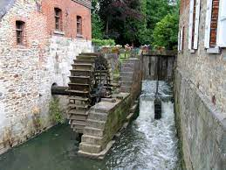
Biblical Redemption &Economic Growth
1st through OT Israel, now in the Church era
Might think priority to evangelise/disciple (Matthew 28:18-20) leaves little space for GDP.
But, alongside God’s plan of salvation, common grace still operates and Christians are to be delivery agents, e.g.
Jeremiah chapter 29 “… build houses… plant crops…grow your families…seek the welfare of the city…”
Even pre- 17th C. “scientific revolution” (itself owing a lot to Christianity) in the mid Middle Ages a mini industrial revolution including tech improvements in the monasteries, e.g. application of watermills.
Francis Bacon “relief of man’s estate”.

Slide 7
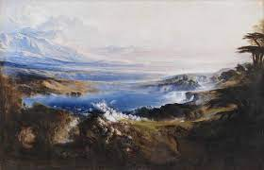
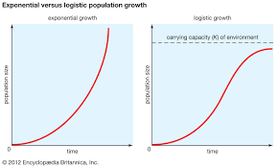
Biblical Last Things/Consummation & growth
Growth NOT irrelevant in the New Heaven and New Earth:
Even with fire of judgement, some continuity to this world: Rev. 21:24, 26 (“kainos”, not “neos”).
Heaven not “static” but (likely) continuous and infinite growth in knowledge (primarily of God, but could be of other things too). We know (50s growth theory etc.) knowledge is the main driver of economic growth!
Picture- Tate Gallery Diagrams- Encyclopedia Britainnica

Slide 8
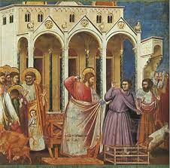
Final thoughts
Necessary realism
Not claiming GDP a perfect measure (but quality of life measures have problems too, whose value judgements?)
Recognise “moral challenge” to economic growth (people choose the wrong goods and services) but the moral challenge cuts both ways (B. Friedman)
Certainly not saying growth should always be the highest priority and Bible some helpful moral restraints:
(a.) “Remember” the LORD is the source of wealth, Deut. 8:18.
(b.) One day in seven break from work (Gen.2:1-2 and Exodus 20:8-10)

Slide 9
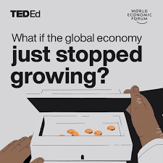
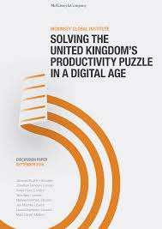
Final, Final thoughts
Cannot deny scale of the Carbon/other environmental challenge, e.g. getting to “sufficient absolute de-coupling”.
Even if “relatively pro-growth” need to recognise prospects for such growth relatively limited, i.e. in the West not going back to the 1960s!
Picture: World
Economic Forum &
McKinsey

Slide 10
Thank you Looking forward to discussion
Dr Esmond Birnie
07703 184459
esmond.birnie@ulster.ac.uk

