Slide 1
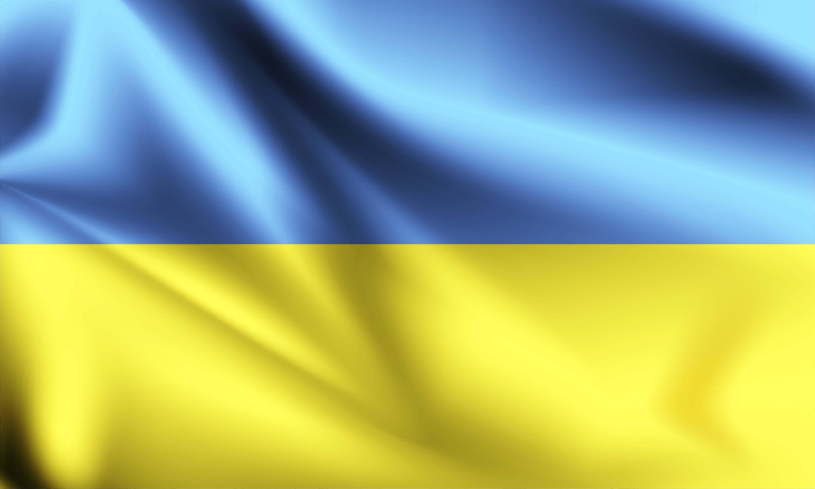
Ethics of war – the Ukrainian tragedy
Adam Plachciak

Slide 2
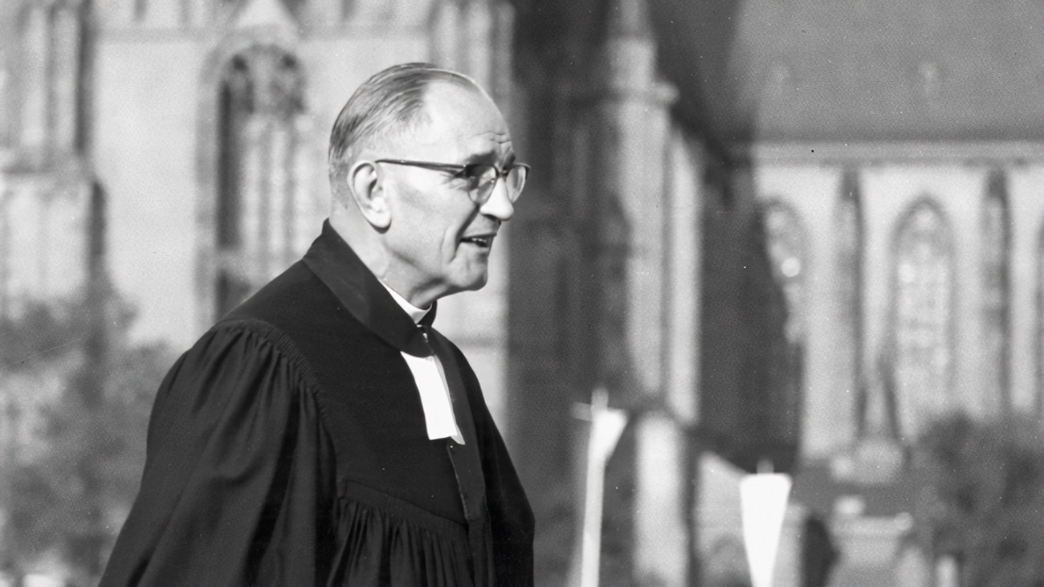
First they came for the Jews and I did not speak out, because I was not a Jew.
Then they came for the Communists and I did not speak out, because I was not a Communist.
Then they came for the trade unionists and I did not speak out, because I was not a trade unionist.
Then they came for me and there was no one left to speak out for me.
Martin Niemӧller

Slide 3
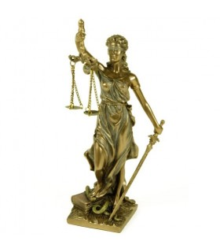
Three levels of the ethical reflections of war:
Ius ad bellum
Ius in bello
Ius post bellum

Slide 4

Four historical perspectives in Rusian
invasion in Ukrain
The inheritance of the Soviet Union
The return of the Russian imperialism
The activity of the Russian oligarchs
The sphere of religion

Slide 5

The Barmen Declaration includes six theses:
The source of revelation is only the Word of God – Jesus Christ. Any other possible sources (earthly powers, for example) will not be accepted;
Jesus Christ is the only Lord of all aspects of personal life. There should be no other authority;
The massage and order of the church should not be influenced by the current political convictions;
The church should not be ruled by a leader ("Führer"). There is no hierarchy in the church (Mt.20. 25f);
The state should not fulfill the task of the church and vice versa. State and church are both limited to their own business;
Therefore, the Barmen Declaration rejects (a) the subordination of the Church to the state, and (b) the subordination of the Word and Spirit to the Church.

