Slide 1
Fixing a Mistake in the Principal Agent Model with Exogenous lying costs
From Isa Hafalir
Gordon Menzies
Notes:
Mark Twain: Figures often beguile me, particularly when I have the arranging of them myself; in which case the remark attributed to Disraeli would often apply with justice and force: 'There are three kinds of lies: lies, damned lies, and statistics.

Slide 2




Economic (Christian) Humanists
Persons are more than individuals, society is more than exchange, flourishing is more than utility maximization.
Peter Eckley, Bank of England
Masao Ogaki, President of the Japanese Economic Association
Bernhard Kassberger, Düsseldorf Institute for Competition Economics
Arttu Makipaa,
EU official and economist & ethicist, recent PhD on Emil Brunner

Slide 3
Theology and Methodogy
Brunner: the closer you are to the ‘personal’ the greater the noetic effects of sin
Consider the progress of the social sciences vs the physical sciences
A possible reason is the mystery of the human person is irreducible to one social science (including economics)
Therefore methodological eclecticism is a Christian option
Here we introduce a ‘lying cost’ – a proclivity to lie – which is not model consistent. It comes from ‘outside’ (another social science or theology)

Slide 4
This is a great failure of the curriculum of every business school I know: we teach our students the importance of cost/ benefit analysis in everything they do. In most cases, this is useful – but not when it comes to behaving with. In fact, treating integrity ... as a matter of cost/benefit analysis virtually guarantees that you will not be a person of integrity.
Michael Jensen, creator of Principal Agent Model
In this paper we argue that Prof Jensen himself has created a model which is morally flawed in its description
This is the Principal-Agent (PA) model

Slide 5
PA model
Agent works on behalf of Principal
Agents actions are hidden
Output is only partly determined by Agent’s hidden actions and so is not inferable from it
Principal has to motivate Agent with an incentive contract
Agent is risk averse (P is not) so is loaded up with risk, inefficiently
The Principal has to compensate the agent for risk.

Slide 6
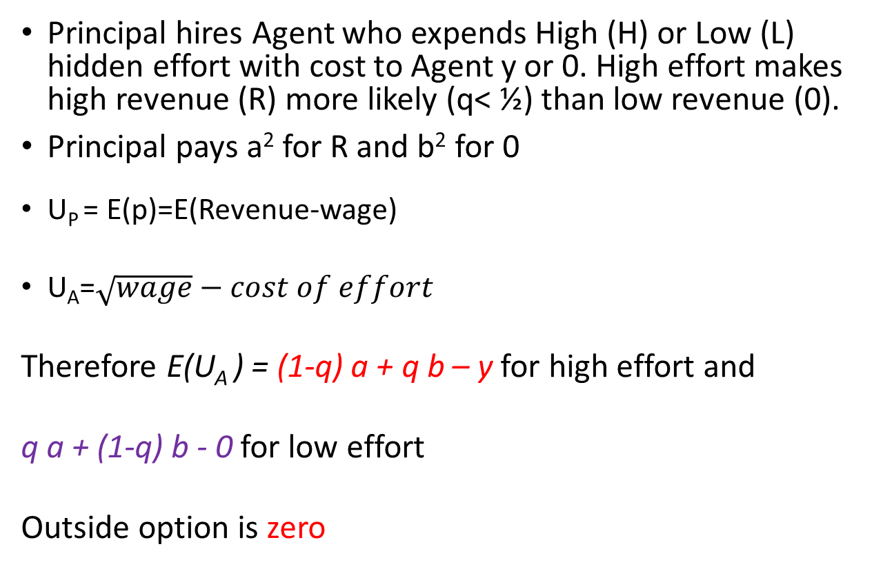
Where is the mistake in PA?
Principal hires Agent who expends High (H) or Low (L) hidden effort with cost to Agent y or 0. High effort makes high revenue (R) more likely (q< ½) than low revenue (0).
Principal pays a² for R and b² for 0
U_{P} = E(p)=E(Revenue-wage)
U_{A}=$\sqrt{wage}−cost of effort$
Therefore E(U_{A} ) = (1-q) a + q b – y for high effort and
q a + (1-q) b - 0 for low effort
Outside option is zero
Technology | R | 0
High effort | 1-q | q
Low effort | q | 1-q
Reward | R | 0
 | a² | b²

Slide 7
Classic Principal Agent solution: in algebra
We assume R is high enough and q is low enough that Principal wants a high effort solution
Solution involves meeting two conditions at minimum cost (in axb space)
The participation constraint
(1-q)a+qb-y≥0 ⬄ a ≥ (y-qb)/(1-q)
H is more attractive to Agent than L
(1-q)a+qb-y ≥ qa + (1-q)b ⬄ a ≥ b + y/(1-2q)

Slide 8
Classic Principal Agent solution: Blue dot assures participation and high effort at minimum cost
Here is the informational rent

Slide 9
It is really ‘duplicity rent’
It is taken as given that any economic agent with an informational advantage who can exploit this for gain will do so
But such an advantage disappears if the agent discloses the information
Therefore the purported value of information relies on a willingness to lie (or decline to answer) when asked to disclose it
The mistake is to assume this will always happen and not allow for agents to sometimes reliably disclose what they know – i.e. to be trustworthy
In contrast to current economic theory, in reality informational advantages are necessary but not sufficient for distortions and rent

Slide 10
If they are trustworthy, actions are effectively observable
The solution is a=b=y (contingent on high effort)

Slide 11
The lying mechanism
We change the setup
Agents are paid on high or low revenue (as before)
But also on declarations of high (h) or low (l) effort
H and L are still important, because they still affect the probability of revenue outcomes and lying costs
Now if H ≠ h or L≠ l there is a lying cost ‘x’ to Agent
For reasons Arttu outlined, we need not get this cost from economic analysis – it could come from other social sciences or theology
before | R | 0
 | a² | b²
Now | R | 0
h | a² | b²
l | c² | d²

Slide 12
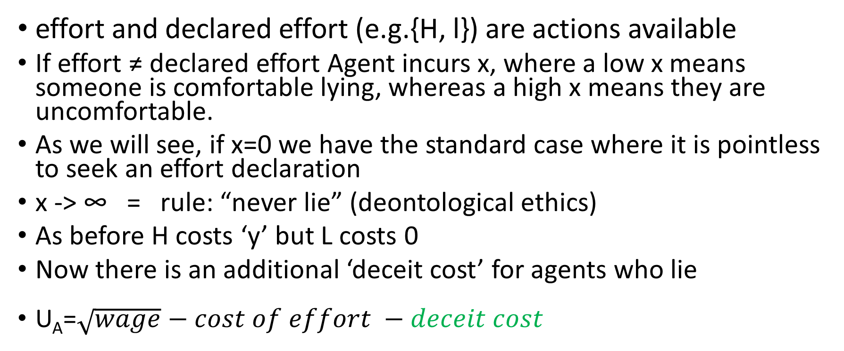
If H ≠ h or L ≠ l there is a lying cost
effort and declared effort (e.g.{H, l}) are actions available
If effort ≠ declared effort Agent incurs x, where a low x means someone is comfortable lying, whereas a high x means they are uncomfortable.
As we will see, if x=0 we have the standard case where it is pointless to seek an effort declaration
x -> ∞ = rule: “never lie” (deontological ethics)
As before H costs ‘y’ but L costs 0
Now there is an additional ‘deceit cost’ for agents who lie
U_{A}=$\sqrt{wage}−cost of effort −deceit cost$

Slide 13
Principal knows x
 | Rev=R | Rev=0
Actions | Prob, pay |  | Expected Utility | Expected Profits
{H, h} | 1-q, a² | q, b² | (1-q) a + q b - y | (1-q) R - [(1-q)a²+q.b²]
{L, h} | q, a² | 1-q, b² | q a + (1-q) b –x | q R - [q.a²+(1-q).b²]
{L, l} | q, c² | 1-q, d² | q c + (1-q) d | q R - [q.c²+(1-q).d²]
{H, l} | 1-q, c² | q, d² | (1-q) c + q d – y -x | (1-q) R - [(1-q)c²+q.d²]
Here are the payoffs
(H, l) will not be chosen by Agent because (H, h) dominates it

Slide 14
Principal knows x
 | Rev=R | Rev=0
Actions | Prob, pay |  | Expected Utility | Expected Profits
{H, h} | 1-q, a² | q, b² | (1-q) a + q b - y | (1-q) R - [(1-q)a²+q.b²]
{L, h} | q, a² | 1-q, b² | q a + (1-q) b –x | q R - [q.a²+(1-q).b²]
{L, l} | q, c² | 1-q, d² | q c + (1-q) d | q R - [q.c²+(1-q).d²]
It can be shown that in the optimal selection c=d=0
The proofs are ‘by contradiction’
We suppose that in the optimal mechanism a, b, c, and d are all strictly positive
We then show that exactly the same incentive structure can be achieved by setting first d and then c to zero.

Slide 15
Principal knows x
 | Rev=R | Rev=0
Actions | Prob, pay |  | Expected Utility | Expected Profits
{H, h} | 1-q, a² | q, b² | (1-q) a + q b - y | (1-q) R - [(1-q)a²+q.b²]
{L, h} | q, a² | 1-q, b² | q a + (1-q) b –x | q R - [q.a²+(1-q).b²]
{L, l} | q, 0 | 1-q, 0 | 0 | q R - 0

Slide 16
(L, l) is like an outside option for Agent (since its payoff is zero)
 | Rev=R | Rev=0
Actions | Prob, pay |  | Expected Utility | Expected Profits
{H, h} | 1-q, a² | q, b² | (1-q) a + q b - y | (1-q) R - [(1-q)a²+q.b²]
{L, h} | q, a² | 1-q, b² | q a + (1-q) b –x | q R - [q.a²+(1-q).b²]
{L, l} | q, 0 | 1-q, 0 | 0 | q R

Slide 17
Problem: incentivize participation of (H, h) and ensure it dominates (L, h)
 | Rev=R | Rev=0
Actions | Prob, pay |  | Expected Utility | Expected Profits
{H, h} | 1-q, a² | q, b² | (1-q) a + q b - y | (1-q) R - [(1-q)a²+q.b²]
{L, h} | q, a² | 1-q, b² | q a + (1-q) b –x | q R - [q.a²+(1-q).b²]

Slide 18
Classic Principal Agent solution: in algebra
flashback
We assume R is high enough and q is low enough that Principal wants a high effort solution
Then the solution involves meeting two conditions at minimum cost
The participation constraint
(1-q)a+qb-y≥0 ⬄ a ≥ (y-qb)/(1-q)
H is more attractive to A than L
(1-q)a+qb-y ≥ qa + (1-q)b ⬄ a ≥ b + y/(1-2q)

Slide 19
Classic Principal Agent solution: in algebra
We assume R is high enough and q is low enough that Principal wants a high effort solution
Then the solution involves meeting two conditions at minimum cost
The participation constraint
(1-q)a+qb-y≥0 ⬄ a ≥ (y-qb)/(1-q)
H is more attractive to A than L
(H, h) is more attractive to A than (L, h)
(1-q)a+qb-y ≥ qa + (1-q)b ⬄ a ≥ b + y/(1-2q)
(1-q)a+qb-y ≥ qa + (1-q)b -x ⬄ a ≥ b + [y-x]/(1-2q)

Slide 20
Classic Principal Agent solution: in algebra
We assume R is high enough and q is low enough that Principal wants a high effort solution
Then the solution involves meeting two conditions at minimum cost
The participation constraint
(1-q)a+qb-y≥0 ⬄ a ≥ (y-qb)/(1-q)
H is more attractive to A than L
(H, h) is more attractive to A than (L, h)
(1-q)a+qb-y ≥ qa + (1-q)b ⬄ a ≥ b + y/(1-2q) OLD
(1-q)a+qb-y ≥ qa + (1-q)b -x ⬄ a ≥ b + [y-x]/(1-2q) NEW

Slide 21
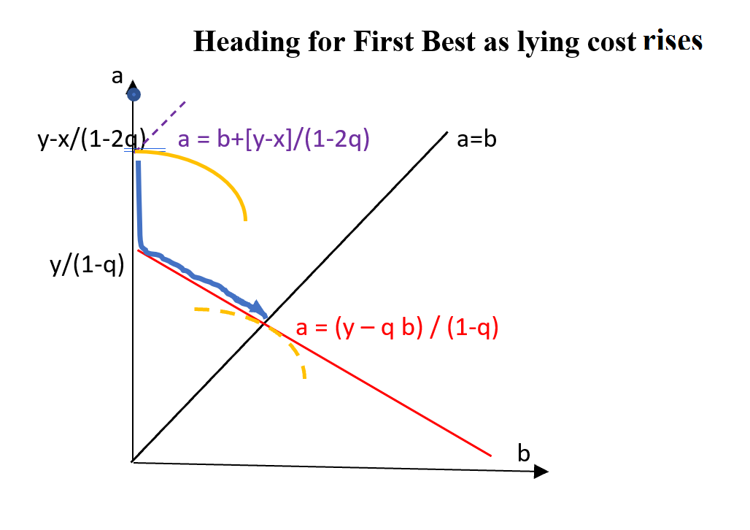
We solve by adding a lying cost x > 0

