Slide 1
Biblical Requisites and Implications for Economic Globalization
Robert C. Tatum
Cary Caperton Owen Distinguished Professor of Economics
University of North Carolina Asheville

Slide 2

Universal Economy Doctrine
God in his divine providence scattered necessary resources and goods across the earth to encourage trade and bring the peoples of the world together.

Slide 3
Biblical Basis for Economic Globalization
Shared humanity
Eventual unity
Valued differences
Genesis 1:27
Romans 14:11 and Philippians 2:10-11
Revelation 7:9
Revelation 21
1 Corinthians 12
Luke 10:25-37
Matthew 5:43-44

Slide 4

Biblical Basis for Reform of Economic Globalization
Luke 15:11-32 - Parable of the Prodigal Son
Acts 2 - Day of Pentecost
Micah 4:1-5

Slide 5
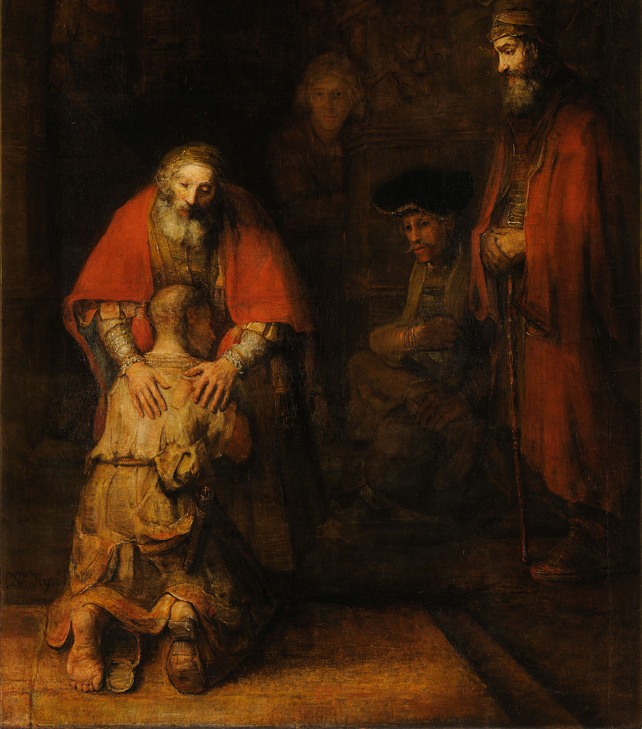
The Prodigal Son
Relationships should be the priority.
Embrace or the welcoming of one returning to the family comes before any consequences are meted out.
Rules still matter.

Slide 6

Day of Pentecost
Globalization policies should seek to preserve political, economic, and cultural diversity as is reasonably possible.
When a given institutional structure contributes to injustices, it is worth rethinking and reforming those structures

Slide 7

Micah 4:1-5
“Do justice” (6:8)
Nevertheless, proceed with:
Caution,
Humility, and
Willingness to embrace

Slide 8
Conclusion
The economic case for globalization is based on aggregate gains in efficiency, output, choice, and agency around those choices.
A theological basis for globalization can be found in our shared humanity, valued differences, and eventual unity.
Theology also provides basis for and calls us to globalization reform.

Slide 9

Thank you
Feedback is welcome.
I am happy to provide a current draft of the paper upon request.
Robert Tatum
rtatum@unca.edu

