Slide 1
Revelation Chapter 13
The “Beast” is a symbol of sinful humanity.
Both Adam and the beast were created on the sixth day
God setups up the seventh day as the goal which Adam was to strive.
For six days he was to work and reign as king, having dominion over creation.
At the most basic level, “beast” symbolizes man’s fallenness.
Rome itself is a symbol of any nation throughout history that has turned its back on God.

Slide 2
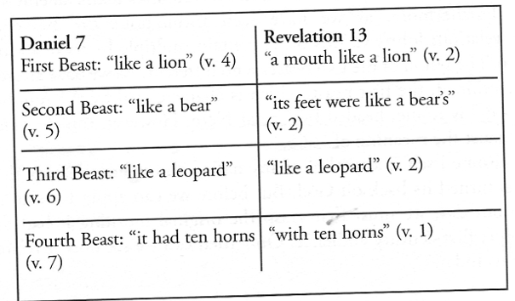
Revelation Chapter 13

Slide 3
Revelation Chapter 13
Daniel’s Four Beast Represent:
Babylon
Medo-Persia
Greece
Rome ← This is the Beast in Revelation Chapter 13
  The horns and heads represent political authority
  Rome represents any state that turns from God to persecute His people
  666 is the numeric value for Nero Cesar in Hebrew
  666 can have many levels of interpretation
  666 look at Gospel of John chapter 6 verse 66

Slide 4
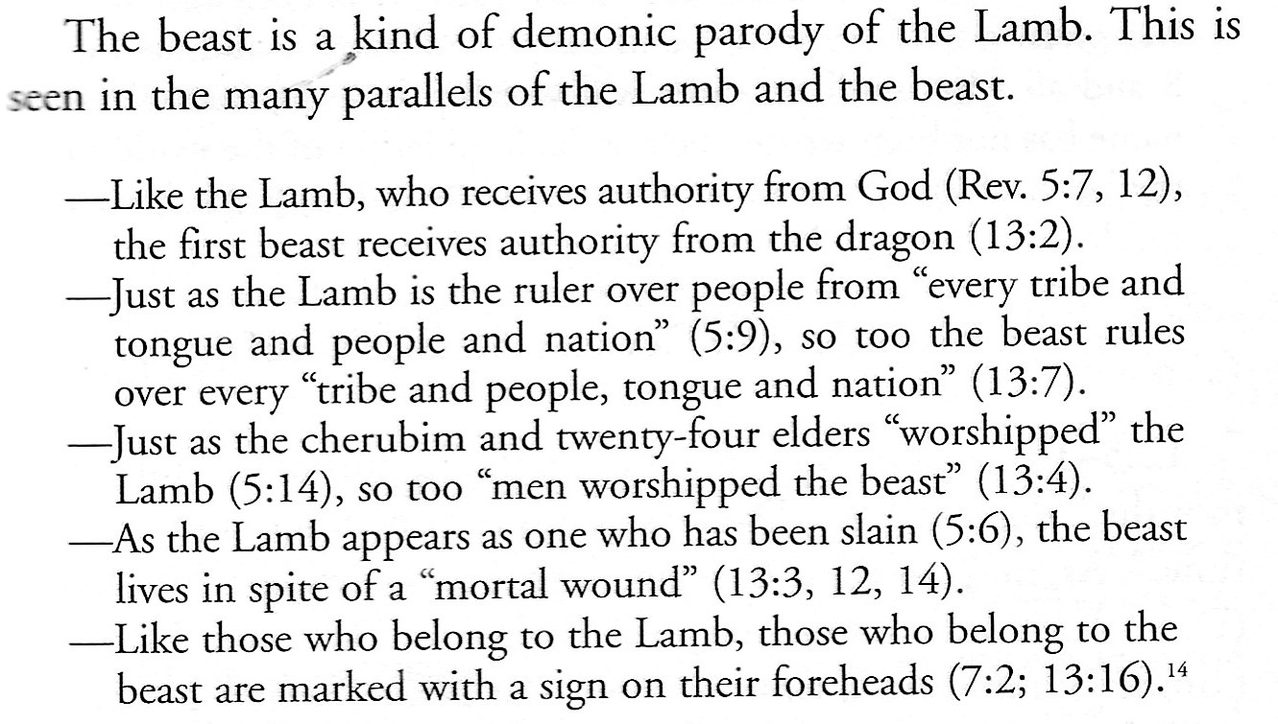
Revelation Chapter 13

