Slide 1
Signal Park Parking Guidance Systems
City of Scottsdale
1-7-26

Slide 2
Parking Guidance A better experience for the Motorist and the Municipality
For the Motorist
Dynamic count signs located at strategic positions guide the motorist to the nearest available space
Spaces can be separated on signs between Standard, ADA , EV , Police/Fire, Carpool, etc
Detectors can be programmed to be ANY color on the color wheel and can be dimmed/brightened
For the Municipality
All parking data is collected from the time the system is started
This includes: Time vehicle parked, time vehicle left, length of stay, how long space was vacant
This data is all easily exported to Excel to garner average stay time, peak hours, peak days
System uses very little power, about 2/3 watt per “device”. Sign power varies as they auto brighten and dim and depends on numerals indicated
Length of stay can be programmed in and system can send alerts when a vehicle is overtime. This also shows on the plan view/God’s eye view as vehicle is automatically circled in yellow.
Open communication protocol enabling the software to communicate with almost any type of hardware. Over 20 database types built in.

Slide 3
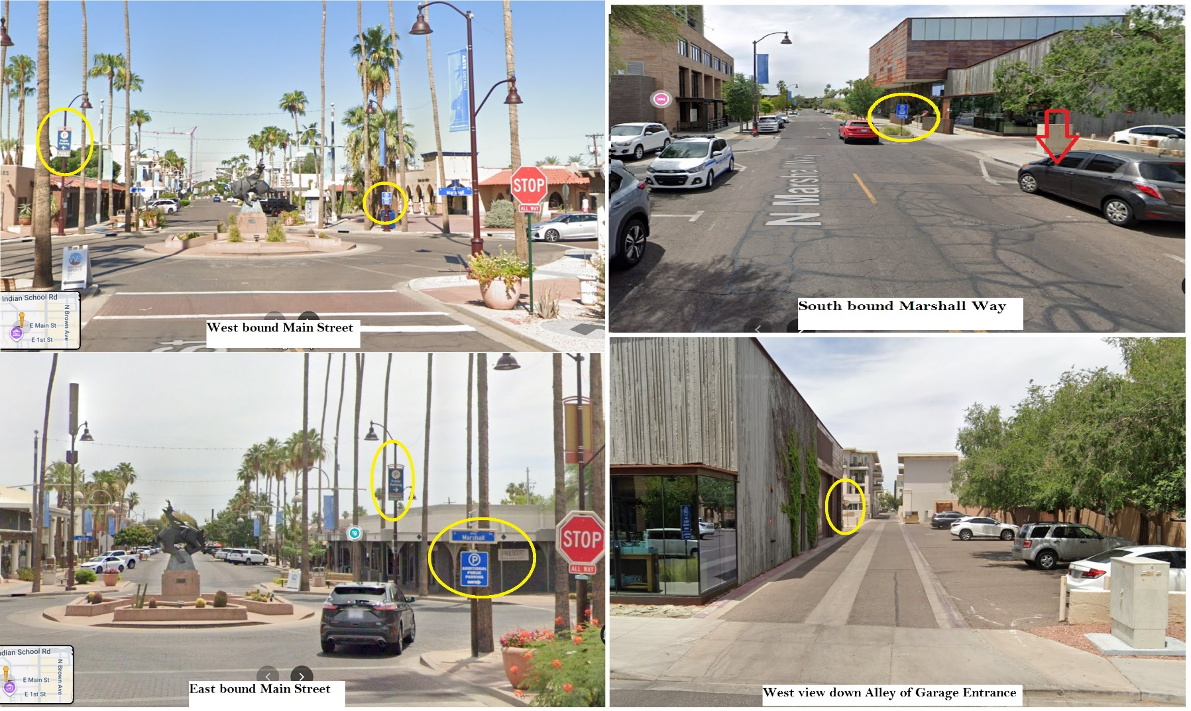
“Where’s Waldo” is not good for Parking

Slide 4
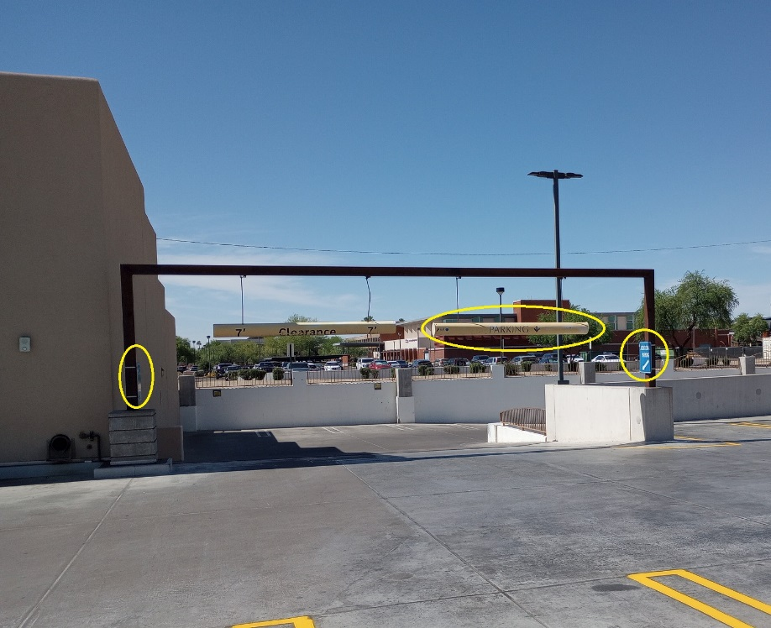
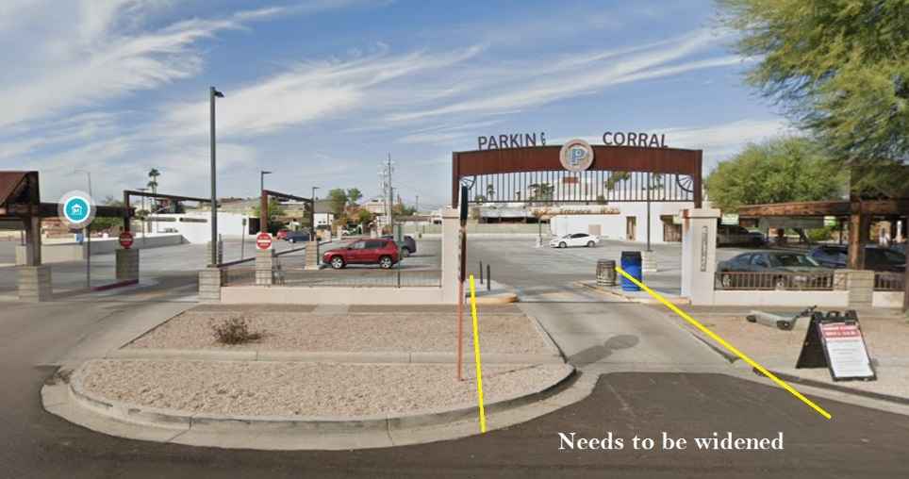
More Where’s Waldo at the Corral

Slide 5
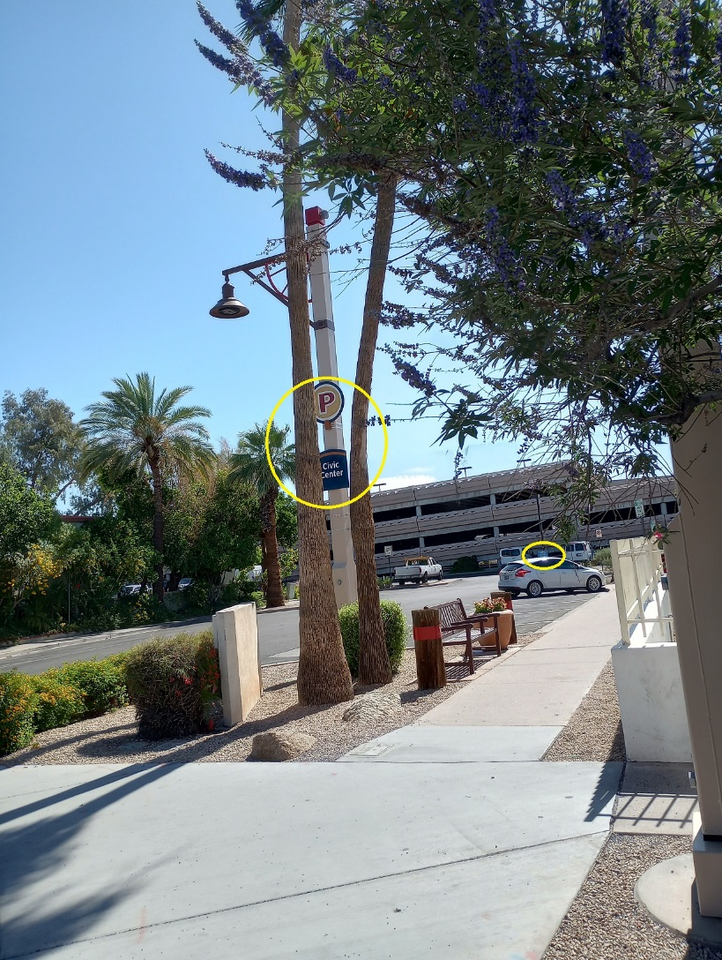
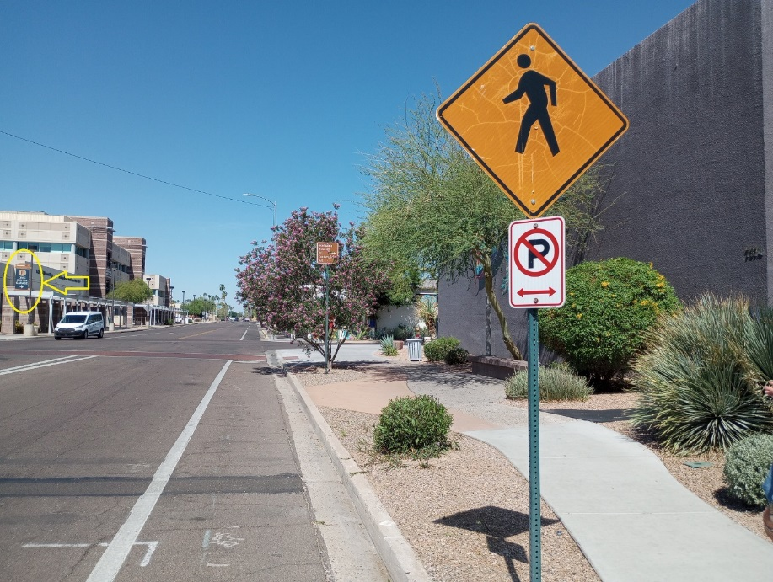
And a third round at Civic Center Garage

Slide 6
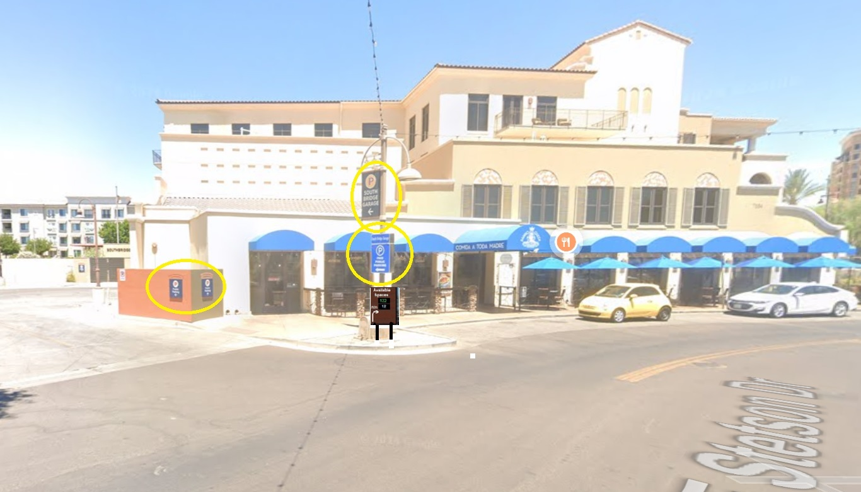
South Bridge at least has signage

Slide 7
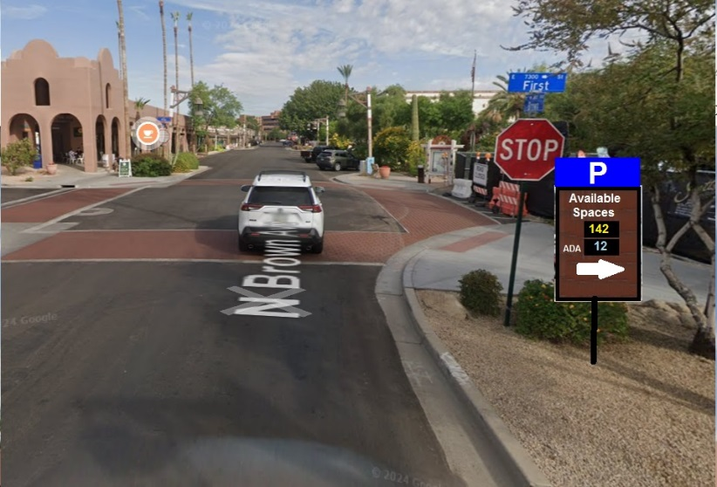
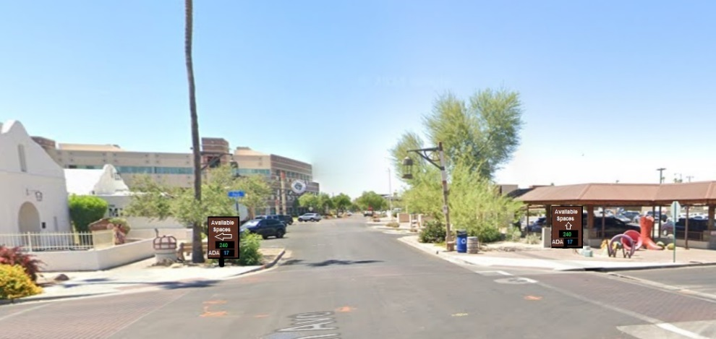
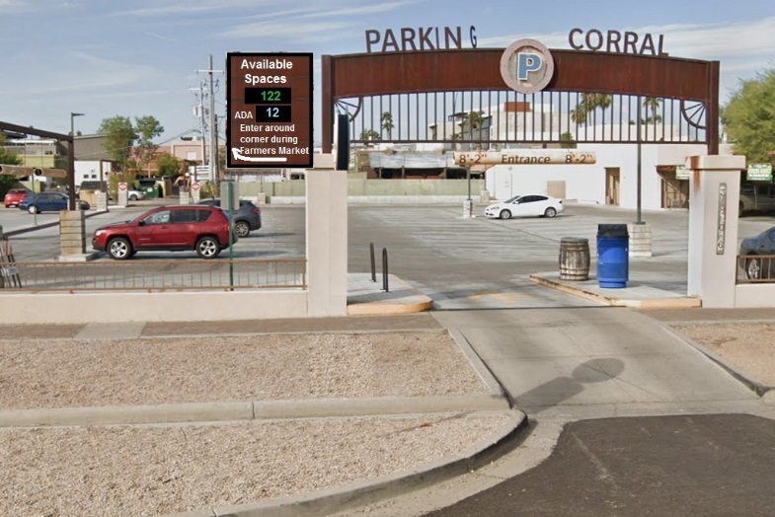
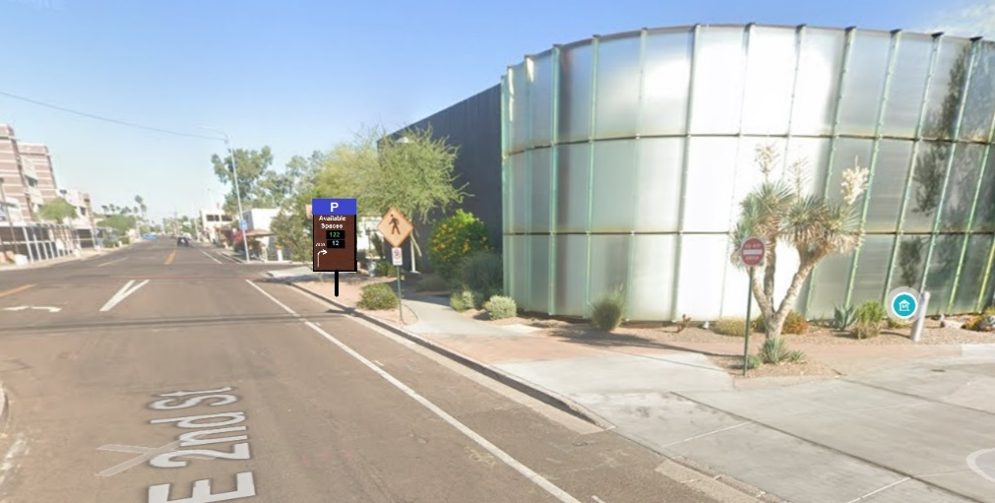
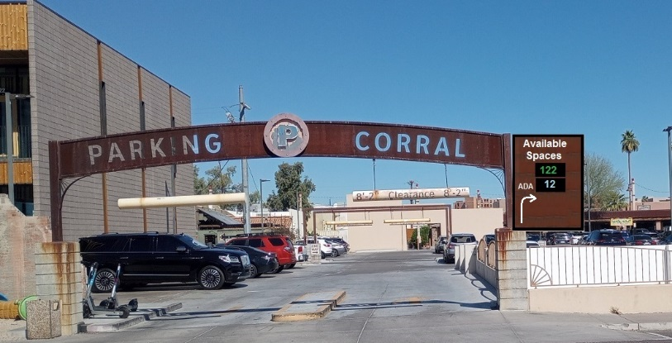
Strategic Exterior, Accurate Signage is the Key

Slide 8
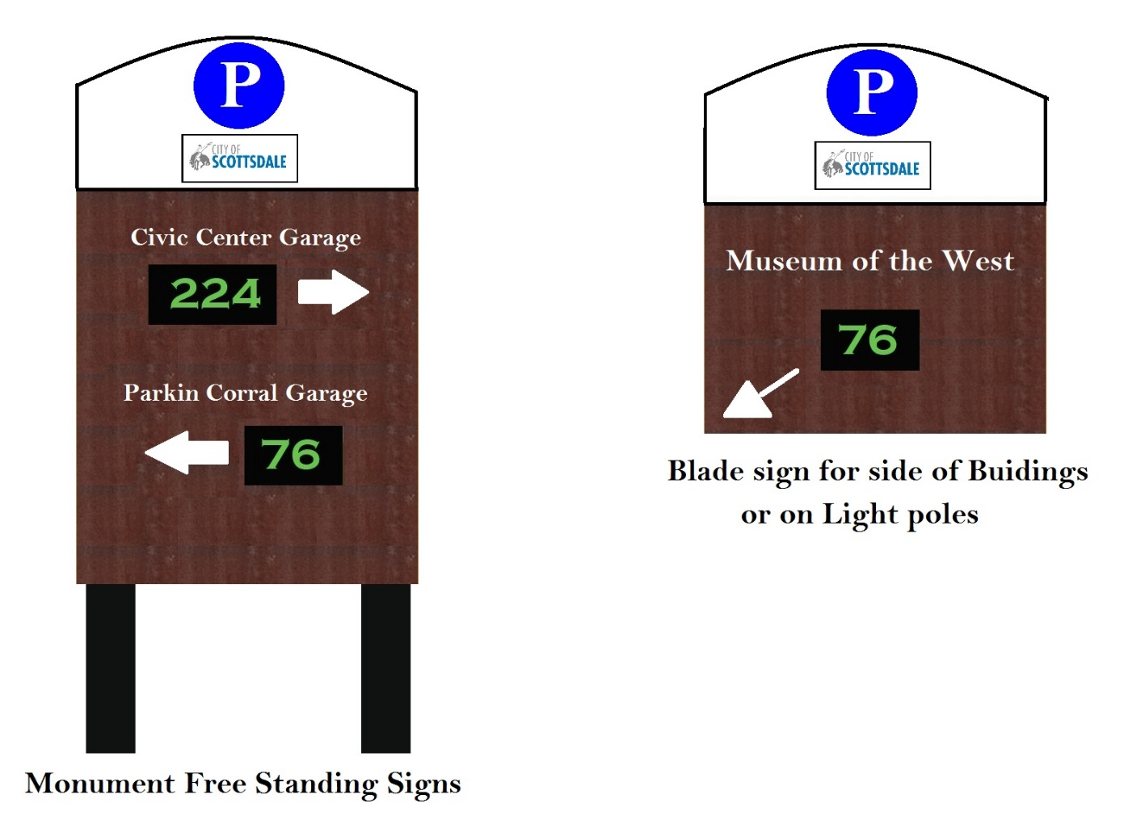
Rustic sign design examples
Yellow LEDs recommended near stop signs

Slide 9
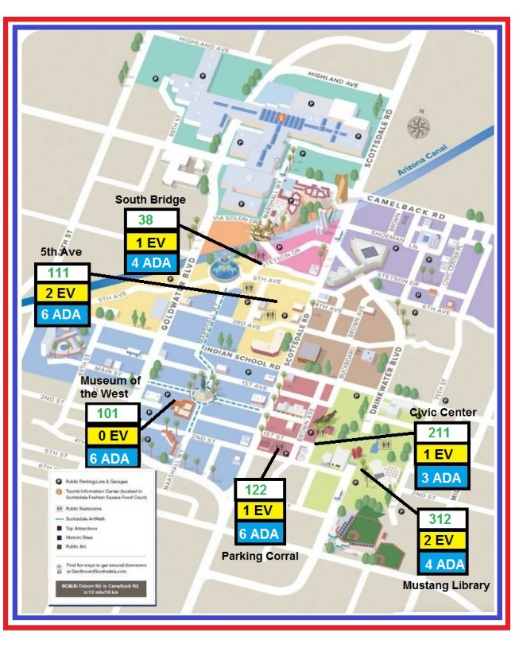

All Data can be pushed to a Website via JSON and NO APP needed

Slide 10

Suggestion for City of Scottsdale Parking Website Page

Slide 11
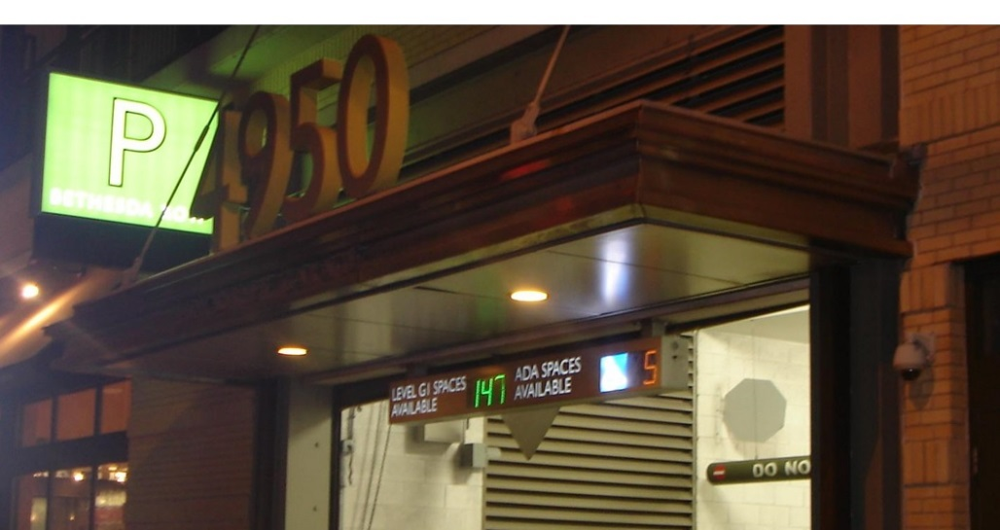
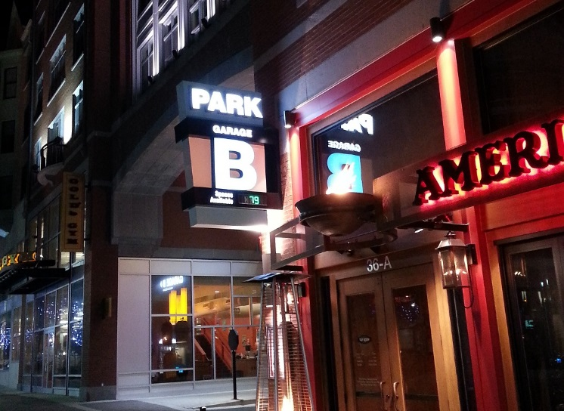
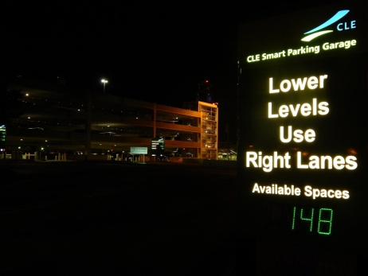
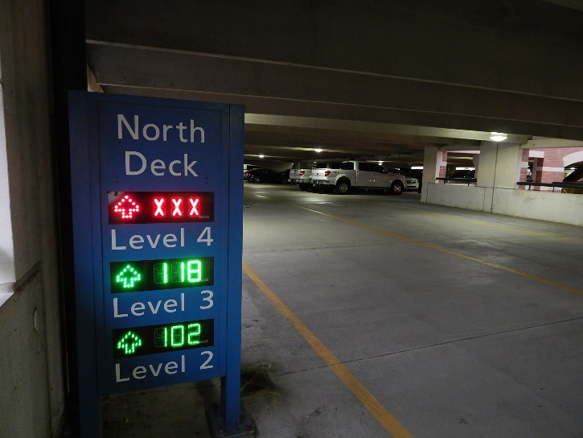
Blade Signs
Monument Signs

Slide 12
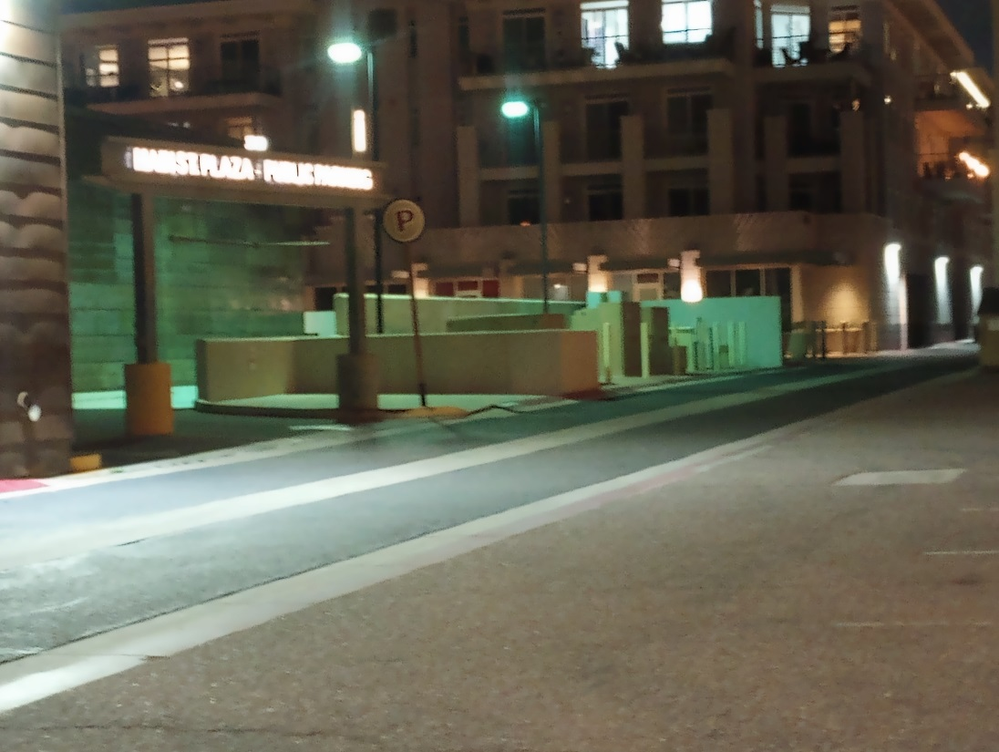
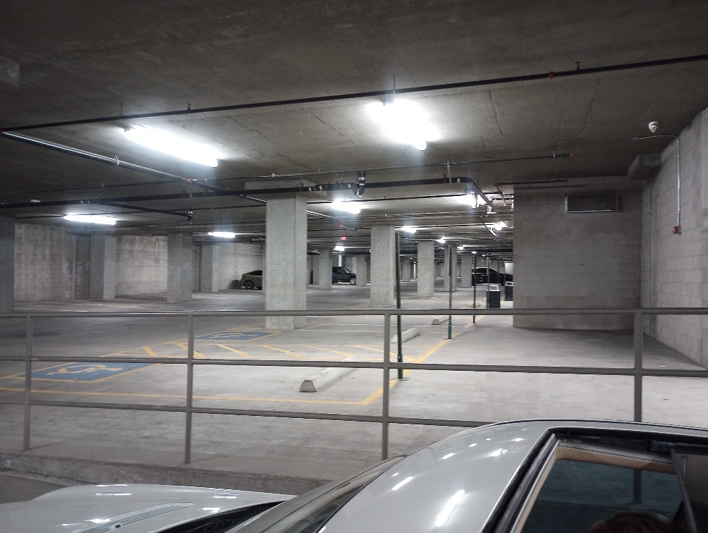

Slide 13
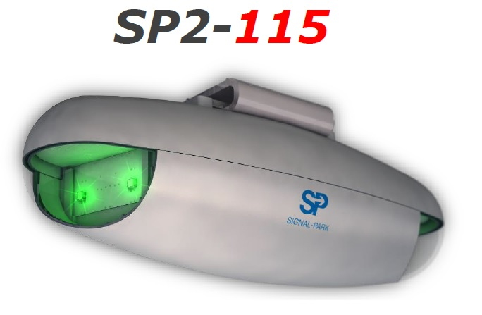
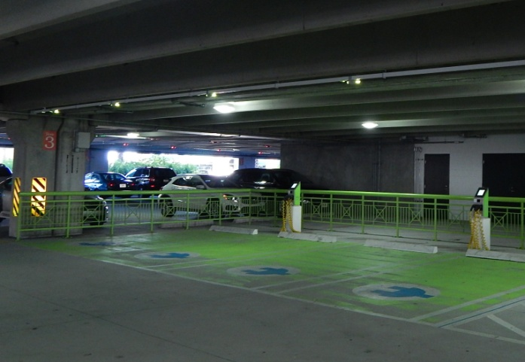
Parking Sensors
In aisle detector
Detector colors are programmable which enables stocking of just one type of detector
Detectors can be programmed to be any color as the electric spaces above have been changed to lime green to match the charging stations.

Slide 14
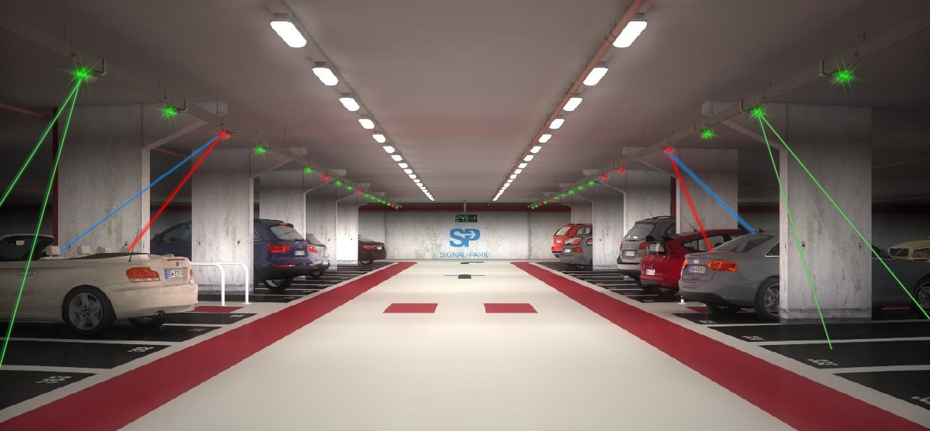
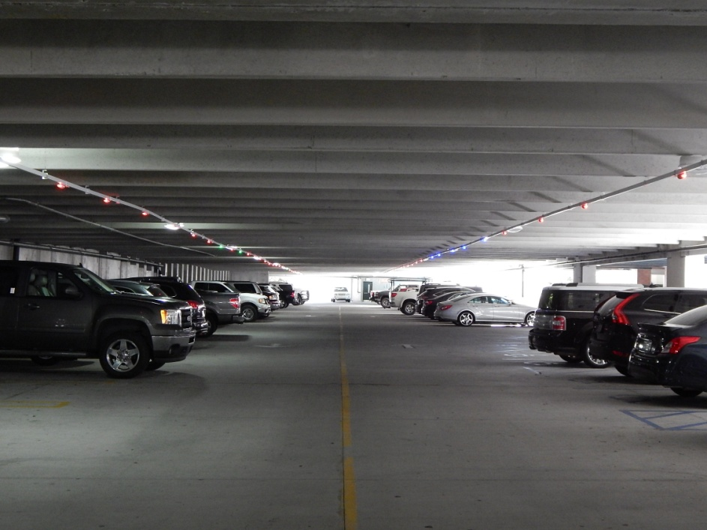
In Aisle detectors

Slide 15
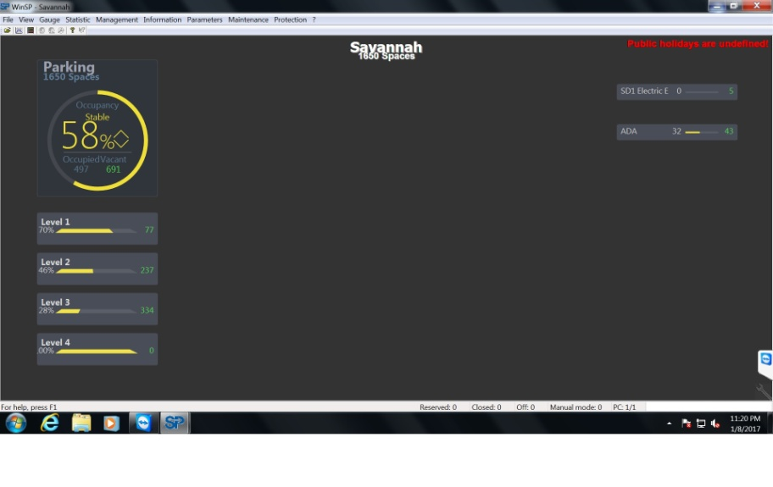
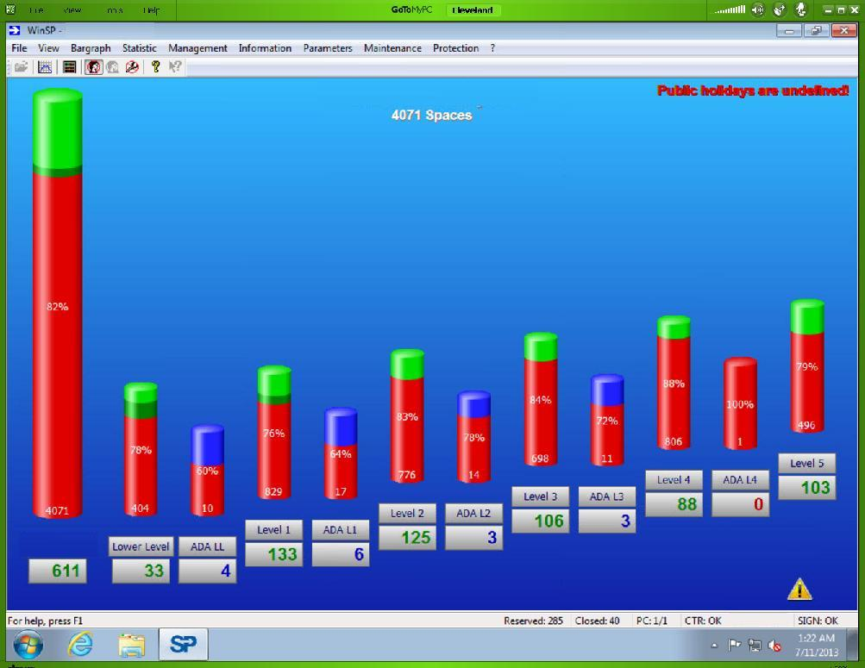
Signal Park Software WinSP
Entire system is powered by standard PC workstation
System can be powered by a laptop as well.

Slide 16
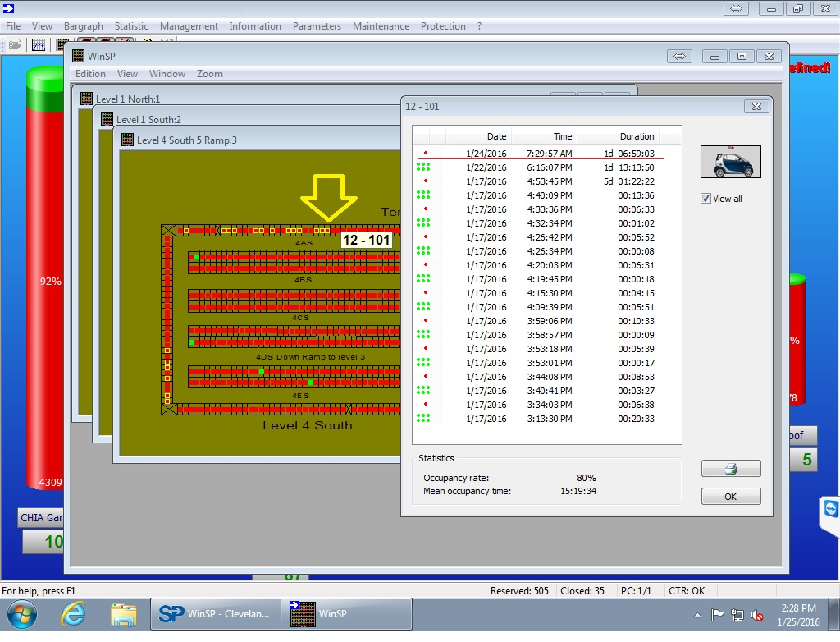
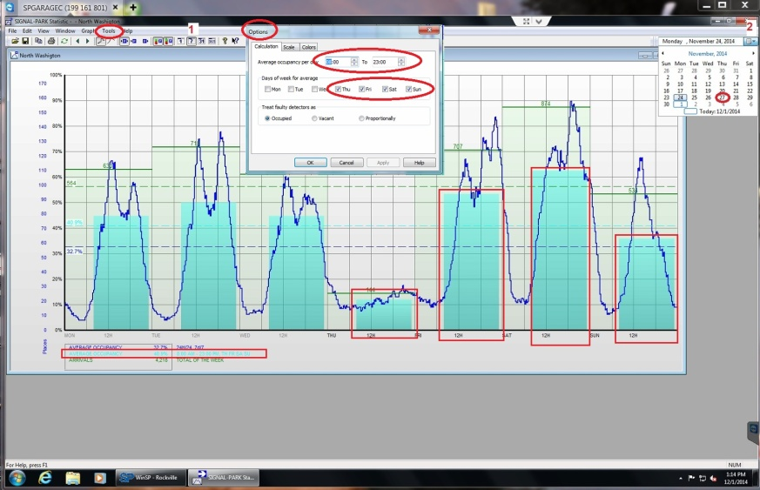
Complete Statistical Data
All data is saved an can easily be exported to Excel or other programs
Sorting data is easy with selectable menus
All menus and data are definable by the garage owner
Yellow Ring circles “overtime” vehicles at time specified by garage owner
Complete statistics of each space from the time of startup.
Greatly aids in security efforts

Slide 17
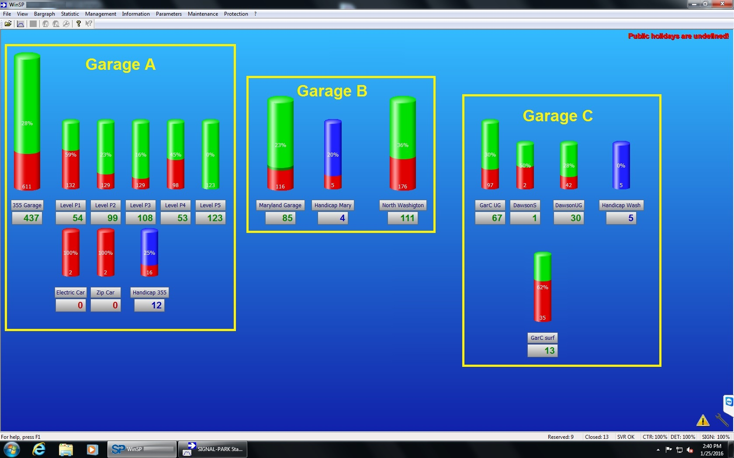
All garages are Networkable

Slide 18
Version 6 key features
All components (detectors, loop interfaces and signs) use the same communication protocol RS-485 with a range of one mile
All components are able to be remotely programmed
System detects components that aren’t programmed and alerts operator
All data and power are now in parallel rather than series Power is 48VDC. Entire system is modular.
Signs can be added anywhere there is an available outlet in the Canalis which are approx every three feet and can be pole mounted
All LED’s are high intensity and low power usage component power usage is approx 2/3 watt per component

Slide 19
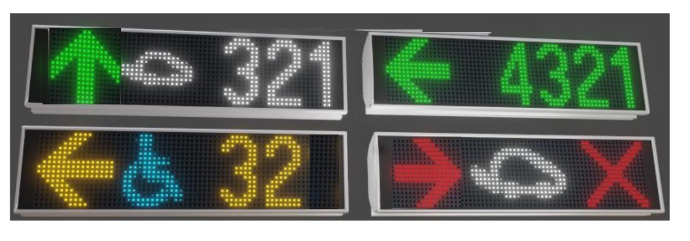
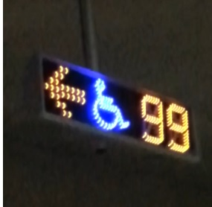
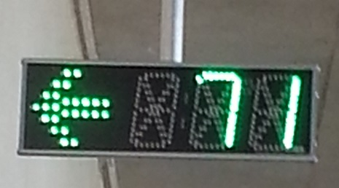
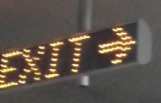
New Signs with walking arrows
New signs rotate through Standard, ADA and EV
Signs have built in light meters and auto adjust.

Slide 20
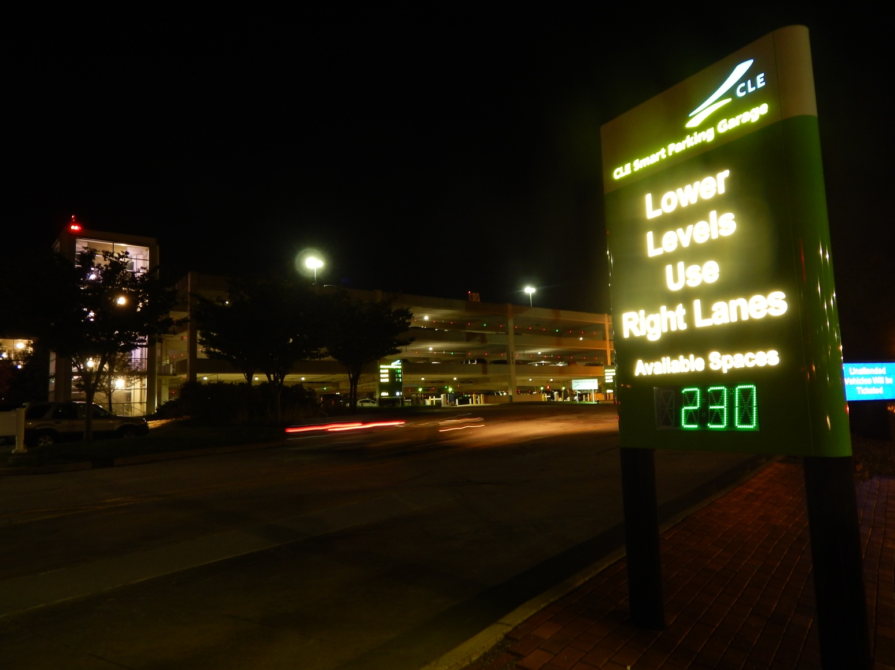
Exterior sign and view of Detectors

Slide 21
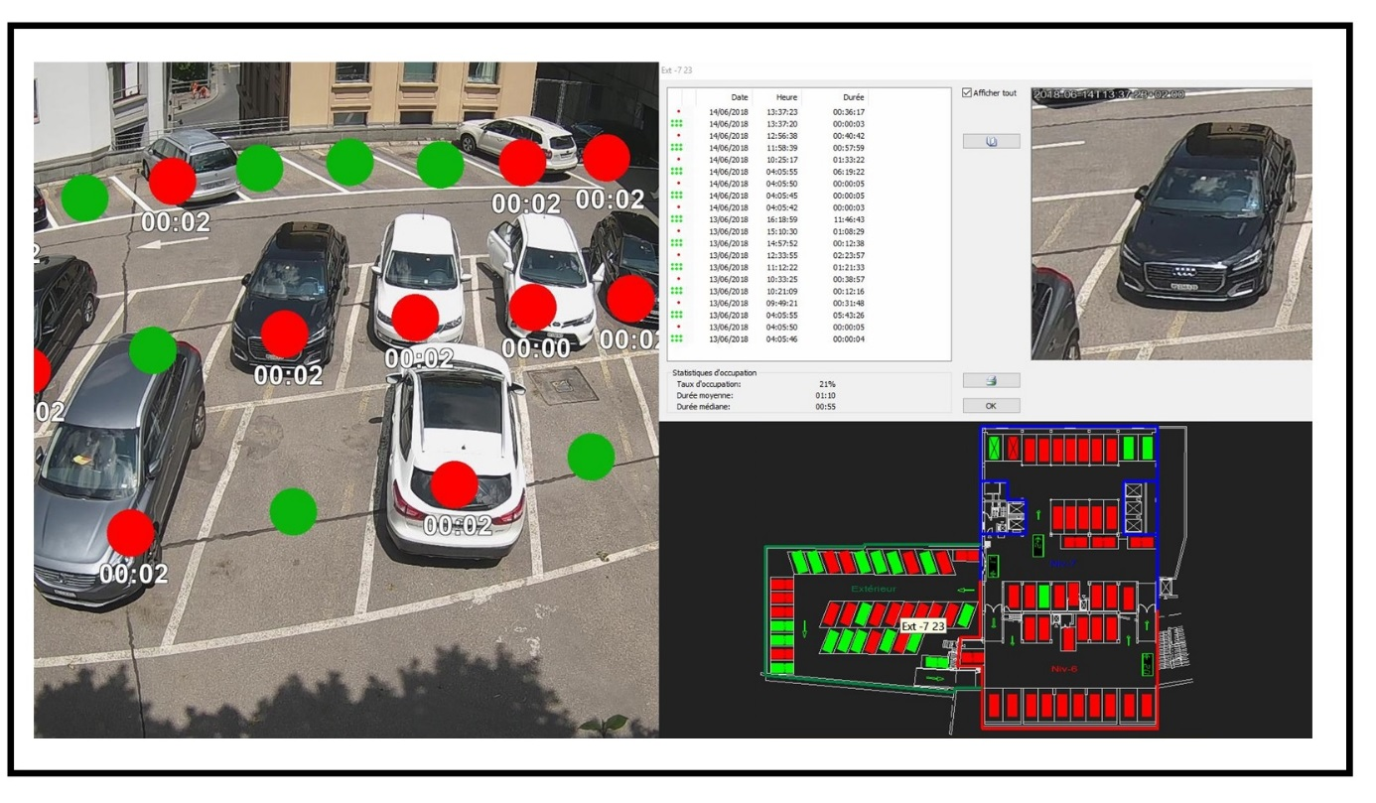
Surface Lot Monitoring

Slide 22



Some of our Clients
1,640 spaces
Two garages:
4,400 spaces
3,800 spaces
Other Systems:
BWI 21,000 spaces
Rockville Town Square 929 spaces
Bethesda Row 200 spaces
Fairfax County 724 spaces
4,195 spaces

Slide 23
Thank You!
8390 E Via De Ventura Blvd
Suite F-110
Scottsdale, AZ 85258
P: (480) 922-4933
info@SoniPark.com
www.SoniPark.com

