Slide 1
DevOps Transformation Practices Maturity Assessment Workshop
© EngineeringDevOps 2019 This template is available in PowerPoint format on www. EngineeringDevOps.com

Slide 2
DevOps Transformation Practices Maturity Assessment Workshop
This workshop scores practices for :
DevOps 9 pillars
Deep-Dive Topics
Scope:
Application selected by the DevOps Transformation Leadership Team
Importance Score is relative to the DevOps Transformation Goal
Practice Level is the Current practice level.
The calculated Scores are used to determine the Rank for practices of the 9 Pillars and Deep-Dive topics that are most important to improve to meet the DevOps Transformation goals.

Slide 3
DevOps 9 Pillars Practices Maturity Workshop
Enter
Calculate
For each practice enter Importance (I) for meeting the DevOps Transformation Goal and the Current Level of Practice (P)
Once all data is entered calculate Score and GAP Rank to determine the highest gapped practices.
Practices for each of the 9 Pillars: Leadership, Collaborative Culture, Design for DevOps, Continuous Integration, Continuous Testing, Elastic Infrastructure, Continuous Monitoring, Continuous Security and Continuous Delivery/Deployment
© EngineeringDevOps 2019 This template is available in Excel format on www. EngineeringDevOps.com

Slide 4
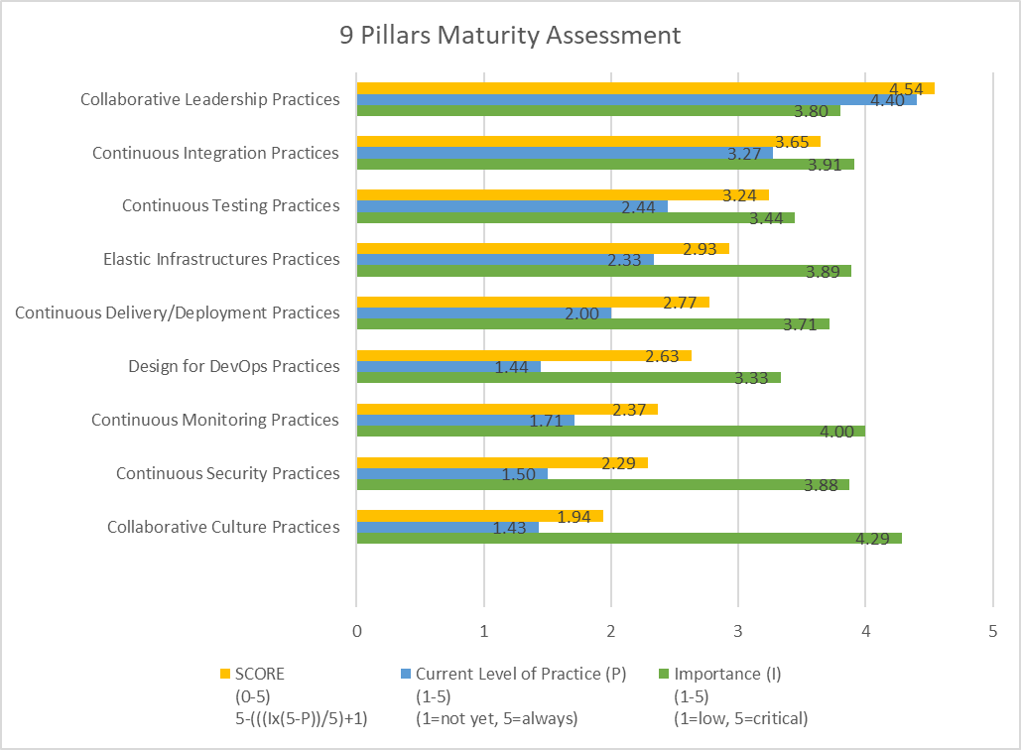
DevOps 9 Pillars Practices Maturity Workshop
The calculated Scores are used to determine the Rank indicated which Pillar and practices are most important to improve to meet the DevOps Transformation goals.
© EngineeringDevOps 2019 This template is available in Excel format on www. EngineeringDevOps.com

Slide 5
DevOps Deep-Dive Topics Practices Maturity Workshop
Enter
Calculate
For each practice enter Importance (I) for meeting the DevOps Transformation Goal and the Current Level of Practice (P)
Once all data is entered calculate Score and GAP Rank to determine the highest gapped practices.
Practices for each of the Deep-Dive topics that are selected for assessment: Training Practices, Governance Practices, Value-Stream Management Practices, Application Performance Monitoring (APM) Practices, Site Reliability Engineering (SRE) Practices, Service Catalog Practices, Application Release Automation (ARA) Practices, Multi-Cloud Practices, Infrastructure-as-Code (IaC) Practices, Hybrid Cloud Practices, Version Management Practices
© EngineeringDevOps 2019 This template is available in Excel format on www. EngineeringDevOps.com

Slide 6
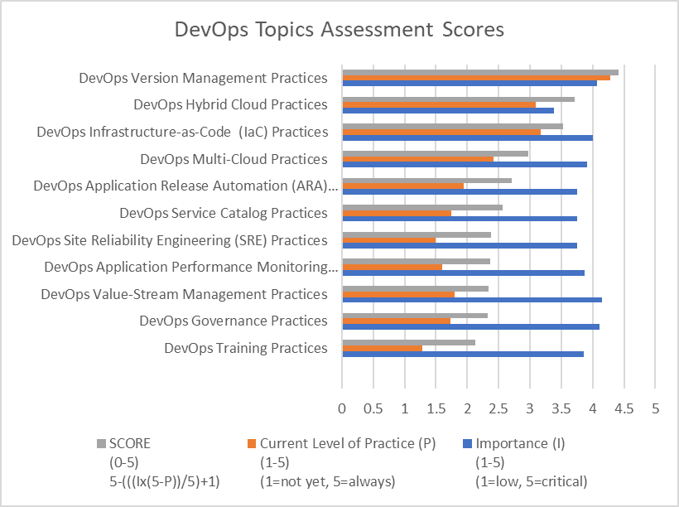
DevOps Deep-Dive Topics Practices Maturity Workshop
The calculated Scores are used to determine the Rank indicated which Deep-Dive topic and practices are most important to improve to meet the DevOps Transformation goals.
© EngineeringDevOps 2019 This template is available in Excel format on www. EngineeringDevOps.com

