Slide 1
DevOps Transformation Alignment Meeting
Attendees
DevOps Sponsor
DevOps Initiator
DevOps Expert
© EngineeringDevOps 2019 This template is available in PowerPoint format on www.EngineeringDevOps.com

Slide 2
DevOps Transformation Team Leaders
Name | Role/Responsibility
 | DevOps Transformation Sponsor
 | DevOps Expert
 | Product Development
 | Product Quality Assurance
 | Operations Support
 | Infrastructure
 | DevOps Tools
 | Partner Management
 | Product Owner
 | Security
 | Project Management
 | Training
 | Finance
 | Human Resources
 | Governance
Identify strategic level leaders and partners that cover the cross-section of organization functions that are most relevant to the DevOps transformation. For example, strategic leaders with responsibility over roles from Development, Quality Assurance, Operations, Infrastructure, DevOps Tools, 3rd party suppliers, Product Owners, Security, Project Management, Training, Finance, Human Resources and Governance should be considered, depending on the extent to which each of the roles are likely to be affected by the transformation.

Slide 3
Strategic Goals for the DevOps Transformation
Our product organization shall be the market leader, measured by volume of sales, within three years, through increasing new product release velocity ten times while reducing non-value added costs in the delivery pipeline two times.
WHY? The market for this product category is maturing. Only the top three competitors are expected to survive the next 5 years. Industry trends show the winning companies will the ones with the fastest, most innovative value-stream and lowest price.
At this level the goals are expressed as visionary and qualifiable, but not necessary quantifiable objectives which will have a major impact on the purpose of the organization. These are not technical goals as much as they are business goals. For example, statements about improvements to competitiveness, innovation, customer satisfaction, employee satisfaction would qualify as visionary strategic goals. Technologies expected to accomplish these goals may be included but the emphasis of these goals are on strategic outcomes instead of the means to accomplish them. Usually there are no more than one or two strategic goals because the intent is to have a simply stated, clear, common visionary goal that the entire organization can understand and rally around. Strategic goals do not substitute for tactical goals. It is important to explain WHY this goal was chosen over alternatives considered.
An example strategic goal is shown above:

Slide 4
Definition of DevOps
DevOps is the application of lean practices Continuous Flow, Continuous Feedback and Continuous Improvement to people, process and technology for the benefit of agility, stability, efficiency, quality, security and satisfaction.
DevOps_The_Gray
There is no industry standard definition of DevOps yet it is important for each organization to have a definition the team can accept and rally around. The above definition is suggested. Alternative definitions are also acceptable provided the DevOps Transformation Team accepts a definition for use in the organization.

Slide 5
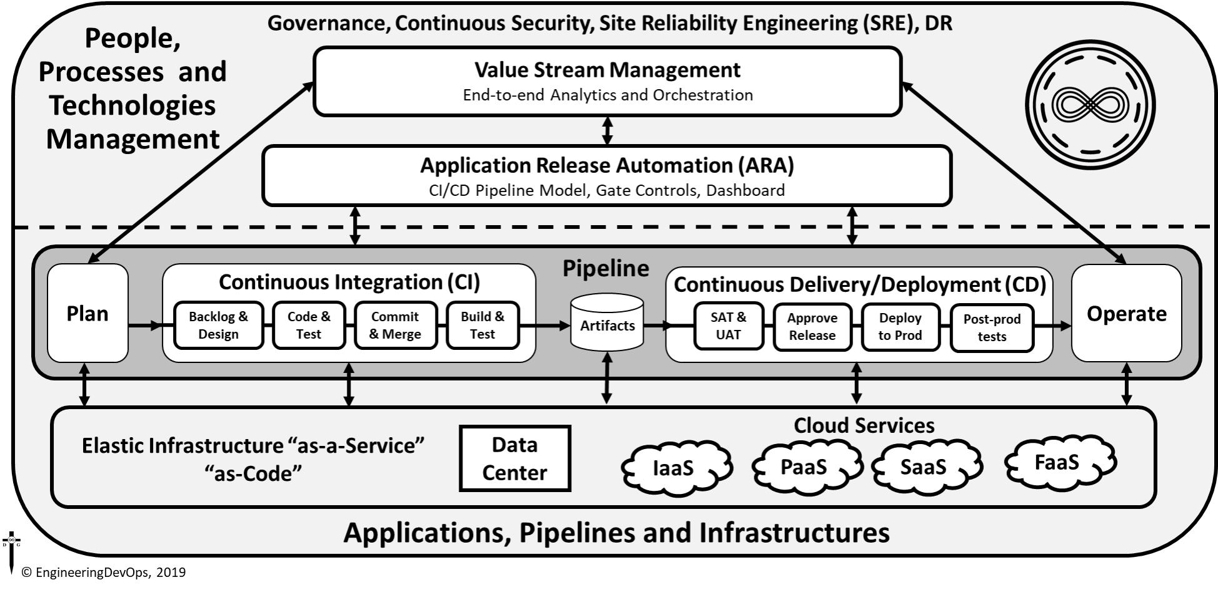


Slide 6
DevOps Transformation Application Selection
The DevOps transformation will apply to the following applications: <name of application(s)>
The <name> application will be used as a model for kicking-off and evaluating changes needed to people, process and technology for the DevOps transformation.
WHY? A DevOps Application Selection Scorecard indicates these application(s) will most likely benefit from the DevOps transformation.

Slide 7
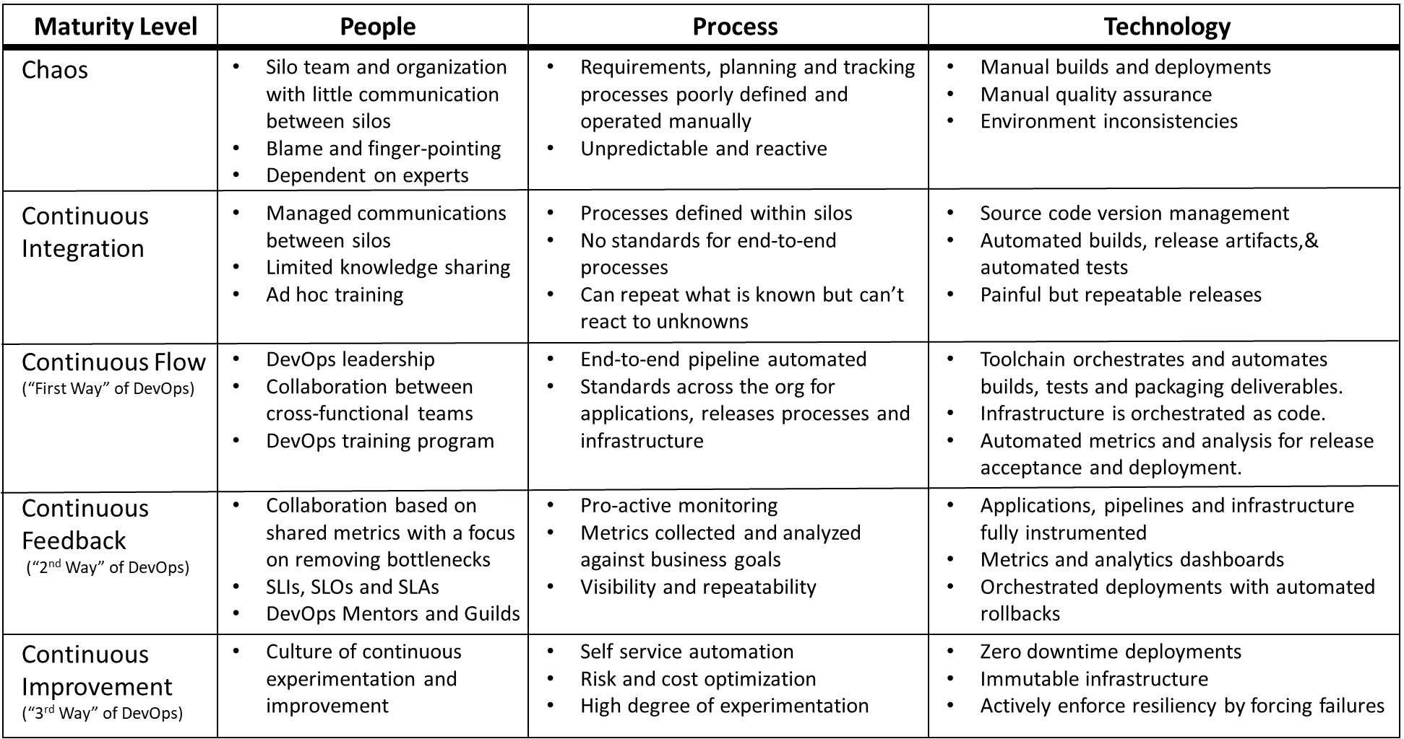
DevOps Maturity Levels
What is the Maturity Level of the Selected Application?

Slide 8
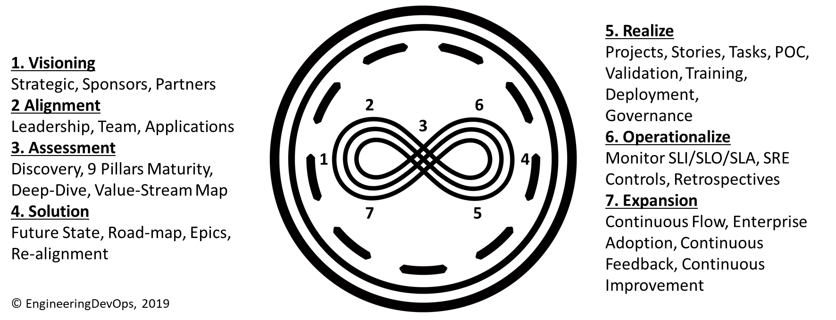
DevOps Seven-Step Transformation Engineering Blueprint

Slide 9
DevOps Transformation Goals Workshop
Calculate
Enter
For each goal enter Unit, Importance (I), Current State, Desired State.
Once all goal data is entered calculate % Improvement, Score and Rank to determine the top goals.
20 goals in six categories: Agility, Stability, Efficiency, Quality, Security, and Satisfaction
© EngineeringDevOps 2019 This template is available in Excel format on www.EngineeringDevOps.com

Slide 10
DevOps Transformation Practices Score Workshop
Enter
Calculate
For each Practice Category enter Importance and Current Level of Practice Score
Once all data is entered calculate a score and rank to determine the top priority practices.
Nine Pillars and 11 Deep-Dive Topics
© EngineeringDevOps 2019 This template is available in Excel format on www.EngineeringDevOps.com

Slide 11
DevOps Transformation Assessment Workshops
Planned Agenda
Recap DevOps Goals
Summary of Discovery Surveys
Maturity Assessment Workshops
Current State Value Stream Map Workshop

Slide 12
Next Step Actions towards Alignment
Action | Date | Responsible
Schedule date to complete Alignment Data | MM/DD/YYYY | Initiator
Schedule date to complete Assessment inputs | MM/DD/YYYY | Initiator
Schedule data for DevOps Transformation Assessment Workshops | MM/DD/YYYY | Initiator
Arrange Logistics for DevOps Transformation Assessment Workshops | MM/DD/YYYY | Initiator

